Slide 1

Referee App

Slide 2

Introduction
Team Members
What is the ”Referee App”?

Slide 3
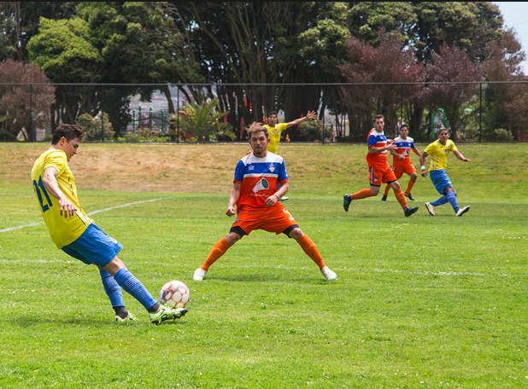
Target Audience
Referees
League Teams
Individual Players
Avid Fans

Slide 4
Problem Being Solved
Record key game statistics (cards given) in real time
Display live statistic of local league games in the map

Slide 5
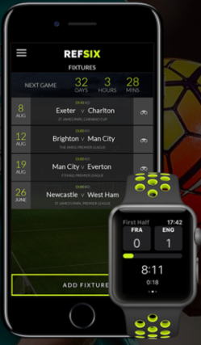
In Comparison to Other Apps
Needs login to use app
Only referees can use the app

Slide 6
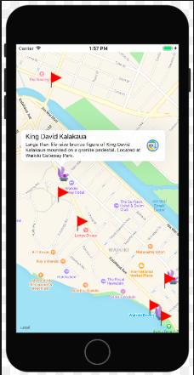
Frameworks
MapKit
CoreLocation

Slide 7
Iterative Product Design
Prototype
Feedback
Implementation
Minimum viable product

Slide 8
Demonstation

Slide 9
Q&A
Any questions?

