Slide 1
Marine Toolkit Development Seaward extensions component considerations
Dec 2022

Slide 2
Seaward extension definition (Dec 2022)
SEAWARD EXTENSION DEFINITION: These are marine areas immediately surrounding seabird breeding colonies. The areas are typically used for ecologically relevant behaviours such as rafting, preening, bathing, foraging or transiting between foraging trips, depending on a species.
DO WE WANT TO CONSIDER A BETTER DEFINITION? Above comes from Handley et al. 2022 (Falklands KBA paper)
CAUTION: Defining seaward extensions around seabird breeding colonies should consider the ecology of the species. In other words: it is generally unsuitable to try and delineate important sites using this method that are artificially large. For example, it would likely be unsuitable to use this method to derive a foraging area for albatross; tracking data would be better suited for defining a foraging area for albatross. See further examples in the Marine Toolkit.

Slide 3
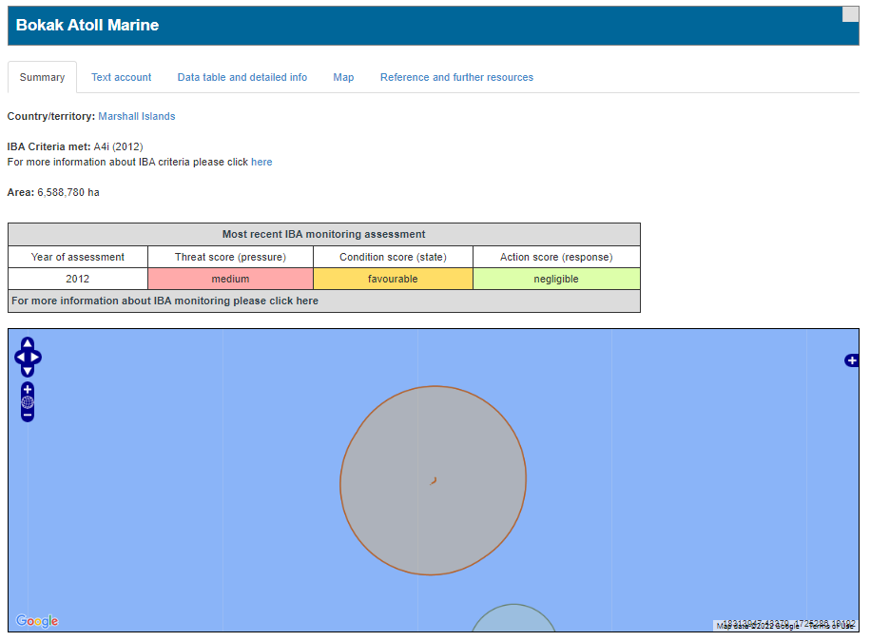
Which types of seaward extensions have been used in the past by BirdLife?
Typically: A foraging radius buffer around a colony. E.g. a point location.
See for example: http://datazone.birdlife.org/site/factsheet/30991
Concern: Are these large buffers that were based on foraging distances really the best approach, especially for certain species?
The example shows a buffer of ~140km for Great Frigatebird; could you really justify all of this area as an IBA / KBA?
Preference: Enhance foraging radius method to better account for ecology of different species.

Slide 4
Seaward extensions used in the past
Colony
Foraging distance buffer.
Buffer is defined by either the:
Maximum distance a species has been recorded to forage over. (Bias to outlier distances)
Mean of maximum distances a species has been recorded to forage over. (also likely biased by outlier distances)
Mean of mean maximum distances a species has been recorded to forage over. i.e. the mean of the mean of maximum distances recorded from individual birds over several trips (hopefully the least biased method).
Potential problems:
Could define artificially large areas as important that are only seldom used by the species – especially for farther ranging species that might target specific features further offshore (e.g. albatross)
Does not account for direction of travel when applicable
Does not account for other landmasses
Island
Buffer

Slide 5
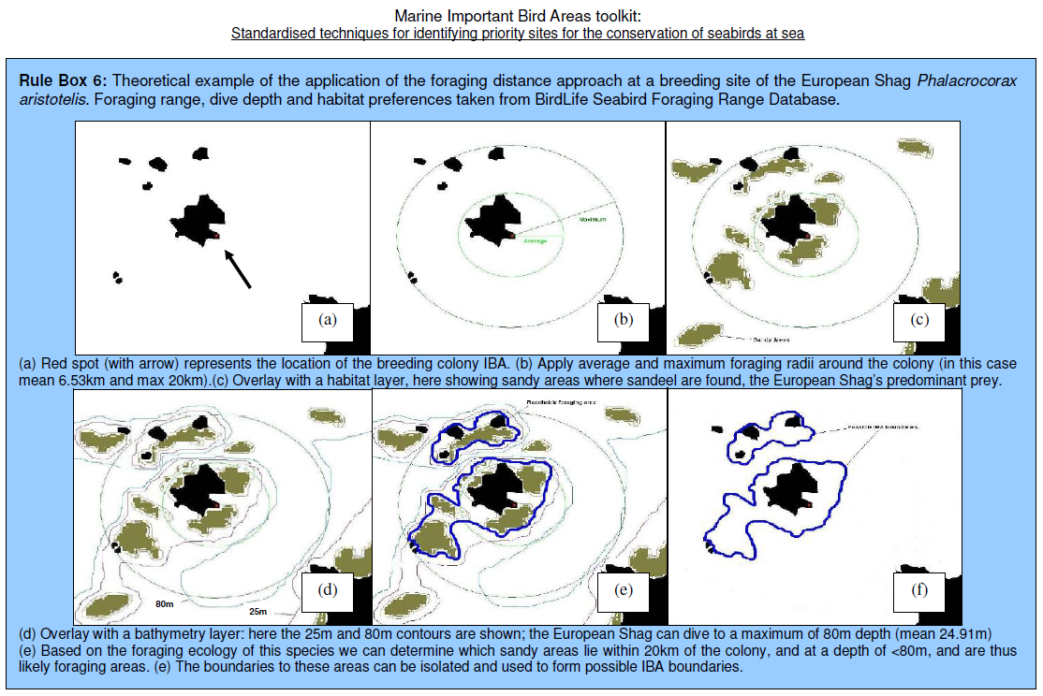
Seaward extensions used in the past
Foraging distance buffer clipped by bathymetry.
Buffer is defined by either the:
See Foraging distance buffer only details in previous slide
Buffer is clipped by likely depth birds are limited to.
Potential problems:
Same as foraging distance buffer only method
Also, not necessarily suited to species that do not specifically target benthic prey / features.
Consider:
Could include bathymetry as a potential extra parameter – consider different species.
From the Marine Toolkit 2010

Slide 6
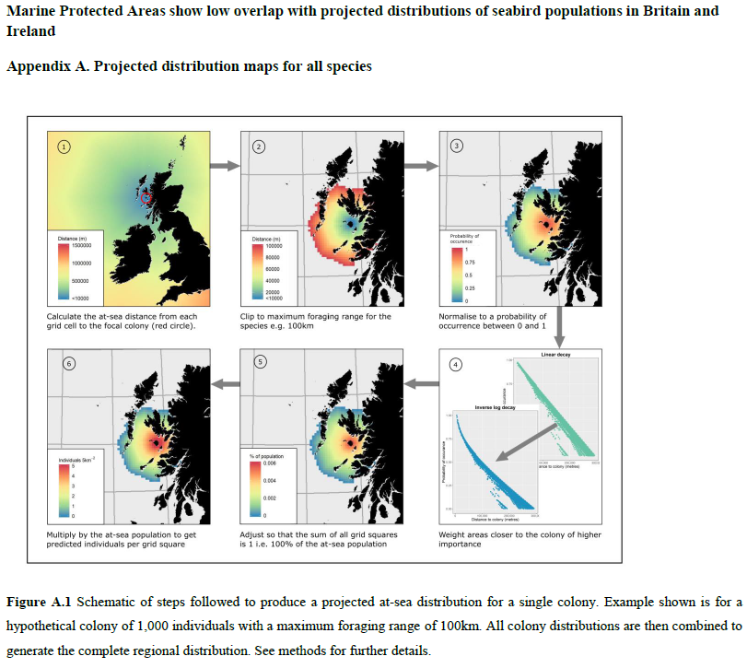
Seaward extensions used in the past
Foraging distance buffer with decay function
See Critchley et al. 2018 appendix A
Potential problems:
Did original code really account for wrapping around land?
Limitations without directional component
Is mean of maximum distance the best buffer for potential foraging areas?
For IBA / KBA purposes, adjusting the population estimate as in step 5 is not really appropriate
Note: Handley et al. 2022 makes some adjustments to the code to account for above.

Slide 7
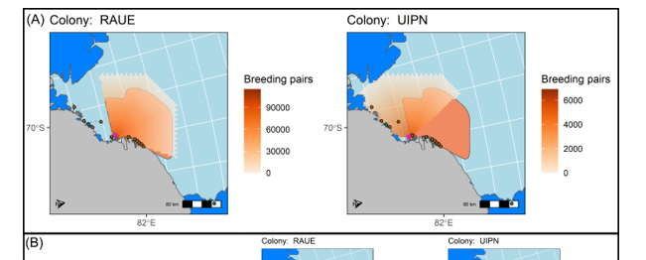
Seaward extensions used in the past
Foraging distance buffer with decay function and directional component
See Handley et al. 2021 Appendix “Density distribution surfaces – methods”
Potential problems:
Directional component manually defined – need to find a way to automate this
Buffer distance based on mean of maximum distances travelled as per Critchley et al. 2018
Written in combination of old sp / raster code and sf code.

Slide 8
Seaward extensions used in the past
BEHAVIOURALLY CONSTRAINED distance buffer. i.e. a buffer that does not necessarily reflect foraging but rather a different behaviour
Potential problems:
Typically, the buffer has been applied to the island that a seabird breeds on.
The problem is then what about when you have areas where seabirds breed but are not on islands – how do you find a better way to automate steps needed to define a buffer in these instances.
Smaller buffer compared to potential foraging buffer

Slide 9
What Seaward extension approach will we take for the new Marine Toolkit.
Output goal options:
From source breeding site, raster with decay function for abundance estimates at sea
Representing likely foraging areas
From source breeding site, raster with abundance estimates at sea matching colony abundance
Representing likely at-sea behaviours other than foraging
From source breeding site, polygon with abundance estimates at sea matching colony abundance
Representing likely at-sea behaviours other than foraging

Slide 10
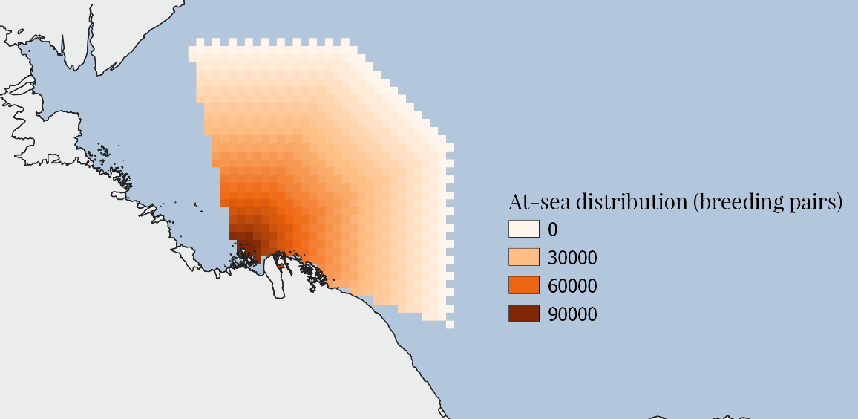
What Seaward extension approach will we take for the new Marine Toolkit.
Example: Likely Adelie penguin (chick-rearing) foraging area in Antarctica
Output goal options:
From source breeding site, raster with decay function for abundance estimates at sea
Representing likely foraging areas
Consider example code from Handley et al. 2021 (see figure)
Buffer distance based on mean of maximum distances travelled as per Critchley et al. 2018
Bearing of buffer manually defined (needs improvement)
Buffer width defined by user-chosen angle of choice (improvements needed)
Do we allow manual specification of buffer width (dependent on species)
Do we try facilitate automation of this buffer width?
Abundance estimates at-sea derived from breeding site estimate, with decay function.
NOTE: Beth’s suggestion to improve this.
bearing
buffer width
Density decay functions from colonies
(simple habitat model)
Abundance
estimate
Maximum buffer based on literature review of tracking studies

Slide 11
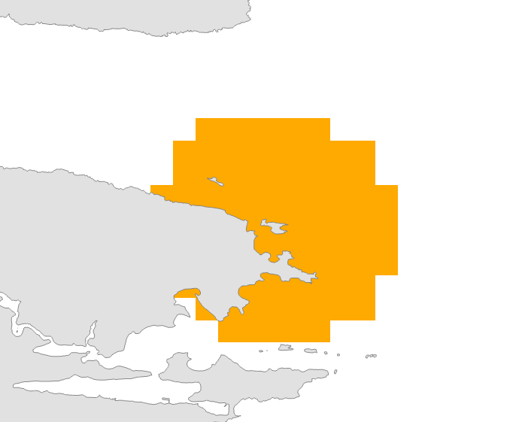
What Seaward extension approach will we take for the new Marine Toolkit.
Example: Likely Sooty Shearwater (chick-rearing) rafting area in Falkland Islands (Kidney Island site)
Output goal options:
From source breeding site, raster with abundance estimates at sea matching colony abundance
Representing areas of likely at-sea behaviours other than foraging
Typically applied to breeding sites on small islands
Buffer normally applied to island polygon as opposed to breeding site (challenge for transferring method when you have a breeding site that only forms part of a much bigger land mass (i.e. polygon))
Influence of other land masses not accounted for
Buffer radius

Slide 12
What Seaward extension approach will we take for the new Marine Toolkit.
Output goal options:
From source breeding site, polygon with abundance estimates at sea matching colony abundance
Representing areas of likely at-sea behaviours other than foraging
Same challenges as option 2, but ultimately outputs a polygon as opposed to a raster
Will need smoothing option to convert grid-like raster into smoothed circular-like polygon OR will need option to produce polygon as primary output as opposed to raster.

Slide 13
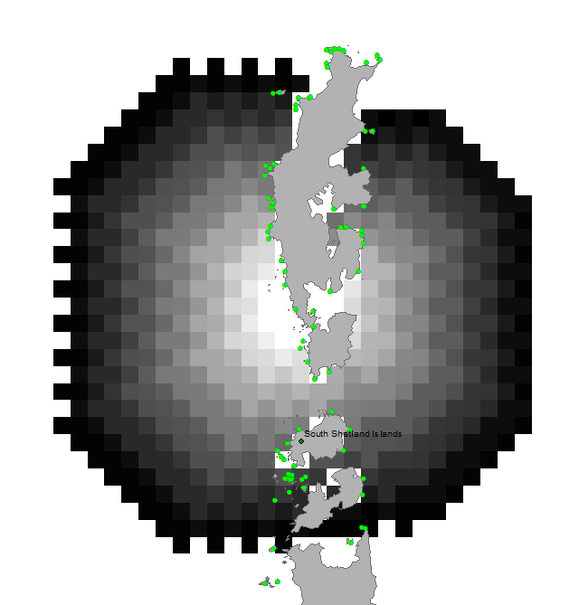
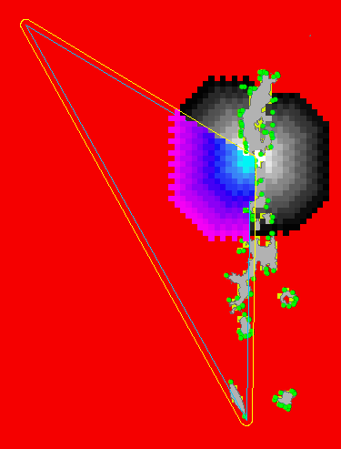
What Seaward extension approach will we take for the new Marine Toolkit.
As per Handley et al. 2021 code
NEED TO IMPROVE / BETTER AUTOMATE THIS METHOD
Output goal options:
Beth’s suggested improvements
Defining bearing:
use surrounding lass mass to determine appropriate bearing
based on tests of proportion of land surrounding breeding sites
tests to potentially be done at 5º intervals around entire breeding site, whereby proportion of land covering line of length buffer-distance is used to support setting of appropriate bearing
CONSIDER: Pragmatic choice could be to use this method to determine bearing and just insert this option within the code of Handley et al. 2021.
This would negate the need to determine bearing manually as currently done.
Will need to consider possible projection challenges
Defining buffer width:
Currently, Handley et al. 2021 code just clips out an area like an ice-cream cone / V-shaped area. This is somewhat suited to point location data / unique isolated colonies. It is not well suited to breeding sites that are better represented by a polygon (e.g. a long breeding cliff site)
Basically, we need to consider a better method to define the extent of the buffered area.
Applicable to different scenarios: likely foraging areas AND likely other behaviour areas
Without a directional buffer
Colony from which foraging radius was applied
In reality, it’s very unlikely that birds would swim around the island!
Therefore, need some sort of directional component!!

Slide 14
What Seaward extension approach will we take for the new Marine Toolkit.
Output goal options:
Other improvement considerations
Bathymetry mask
Can we support an option to clip sites by bathymetry when evidence suggests appropriate?
Perhaps bring in data from ‘marmap’ R package, or allow users to use custom layers?

