Slide 1
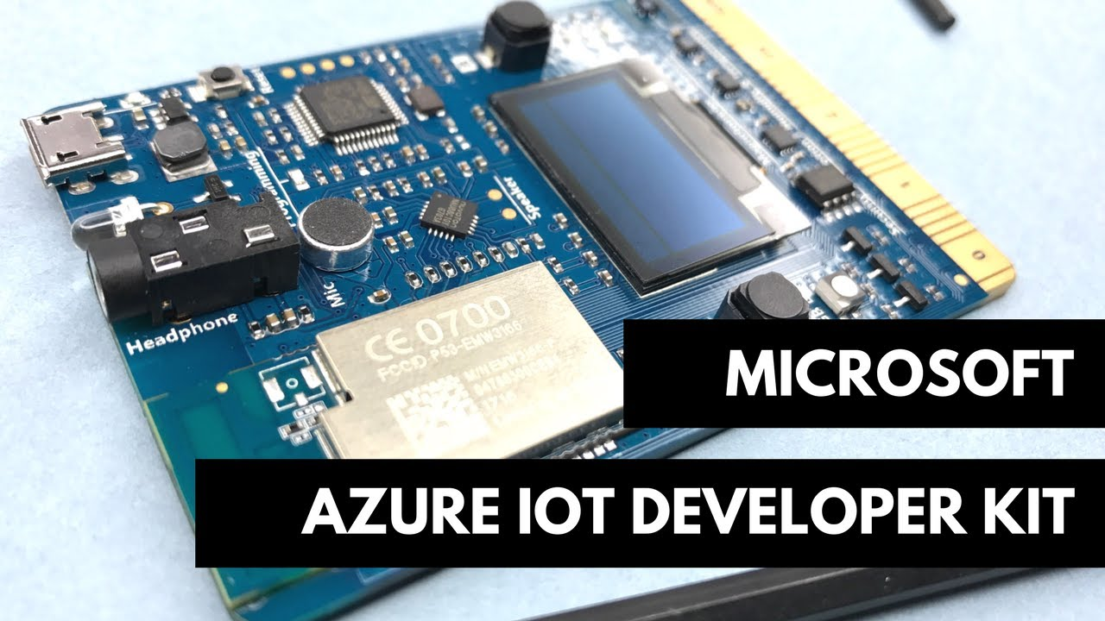


Azure IoT Dev Kit Hack
Learning hack

Slide 2
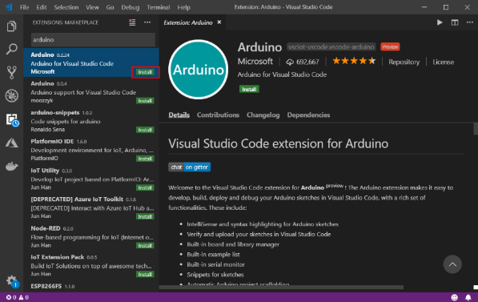
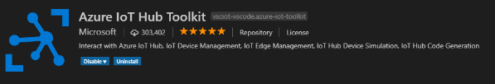


Visual Studio Code Extensions to install
Software Prerequisites
Getting Started
Install Arduino IDE
https://www.arduino.cc
Install Visual Studio Code
https://code.visualstudio.com
Install Visual Studio Code Extensions
Arduino
Azure Iot Hub Toolkit
Azure Iot Device Workbench
Azure IoT Tools
Azure Functions
Install ST Link Drivers
https://www.st.com/en/development-tools/stsw-link009.html

Slide 3
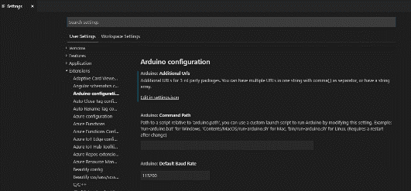
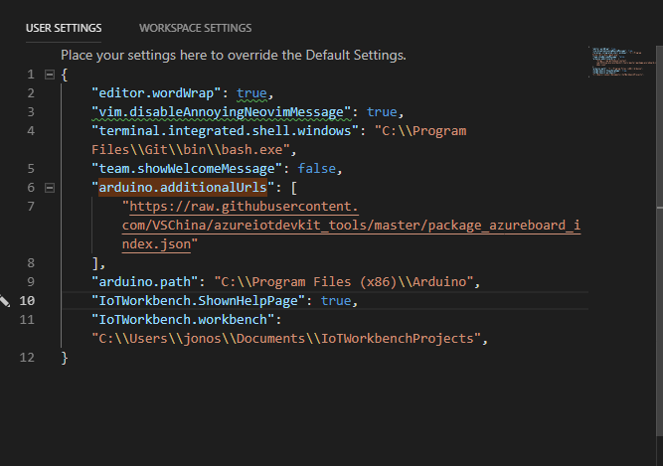
Software Configuration
VS Code Arduino Extension Configuration
Open Settings > Extensions > Arduino configuration
Add the following settings to the settings.json for the Arduino Configuration
"arduino.path": "C:\\Program Files (x86)\\Arduino",
"arduino.additionalUrls": "https://raw.githubusercontent.com/VSChina/azureiotdevkit_tools/master/package_azureboard_index.json"

Slide 4
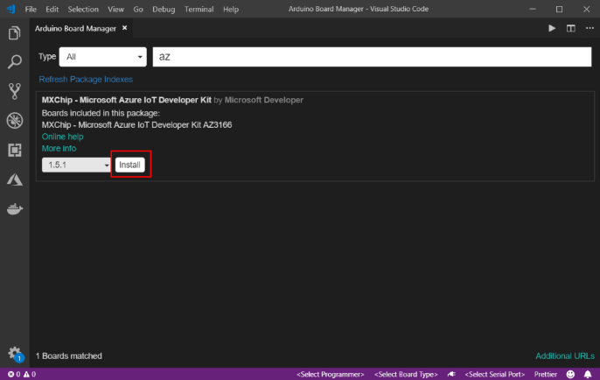
Software Configuration
Software Configuration - continued
VS Code Arduino Configuration
Open the command pallet (F1) and select the Arduino: Board Manager
Filter by ‘AZ’
Install the latest version of MXChip – Azure IoT Developer Kit (1.5x) package available
Arduino Board Manager - configuration

Slide 5
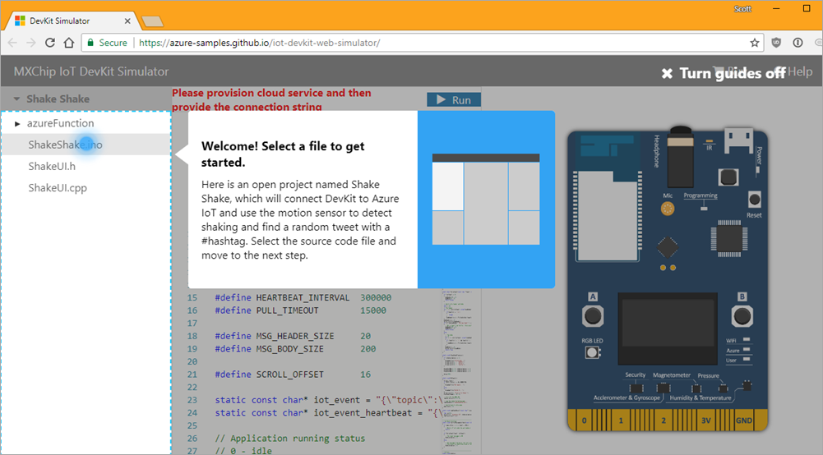
DevKit Simulator Resources
There is an open source simulator available for the IoT DevKit that allows folks to try out some of the functionality the device offers. See resources below.
DevKit Simulator
https://azure.microsoft.com/en-us/resources/samples/iot-devkit-web-simulator/
Devkit Simulator Demo
https://azure-samples.github.io/iot-devkit-web-simulator/
DevKit Simulator Github repo
https://github.com/Azure-Samples/iot-devkit-web-simulator

Slide 6
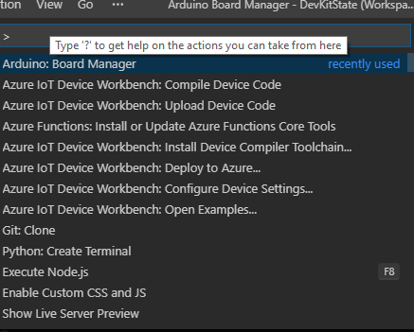
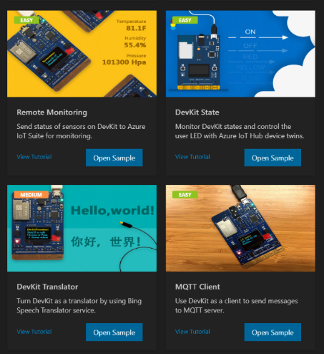
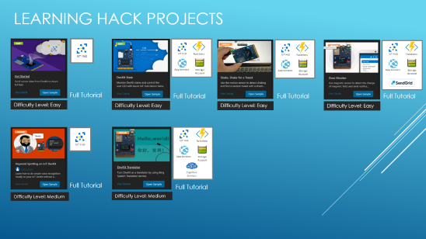
Leveraging vscode Iot device workbench
Primary Iot Dev Kit Commands in VSCode
View > Command Pallet > Azure Iot Workbench: Open Examples
View > Command Pallet > Azure Iot Workbench: Provision Azure Services
View > Command Pallet > Azure Iot Workbench: Deploy to Azure
View > Command Pallet > Azure Iot Workbench: Configure Device Settings
View > Command Pallet > Azure Iot Workbench: Upload device code
Please choose from one of the projects below for the learning hack. Note full tutorial documentation available in each project slide.

Slide 7
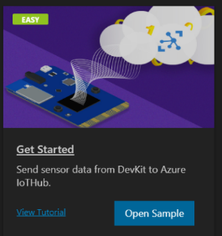
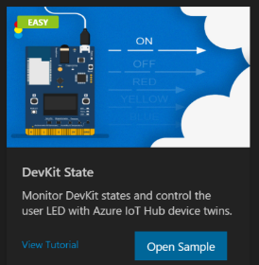
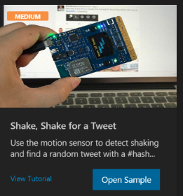
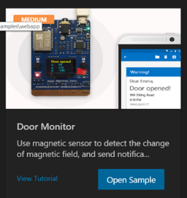
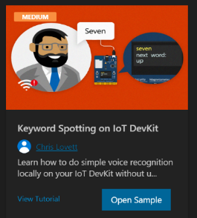
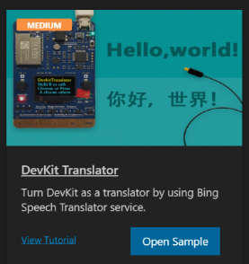
LEARNING HACK PROJECTS
Full Tutorial
Full Tutorial
Full Tutorial
Full Tutorial
Difficulty Level: Easy
Difficulty Level: Easy
Difficulty Level: Easy
Difficulty Level: Easy
Full Tutorial
Full Tutorial
Difficulty Level: Medium
Difficulty Level: Medium

Slide 8
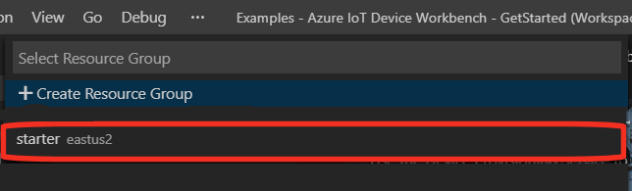
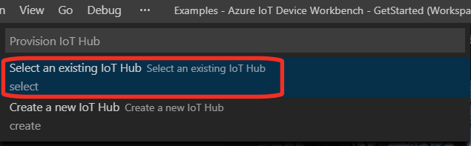
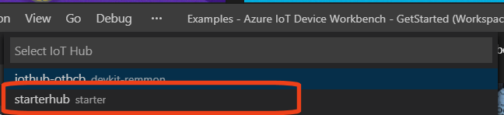
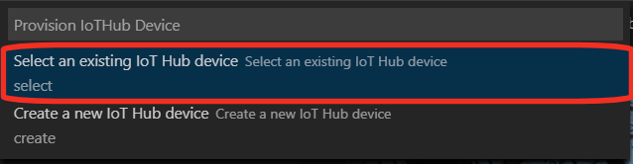
CONNECTING TO AZURE RESOURCES - VSCODE
Select the subscription 3M has provisioned for the Learning hack.
Select the resource group provided for the lab.
Select the hub provided for the lab
Select the Existing IoT Device provided for the lab.

Slide 9
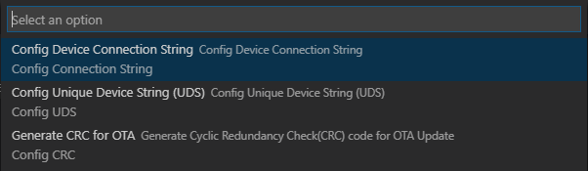
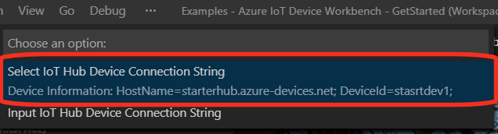
VS CODE – configuring connection strings
Once the azure resources have been provisioned and connected to the hub connection settings are available for device configuration in VS Code.
The user can also input their own connection string if desired.

Slide 10
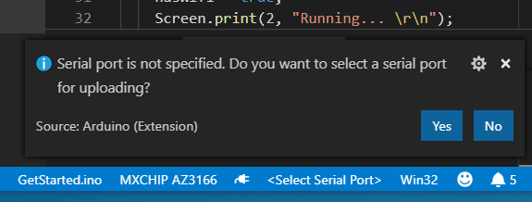

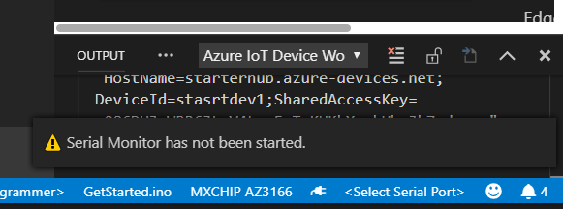

VS CODe – Com Ports and serial MONITOR
The message to the right will be displayed if the com port has not been specified in VS Code. Choose ‘Yes’ and select the com port specified as STMicroelectronics.
To start the serial monitor, select the ‘plug’ socket icon on the bottom right hand side of the VS Code IDE.

Slide 11
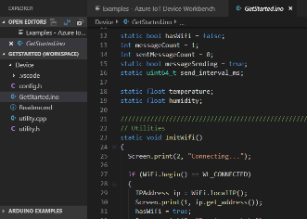
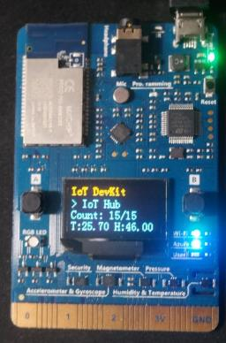
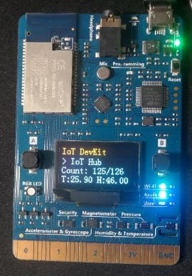
LAB - GETTING STARTED
Azure Iot Workbench: Open Examples Getting Started
Azure Iot Workbench: Connect to Azure Services
Azure Iot Workbench: Configure Device Settings (Config Device ConnectionString)
Azure Iot Workbench: Upload device code
Full Tutorial

Slide 12
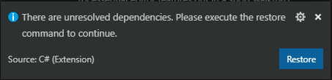
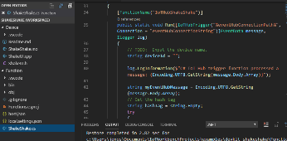
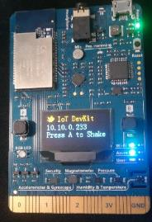
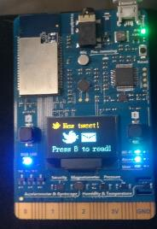
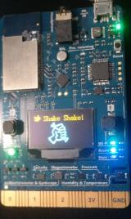
LAB - SHAKESHAKE
Azure Iot Workbench: Open Examples ShakeShake
Azure Iot Workbench: Connect to Azure Services
Update shakeshake.cs with corresponding deviceid (string deviceId = "shakedev1";)
Azure Iot Workbench: Deploy to Azure – (Deploy shakeshake function with updated deviceid)
Azure Iot Workbench: Configure Device Settings (Config Device ConnectionString)
Azure Iot Workbench: Upload device code
Full Tutorial

Slide 13
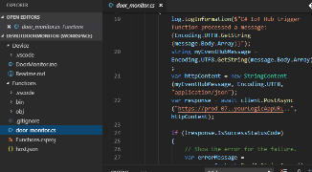
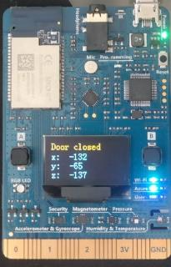
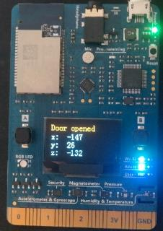
LAB - doormon
Azure Iot Workbench: Open Examples Door Monitor
Azure Iot Workbench: Connect to Azure Services
Update door_monitor.cs with corresponding function endpoint (var response = await client.PostAsync("https://doormonfun.azurewebsites.net/", httpContent);
Azure Iot Workbench: Deploy to Azure (Deploy doormon function with updated endpoint)
Azure Iot Workbench: Configure Device Settings (Config Device ConnectionString)
Azure Iot Workbench: Upload device code
Full Tutorial

Slide 14
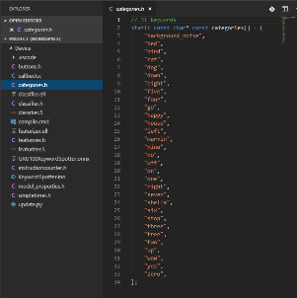

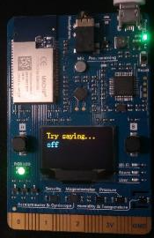
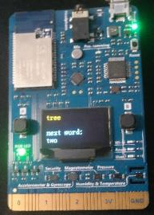
LAB - KEYWORD
Deployment Step
Azure Iot Workbench: Open Examples: Keyword Spotting on IoT DevKit
Azure Iot Workbench: Connect to Azure Services
Azure Iot Workbench: Configure Device Settings ( (Config Device ConnectionString)
Azure Iot Workbench: Upload device code
Follow instructions located on the device
Full Tutorial

Slide 15
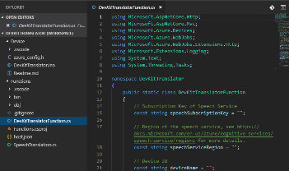
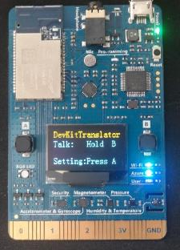
LAB - Translator
Manually Provision Cognitive Services Note Primary Key and region
Azure Iot Workbench: Open Examples: DevKit Translator
Azure Iot Workbench: Connect to Azure Services
Update DevkitTranslatorFunction.cs with Cognitive Services Primary Key, corresponding region and devicename // Subscription Key of Speech Service const string speechSubscriptionKey = "fbc47705ad974966a717ccec5ce7b94c"; // Region of the speech service, see https://docs.microsoft.com/en-us/azure/cognitive-services/speech-service/regions for more details. const string speechServiceRegion = "eastus2"; // Device ID const string deviceName = "transdevice";
Azure Iot Workbench: Deploy to Azure (Deploy translator function with updated device name)
Azure Iot Workbench: Configure Device Settings (Config Device ConnectionString)
Azure Iot Workbench: Upload device code
Follow instructions located on the device
Full Tutorial

Slide 16
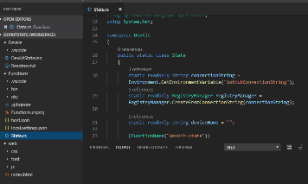
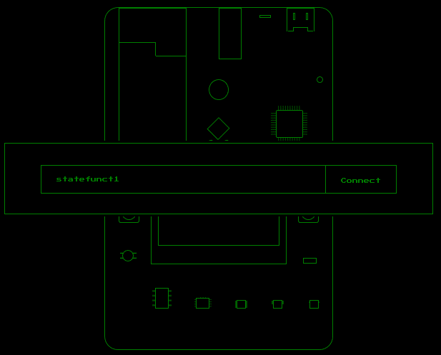
LAB - DEvKIT State - TWINS
Azure Iot Workbench: Open Examples: DevKit State
Azure Iot Workbench: Connect to Azure Services
Update State.cs with corresponding function device name (static readonly string deviceName = "statedev1";)
Azure Iot Workbench: Deploy to Azure (Deploy State function with updated device name)
Azure Iot Workbench: Configure Device Settings ( (Config Device ConnectionString)
Browse the index.html file located in the project in a web browser.
Enter the function name and select ‘connect’
Full Tutorial
Related Resources

Slide 17
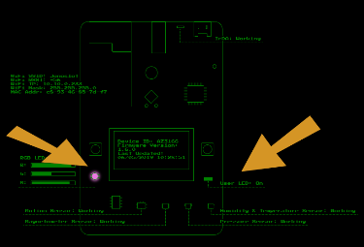
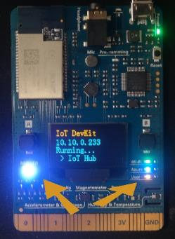
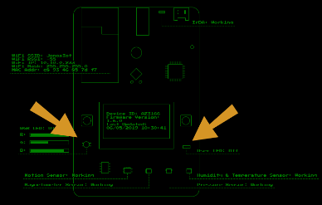
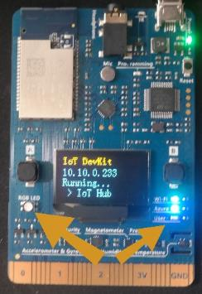
LAB - DEvKIT State – TWINS Continued
By updating the device on the display, the physical device will also be updated. To the left are the LEDs being controlled through the devices local web UI.

Slide 18
Additional Resources
General Resources for IoT DevKit
Iot Dev Kit Overview
Iot Dev Kit Prerequisites
Iot Dev Kit Getting Started - Samples
Getting Started with Iot Devkit
How to get started, connect your device to Iot Central
Project related Documentation Resources
Use IoT DevKit AZ3166 with Azure Functions and Cognitive Services - Language Translator
How to get started, connect your device to Iot Central
Send messages to an MQTT server using Eclipse
Weather forecast using Azure Machine Learning
Monitor magnetic field and send email when door opens
Remote Monitoring Solution Accelerator
Connect Azure DevKit IoT Device to Monitoring Solution Accelerator
IoT Toolkit and Workbench Resources
Channel 9 – Iot workbench
Channel 9 – What’s new in the Iot Toolkit

Slide 19
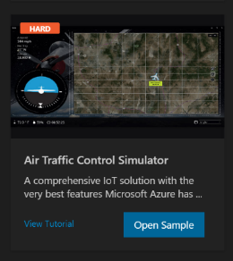
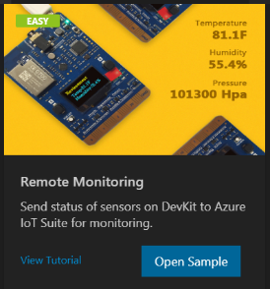
Labs - advanced
Full Tutorial
Full Tutorial
Difficulty Level: Hard
Difficulty Level: Hard

Slide 20
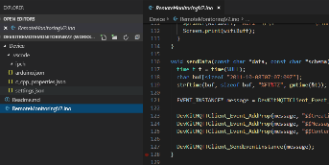
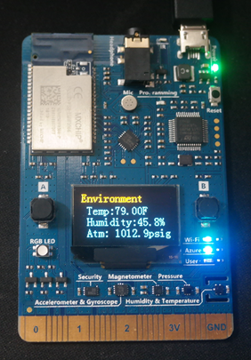
LAB - Remote Monitor v2
Deploy Perquisites
Azure Iot Workbench: Open Examples Remote Monitor v2
Azure Iot Workbench: Connect to Azure Services
Azure Iot Workbench: Configure Device Settings (Config Device ConnectionString)
Azure Iot Workbench: Upload device code
Full Tutorial
Remote Monitoring Solutions Accelerator GitHub Repo

Slide 21


LAB - AIR TRAFFIC Controller
Azure Iot Workbench: Open Examples: Air Traffic Control Simulator
Azure Iot Workbench: Connect to Azure Services
Update config.h with Display Name for project #define DISPLAY_NAME "Flight Controller"
Azure Iot Workbench: Deploy to Azure Deploy flight function with updated display name
Azure Iot Workbench: Configure Device Settings ( (Config Device ConnectionString)
Azure Iot Workbench: Upload device code
This completes HOL1, for additional advanced configuration see documentation links on next slide.

Slide 22
AIR TRAFFIC Controller – HOL2, HOL3 and HOL4
Deploy Event hub
Complete configuration steps for HOL 2
Deploy Stream Analytics
Complete configuration steps for HOL 3
Complete configuration steps for HOL 4
Full Tutorial

