Slide 1

Investigating Relationships Between the Backdrop of Provincial Economic Volatility and Wider Mental Health in Alberta
Anna Iuferova Marc McCoy Jon Peters
Course 601 - Working with Data and Visualization

Slide 2
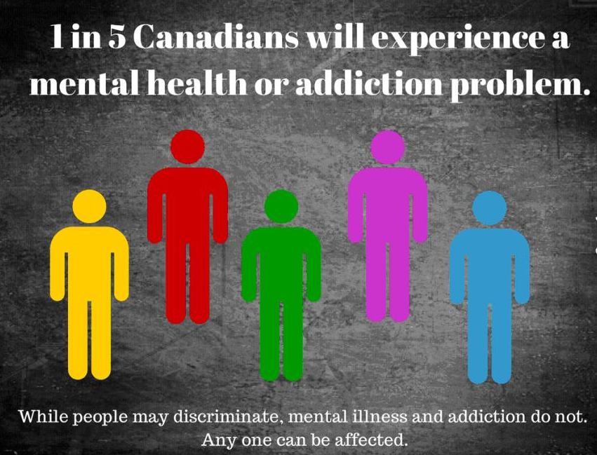
Background
More than 6.7 million people in Canada are living with a mental health problem or illness today; or about 19.8% of Canada’s population in any given year. ⁽¹⁾
The World Health Organization (WHO) claims the incidence of mental illness is expected to rise in the coming decade.
Over the past decade, the economy has become to take a dramatic turns as drivers have shifted more towards a “gig-economy”.
Previous research has shown a connection between economic standing and mental health, we aim to find a similar connection in the province of Alberta.⁽¹⁾
(1) Source: Smetanin et al. (2011). The life and economic impact of major mental illnesses in Canada: 2011-2041. Prepared for the Mental Health Commission of Canada. Toronto: RiskAnalytica.

Slide 3
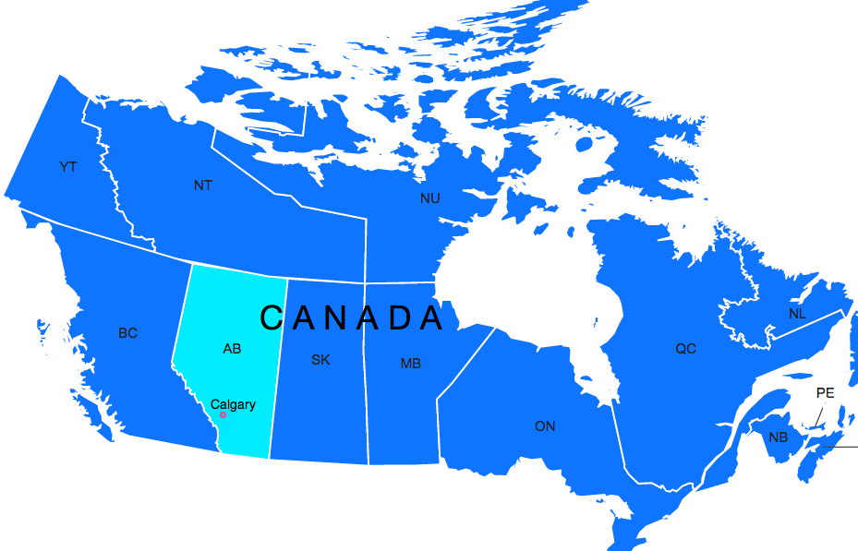


Guiding Questions To Be Answered
1
Is there an identifiable relationship between the dynamic economic situation and the wider mental health trend within Alberta?
2
Which subpopulations have been the most adversely affected by the economic volatility in Alberta within the last decade?
?
3
What have been the trends in more granular hospital-based mental health data, and do those findings relate to the wider economic analysis and subgroup analysis?

Slide 4




Core Data Utilized
Canadian Community Health Survey (CCHS)
Alberta Economic Dashboard Data
Canadian Institute for Health Information (CIHI)
All data is open source

Slide 5
1
Is there an identifiable relationship between the dynamic economic situation and the wider mental health trend within Alberta?

Slide 6
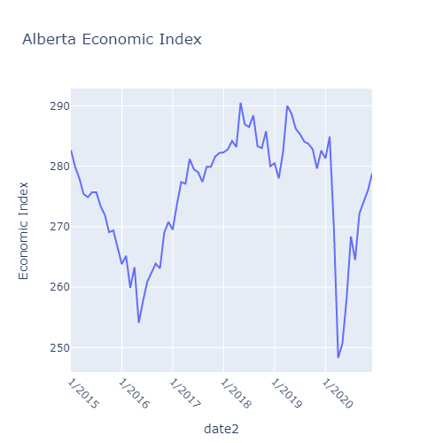
1

Slide 7
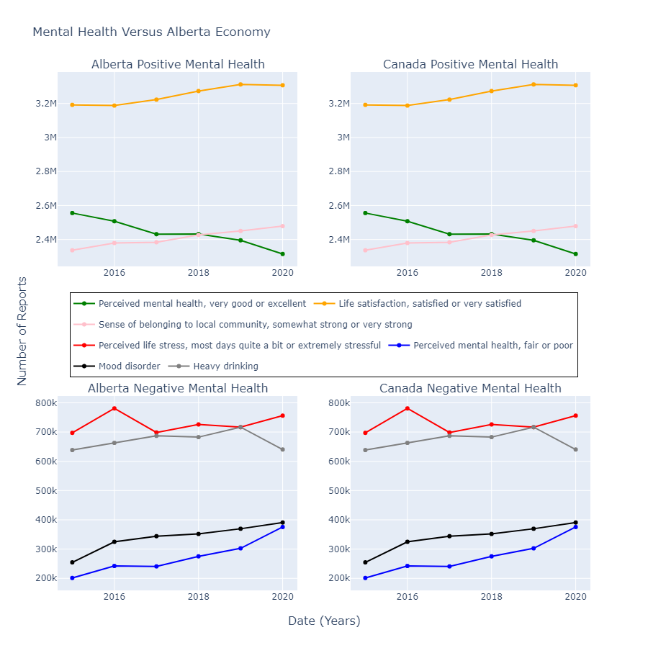
1
A constant decrease in perceived ‘good’ or ‘excellent’ Mental Health status
‘Stress most days’ peaks around 2016, where we previously saw economic decline
A steeper than nor increase in ‘fair’ or ‘poor’ mental health status in 2016 and 2020.

Slide 8
1
What subsectors of Alberta's economy change the most with economic decline / rise in poor mental health reports?

Slide 9
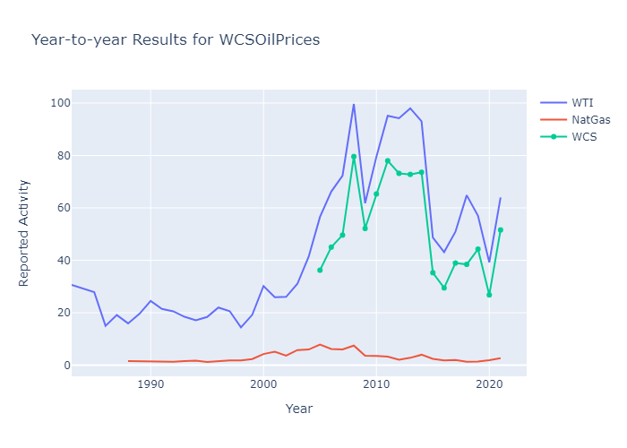
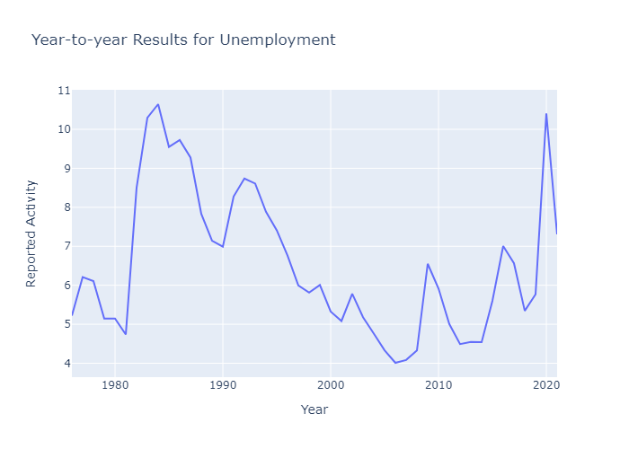
1
Alberta Key Economic Indicator (Oil) saw rapid fluctuation after 2008.
Largest decrease was in 2015, with another dip shortly after in 2020
Unemployment likewise saw spike in 2008, 2016, and 2020

Slide 10
1
Correlation does not infer Causation
But, trends in poor mental health do follow those trends in poor economic performance.
Thus, there exists an identifiable relationship between these two factors.

Slide 11
2
Which subpopulations have been the most adversely affected by the economic volatility in Alberta within the last decade?

Slide 12
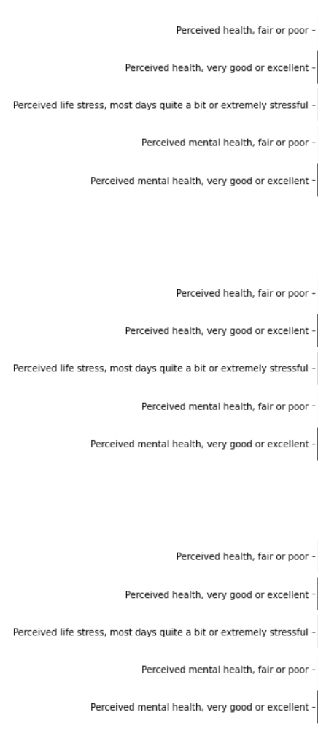
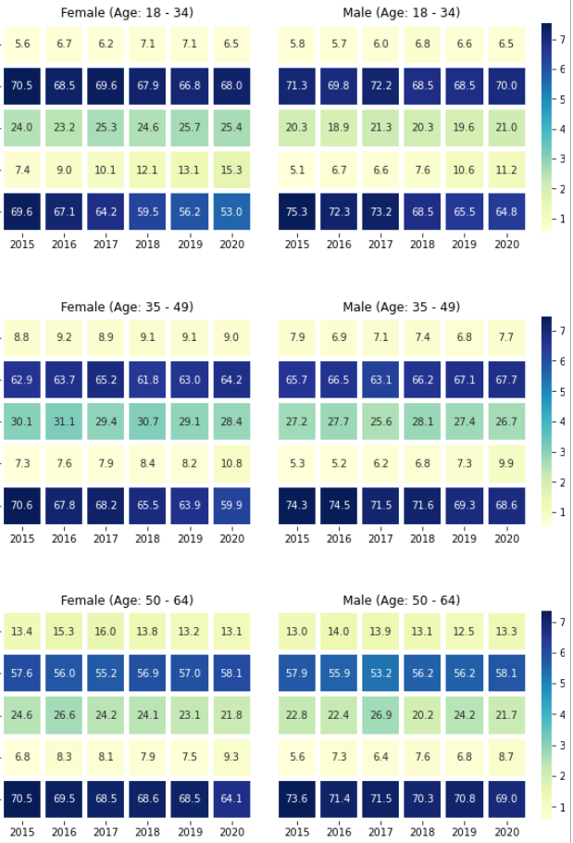
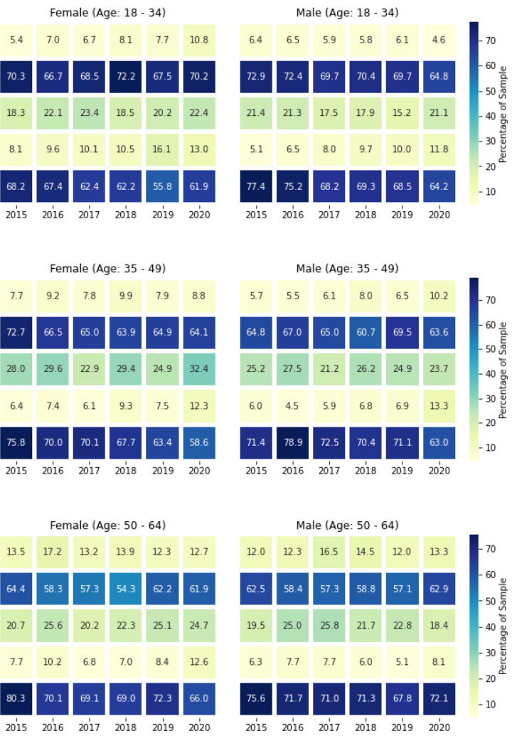
2
Analysis:
Canada
Alberta

Slide 13
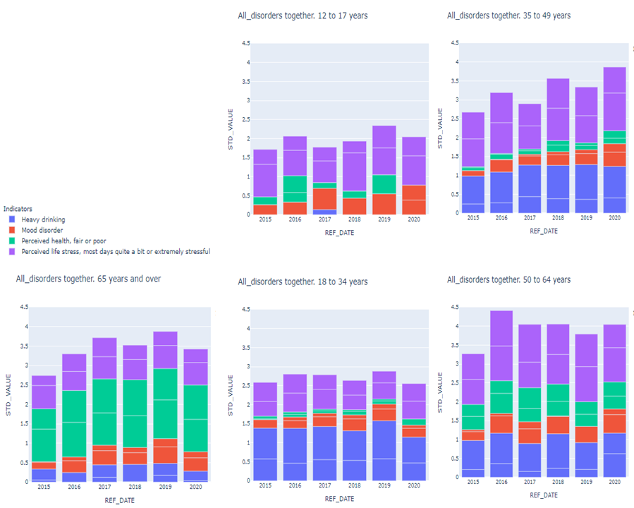

2
Conclusions:
35 to 49 years old group was the mostly affected
Females have been affected more than males
The Mental health of people in Alberta was affected by the changing in Economy situation in much more than in Canada as a whole.

Slide 14
3
What have been the trends in more granular hospital-based mental health data, and do those findings relate to the wider economic analysis and subgroup analysis?

Slide 15
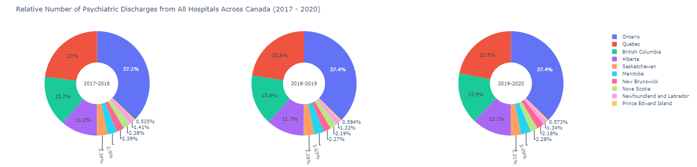
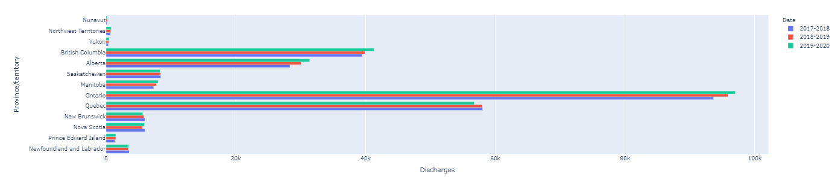
3
No relative changes in aggregate discharges across provinces

Slide 16
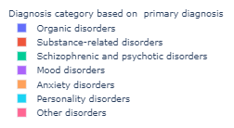
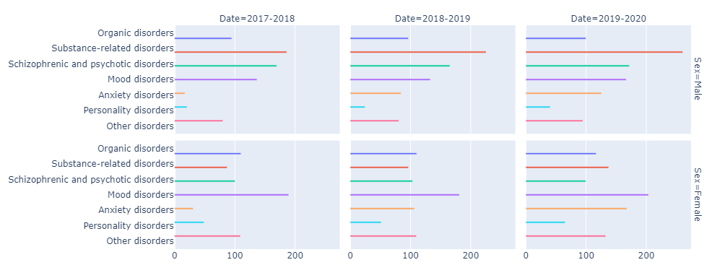
3
Alberta Crude Discharge per 100,000 population shows more clearly that anxiety is rising amongst Albertans

Slide 17
Conclusion
1
2
3
Is there an identifiable relationship between the dynamic economic situation and the wider mental health trend within Alberta?
Which subpopulations have been the most adversely affected by the economic volatility in Alberta within the last decade?
What have been the trends in more granular hospital-based mental health data, and do those findings relate to the wider economic analysis and subgroup analysis?

Slide 18
Next Steps
Utilization of trends within mental health data to improve allocation of provincial healthcare budgets
Feasibility assessment of potential of social outreach centers to help address stress and anxiety within patients aged 35-49
Social programs to proactively address declining mental health indicators when an economic downturn is occuring

Slide 19
References:
Franklin, M. (2021) ‘Alberta Blue Cross reminds families to pay attention to their children's mental health,’ CTVNewsCalgary.ca, 27 August [Online]. Available at: https://calgary.ctvnews.ca/alberta-blue-cross-reminds-families-to-pay-attention-to-their-children-s-mental-health-1.5564331 (Accessed: 23 September 2021)
Macintyre, A. (2018) ‘What has economics got to do with it? The impact of socioeconomic factors on mental health and the case for collective action’, Humanities & Social Sciences Communications, 4(10) [Online]. Available at: https://www.nature.com/articles/s41599-018-0063-2 (Accessed: 25 September 2021)
Mental Health Commission of Canada. (2021) Why Investing In Mental Health Will Contribute To Canada’s Economic Prosperity and To the Sustainability of Our Healthcare System [Online]. Available at: https://www.mentalhealthcommission.ca/wp-content/uploads/drupal/MHStrategy_CaseForInvestment_ENG_0_1.pdf (Accessed: 25 September 2021)
Smetanin, P. (2011) ‘The life and economic impact of major mental illnesses in Canada: 2011-2041.’ Prepared for the Mental Health Commission of Canada [Online]. Available at: https://www.mentalhealthcommission.ca/wp-content/uploads/drupal/MHCC_Report_Base_Case_FINAL_ENG_0_0.pdf (Accessed: 24 September 2021)
World Health Organization. (2013) Mental health action plan 2013 - 2020 [Online]. Available at: https://www.who.int/publications/i/item/9789241506021 (Accessed: 26 September 2021)

Slide 20
Comprehensive Data Source Attributions:
Alberta Economic Dashboard. (2021) Government of Alberta, 17 September [Online]. Available at: https://economicdashboard.alberta.ca/
Alberta Activity Index Data Tables. (2021) Government of Alberta, 17 September [Online]. Available at: https://open.alberta.ca/opendata/alberta-activity-index-data-tables
Canadian Community Health Survey (CCHS). (2021) Statistics Canada (Canadian Dataset), 2 October [Online] Available at: https://www150.statcan.gc.ca/t1/tbl1/en/cv!recreate.action?pid=1310009601&selectedNodeIds=1D10,4D1,4D2,4D3,4D4,4D5,4D14,4D15,4D17,4D23,4D24,4D26,5D1&checkedLevels=1D2,2D2,3D2&refPeriods=20150101,20200101&dimensionLayouts=layout2,layout2,layout2,layout3,layout2,layout2&vectorDisplay=false
Canadian Community Health Survey (CCHS). (2021) Statistics Canada (Alberta Dataset), 2 October [Online] Available at: https://www150.statcan.gc.ca/t1/tbl1/en/cv!recreate.action?pid=1310009601&selectedNodeIds=4D1,4D2,4D3,4D4,4D5,4D14,4D15,4D17,4D23,4D24,4D26,5D1&checkedLevels=0D1,1D2,2D2,3D2&refPeriods=20150101,20200101&dimensionLayouts=layout2,layout2,layout2,layout3,layout2,layout2&vectorDisplay=false
Canadian Institute for Health Information (CIHI) Data and Reports Database. (2021) 3 October [Online]. Available at: https://www.cihi.ca/en/access-data-reports/results?fs3%5B0%5D=primary_theme%3A678

Slide 21
Thank you!

