Slide 1
Executive Scheduler
Atli Marcher Pálsson
Haukur Ágústsson
Jón Rúnar Baldvinsson
Pétur Sigurðsson

Slide 2
Scope of initial release
In the initial release you will be able to create your own user account and by doing that, each user will be able to view and manage their own schedule. Every user will be able to create, edit and remove events. Once the user has created an event he will be able to view his daily, weekly or monthly schedule.
Were not able to create a daily or monthly schedule
Added sharing event ability
Implemented 2 out of 3 major features
Plan on implementing the third next semester.

Slide 3
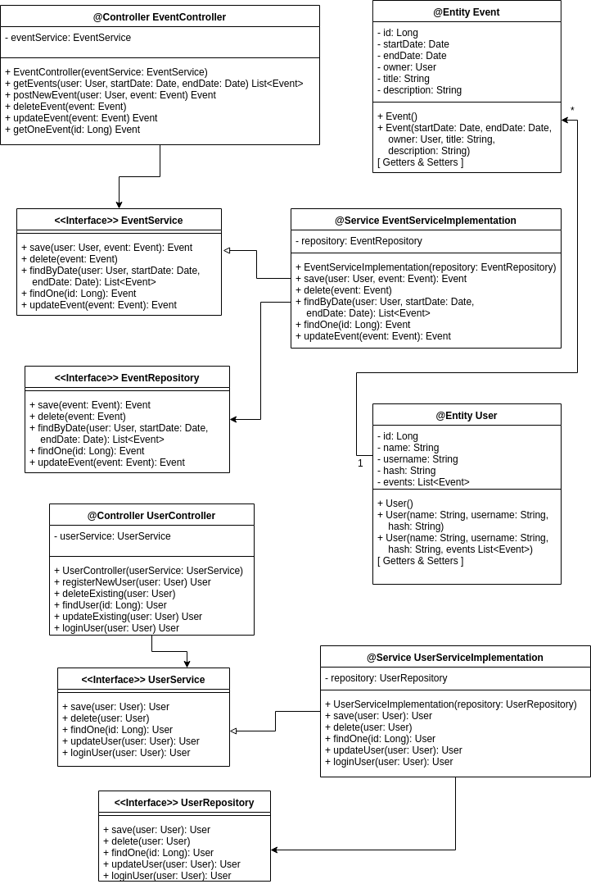
Class Diagram

Slide 4
Controller
Created three Controllers.
EventController (In the class diagram)
Keeps track of Events
UserController (In the class diagram)
Keeps track of users
LoginController (Added later)
Register and Login

Slide 5
Entity
Two Entities with many to many relationships
Event
Id
Start date
End date
Title
Description
Users
User
Id
Name
Username
Password
Token
Events
Tala um relationship vandamál

Slide 6
Service
Two services
Event Service
User Service
Handle all validations and errors in the backend.
Communicates with the Repository.

Slide 7
Database
We used Postgresql to persistently store data.

Slide 8
Authentication
Token based authentication
HTTP filter to catch unautherized
Invalid token
not authorized to see this end point.
Password encrypted with BCrypt

Slide 9
REST Endpoints
/event
POST – creates new event
GET – fetches all events with startdate and enddate query string parameters
/event/:id
GET – fetches event with given id
POST – updates event with given id
/event/:id/users
POST – Adds users to events userlist
/login
POST – Gets username and password. Returns token if authenticated
/register
POST – Creates new user.

Slide 10
React
Our front end uses the React framework
Communicates with backend sending HTTP requests to REST endpoints
Validates Form inputs. (e.g. matching password in register, end date before start date)

Slide 11
What went well
Great teamwork between strangers
Different skillsets that fit well together
Not many problems learning how to use Spring
Started from day 1
Interesting and challenging project
Kept true to our vision and scope document

Slide 12
What went wrong
Endless recursion when parsing JSON object
Took a long time noticing bugs in the back end
Deleting event deleted user
Many to many relationship problem
Problems with CORS
Could not fetch data from backend

Slide 13
What could have been done better
Starting on the front end sooner
Could not start properly before the back end was useable
Could have created mock objects
Create third entity for relationship between user and event
Realizing earlier the size of the project
Kept changing structure of our project

