Slide 1

Project Instructor – Dr. Kailash W. Kalare,
MNNIT Allahabad
EEG Based Depression Severity Prediction Using Deep Learning

Slide 2
Team Members :
Nitish Sonkar (20221060)
Antariksh Kashyap Mech (20224026)
Shreyansh Karamtot (20223255)
Kiran Kumar Sharma (20214116)
Motilal Nehru National Institute of Technology, Allahabad
Department of Computer Science & Engineering

Slide 3
Outline / Roadmap
1. Problem Statement & Motivation
2. Project Objectives
3. Methodology
4. Model Formulation
5. Solution & Key Results
6. Sensitivity Analysis / What-If Scenarios
7. Conclusion & Future Work

Slide 4
Problem Statement & Motivation
Depression is a common mental disorder characterized by symptoms such as a depressed mood, loss of interest, low self-esteem, and anxiety. Traditional diagnosis relies on subjective questionnaires prone to bias.
This project aims to perform multiclass depression classification using EEG signals with deep learning models to develop an objective, data-driven diagnostic tool.

Slide 5
Project Objectives
• Implement four advanced deep-learning architectures for EEG-based depression recognition
• Provide a comparative analysis of methods and Evaluate performance across standardized metrics

Slide 6
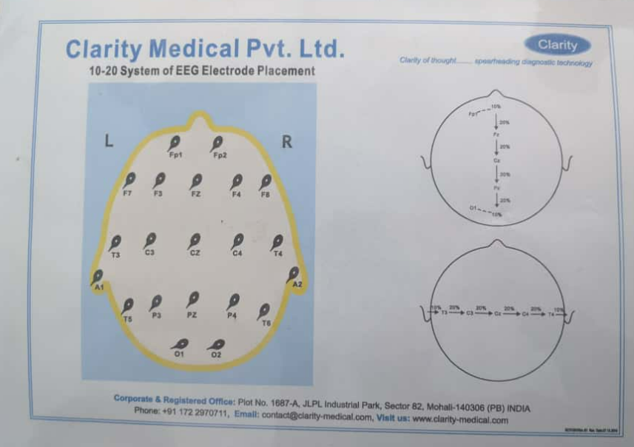
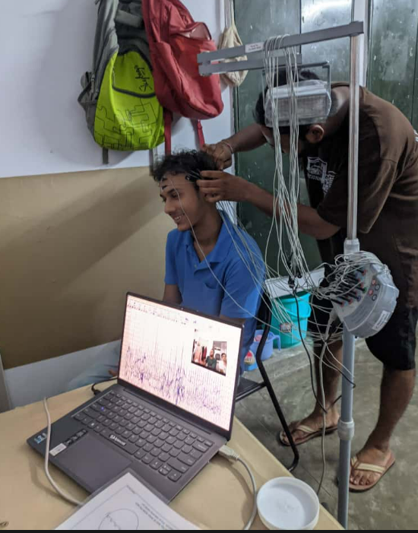
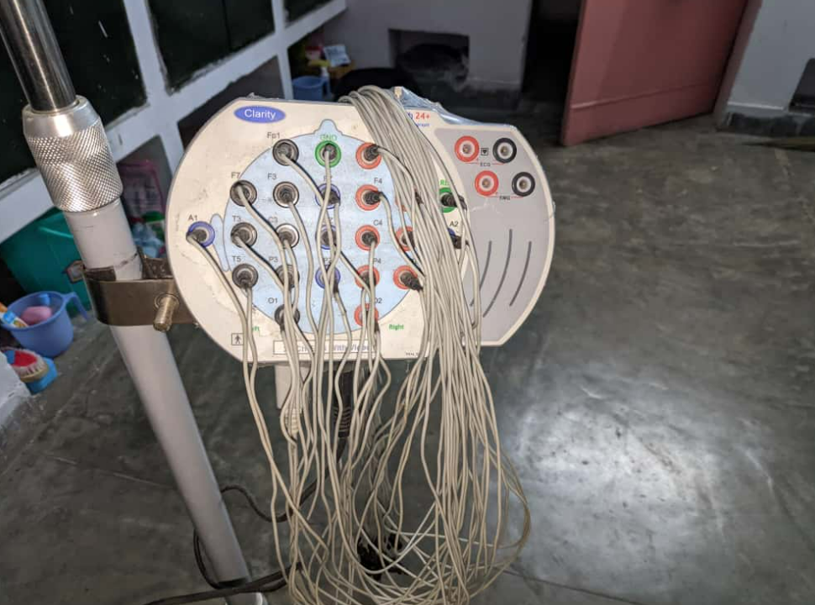
Methodology
1. Dataset : MODMA (Multimodal Open Dataset for Mental-health Analysis) EEG Dataset (53 subjects)

Slide 7
Cont.
2. Preprocessing:
Sampling frequency: 500 Hz
Electrode impedance: < 50 kΩ
Software used: MATLAB 2017b with EEGLAB toolbox
Bandpass Filtering: 1–40 Hz)
Downsampling: to 250 Hz
Segmentation: 20 segments × 4-10 seconds each (aligned with stimuli)
Artifact removal: Independent Component Analysis (ICA) for eye / head movement / power noise

Slide 8
Cont.
3. Training: Adam optimizer, stratified K-fold cross-validation
1. UA-DAAN (Uncertainty-Aware Dynamic Adversarial Adaptation Network
Trained using domain-adversarial loss with uncertainty weighting to align source and target EEG domains.
Optimized via Adam optimizer and 5-fold cross-validation on MODMA EEG dataset.
2. MTNet (Transformer-based EEG Model)
Trained end-to-end with Adam optimizer using cross-entropy loss, capturing long- range dependencies via multi-head attention.
Used stratified K-fold validation for balanced evaluation across depression classes.
3. MSDSTT (Multi-Scale Deep Spatio-Temporal Transformer)
Trained using Adam (lr = 0.0005) with cross-entropy loss for 800 epochs and 5-fold cross-validation to prevent overfitting.
Implemented early stopping and batch normalization to stabilize training and enhance generalization.
4. 1DCNN–BiLSTM–Cross Attention (Stress Severity Detection)
Trained with MSE loss and 5-fold cross-validation using XGBoost regression for final stress score prediction.
Implemented in Keras/Python, optimized with GPU acceleration (GTX 3060) for faster convergence and robustness.

Slide 9
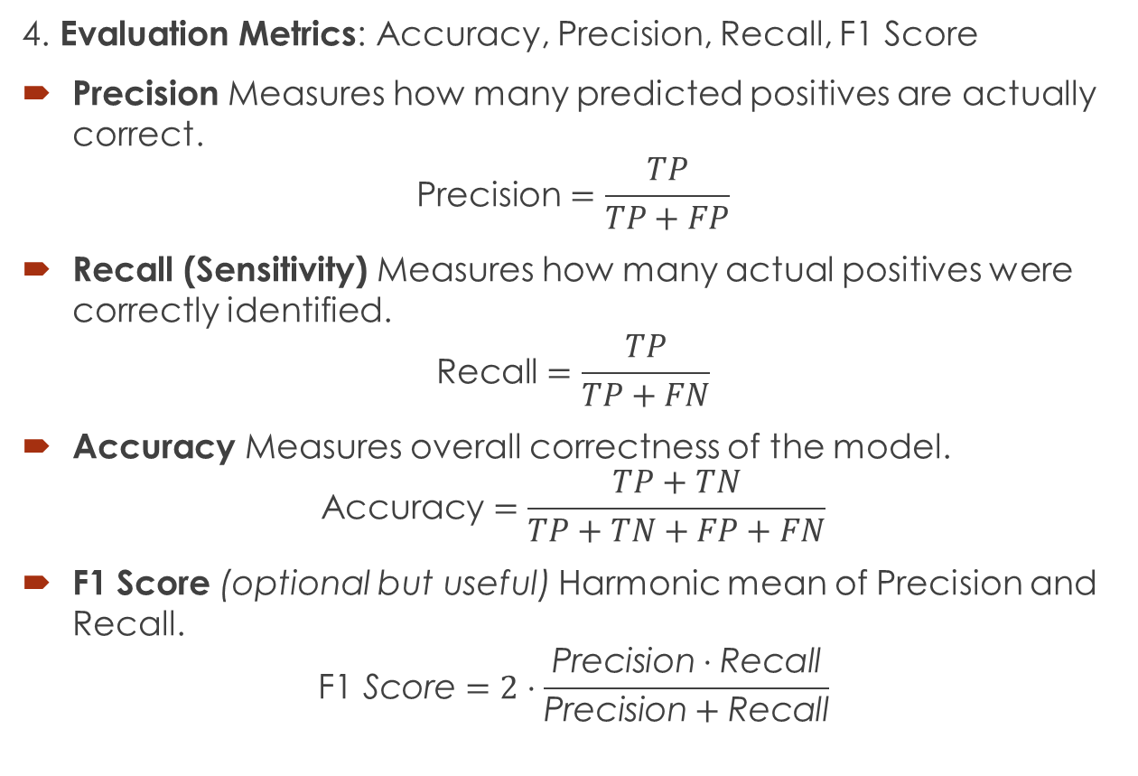
Cont.
4. Evaluation Metrics: Accuracy, Precision, Recall, F1 Score
Precision Measures how many predicted positives are actually correct.
$$\text{Precision}=\frac{TP}{TP+FP}$$
Recall (Sensitivity) Measures how many actual positives were correctly identified.
$$\text{Recall}=\frac{TP}{TP+FN}$$
Accuracy Measures overall correctness of the model.
$$\text{Accuracy}=\frac{TP+TN}{TP+TN+FP+FN}$$
F1 Score (optional but useful) Harmonic mean of Precision and Recall.
$$\text{F}\text{1} \text{Score}=2⋅\frac{\text{Precision}⋅\text{Recall}}{\text{Precision}+\text{Recall}}$$

Slide 10
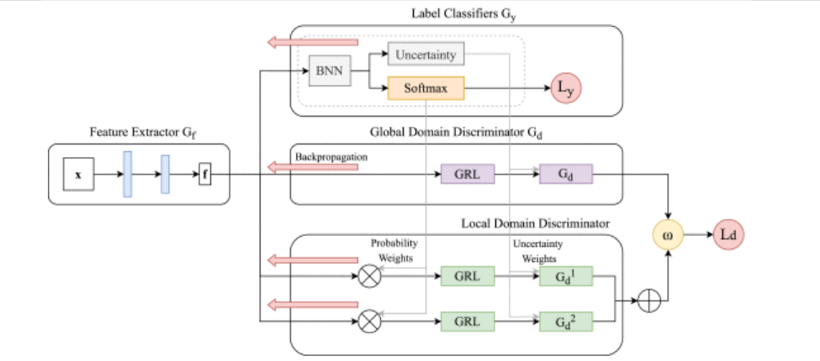
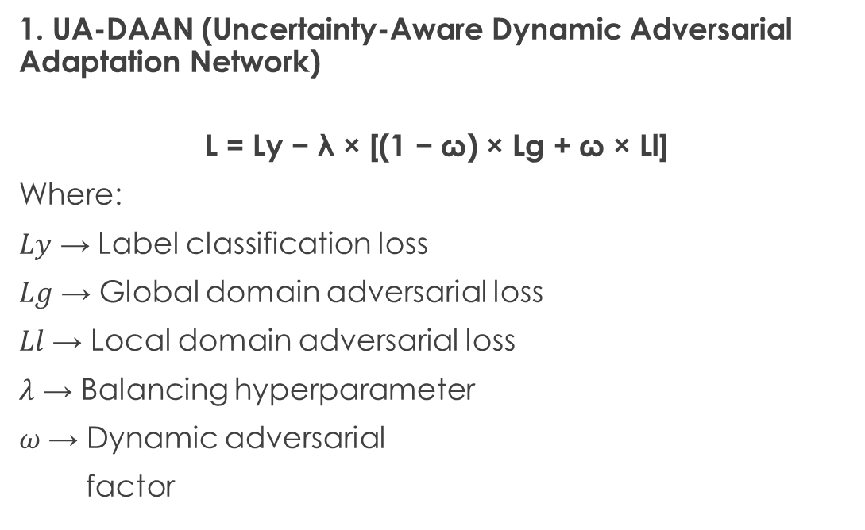
Model Formulation
1. UA-DAAN (Uncertainty-Aware Dynamic Adversarial Adaptation Network)
$$\text{L}\text{ = }\text{Ly}\text{ − }\text{λ}\text{ × [(1 − }\text{ω}\text{) × }\text{Lg}\text{ + }\text{ω}\text{ × }\text{Ll}\text{]}$$
Where:
𝐿𝑦 → Label classification loss
𝐿𝑔 → Global domain adversarial loss
𝐿𝑙 → Local domain adversarial loss
𝜆 → Balancing hyperparameter
𝜔 → Dynamic adversarial
factor

Slide 11
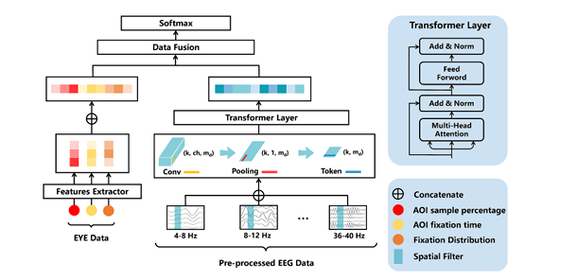
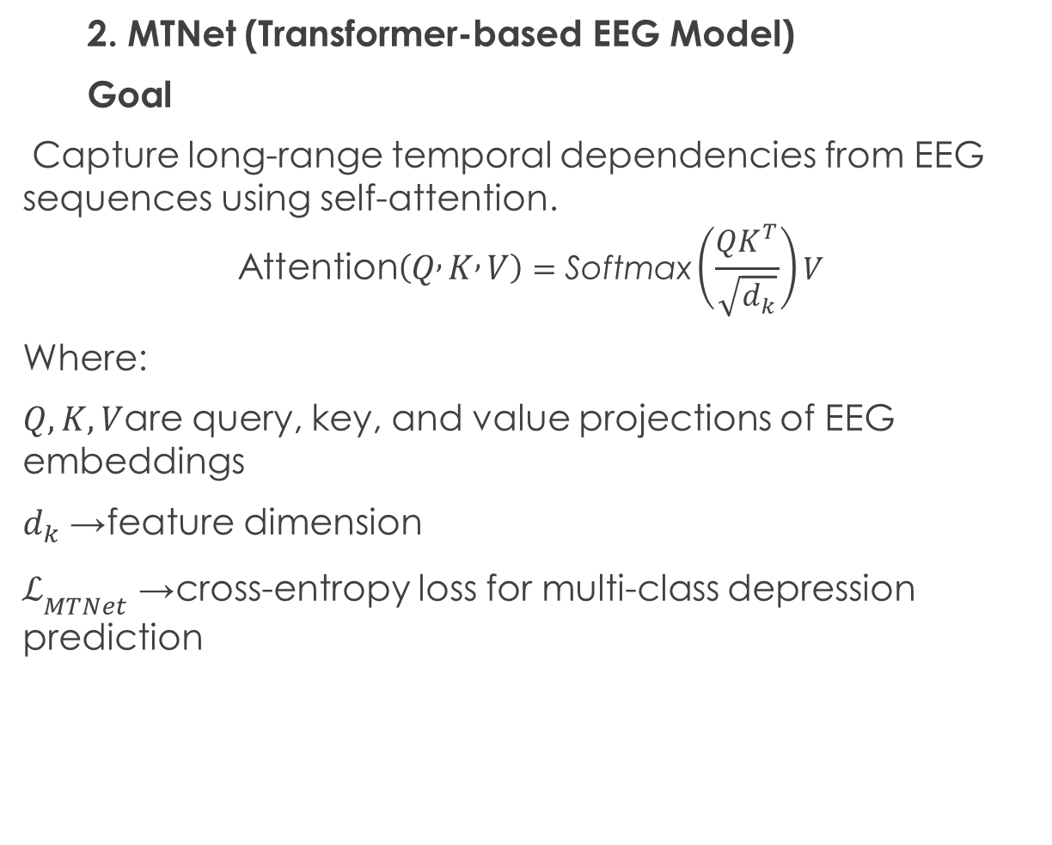
Cont.
2. MTNet (Transformer-based EEG Model)
Goal
Capture long-range temporal dependencies from EEG sequences using self-attention.
$$\text{Attention}\left(Q , K , V\right)=\text{Softmax}\left(\frac{QK^{T}}{\sqrt{d_{k}}}\right)V$$
Where:
$Q,K,V$are query, key, and value projections of EEG embeddings
$d_{k}$→ feature dimension
$ℒ_{MTNet}$→ cross-entropy loss for multi-class depression prediction

Slide 12
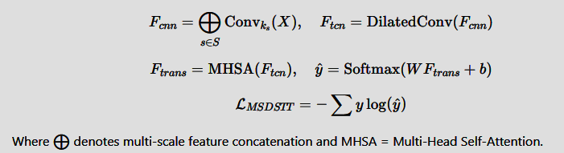
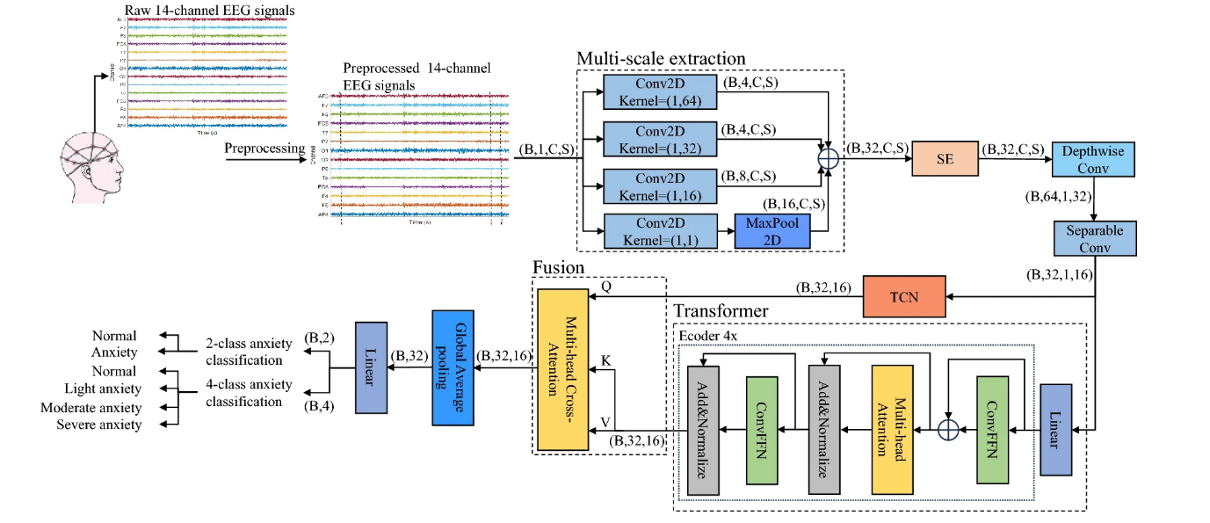
Cont.
3. MSDSTT (Multi-Scale Deep Spatio-Temporal Transformer)

Slide 13
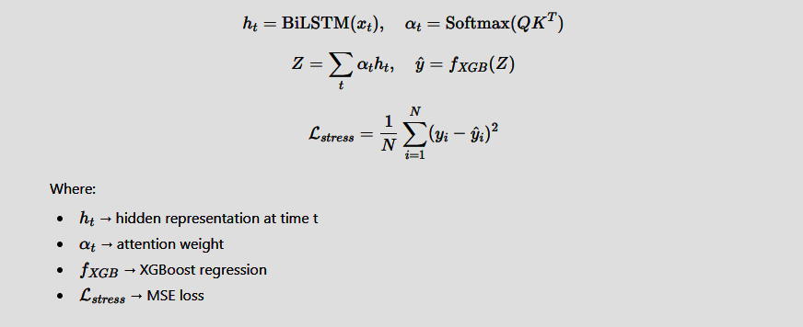
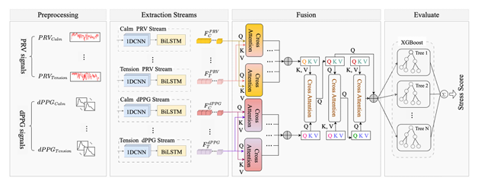
Cont.
4. 1DCNN–BiLSTM–Cross Attention (Stress Severity Detection
Model)

Slide 14
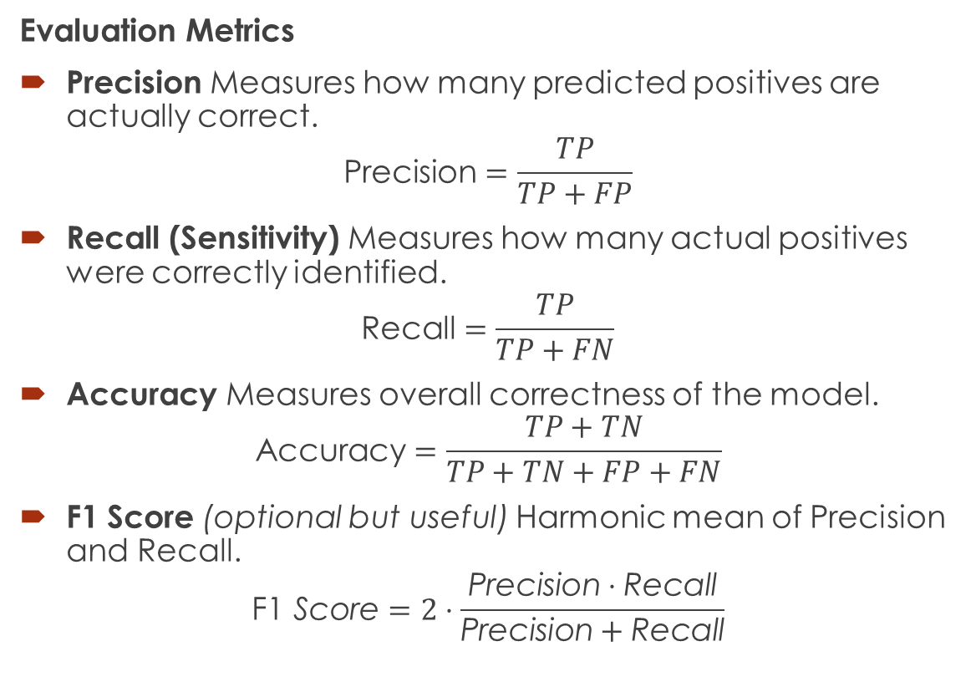
Solution & Key Results
Evaluation Metrics
Precision Measures how many predicted positives are actually correct.
$$\text{Precision}=\frac{TP}{TP+FP}$$
Recall (Sensitivity) Measures how many actual positives were correctly identified.
$$\text{Recall}=\frac{TP}{TP+FN}$$
Accuracy Measures overall correctness of the model.
$$\text{Accuracy}=\frac{TP+TN}{TP+TN+FP+FN}$$
F1 Score (optional but useful) Harmonic mean of Precision and Recall.
$$\text{F}\text{1} \text{Score}=2⋅\frac{\text{Precision}⋅\text{Recall}}{\text{Precision}+\text{Recall}}$$

Slide 15
Cont.
Model | Accuracy | Precision | Recall | F1-Score
UA-DAAN | 60.56% | 69.49% | 59.99% | 64.39%
MSDSTT | 62.6% | 33.3% | 63.9% | 65.5%
MTNet (EEG-only) | 64.% | 78% | 64% | 54%
CNN–BiLSTM–Cross Attention | 40% | 37% | 40% | 36.5%
UA-DAAN generalizes overall best across subjects, while MTNet shows highest accuracy.

Slide 16
Sensitivity Analysis / What-If Scenarios
UA-DAAN :
Performance analyzed under varying domain shifts and uncertainty thresholds; robustness confirmed against cross-subject variations.
MTNet :
Evaluated across different sequence lengths and learning rates; attention layers shown to stabilize results under temporal noise.
MSDSTT :
Tested with variable EEG channel counts and scaling factors; maintained accuracy, proving resilience to missing or noisy electrodes.
1DCNN–BiLSTM–Cross Attention :
Assessed under changing emotional conditions, dropout rates, and noise levels; model remained consistent, showing strong generalization.

Slide 17
Conclusion
1. UA-DAAN
The UA-DAAN model effectively generalizes across subjects by combining domain adaptation and uncertainty modeling.
It achieves robust EEG-based depression recognition, outperforming baseline models in cross-domain scenarios.
2. MTNet
MTNet successfully captures long-range temporal dependencies in EEG signals using Transformer attention mechanisms.
It delivers the highest classification accuracy and F1-score, proving its strength in depression severity prediction.
3. MSDSTT
MSDSTT demonstrates superior performance by integrating multi-scale CNN, TCN, and Transformer modules.
Its deep spatio-temporal fusion enables accurate and stable EEG-based anxiety and emotion classification.
4. 1DCNN–BiLSTM–Cross Attention
This hybrid model efficiently combines spatial-temporal learning with attention and XGBoost regression.
It achieves reliable stress severity estimation, showing strong robustness and emotion-aware performance.

Slide 18
Future Work
Multimodal Fusion (EEG + EOG + HRV) Combines brain signals, eye movements, and heart rate variability for richer emotional and physiological insights.
Self-Supervised EEG Pretraining Learns patterns from unlabeled EEG data before fine-tuning, improving model performance and generalization.
Regression-Based Severity Scoring Predicts a continuous depression score instead of fixed categories, allowing finer diagnosis and tracking.
Explainability with Grad-CAM & SHAP Highlights important EEG features influencing predictions, helping clinicians interpret model decisions.

Slide 19
References
UA-DAAN [UA-DAAN: An Uncertainty-Aware Dynamic Adversarial Adaptation Network for EEG-Based Depression Recognition | IEEE Journals & Magazine | IEEE Xplore]
MTNet [MTNet: Multimodal transformer network for mild depression detection through fusion of EEG and eye tracking - ScienceDirect]
MSDSTT [EEG-based anxiety emotion classification using an optimized convolutional neural network and transformer | Signal, Image and Video Processing]
CNN–BiLSTM–Cross Attention [Stress Severity Detection in College Students Using Emotional Pulse Signals and Deep Learning | IEEE Journals & Magazine | IEEE Xplore]

