Slide 1
Universal Beam Prediction without User-Equipment Side Beam-Codebook Variation Information
Speaker: Chih-Chung Shen
Advisor: Shih-Chun Lin, Chu-Hsiang Huang Co-Author: Ci-En Yu, Yi-Lun Li, Yungmin Kim
Date: 2025/11/03

Slide 2
Outline
Introduction
System Model
Universal Beam Prediction Schemes
Genie-aided linear prediction with known BS codebook
Universal beam prediction with full Set B reported
Low reporting overhead universal beam prediction
Special case: Genie-aided prediction with narrow beam
Simulation Result
Conclusion

Slide 3
Introduction
The base station (BS) wants to transmit signals to user equipment (UE) through "good" beams
“Good” beams are the ones that have higher received power (gain)
Received power is determined by
BS beamforming
UE beamforming
Channel
The spatial domain helps us predict the received power from a subset of beams

Slide 4


Reference Signal Received Power
The beam management procedures in the 3GPP 5G standards
Gain$=$ $×$

Slide 5
Beamforming Gain
The actual beamforming process is much more complex, and different BS use different beam codebook
Gain
AoA

Slide 6
Beam Prediction Scenario
The simplest scenario is when the UE knows the BS beam codebook
BS
Transmit all DL Tx beams
UE
Must know BS beam codebook
Report the best N beams
Transmit through best N beams

Slide 7
Beam Prediction Scenario
Our novel universal DL Tx beam prediction
BS
Transmit some DL Tx beams
UE
Assume a common codebook, construct all beam and report best N beams (not the truly best)
Doesn’t need to know BS beam codebook
Using the best N beams from UE to estimate the UE perspective and construct truly best N beams

Slide 8
System Model

Slide 9
System Model
3GPP Clustered Delay Line (CDL) channel model

Slide 10
Received Signal Power
To simplify the CDL model to a received signal model
Where
are the Tx beamforming gain, Rx beamforming
gain, and channel power gain, respectively
Note that there is no noise in our model

Slide 11
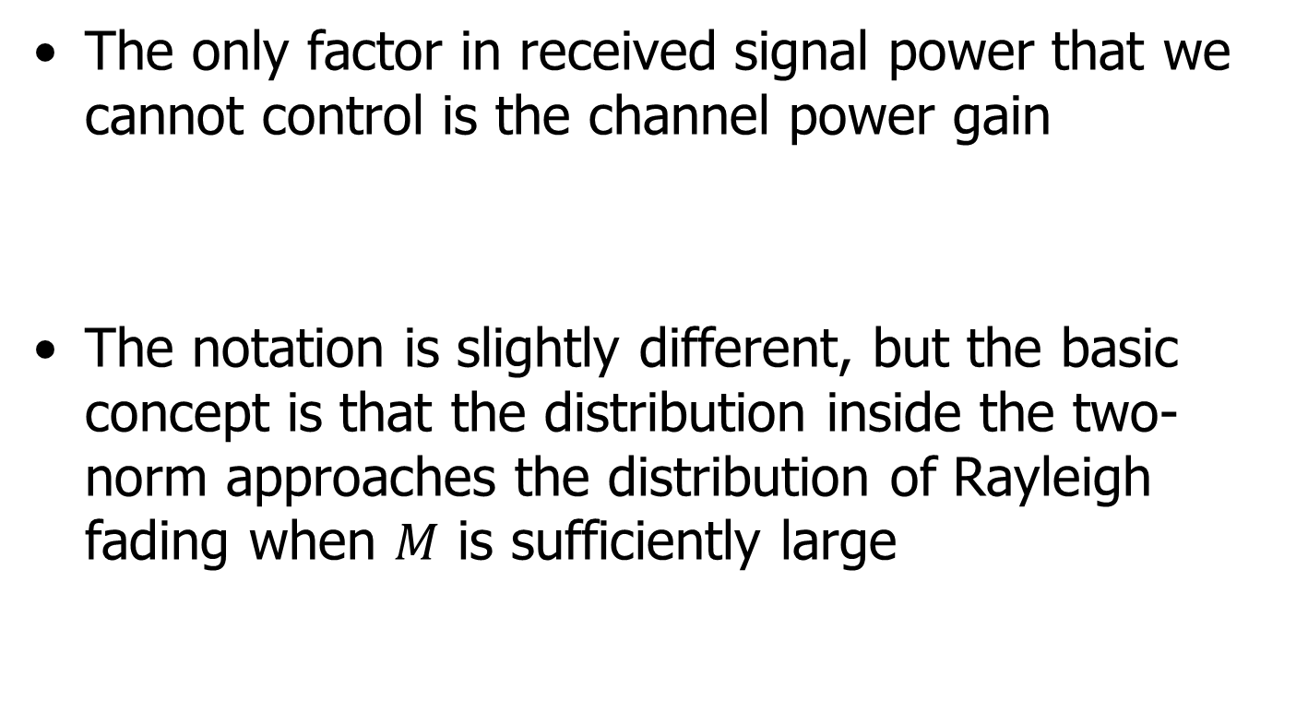
Approximate Gaussian Model
The only factor in received signal power that we cannot control is the channel power gain
The notation is slightly different, but the basic concept is that the distribution inside the two-norm approaches the distribution of Rayleigh fading when $M$ is sufficiently large

Slide 12
Approximate Gaussian Model
Received signal power is the sum of independent but not identical exponential random variables
By the Berry–Esseen theorem, we can prove that the power is approximately a Gaussian random variable

Slide 13
Beam Prediction Formulation
Separate the DL Tx beams into Set A (predicted beams) and Set B (measured beams)
We care more about which beams have the highest power gain than about the exact power gain of each beam

Slide 14

Beam Prediction Formulation
The best beams have a low probability of lying in Set B
Set B
Set A

Slide 15
Universal Beam Prediction Schemes

Slide 16
Prediction Schemes
Genie-aided linear prediction with known BS codebook: UE knows BS beam codebook
Universal beam prediction with full Set B reported: UE doesn’t know BS beam codebook
Low reporting overhead universal beam prediction: UE doesn’t know BS beam codebook and reports only part of the information from Set B

Slide 17
Genie-aided linear prediction with known BS codebook
The entire received signal power follows a multivariate Gaussian distribution

Slide 18
Genie-aided linear prediction with known BS codebook
Since the UE knows the BS beam codebook, the mean and covariance matrix can be obtained by statistical learning
But what if the UE doesn’t know the BS beam codebook?

Slide 19
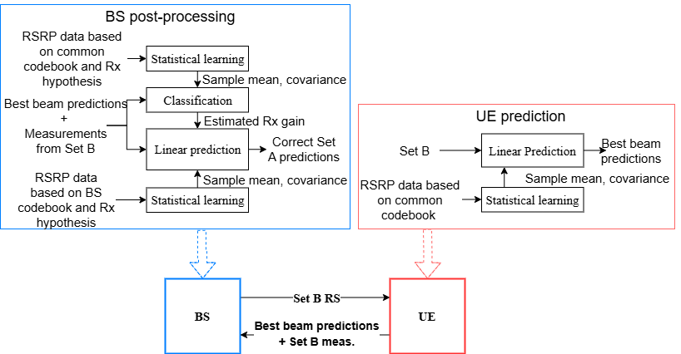
Universal beam prediction with full Set B reported

Slide 20
Universal beam prediction with full Set B reported

Slide 21
Universal beam prediction with full Set B reported
Assume there is a common beam codebook known by both the BS and the UE
The UE treats the common beam codebook as the actual codebook
Note that the UE also needs to report Set B information back to the BS

Slide 22
Universal beam prediction with full Set B reported

Slide 23
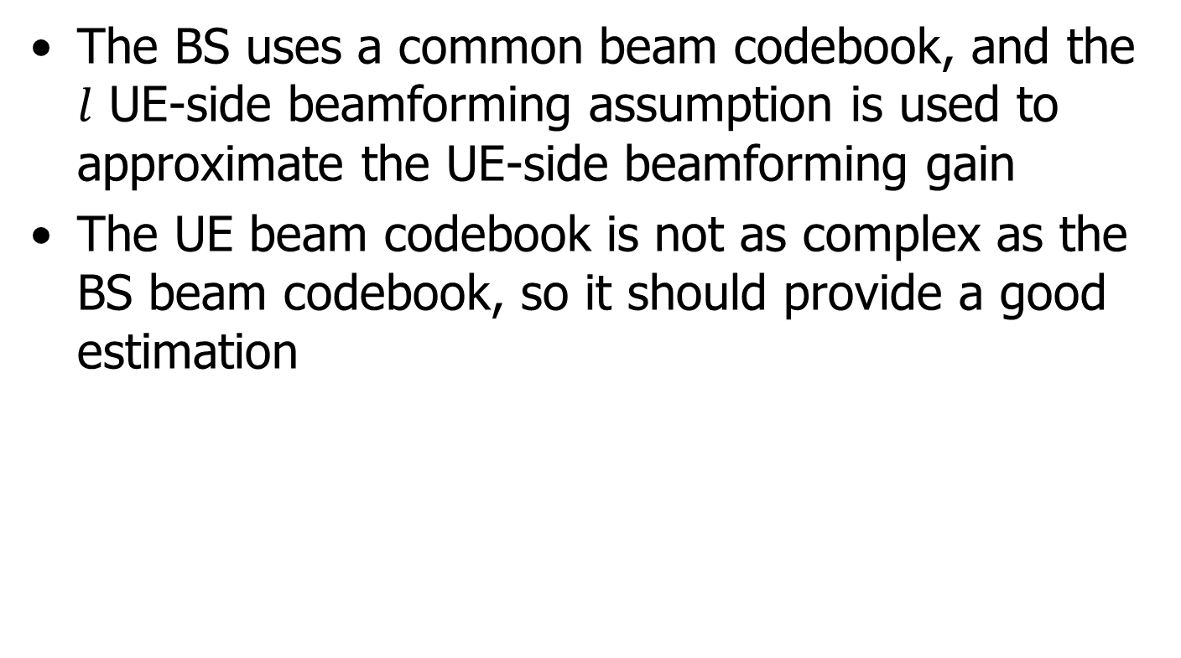
Universal beam prediction with full Set B reported
The BS uses a common beam codebook, and the $l$ UE-side beamforming assumption is used to approximate the UE-side beamforming gain
The UE beam codebook is not as complex as the BS beam codebook, so it should provide a good estimation

Slide 24
Universal beam prediction with full Set B reported

Slide 25
Universal beam prediction with full Set B reported
Using the BS’s own beam codebook and a good estimation of the UE beamforming gain, we can finally complete our estimation
It’s a bit complex, but let’s return to the system model

Slide 26
Low reporting overhead universal beam prediction
When the UE reports only part of the Set B information back to the BS
The BS needs to recover the rest of the Set B information; after that, this case becomes the same as the previous one

Slide 27
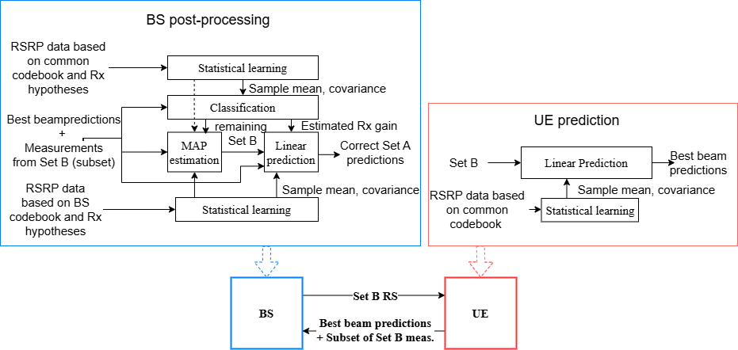
Low reporting overhead universal beam prediction

Slide 28
Low reporting overhead universal beam prediction

Slide 29
Low reporting overhead universal beam prediction
Separate it into two situations
Overdetermined, when
Underdetermined, when
The first situation can be easily solved using linear equations, but the second one is much more complex

Slide 30
Low reporting overhead universal beam prediction
For the first situation, we solve the following problem
The system is overdetermined, so we know the minimum is zero; the problem then becomes solving linear equations

Slide 31
Low reporting overhead universal beam prediction
For the second situation, we cannot directly find the exact value, but we can first estimate the mean and covariance matrix, just like in the first case where the UE knows everything

Slide 32
Low reporting overhead universal beam prediction
Then we solve the following optimization problem

Slide 33
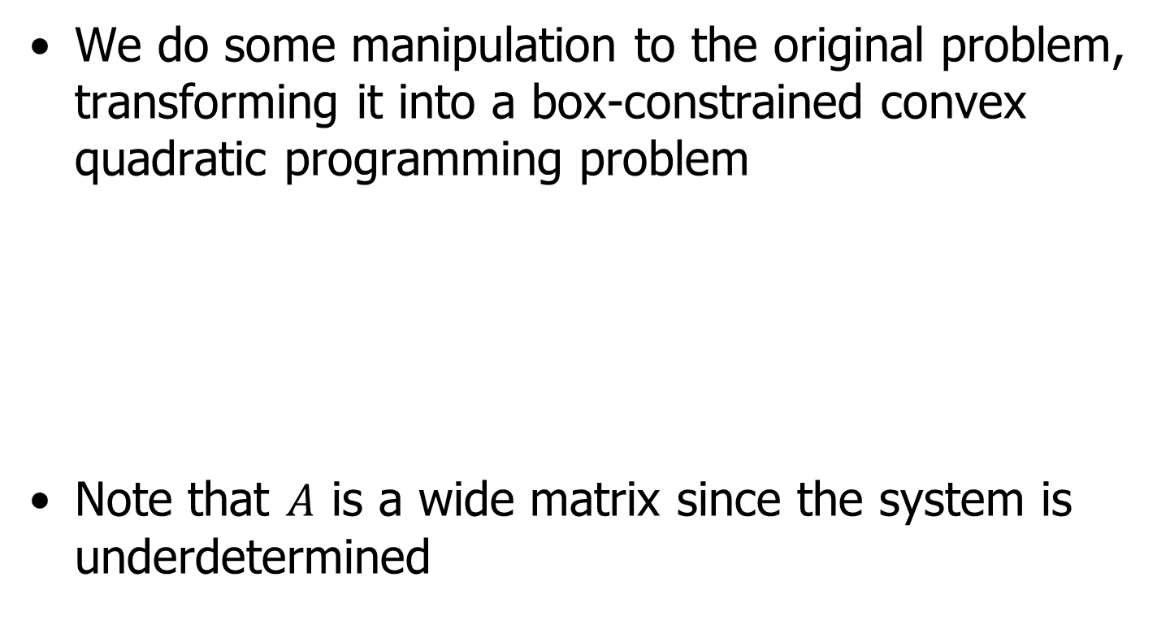
Low reporting overhead universal beam prediction
We do some manipulation to the original problem, transforming it into a box-constrained convex quadratic programming problem
Note that $A$ is a wide matrix since the system is underdetermined

Slide 34
Low reporting overhead universal beam prediction
If there are no inequality constraints, it can be simply solved using the Lagrange dual function
Together with

Slide 35
Low reporting overhead universal beam prediction
If inequality constraints exist, since the system is convex, the problem becomes identifying which inequality constraints are “active”

Slide 36
Low reporting overhead universal beam prediction
Active set: The set that contains all the inequality constraints for which the equality holds
Active set method:
Start with an arbitrary valid point and continuously move the point to decrease the value of the target function
While the point moves, add or remove a constraint from the active set

Slide 37
Low reporting overhead universal beam prediction
The active set method can only modify one constraint at a time
By attempting to move multiple constraints simultaneously, we apply the Lagrange dual function again

Slide 38

Low reporting overhead universal beam prediction
We can take advantage of the box constraints
At least one of $λ_{i}^{∗}$ and $r_{i}^{∗}$ is zero

Slide 39
Low reporting overhead universal beam prediction
First, assume the active set is empty
If the solution is valid, the algorithm stops; if it isn’t, we update our guess and continue iterating

Slide 40
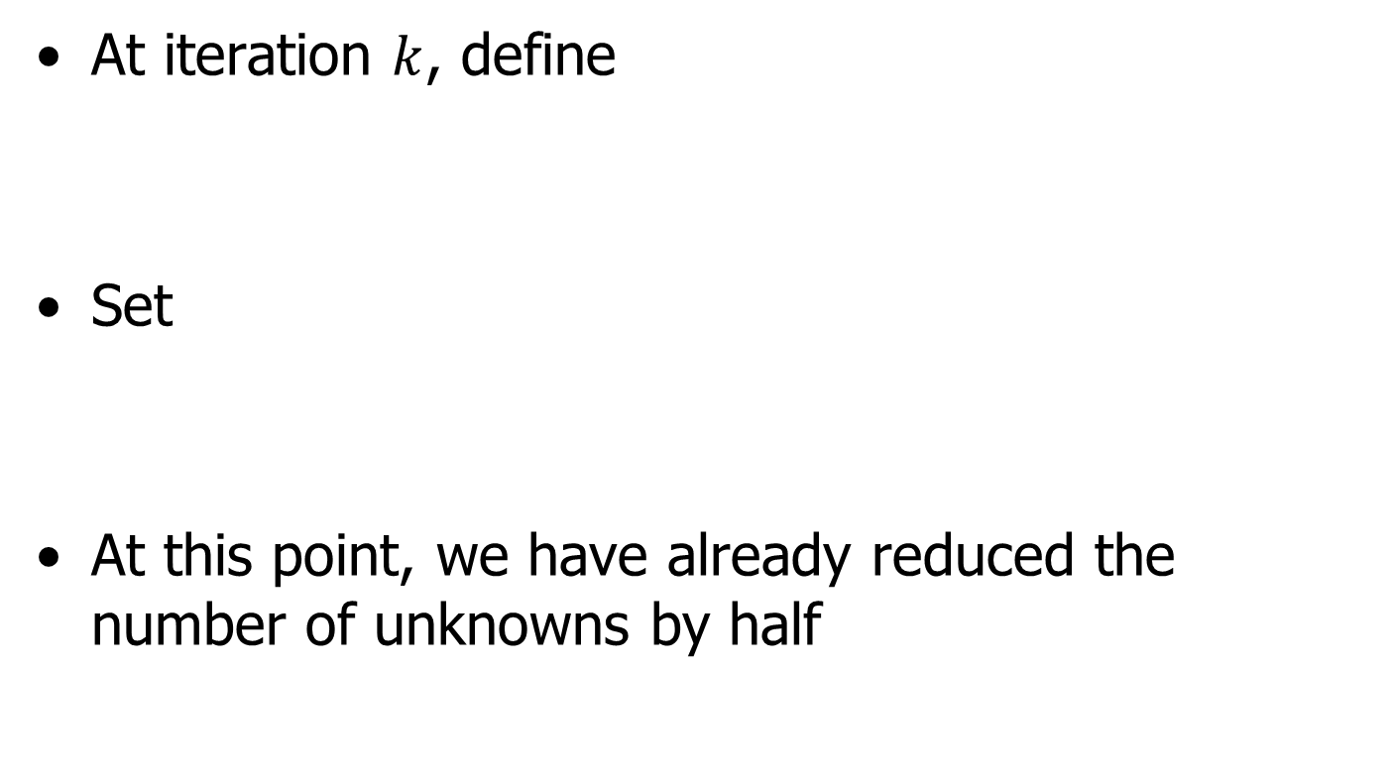
Low reporting overhead universal beam prediction
At iteration $k$, define
Set
At this point, we have already reduced the number of unknowns by half

Slide 41
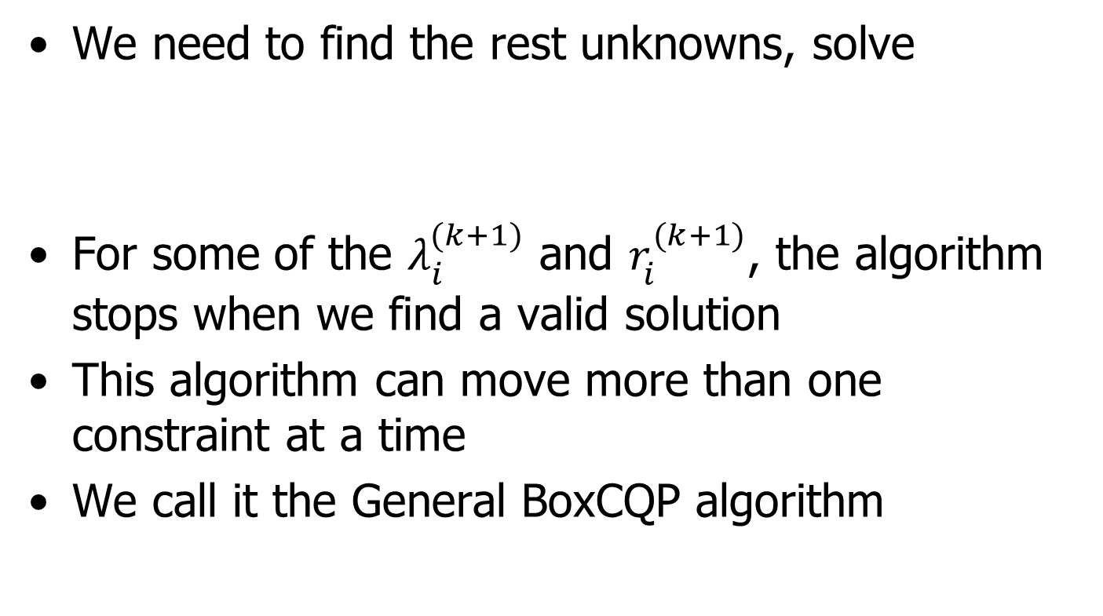
Low reporting overhead universal beam prediction
We need to find the rest unknowns, solve
For some of the $λ_{i}^{(k+1)}$ and $r_{i}^{(k+1)}$, the algorithm stops when we find a valid solution
This algorithm can move more than one constraint at a time
We call it the General BoxCQP algorithm

Slide 42
Low reporting overhead universal beam prediction
Returning to the original problem, we aim to solve the following

Slide 43
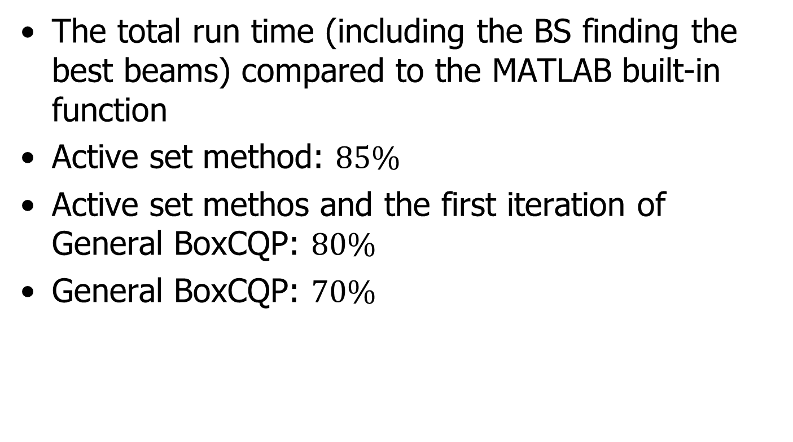
Low reporting overhead universal beam prediction
The total run time (including the BS finding the best beams) compared to the MATLAB built-in function
Active set method: $85\%$
Active set methos and the first iteration of General BoxCQP: $80\%$
General BoxCQP: $70\%$

Slide 44
Special case: Genie-aided prediction with narrow beam
Returning to the system model, if there are not many clusters, the Gaussian approximation may not be accurate enough
We need to solve an optimization problem related to exponential random variables

Slide 45
Special case: Genie-aided prediction with narrow beam
Slightly modify the system model
All the beams in Set A contains only one cluster
All the beams in Set B contain two or three clusters, which is equivalent to containing two or three beams in Set A (although most of them contain two clusters)

Slide 46
Special case: Genie-aided prediction with narrow beam
We can still try using LMMSE, although it is not the optimal estimator
We want to understand under which scenarios LMMSE would perform comparably well to the MAP estimator, which is the optimal estimator in every case

Slide 47
Special case: Genie-aided prediction with narrow beam
A quick example
Set B
Set A

Slide 48
Special case: Genie-aided prediction with narrow beam
If there are two beams in Set B, four beams in Set A
We want to know which beam has the highest probability to have highest gain among all six beams
Note that we know the distribution of each beam just like genie-aided prediction

Slide 49
Special case: Genie-aided prediction with narrow beam
How to handle the inequality in the integral
Add the constraint to the integration limit: Hard, because the limit changes
Use indicator functions: Closed-form is difficult, but numerical integration may work
How to simplify the integration
Use Fourier-Motzkin elimination to build indicator functions

Slide 50
Special case: Genie-aided prediction with narrow beam
The probability is described as below
All the integral except the beams that contain target cluster can do separately

Slide 51
Special case: Genie-aided prediction with narrow beam
The probability is described as below

Slide 52
Special case: Genie-aided prediction with narrow beam
Together with the indicator function
The last indicator function is constructed using the Fourier-Motzkin elimination

Slide 53
Special case: Genie-aided prediction with narrow beam
When a beam contains three clusters, only one integral remains
Assuming most beams have fewer clusters, the number of required integrals is limited
The actual performance is shown in the simulation results

Slide 54
Special case: Genie-aided prediction with narrow beam
Moreover, we consider the case that contain AWGN
But the case is way more complex

Slide 55
Simulation Result

Slide 56
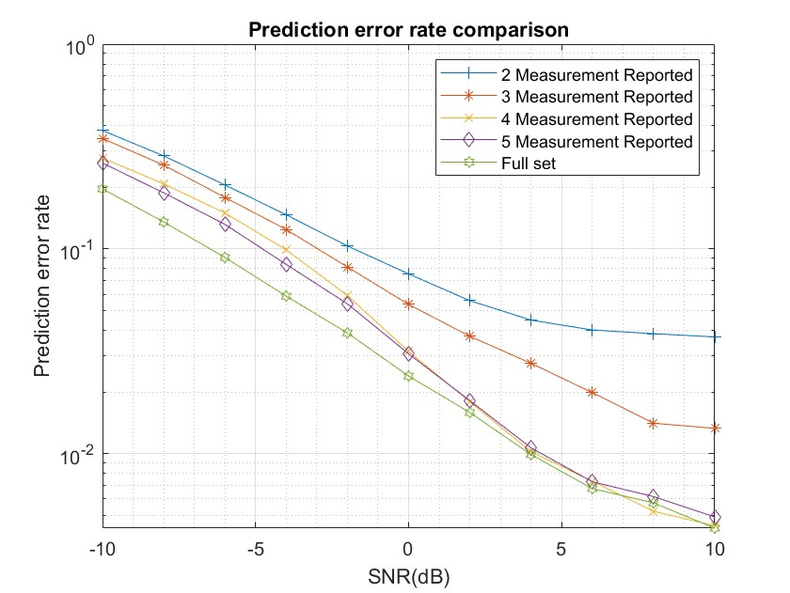
Simulation Result
Full set has 8 measurement beams

Slide 57
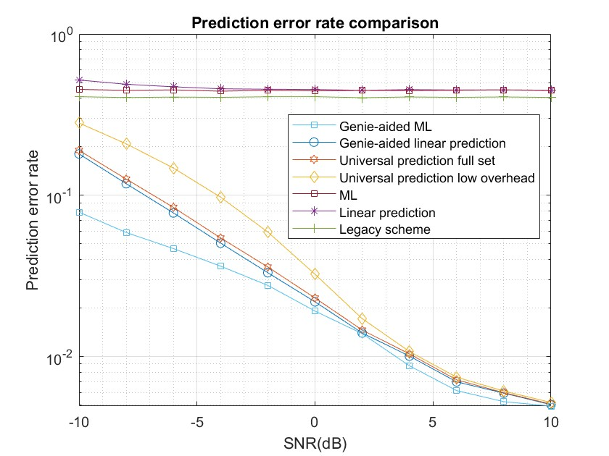
Simulation Result

Slide 58
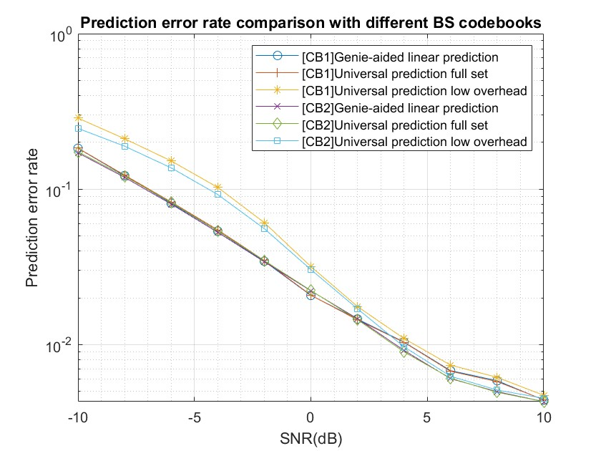
Simulation Result

Slide 59
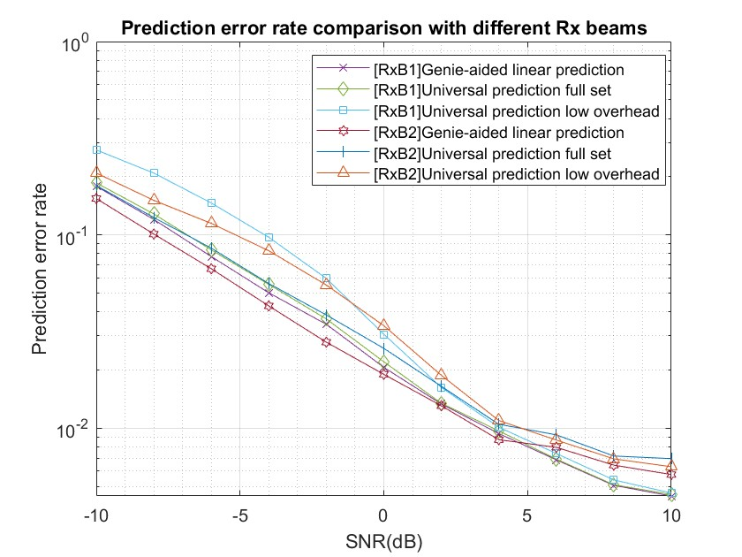
Simulation Result

Slide 60
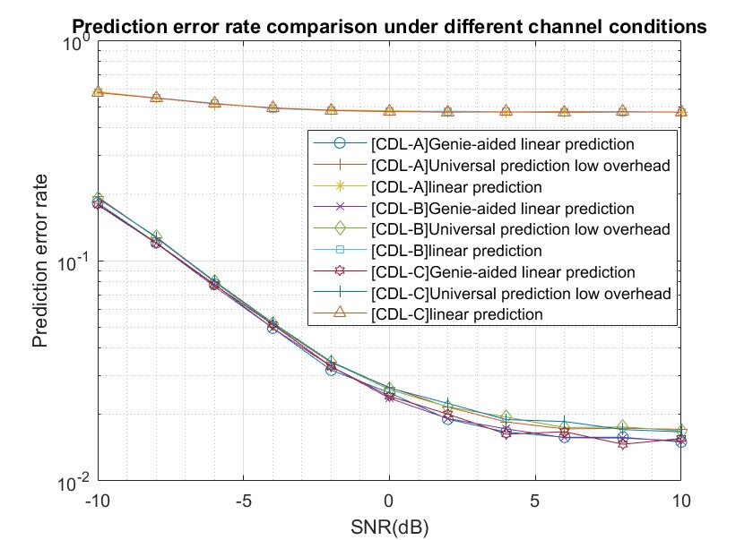
Simulation Result

Slide 61
Simulation Result
We set the parameter as below

Slide 62
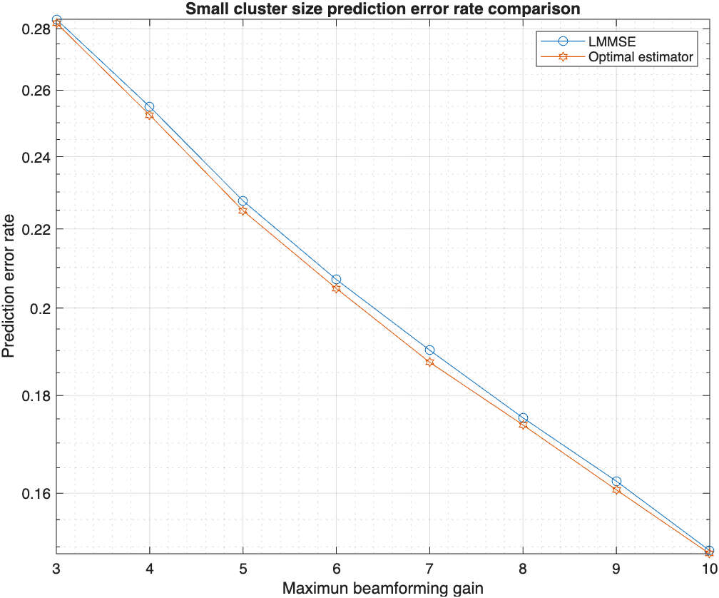
Simulation Result

Slide 63
Conclusion
Universal beam prediction schemes to enable UE DL Tx beam predictions without the knowledge of the BS beam codebooks
A low-overhead UE reporting interface
The proposed universal prediction schemes are compatible with 3GPP mmW BM framework and the ongoing AI/ML beam prediction air-interface specification works
Some scenarios with small cluster size are also compatible

