Slide 1
Universal Beam Prediction without User-Equipment Side Beam-Codebook Variation Information
Speaker: Chih-Chung Shen
Advisor: Shih-Chun Lin, Chu-Hsiang Huang Co-Author: Ci-En Yu, Yi-Lun Li, Yungmin Kim
Date: 2025/11/10

Slide 2
Outline
Introduction
System Model
Universal Beam Prediction Schemes
Genie-aided linear prediction with known BS codebook
Special case: Genie-aided prediction with small cluster size
Universal beam prediction with full Set B reported
Low reporting overhead universal beam prediction
Simulation Result
Conclusion

Slide 3
Introduction to Beam Management
The base station (BS) wants to transmit signals to user equipment (UE) through "good" beams
“Good” beams are the ones that have higher received power
Received power is determined by
BS beamforming
UE beamforming
Channel

Slide 4


Reference Signal Received Power
The beam management procedures in the 3GPP 5G standards
Gain$=$ $×$
Cluster

Slide 5
Beam Management to Beam Prediction
BS is allowed to use different beam codebook
Beam prediction: use subset of beams to predict other beams
The spatial domain allows us to do that

Slide 6
Beam Prediction Scenario
When the UE knows the BS beam codebook
BS
Transmit all DL Tx beams
UE
Must know BS beam codebook
Report the best N beams
Transmit through the best beam

Slide 7
Beam Prediction Scenario
Novel universal DL Tx beam prediction
BS
Transmit some DL Tx beams
UE
Assume a common codebook, construct all beam and report best N beams and received power
Doesn’t need to know BS beam codebook
Using the best N beams and UE received power from UE to estimate the UE perspective and construct
the best beam

Slide 8
System Model

Slide 9
System Model
3GPP Clustered Delay Line (CDL) channel model

Slide 10
Received Signal Power
Simplify the CDL model to a received signal model
Where
are the Tx beamforming gain, Rx beamforming
gain, and channel power gain, respectively

Slide 11
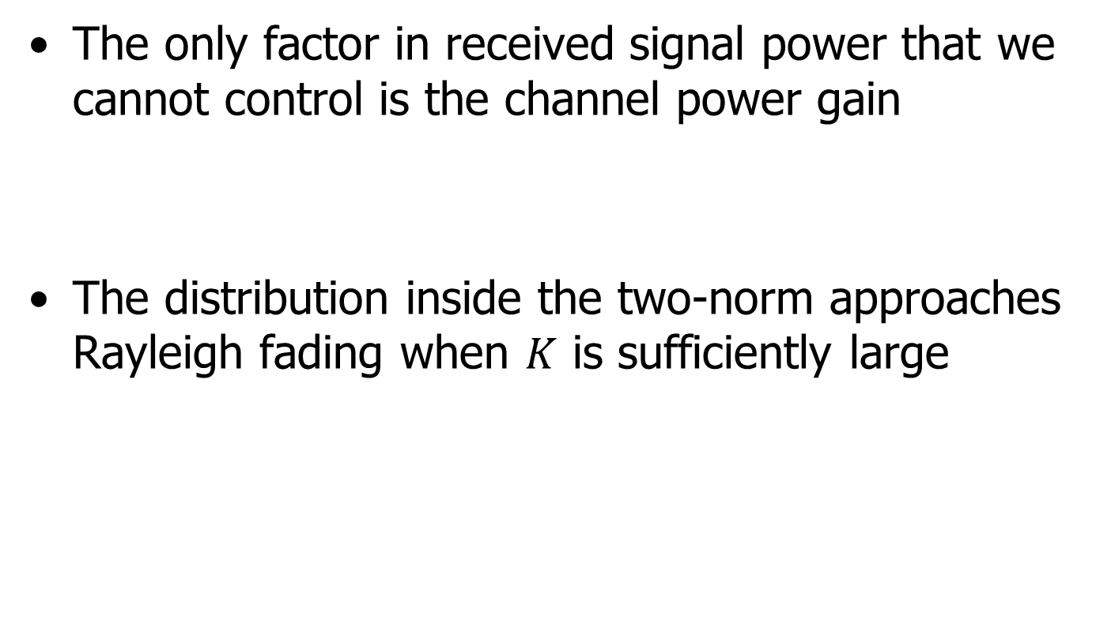
Approximate Exponential model
The only factor in received signal power that we cannot control is the channel power gain
The distribution inside the two-norm approaches Rayleigh fading when $K$ is sufficiently large

Slide 12
Beam Prediction Formulation
Separate the DL Tx beams into Set A (predicted beams) and Set B (measured beams)
We care more about which beams have the highest received power than about the exact received power of each beam

Slide 13

Beam Prediction Formulation
The best beams have a low probability of lying in Set B
Set B
Set A

Slide 14
Approximate Gaussian Model
Received signal power is the sum of independent but not identical exponential random variables
The power is approximately a Gaussian random variable
All beams power form a jointly Gaussian distribution

Slide 15
Universal Beam Prediction Schemes

Slide 16
Prediction Scenarios
Genie-aided linear prediction with known BS codebook: UE knows BS beam codebook
Special case: Genie-aided prediction with small cluster size: UE knows BS beam codebook, but cluster size is small

Slide 17
Genie-aided linear prediction with known BS codebook
The entire received signal power follows a jointly Gaussian distribution
LMMSE is a good estimator that helps us to find best beam

Slide 18
Genie-aided linear prediction with known BS codebook
Conditional mean

Slide 19
Genie-aided linear prediction with known BS codebook
Since the UE knows the BS beam codebook, the mean and covariance matrix can be obtained by statistical learning
When the UE doesn’t know the BS beam codebook, we can’t do this

Slide 20
Special case: Genie-aided prediction with narrow beam
If there are not many clusters, the Gaussian approximation may not be accurate enough
We need to solve an optimization problem related to exponential random variables

Slide 21
Special case: Genie-aided prediction with narrow beam
Slightly modify the system model
All the beams in Set A contains only one cluster
All the beams in Set B contain two or three clusters, which is equivalent to containing two or three beams in Set A (most of them contain two clusters)

Slide 22
Special case: Genie-aided prediction with narrow beam
We can still try using LMMSE, although it is maybe not a good estimator
In the scenario that one of the clusters has sufficiently large gain, LMMSE might approach optimal estimator

Slide 23
Special case: Genie-aided prediction with narrow beam
A quick example
Set B
Set A

Slide 24
Special case: Genie-aided prediction with narrow beam
If there are two beams in Set B, four beams in Set A
We want to know which beam has the highest probability to have highest gain among all six beams
Note that we know the distribution of each beam just like genie-aided prediction

Slide 25
Special case: Genie-aided prediction with narrow beam
The probability is described as below

Slide 26
Special case: Genie-aided prediction with narrow beam
All the integral except the beams that contain target cluster can do separately

Slide 27
Special case: Genie-aided prediction with narrow beam
Only need to calculate the numerator
Put indicator function away at first

Slide 28
Special case: Genie-aided prediction with narrow beam

Slide 29
Special case: Genie-aided prediction with narrow beam
Together with the indicator function
The last indicator function is constructed using the Fourier-Motzkin elimination

Slide 30
Special case: Genie-aided prediction with narrow beam
When a beam contains three clusters, one integral remains
Assuming most beams have only two clusters, the number of required integrals is limited
The performance compared to LMMSE is shown in the simulation results

Slide 31
Special case: Genie-aided prediction with narrow beam
Moreover, we consider the case that contain AWGN
But the case is way more complex

Slide 32
Special case: Genie-aided prediction with narrow beam
It can’t be written as bivariate Gaussian distribution
Use numerical integration to approach it

Slide 33
Prediction Scenarios
Universal beam prediction with full Set B reported: UE doesn’t know BS beam codebook
Low reporting overhead universal beam prediction: UE doesn’t know BS beam codebook and reports only part of the information from Set B

Slide 34
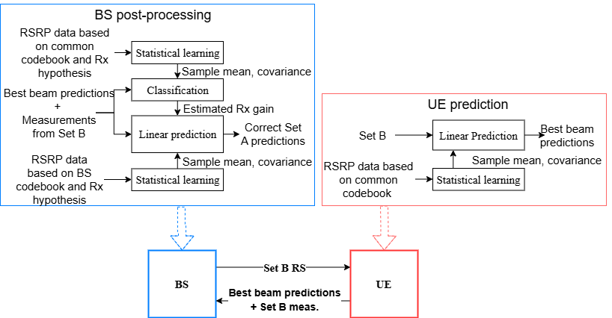
Universal beam prediction with full Set B reported

Slide 35
Universal beam prediction with full Set B reported

Slide 36
Universal beam prediction with full Set B reported
Assume there is a common beam codebook known by both the BS and the UE
The UE treats the common beam codebook as the actual codebook
Note that the UE also needs to report Set B information back to the BS

Slide 37
Universal beam prediction with full Set B reported

Slide 38

Universal beam prediction with full Set B reported
The BS uses a common beam codebook, and the $l$ UE-side beamforming assumption is used to approximate the UE-side beamforming gain

Slide 39
Universal beam prediction with full Set B reported

Slide 40
Universal beam prediction with full Set B reported
Using the BS’s own beam codebook and the estimation of the UE beamforming gain, we can finally complete our estimation
It’s a bit complex, but let’s return to the system model

Slide 41
Low reporting overhead universal beam prediction
When the UE reports only part of the Set B information back to the BS
The BS needs to recover the rest of the Set B information; after that, this case becomes the same as the previous one

Slide 42
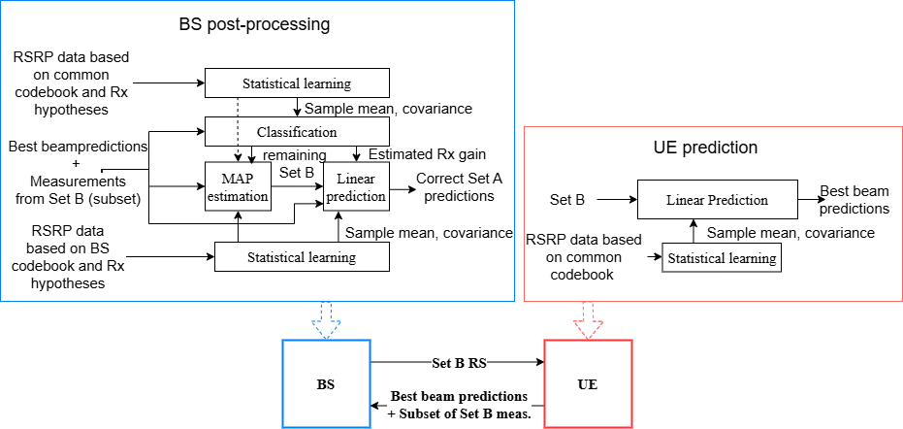
Low reporting overhead universal beam prediction

Slide 43
Low reporting overhead universal beam prediction

Slide 44
Low reporting overhead universal beam prediction
Separate it into two situations
Overdetermined, when
Underdetermined, when
The first situation can be easily solved using linear equations, but the second one is much more complex

Slide 45
Low reporting overhead universal beam prediction
For the first situation, we solve the following problem
The system is overdetermined, so we know the minimum is zero; the problem then becomes solving linear equations

Slide 46
Low reporting overhead universal beam prediction
For the second situation, we cannot directly find the exact value, but we can first estimate the mean and covariance matrix

Slide 47
Low reporting overhead universal beam prediction
Then we solve the following optimization problem

Slide 48
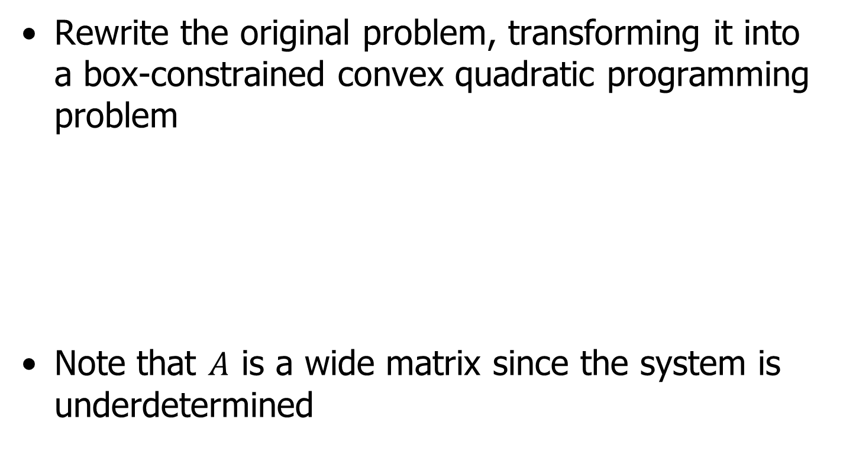
Low reporting overhead universal beam prediction
Rewrite the original problem, transforming it into a box-constrained convex quadratic programming problem
Note that $A$ is a wide matrix since the system is underdetermined

Slide 49
Low reporting overhead universal beam prediction
If there are no inequality constraints, it can be simply solved using the Lagrange dual function
Together with

Slide 50
Low reporting overhead universal beam prediction
If inequality constraints exist, since the system is convex, the problem becomes identifying which inequality constraints are “active”

Slide 51
Low reporting overhead universal beam prediction
Active set: The set that contains all the inequality constraints for which the equality holds
Active set method:
Start with an arbitrary valid point and continuously move the point to decrease the value of the target function
While the point moves, add or remove a constraint from the active set

Slide 52

Low reporting overhead universal beam prediction
The problem becomes
$α^{(k)}$ is for blocking constraint

Slide 53
Low reporting overhead universal beam prediction
The active set method can only modify one constraint at a time
By attempting to move multiple constraints simultaneously, we apply the Lagrange dual function again

Slide 54

Low reporting overhead universal beam prediction
We can take advantage of the box constraints
At least one of $λ_{i}^{∗}$ and $r_{i}^{∗}$ is zero

Slide 55
Low reporting overhead universal beam prediction
The original algorithm is from Kunisch and Rendl (2003), where there is no equality constraints
We deal with the equality constraints and box-constraints simultaneously

Slide 56
Low reporting overhead universal beam prediction
First, assume the active set is empty
If the solution is valid, the algorithm stops; if it isn’t, we update our guess and continue iterating

Slide 57
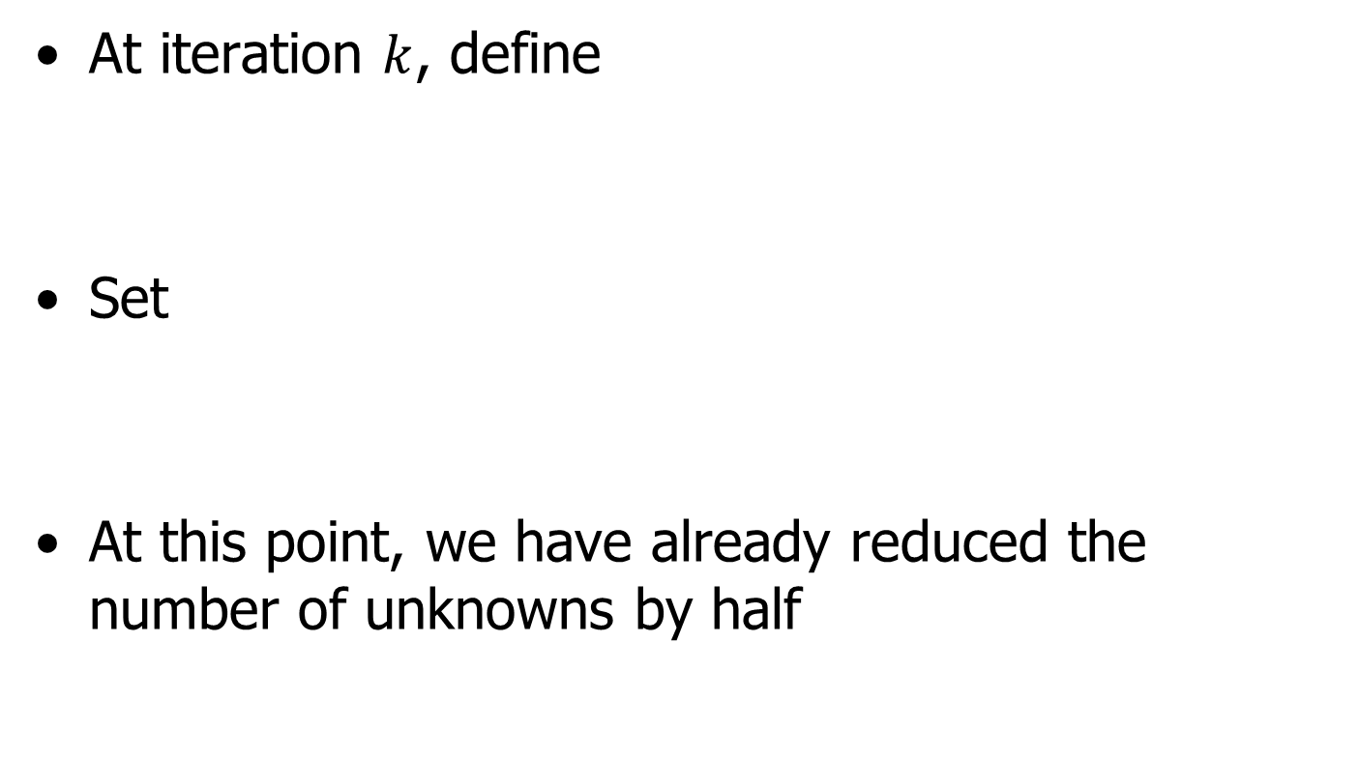
Low reporting overhead universal beam prediction
At iteration $k$, define
Set
At this point, we have already reduced the number of unknowns by half

Slide 58
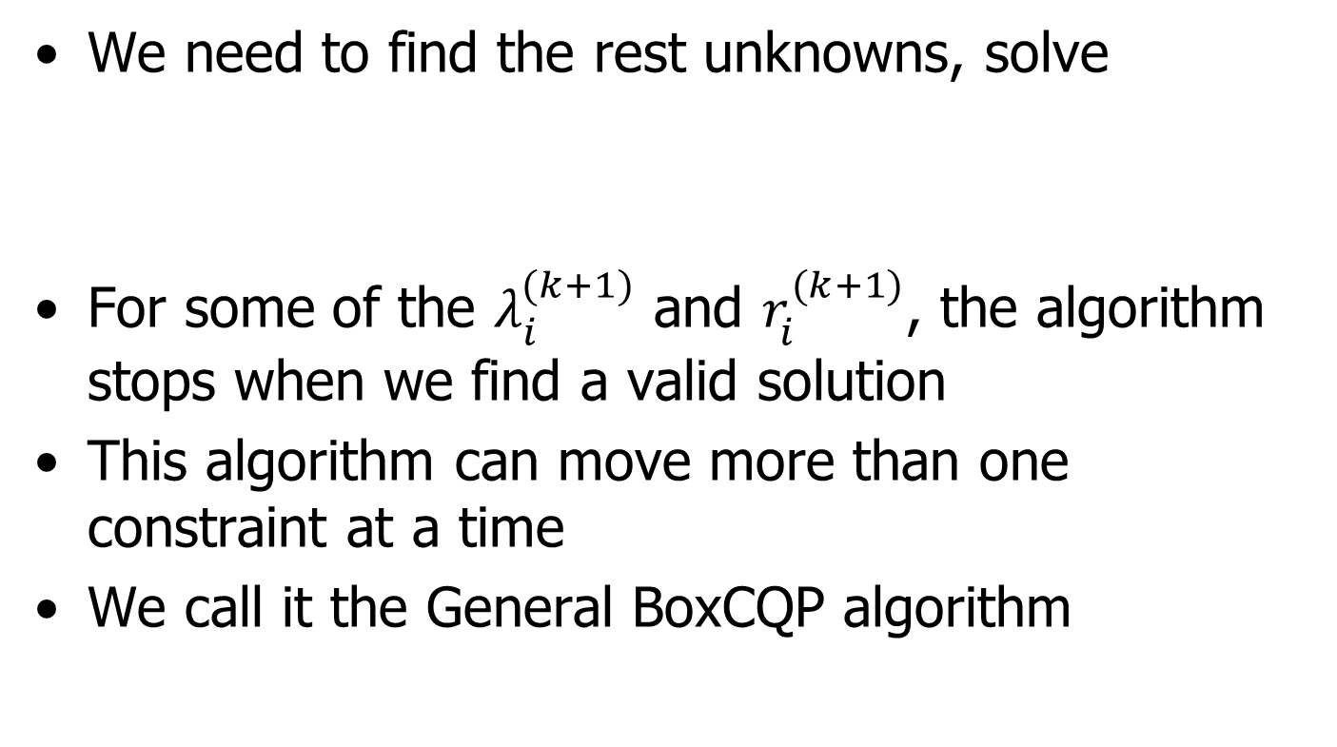
Low reporting overhead universal beam prediction
We need to find the rest unknowns, solve
For some of the $λ_{i}^{(k+1)}$ and $r_{i}^{(k+1)}$, the algorithm stops when we find a valid solution
This algorithm can move more than one constraint at a time
We call it the General BoxCQP algorithm

Slide 59
Low reporting overhead universal beam prediction
Returning to the original problem, we aim to solve the following

Slide 60
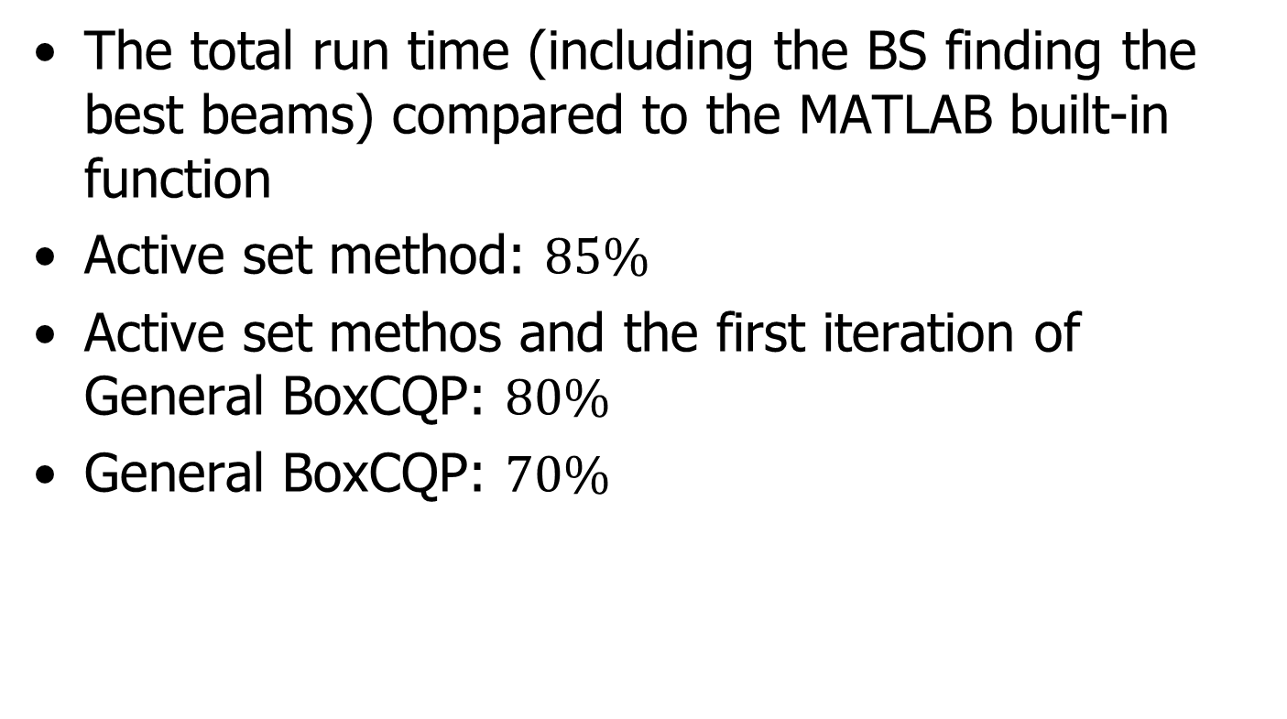
Low reporting overhead universal beam prediction
The total run time (including the BS finding the best beams) compared to the MATLAB built-in function
Active set method: $85\%$
Active set methos and the first iteration of General BoxCQP: $80\%$
General BoxCQP: $70\%$

Slide 61
Simulation Result

Slide 62
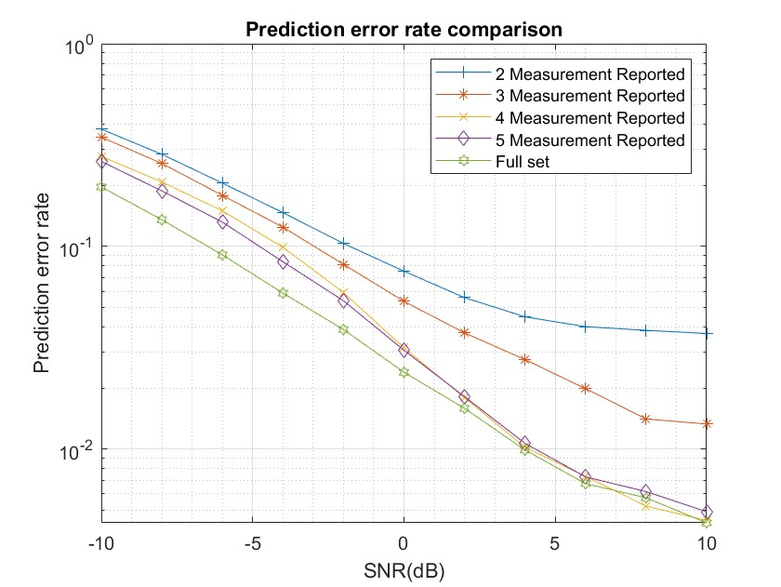
Simulation Result
Full set has 8 measurement beams

Slide 63
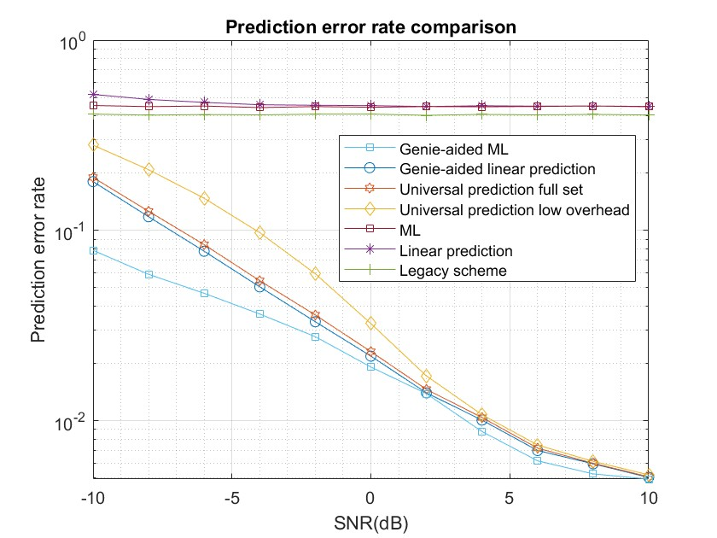
Simulation Result

Slide 64
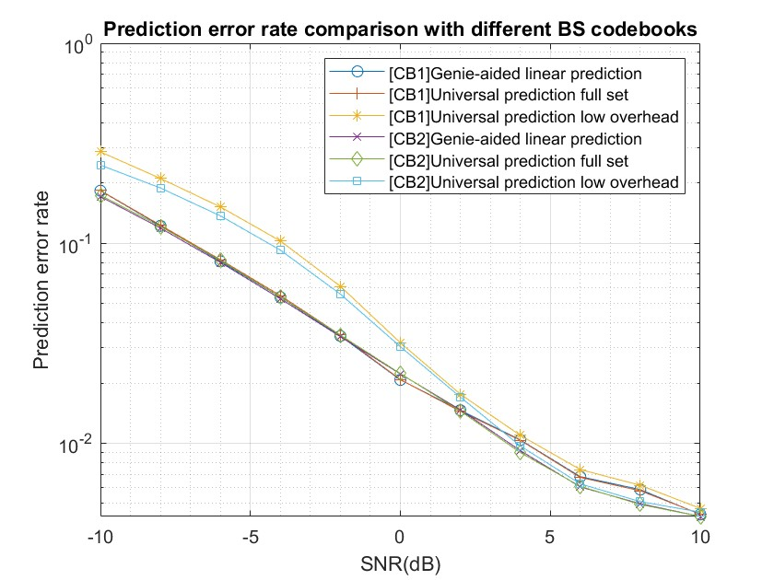
Simulation Result

Slide 65
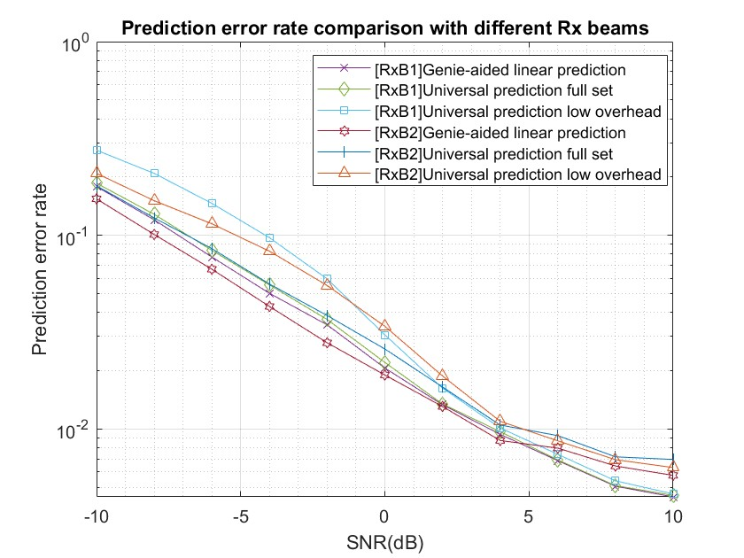
Simulation Result

Slide 66
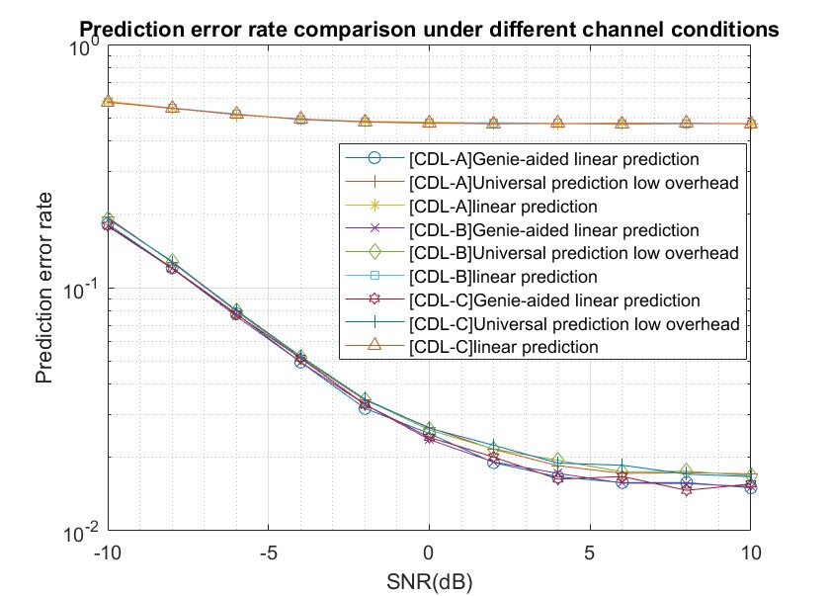
Simulation Result

Slide 67
Simulation Result
We set the parameter as below

Slide 68
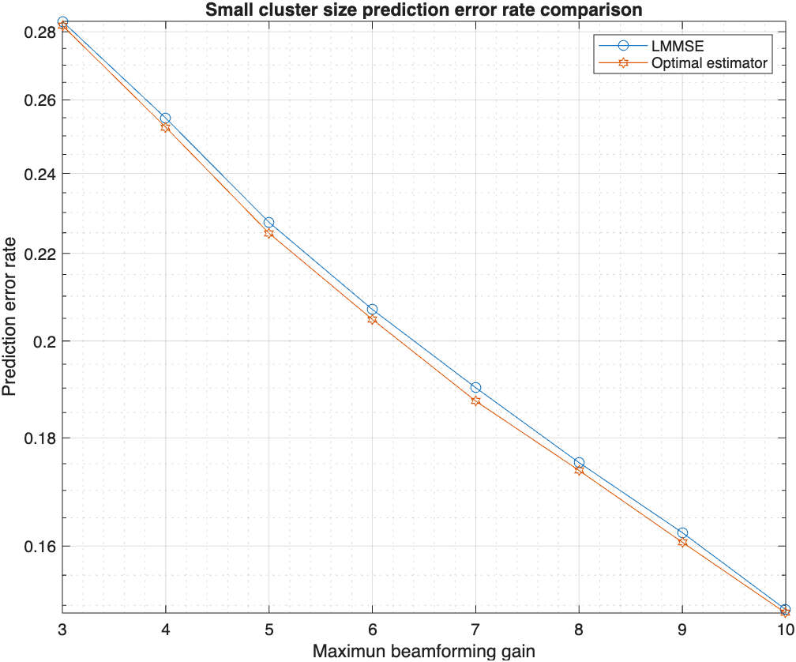
Simulation Result

Slide 69
Conclusion
Universal beam prediction schemes to enable UE DL Tx beam predictions without the knowledge of the BS beam codebooks
A low-overhead UE reporting interface
Optimal estimator is solved under some scenarios that cluster size is small

Slide 70
Reference
Wong, E. (2011). Active-Set Methods for Quadratic Programming [Doctoral dissertation, University of California, San Diego].
Kunisch, K., & Rendl, F. (2003). An infeasible active set method for quadratic problems with simple bounds. SIAM Journal on Optimization, 14(1), 35–52.

