Slide 1
Employee Data Analysis using Excel
STUDENT NAME:
REGISTER NO: 422200837 ( NM USER ID : unm148722ism049 )
DEPARTMENT: Bcom ( ISM )
COLLEGE : JHA Agarsen college
MARK JONS S

Slide 2
PROJECT TITLE
Employee Performance Analysis using Excel

Slide 3


AGENDA
Problem Statement
Project Overview
End Users
Our Solution and Proposition
Dataset Description
Modelling Approach
Results and Discussion
Conclusion
3/21/2024 Annual Review

Slide 4

PROBLEM STATEMENT
For Employee achievement .
For increment and its is a base of employee
Performance .
Identify the specific area of performance
That is problematic .
To finalys the employee performance
About there activity .

Slide 5

PROJECT OVERVIEW
.
Employee performance analysis is the process of evaluating employee’s work performance and productivity to identify strengths,weakness ,opportunities and area for improvement.
Setting clear the goals and expectations .
Regular feed back and coaching .
Performance metrics and data collections .
Development of improvement plans .

Slide 6
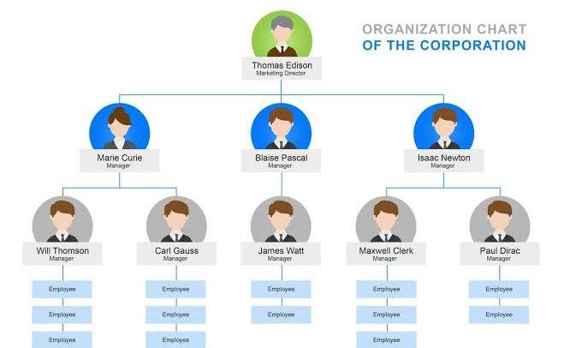

WHO ARE THE END USERS?

Slide 7

OUR SOLUTION AND ITS VALUE PROPOSITION
Conditional formatting – missing
Filter remove
Formula – performance
Pivot – summary
Graph data visualization

Slide 8
Dataset Description
Employee = Kaggle
Features of 26
Features of 9
Emp id number
Name – text
Emp type
Performance level
Gender – male and female
Employee rating numerical

Slide 9

THE "WOW" IN OUR SOLUTION
Performance level
IFS(Z8>=5,”VERY HIGH”.Z8>4,”HIGH”
,Z8>=3,”MED”,TRUE,”LOW”)
3/21/2024 Annual Review
9

Slide 10
MODELLING
DATA COLLECTION
collections of data into the edunnet dashboard
Download the data in the Kaggle site
FEATURES COLLECTIONS
data cleaning
Identifying the missing value
Filter out the missing value
PERFORMANCE LEVEL
Rating between employee
High to low
Low to high
10

Slide 11
PIVOT TABLE
Data analysis
Data filtering
Data comparison
VISUALIZATION
Rise the chart of employee
Analysis the chart
Preparing according to their activity
SUMMARY
Goal setting
Performance metrics
Regular feedback
Evaluation
Development planning

Slide 12
RESULTS

Slide 13
RESULTS

Slide 14
conclusion
Enchance the job satisfaction and retension
Regular feedback and coaching
Achieve business objectives and success
Oppurtunites for growth and development
Attracts and retains top talents
Drives business results and success

