Slide 1
Connecting our Ethereum private blockchain and
interacting with it.
Tools:
A private blockchain: Setup and provided by the university.
MetaMask: Wallet.
Remix Ethereum: Online Solidity compiler.

Slide 2
Outline
We show how to connect to our private blockchain and interact with it.
Steps:
Install MetaMask. Create an account (i.e. an address and public-private key) via MetaMask.
Send us your account address, so we can give you some Ether.
Get familiar with Solidity and the Remix compiler:
Write smart contracts, debug and compile them online.
Send/deploy the latest version of the contract to the blockchain and interact with the deployed contract.

Slide 3
Step 1: Install Metamask
It is an extension for Firefox and Google Chrome.
Allows us to create our public/private keys and connect to the blockchain.
We recommend using MetaMask for Firefox or Chrome
Download it from:
https://metamask.io/
Follow the instructions to install it.

Slide 4
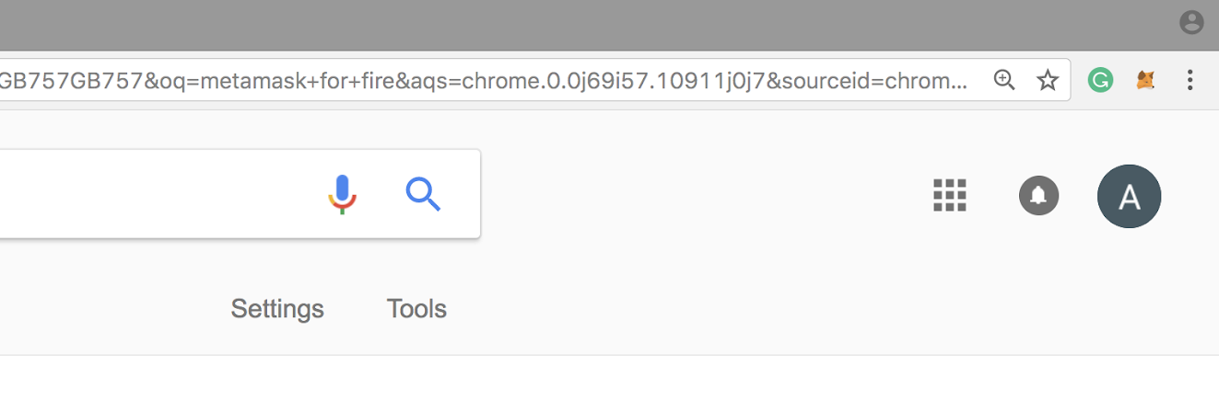
Step1.1: Set Up an Account in MetaMask
Click on the MetaMask icon on the top right side of your Firefox browser.

Slide 5
Step1.2: Create an Account in MetaMask
Follow the instructions to create an account.
After you provide a password, an account (i.e. an address, public and secret keys) will be created for you.
Store your seed: you want it to restore your wallet in case you delete Metamask

Slide 6
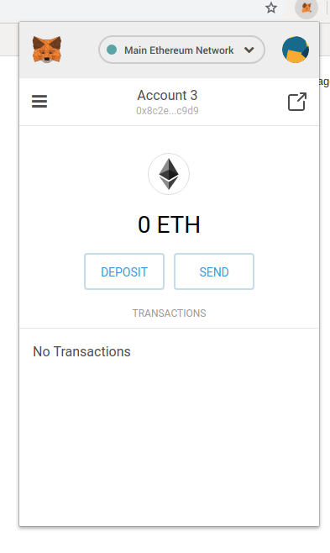
Step1.3: Connect MetaMask to the Private Blockchain
3.1. Click the MetaMask icon.
3.2. Click on the Network option
3.3. Click on “Custom RPC”

Slide 7
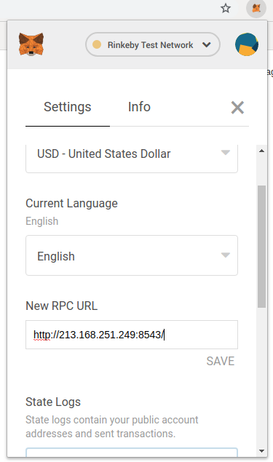
Step1.3: Connect MetaMask to the Private Blockchain
3.1. In the box on the top, insert the following link:
http://213.168.251.249:8543/
3.2. Click on Save to save it.
3.3. Press X to go to the main page.

Slide 8
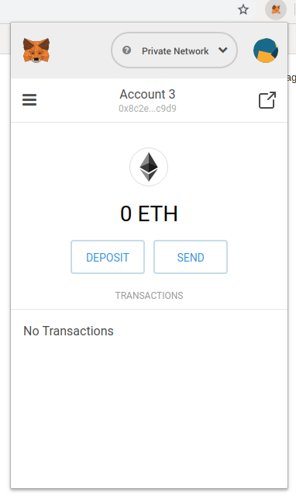
Step1.3: Your Address
When you’ve successfully connected to the chain, this page will appear.
This is your address; click on it to copy and send it to those who want to pay you.

Slide 9
Step 2: Send us Your Account Address
You need some Ether to send a transaction and interact with a smart contract.
We have created a lot of Ether - you can also have some.
Request some Ether by sending your account’s address to this email address:
dimitris.karakostas@ed.ac.uk

Slide 10
Step 3: Getting Familiar with Remix Ethereum: Online Solidity Compiler
You can write, debug, deploy (i.e. send to a blockchain) your smart contract via remix Ethereum: remix.ethereum.org
(If you are using Chrome, it is possible that an error message appears when you load Remix – you can ignore it and then compile your smart contracts as usual, or use Mozilla Firefox instead
Also, you can interact with your deployed contract using Remix.

Slide 11
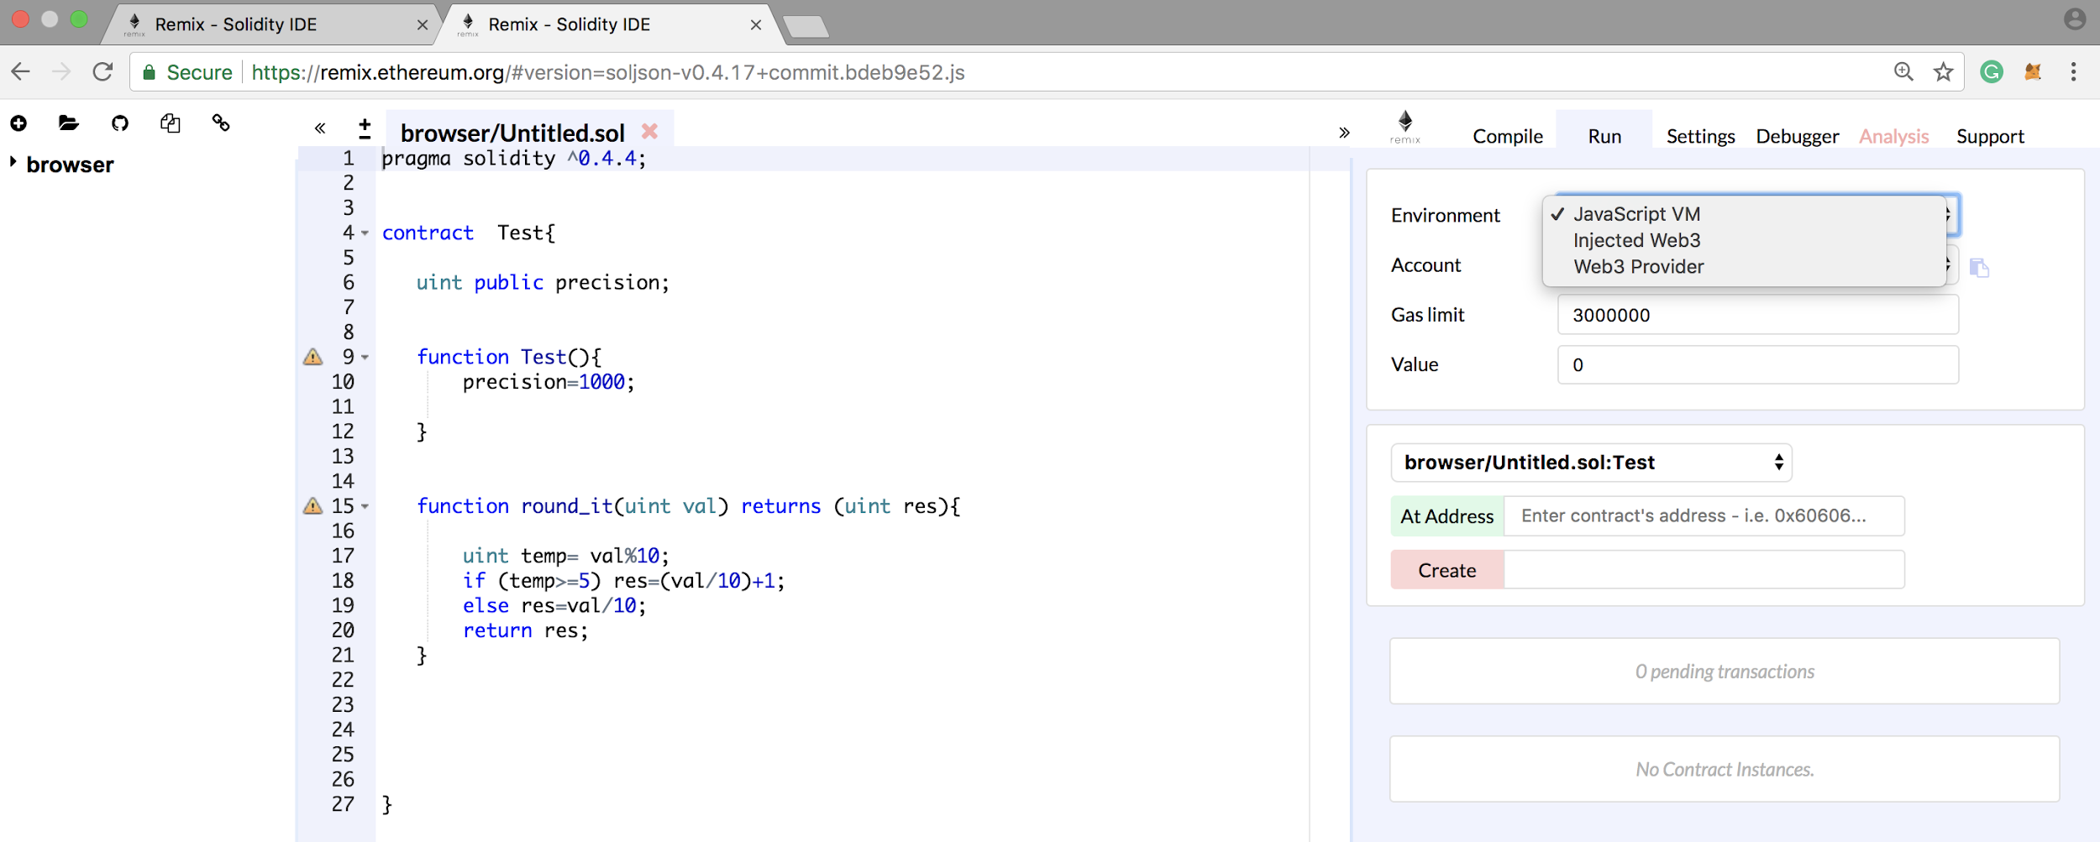
Step 3: Getting familiar with Remix Ethereum: Online Solidity Compiler
In the case where you want to run it online, you should set environment to: JavaScript VM.
Before you deploy your smart contract to the private chain, run and debug it online.

Slide 12
Step 3: Getting familiar with Remix Ethereum: Online Solidity Compiler
To compile your smart contract, click on Create button.
After compiling the contract, remix creates a user interface for the functions you defined in the contract and you can pass parameters to it.

Slide 13
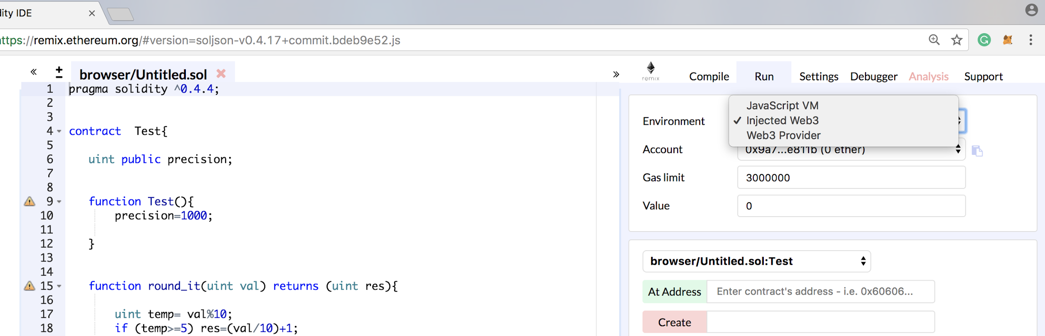
Step 4.1: Deploying Smart Contract to the Private Chain Configurations
First, you need to connect Metamask to the blockchain, as we described in the earlier slides.
In remix, set the environment to: Injected Web3.

Slide 14
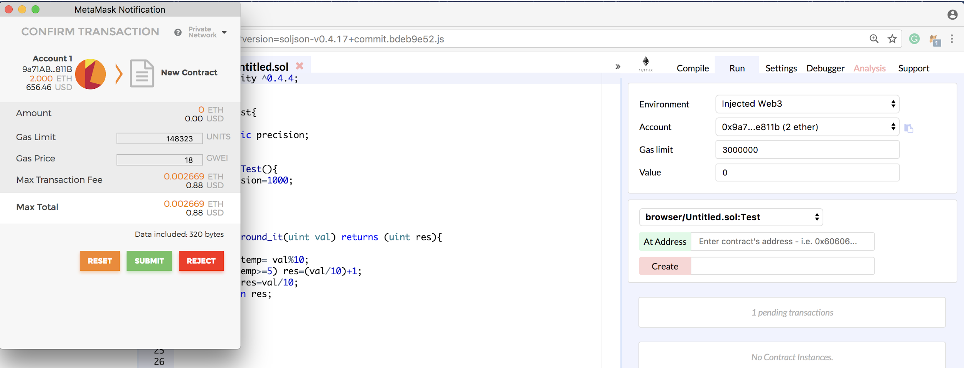
Step 4.2:
Deploying Smart Contract to the Private Chain
Deploying a Contract to the Blockchain
Click on Create button.
Next, MetaMask page will appear and by clicking on submit, you send your contract to the blockchain.

Slide 15
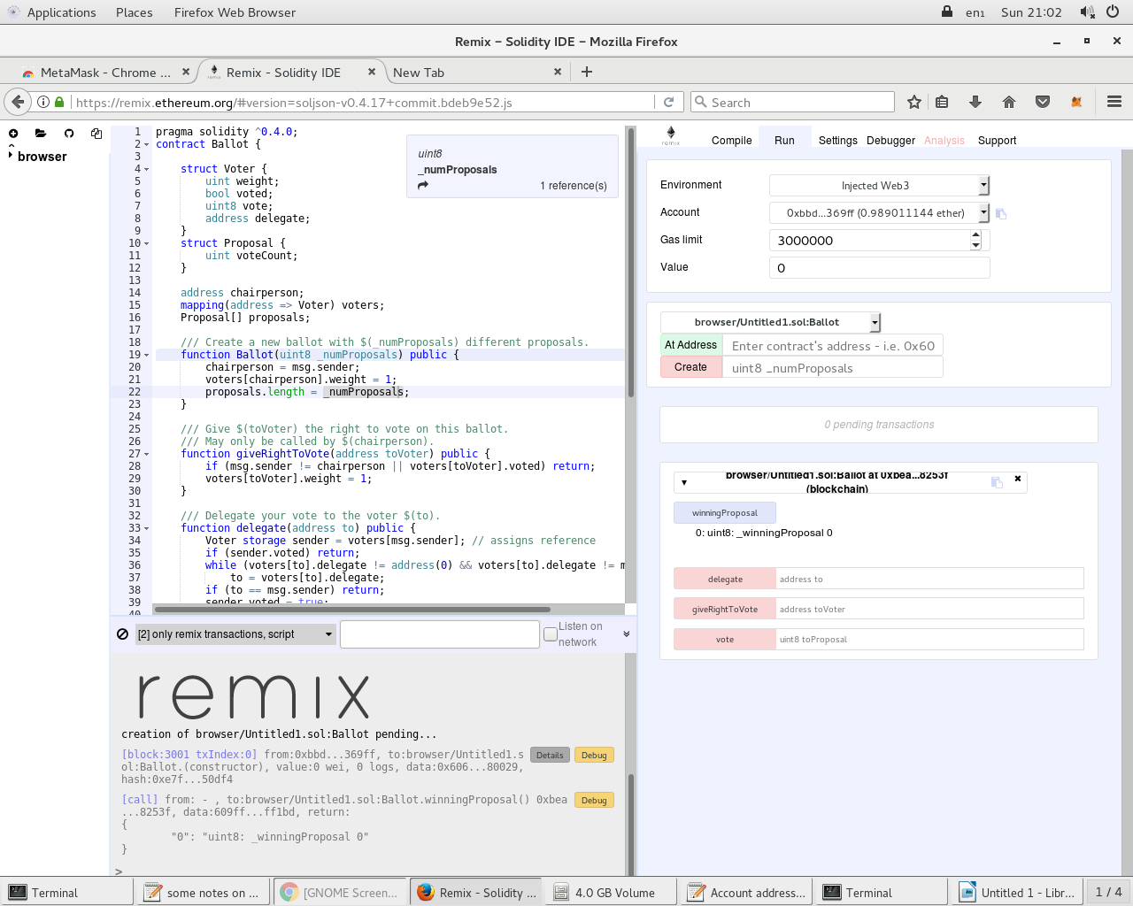
Step 4.3:
Deploying Smart Contract to the Private Chain
Saving the Deployed Contract's Address
When, your contract is successfully submitted/deployed, remix provides the contract address on the blockchain.
You can copy the address from here.
You need the contract code and the address next time you want to interact with your deployed contract.

Slide 16
Step 4.3:
Deploying Smart Contract to the Private Chain
Interacting with a Deployed Contract
Log in to MetaMask and connect to the blockchain (as previously explained)
In remix, set the environment to: Injected Web3.
3. In remix, insert the contract code, insert the deployed contract’s address and click on: At Address.

Slide 17
Step 4.3:
Deploying Smart Contract to the Private Chain
Interacting with a Deployed Contract
4- All the public/external functions in the contract are provided and you can pass arguments on them and invoke them.
The invocation of a function, that changes the contract state, will result in new transaction.

