Slide 1
Connecting our Ethereum private blockchain and
interacting with it.
Tools:
A private blockchain: Setup and provided by the university.
MetaMask: Wallet.
Remix Ethereum: Online Solidity compiler.

Slide 2
Outline
We show how to connect to our private blockchain and interact with it.
Steps:
Install MetaMask. Create an account (i.e. an address and public-private key) via MetaMask.
Send us your account address, so we can give you some Ether.
Get familiar with Solidity and the Remix compiler:
Write smart contracts, debug and compile them online.
Send/deploy the latest version of the contract to the blockchain and interact with the deployed contract.

Slide 3
Step 1: Install Metamask
It is an extension for Firefox and Google Chrome.
Allows us to create our public/private keys and connect to the blockchain.
We recommend using MetaMask for Firefox or Chrome
Download it from:
https://metamask.io/
Follow the instructions to install it.

Slide 4
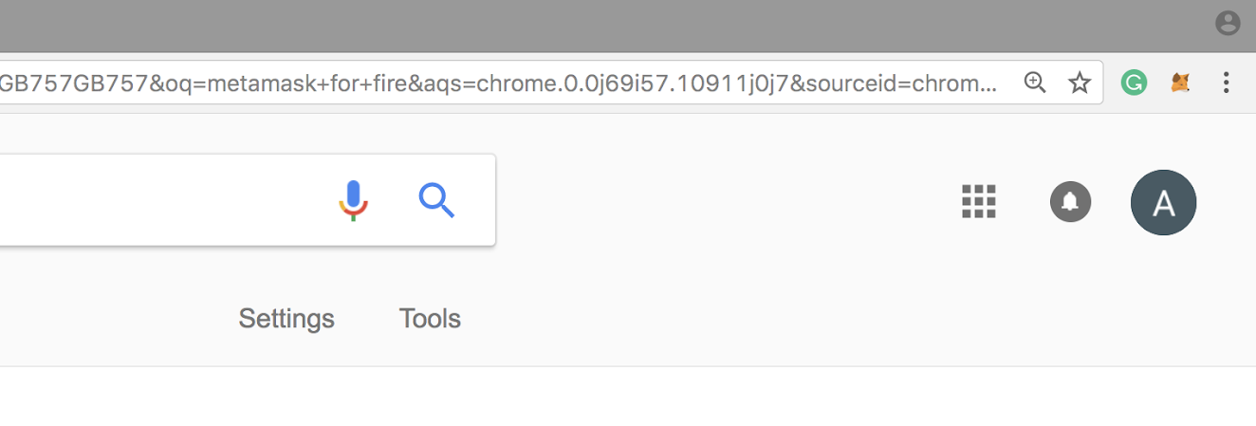
Step1.1: Set Up an Account in MetaMask
Click on the MetaMask icon on the top right side of your browser.

Slide 5
Step1.2: Create an Account in MetaMask
Follow the instructions to create an account – you can choose the beta version which is more user friendly
After you provide a password, an account (i.e. an address, public and secret keys) will be created for you – you can also create more than one accounts per wallet
Store your seed: you will need it to restore your wallet in case you delete Metamask

Slide 6
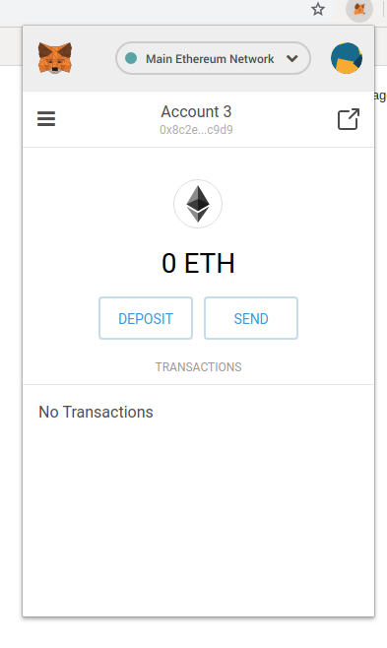
Step1.3: Connect MetaMask to the Private Blockchain
3.1. Click the MetaMask icon.
3.2. Click on the Network option
3.3. Click on “Custom RPC”

Slide 7
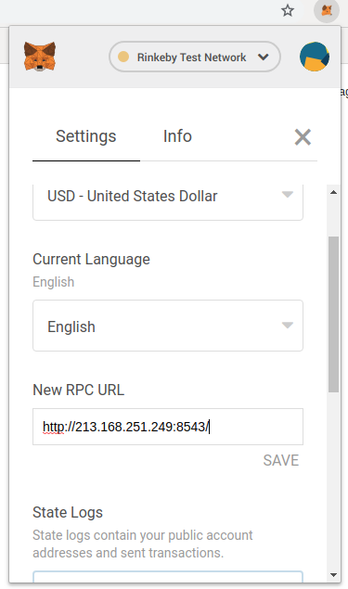
Step1.3: Connect MetaMask to the Private Blockchain
3.1. In the “New RPC URL” box, insert the following link:
http://213.168.251.249:8543/
3.2. Click on Save
3.3. Press X to go to the main page

Slide 8
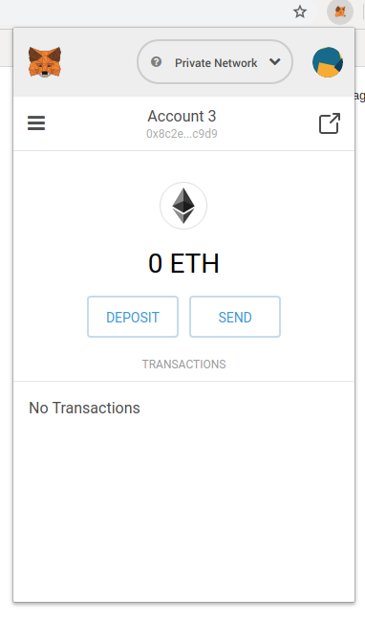
Step1.3: Your Address
When you’ve successfully connected to the chain, this page will appear
Your address is under the account’s name – here it starts with “0x8c” and ends with “c9d9”
Click on it to copy it and then send it to those who want to pay you

Slide 9
Step 2: Send us Your Account Address
You need some Ether to send a transaction and interact with a smart contract.
We have created a lot of Ether - you can also have some.
Request some Ether by sending your account’s address to this email address:
dimitris.karakostas@ed.ac.uk

Slide 10
Step 3: Getting Familiar with Remix Ethereum: Online Solidity Compiler
You can write, debug, deploy (i.e. send to a blockchain) your smart contract via remix Ethereum: remix.ethereum.org
If you are using Chrome, it is possible that an error message appears when you load Remix – you can ignore it and then compile your smart contracts as usual, or use Mozilla Firefox instead
After you deploy your contract, you can interact with it using Remix

Slide 11
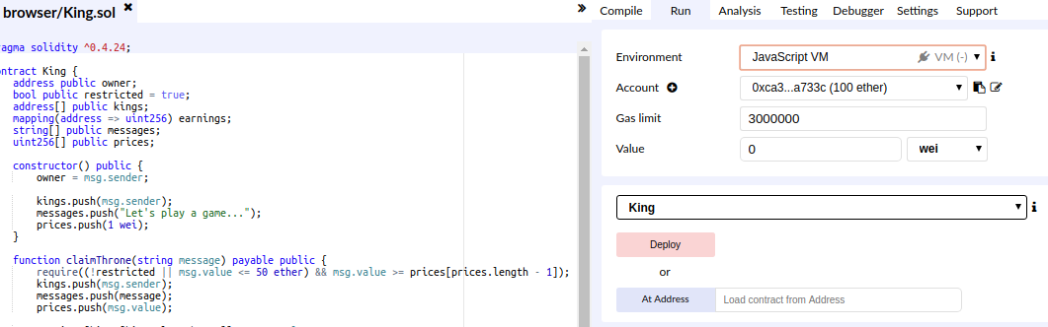
Step 3: Getting familiar with Remix Ethereum: Online Solidity Compiler
In Remix you can choose the development environment
Before you deploy your smart contract to the private chain, run and debug it online.

Slide 12
Step 3: Getting familiar with Remix: Javascript VM environment
Javascript VM
This is a testing environment
It is a local environment that lives on your browser’s tab
Whatever you do in this environment does not affect your funds, i.e. it does not have access to your wallet
When you close the browser it is deleted and when you open it again it is created fresh, so every time you use this environment you need to re-deploy your contracts

Slide 13
Step 3: Getting familiar with Remix: Injected Web3 environment
Injected Web3
This environment has access to your Metamask
It connects to the network to which Metamask is connected and uses the funds of your wallet
Every time you try to use a contract, Metamask will request permission before completing the operation – this is because an actual transaction is posted and the actual funds in your wallet are used

Slide 14
Step 3: Getting familiar with Remix Ethereum: Online Solidity Compiler
To compile your smart contract, click on Deploy
After compiling the contract, Remix creates a user interface to interact with the contract

Slide 15
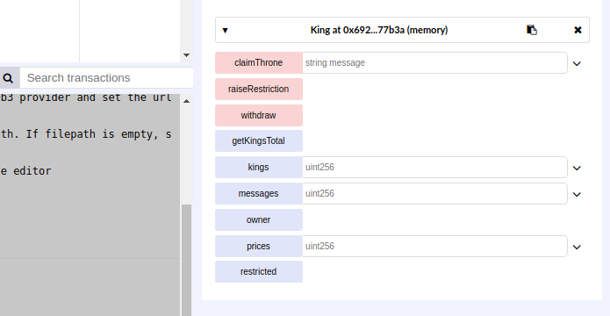
Step 3: Getting familiar with Remix Ethereum: Online Solidity Compiler
In the contract’s interface:
You can call functions
You can pass parameters when calling functions
You can access public variables of the contract

Slide 16
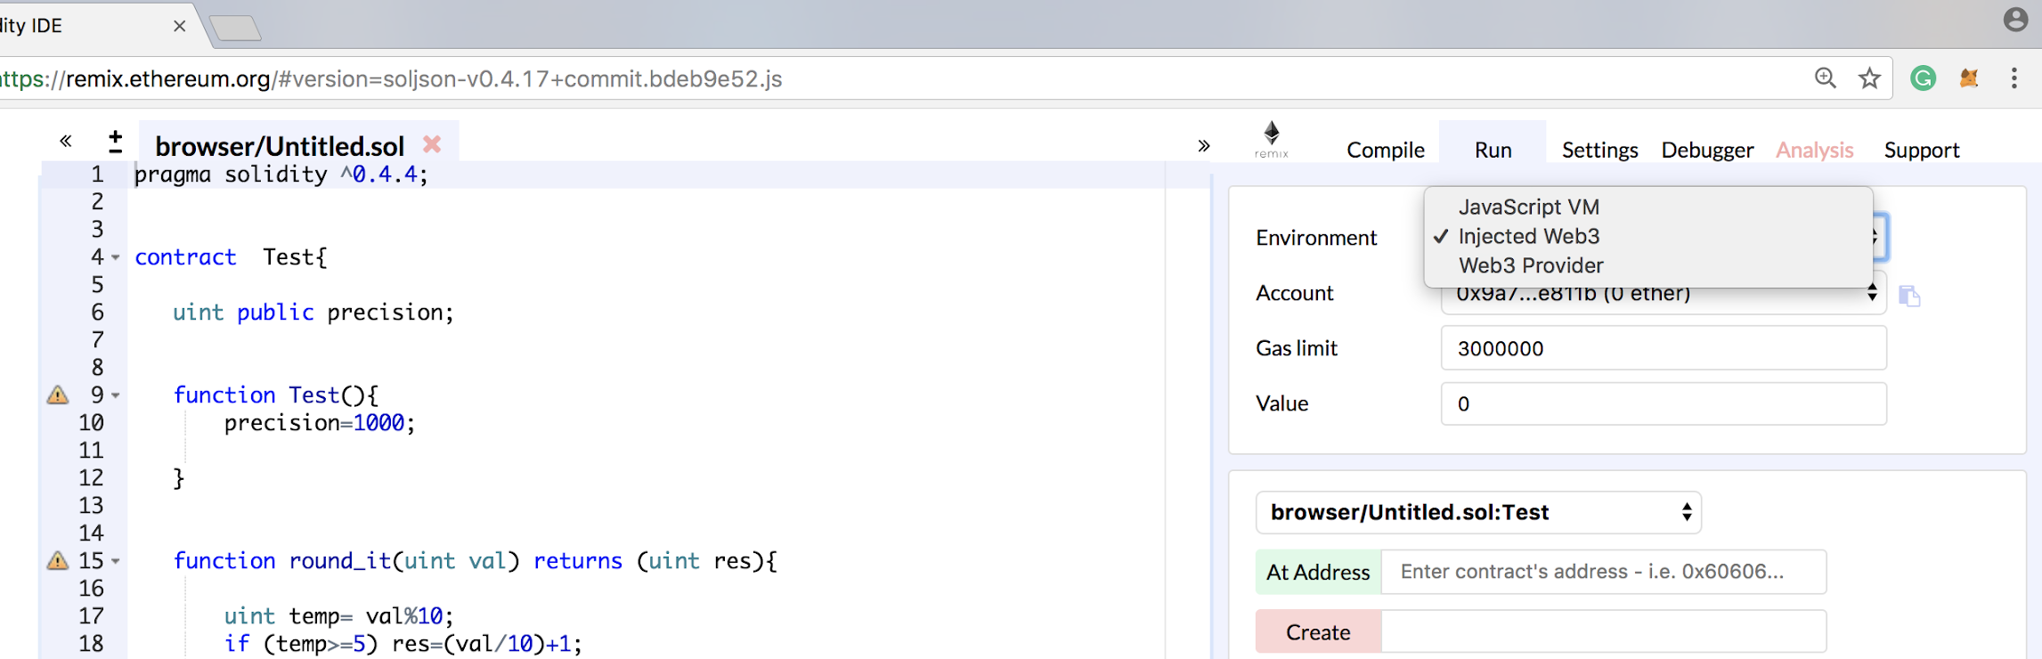
Step 4.1: Deploying Smart Contract to the Private Chain Configurations
First, you need to connect Metamask to the blockchain, as we described in the earlier slides.
In Remix, set the environment to: Injected Web3.

Slide 17
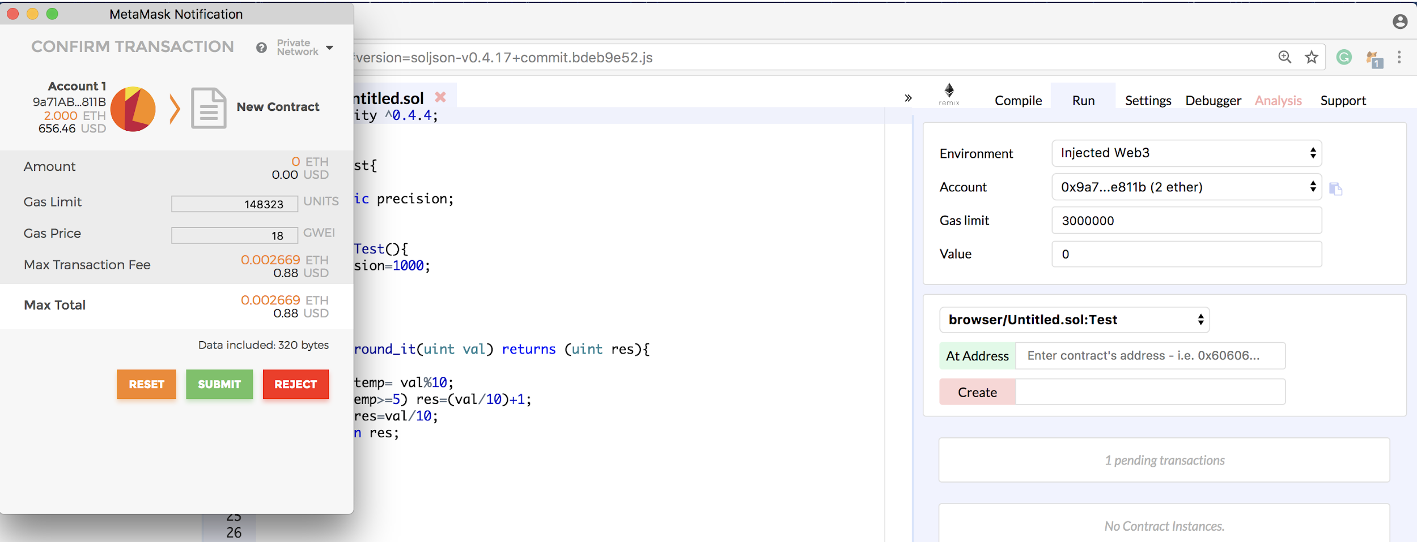
Step 4.2:
Deploying Smart Contract to the Private Chain
Deploying a Contract to the Blockchain
Click on Deploy
MetaMask will request your permission to send your contract to the blockchain - by clicking on submit, you publish your contract (and pay the fee)

Slide 18
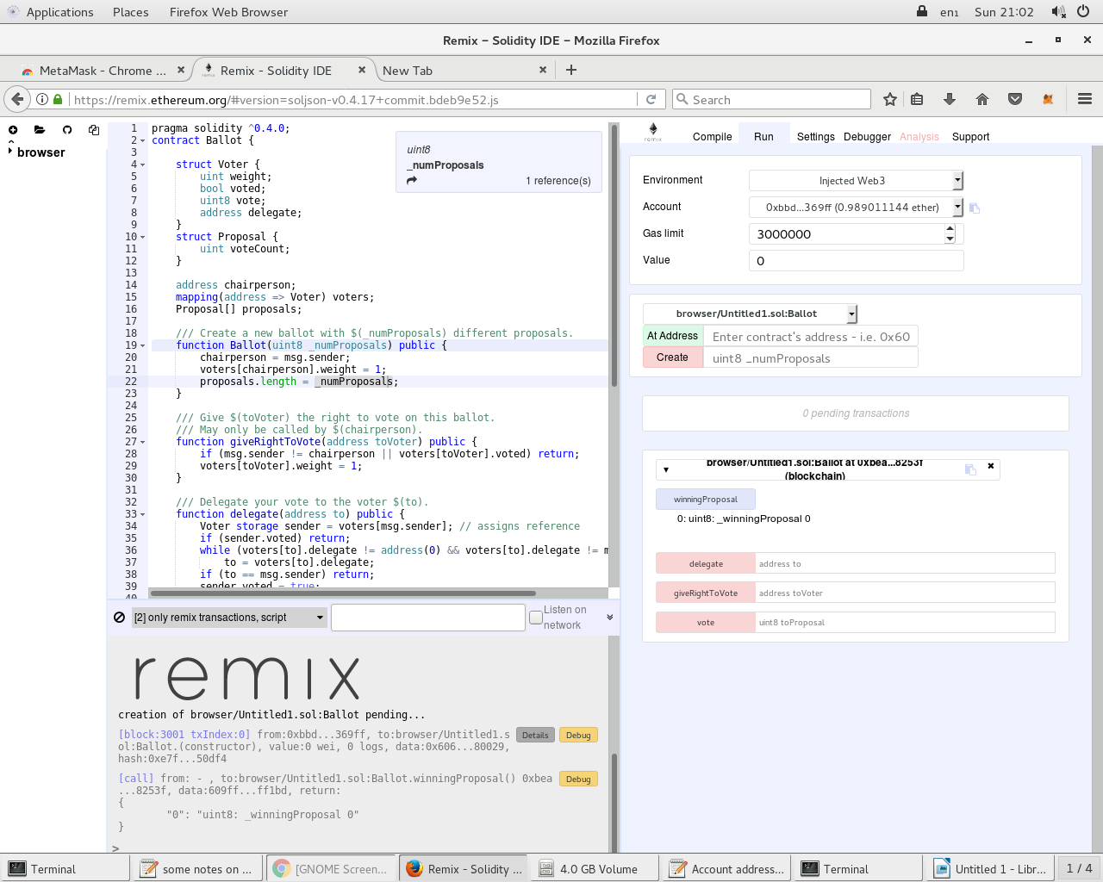
Step 4.3:
Deploying Smart Contract to the Private Chain
Saving the Deployed Contract's Address
When, your contract is successfully submitted & deployed, Remix provides the contract’s address
You need the contract’s code and the address next time you want to interact with your deployed contract.

Slide 19
Step 4.3:
Deploying Smart Contract to the Private Chain
Interacting with a Deployed Contract
Log in to MetaMask and connect to the blockchain (as previously explained)
In Remix, set the environment to: Injected Web3.
3. In Remix, insert the contract’s code, insert the deployed contract’s address and click on: At Address.

Slide 20
Step 4.3:
Deploying Smart Contract to the Private Chain
Interacting with a Deployed Contract
4- All the public/external functions in the contract are provided and you can pass arguments on them and invoke them
Red fields change the contract’s state, so you create a transaction and spend funds - at minimum you pay the fees, if your transaction does not send funds to the contract
Blue fields just show you the contract’s state and are free

Slide 21
Debugging
If you don’t see your funds in Metamask
Double check that you are connected to the correct network, i.e. the private network and not e.g. the Ethereum mainnet
If you are connected to the private network, try connecting to a different network (e.g. the Ethereum mainnet) and then reconnecting back to the private network – sometimes Metamask’s connection breaks down, so this will reset the network
If you still don’t see your funds, try deleting Metamask from your browser (remember to store your seed first), and then re-install it, recreate your wallet using your seed (if you have more than one accounts in your wallet, you have to create them all manually again) and connect to the private network – sometimes Metamask’s internal transaction generator breaks down (due to temporary network issues), so this will reset your wallet from scratch
If you still don’t see your funds contact the course’s TA

Slide 22
Debugging
If you want to find past transactions’ IDs
Metamask keeps a list of all transactions that you have made
Click on a transaction and it will redirect you to Etherscan – the public Ethereum network’s explorer
Etherscan will not show you anything, because it does not track the private network but the public Ethereum
Either in the URL or in Etherscan’s page you will find the transaction ID
If you interact with a contract but don’t see your changes published
Make sure that you have set the environment to Injected Web3
Double check that the address of the contract to which you connect is the correct one

