Slide 1
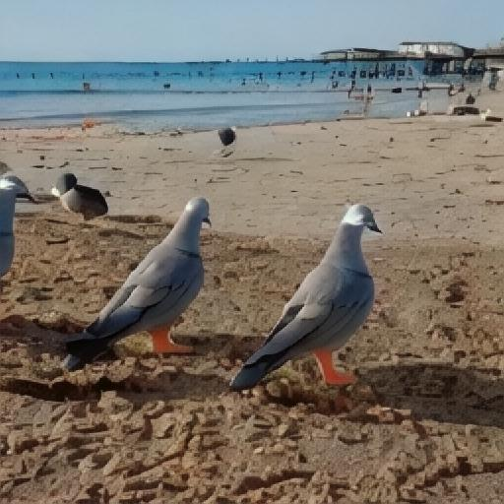
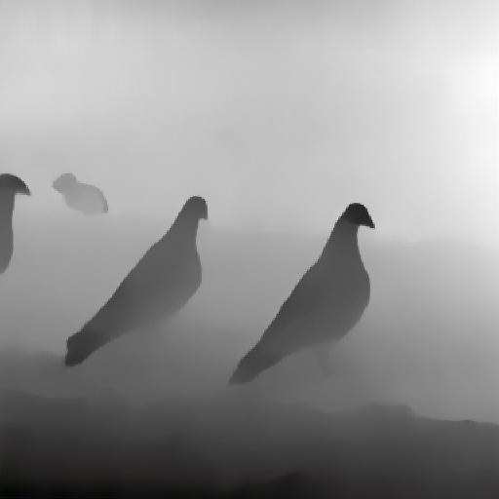
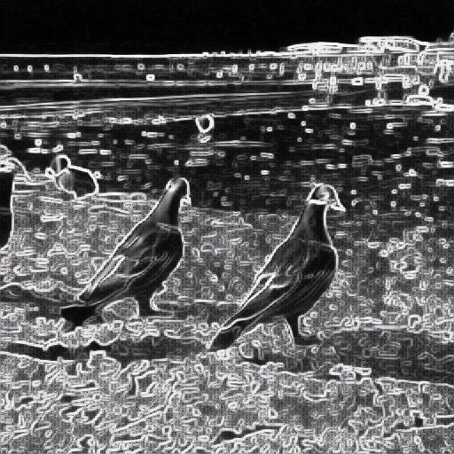

An image of a beach with a group of pigeons standing on the sand……
Notes:
COME_Easy_1074.jpg

Slide 2

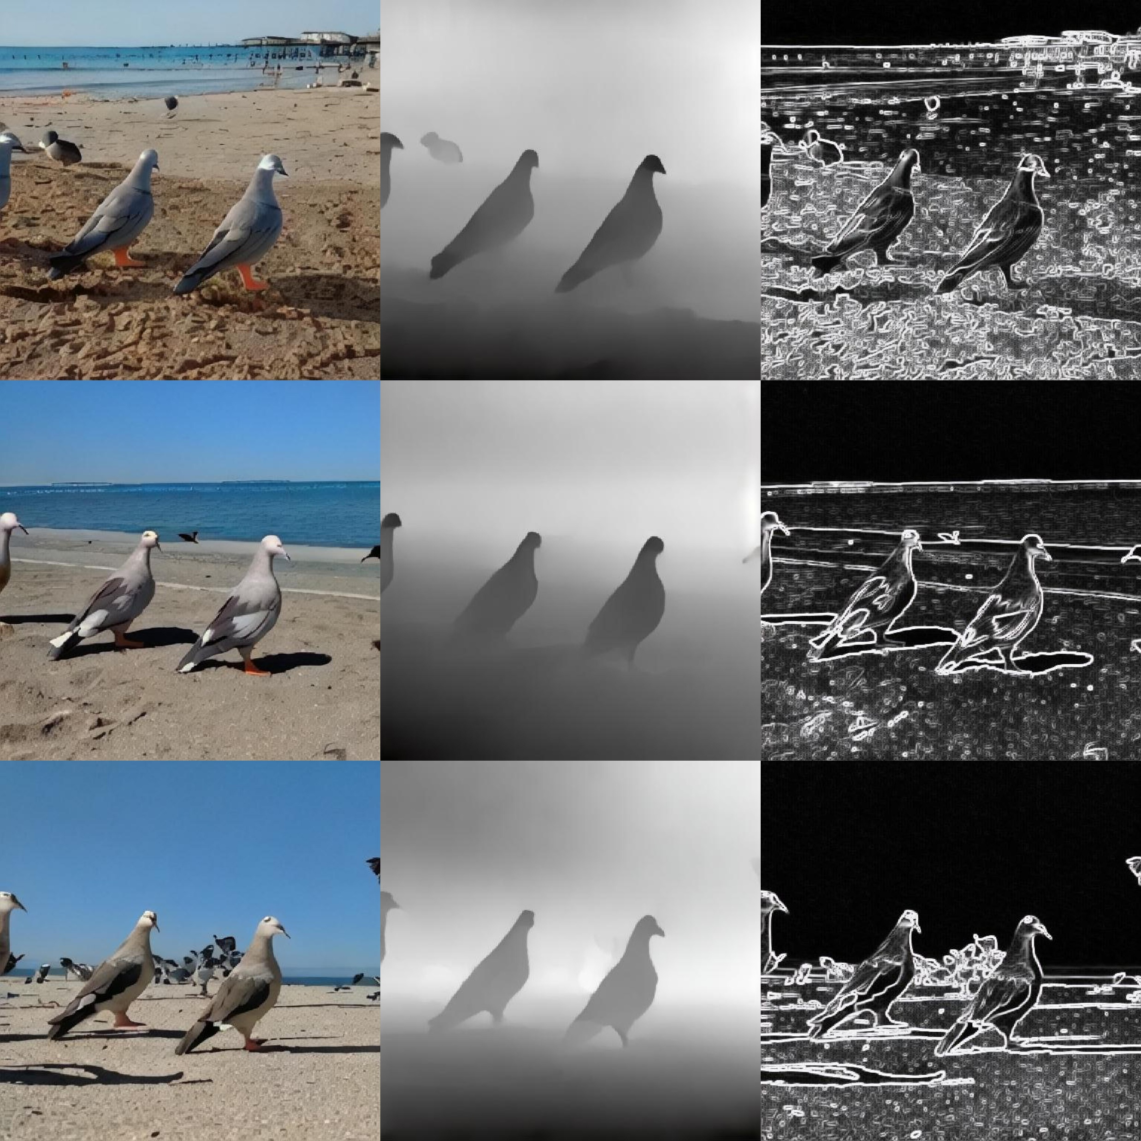
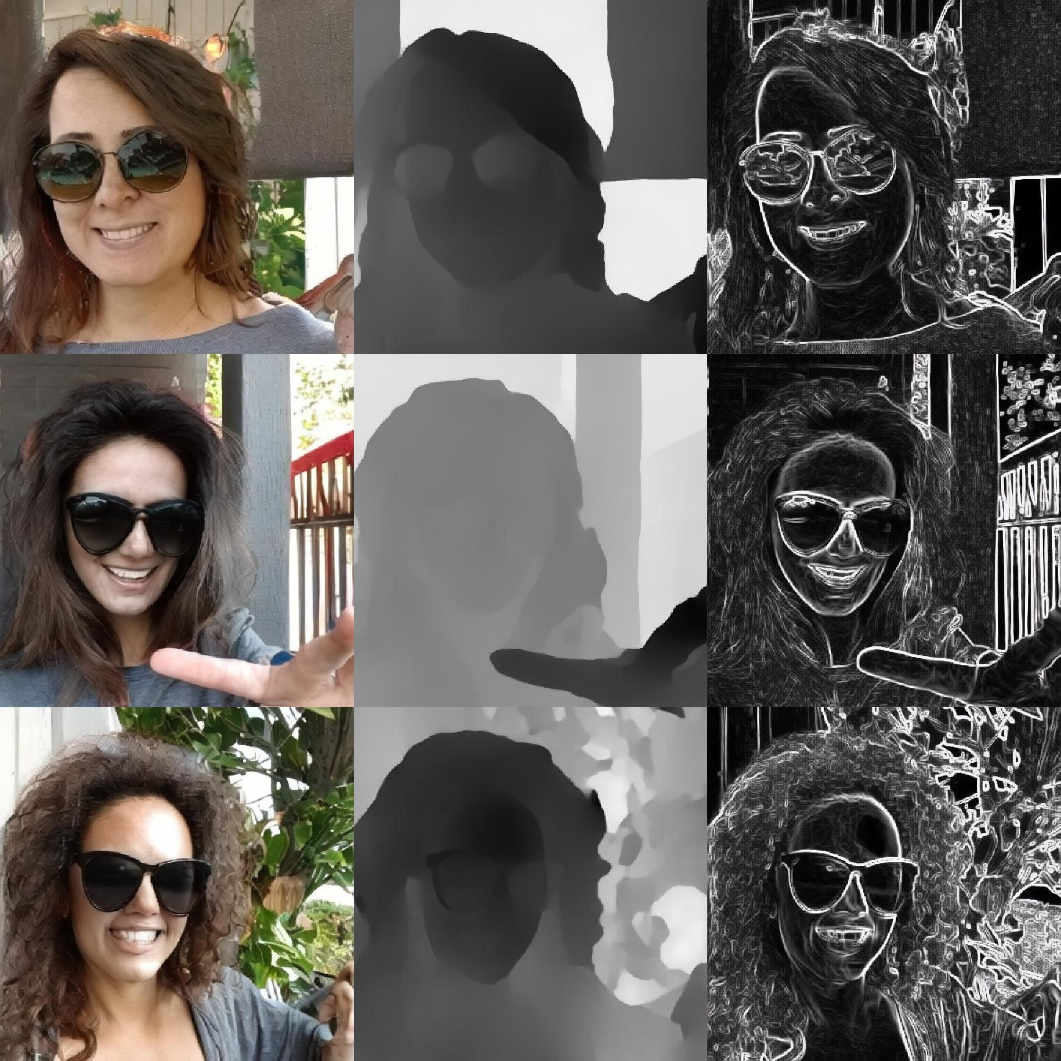
An image of a beach with a group of pigeons standing on the sand……
An image of a woman wearing sunglasses and a gray shirt, standing outside in front of a house……
Notes:
COME_Easy_1074.jpg
COME_Easy_127.jpg

