Slide 1
result
Computer Vision & Multimedia LAB
Jiyun Joo
2018-02-01

Slide 2
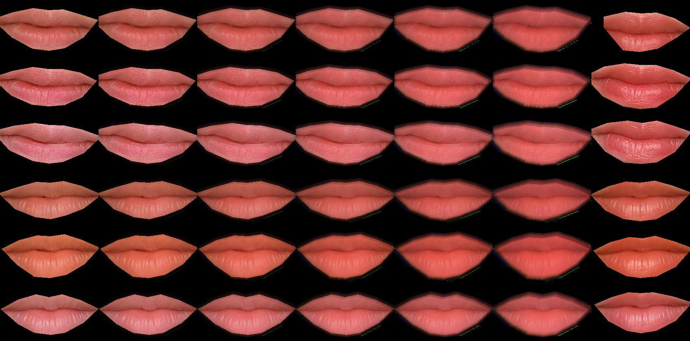
Lipstick 1 ,model 7,8
No makeup
Blending output
Model’s output
Makeup

Slide 3
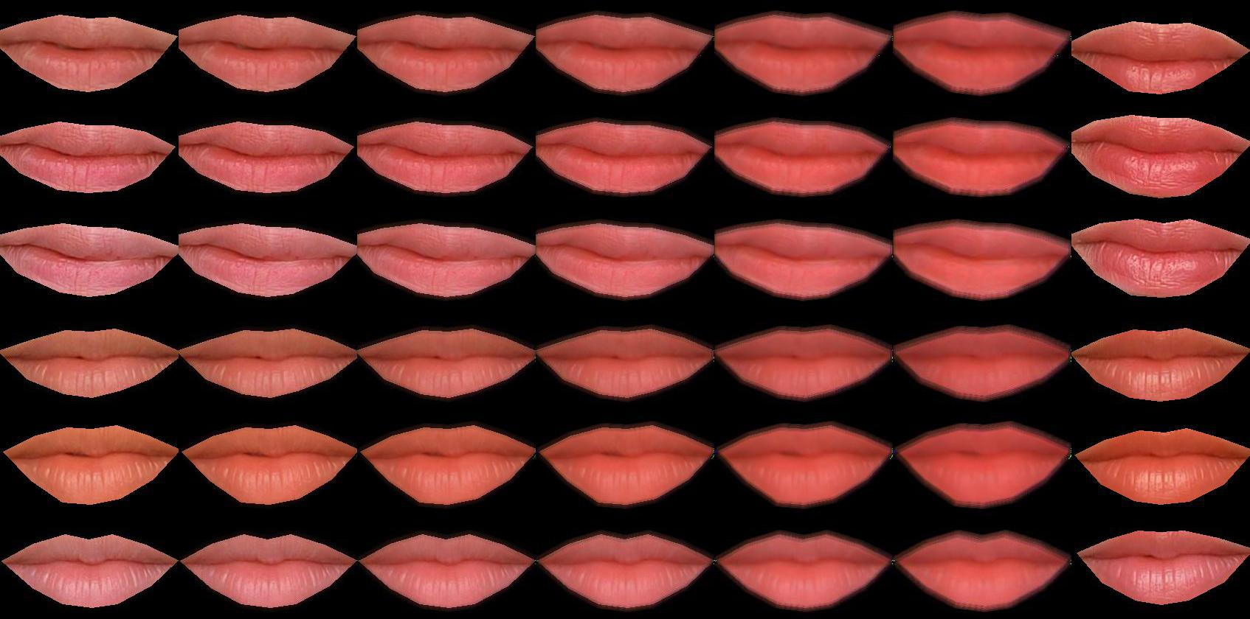
Lipstick 1 ,model 7,8 – new mask, small model

Slide 4
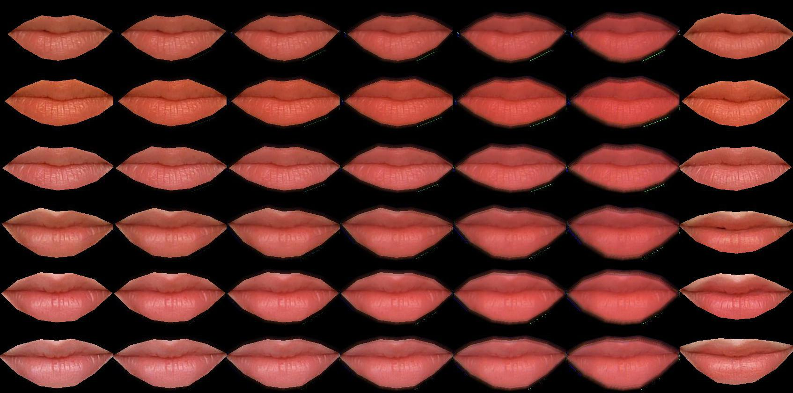
Lipstick 2, model 3,4

Slide 5
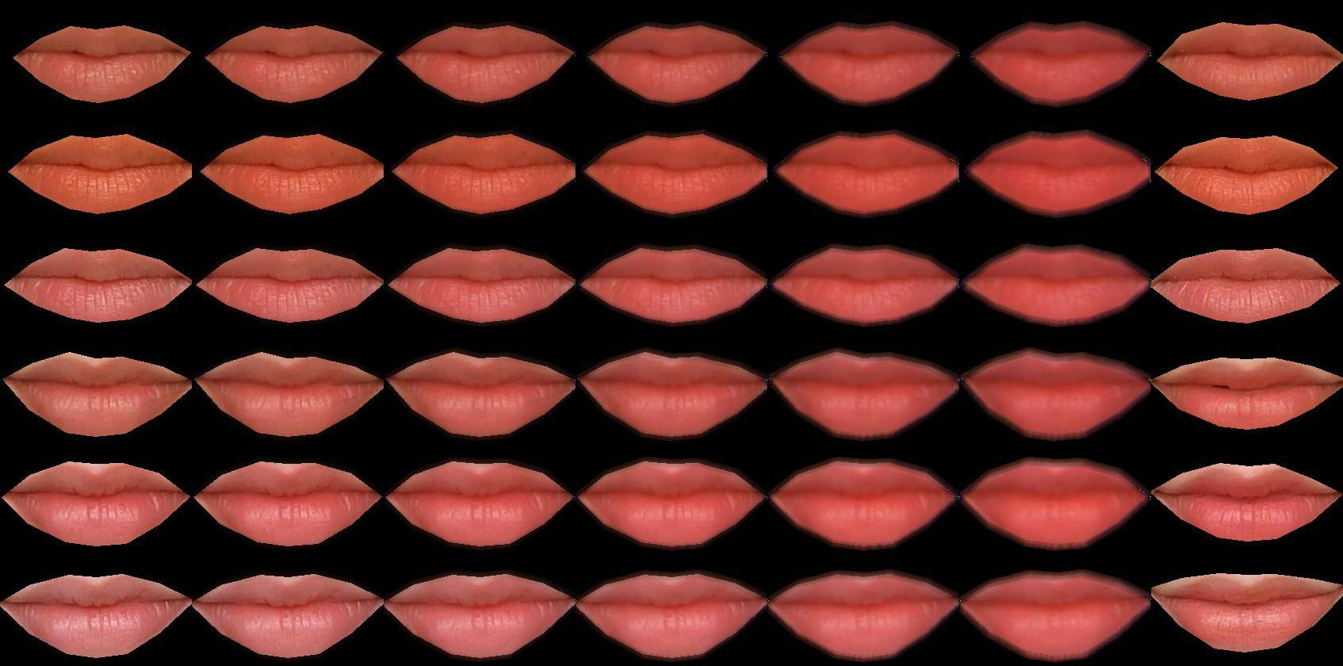
Lipstick 2, model 3,4 – new mask, small model

Slide 6
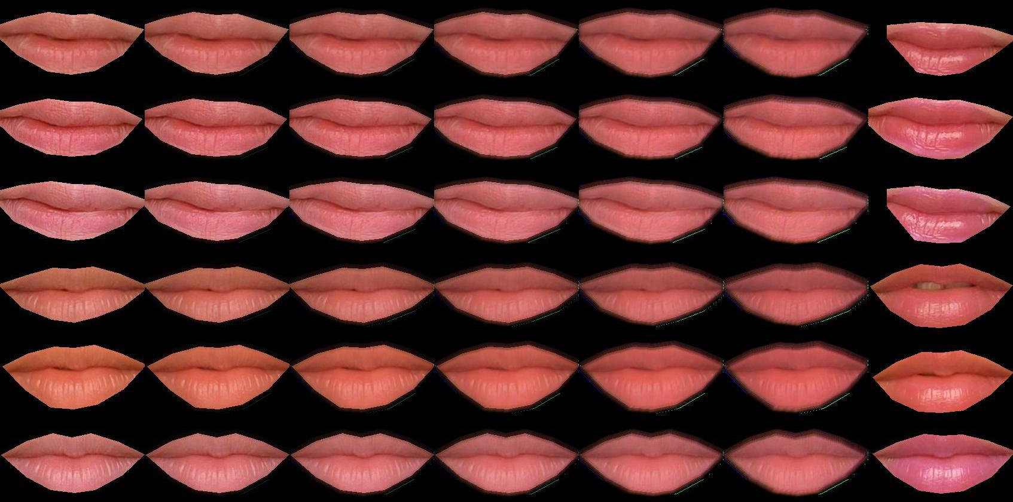
Lipstick 3 ,model 7,8

Slide 7
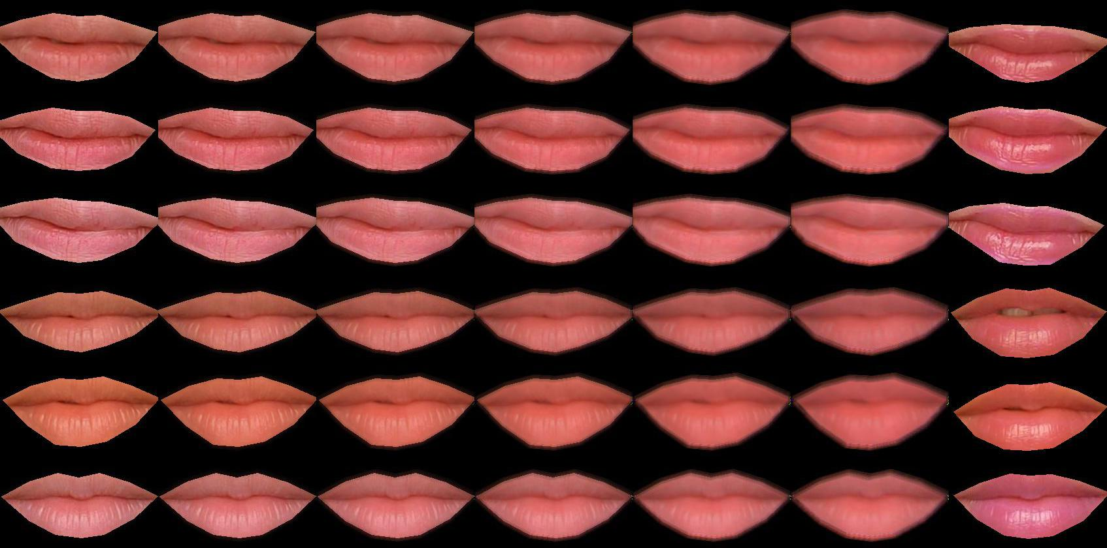
Lipstick 3 ,model 7,8 – new mask, small model

Slide 8
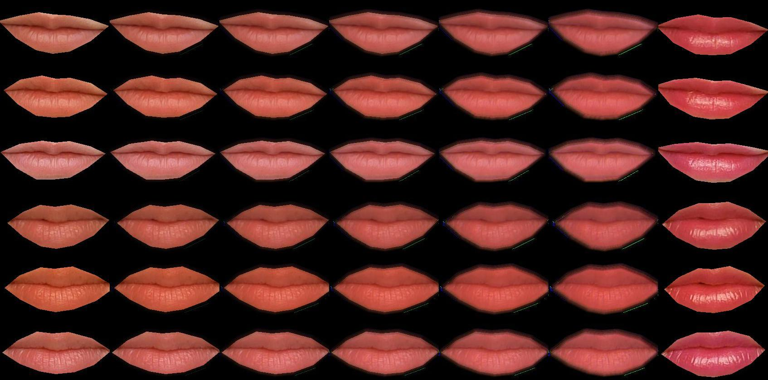
Lipstick 4 ,model 1,2

Slide 9
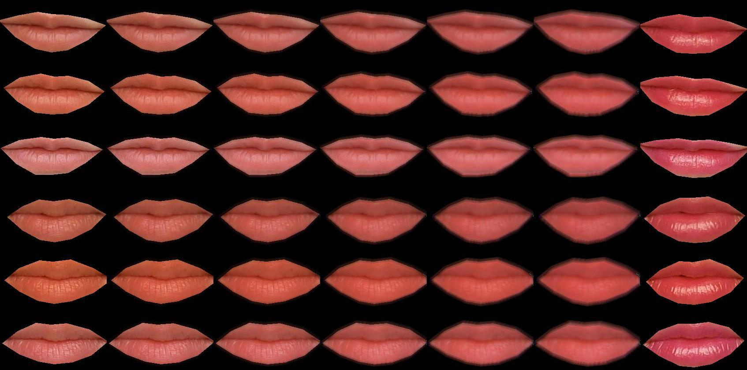
Lipstick 4 ,model 1,2 – new mask, small model

Slide 10
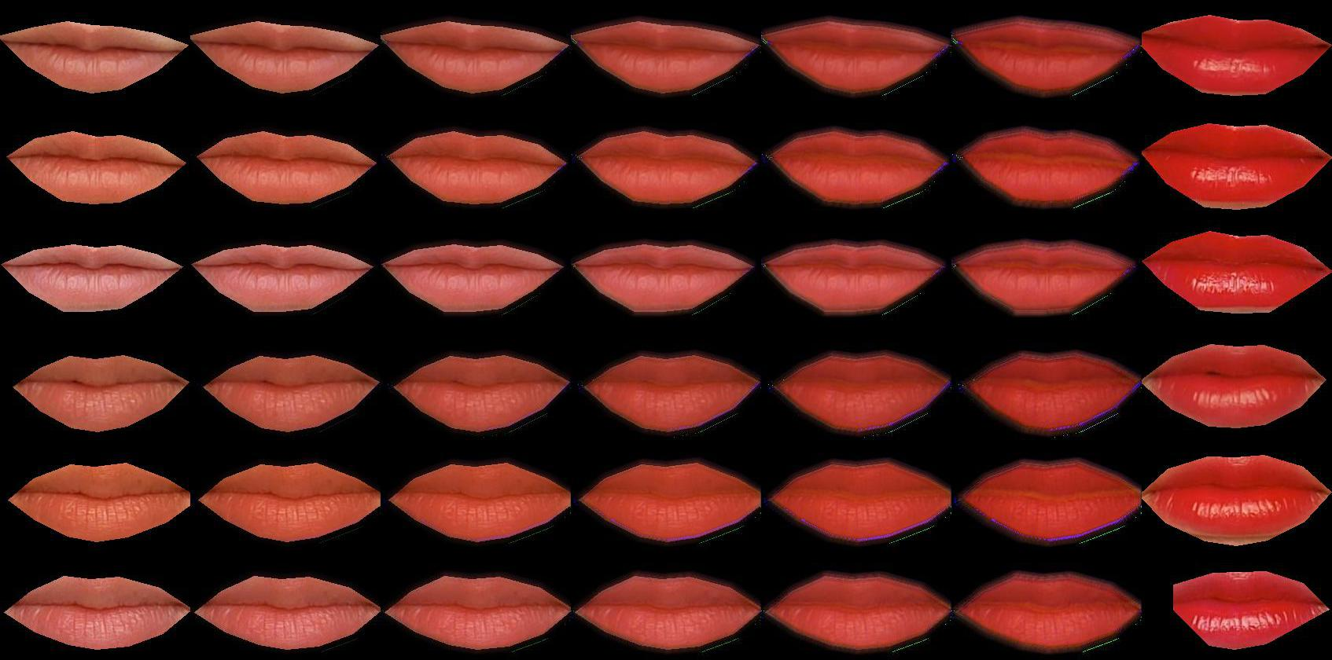
Lipstick 5 ,model 1,2

Slide 11
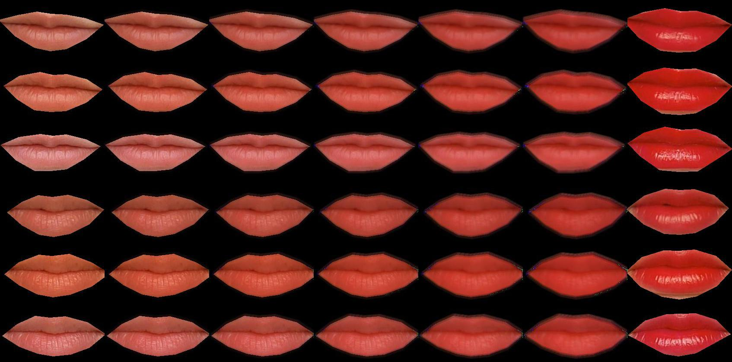
Lipstick 5 ,model 1,2 – new mask, small model

Slide 12
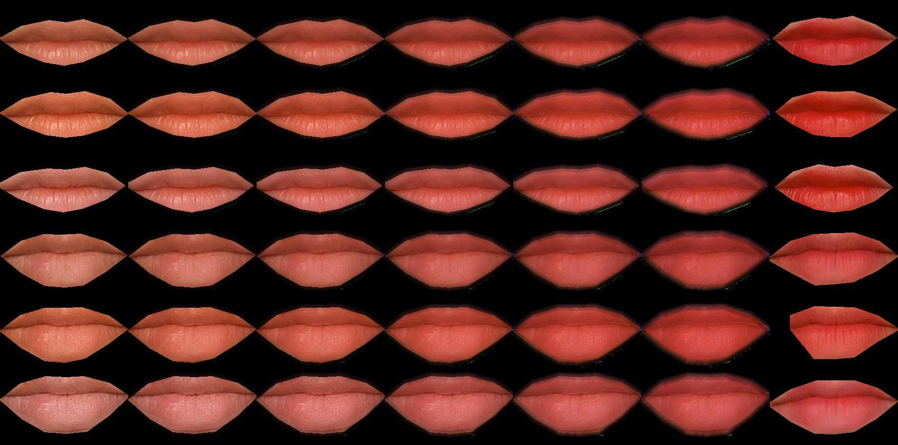
Lipstick 6 ,model 17,18

Slide 13
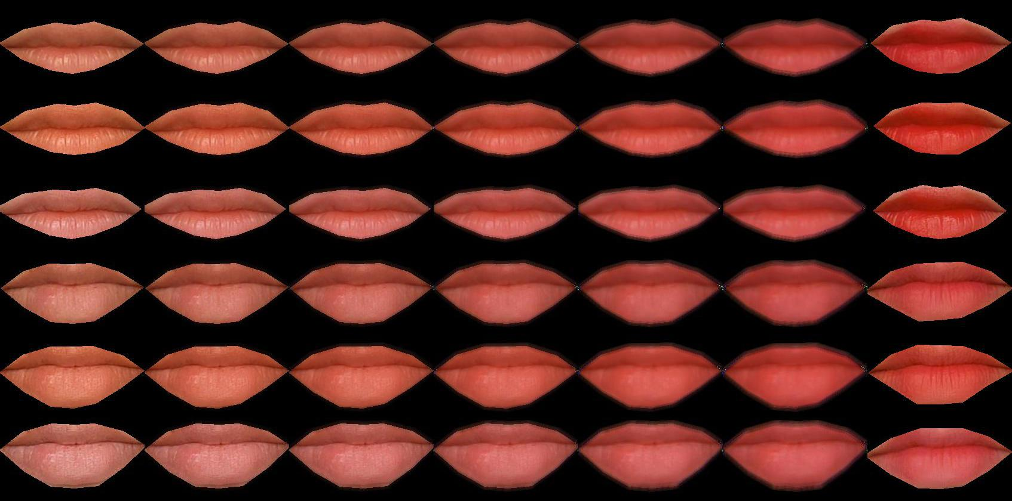
Lipstick 6 ,model 17,18 – new mask, small model

Slide 14
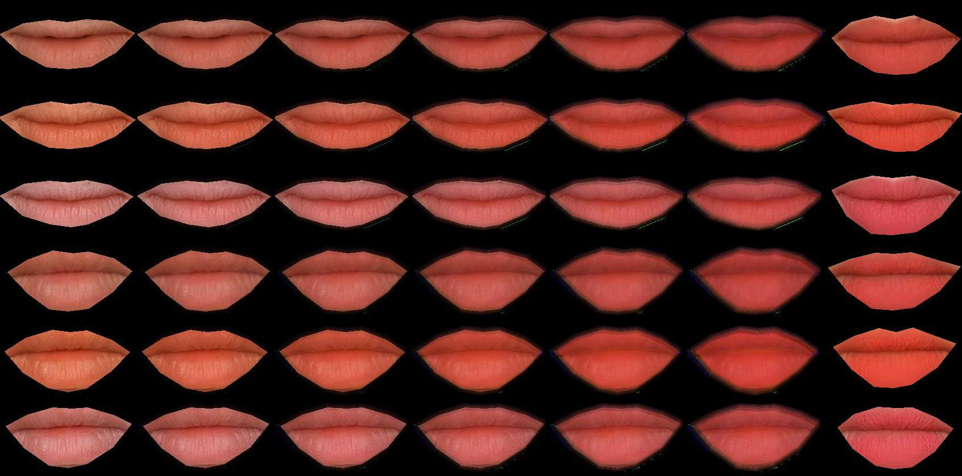
Lipstick 7 ,model 11,12

Slide 15
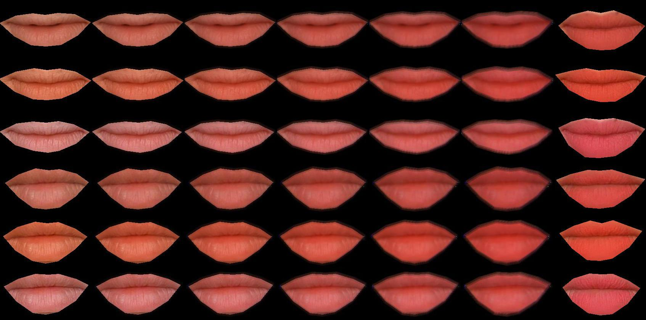
Lipstick 7 ,model 11,12 – new mask, small model

Slide 16
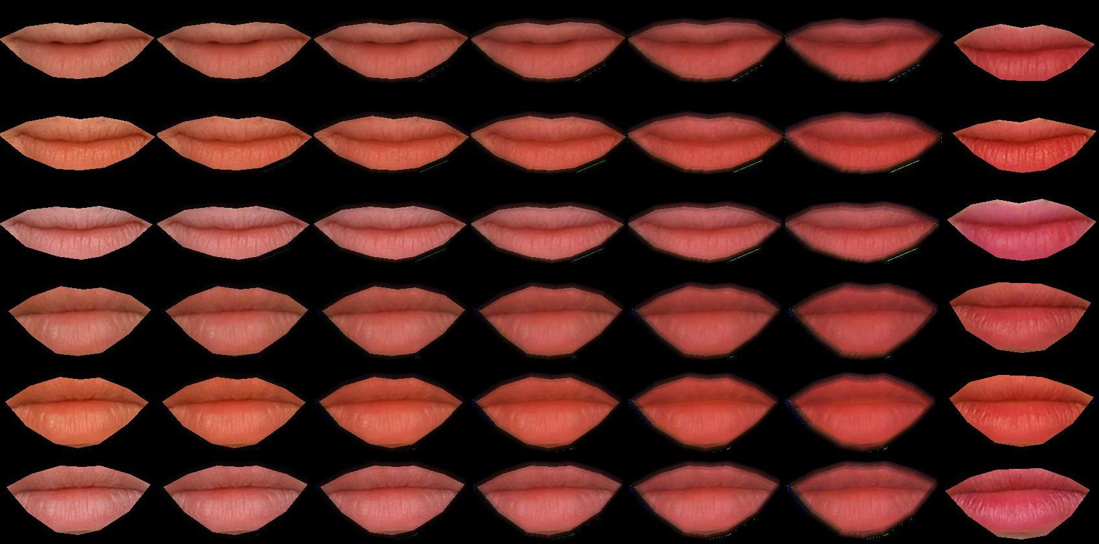
Lipstick 8 ,model 11,12

Slide 17
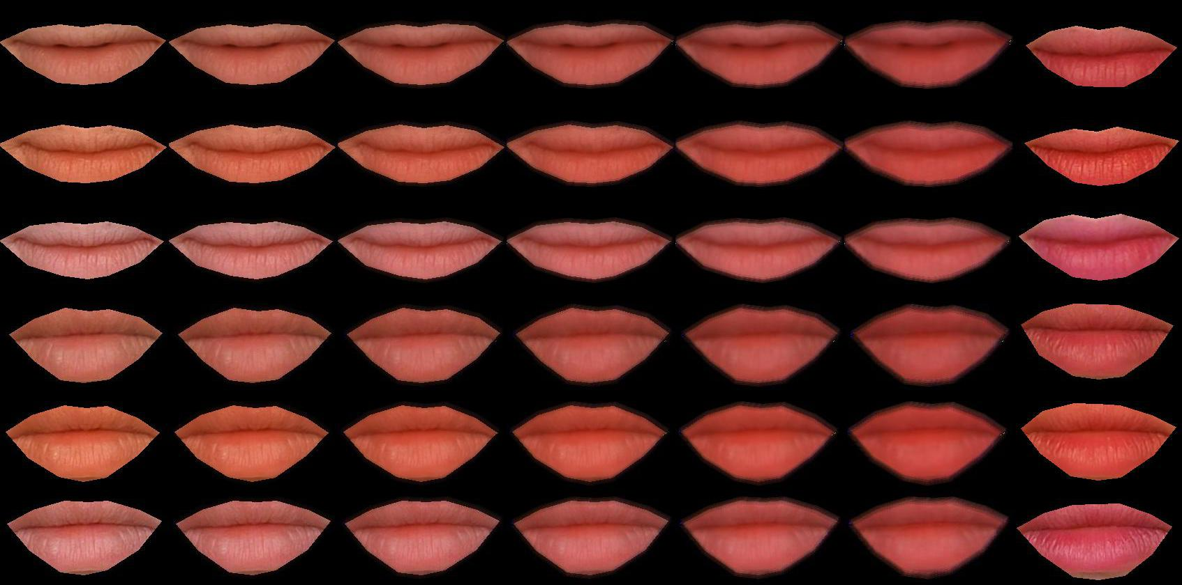
Lipstick 8 ,model 11,12 – new mask, small model

Slide 18
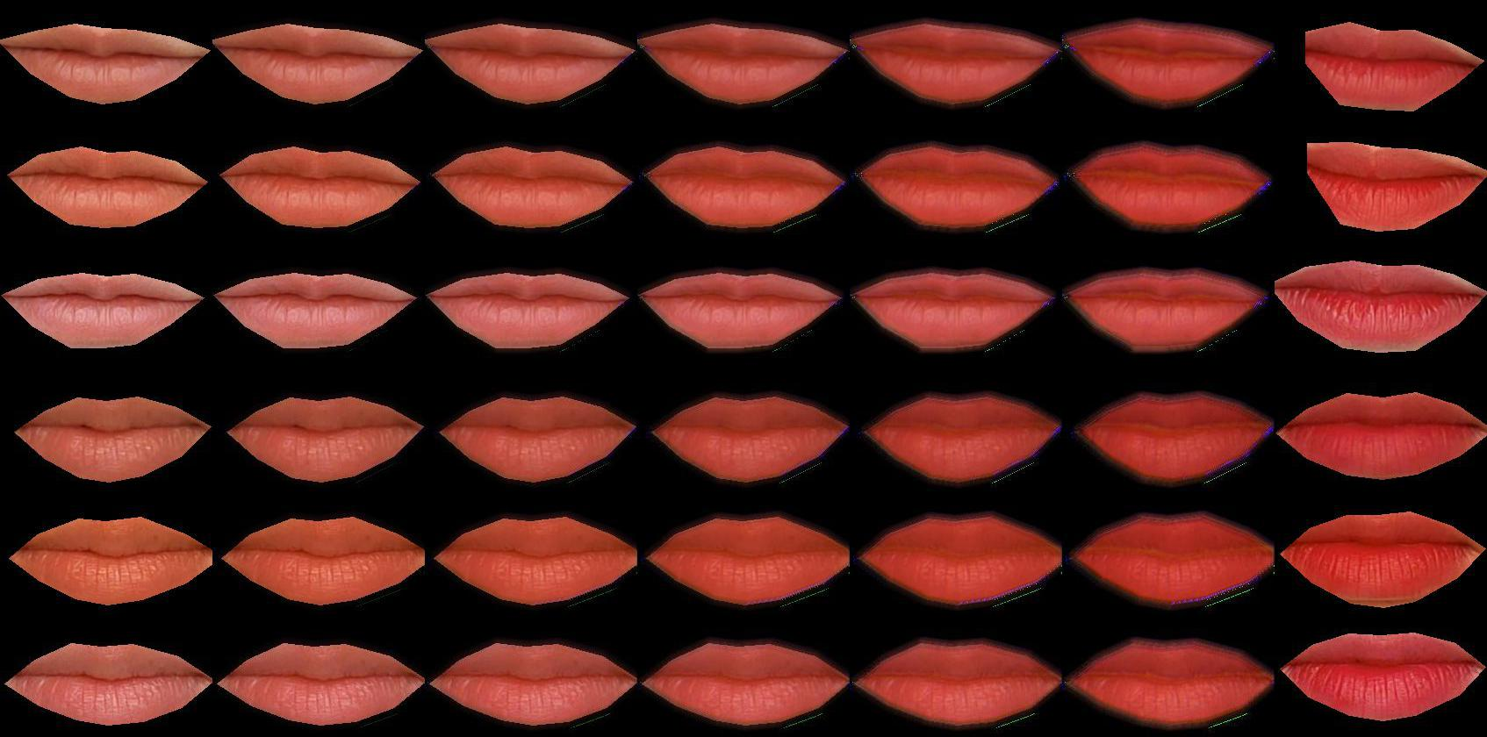
Lipstick 9 ,model 1,2

Slide 19
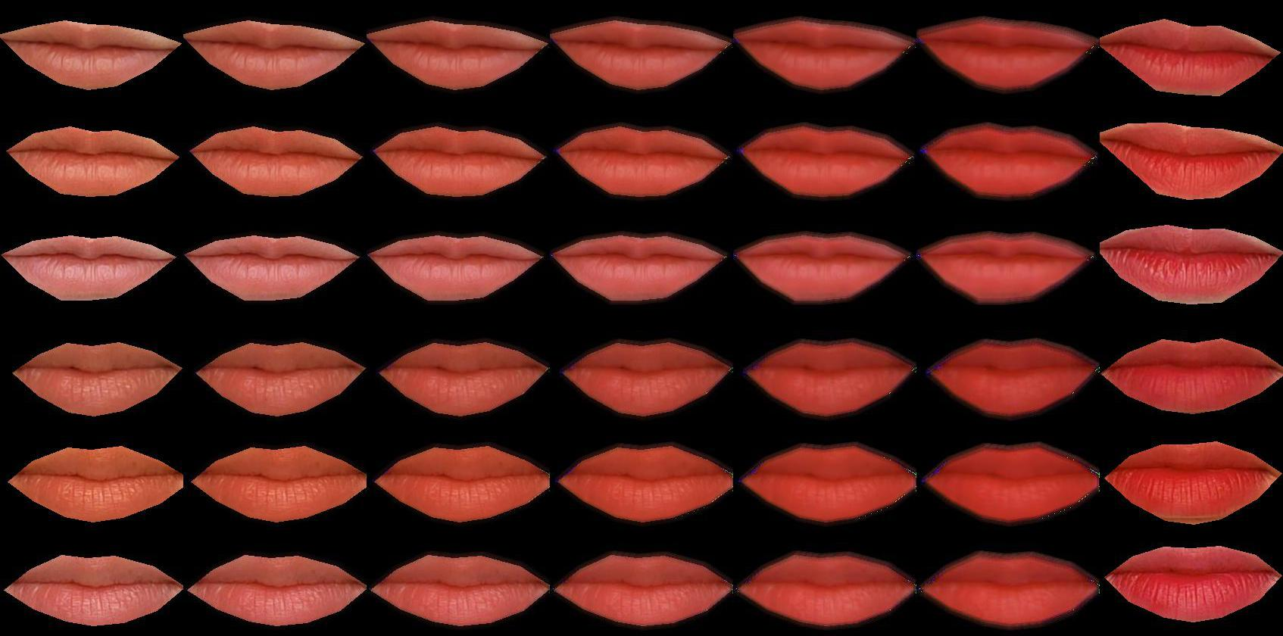
Lipstick 9 ,model 1,2 – new mask, small model

Slide 20
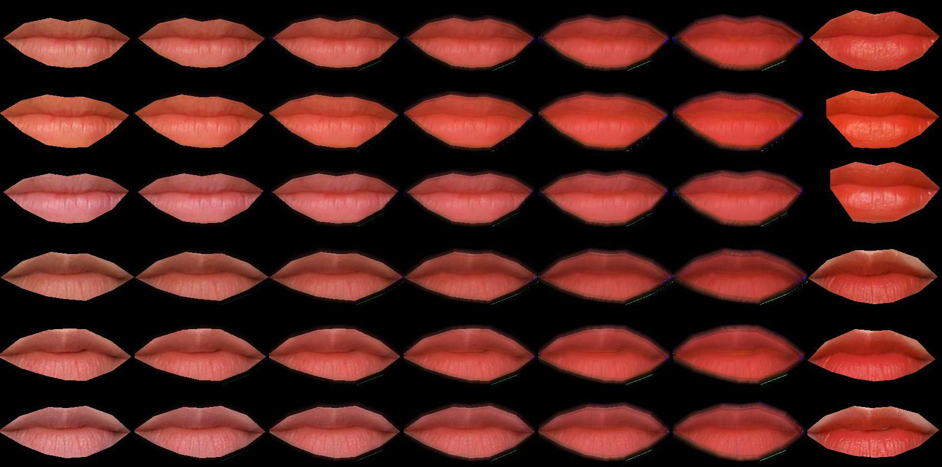
Lipstick 10 ,model 5,6

Slide 21
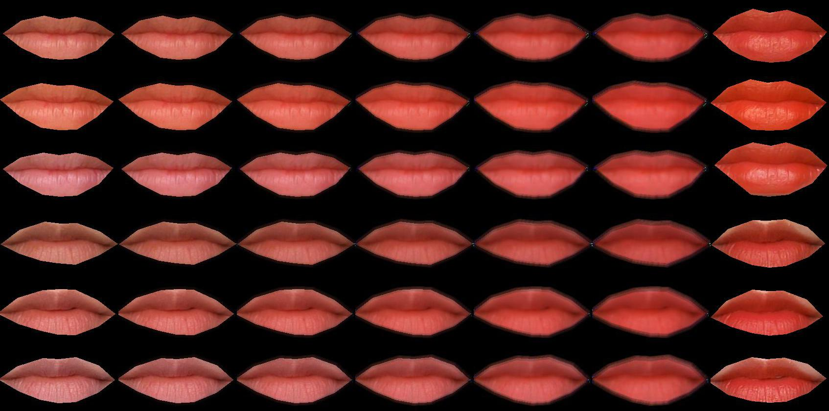
Lipstick 10 ,model 5,6 – new mask, small model

Slide 22
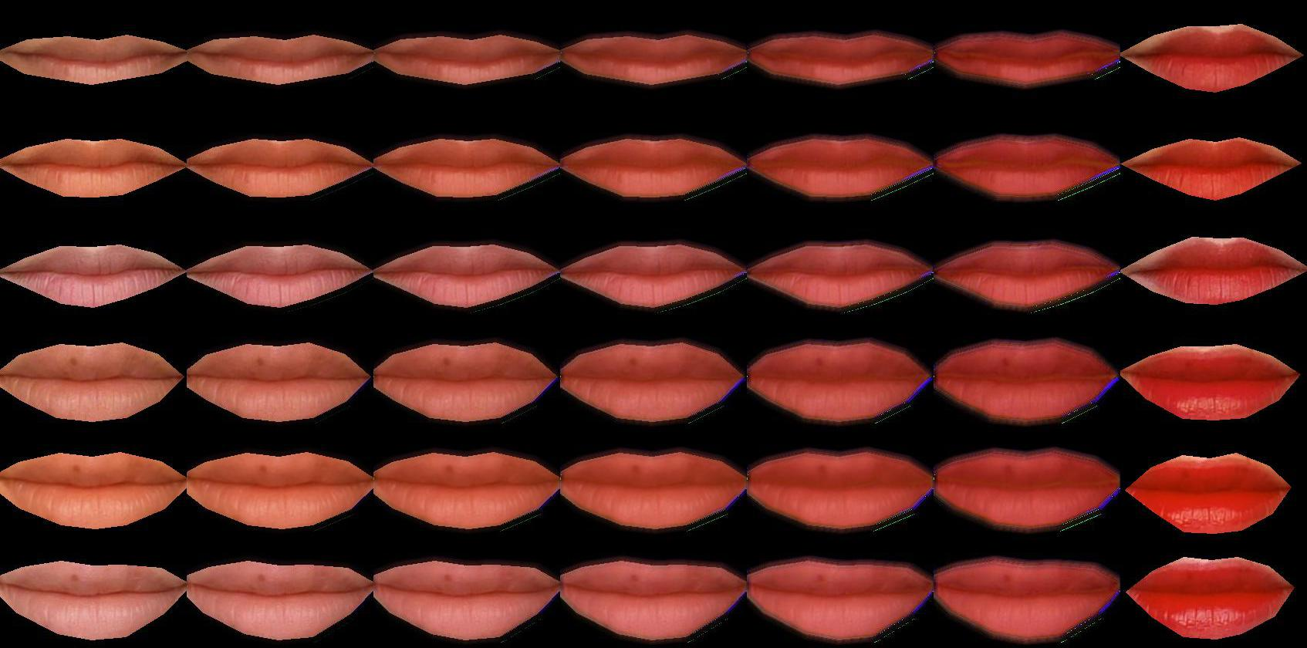
Lipstick 11 ,model 11,12

Slide 23
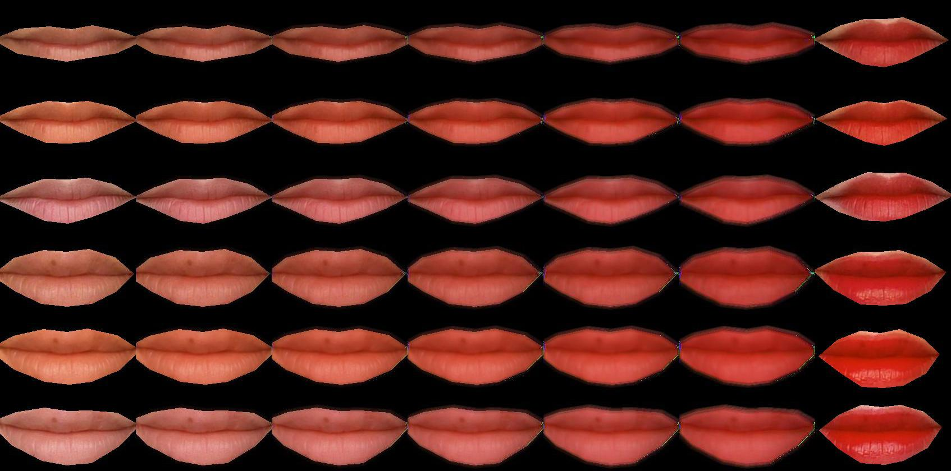
Lipstick 11 ,model 11,12 – new mask, small model

Slide 24
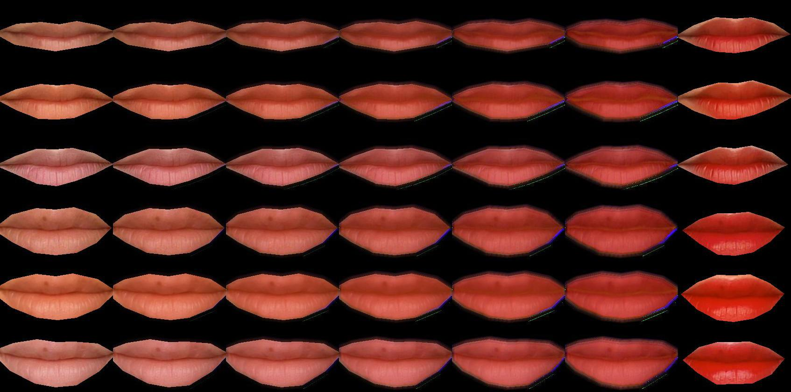
Lipstick 12 ,model 11,12

Slide 25
Lipstick 12 ,model 11,12 – new mask, small model

Slide 26
END

