Slide 1

병렬프로그래밍 3조
Tensor core

Slide 2
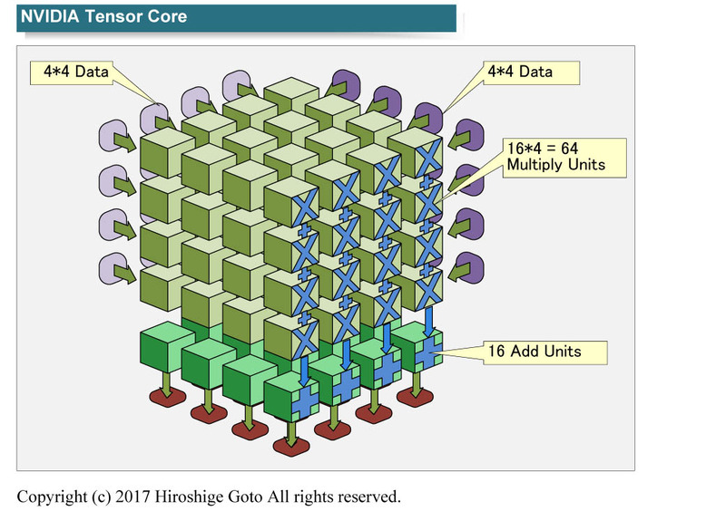
Tensor core
One matrix multiply and accumulate operation on
A 4x4 matrix in one GPU clock cycle
1. input half floating point precision(FP16)
Multiplication in half precision
Accumulation in single precision(FP32)
or half precision
Compared to single precision. Half precision data only requires half memory,
Bandwidth and footprint, resulting in faster data transfer
병렬프로그래밍 3조

Slide 3
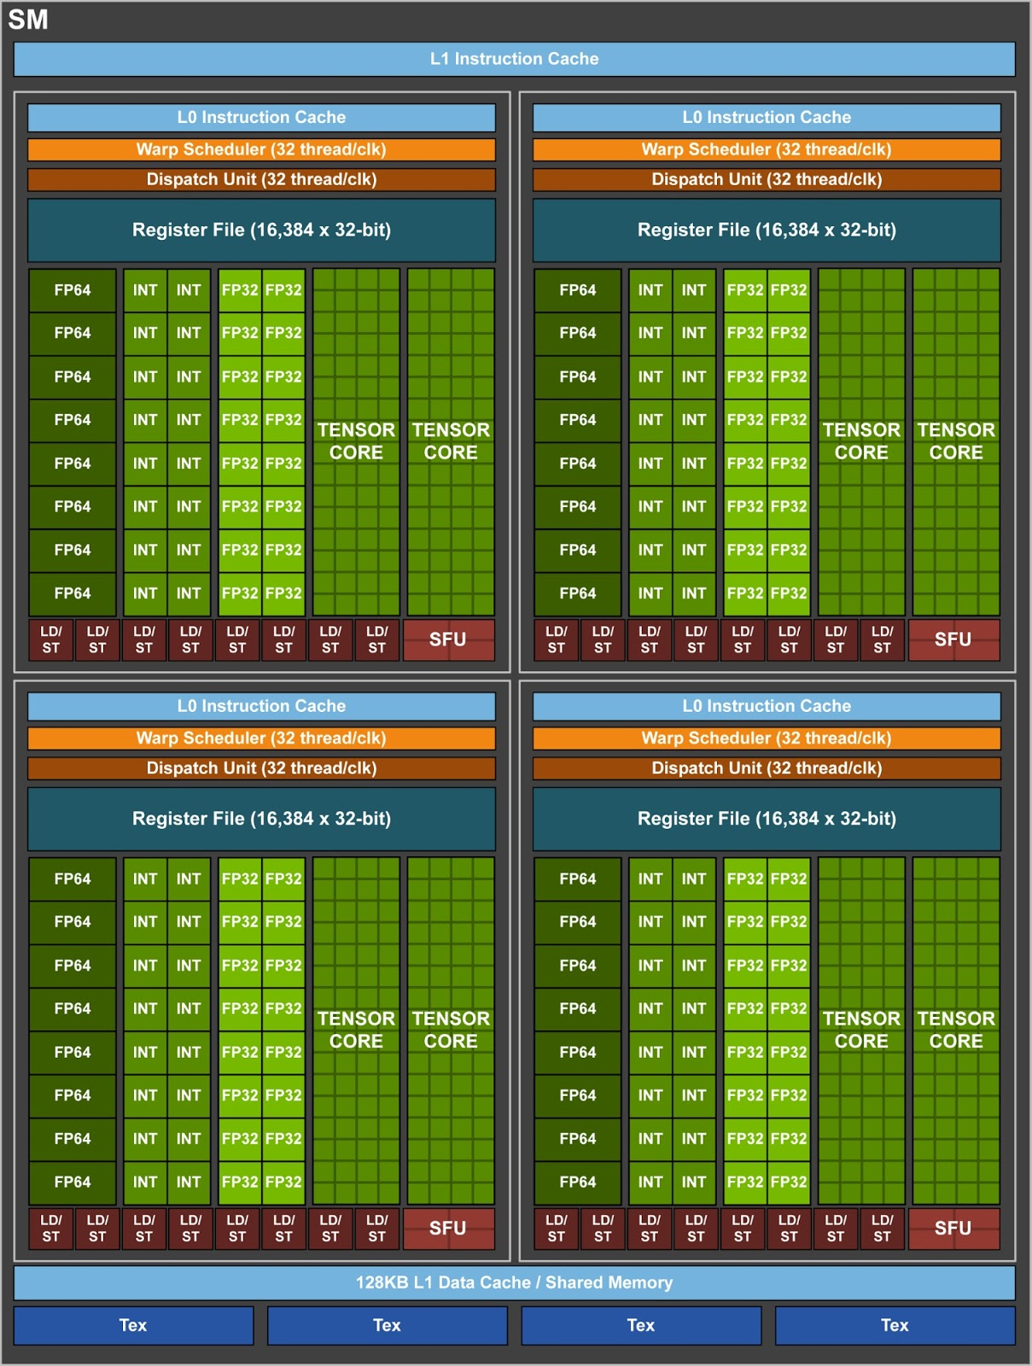
Tensor core
1 Tensor Core -> floating point FMA mixed-precision operation – 64times
1 SM(8 Tensor Core) -> floating point FMA mixed-precision operation – 1024times (64 * 8 * 2)
Each Tensor Core performs 64 floating point FMA mixed-precision operations per clock
8 Tensor Cores in an SM perform a total of 1024 floating point operations per clock.
병렬프로그래밍 3조

Slide 4
Tensor core Library
cuBLAS_GEMM
GEMMs that do not satisfy the above rules will fall back to a non-Tensor Core implementation
// First, create a cuBLAS handle:
cublasStatus_t cublasStat = cublasCreate(&handle);
// Set the math mode to allow cuBLAS to use Tensor Cores:
cublasStat = cublasSetMathMode(handle, CUBLAS_TENSOR_OP_MATH);
// Allocate and initialize your matrices (only the A matrix is shown):
size_t matrixSizeA = (size_t)rowsA * colsA;
T_ELEM_IN **devPtrA = 0;
cudaMalloc((void**)&devPtrA[0], matrixSizeA * sizeof(devPtrA[0][0]));
T_ELEM_IN A = (T_ELEM_IN *)malloc(matrixSizeA * sizeof(A[0]));
memset( A, 0xFF, matrixSizeA* sizeof(A[0]));
status1 = cublasSetMatrix(rowsA, colsA, sizeof(A[0]), A, rowsA, devPtrA[i], rowsA);
// ... allocate and initialize B and C matrices (not shown) ...
// Invoke the GEMM, ensuring k, lda, ldb, and ldc are all multiples of 8,
// and m is a multiple of 4:
cublasStat = cublasGemmEx(handle, transa, transb, m, n, k, alpha,
A, CUDA_R_16F, lda,
B, CUDA_R_16F, ldb,
beta, C, CUDA_R_16F, ldc, CUDA_R_32F, algo);
A. The routine must be a GEMM;
currently, only GEMMs support
Tensor Core execution.
B. The math mode must be set to CUBLAS_TENSOR_OP_MATH. cuBLAS requires the user to “opt in” to the use of tensor cores.
C. All of k, lda, ldb, and ldc must be a multiple of eight; m must be a multiple of four. The Tensor Core math routines stride through input data in steps of eight values, so the dimensions of the matrices must be multiples of eight.
D.The input and output data types for the matrices must be either half precision or single precision.
병렬프로그래밍 3조

Slide 5
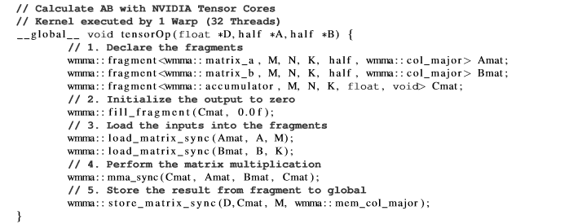
Tensor core Library
WMMA(Warp Matrix Multiply Accumulate)
the lowest level interface to program NVIDIA Tensor Cores is CUDA 9
provides a direct way to calculate 16x16 matrix matrix-multiply-and-accumulate
병렬프로그래밍 3조

Slide 6
Tensor core Library
CUTALSS
CUTLASS (CUDA Templates for Linear Algebra Subroutines) is
a CUDA C++ templated header-only library to perform
GEMM operation in different precisions (dgemm,sgemm and hgemm)
CUTLASS makes use of these techniques to provide an
optimized use of CUDA 9 WMMA
병렬프로그래밍 3조

Slide 7
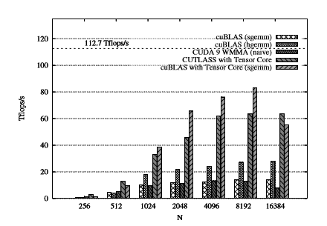
Tensor core Library - NVIDIA Tesla V100 test
병렬프로그래밍 3조

