Slide 1
Figures for TCE tutorial
December 2012
Erno Salminen
Tampere University of Technology

Slide 2
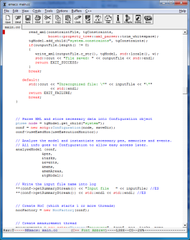
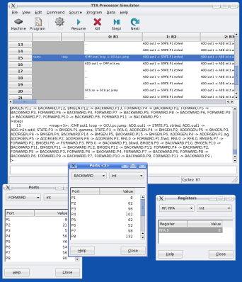
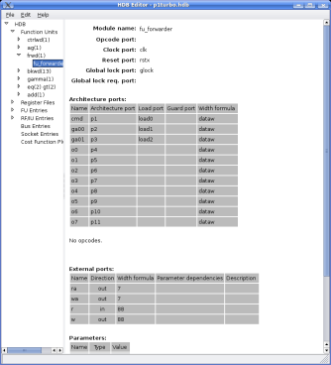
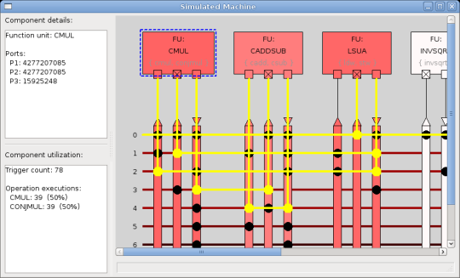
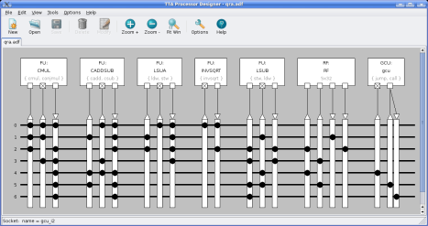
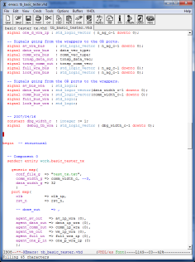
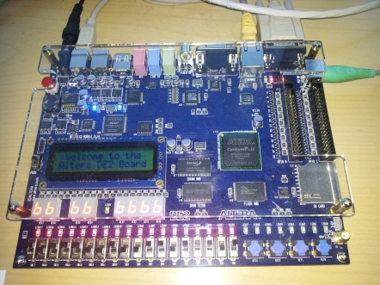
C/C++/
OpenCL
TCE toolset
Design TTA
Compile + debug
Generate HDL
Analyze
Program image
VHDL
FGPA

Slide 3
C/C++/
OpenCL
TCE toolset
Design TTA
Compile + debug
Generate HDL
Analyze
Program image
VHDL
ASIC/FPGA
Tool Flow

Slide 4
Reflect operation: SW vs. HW
On software: On hardware:
for (bit = 0; bit < nBits; bit++) {
if (data & 0x01) {
reflection I=
(1 << ((nBits-1) – bit));
}
data = (data >> 1);
}
INPUT DATA
7 6 5 4 3 2 1 0
“1 1 0 1 0 0 1 0”
Registers
“0 1 0 0 1 0 1 1”
7 6 5 4 3 2 1 0
OUTPUT DATA

