Slide 1
Efficient All-Electron Periodic Fourier-Transformed Coulomb Method

Slide 2
Main figures

Slide 3



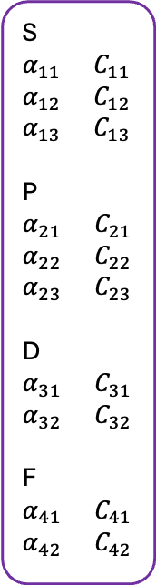

Workflow chart
S
$α_{11}$ $C_{11}$
$α_{12}$ $C_{12}$
$α_{13}$ $C_{13}$
P
$α_{21}$ $C_{21}$
$α_{22}$ $C_{22}$
$α_{23}$ $C_{23}$
D
$α_{31}$ $C_{31}$
$α_{32}$ $C_{32}$
F
$α_{41}$ $C_{41}$
$α_{42}$ $C_{42}$
S
$α_{11}$ $C_{11}$
$α_{12}$ $C_{12}$
P
$α_{21}$ $C_{21}$
$α_{22}$ $C_{22}$
D
$α_{31}$ $C_{31}$
$α_{32}$ $C_{32}$
Ewald summation
$$J_{CC}=\left(CC | CC\right){.D}_{CC}+\left(CC | CD\right){.D}_{DC}+\left(CC | DD\right).D_{DD}$$
$$J_{CD}=\left(CD | CC\right){.D}_{CC}+\left(CD | CD\right){.D}_{DC}+\left(CD | DD\right).D_{DD}$$
S
$α_{13}$ $C_{13}$
P
$α_{23}$ $C_{23}$
F
$α_{41}$ $C_{41}$
$α_{42}$ $C_{42}$
$$J_{DD}=\left(DD | CC\right){.D}_{CC}+\left(DD | CD\right){.D}_{DC}+\left(DD | DD\right).D_{DD}$$
Plane-wave density fitting
$ρ\left(G\right)= ρ_{CC}\left(G\right)+ρ_{CD}\left(G\right)$ + $ρ_{DD}\left(G\right)$
$$W\left(P\right)=W_{CC}\left(P\right)+W_{CD}\left(P\right)$$

Slide 4
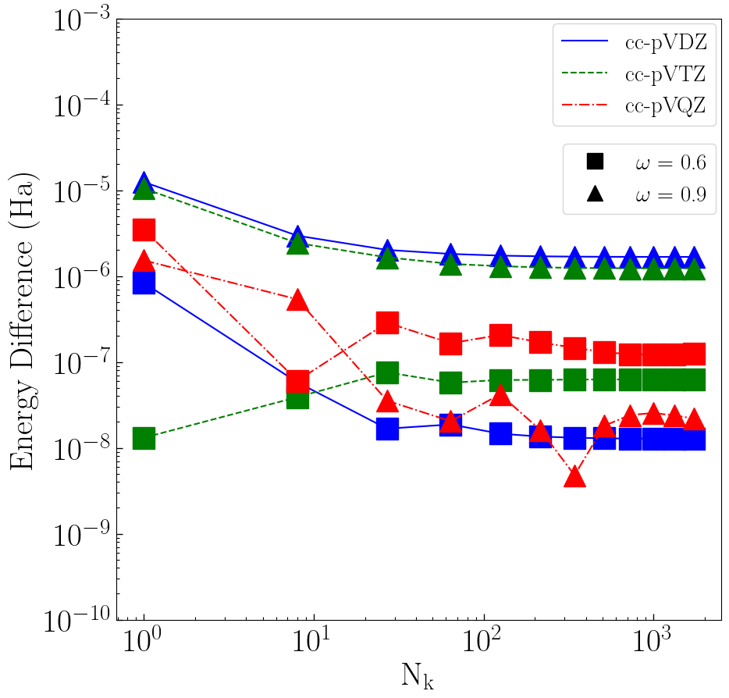
Si energy

Slide 5
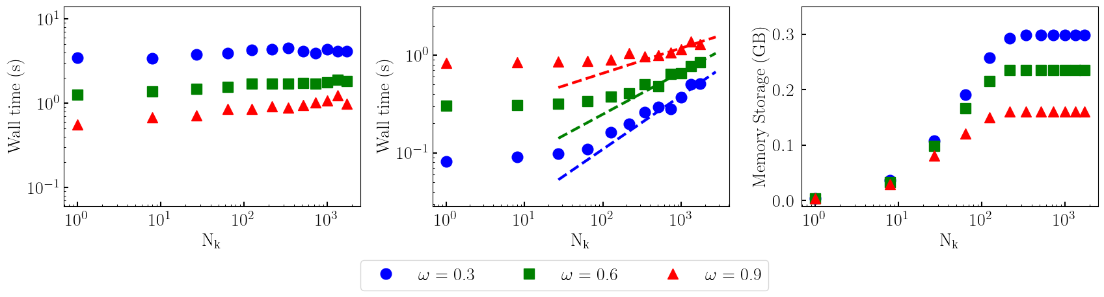
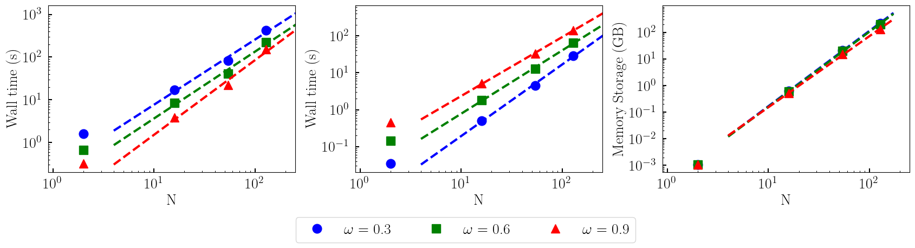












(a)
(b)
$$O(N_{k}^{0.26})$$
(c)
$$O(N_{k}^{0.43})$$
$$O(N_{k}^{0.55})$$
(a)
(b)
$$O(N^{1.72})$$
(c)
$$O(N^{2.82})$$
$$O(N^{1.52})$$
$$O(N^{2.83})$$
$$O(N^{1.60})$$
$$O(N^{2.67})$$
$$O(N^{1.56})$$
$$O(N^{1.75})$$
$$O(N^{1.94})$$

Slide 6
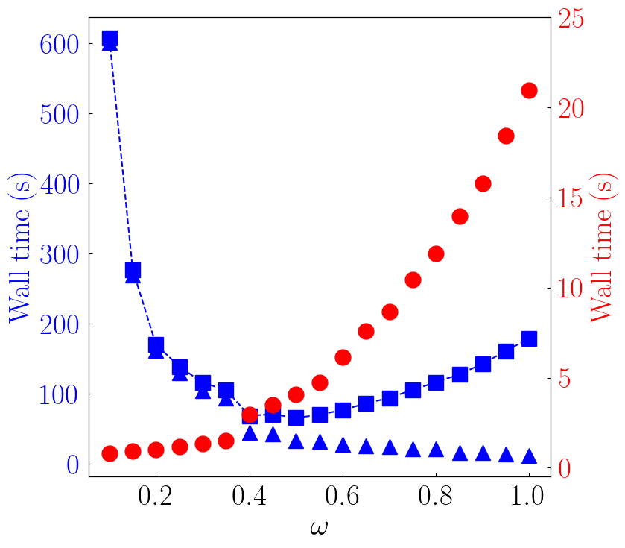
Omega dependence

Slide 7
SI figure

Slide 8
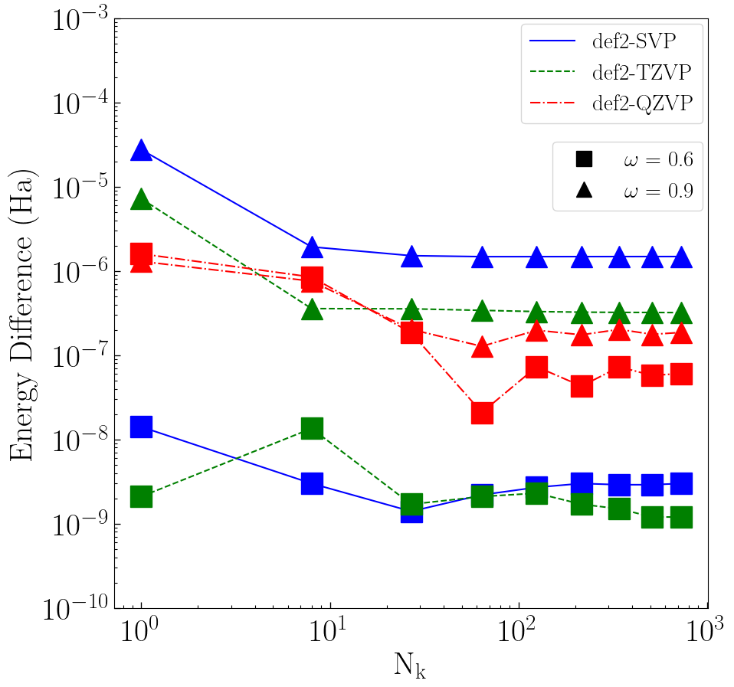
LiF energy

Slide 9
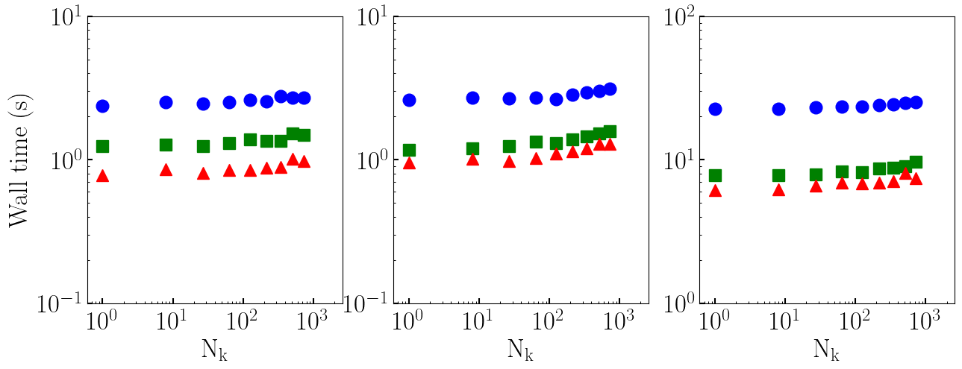
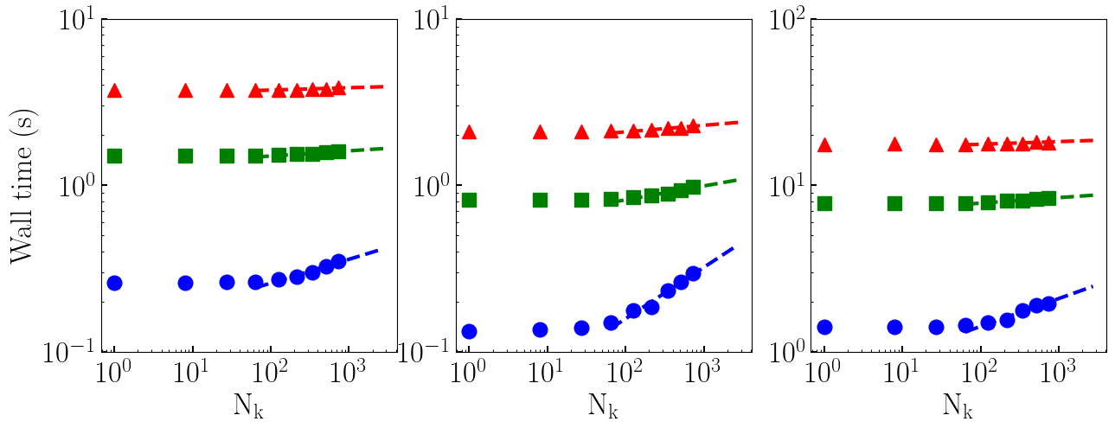
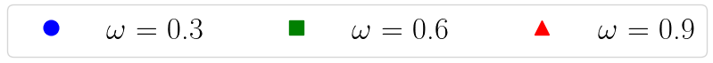









SI figures (LiF run time)
(a)
(b)
(c)
(d)
(e)
(f)
$$O(N_{k}^{0.01})$$
$$O(N_{k}^{0.04})$$
$$O(N_{k}^{0.02})$$
$$O(N_{k}^{0.03})$$
$$O(N_{k}^{0.08})$$
$$O(N_{k}^{0.03})$$
$$O(N_{k}^{0.31})$$
$$O(N_{k}^{0.17})$$
$$O(N_{k}^{0.14})$$

Slide 10
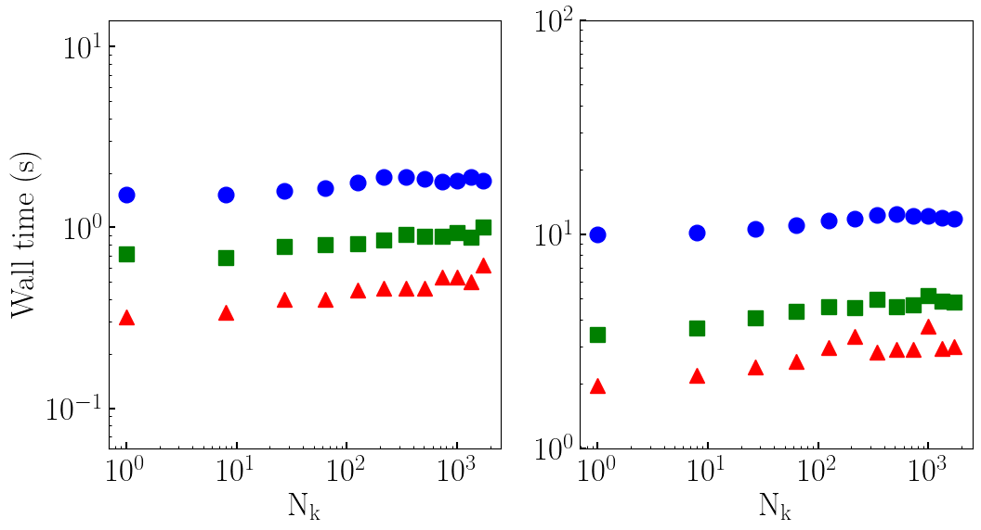
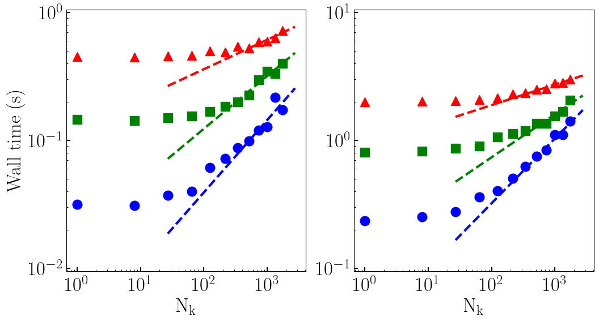
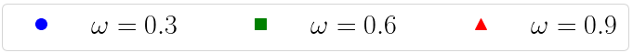






Si wall time (ccpvdz + ccpvqz)
(a)
(b)
(c)
$$O(N_{k}^{0.23})$$
(d)
$$O(N_{k}^{0.16})$$
$$O(N_{k}^{0.41})$$
$$O(N_{k}^{0.34})$$
$$O(N_{k}^{0.57})$$
$$O(N_{k}^{0.51})$$

Slide 11
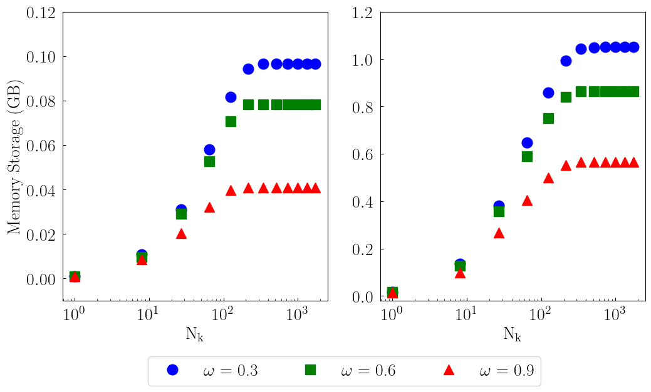
Storage plot for Si
(a)
(b)

