Slide 1

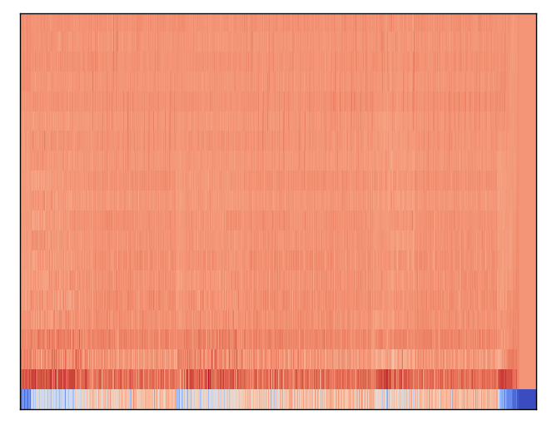
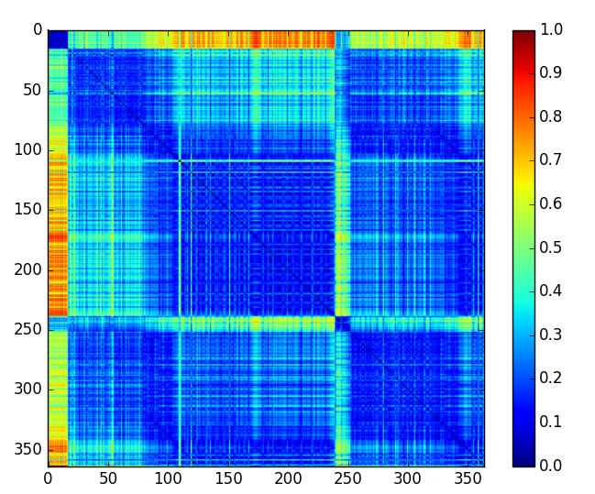
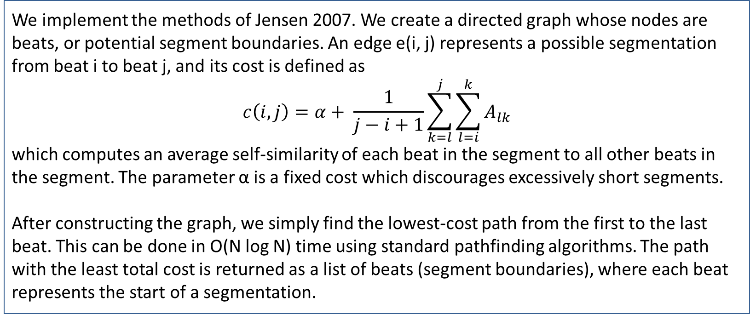
Structify: Automatic Segmentation of Pop Songs
Tushar Chandra¹, Joon Park²³, Adrick Tench³
Northwestern University
¹McCormick School of Engineering, ²Bienen School of Music, ³Weinberg College of Arts and Sciences
Abstract
Methods
It is well-known that repetition is fundamental to music; it both gives music structure and allows humans to perceive this structure. Pop songs often repeat verses and choruses, sometimes with minor variations, to create structure. Approaches to computationally analyzing this structure often involve detecting repeating patterns in a self-similarity matrix of spectral features.
We implement the work of Jensen 2007, in which a self-similarity matrix of timbre features was used to automatically segment music¹. A shortest path algorithm is implemented on a graph of potential segment boundaries with weights as the cost of computing segments.
When using timbre features on a dataset of 10 pop songs, we were able to correctly identify XX% of manually coded segmentations (recall). Moreover, XX% of automatically identified segmentations were correct (precision). Our average F1 measure was XX.
We implement the methods of Jensen 2007. We create a directed graph whose nodes are beats, or potential segment boundaries. An edge e(i, j) represents a possible segmentation from beat i to beat j, and its cost is defined as
$$c\left(i, j\right)=α+ \frac{1}{j−i+1}\sum_{k=l}^{j}{\sum_{l=i}^{k}{A_{lk}}}$$
which computes an average self-similarity of each beat in the segment to all other beats in the segment. The parameter α is a fixed cost which discourages excessively short segments.
After constructing the graph, we simply find the lowest-cost path from the first to the last beat. This can be done in O(N log N) time using standard pathfinding algorithms. The path with the least total cost is returned as a list of beats (segment boundaries), where each beat represents the start of a segmentation.
Chart 1. Label in 16pt Calibri.
Music Representations
Results
Discussion
Our analysis of music revolves around the self-similarity matrix, a graphical representation of sequences in a data series. To construct this, we transform a discrete audio time series into a sequence of feature vectors. Various methods are used to compute the feature vectors, including construction of chromgragrams, tempogram, and timbregrams. We tested all three, but ultimately use the timbregram due to its superior performance¹ in the literature.
We compute a standard spectrogram as the concatenation of short-time Fourier transforms (STFTs). The frequency vectors for each frame are mapped into mel-space, yielding mel-frequency cepstral coefficients (MFCCs). The timbregram is then computed as the concatenation of the MFCC feature vectors.
The pairwise distance between each feature vector in the timbregram is computed and stored in the self-similarity matrix. Distances are computed using the Euclidean norm, though others (including cosine, cityblock, and correlation) have been tested. Finally, we aggregate features that belong to the same beat by taking their median, which reduces dimensionality, increases computational efficiency, and gives each feature vector more meaning.
We tested our segmentation algorithm on a dataset of ten pop songs, chosen semirandomly from a list of all-time most popular songs. In each case, we compared the boundaries to manually identified boundaries, obtained by group members listening to each song and noting transitions between sections. We define a segment boundary within two beats of an actual boundary as being correct.
We computed the proportion of actual boundaries that were identified (precision), the proportion of identified boundaries that were correct (recall), and the F1 measure from these. This was done for each type of feature vector (chroma, tempo, and timbre features).
Table 1 presents a detailed comparison of the F1 measures for the ten testing songs.
Click here to insert your Discussion text. Type it in or copy and paste from your Word document or other source.
This text box will automatically re-size to your text. To turn off that feature, right click inside this box and go to Format Shape, Text Box, Autofit, and select the “Do Not Autofit” radio button.
To change the font style of this text box: Click on the border once to highlight the entire text box, then select a different font or font size that suits you. This text is Calibri 20pt and is easily read up to 3 feet away on a 24x36 poster, and up to 6 feet away on a 48x72 poster.
Zoom out to 100% (for 24x36) or 200% (for 48x72) to preview what this will look like on your printed poster.
 | Chroma | Tempo | Timbre
Bohemian Rhapsody | 0.12 | 0.22 | 0.19
Call Me Maybe | 0.53 | 0.47 | 0.66
Come On Eileen | 0.28 | 0.31 | 0.38
Firework | 0.35 | 0.53 | 0.53
Happy Together | 0.38 | 0.38 | 0.25
Hotel California | 0.44 | 0.14 | 0.38
Raspberry Beret | 0.36 | 0.53 | 0.50
Rolling in the Deep | 0.47 | 0.31 | 0.43
Titanium | 0.25 | 0.33 | 0.78
When Doves Cry | 0.36 | 0.20 | 0.27
Average | 0.35 | 0.34 | 0.44
Conclusions
Click here to insert your Conclusions text. Type it in or copy and paste from your Word document or other source.
This text box will automatically re-size to your text. To turn off that feature, right click inside this box and go to Format Shape, Text Box, Autofit, and select the “Do Not Autofit” radio button.
To change the font style of this text box: Click on the border once to highlight the entire text box, then select a different font or font size that suits you. This text is Calibri 20pt and is easily read up to 3 feet away on a 24x36 poster, and up to 6 feet away on a 48x72 poster.
Zoom out to 100% (for 24x36) or 200% (for 48x72) to preview what this will look like on your printed poster.
Figure 1. Timbregram for “Call Me Maybe” by Carly Rae Jespen
Figure 2. Similarity matrix for “Call Me Maybe”.
Table 1. Comparison of feature vectors on testing dataset
Contact
References
Tushar Chandra; Joon Park; Adrick Tench
Northwestern University
Email: tchandra@u.northwestern.edu / joonpark@u.northwestern.edu / adricktench2018@u.northwestern.edu
Website: https://github.com/joonpark13/structify
Jensen, Kristoffer. "Multiple scale music segmentation using rhythm, timbre, and harmony." EURASIP Journal on Applied Signal Processing 2007.1 (2007): 159-159.
Couvreur, Laurent, et al. "Audio thumbnailing." QPSR of the numediart research program 1 (2008): 67-85.

