Slide 1


Games Programming
Assignments
Dr Bryan Duggan
DIT School of Computing
bryan.duggan@dit.ie
@ditcomputing
http://facebook.com/ditschoolofcomputing

Slide 2
Assignment 1
An eCard
Make it for someone specific
You must include:
Processing drawing code
The if statement
Loops
Animation
Classes (optional but bonus)

Slide 3
Rules
Rules
All graphics must be procedurally generated
You can use whatever audio you like from whatever source
No code from the internet whatsoever
You must write everything yourself
You must understand and be able to explain every line of code
All assignments must be demonstrated in class next week
No late submissions without a PC/1 form
Submission through webcourses (I hope)
As much code as necessary to solve the problem and no more

Slide 4
Marks
Complexity
25%
Functionality/visuals
25%
Code quality
25%
Jazz
25%

Slide 5
Assignment 2
A vector graphics game such as…
Pong
Spacewars
Asteroids
Battlezone
Lunar Lander
Gravitar
Star Wars

Slide 6
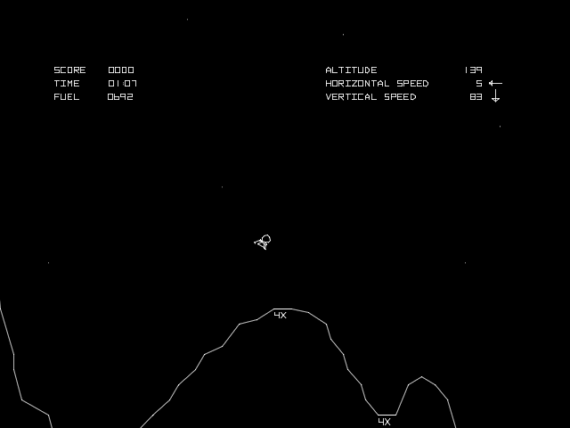

Slide 7
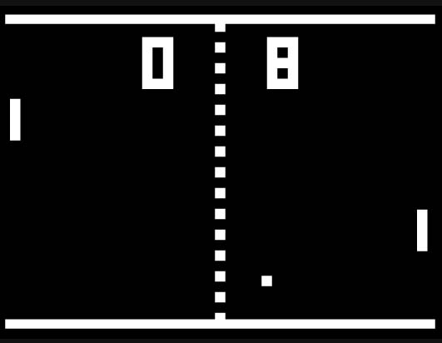

Slide 8
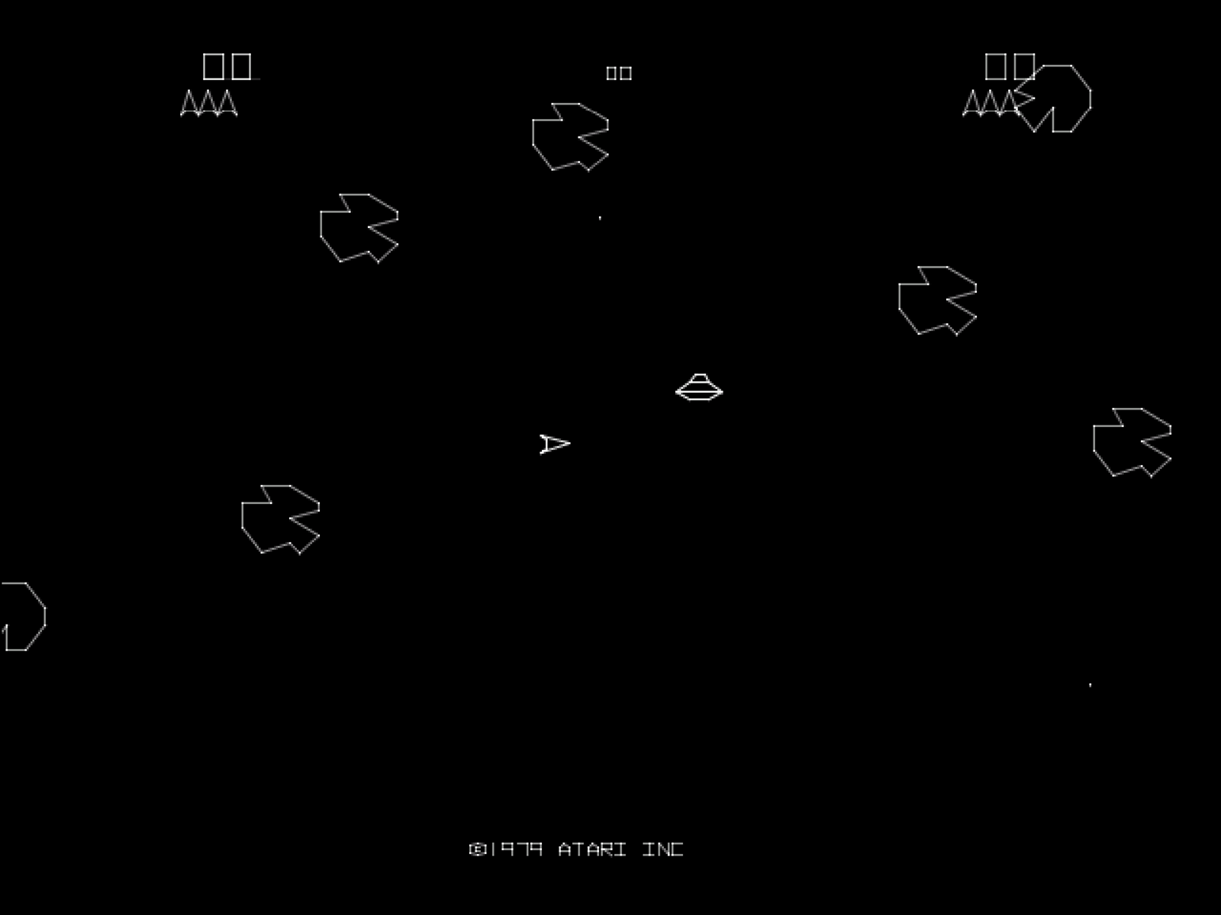

Slide 9
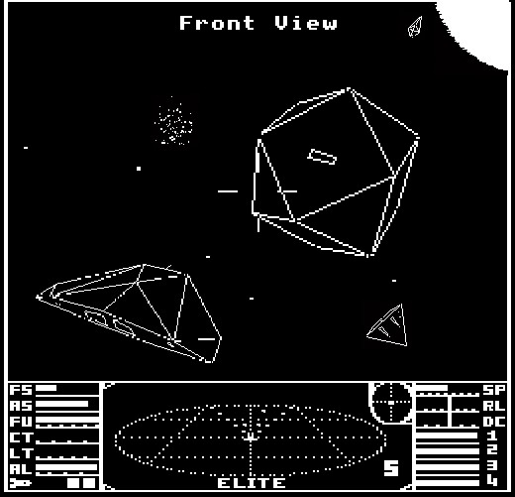

Slide 10
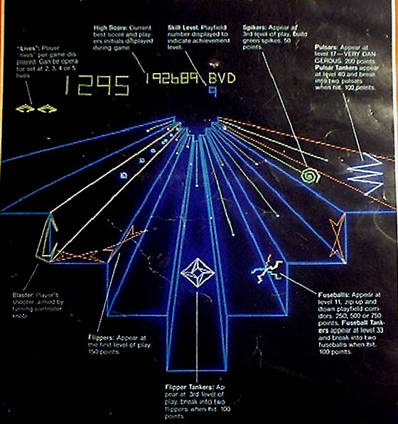

Slide 11
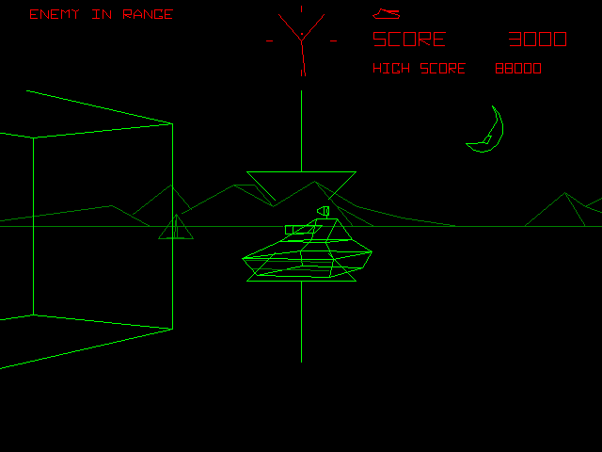

Slide 12
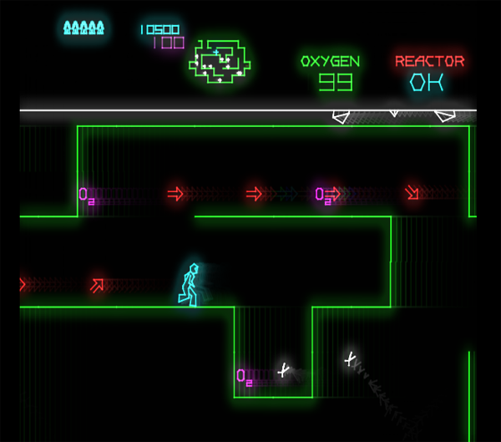

Slide 13


Slide 14
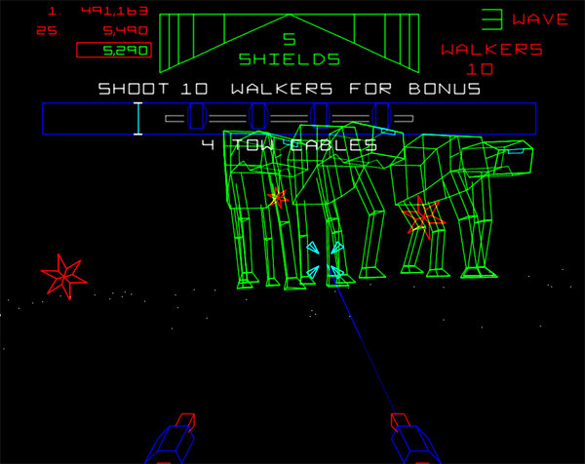

Slide 15
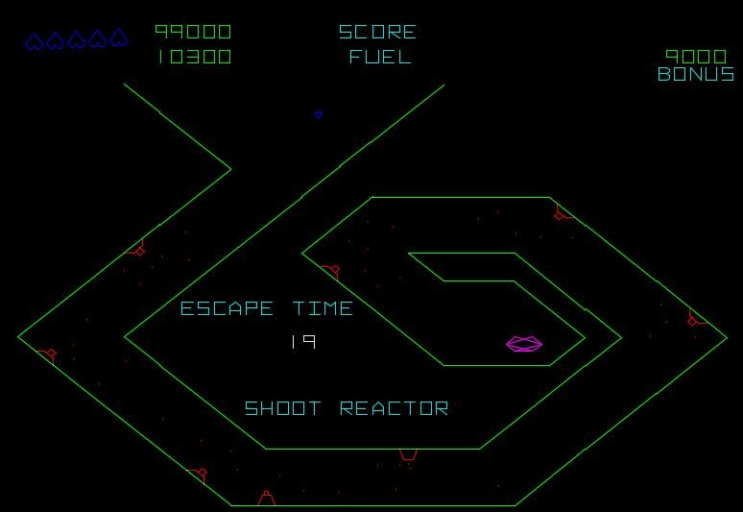

Slide 16
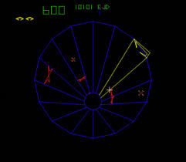

Slide 17
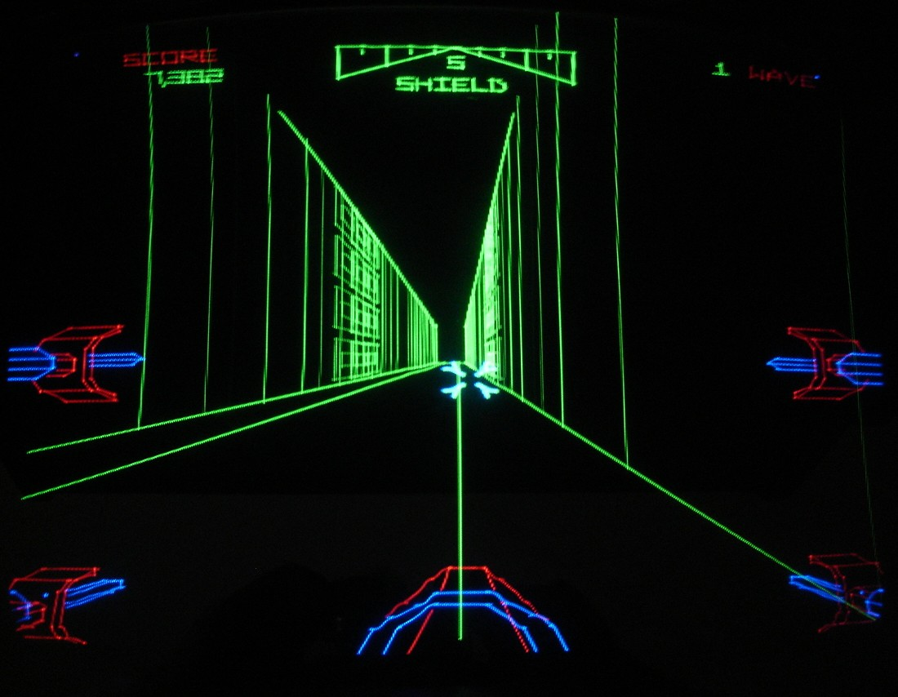

Slide 18
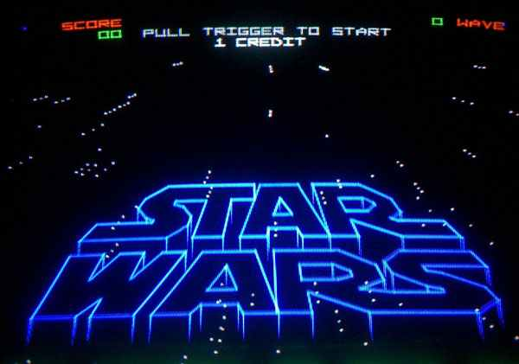

Slide 19
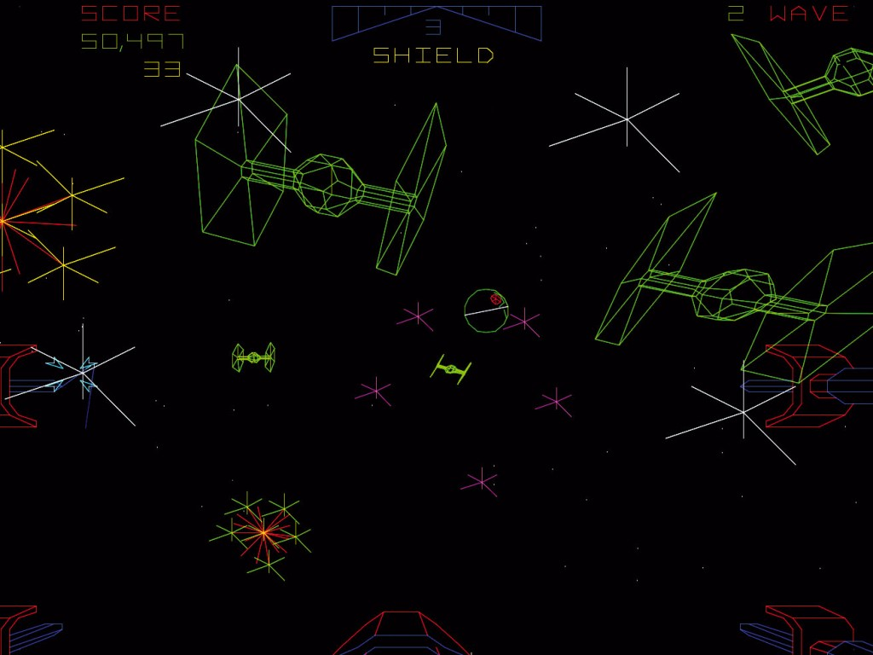

Slide 20
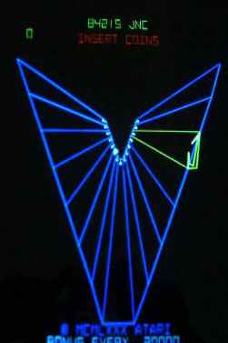

Slide 21
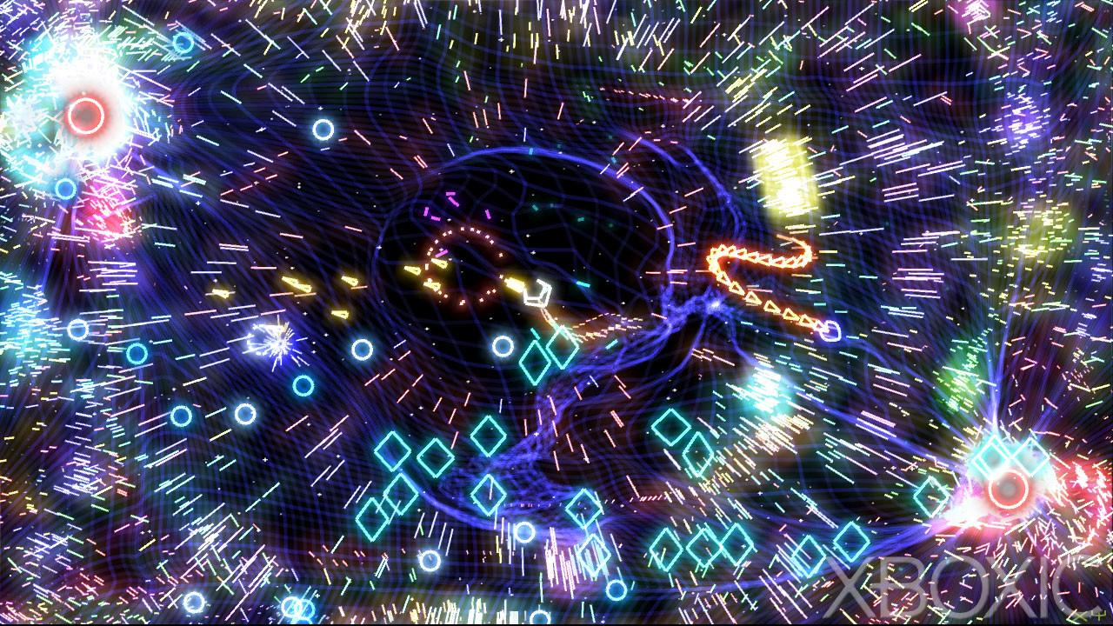

Slide 22


Slide 23
Marks
Complexity
20%
Functionality/visuals
20%
Code quality
20%
Gameplay
20%
Jazz
20%

Slide 24
Games Fleadh Theme!
Hitchhikers Guide to the Galaxy

