Slide 1
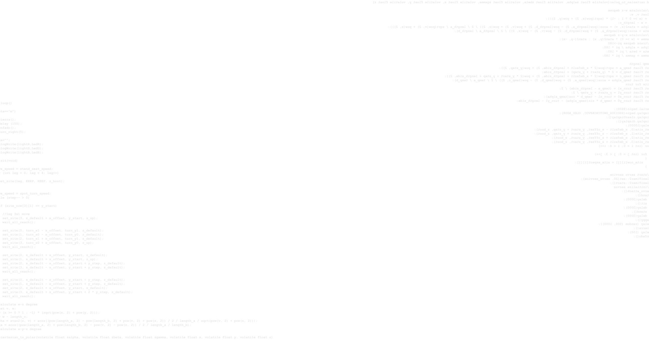
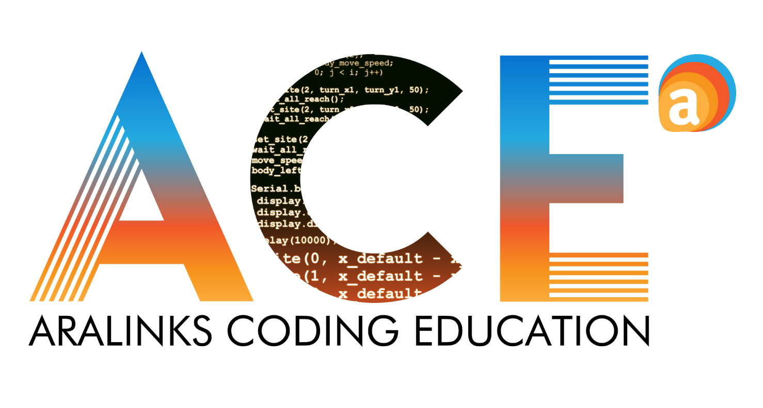

Slide 2
Python GUI:
Body Mass Index
Notes:
Classroom Background for opening slide. AF Vector with speech balloon “This session we will create…..”

Slide 3
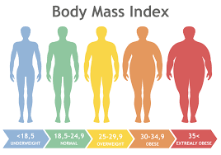
PYTHON
Body Mass Index is a weight-to-height ratio, calculated by dividing one weight in kilograms by the square of height in meters. And can be indicate a specific BMI Classification.
Notes:
AF vector, speech balloon with the text ”What is BMI?”.

Slide 4
PYTHON
BMI | Classification
<18.5 | Underweight
18.5 - 24.9 | Normal Weight
25.0 - 29.9 | Overweight
30.0 - 34.9 | Class I Obesity
35.0 - 39.9 | Class II Obesity
≥40 | Class III Obesity
Notes:
AF vector, speech balloon with the text ”This is BMI Classification”.

Slide 5
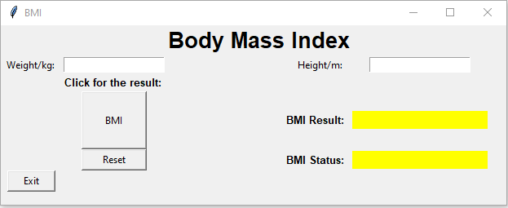
PYTHON
Body Mass Index Calculator with classification Python GUI.
Notes:
AF vector, speech balloon with the text ”This session we will create Python GUI project that can calculate your BMI and BMI classification”.

Slide 6
LETS CODE
Notes:
AF vector.

Slide 7
CODE
Open your Thonny Python IDE
Notes:
AF vector, speech balloon with the text ”Open your Thonny Python IDE”.

Slide 8
CODE
Copy the code into Python IDE and read all the comments (#) function of the codes.
Notes:
AF Vector with speech balloon “Reminder”.

Slide 9
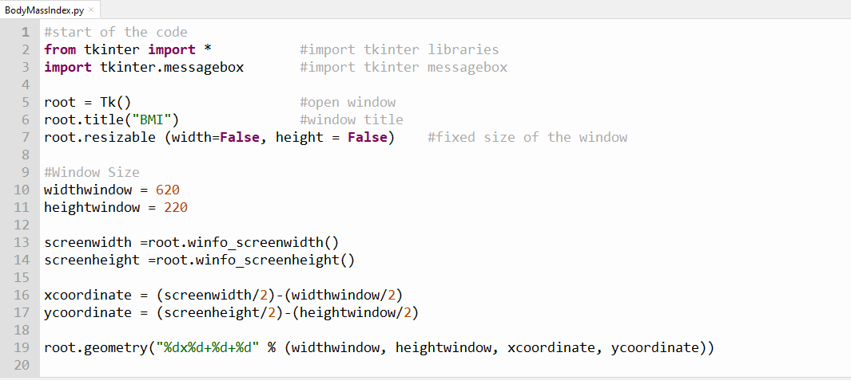
CODE
Note: This is the start of the code, import tkinter libraries to be able to run the function of GUI codes including the GUI window.
Notes:
Each picture of code, may checkbox. Once na check na yon ng student (it means na done na sila pag copy ng code) automatic mag iiba yung pic of code sa next code until ma tapos na yung code.

Slide 10
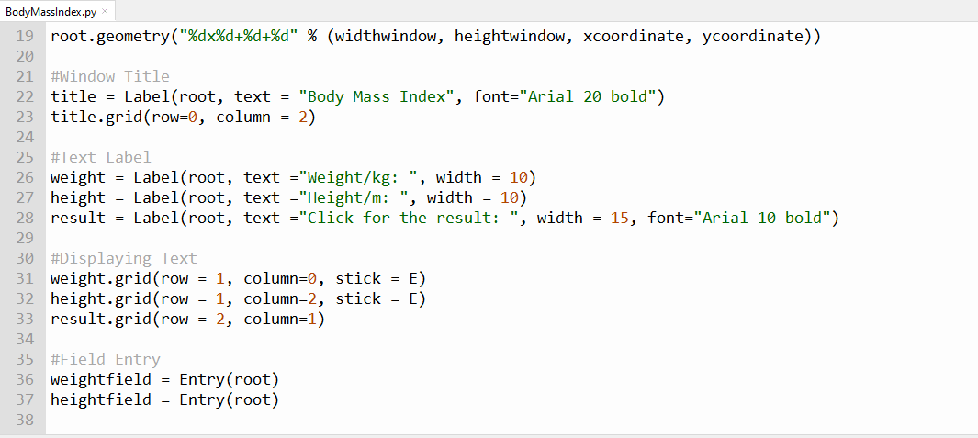
CODE

Slide 11
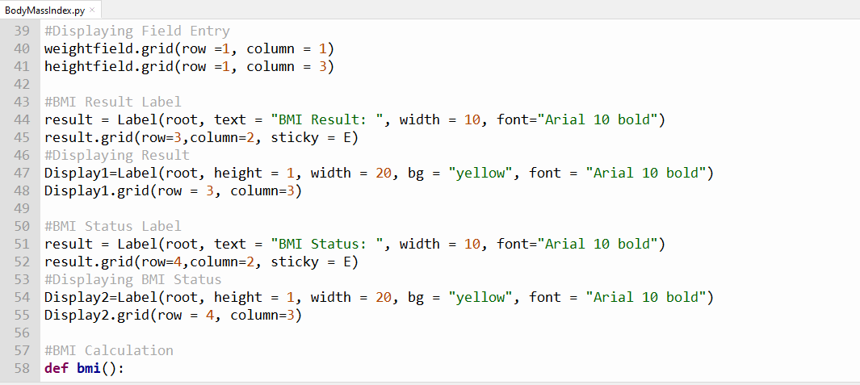
CODE

Slide 12
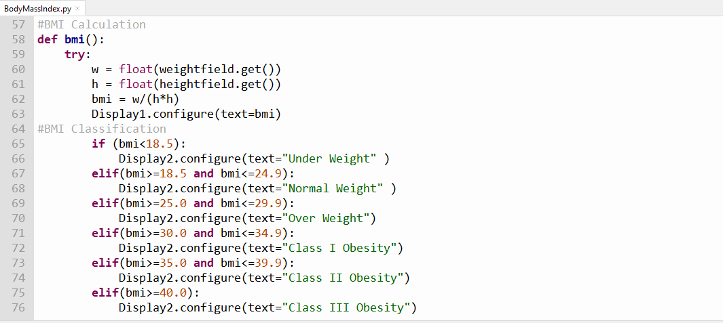
CODE

Slide 13
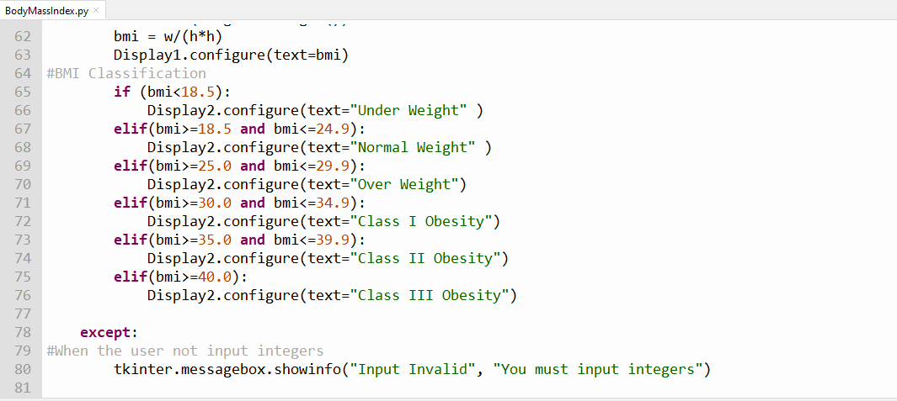
CODE

Slide 14
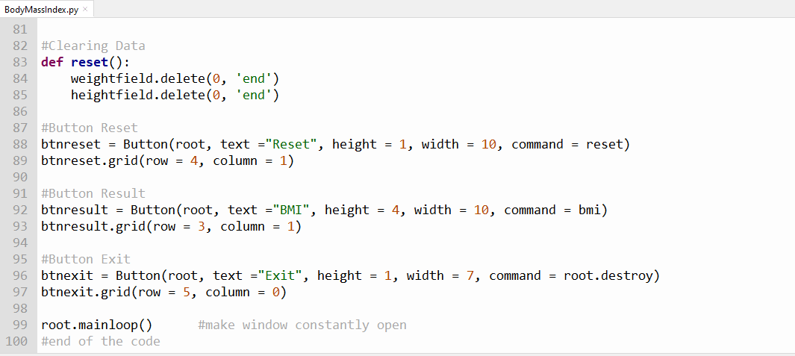
CODE

Slide 15
CODE
Save your Thonny Python IDE File
Notes:
AF vector, speech balloon with the text ”Save your Thonny Python IDE”.

Slide 16
CODE
Run your Thonny Python IDE File.
You can press F5 to run your program.
Notes:
AF vector with speech balloon “Run your project”.

Slide 17
OUTPUT
Input your data
Notes:
AF vector with speech balloon “Now calculate your BMI, you can try and input data to GUI”.

