Slide 1
UT2. Developing Interfaces Using XAML
Interface Development

Slide 2
Index
Developing user interfaces​​
Components
Interface development tools​​
Containers
Interface Controls
Associating actions with events​
Dialogues manners and non -manners
Code editing​
Classes , properties and methods

Slide 3
Lenguajes de descripción de interfaces basados en XML. XAML
XAML is a markup language​ used for creating interfaces in the Microsoft .NET Framework programming model . Applications created will be able to run in Windows environments .
Using XAML you can they can create it that HE know as RIA ( Rich Interface Applications) that contain abundant material chart .
XAML consists of a series of XML elements to represent the main components graphics , so such as layout , panels , and event handlers . You can become programming directly the interface through a text editor , or through the development environment​ chart .

Slide 4
Interface description languages​​ XML- based . XAML
Performing calculations​​ HE add in a archive independent . This allows the development team and the design team work separately , without interfering mutually in their job .
Mapping process :​​ performed at runtime , the interface elements are​ connect to objects in the .NET framework and attributes to properties of these objects to integrate them into the application . To facilitate the translation of XAML to .NET code, a .NET code has been created a relationship for each XAML element with a .NET class .

Slide 5
Interface description languages​​ XML- based . XAML
XAML : “ Xtensible Application Markup Language”
Microsoft
Based on XML that define objects and their properties .
Syntax → define the UI for the “Windows Presentation Foundation" (WPF)
Application code independence .​​
Tutorials : http://www.scriptol.com/xaml/

Slide 6
XML-based interface description languages. XAML
WPF ( Windows Presentation Foundation ). It is a series of assemblies and tools of the .NET framework . It is intended to provide an API ( Application Programming Interface ) to create user interfaces​ rich and sophisticated for Windows.
Combine different development platforms . Take​ development things​ web , rich internet applications or RIA (from the English Rich Internet Applications) and of course the development of applications for Windows .
From web development it inherits the use of a meta tag language for UI graphical interface development and styles . Of the applications RIA inherits the graphics vector , animations and multimedia support .
In addition to contributions from other platforms , WPF incorporates new Features as 3D support , typography advanced and documents similar to PDF.

Slide 7
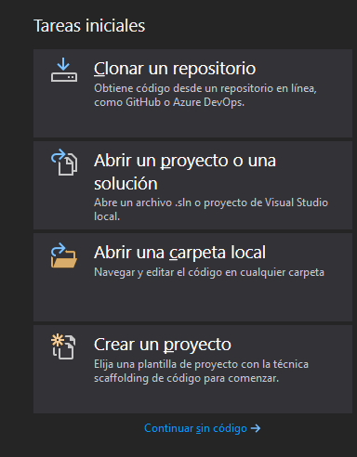
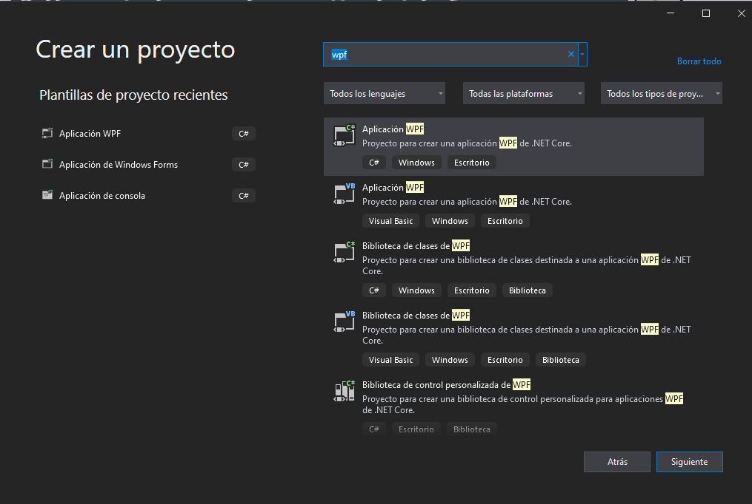
XML-based interface description languages. XAML
Create a new WPF “Hello World” project

Slide 8
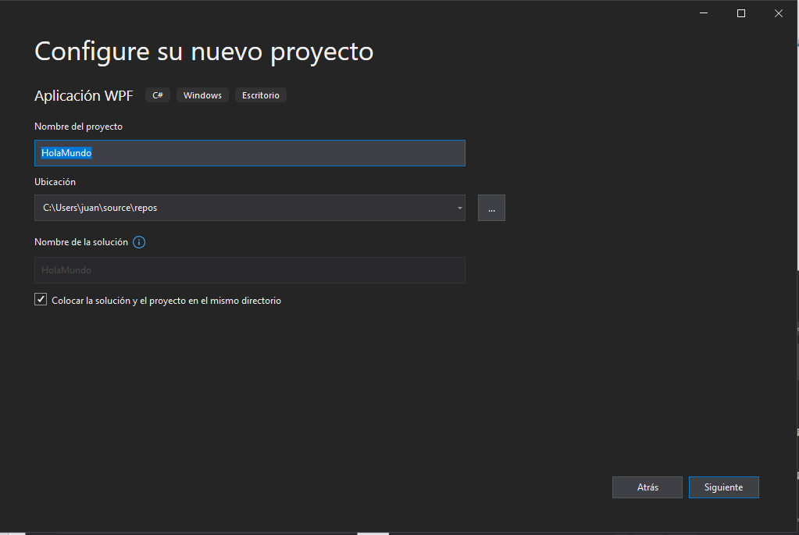
Lenguajes de descripción de interfaces basados en XML. XAML
Crear un nuevo proyecto WPF ”Hola Mundo”

Slide 9
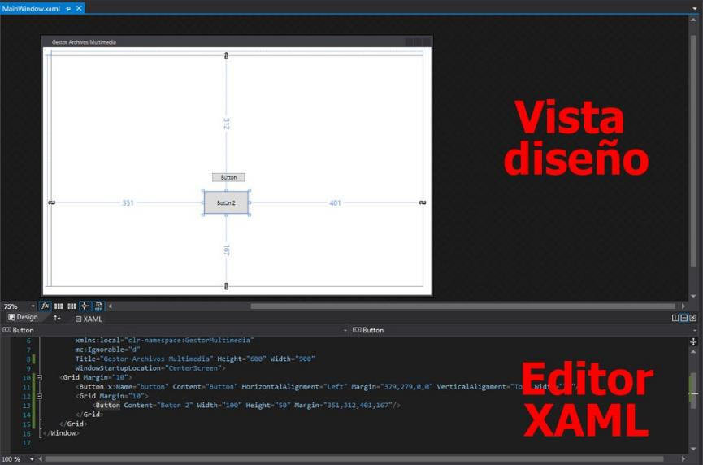
XML-based interface description languages. XAML
WPF “Hello World” Project Views

Slide 10
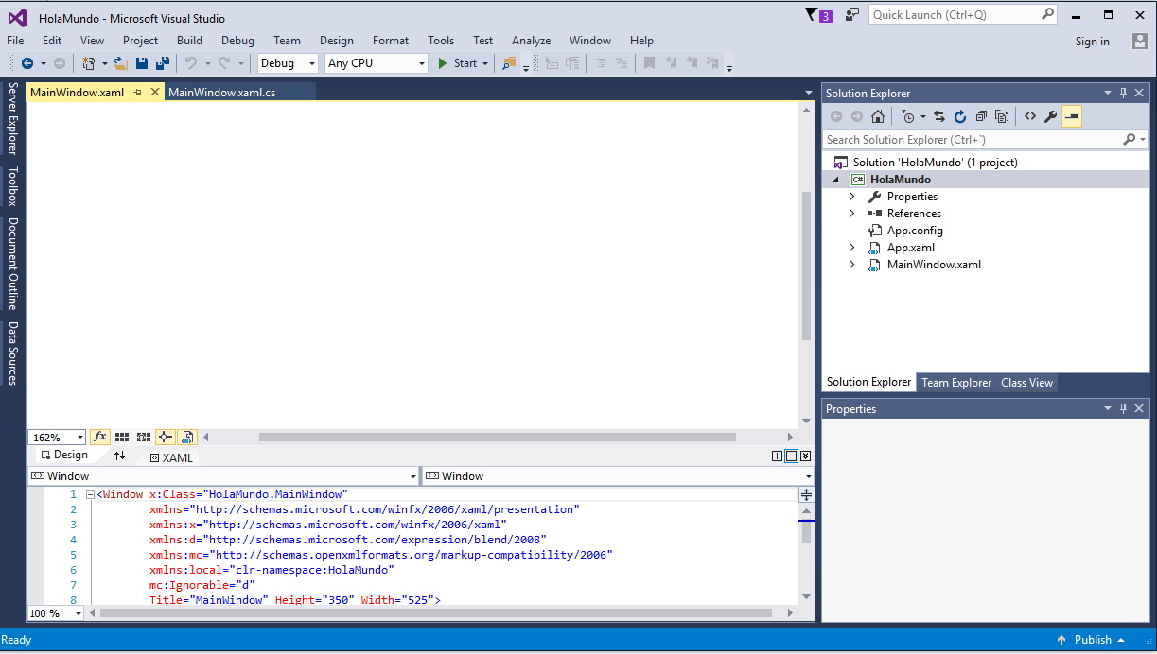
XML-based interface description languages. XAML
WPF “Hello World” Project Views
View
Controller
View XAML file

Slide 11
XML-based interface description languages. XAML
In the XAML document , we see a XML document in which the element root is Window . In the own label Window HE include the attributes that define the window that will create .
Within this​ label root we see the container main interface components . By default will be of type Grid .
If we add a label and a button to the interface , from the Toolbox menu , we will see that VS add two new tags in the XAML document that represent the < Label > and < Button > components . The text of each control HE find in the field Content of your label corresponding , although can also be edited from the Properties panel . By double - clicking on the button , the file appears Controller to define the event Click that also will appear in the XML document .
Although initially does not appear defined , it is convenient put a name Name all controls to identify them​

Slide 12
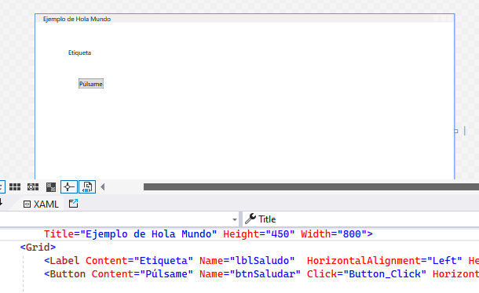
XML-based interface description languages. XAML
WPF “Hello World” Project Views

Slide 13
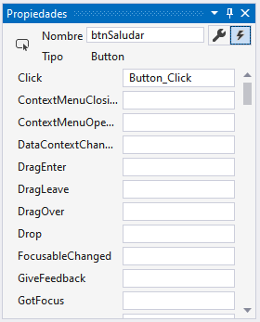
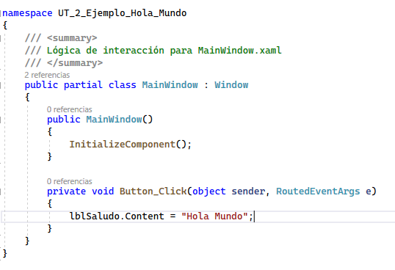
XML-based interface description languages. XAML
WPF “Hello World” Project Views

Slide 14
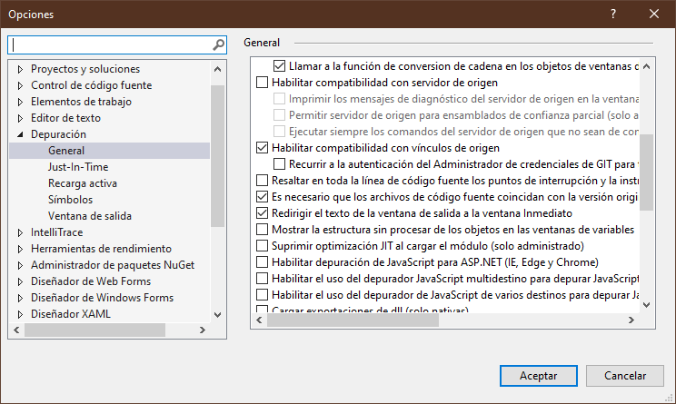
XML-based interface description languages. XAML
“ Hello World” Project Views
Debug menu → Options
To get show messages​ Debug.WriteLine (””) in the window Immediate .

Slide 15
Interface description languages​​ based on XML. XAML. MVC architecture
The MVC architecture is based on separating the code into three layers different , limited by their responsibility , in the that HE They call Models , Views and Controllers .​​​​
Models → It is the layer where HE works with data ( files , databases , network, ... )
Views → Display of user interfaces ( graphical interface , text mode interface , ... )
Drivers → Contains the code necessary to respond to actions that HE request in the application ( link between views and models )​

Slide 16
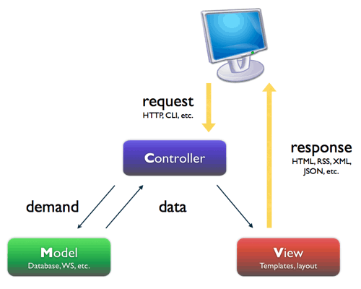
Interface description languages​​ based on XML. XAML. MVC architecture

Slide 17
Interface description languages​​ based on XML. XAML. MVC architecture
The user performs a application that reaches the controller .​
The controller communicates with both models as with views . To the models them requests data or them send carry out data updates . To the views them request departure​ corresponding , a time HE have performed the operations relevant according to business logic . File with extension​ .xaml.cs​ It is the part of the programming code .
To produce the output , sometimes the views they can request further information to the models .
The views send the output to the user . It is the Design view in the file .xaml​

Slide 18
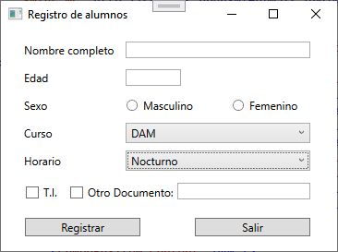
Interface description languages​​ XML - based . XAML. Student registration interface example

Slide 19
XML-based interface description languages. XAML. Student registration interface example
<Window x:Class="Ejemplos.MainWindow" xmlns="http://schemas.microsoft.com/winfx/2006/xaml/presentation" xmlns:x="http://schemas.microsoft.com/winfx/2006/xaml" xmlns:d="http://schemas.microsoft.com/expression/blend/2008" xmlns:mc="http://schemas.openxmlformats.org/markup-compatibility/2006" xmlns:local="clr-namespace:Ejemplos" mc:Ignorable="d" Title="Registro de alumnos" Height="280" Width="380"> <Grid> <Label Content="Nombre completo" HorizontalAlignment="Left" Margin="20,10,0,0" VerticalAlignment="Top"/> <TextBox HorizontalAlignment="Left" Margin="135,14,0,0" Text="" TextWrapping="Wrap" VerticalAlignment="Top" Width="200"/> <Label Content="Edad" HorizontalAlignment="Left" Margin="20,40,0,0" VerticalAlignment="Top"/> <TextBox HorizontalAlignment="Left" Margin="135,44,0,0" Text="" TextWrapping="Wrap" VerticalAlignment="Top" Width="60"/> <Label Content="Sexo" HorizontalAlignment="Left" Margin="20,70,0,0" VerticalAlignment="Top"/>

Slide 20
XML-based interface description languages. XAML. Student registration interface example
<RadioButton Content="Masculino" HorizontalAlignment="Left" Margin="135,76,0,0" VerticalAlignment="Top"/> <RadioButton Content="Femenino" HorizontalAlignment="Left" Margin="250,76,0,0" VerticalAlignment="Top"/> <Label Content="Curso" HorizontalAlignment="Left" Margin="20,100,0,0" VerticalAlignment="Top"/> <ComboBox HorizontalAlignment="Left" Margin="135,102,0,0" VerticalAlignment="Top" Width="200"> <ComboBoxItem Content="SMR"/> <ComboBoxItem Content="DAM"/> <ComboBoxItem Content="DAW"/> <ComboBoxItem Content="ASIR"/> </ComboBox> <Label Content="Horario" HorizontalAlignment="Left" Margin="20,130,0,0" VerticalAlignment="Top"/>

Slide 21
XML-based interface description languages. XAML. Student registration interface example
<ComboBox HorizontalAlignment="Left" Margin="135,132,0,0" VerticalAlignment="Top" Width="200"> <Button Content="Diurno"/> <CheckBox Content="Vespertino"/> <RadioButton Content="Nocturno"/> </ComboBox> <CheckBox Content="T.I." HorizontalAlignment="Left" Margin="26,170,0,0" VerticalAlignment="Top"/> <CheckBox Content="Otro Documento:" HorizontalAlignment="Left" Margin="74,170,0,0" VerticalAlignment="Top"/> <TextBox HorizontalAlignment="Left" Margin="191,167,0,0" TextWrapping="Wrap" Text="" VerticalAlignment="Top" Width="144"/> <Button Content="Registrar" HorizontalAlignment="Left" Margin="26,205,0,0" VerticalAlignment="Top" Width="125"/> <Button Content="Salir" HorizontalAlignment="Left" Margin="210,205,0,0" VerticalAlignment="Top" Width="125"/> </Grid> </Window>

Slide 22
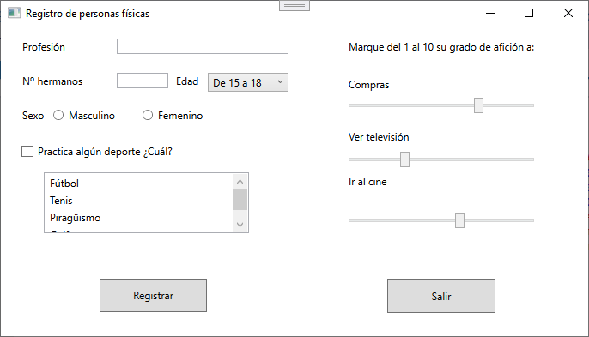
XML-based interface description languages. XAML. Example of a registration interface for individuals

Slide 23
XML-based interface description languages. XAML. Dialog box example
public partial class MainWindow : Window { public MainWindow(){ InitializeComponent(); } private void btnSaludar_Click(object sender, RoutedEventArgs e) { MessageBox.Show("Hola " + txtNombre.Text); } private void btnSalir_Click(object sender, RoutedEventArgs e){ App.Current.Shutdown(); } }

Slide 24
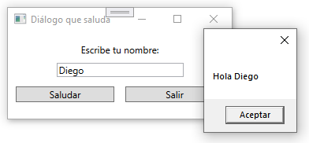
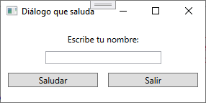
XML-based interface description languages. XAML. Dialog box example
< Window x : Cl ...
... Title ="Dialogue that greets" Height ="150" Width ="300" >
<Grid> <Label Name="lblInstrucciones" Content="Escribe tu nombre:" HorizontalAlignment="Center" Margin="0,10,0,0" VerticalAlignment="Top"/> <TextBox Name="txtNombre" HorizontalAlignment="Center" Width="161" Margin="0,40,0,0" TextWrapping="Wrap" VerticalAlignment="Top"/> <Button Name="btnSaludar" Content="Saludar" Margin="10,70,0,0" HorizontalAlignment="Left" VerticalAlignment="Top" Width="125" Click="btnSaludar_Click"/> <Button Name="btnSalir" Content="Salir" HorizontalAlignment="Right" Margin="0,70,10,0" VerticalAlignment="Top" Width="125"/> </Grid> </Window>

Slide 25


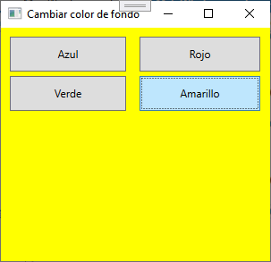
XML-based interface description languages. XAML. Other examples
Copy a value of a field to another . Use the attribute Text
Heartbeat counter on​ a button . Use the attribute Content
Change background color of the application . Use the attribute Background and class SolidColorBrush

Slide 26
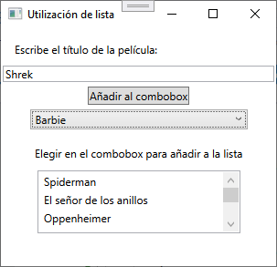
XML-based interface description languages. XAML. Example of adding to a list and selecting an item
btn Add_Click :
cmb Movies.Items.Add(txt Movie.Text );
cmb Movies_SelectionChanged:
lstMovies.Items.Add(cmbMovies.SelectedValue);

Slide 27
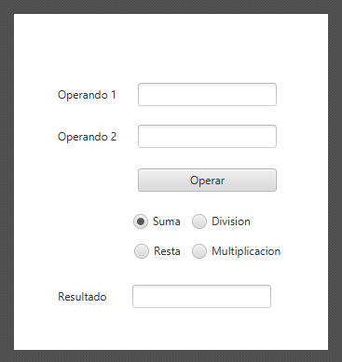
XML-based interface description languages. XAML. Example of a calculator with four operations

Slide 28
XML-based interface description languages. XAML. Containers.
Container Grid : It is the default container , it has a style table with rows and columns . Allows split the content into rows , each one with a broad that can be different , and columns , which have each a a high that also can be variable . The first that HE will do will be define the rows and columns , and a time defined We place the elements through the properties Grid.Row and Grid.Column .
It has the ability to merge both rows as columns .
Their sizes They can be absolute , in pixels , relative , in percentages , or automatic , using the *
If we want do variable some column or row we can use the control GridSplitter .

Slide 29
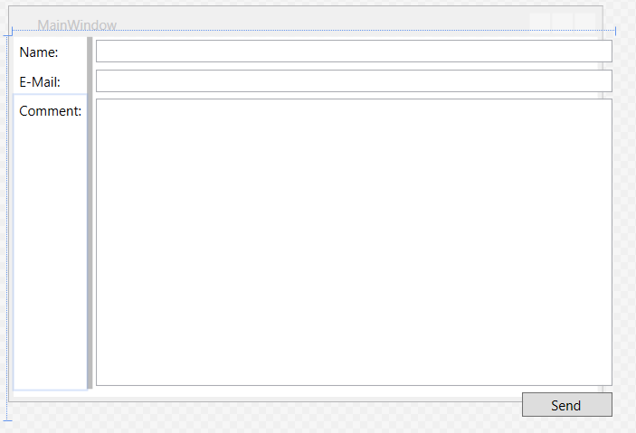
XML-based interface description languages. XAML. Containers. Grid

Slide 30
Lenguajes de descripción de interfaces basados en XML. XAML. Contenedores. Grid
<Grid>
<Grid.RowDefinitions>
<RowDefinition Height="Auto" />
<RowDefinition Height="Auto" />
<RowDefinition Height="*" />
<RowDefinition Height="28" />
</Grid.RowDefinitions>
<Grid.ColumnDefinitions>
<ColumnDefinition Width="Auto" />
<ColumnDefinition Width="Auto" />
<ColumnDefinition Width="*" />
</Grid.ColumnDefinitions>
<Label Grid.Row="0" Grid.Column="0" Content="Name:"/>
<Label Grid.Row="1" Grid.Column="0" Content="E-Mail:"/>
<Label Grid.Row="2" Grid.Column="0" Content="Comment:"/>
<GridSplitter HorizontalAlignment="Right"
VerticalAlignment="Stretch"
Grid.RowSpan="3" Grid.Column="1" ResizeBehavior="PreviousAndNext"
Width="5" Background="#FFBCBCBC"/>
<TextBox Grid.Column="2" Grid.Row="0" Margin="3" />
<TextBox Grid.Column="2" Grid.Row="1" Margin="3" />
<TextBox Grid.Column="2" Grid.Row="2" Margin="3" />
<Button Grid.Column="2" Grid.Row="3" HorizontalAlignment="Right"
MinWidth="80" Margin="3" Content="Send" />
</Grid>

Slide 31
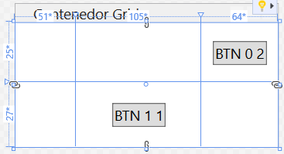
XML-based interface description languages. XAML. Containers. Example of a Grid designed with XAML
<Grid Name="contenedor"> <Grid.RowDefinitions> <RowDefinition Height="25*"/> <RowDefinition Height="27*"/> </Grid.RowDefinitions> <Grid.ColumnDefinitions> <ColumnDefinition Width="51*"/> <ColumnDefinition Width="105*"/> <ColumnDefinition Width="64*"/> </Grid.ColumnDefinitions> <Button Grid.Column="1" Grid.Row="1".../> <Button Grid.Column="2" Grid.Row="0".../> </Grid>

Slide 32
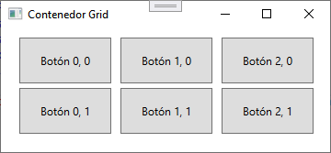
XML-based interface description languages. XAML. Containers. Adding controls to a Grid that is not divided into rows and columns.
for ( inte i = 0 ; i < 3 ; i ++ ) { for ( int j = 0 ; j < 2 ; j++ ) { Button button = new Button ( ) ; button.Width = 100; button.Height = 50; button.Content = " Button " + i + ", " + j; button.HorizontalAlignment = HorizontalAlignment.Left ; button.VerticalAlignment = VerticalAlignment.Top ;
// Placement of controls depends // his alignment and margin of each control
button.Margin = new Thickness (20 + i * 110, 10 + j * 55, 0, 0); container.Children.Add ( button ); } }

Slide 33
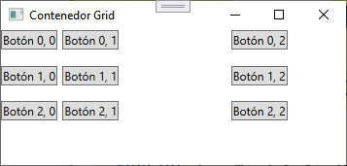
XML-based interface description languages. XAML. Containers. Adding controls to a Grid divided into rows and columns
for ( int i = 0; i < 3; i++) { for ( int j = 0; j < 3; j++) {
Button button = new Button(); button.Content = " Button " + i + ", " + j; button.HorizontalAlignment = HorizontalAlignment.Left ; button.VerticalAlignment = VerticalAlignment.Top ;
// Placement of controls It depends on the methods // static SetRow and SetColumn of the class Grid
Grid.SetRow ( button , i); Grid.SetColumn ( button , j); container.Children.Add ( button ); } }

Slide 34
XML-based interface description languages. XAML. Containers
UniformGrid : Distribution of elements in a matrix square uniform , that is , according to the size of the objects that contains , distributes space proportionally to all .​​
works the same way as Grid but with the difference that all rows​ will have the same height and all columns the same​ broad .
It is used to create tables where the cells have dimensions similar . A time defined the rows and columns , the controls HE automatically placed​ according HE create .

Slide 35
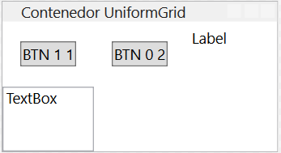
XML-based interface description languages. XAML. Containers. Example of UniformGrid designed with XAML
<UniformGrid Rows="2" Columns="3"> <Button Content="BTN 1 1".../> <Button Content="BTN 0 2".../> <Label Content="Label"/> <TextBox TextWrapping="Wrap".../> </UniformGrid>

Slide 36
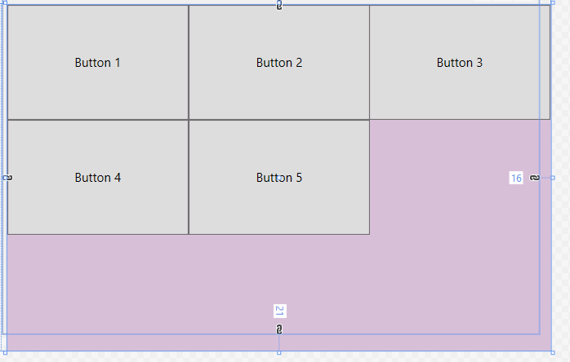
XML-based interface description languages. XAML. Containers. UniformGrid
< UniformGrid Background ="Thistle">
< Button Content ="Button 1"/>
< Button Content ="Button 2"/>
< Button Content ="Button 3"/>
<Button Content="Button 4"/>
<Button Content="Button 5"/>
</UniformGrid>

Slide 37
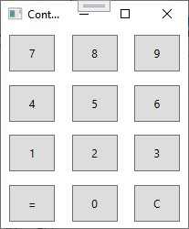
XML-based interface description languages. XAML. Containers. Adding controls to a UniformGrid
for (int i = 0; i < 4; i++){ for (int j = 0; j < 3; j++){ Button boton = new Button(); boton.Width = 50; boton.Height = 40; if (i == 3) switch (j){ case 0: boton.Content = "="; break; case 1: boton.Content = "0"; break; case 2: boton.Content = "C"; break; } else boton.Content = (9 - 3 * i) - (2 – j); boton.HorizontalAlignment = HorizontalAlignment.Center; boton.VerticalAlignment = VerticalAlignment.Center;
// Placement of controls It depends on the methods // static SetRow and SetColumn of the class Grid
Grid.SetRow ( button , i); Grid.SetColumn ( button , j); container.Children.Add ( button ); } }

Slide 38
XML-based interface description languages. XAML. Containers
Canvas . It is the most simple and intuitive for everyone . It imitates the features of a Windows Forms panel . It allows assign coordinates absolute where the (0,0) of the coordinate axis It is in the upper left corner . It is a location requires elements .​
The objects They are stacked on top of each other if we do not indicate his position absolute .
Define a area where each control son is positioned in coordinates absolute .
It is used when HE needs control absolute of the control positions .
I don't know I recommend use it unless you have some need special .

Slide 39
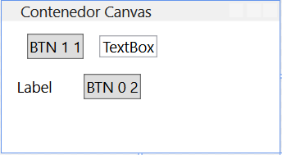
XML-based interface description languages. XAML. Containers. Example of Canvas designed with XAML
<Canvas Name="contenedor"> <Button Content="BTN 1 1" Canvas.Top="10" Canvas.Left="20".../> <Button Content="BTN 0 2" Canvas.Left="65" Canvas.Top="42".../> <Label Content="Label" Canvas.Left="7" Canvas.Top="39".../> <TextBox Canvas.Left="77" Canvas.Top="11".../> </Canvas>

Slide 40
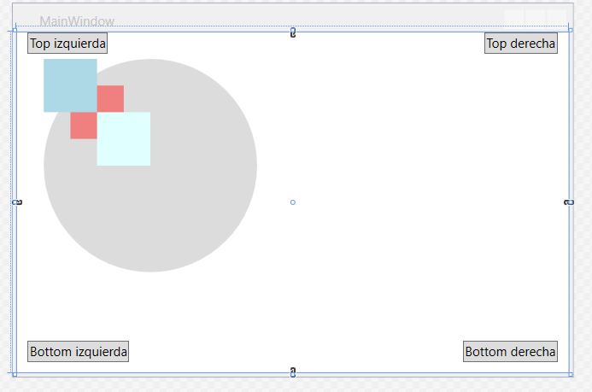
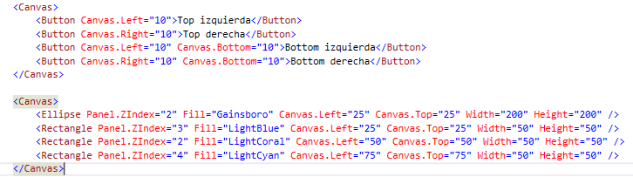
XML-based interface description languages. XAML. Containers. Canvas

Slide 41
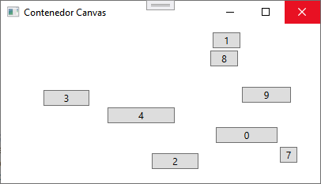
XML-based interface description languages. XAML. Containers. Adding components to a Canvas
Random random = new Random (); for ( inte i = 0 ; i < 10 ; i ++ ){ Button button = new Button(); button.Content = i; button.Width = random.Next (100); button.HorizontalAlignment = HorizontalAlignment.Center ; button.VerticalAlignment = VerticalAlignment.Center ;
// Placement of controls It depends on the methods // static SetLeft and SetTop of the class Canvas
Canvas.SetLeft ( button , random.Next ( ( int ) this.Width )); Canvas.SetTop ( button , random.Next ( ( int ) this .Height )); container.Children.Add ( button ); } }
Observations: Include a canvas (can be done manually) and include the form name “container”.

Slide 42
XML-based interface description languages. XAML. Containers
DockPanel : Position is relative to another​​ object son inside the container .
Allows couple controls mapping the screen into five different parts . The possible positions They are Top, Right, Bottom and Left ( Up , Down , Left and Right )
The fifth part will be the remaining space , normally in the center where HE will expand the last component to the area spare .
It is used to divide the window into zones with functionalities specific .

Slide 43
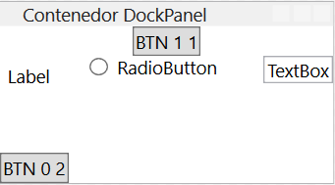
XML-based interface description languages. XAML. Containers. Example of DockPanel designed with XAML
<DockPanel Name="contenedor"> <Button Content="BTN 1 1" DockPanel.Dock="Top" .../> <Button Content="BTN 0 2" DockPanel.Dock="Bottom".../> <Label Content="Label" DockPanel.Dock="Left"/> <TextBox Text="TextBox" DockPanel.Dock="Right".../> <RadioButton Content="RadioButton" Width="95" .../> </DockPanel>

Slide 44
XML-based interface description languages. XAML. Containers
WrapPanel : The position of the objects children is sequential horizontal from left to right or vertical from top toward down . Does not adjust object sizes .
It is used to position controls one after the other , similar to how HE manage components in raw HTML documents .​
If missing space on the line move on to the next one .
You can configure so that HE do vertical .

Slide 45
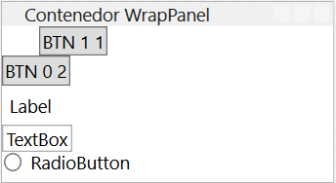
XML-based interface description languages. XAML. Containers. WrapPanel example designed with XAML
<WrapPanel Name="contenedor" Orientation="Vertical"> <Button Content="BTN 1 1" .../> <Button Content="BTN 0 2" .../> <Label Content="Label"/> <TextBox Text="TextBox" .../> <RadioButton Content="Radio .../> </WrapPanel>

Slide 46
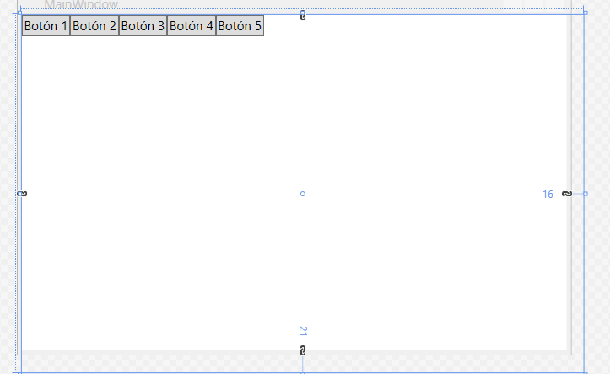
XML-based interface description languages. XAML. Containers. WrapPanel
< WrapPanel Orientation ="Horizontal">
< Button Content ="Button 1" />
< Button Content ="Button 2" />
< Button Content ="Button 3" />
<Button Content="Botón 4" />
<Button Content="Botón 5" />
</WrapPanel>

Slide 47
XML-based interface description languages. XAML. Containers
StackPanel : It is a container that stacks objects in a manner horizontal or vertical . By default HE stacked vertically but distributed​ about the entire surface .
It works similar to how it does WrapPanel but it does n't adapts if the controls occupy too much but HE expand .
Can​ stack horizontally​ modifying the attribute Orientation = ” Horizontal ”.
Each control HE stretch to occupy the entire space ( height or width , depending on your orientation ) according to HE need .

Slide 48
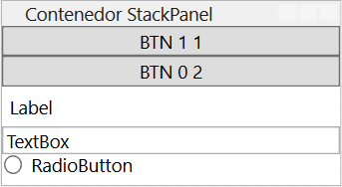
XML-based interface description languages. XAML. Containers. StackPanel example designed with XAML
<StackPanel Name="contenedor" Orientation="Vertical"> <Button Content="BTN 1 1"/> <Button Content="BTN 0 2"/> <Label Content="Label"/> <TextBox Text="TextBox" TextWrapping="Wrap"/> <RadioButton Content="RadioButton"/> </StackPanel>

Slide 49
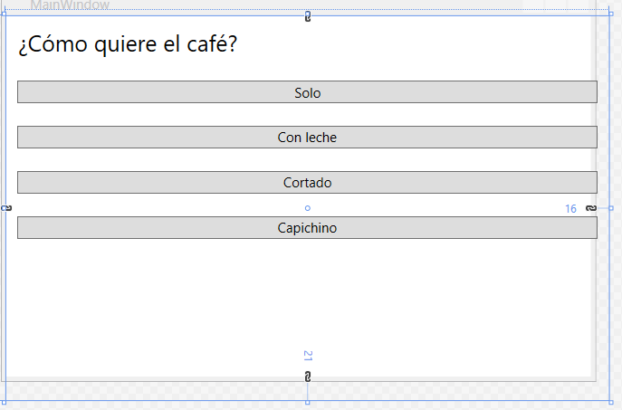
XML-based interface description languages. XAML. Containers. StackPanel
< StackPanel >
< TextBlock Margin ="10" FontSize ="20"> How would you like your coffee ? </TextBlock>
< Button Margin = "10" > Only </ Button >
<Button Margin="10">Con leche</Button>
<Button Margin="10">Cortado</Button>
<Button Margin="10">Capichino</Button>
</StackPanel>

Slide 50
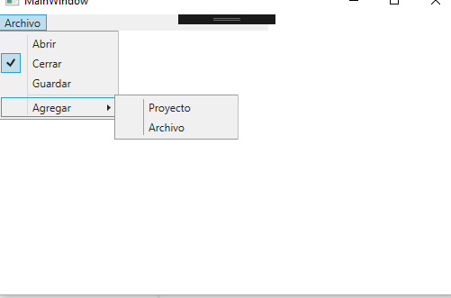
XML-based interface description languages. XAML. Containers. Menu
< Menu Name ="menu1" Width ="300" HorizontalAlignment ="Left" VerticalAlignment ="Top" >
< MenuItem Header ="_File" >
<MenuItem Header="A_brir" IsCheckable="true" />
<MenuItem Header="_Cerrar" IsCheckable="true" IsChecked="True" />
<MenuItem Header="_Guardar" >
<MenuItem.Icon>
<Image Source="setup.ico" Width="16" Height="16" />
</MenuItem.Icon>
</MenuItem>
<Separator />
<MenuItem Header="A_gregar" >
<MenuItem Header="Proyecto" />
<MenuItem Header="Archivo" />
</MenuItem>
</MenuItem>
</Menu>

Slide 51
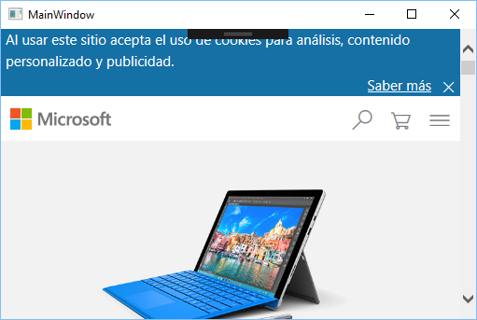
Lenguajes de descripción de interfaces basados en XML. XAML. Contenedores. Frame
<Grid>
<Frame Name="miFrame" Source="http://www.microsoft.com" />
</Grid>

Slide 52
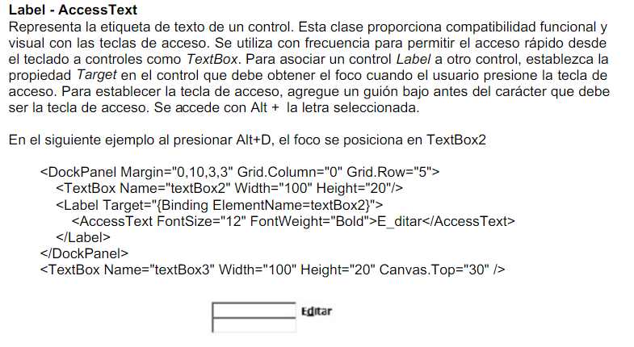
XML-based interface description languages. XAML. Controls. Label – Access Text

Slide 53
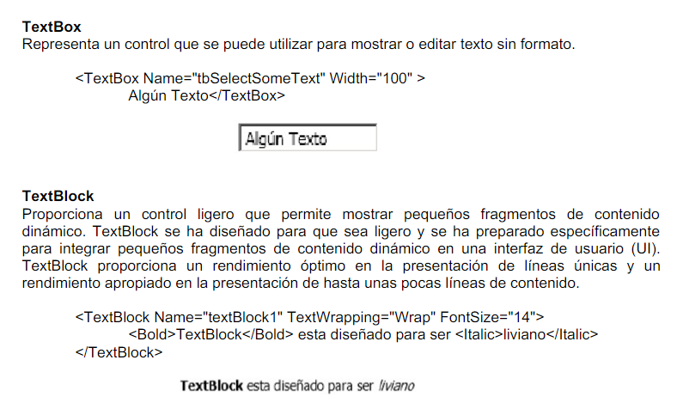
XML-based interface description languages. XAML. Controls. TextBox and TextBlock

Slide 54
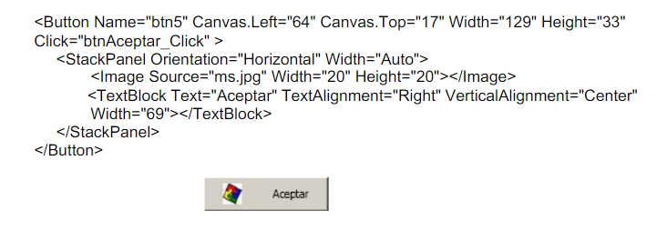
XML-based interface description languages. XAML. Controls. Button
Button
Its content property is Content and its main event is
Click. The following example shows a button containing an image and text made up of contained controls.

Slide 55
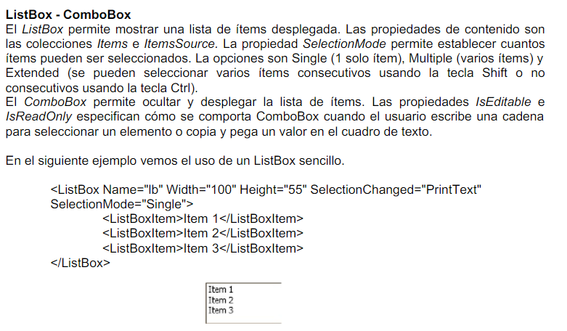
XML-based interface description languages. XAML. Controls. ListBox and ComboBox

Slide 56
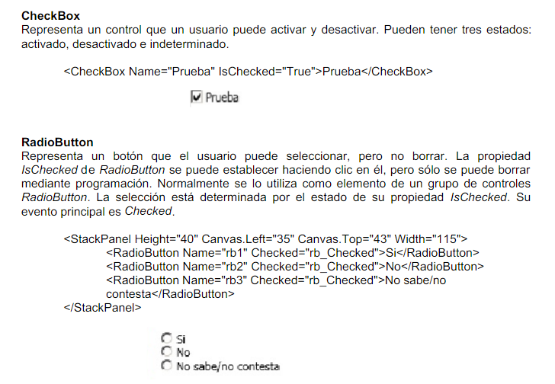
XML-based interface description languages. XAML. Controls. CheckBox and RadioButton

Slide 57
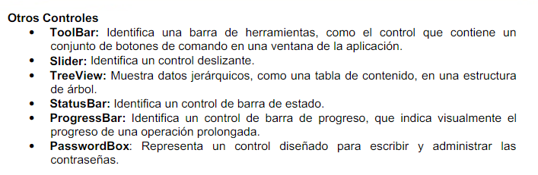
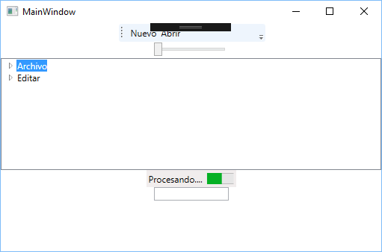
XML-based interface description languages. XAML. Advanced controls

Slide 58
XML-based interface description languages. XAML. Advanced controls
>
<StackPanel>
<ToolBar Height="26" Name="toolBar1" Width="200" >
<Button>
<Image Source="setup.ico"/>
</Button>
<Button>Nuevo</Button>
<Button>Abrir</Button>
</ToolBar>
<Slider Height="21" Name="slider1" Width="100" />
<TreeView Height="150">
<TreeViewItem Header="Archivo">
<TreeViewItem Header="Nuevo" />
<TreeViewItem Header="Abrir" />
<TreeViewItem Header="Cerrar" />
</TreeViewItem>
<TreeViewItem Header="Editar">
<TreeViewItem Header="Cortar" />
<TreeViewItem Header="Copiar" />
<TreeViewItem Header="Pegar" />
</TreeViewItem>
</TreeView>
<StatusBar Height="23" Name="statusBar1" Width="120" >
<TextBlock Height="15" Text="Procesando...." />
<ProgressBar Height="15" Name="progressBar1" Width="100" Value="20" />
</StatusBar>
< PasswordBox Name ="pwdBox" Width ="100" MaxLength ="64" PasswordChar ="*" />
</StackPanel>​​

Slide 59
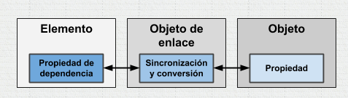
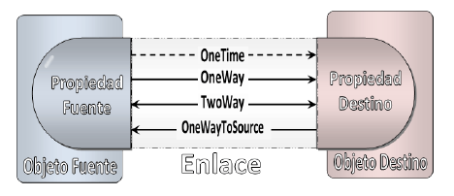
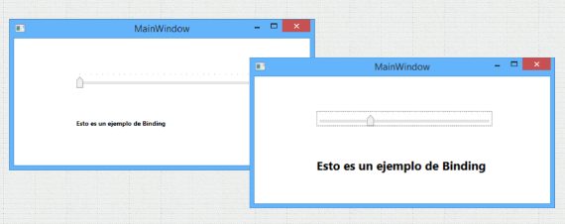
XML-based interface description languages. XAML. Data Binding - Example
Data binding is a mechanism that establishes a connection between the graphical user interface of an application and the data provided by objects belonging to the business logic of that application.
<Slider Name="MiSlide" HorizontalAlignment="Left"
<TextBlock Name="LblEjemploTexto"
FontSize="{Binding ElementName=MiSlide, Path=Value,Mode=TwoWay}"

Slide 60
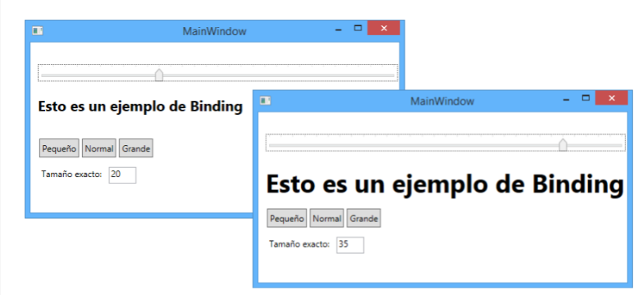
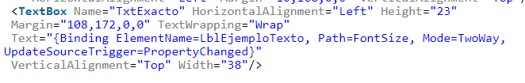
XML-based interface description languages. XAML. Data Binding - Example

Slide 61
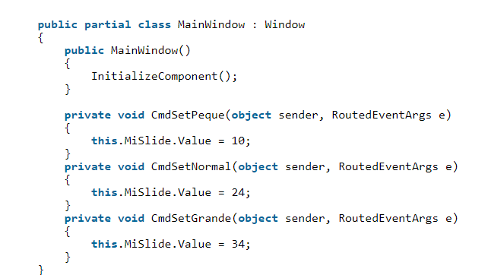
XML-based interface description languages. XAML. Data Binding - Binding data - Example

Slide 62
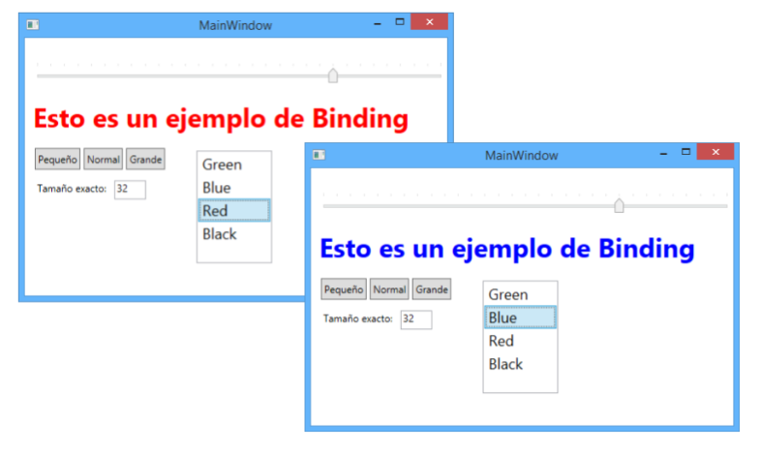
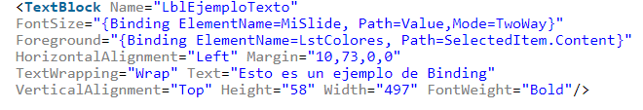
XML-based interface description languages. XAML. Data Binding – Example 2

Slide 63

XML-based interface description languages. XAML. Data Binding – Example 2

Slide 64

XML-based interface description languages. XAML. Data Binding – Example 3

Slide 65


XML-based interface description languages. XAML. Data Binding – Example 3
https://wpf.csharp.com.es/binding/

Slide 66

XML-based interface description languages. XAML. Data Binding – Example 4
< Grid >
<StackPanel>
<ListBox x:Name="lbProvincias" Width="248" Height="80">
<ListBoxItem Content="Buenos Aires"/>
<ListBoxItem Content="Córdoba"/>
<ListBoxItem Content="Mendoza"/>
<ListBoxItem Content="Salta"/>
<ListBoxItem Content="Neuquen"/>
</ListBox>
<TextBlock Width="248" Height="24" Text="Provincia elegida:" />
<TextBlock Width="248" Height="24">
< TextBlock.Text >
< Binding ElementName ="lbProvinces" Path ="SelectedItem.Content"/>
</ TextBlock.Text ></ TextBlock >
</StackPanel>​​
</ Grid >

Slide 67


XML-based interface description languages. XAML. Example of filling out a combobox
1.a) We create the User class

Slide 68

XML-based interface description languages. XAML. Example of filling out a combobox
1.b) We create the interface

Slide 69

XML-based interface description languages. XAML. Example of filling out a combobox
1.c) We give functionality to the button

Slide 70

XML-based interface description languages. XAML. Example of filling out a combobox
2.a) We select the SelectionChanged event and implement the code
lblSelected.Content = cmbUsers.SelectedItem.ToString();

Slide 71

XML-based interface description languages. XAML. Example of replicating a TextBox in a Label
<Label x:Name="lblLabel" Content="{ Binding ElementName=txtBox, Path=Text}" HorizontalAlignment="Left" VerticalAlignment="Top" Margin="153,130,0,0" Width="320"/>

Slide 72
XML-based interface description languages. XAML. Mirror example using Binding
Let 's create a imitator , as if it were a mirror .
We will have two pairs of element sets​ separated ( you can wear a separator ) and when us we click on a element or we write in a field , it has to change the other side.
For example , if I I have a text field and I write in it , the text field What is your reflection also will receive that text .
Only know can modify on one side, the other set is not can modify , that is , it is not bidirectional .

Slide 73

XML-based interface description languages. XAML. Mirror example using Binding

Slide 74
XML-based interface description languages. XAML. Example of using Slider
We have a object colored rectangle​​​ blue . Also have three objects Slider . Each of them change ownership​ height , width and opacity of the rectangle .
We add it slider's to set the color to the rectangle , and the brightness
RGB and A( brightness ) ( values between 0 and 255). Initialize the slider's to 0. If we put other worth will give issues already that the four They call the same method and some objects have not been created in the first method call .​

Slide 75

XML-based interface description languages. XAML. Example of using Slider

Slide 76



XML-based interface description languages. XAML. Example of use of InkCanvas
< Grid Background ="Yellow">
< InkCanvas x : Name ="lnkPizarra" Height ="400" Width ="250"/>
<Button x:Name="btnLimpiar" Content="Limpiar" HorizontalAlignment="Left" Margin="50,483,0,0" VerticalAlignment="Top" Height="34" Width="115" Click="btnLimpiar_Click"/>
<Button x:Name="btnSalir" Content="Salir" HorizontalAlignment="Left" Margin="193,483,0,0" VerticalAlignment="Top" Height="34" Width="107" Click="btnSalir_Click"/>
</Grid>

Slide 77
XML-based interface description languages. XAML. Example of use of InkCanvas
private void grosor_ValueChanged(object sender, RoutedPropertyChangedEventArgs<double> e)
{
paint.DefaultDrawingAttributes.Width = grosor.Value;
paint.DefaultDrawingAttributes.Height = grosor.Value;
}
private void ValueChanged(object sender, RoutedPropertyChangedEventArgs<double> e)
{
Brush brush = new SolidColorBrush(Color.FromArgb((Byte)sldbrillo.Value, (Byte)sldred.Value, (Byte)sldgreen.Value, (Byte)sldblue.Value));
SolidColorBrush scbrush = (SolidColorBrush)brush;
paint.DefaultDrawingAttributes.Color = scbrush.Color;
rectcolor.Fill = brush;
}

Slide 78


XML-based interface description languages. XAML. Login Form Example
When you place the mouse pointer over the button

Slide 79

XML-based interface description languages. XAML. Login Form Example

Slide 80
XML-based interface description languages. XAML. Login Form Example
<Grid>
<TextBlock HorizontalAlignment="Left" Height="48" Margin="0,62,0,0" Text="Sig in" TextWrapping="Wrap" VerticalAlignment="Top" TextAlignment="Center"
FontFamily="Arial"
FontSize="40"
FontWeight="Bold"
Foreground="#FF534C4C" Width="440"/>
<TextBox HorizontalAlignment="Center" Height="38" Margin="0,149,0,0" Text="Username" TextWrapping="Wrap" VerticalAlignment="Top" Width="362"
FontSize="26"
BorderBrush="{x:Null}"
Background="#FFF6F6F6"
Foreground="DarkGray"
TextAlignment="Center"/>
<TextBox HorizontalAlignment="Center" Height="38" Margin="0,218,0,0" Text="Password" TextWrapping="Wrap" VerticalAlignment="Top" Width="362"
FontSize="26"
BorderBrush="{x:Null}"
Background="#FFF6F6F6"
Foreground="DarkGray"
TextAlignment="Center"/>
<Button Style="{DynamicResource RoundedButtonStyle}" Content="Login" HorizontalAlignment="Center" Height="62" Margin="0,288,0,0" VerticalAlignment="Top" Width="210"
Background="#FF64CCF1"
Foreground="White"
FontFamily="Arial"
FontSize ="20"/>
</ Grid >

Slide 81

XML-based interface description languages. XAML. Login Form Example

Slide 82
XML-based interface description languages. XAML. Login Form Example
< Setter Property ="BorderThickness" Value ="0" />
<Border x:Name="border" CornerRadius="20" Background="{TemplateBinding Background}" BorderThickness="{TemplateBinding BorderThickness}" BorderBrush="{TemplateBinding BorderBrush}" SnapsToDevicePixels="true">
<Trigger Property="IsMouseOver" Value="true">
<Setter Property="Background" TargetName="border" Value="#EAB01E"/>
<Setter Property="BorderBrush" TargetName="border" Value="#EAB01E"/>
</Trigger>
<Trigger Property="IsPressed" Value="true">
<Setter Property="Background" TargetName="border" Value="#F1CA68"/>
< Setter Property ="BorderBrush" TargetName ="border" Value ="#F1CA68" />
</ Trigger >

Slide 83

XML-based interface description languages. XAML. Example of managing a people table
The following example will use a DataGrid control which is a table containing data. It initially has sample data that is not visible.

Slide 84

XML-based interface description languages. XAML. Example of managing a people table
The columns of the table HE must edit . It can be by creating a​ Data binding on the ItemSource that allows link the data to a database query , or any​​ other data source .​
To modify the columns We must press the button right and choose the type of control that HE wants use in this column

Slide 85
XML-based interface description languages. XAML. Example of managing a people table
Types of table columns​​ that HE they can select are :
DataGridCheckBoxColumn : CheckBox that HE used to show values booleans .
DataGridComboBoxColumn : ComboBox used to show a election of a listing .
DataGridHyperlinkColumn : Hyperlink that HE used to link to a URL
DataGridTemplateColumn : Allows use others types of components specific and personalized
DataGridTextColumn : Text string​

Slide 86
XML-based interface description languages. XAML. Example of managing a people table
In XAML, in the tag DataGrid , we add AutoGenerateColumns = " False " and we will remove the example data binding :
d : ItemsSource ="{ d : SampleData ItemCount = 5 }"
Besides we will add 3 columns of type text adding a Binding :
<DataGridTextColumn Header="Nombre" Binding="{Binding Nombre}" /> <DataGridTextColumn Header="Apellidos" Binding="{Binding Apellidos}" /> <DataGridTextColumn Header="Edad" Binding="{Binding Edad}" />
So that the header of each appears column in the table HE has to modify in the properties , in the section Header , the property Header
In the DataGrid properties HE they can edit header attributes​​ as column dimensions​

Slide 87

XML-based interface description languages. XAML. Example of managing a people table

Slide 88

XML-based interface description languages. XAML. Example of managing a people table
In order to add elements to the DataGrid HE must carry out several actions preparatory .
The first step will be create a new class that implement the elements that will be added to the list. In this case a class “ People ”
pressing the button right on the project we select Add → Class

Slide 89
XML-based interface description languages. XAML. Example of managing a people table
In the new class HE will create the attributes private corresponding to the columns of the table , in this case name , surname and age .
private String name ; private String lastnames ; private int age ;
To create the constructor we press the button right on the class name and choose​ Actions quick and refactorings … and then on to Generate builder ...
In the window that appears , we choose the fields that We want pass as parameter

Slide 90
XML-based interface description languages. XAML. Example of managing a people table
For each class attribute​ We choose again Actions quick and refactorings … and now We choose Encapsulate field : So We generate the Getters and Setters as properties accessible from the outside . If necessary , will add further members
public Person ( string name , string surnames , int age ) { this .name = name ; this .lastNames = lastNames ; this .age = age ; }
public string Name { get => name ; set => name = value ; } public string LastNames { get => lastNames ; set => lastNames = value ; } public int Age { get => age ; set => age = value ; }

Slide 91
XML-based interface description languages. XAML. Example of managing a people table
A time that HE has the class , it will create a list of objects of this type . It will be a member private class​ that contains the application .
Will represent the Model in the model MVP and will be the one will contain the list of datagrid items .
public partial class MainWindow : Window { private List<Persona> lstPersonas; public MainWindow(){ InitializeComponent(); lstPersonas = new List<Persona>(); dgvPersonas.ItemsSource = lstPersonas; }
private void btnAdd_Click ( object sender , RoutedEventArgs e){ lstPersons.Add ( new Person( txtFirstName.Text , txtLastName.Text , int .Parse ( txtAge.Text ))); dgvPersons.Items.Refresh (); } }

Slide 92
XML-based interface description languages. XAML. Example of managing a people table
The button Modify can be used to collect the data from the table . Later HE can add the functionality to modify from text fields originals . To collect the data from the DataGrid We use this code :
private void btnModify_Click ( object sender , RoutedEventArgs e) { Person perselected = (Person) dgvPersonas.SelectedItem ; txtName.Text = persElectida.Name ; txtLastNames.Text = persElected.LastNames ; txtAge.Text = persChosen.Age.ToString (); }

Slide 93
XML-based interface description languages. XAML. Example of managing a people table
In case of modifying the data from the very own table , these HE would modify the same time both in the datagrid as in the data warehouse .
The button Eliminate can be used to remove list and table records .
private void btnDelete_Click ( object sender , RoutedEventArgs e) { lstPersonas.Remove ((Person) dgvPersonas.SelectedItem ); dgvPersons.Items.Refresh (); }

Slide 94
Authors:
Diego J. Garcia
Rosa Maria Zapata Calle

