Slide 1
Course Project ”The Snake” game
Novosibirsk State University
Made by:
1st year students, group 21933
Babenko Egor Stepanovich
Ivanov Gleb Evgenievich
2022

Slide 2
Concept
Moving around playing field
The generating apples
Eating apples
Bumping into tail or into borders
Defeat
Victory
Moving “inside itself”

Slide 3
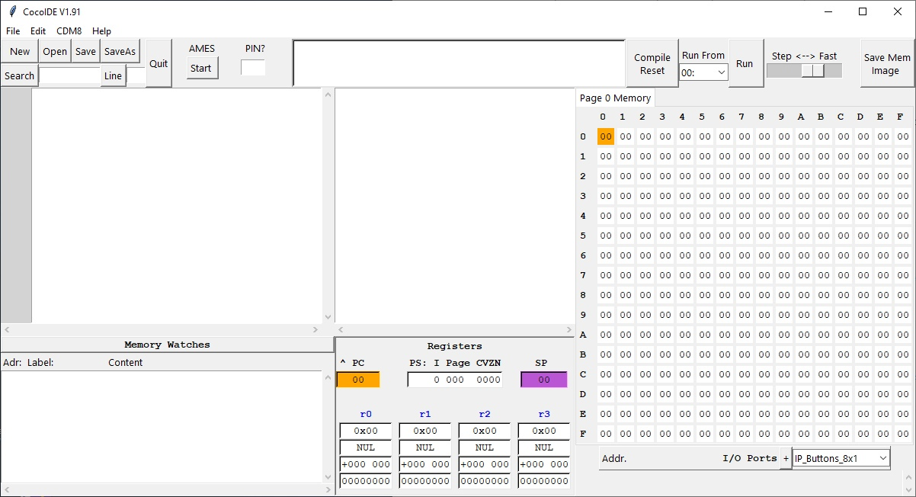
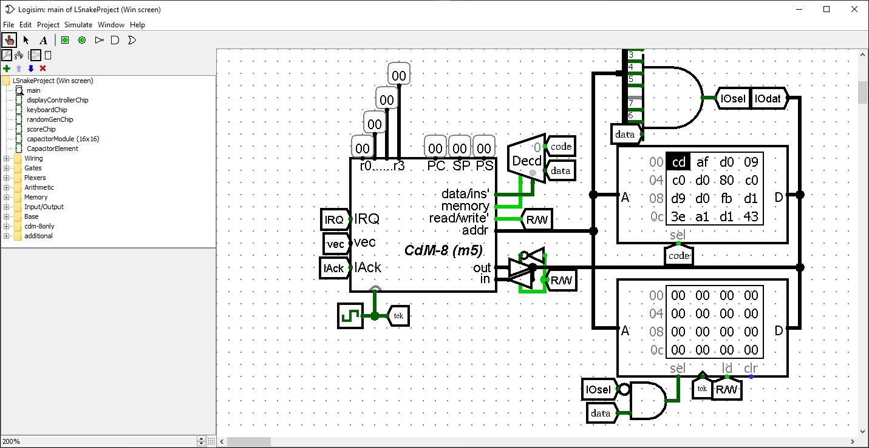
We used

Slide 4
Versions
Software version
Hardware version
Bot version
Game rules - software
Game rules - hardware
Game rules - hardware

Slide 5
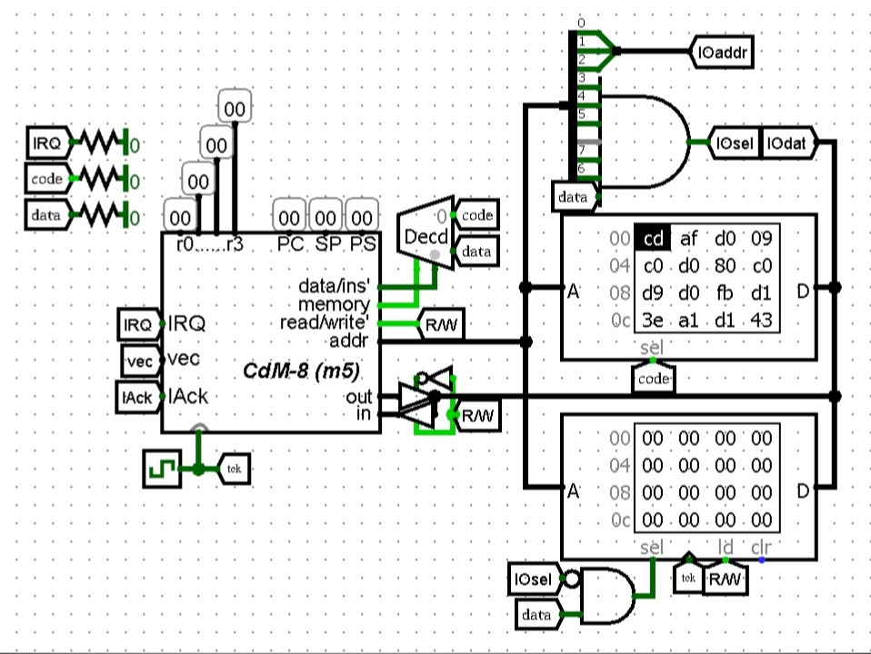
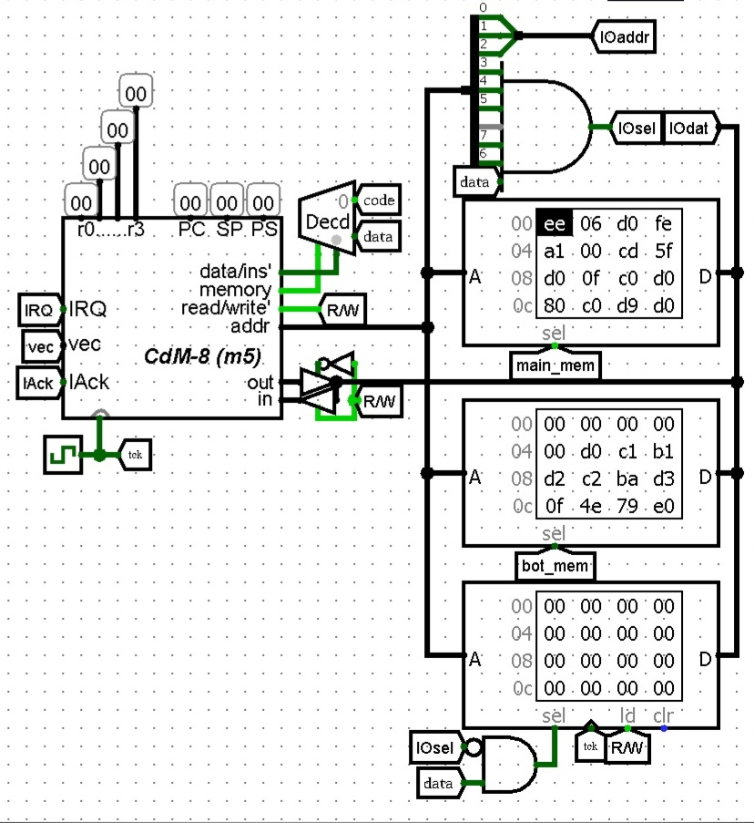
Processor

Slide 6
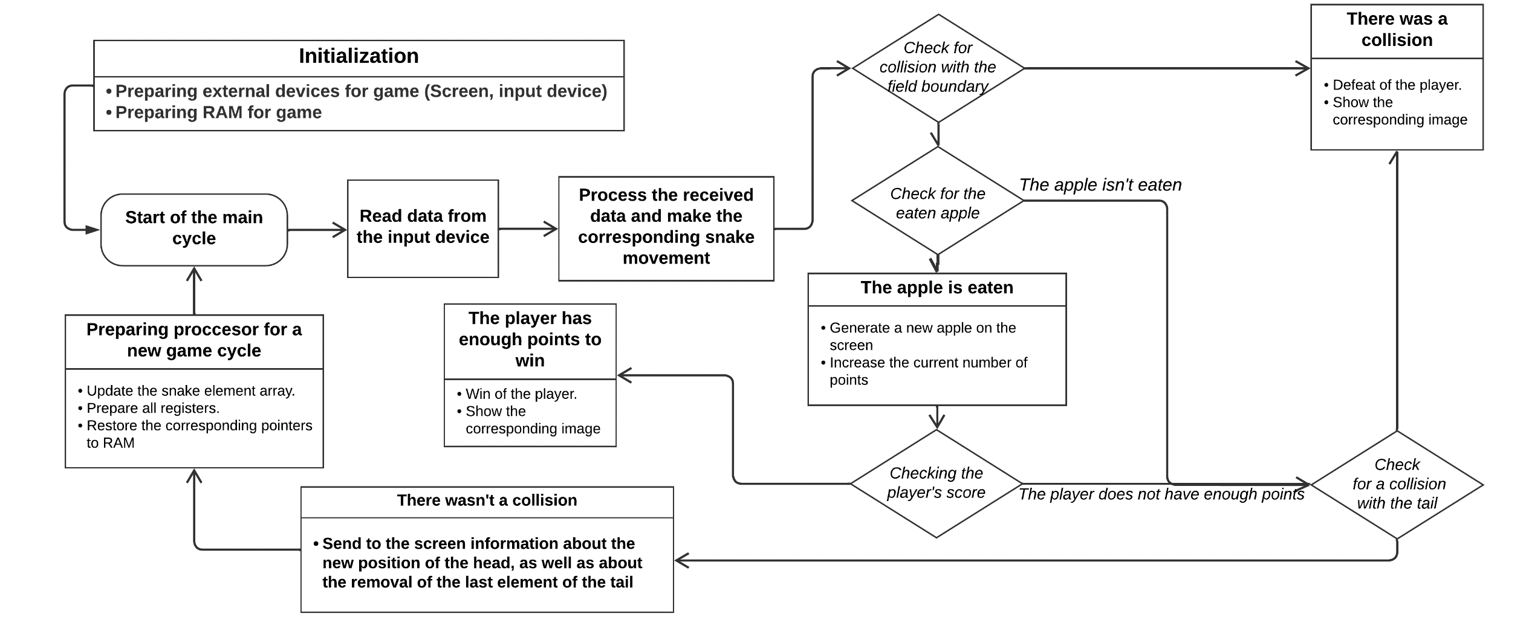
Software version

Slide 7
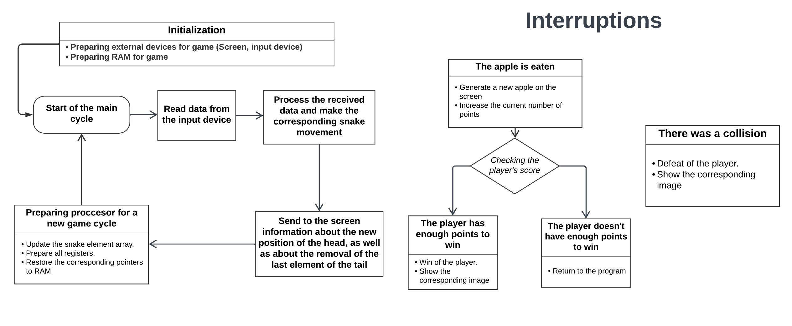
Hardware version

Slide 8
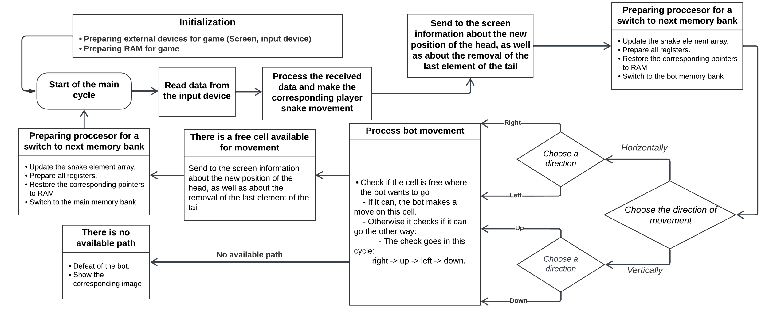
Bot version

Slide 9
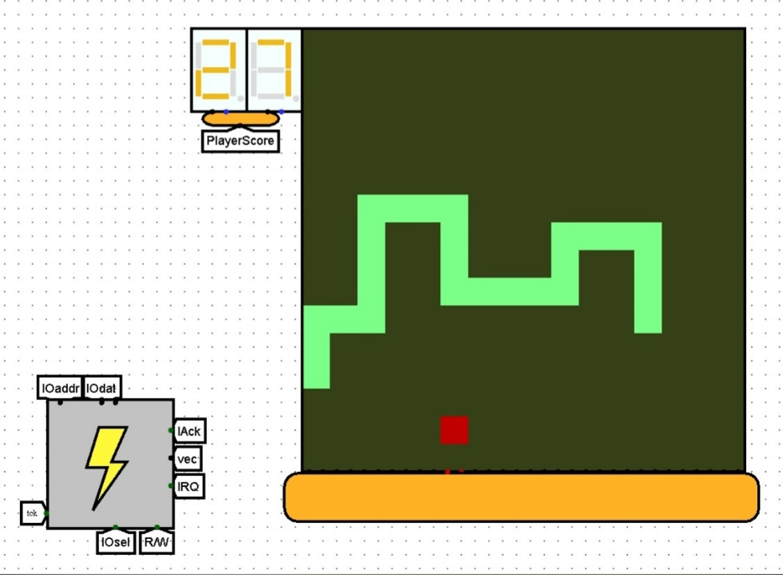
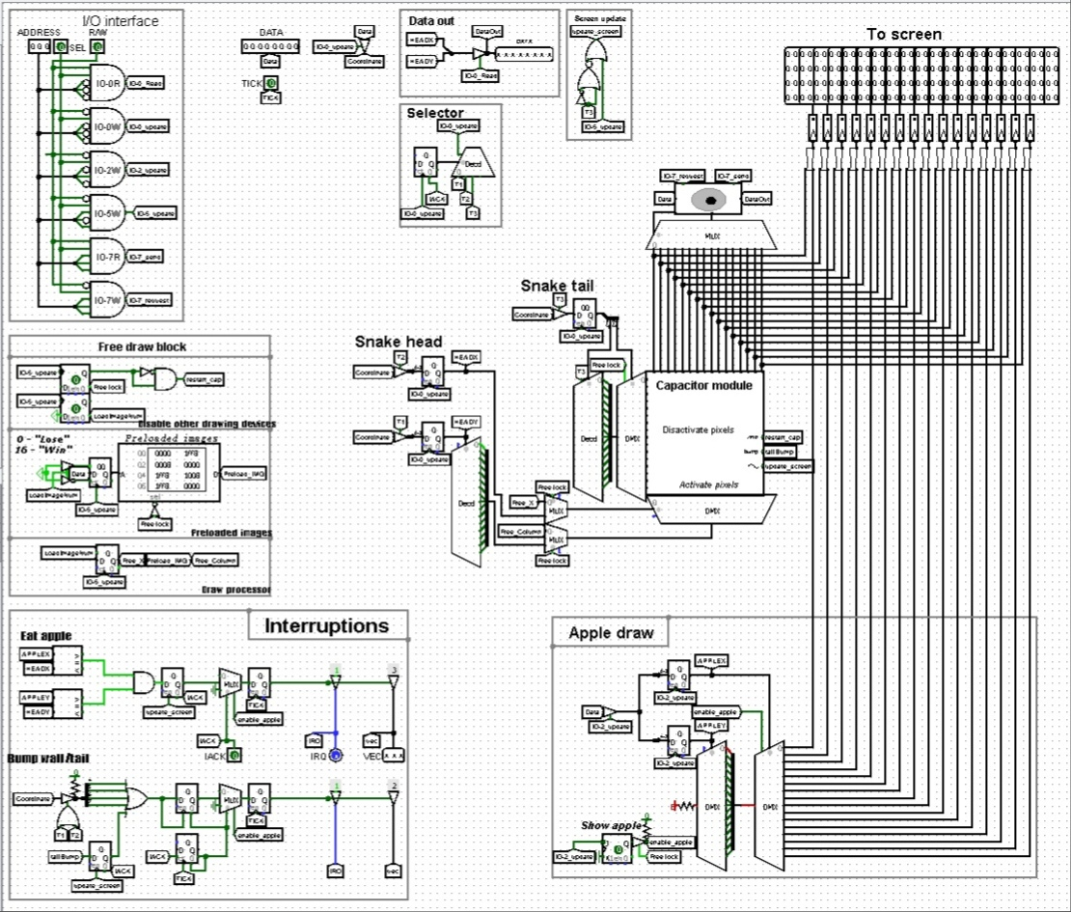
Display

Slide 10
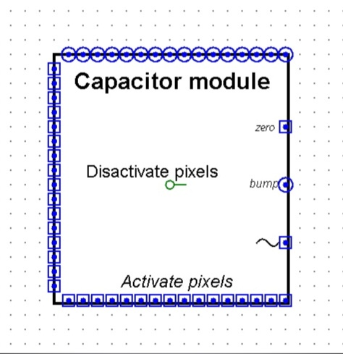
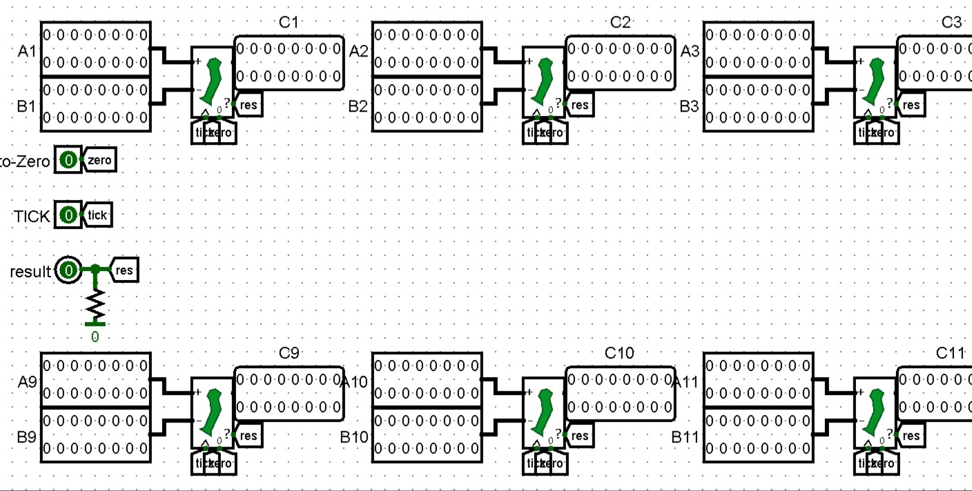
Capacitor module

Slide 11
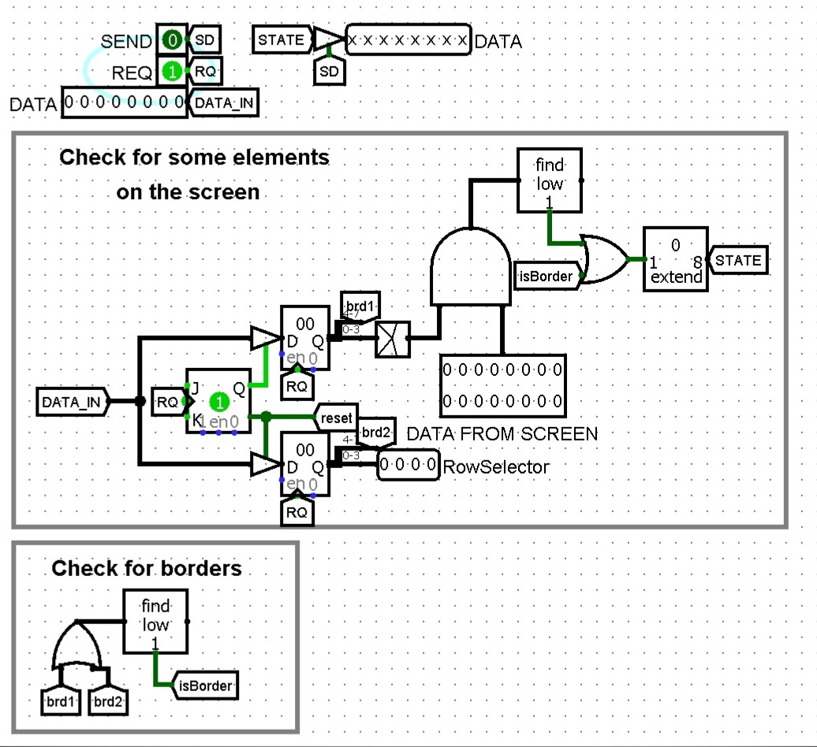
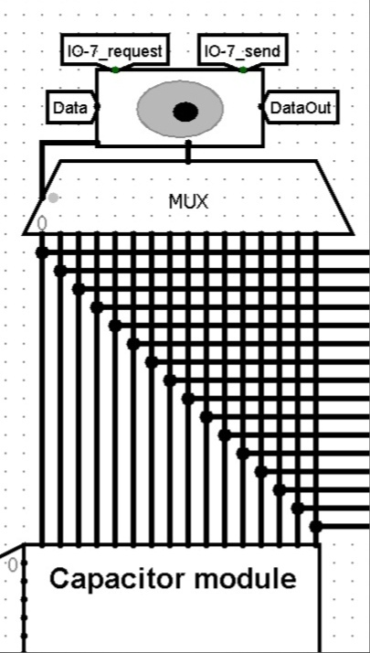
BotEyes

Slide 12
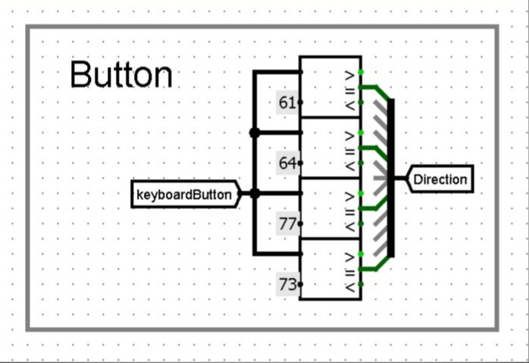
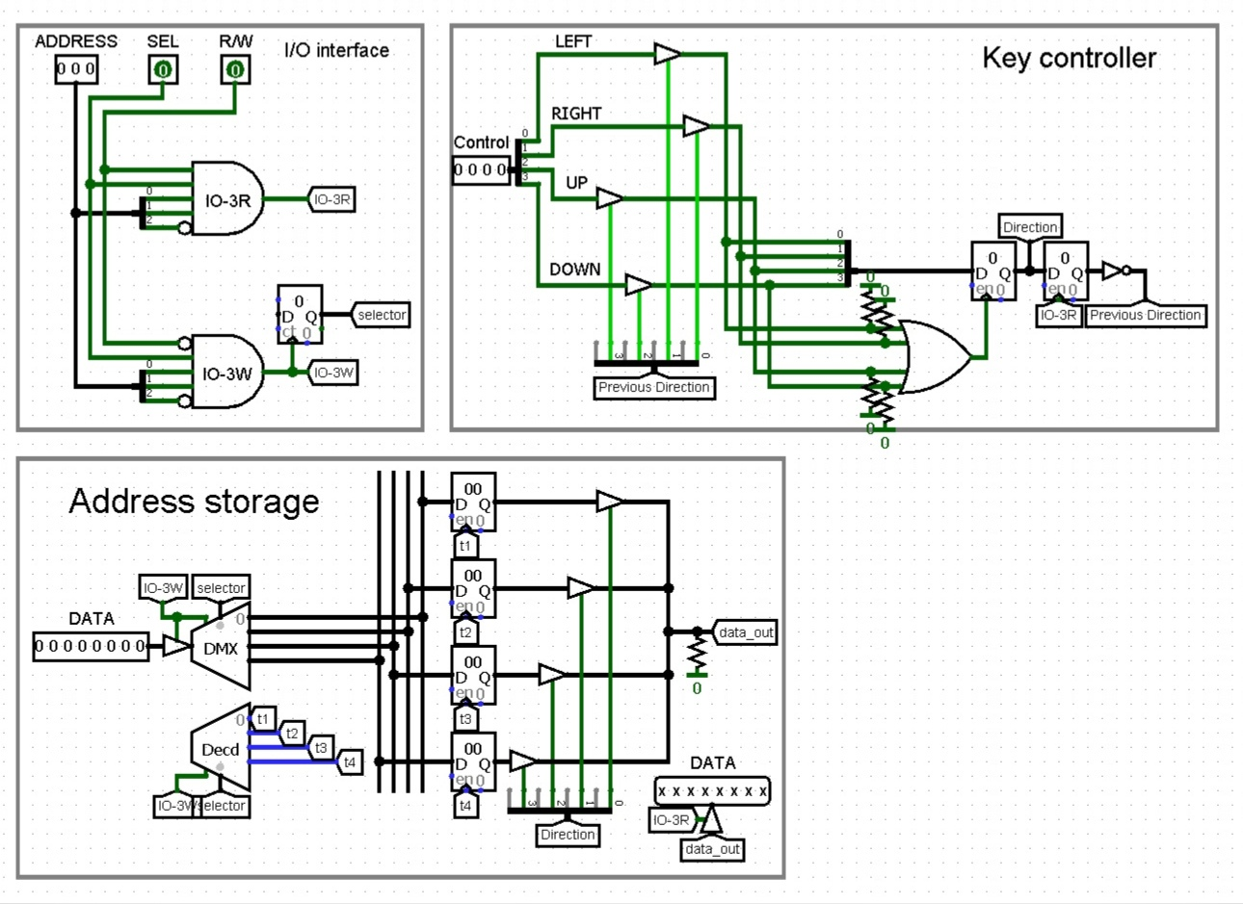
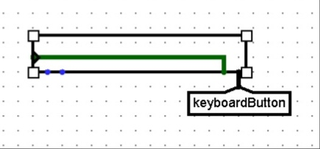
Keyboard

Slide 13
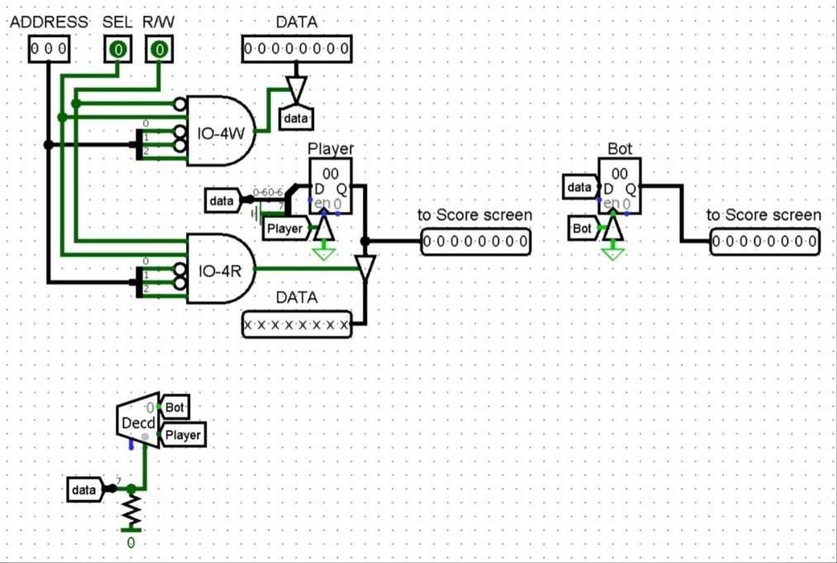
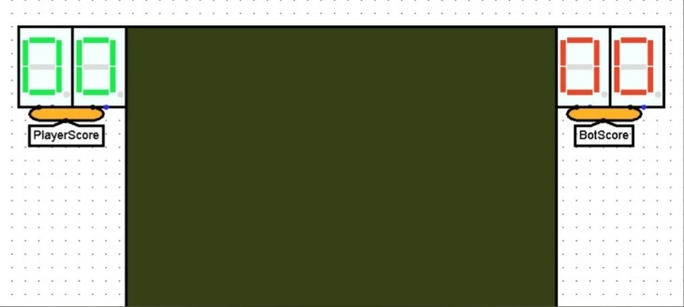
Displaying points

Slide 14
Results

Slide 15
Thanks for your attention!

