Slide 1
Welcome To My Presentation
Joy Dhar
ID: 16201063

Slide 2
ER DIAGRAM
admin_id
Last_name
Contact_no
username
server_id
First_name
username
address
password
password
email
admin_login
user_info
user_login
has
food_name
fid
cart
REGISTER
id
catagory
Belong to
Belong to
food_id
food
belong to
food_name
food_order
Order_id
Food_description
id
tag
food_price
food_catagory
fid
url
tag
fid

Slide 3
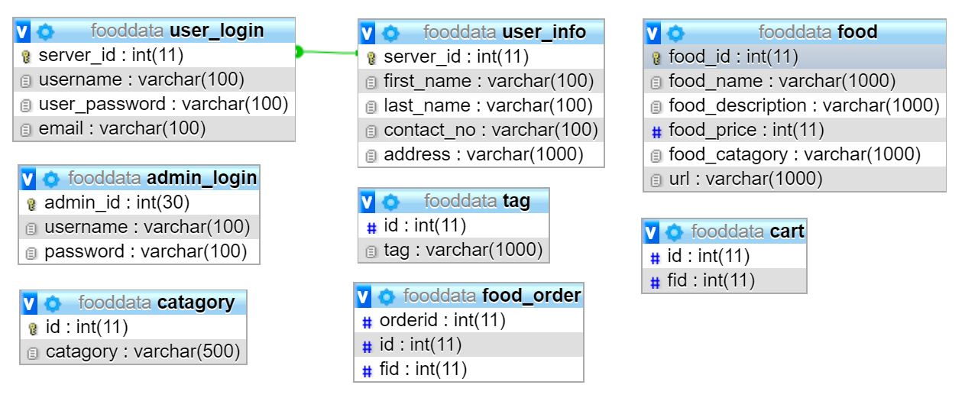
Table Diagram

