Slide 1

FundWise: AN Intelligent Crowdfunding Platform
Name: Jophine Paul C
Guide: Ms. Manju Joy
Roll No: 8

Slide 2


Objective
To create a next-generation crowdfunding platform integrating the MERN stack and Machine Learning to enhance project success rates, provide personalized investor recommendations, and detect fraudulent campaigns.

Slide 3

Existing System
- Traditional crowdfunding platforms focus solely on project listings.
- No intelligent mechanisms to predict success or suggest improvements.
- Lack of personalized recommendations for investors.
- Limited measures to detect fraudulent campaigns.

Slide 4
Proposed System
- Integrates Machine Learning to analyze project success potential.
- Provides personalized project recommendations to investors.
- Detects and flags fraudulent campaigns using AI.
- Offers actionable suggestions to improve campaigns.

Slide 5
Modules
User Management Module
Registration and Login
Project Posting
ML-Driven Project Success Prediction
Investor Recommendations
Fraud Detection
Payment Integration

Slide 6
Technologies Used
- Frontend: React.js
- Backend: Node.js, Express.js
- Database: MongoDB
- Machine Learning: Python (Flask)
- Tools: Scikit-learn, TensorFlow, Razorpay

Slide 7
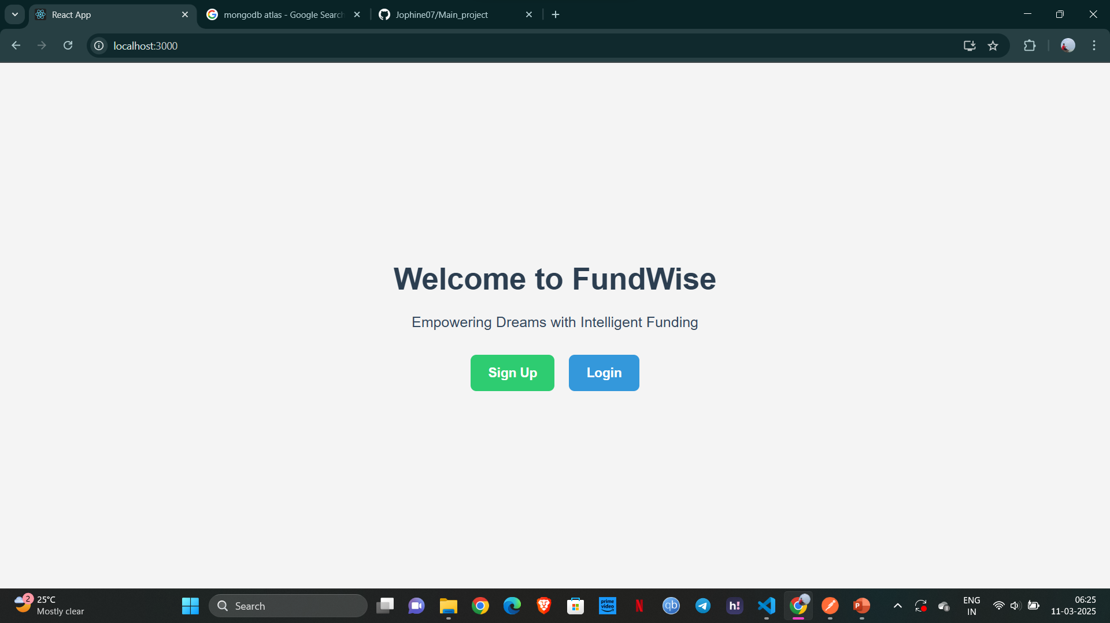
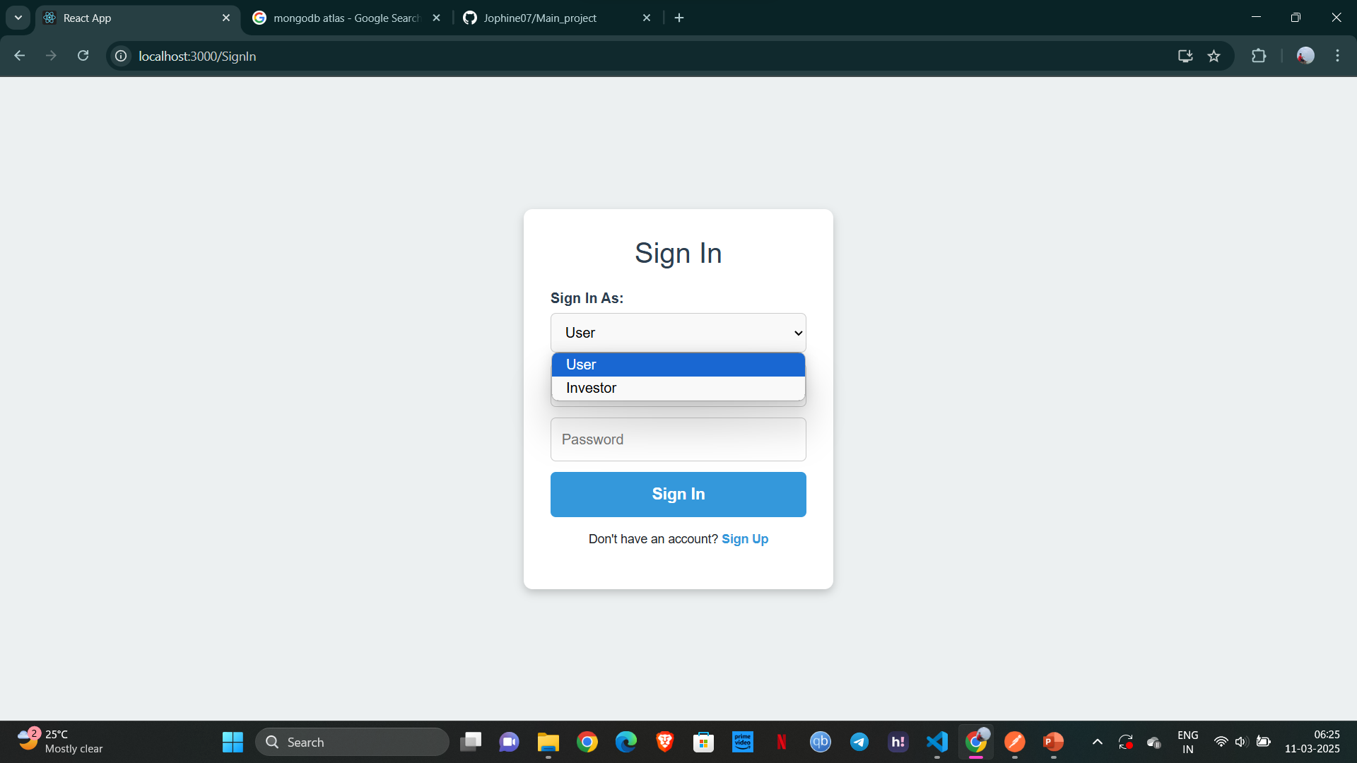
SCREENSHOTS

Slide 8
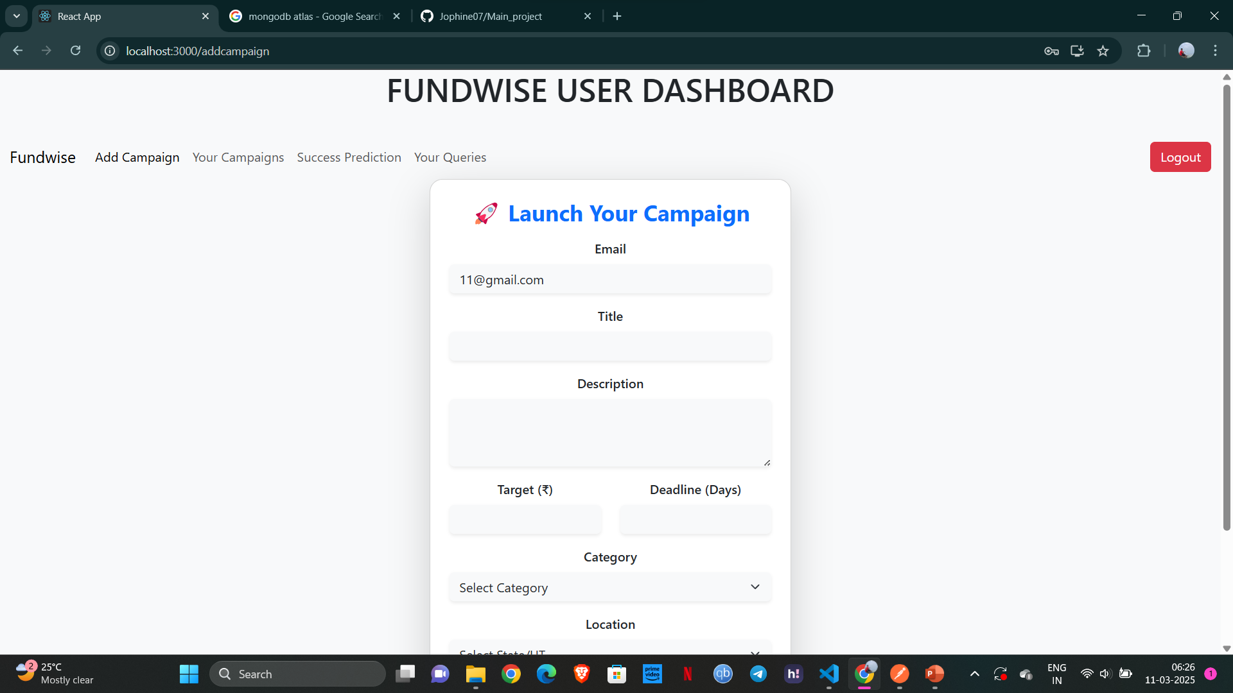
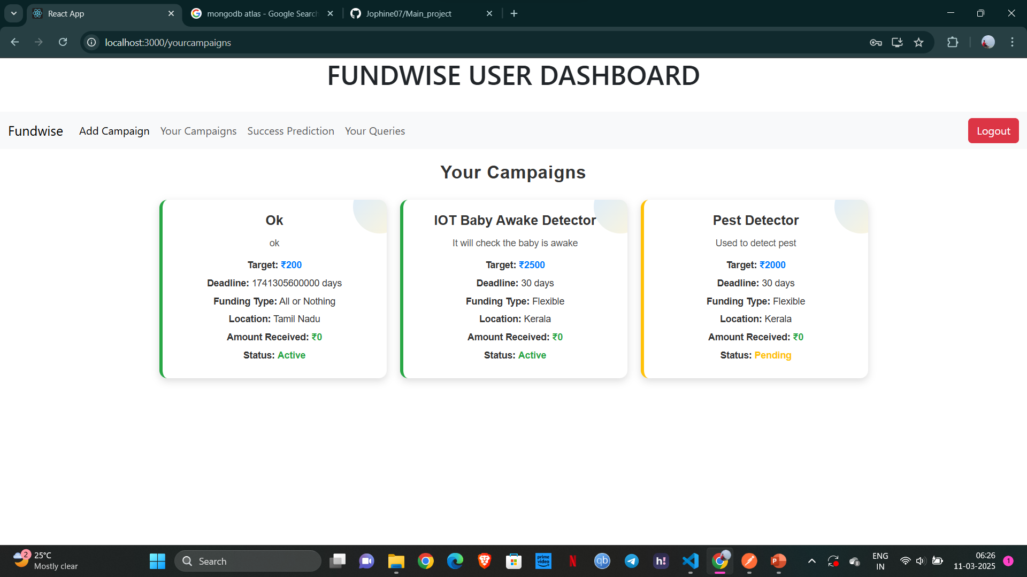

Slide 9
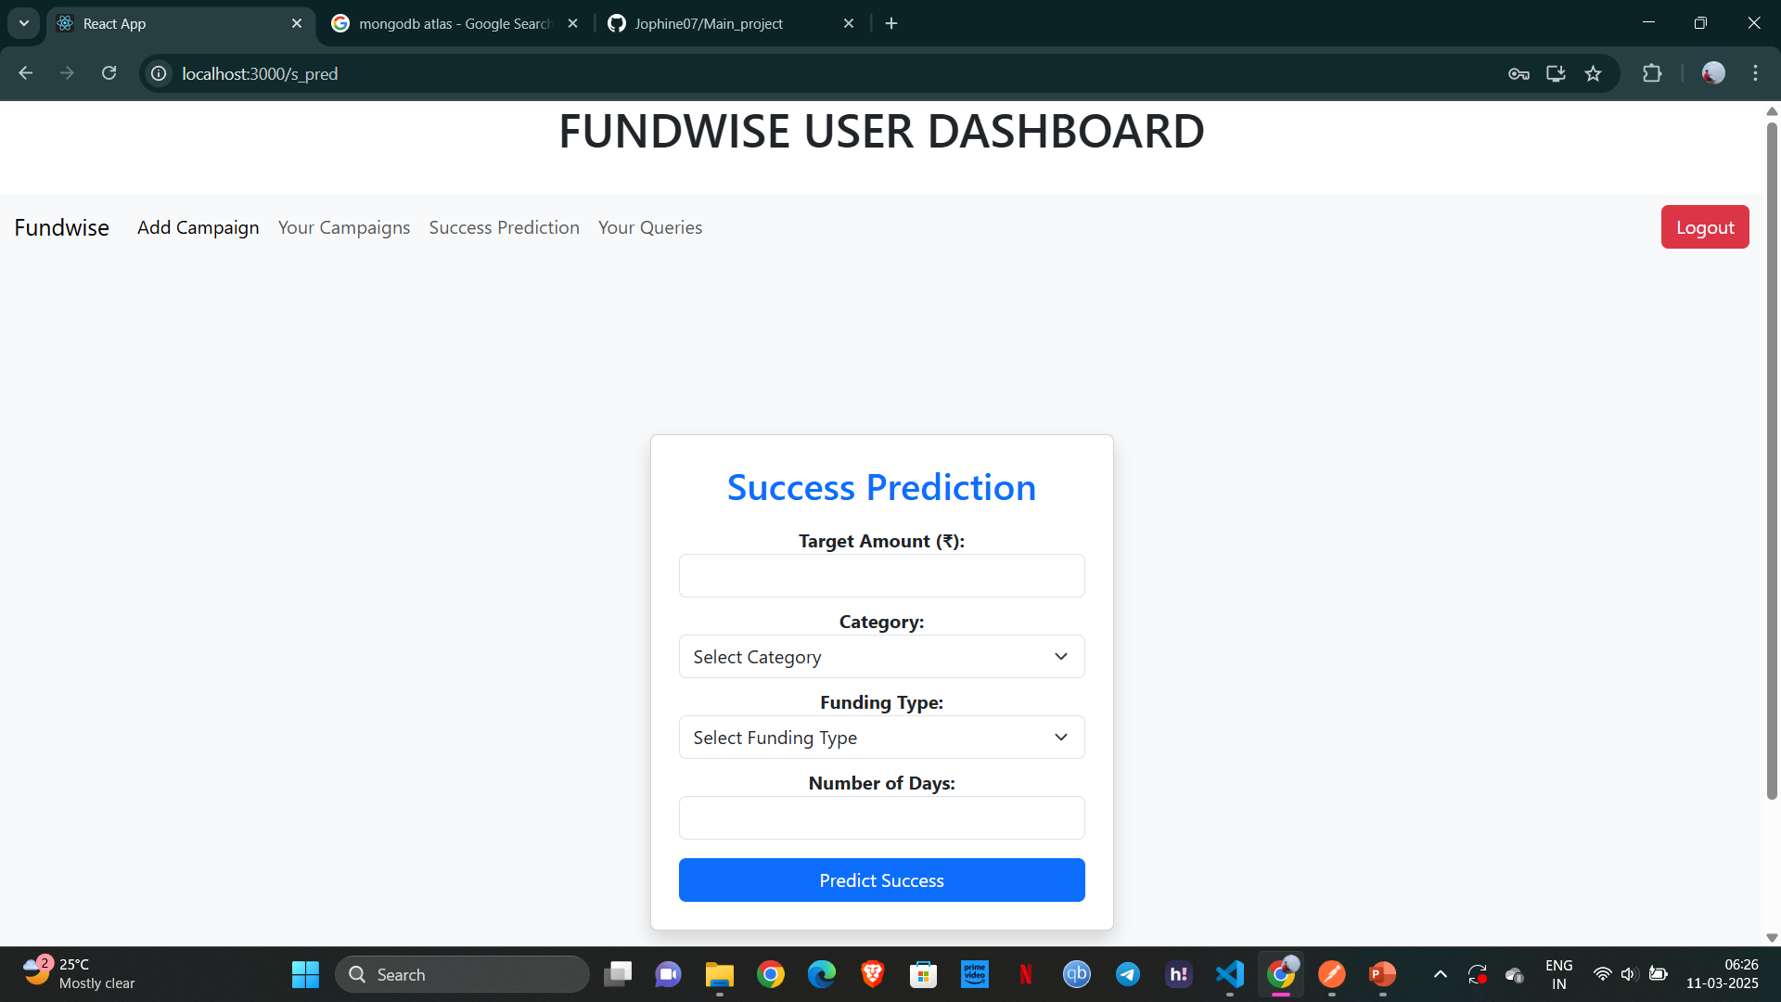
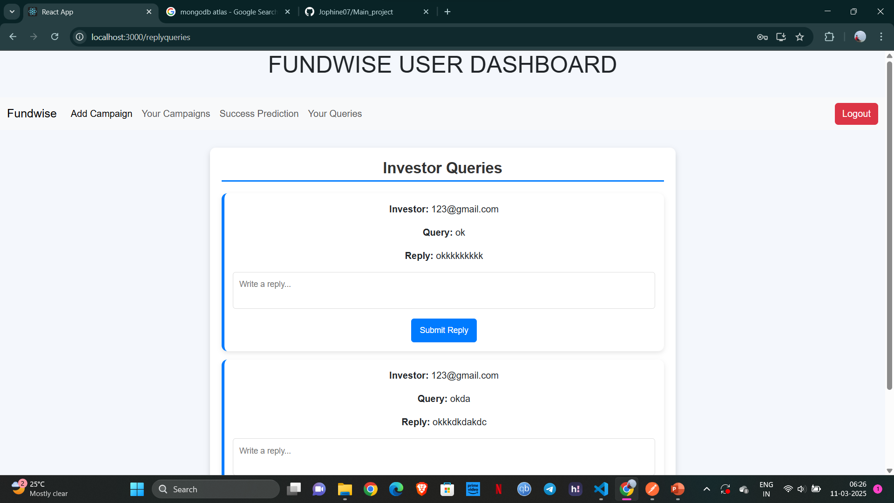

Slide 10
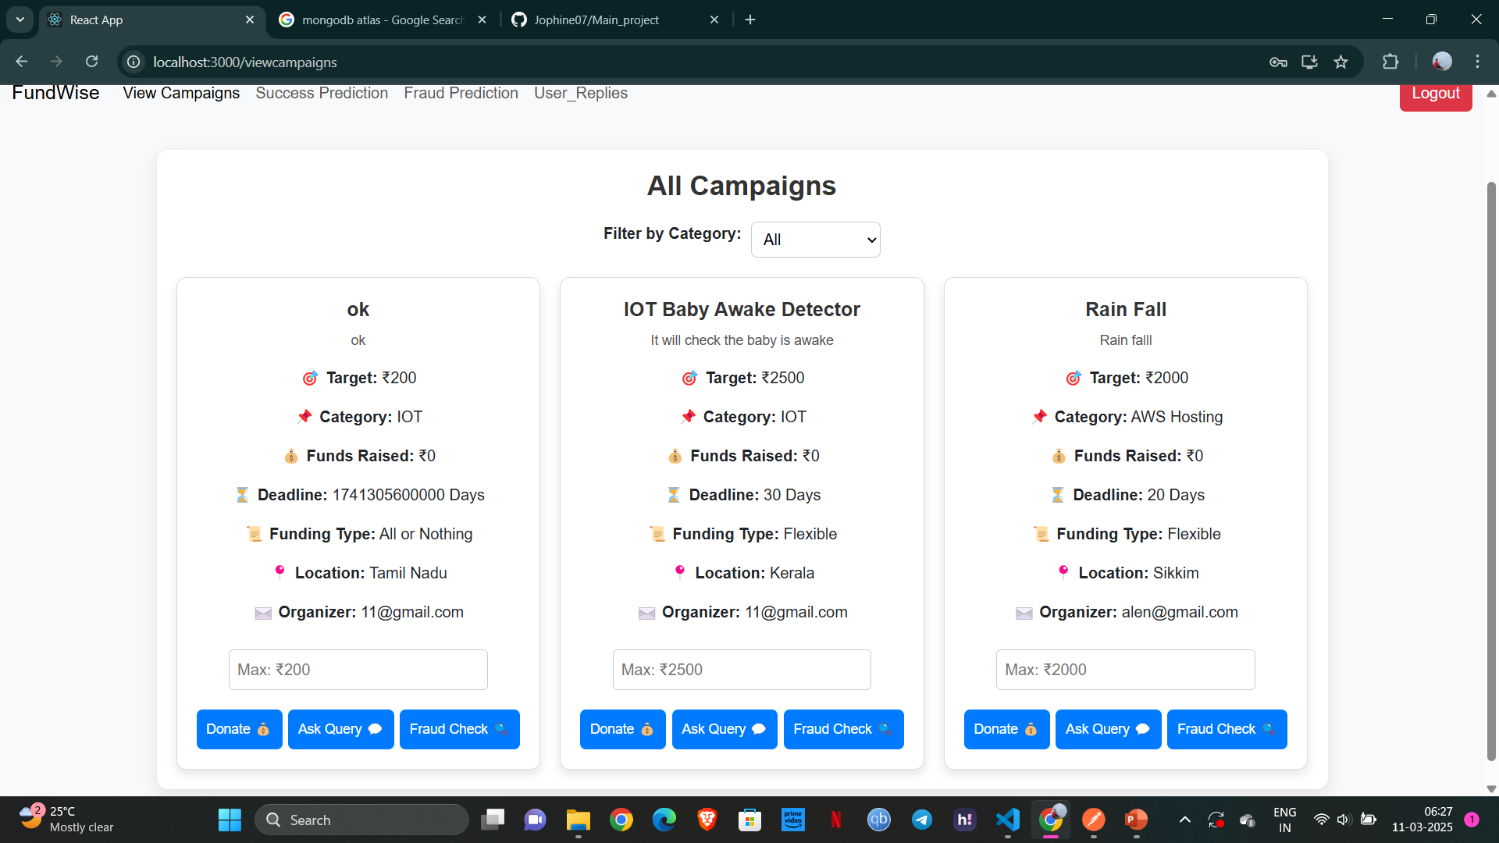
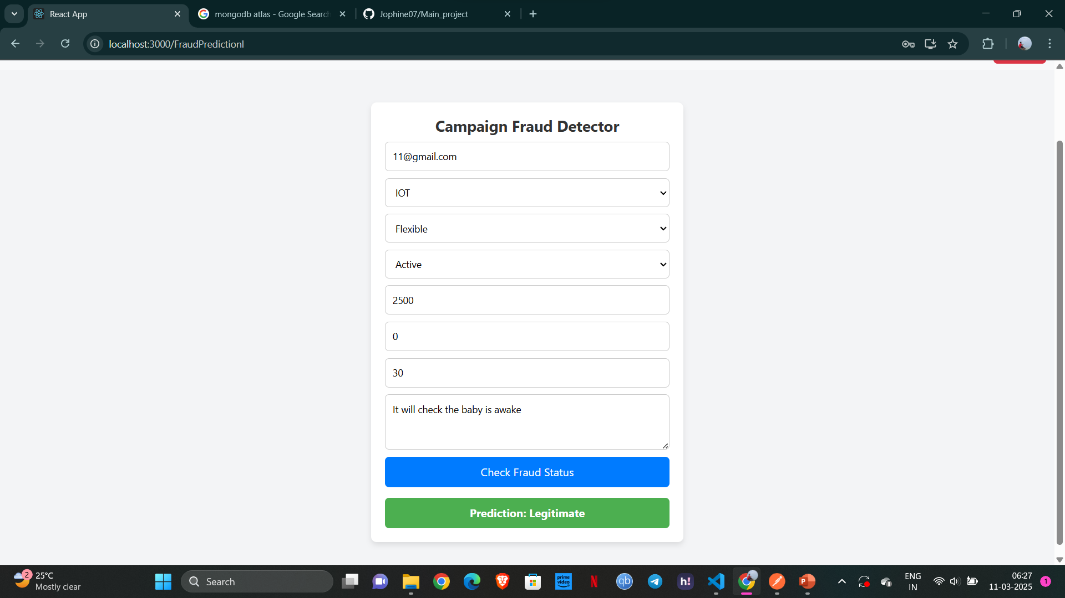

Slide 11
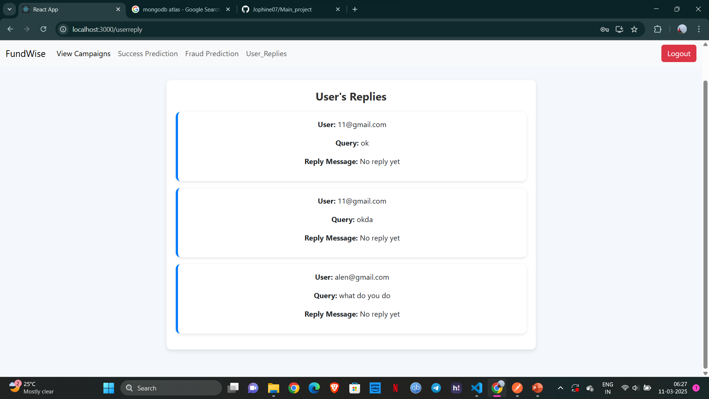
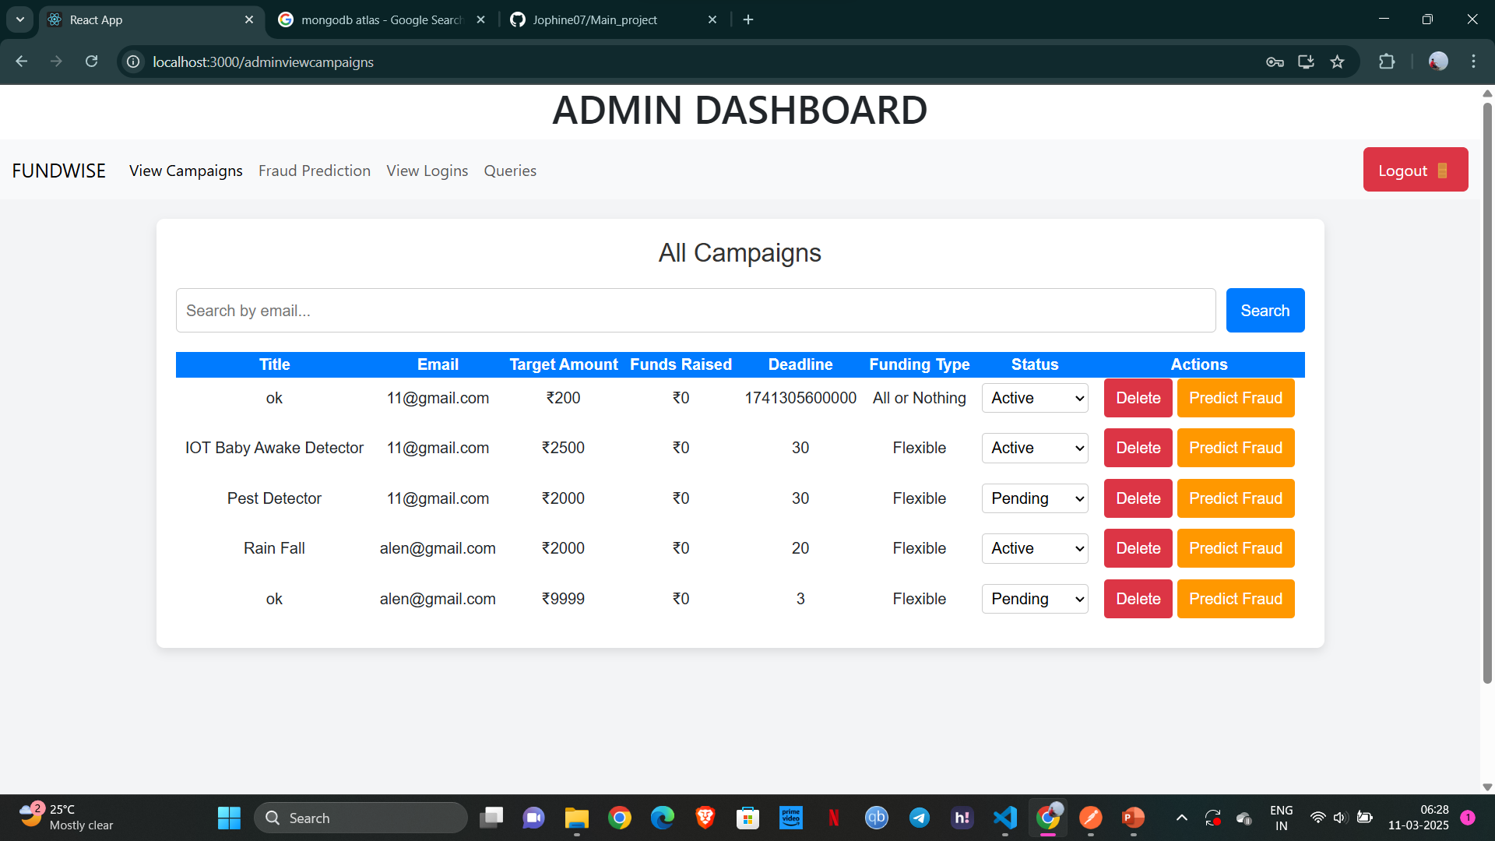

Slide 12
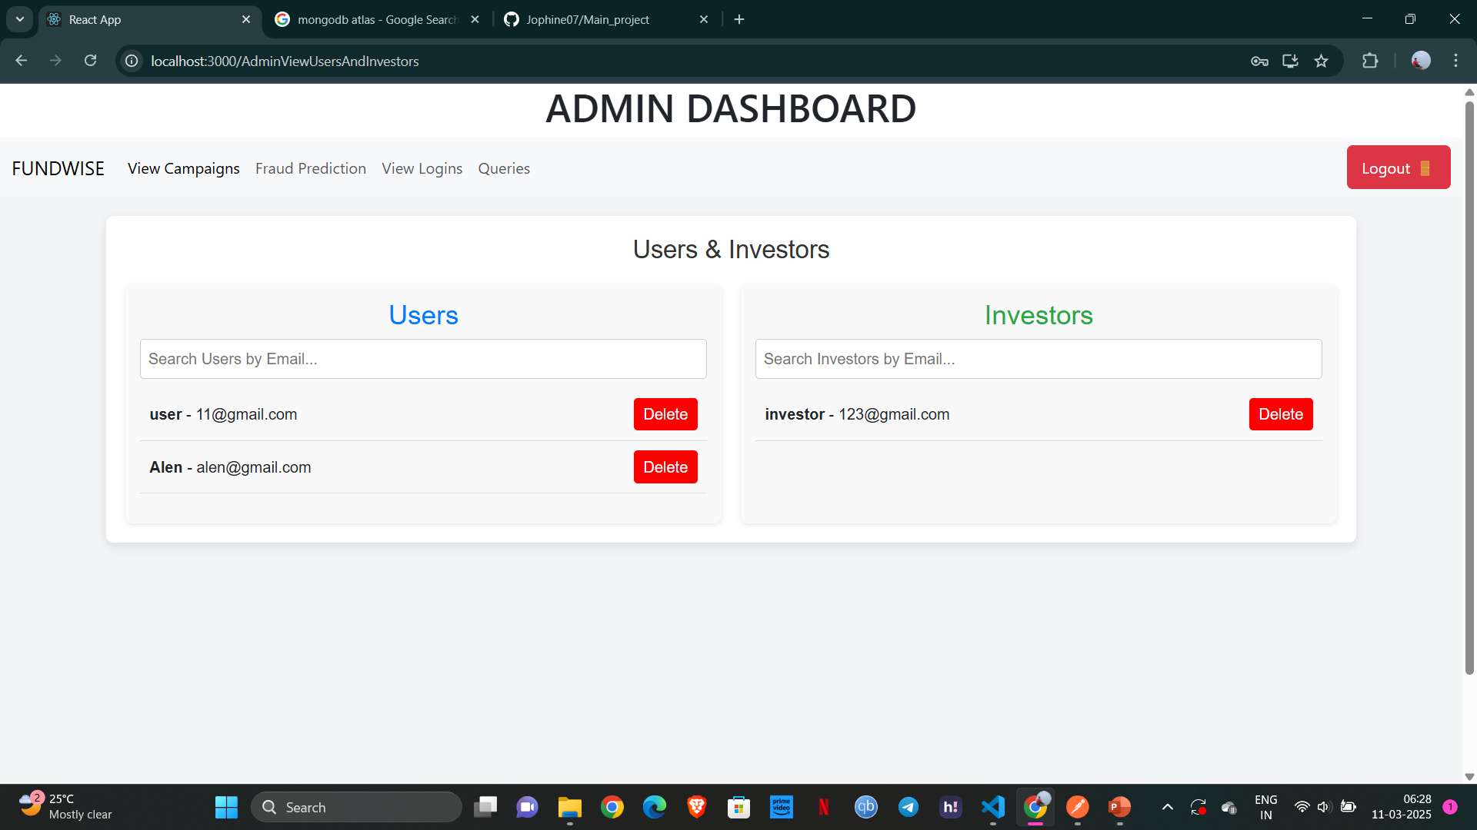
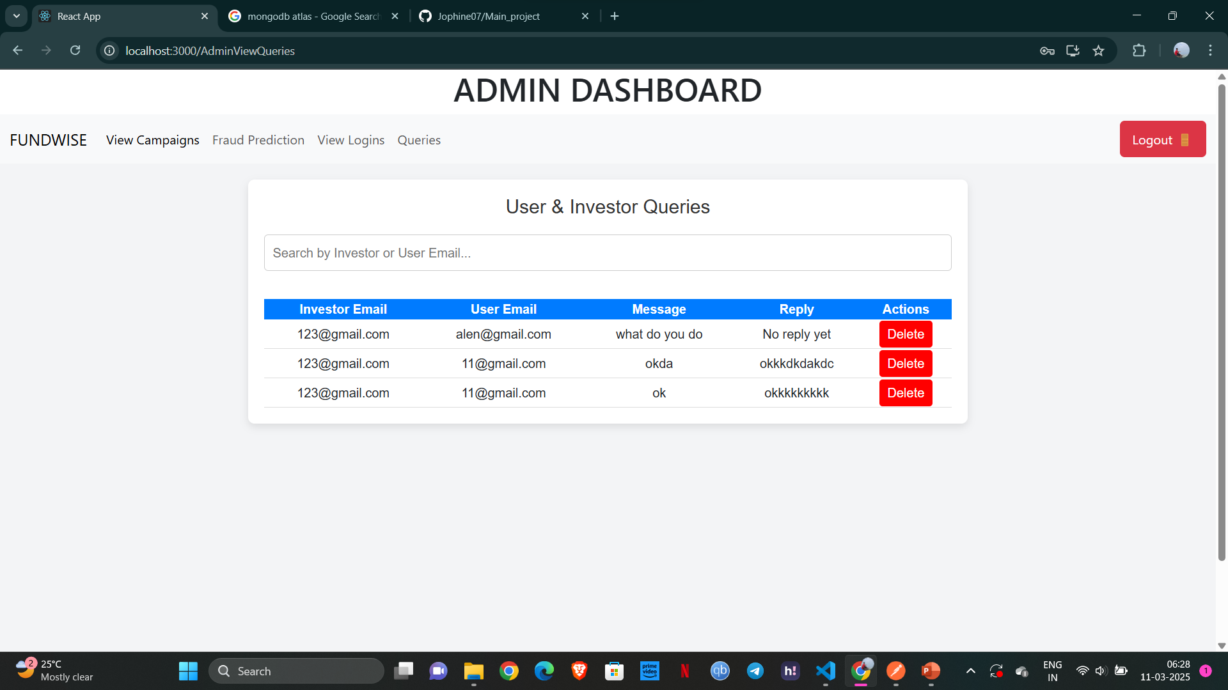

Slide 13
REFERENCES
Mollick, E. (2014). "The Dynamics of Crowdfunding: An Exploratory Study.
Journal of Business Venturing, 29(1), 1-16.
Crowdfunding Project Success Prediction Using Machine Learning Approaches“
Li, Y., Rakesh, V., & Reddy, C. K. (2016). Proceedings of the 9th ACM International Conference on Web Search and Data Mining, 247-256.
"Predicting the Success of Kickstarter Campaigns: A Machine Learning Approach“
Greenberg, M. D., Hui, J. S., & Gerber, E. M. (2013). Proceedings of the 2013 Conference on Computer Supported Cooperative Work, 885-888.

Slide 14
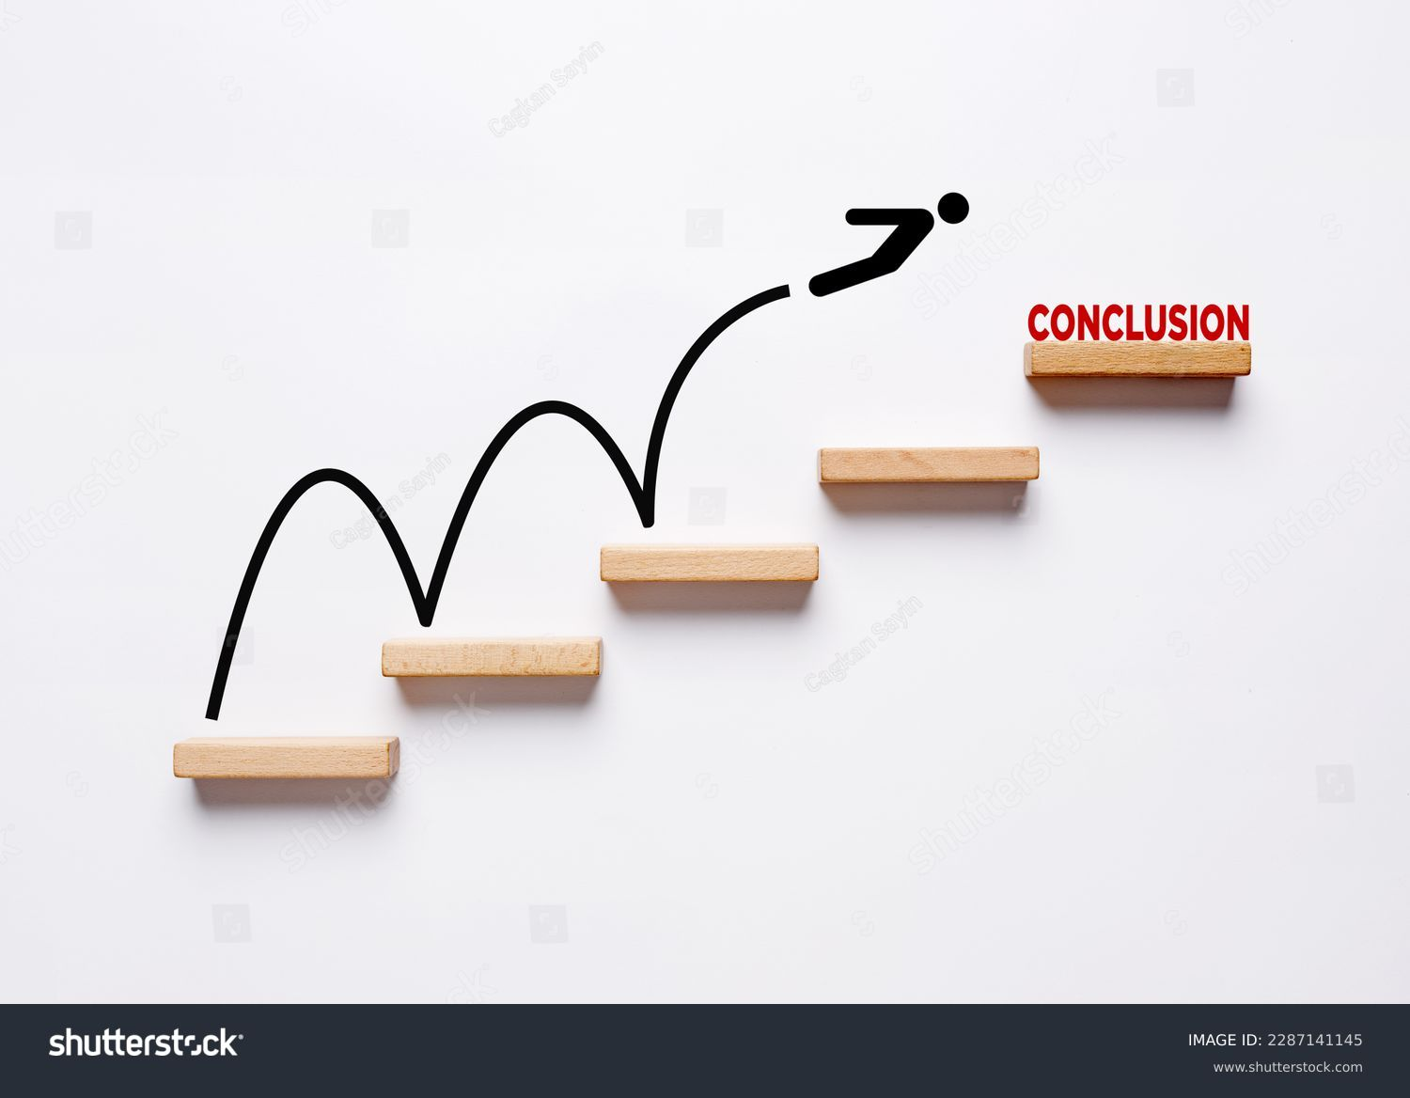
Conclusion
FundWise aims to revolutionize crowdfunding by leveraging advanced technologies to maximize project success, enhance investor satisfaction, and ensure a secure platform. Future plans include model optimization and platform scalability testing.

Slide 15


