Slide 1

FundWise: AN Intelligent Crowdfunding Platform
Name: Jophine Paul C
Guide: Ms. Manju Joy
Roll No: 8

Slide 2


Objective
To create a next-generation crowdfunding platform integrating the MERN stack and Machine Learning to enhance project success rates, provide personalized investor recommendations, and detect fraudulent campaigns.

Slide 3

Existing System
- Traditional crowdfunding platforms focus solely on project listings.
- No intelligent mechanisms to predict success or suggest improvements.
- Lack of personalized recommendations for investors.
- Limited measures to detect fraudulent campaigns.

Slide 4
Proposed System
- Integrates Machine Learning to analyze project success potential.
- Provides personalized project recommendations to investors.
- Detects and flags fraudulent campaigns using AI.
- Offers actionable suggestions to improve campaigns.

Slide 5
Modules
User Management Module
Registration and Login
Project Posting
ML-Driven Project Scoring
Investor Recommendations
Fraud Detection
Gamification
Payment Integration

Slide 6
Technologies Used
- Frontend: React.js
- Backend: Node.js, Express.js
- Database: MongoDB
- Machine Learning: Python (Flask)
- Tools: Scikit-learn, TensorFlow, Razorpay

Slide 7
REFERENCES
Mollick, E. (2014). "The Dynamics of Crowdfunding: An Exploratory Study. Journal of Business Venturing, 29(1), 1-16.

Slide 8
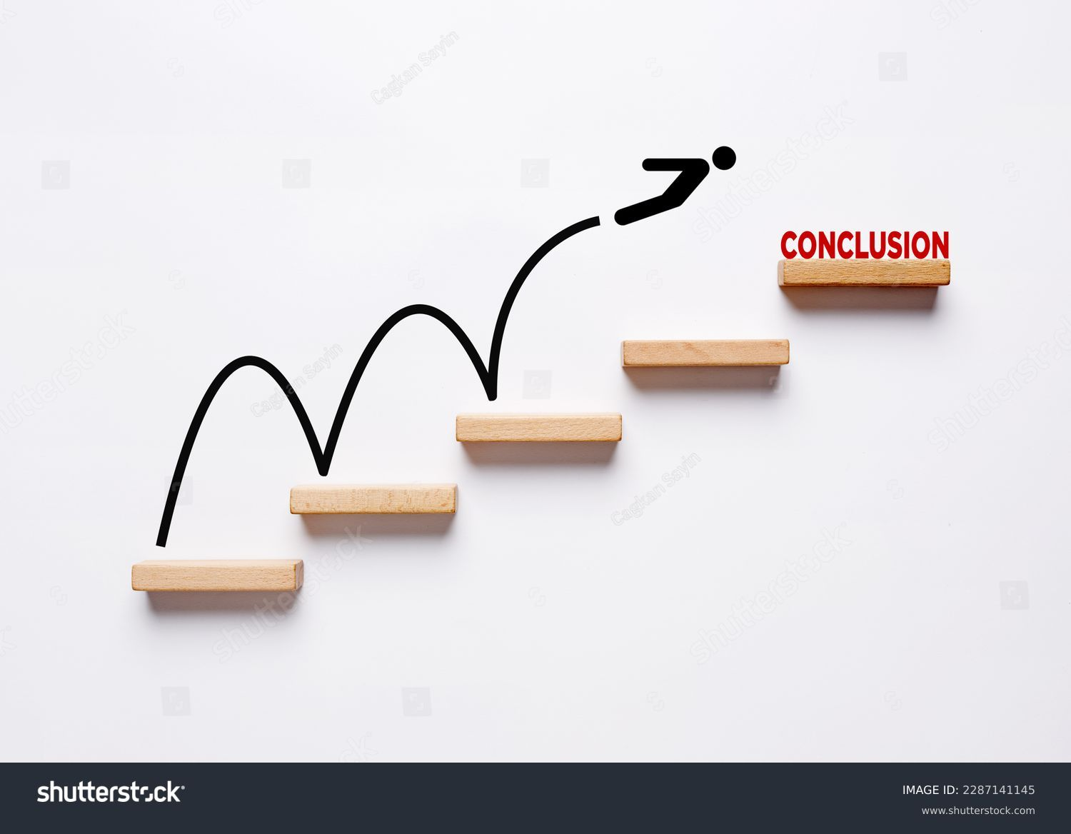
Conclusion
FundWise aims to revolutionize crowdfunding by leveraging advanced technologies to maximize project success, enhance investor satisfaction, and ensure a secure platform. Future plans include model optimization and platform scalability testing.

Slide 9


