Slide 1
Green
Green
Yellow
Red
Green
Track segment
Track segment
Track segment
Track segment

Slide 2


STATION A
STATION B
Track segment 1
Track segment 4
$$t_{1}$$
12 min
8 min
Depart in
5 minutes
Track segment 3
5 min
Track segment 2
Track segment 5
STATION C
15 min
7 min
STATION D
$$t_{2}$$
Depart now

Slide 3
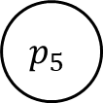

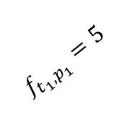
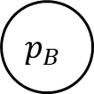
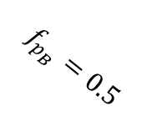
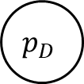


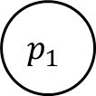

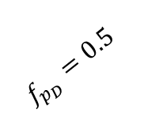
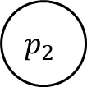
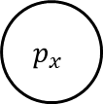
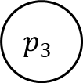

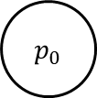
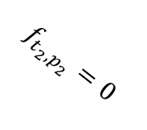



$$f_{p_{1}}=12$$
$$f_{p_{3}}=5$$
$$f_{p_{4}}=8$$
$$p_{1}$$
$$p_{3}$$
$$p_{4}$$
$$p_{B}$$
$$f_{t_{1},p_{1}}=5$$
$$f_{p_{B}}=0.5$$
$$p_{0}$$
$$p_{x}$$
$$f_{t_{2},p_{2}}=0$$
$$f_{p_{D}}=0.5$$
$$p_{2}$$
$$p_{3}$$
$$p_{5}$$
$$p_{D}$$
$$f_{p_{2}}=15$$
$$f_{p_{3}}=5$$
$$f_{p_{5}}=7$$

Slide 4
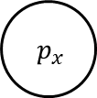
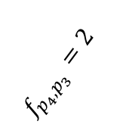
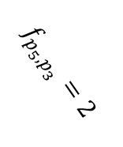
$$f_{p_{1}}=12$$
$$f_{p_{3}}=5$$
$$f_{p_{4}}=8$$
$$p_{1}$$
$$p_{3}$$
$$p_{4}$$
$$p_{B}$$
$$f_{t_{1},p_{1}}=5$$
$$f_{p_{B}}=0.5$$
$$f_{p_{4},p_{3}}=2$$
$$p_{0}$$
$p_{x}$
$$f_{p_{5},p_{3}}=2$$
$$f_{t_{2},p_{2}}=0$$
$$f_{p_{D}}=0.5$$
$$p_{2}$$
$$p_{3}$$
$$p_{5}$$
$$p_{D}$$
$$f_{p_{2}}=15$$
$$f_{p_{3}}=5$$
$$f_{p_{5}}=7$$

Slide 5
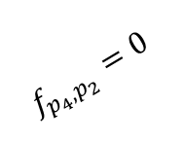
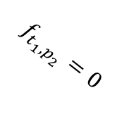
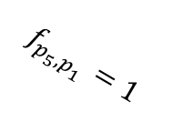
$$f_{p_{1}}=12$$
$$f_{p_{3}}=5$$
$$f_{p_{4}}=8$$
$$p_{1}$$
$$p_{3}$$
$$p_{4}$$
$$p_{B}$$
$$f_{t_{1},p_{1}}=5$$
$$f_{p_{B}}=0.5$$
$$p_{0}$$
$p_{x}$
$$f_{p_{4},p_{2}}=0$$
$$f_{p_{5},p_{1}}=1$$
$$f_{t_{1},p_{2}}=0$$
$$f_{p_{D}}=0.5$$
$$p_{2}$$
$$p_{3}$$
$$p_{5}$$
$$p_{D}$$
$$f_{p_{2}}=15$$
$$f_{p_{3}}=5$$
$$f_{p_{5}}=7$$

Slide 6










$$t_{1}$$
$$2$$
$$4$$
$$5$$
$$7$$
$$8$$
$$9$$
$$6$$
$$t_{2}$$
$$3$$

Slide 7


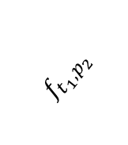












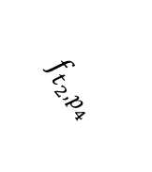



$$p_{2}$$
$$p_{4}$$
$$p_{5}$$
$$p_{7}$$
$$p_{8}$$
$$p_{9}$$
$${ p}_{out_{1}}$$
$$f_{t_{1},p_{2}}$$
$$p_{0}$$
$$p_{x}$$
$$f_{t_{2},p_{4}}$$
$$p_{4}$$
$$p_{5}$$
$$p_{6}$$
$${ p}_{wait}$$
$$p_{8}$$
$$p_{9}$$
$${ p}_{out_{2}}$$
$$δ_{dep}$$

Slide 8
Strategic scheduling system
Scheduling
Traffic management center
Traffic management center
···
Real-time (re)scheduling
Local traffic center
Local traffic center
···
Remote
traffic control
Interlocking signaling
Interlocking signaling
···
Interlocking and signalling
Train and infrastructure control

Slide 9
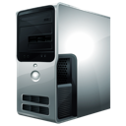


Railway traffic control
Traffic management
Timetable
Timings
Outer control loop
Train timetable rescheduling
Rolling stock rescheduling
Rolling stock plan
Train positions
Rail traffic network
Crew plan
Disturbances, etc.
Rail transport plan
Real-time
information
Train real-time operation
Train driving command
Train model dynamics
Driver
Given train speed profile
Line infrastructure data
Inner control loop
Train on-board computer
Train on-board sensors
Timetable
Others
Real-time train positioning

Slide 10
Velocity
Speed limit
Accelerating
Cruising
Coasting
Braking
Station A
Station B
Distance

Slide 11
Cab
Service brake
Emergency brake
Traction
ATP
ATO
Onboard
Wayside
ATS
ATP
ATO

Slide 12
300
250
200
Maximum traction force
(KN)
150
100
50
0
10
20
30
40
50
Speed (m/s)

Slide 13
















$$Traction_{n}$$
$$Traction_{2}$$
$$Traction_{1}$$
Vehicle n
Vehicle 2
Vehicle 1
· · ·
$$k$$
$$k$$
$$k$$
$${Bracking}_{n}$$
$${Bracking}_{2}$$
$${Bracking}_{1}$$
$${Resistance}_{n}$$
$${Resistance}_{2}$$
$${Resistance}_{1}$$
$$drag\&rolling_{n}$$
$$drag\&rolling_{2}$$
$$drag\&rolling_{1}$$
$$x_{n}$$
$$x_{2}$$
$$x_{1}$$

Slide 14
Velocity
Speed limit
Station A
Station B
Distance

Slide 15
Velocity
Speed limit
Station A
Station B
Distance

Slide 16
Velocity
Speed limit
Station A
Station B
Distance

Slide 17
Velocity
Unreachable states
Maximum acceleration
Achievable states
Maximum braking
Station A
Unreachable
state
Distance

Slide 18


Velocity
$$(s_{j},v_{j})$$
$$(s_{i},v_{i})$$
Station A
Distance

Slide 19































Velocity
$$V_{3}$$
$$V_{4}$$
$$v_{3}^{8}$$
$$v_{4}^{6}$$
Speed limit
$$v_{3}^{7}$$
$$e_{3}^{46}$$
$$v_{4}^{5}$$
$$v_{3}^{6}$$
$$v_{4}^{4}$$
$$v_{3}^{5}$$
$$e_{3}^{45}$$
$$v_{4}^{3}$$
…
$$v_{3}^{4}$$
$$v_{4}^{2}$$
$$V_{0}$$
$$v_{3}^{3}$$
$$e_{3}^{41}$$
$$v_{4}^{1}$$
$$v_{start}$$
$$v_{3}^{2}$$
$$v_{4}^{0}$$
$$e_{3}^{40}$$
$$v_{3}^{1}$$
$$v_{3}^{0}$$
$$s_{0}$$
$$s_{1}$$
$$s_{2}$$
$$s_{3}$$
$$s_{4}$$
$$s_{5}$$
$$s_{6}$$
Distance

Slide 20

Supervision
analysis & control
SCADA
History
database
Near
real time
Long term
Intelligence
Demand
manager
Railway Traffic Control
Rolling Stock Planning
Storage & communications
Infrastructure
databases
Real time Intelligence,
Controlling & monitoring
Control Centre
Real time
Sensors
&
controllers
Train
ATO + ATP
. . .
Train
ATO + ATP

Slide 21
Railway Traffic Control
Rolling Stock Planning
Demand
manager
SCADA
Infrastructure
databases
Control Centre
History
database
Train
ATO + ATP
Train
ATO + ATP

Slide 22


Real time
Update trains driving data
Control Centre
Redis
Real time
Send driving data to CC
(position, velocity, acceleration,
estimated time of arrival, status, ...)
Report statistics (KPIs) during dwell time
Real time
Read trains driving data
Read infrastructure data
(devices statuses, …)
Read schedule
Read CC broadcasts
Train
ATP
Static data
Read train data
Read infrastructure data
(tracks, stations, devices, …)
Real time
Get static & real time data
Send setpoint
PostgreSQL
ATO + ATP
On demand
Get static & real time data
Send optimal trajectory
Compute trajectory

Slide 23
SCADA
Demand
manager
Railway Traffic Control
Rolling Stock Planning
Near real time (on demand)
Boot up new process
Respond to CC with the new schedule
Real time
Update driving data
of all trains
Update devices statuses
(semaphores, needles, …)
Near real time (periodically)
Store driving data
Report statistics (KPIs)
Control Centre
Broadcast alerts
(via subscriptions)
Redis
InfluxDB
Real time
Send driving data to CC
(position, velocity, acceleration,
estimated time of arrival, status, ...)
Report statistics (KPIS) during dwell time
Real time (on demand)
Boot up a new train
Shut down a train
Train
Train
Train
Train

Slide 24
PostgreSQL
Static data
Read train data
Read infrastructure data
(tracks, stations, devices,
available rolling stock …)
Real time
Read trains driving data
Read infrastructure data
(devices statuses, …)
Near real time
Read trains driving data
Railway Traffic Control
Rolling Stock Planning
Redis
InfluxDB
On demand
Compute optimal train schedule for the next hours
Store optimal schedule
Control Centre

Slide 25
(Near) real time
Read trains driving data
Read infrastructure data
(devices statuses, …)
Read schedule
Read CC broadcasts
Read current passenger demand
InfluxDB
Near real time
Read trains driving data
SCADA
Static data
Read train data
Read infrastructure data
(tracks, stations, devices, …)
Redis
On demand
Send user commands to Control Centre
Control Centre
PostgreSQL
Apply user command
Apply user command

