Slide 1
Green
Green
Yellow
Red
Green
Track segment
Track segment
Track segment
Track segment

Slide 2


STATION A
STATION B
Track segment 1
Track segment 4
$$t_{1}$$
12 min
8 min
Depart in
5 minutes
Track segment 3
5 min
Track segment 2
Track segment 5
STATION C
15 min
7 min
STATION D
$$t_{2}$$
Depart now

Slide 3
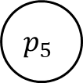

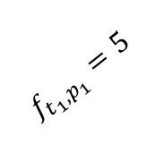
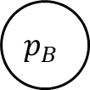
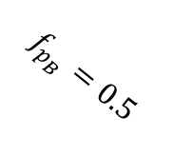
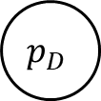


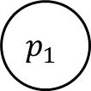

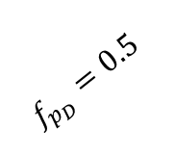
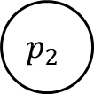
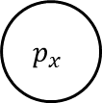
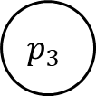

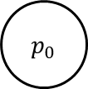
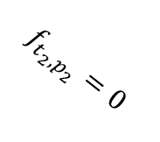



$$f_{p_{1}}=12$$
$$f_{p_{3}}=5$$
$$f_{p_{4}}=8$$
$$p_{1}$$
$$p_{3}$$
$$p_{4}$$
$$p_{B}$$
$$f_{t_{1},p_{1}}=5$$
$$f_{p_{B}}=0.5$$
$$p_{0}$$
$$p_{x}$$
$$f_{t_{2},p_{2}}=0$$
$$f_{p_{D}}=0.5$$
$$p_{2}$$
$$p_{3}$$
$$p_{5}$$
$$p_{D}$$
$$f_{p_{2}}=15$$
$$f_{p_{3}}=5$$
$$f_{p_{5}}=7$$

Slide 4
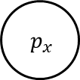
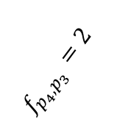
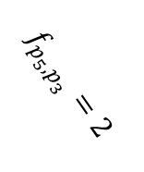
$$f_{p_{1}}=12$$
$$f_{p_{3}}=5$$
$$f_{p_{4}}=8$$
$$p_{1}$$
$$p_{3}$$
$$p_{4}$$
$$p_{B}$$
$$f_{t_{1},p_{1}}=5$$
$$f_{p_{B}}=0.5$$
$$f_{p_{4},p_{3}}=2$$
$$p_{0}$$
$p_{x}$
$$f_{p_{5},p_{3}}=2$$
$$f_{t_{2},p_{2}}=0$$
$$f_{p_{D}}=0.5$$
$$p_{2}$$
$$p_{3}$$
$$p_{5}$$
$$p_{D}$$
$$f_{p_{2}}=15$$
$$f_{p_{3}}=5$$
$$f_{p_{5}}=7$$

Slide 5
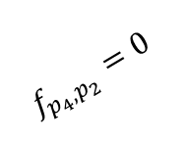
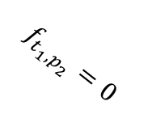
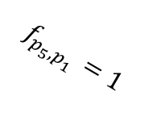
$$f_{p_{1}}=12$$
$$f_{p_{3}}=5$$
$$f_{p_{4}}=8$$
$$p_{1}$$
$$p_{3}$$
$$p_{4}$$
$$p_{B}$$
$$f_{t_{1},p_{1}}=5$$
$$f_{p_{B}}=0.5$$
$$p_{0}$$
$p_{x}$
$$f_{p_{4},p_{2}}=0$$
$$f_{p_{5},p_{1}}=1$$
$$f_{t_{1},p_{2}}=0$$
$$f_{p_{D}}=0.5$$
$$p_{2}$$
$$p_{3}$$
$$p_{5}$$
$$p_{D}$$
$$f_{p_{2}}=15$$
$$f_{p_{3}}=5$$
$$f_{p_{5}}=7$$

Slide 6










$$t_{1}$$
$$2$$
$$4$$
$$5$$
$$7$$
$$8$$
$$9$$
$$6$$
$$t_{2}$$
$$3$$

Slide 7


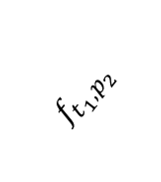












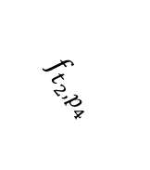



$$p_{2}$$
$$p_{4}$$
$$p_{5}$$
$$p_{7}$$
$$p_{8}$$
$$p_{9}$$
$${ p}_{out_{1}}$$
$$f_{t_{1},p_{2}}$$
$$p_{0}$$
$$p_{x}$$
$$f_{t_{2},p_{4}}$$
$$p_{4}$$
$$p_{5}$$
$$p_{6}$$
$${ p}_{wait}$$
$$p_{8}$$
$$p_{9}$$
$${ p}_{out_{2}}$$
$$δ_{dep}$$

Slide 8
Strategic scheduling system
Scheduling
Traffic management center
Traffic management center
···
Real-time (re)scheduling
Local traffic center
Local traffic center
···
Remote
traffic control
Interlocking signaling
Interlocking signaling
···
Interlocking and signalling
Train and infrastructure control

Slide 9
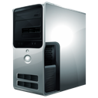


Railway traffic control
Traffic management
Timetable
Timings
Outer control loop
Train timetable rescheduling
Rolling stock rescheduling
Rolling stock plan
Train positions
Rail traffic network
Crew plan
Disturbances, etc.
Rail transport plan
Real-time
information
Train real-time operation
Train driving command
Train model dynamics
Driver
Given train speed profile
Line infrastructure data
Inner control loop
Train on-board computer
Train on-board sensors
Timetable
Others
Real-time train positioning

Slide 10
Velocity
Speed limit
Accelerating
Cruising
Coasting
Braking
Station A
Station B
Distance

Slide 11
Cab
Service brake
Emergency brake
Traction
ATP
ATO
Onboard
Wayside
ATS
ATP
ATO

Slide 12
300
250
200
Maximum traction force
(KN)
150
100
50
0
10
20
30
40
50
Speed (m/s)

Slide 13
















$$Traction_{n}$$
$$Traction_{2}$$
$$Traction_{1}$$
Vehicle n
Vehicle 2
Vehicle 1
· · ·
$$k$$
$$k$$
$$k$$
$${Bracking}_{n}$$
$${Bracking}_{2}$$
$${Bracking}_{1}$$
$${Resistance}_{n}$$
$${Resistance}_{2}$$
$${Resistance}_{1}$$
$$drag\&rolling_{n}$$
$$drag\&rolling_{2}$$
$$drag\&rolling_{1}$$
$$x_{n}$$
$$x_{2}$$
$$x_{1}$$

Slide 14
Velocity
Speed limit
Station A
Station B
Distance

Slide 15
Velocity
Speed limit
Station A
Station B
Distance

Slide 16
Velocity
Speed limit
Station A
Station B
Distance

Slide 17
Velocity
Unreachable states
Maximum acceleration
Achievable states
Maximum braking
Station A
Unreachable
state
Distance

Slide 18


Velocity
$$(s_{j},v_{j})$$
$$(s_{i},v_{i})$$
Station A
Distance

Slide 19































Velocity
$$V_{3}$$
$$V_{4}$$
$$v_{3}^{8}$$
$$v_{4}^{6}$$
Speed limit
$$v_{3}^{7}$$
$$e_{3}^{46}$$
$$v_{4}^{5}$$
$$v_{3}^{6}$$
$$v_{4}^{4}$$
$$v_{3}^{5}$$
$$e_{3}^{45}$$
$$v_{4}^{3}$$
…
$$v_{3}^{4}$$
$$v_{4}^{2}$$
$$V_{0}$$
$$v_{3}^{3}$$
$$e_{3}^{41}$$
$$v_{4}^{1}$$
$$v_{start}$$
$$v_{3}^{2}$$
$$v_{4}^{0}$$
$$e_{3}^{40}$$
$$v_{3}^{1}$$
$$v_{3}^{0}$$
$$s_{0}$$
$$s_{1}$$
$$s_{2}$$
$$s_{3}$$
$$s_{4}$$
$$s_{5}$$
$$s_{6}$$
Distance

Slide 20

Long term
Intelligence
Near
real time
Railway Traffic Control
Rolling Stock Planning
Storage & persistence
History database
Real time Intelligence,
Controlling & monitoring
Train Manager
SCADA
Real time closed loop
Sensors
&
controllers
Demand
manager
Automatic Train Supervision
Train

Slide 21
Railway Traffic Control
History database
Rolling Stock Planning
Train Manager
SCADA
Train
Train
Train
Demand
manager
ATP
ATO
ATP
ATO
ATP
ATO

Slide 22
Railway Traffic Control
History database
Rolling Stock Planning
Train Manager
SCADA
Train
Train
Train
Demand
manager
ATP
ATO
ATP
ATO
ATP
ATO

Slide 23
(*) Get information.
Train
(5) Get external commands propagated by Train Manager.
Server listening
(7) Get communications to other modules.
(3) Update internal data (new sensors measures: position, velocity, acceleration, slope, etc..
(8) Communicate with extra modules.
(4) Get sensors measures (position, velocity, acceleration, etc.)
Other modules
Server listening to setpoints
(6) Propagate external orders.
(2) Update setpoint.
(1) Get sensors measures (position, velocity, acceleration, etc.).
ATS

Slide 24
Train Manager
(2) Update internal data, filter, convert and concentrate.
Server digesting new data
(1) Report real time measures.
(1) Report real time measures.
Train
Train
Client reporting real time measures from Sensors and Controllers
Client reporting real time measures from Sensors and Controllers

Slide 25
Train Manager
(3) Update internal data, filter, convert and concentrate.
Server digesting new data
(2) Report real time demand.
(1) Get infrastructure and real time data.
Demand Manager
Compute passenger demand at each station and passenger routing

Slide 26
Railway Traffic Control
(4) RTC requests data.
History database
Rolling Stock Planning
(3) RSP requests data.
(2) Report near real time data.
Train Manager
(5) SCADA requests data.
Client reporting
near real time data
SCADA
Server feeding SCADA
data requests
(1) Feed SCADA data requests.

Slide 27
Railway Traffic Control
History database
Rolling Stock Planning
(3) Store information provided in (1) and (2).
(1) Send results to Train Manager.
Train Manager
Client reporting
near real time data
SCADA
Server digesting new data
(2) Notify actions taken by the SCADA (any action set by human through HMI.

Slide 28
Train Manager
Client propagating OCC, SCADA and self commands.
(1) Propagate decisions taken by Operating Control Centre, SCADA and Train Manager
(1) Propagate decisions taken by Operating Control Centre, SCADA and Train Manager
Train
Train
Server listening to external orders
Server listening to external orders

Slide 29







Operating Control Center
Railway infrastructure
subnetwork
Rolling stock subnetwork
Station set
subnetwork
Station 1 subnet
Ticket machine
Validate machines
Lift
Escalators
Station employees
Security cameras
Speakers
Illumination

Slide 30

Operating Control Center
Railway infrastructure
subnetwork
Station set
subnetwork
Rolling stock subnetwork
Train 1 subnet
Train $N$ subnet
On-board computer
On-board sensors
On-board computer
On-board sensors
. . .
On-board Security camera
On-board speakers
On-board Security camera
On-board speakers

Slide 31
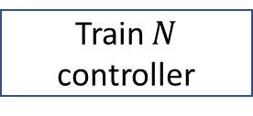
Operating Control Center
Subnetwork X.1
Subnetwork X.2
Subnetwork X.3
Rolling stock controller
Railway infrastructure controller
Station set controller
. . .
Subnetwork X.1.1
Subnetwork X.1.2
Subnetwork X.1.3
Train 1 controller
Train 2 controller
Train $N$ controller
Subnetwork X.1.1
Subnetwork X.1.1.2
Subnetwork X.1.1.3
Subnetwork X.1.1.4
Driverless remote controller
Real-time monitoring controller
Onboard
Security camera controller
Onboard speakers controller

