Slide 1
BuildFlow
Product walkthrough for the team
Construction ERP · Inventory / Stock · Platform Admin
All major functions, roles, and why it matters — with live web & mobile screens.
Demo logins used: Platform Admin + Company Owner (full access) · OTP seed: 111111

Slide 2
Agenda
What this deck covers
• What BuildFlow is (two products, one platform)
• Why teams adopt it — product strengths
• Roles across Construction, Inventory & Platform
• How to sign in (admin / owner demos)
• Construction ERP — every major module
• Inventory / Stock — every major module
• Platform Admin console
• Suggested team walkthrough paths
Screenshot convention
• Left / wide = Desktop web (1440×900)
• Right / tall = Mobile viewport (390×844)
• Captured from running local app
• Owner role for full module access
• Platform Admin for tenant ops
BuildFlow v2.0 · Internal team walkthrough · Confidential
2 / 27

Slide 3
What is BuildFlow?
One codebase · two product modes · role-aware UX
Construction ERP
Inventory / Stock
• Projects, BOQ & estimation
• Proposals / tendering
• CPM planning & schedules
• Daily site reports & attendance
• Procurement, stock, subcontractors
• Accounting (invoices, bills, Tally)
• AI assistant + notifications
• Company settings, users, permissions
• Stock home with scan & checkout
• Materials / SKU catalog
• Parties (customers & vendors)
• Quotes → Sales → Invoices
• Warehouse transfers & GRN
• Procurement / purchase bills
• Reports + GST-oriented flows
• Profiles: retail, wholesale, materials, events…
BuildFlow v2.0 · Internal team walkthrough · Confidential
3 / 27

Slide 4
Why BuildFlow — product strengths
Talking points for the team
Field + boardroom
Role-based access
Same app on phone and desktop — supervisors on site, owners in the office.
Permissions per role; Owners can customize. Site roles hide amounts when needed.
Two products, shared platform
India-ready ops
Construction ERP and Inventory tenants on one stack; Platform Admin oversees all.
₹ currency, GST-oriented invoices/bills, Tally export, OTP login (email/SMS).
End-to-end construction
Inventory verticals
Estimate → BOQ → procure → measure → invoice — not disconnected tools.
Material supplier, retail/kirana FEFO, events/lighting wording, multi-warehouse.
AI assistant
Audit & support
In-app assistant FAB with permission-aware tools for faster ops.
Audit log, tickets, escalations to Platform — built for multi-tenant SaaS.
BuildFlow v2.0 · Internal team walkthrough · Confidential
4 / 27

Slide 5
Roles at a glance
Construction · Inventory · Platform
Construction ERP
Inventory product
Design principle
• Owner / MD — full access
• Project Manager (PM)
• Deputy PM (DPM)
• Senior QC Engineer
• Mechanical Manager
• Store Incharge
• WeighBridge Incharge
• Site Supervisor
• Accountant
• Owner — full inventory + settings
• Inventory Manager — day-to-day stock, sales, procurement
• OWNER gets every permission
• Field roles focus on reports / stock / QC
• Accountant owns money flows + Tally
• Site Supervisor can hide financials
• Company can customize role permissions
Platform
• Platform Admin — tenants, subscriptions, escalated tickets
• Separate login: /platform/login
BuildFlow v2.0 · Internal team walkthrough · Confidential
5 / 27

Slide 6
Demo credentials (seed)
Use these for local walkthroughs — password/OTP as noted
Platform Admin (used for platform screens in this deck)
URL: /platform/login
Email: admin@buildflow.com
Password: Admin@1234
Construction (Owner)
Inventory (Owner)
Company: Reddy Constructions Pvt Ltd
Email: owner@reddyconst.com
OTP: 111111 (seed master code)
Also: pm@ · dpm@ · qc@ · store@ ·
site@ · accounts@ · weighbridge@ ·
mechanical@reddyconst.com (same OTP)
Materials demo (richest):
owner@hydmaterials.com · OTP 111111
Also: kirana-demo · luminalighting ·
cityhardware · deccanwholesale ·
southdistro · apextrading · forgeequip ·
generalstore (see DEMO_CREDENTIALS.txt)
BuildFlow v2.0 · Internal team walkthrough · Confidential
6 / 27

Slide 7
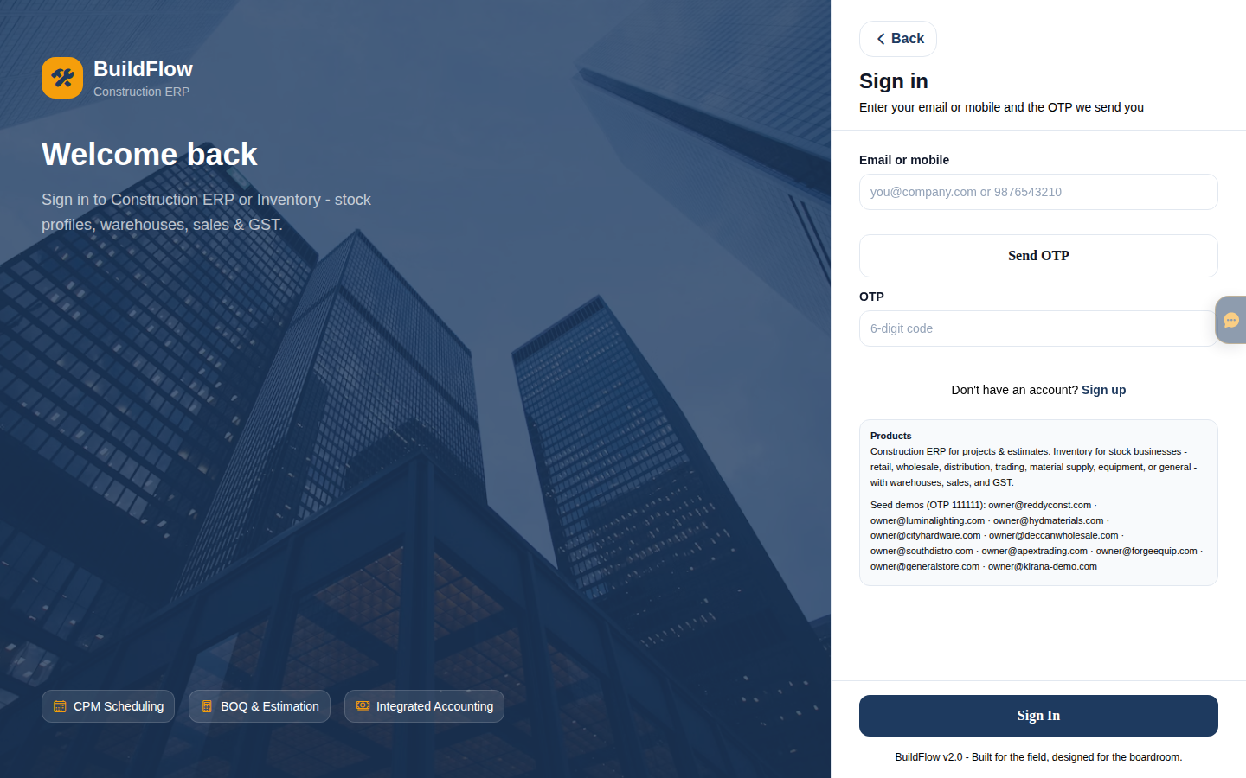
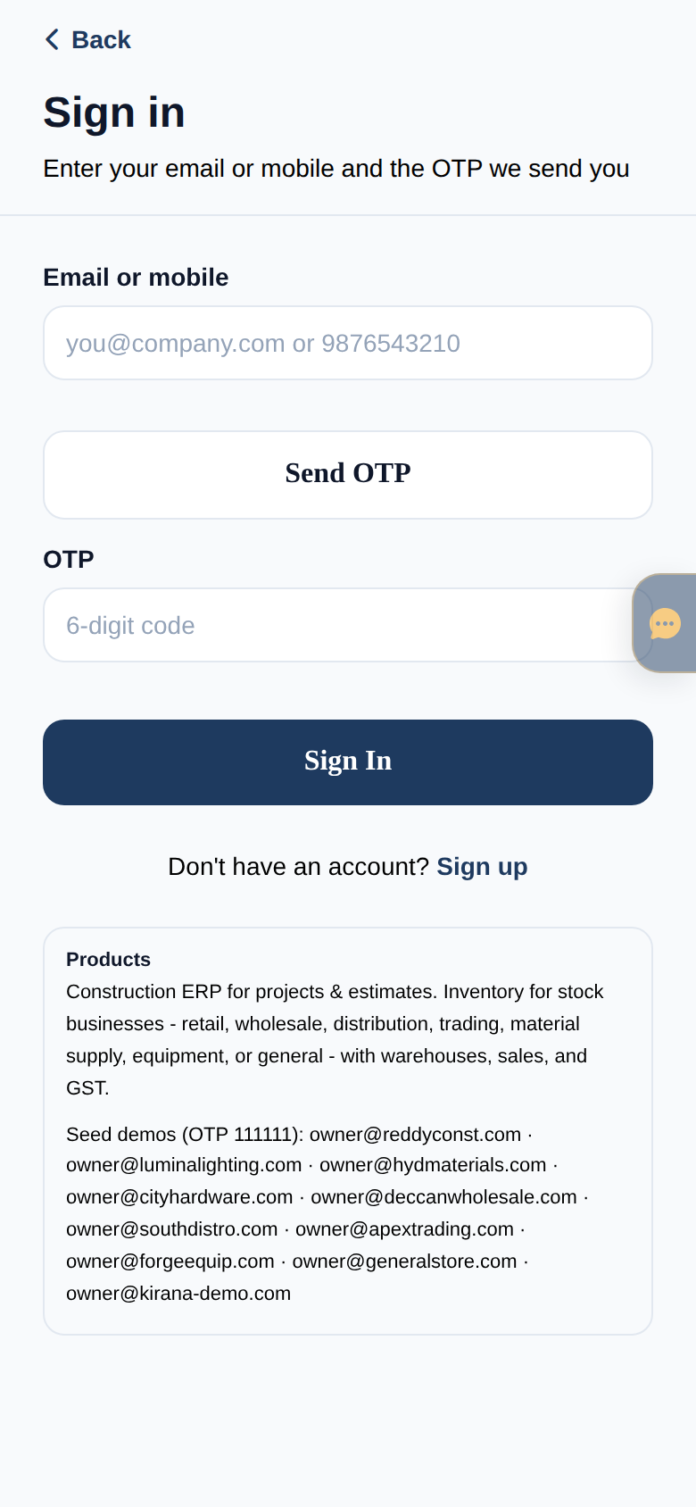
Sign-in experience
Company OTP login + Platform password login
Web — company login (email/mobile + OTP)
Mobile — same flow
BuildFlow v2.0 · Internal team walkthrough · Confidential
7 / 27

Slide 8
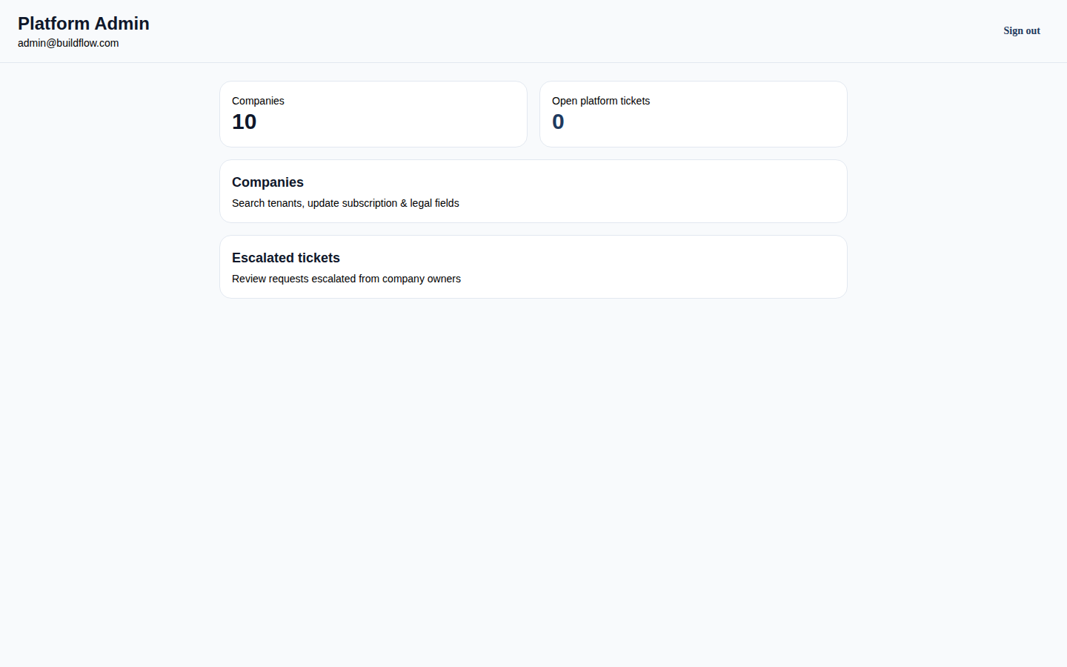
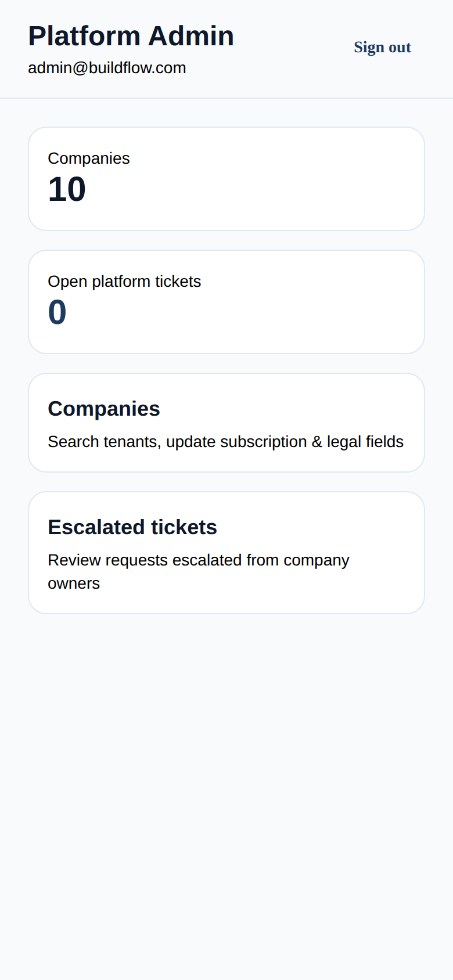
Platform Admin
Tenant oversight — admin@buildflow.com
Web — companies count, tickets, navigation
Mobile viewport
BuildFlow v2.0 · Internal team walkthrough · Confidential
8 / 27

Slide 9
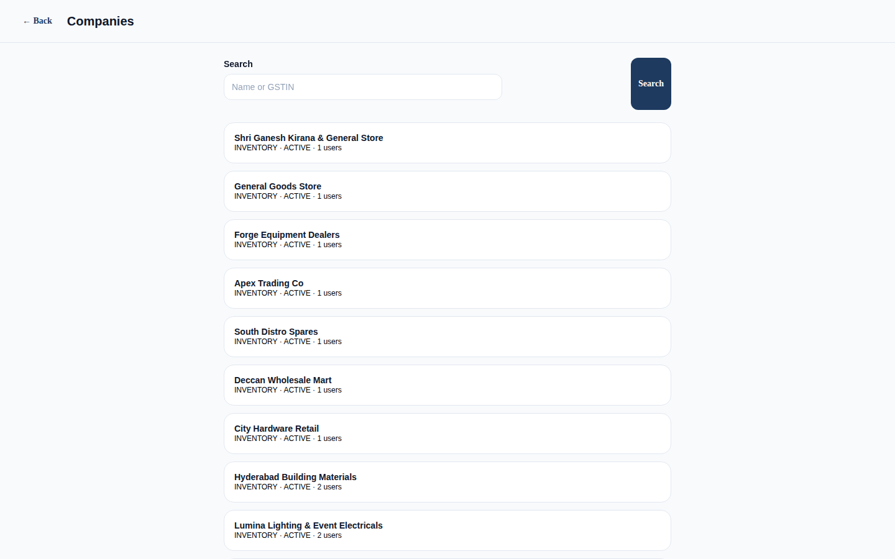
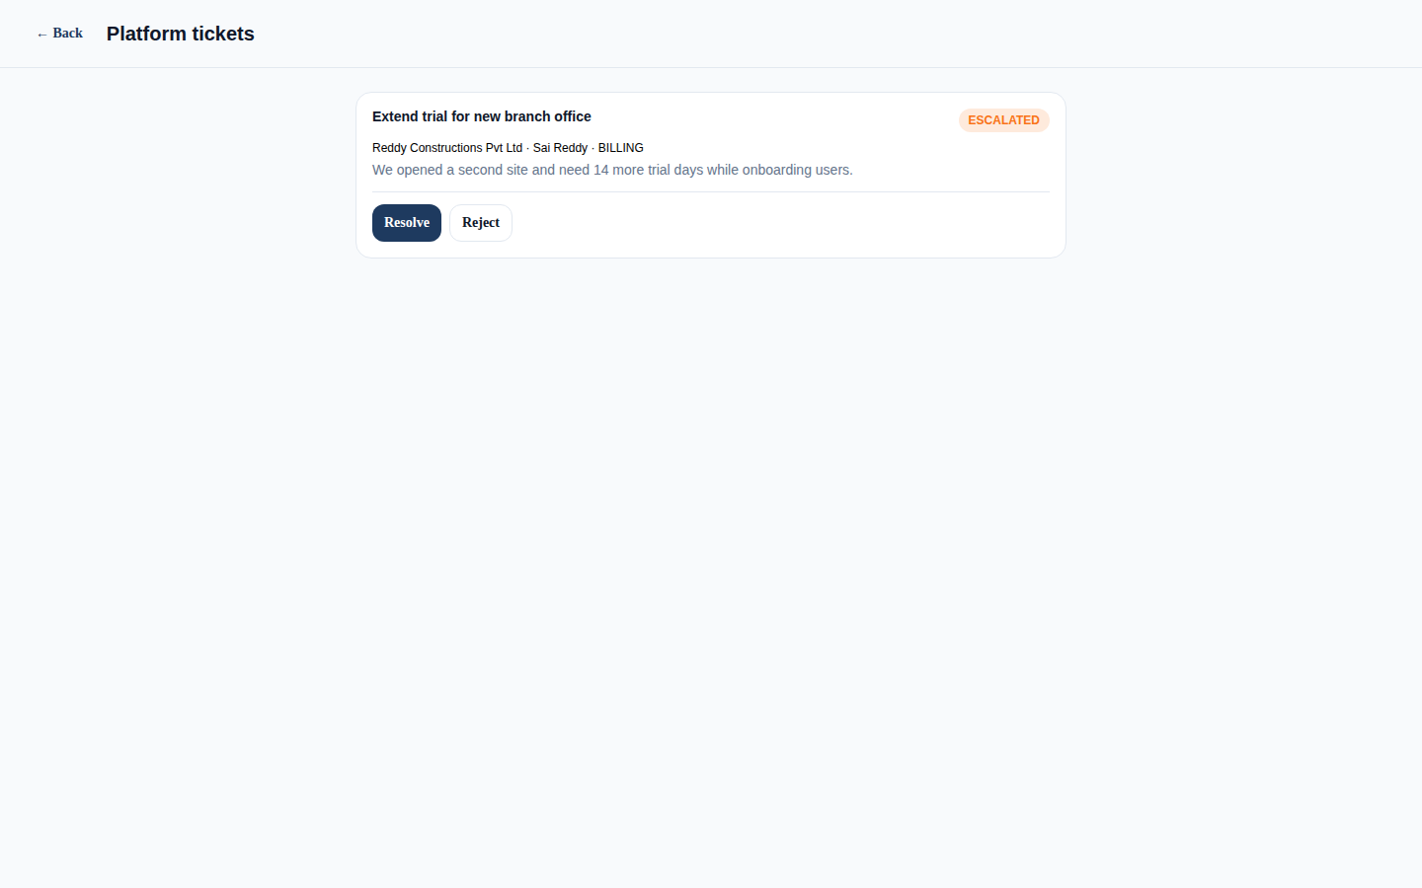
Platform — Companies & tickets
Search tenants, subscriptions, escalations
Companies: manage subscriptions & legal fields · Tickets: review owner escalations
BuildFlow v2.0 · Internal team walkthrough · Confidential
9 / 27

Slide 10
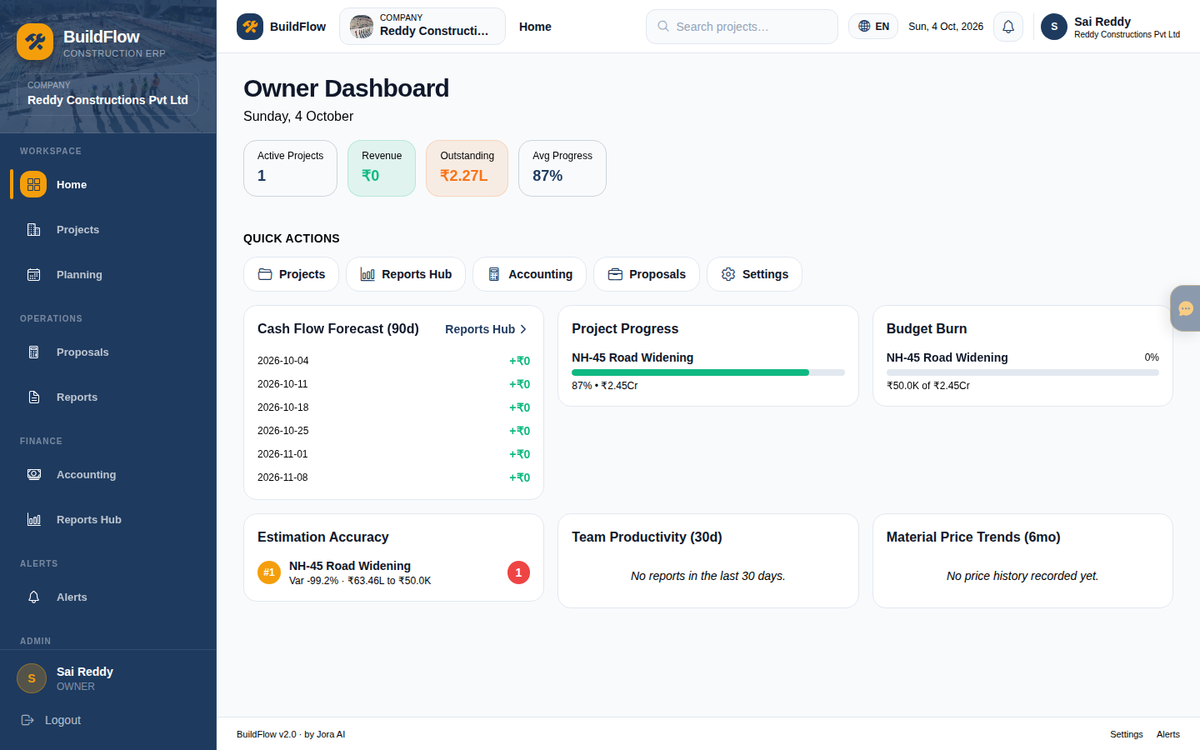
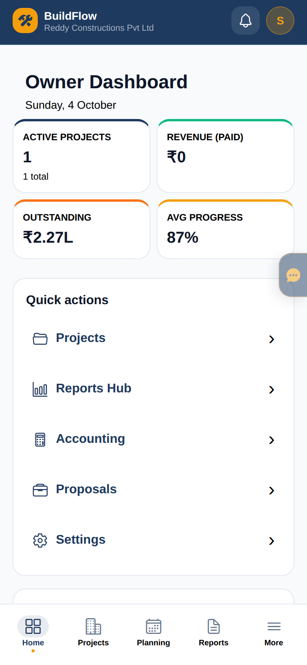
Construction — Owner Dashboard
Projects health, cash, budget burn, quick actions
Web — Owner Dashboard (Reddy Constructions)
Mobile — condensed home
BuildFlow v2.0 · Internal team walkthrough · Confidential
10 / 27

Slide 11
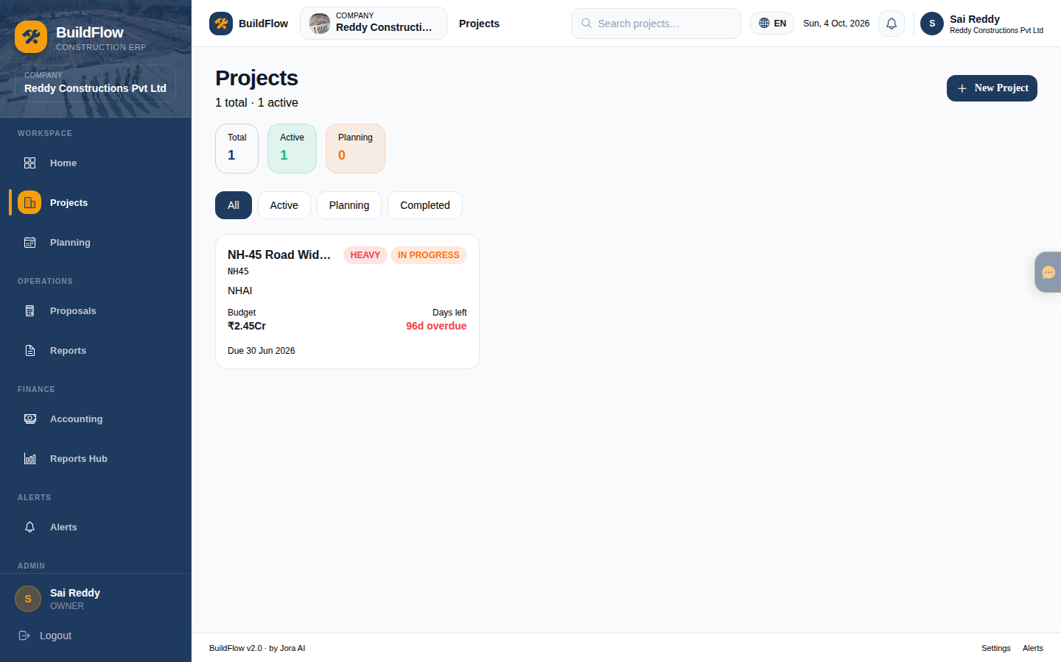
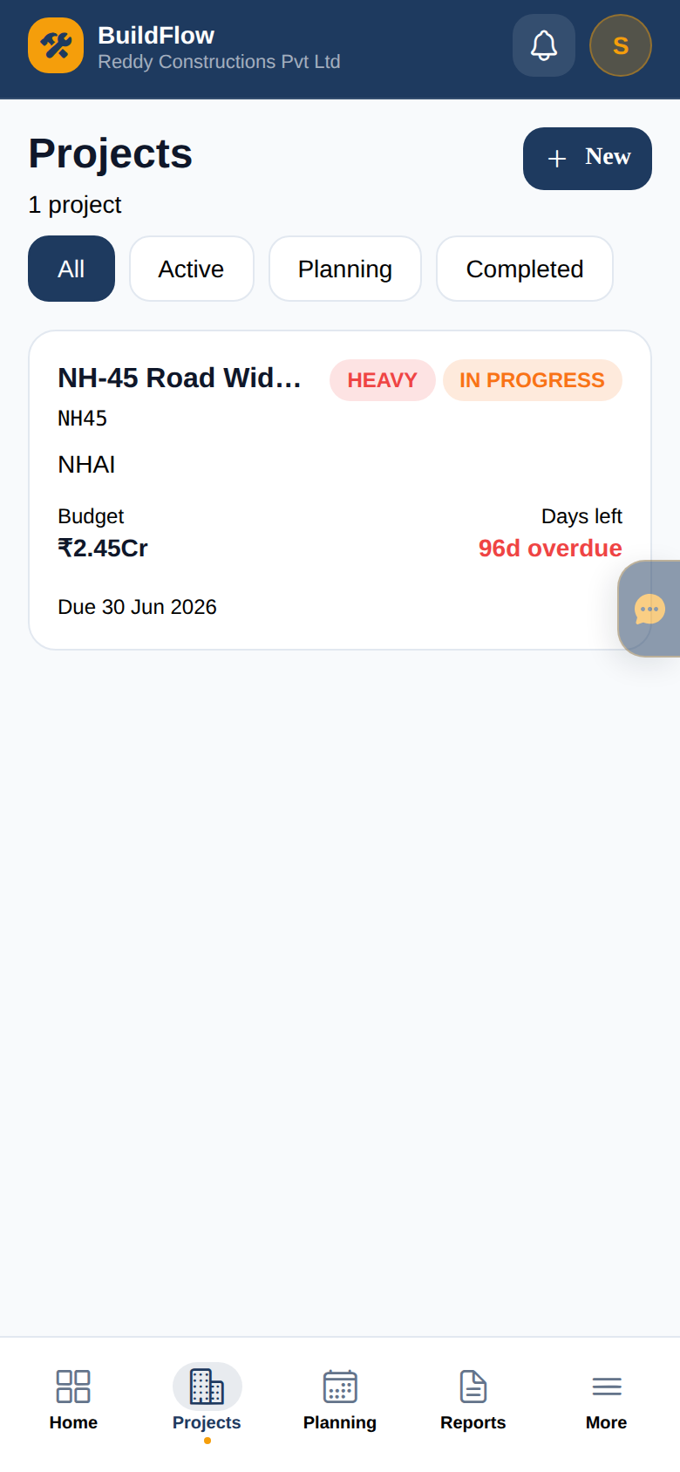
Construction — Projects
Project list, create, detail (BOQ, procurement, COs…)
Web — Projects workspace
Mobile — project list
BuildFlow v2.0 · Internal team walkthrough · Confidential
11 / 27

Slide 12
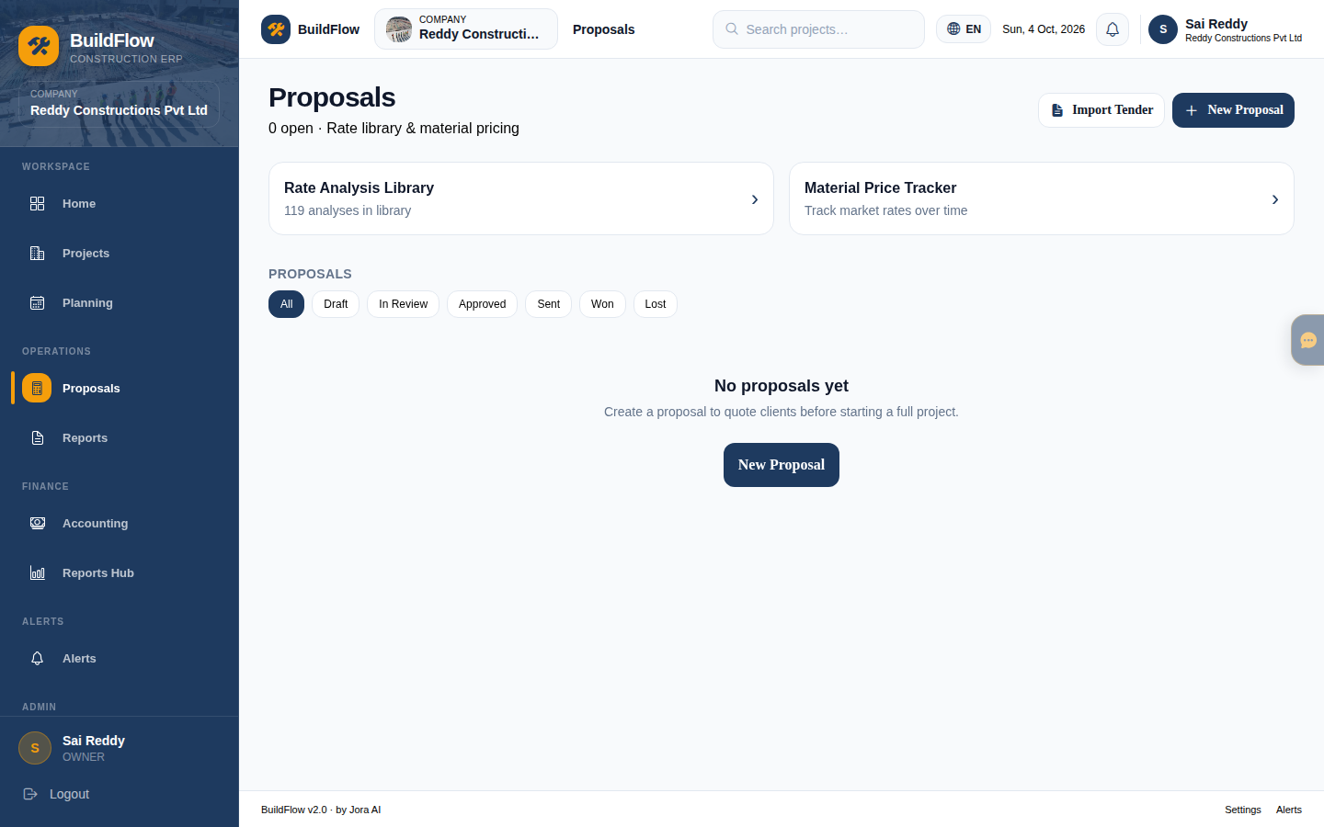

Construction — Proposals & Estimation
Tenders, estimates, rate analysis, BOQ conversion
Left: Proposals · Right: Estimation workspace
BuildFlow v2.0 · Internal team walkthrough · Confidential
12 / 27

Slide 13
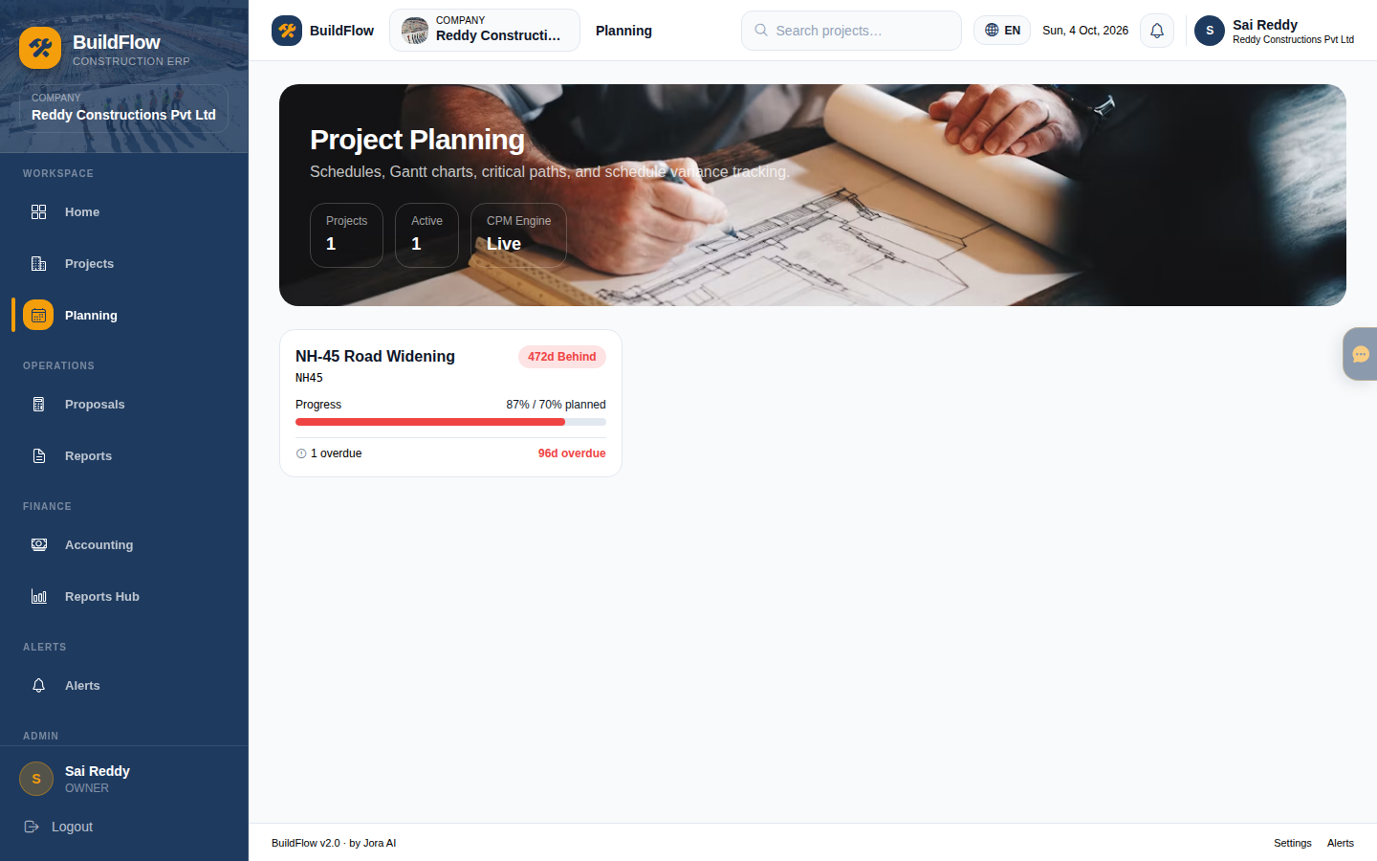
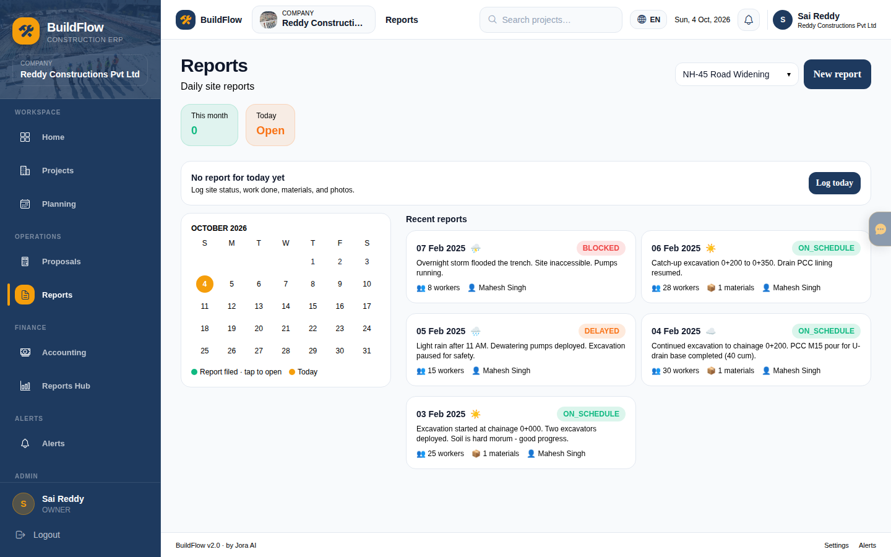
Construction — Planning & Site Reports
Schedules + daily operational reporting
Left: Planning · Right: Reports (site ops)
BuildFlow v2.0 · Internal team walkthrough · Confidential
13 / 27

Slide 14
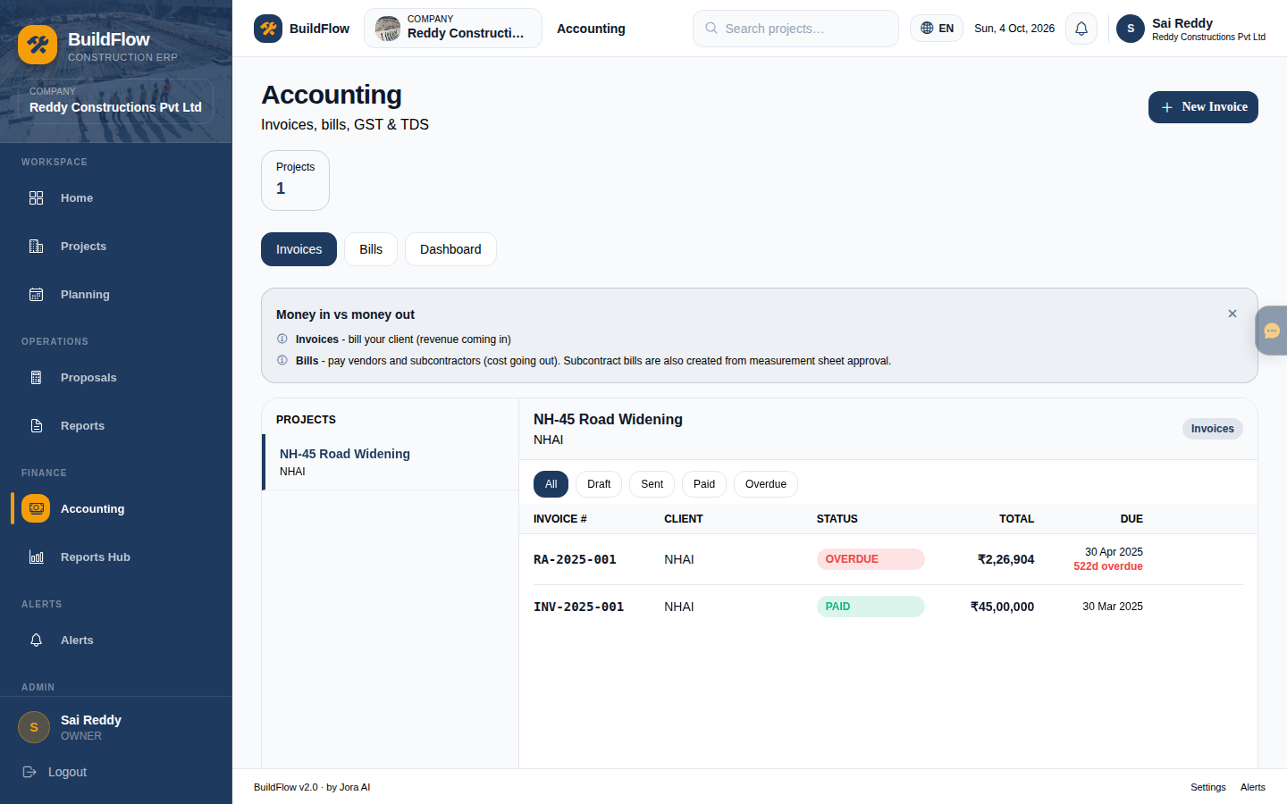
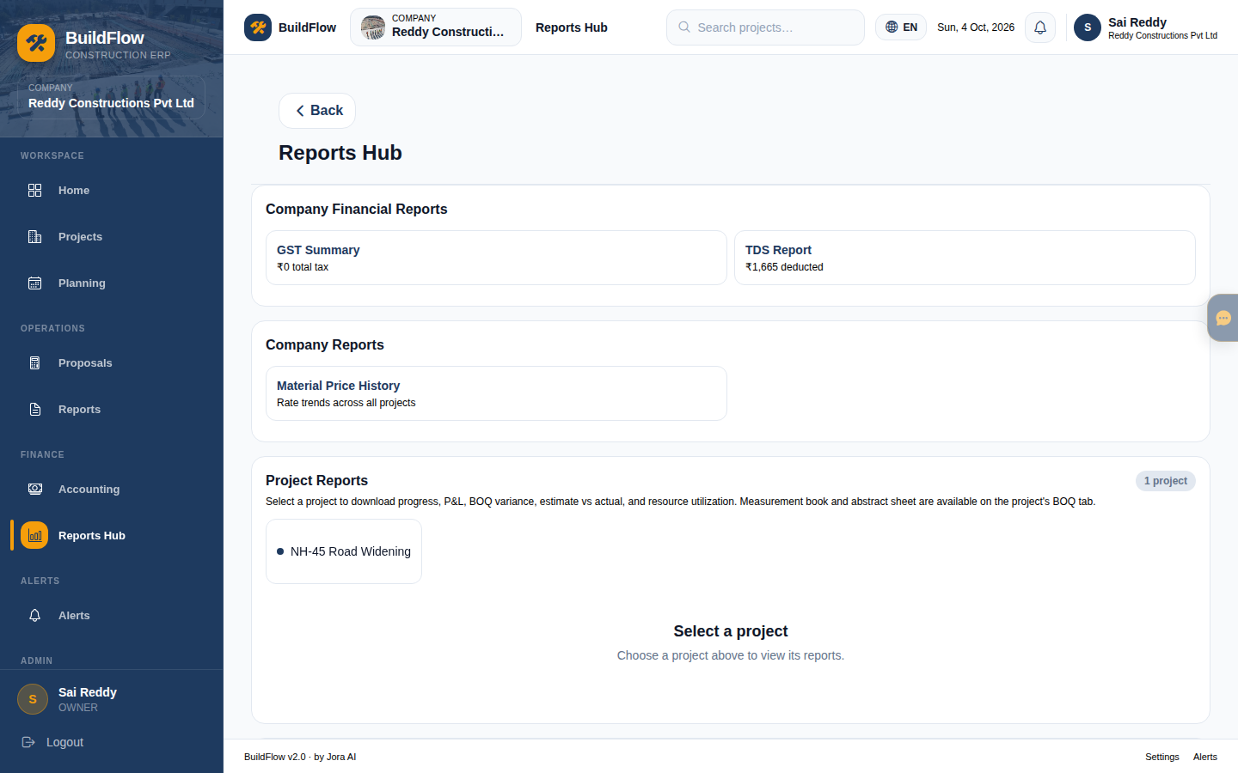
Construction — Accounting & Reports Hub
Invoices, bills, payments · downloadable finance reports
Left: Accounting · Right: Reports Hub
BuildFlow v2.0 · Internal team walkthrough · Confidential
14 / 27

Slide 15
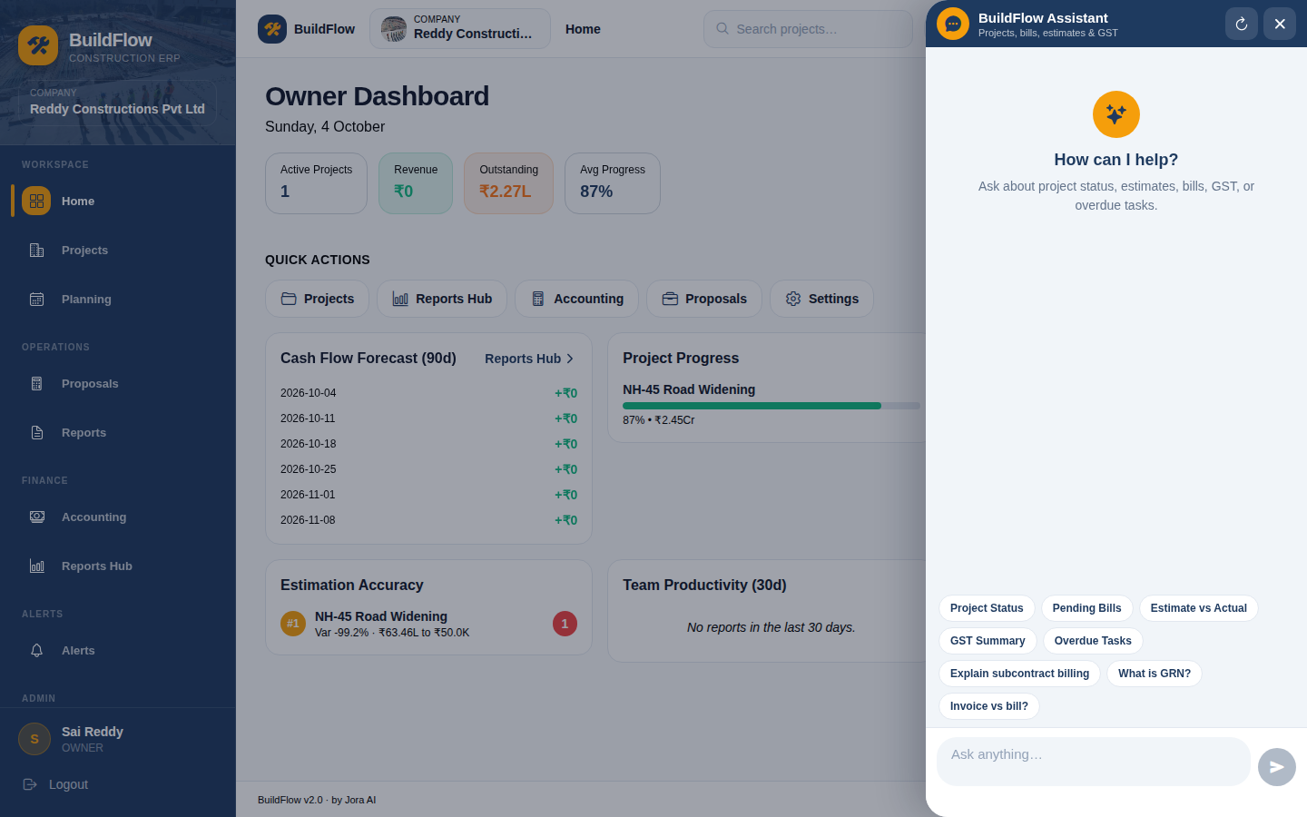
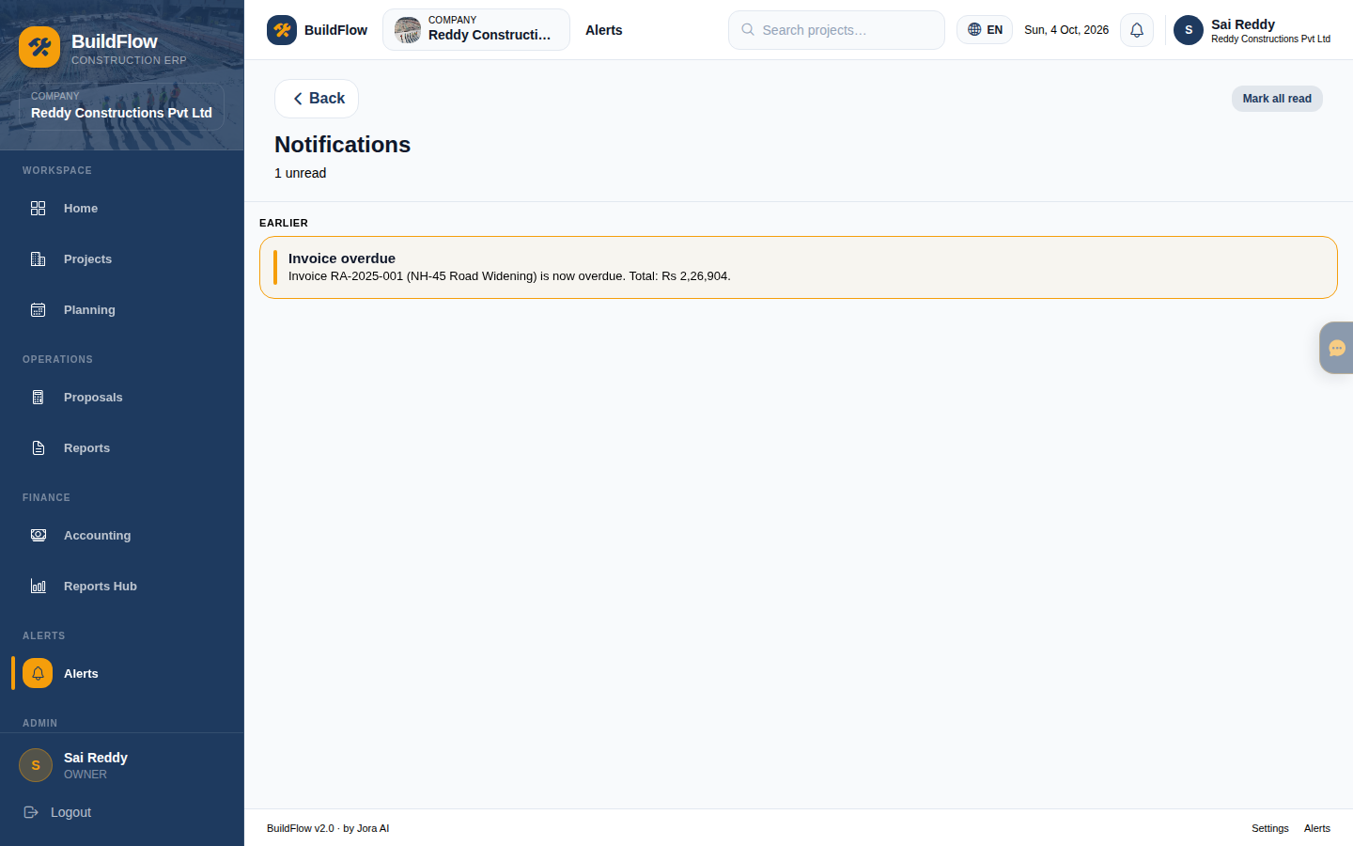
Construction — Assistant & Alerts
Permission-aware AI assistant + in-app notifications
Left: BuildFlow Assistant (overlay on dashboard) · Right: Alerts / notifications
BuildFlow v2.0 · Internal team walkthrough · Confidential
15 / 27

Slide 16
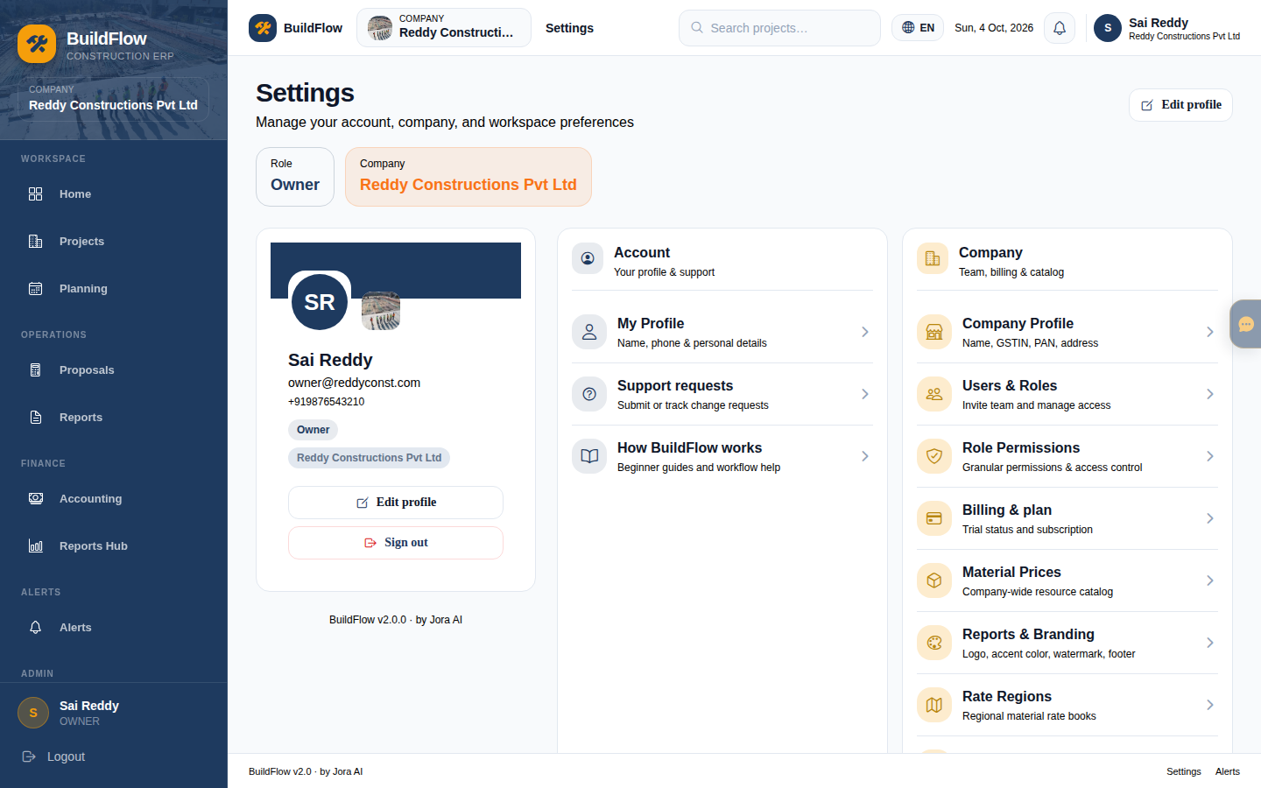
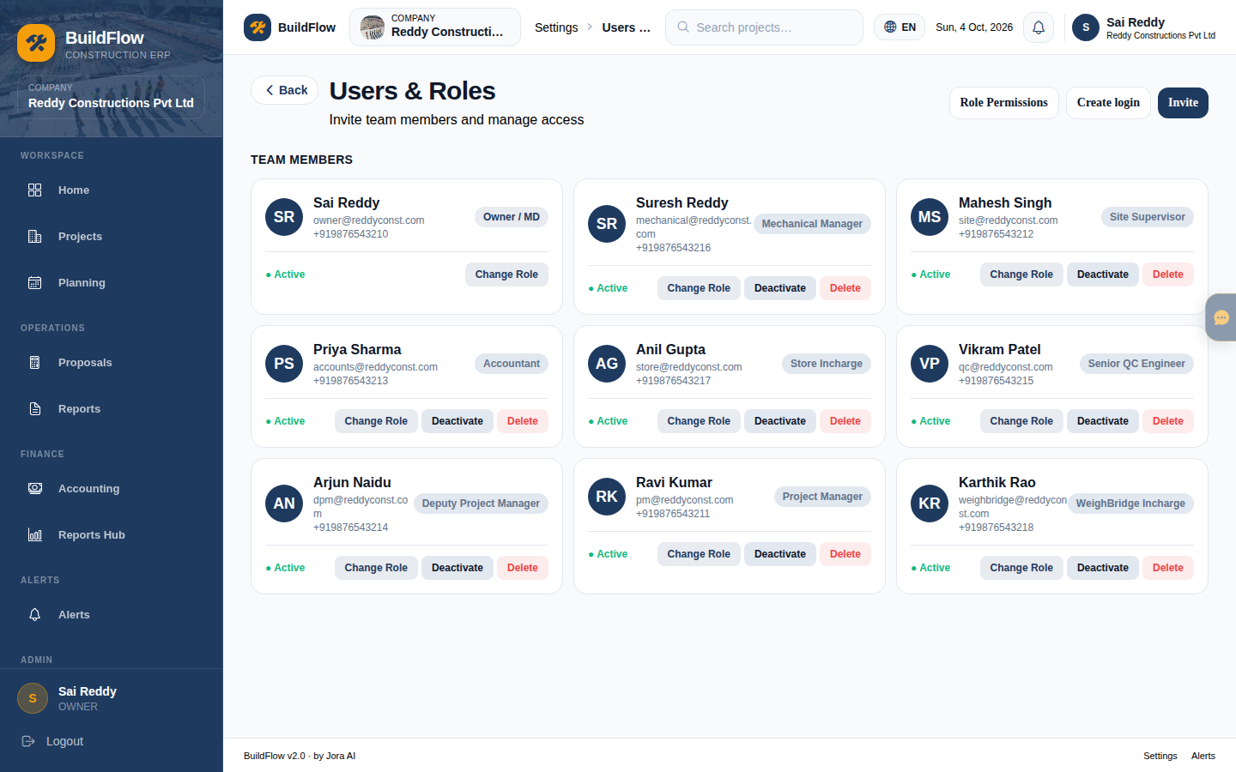
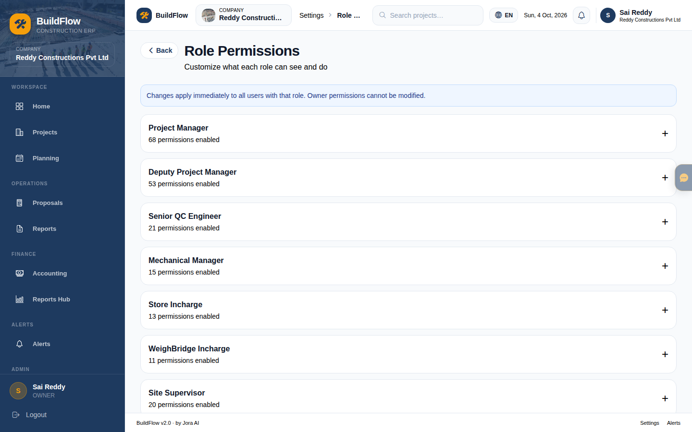
Construction — Admin settings
Company, users/invites, role permissions
Settings home · Users & invites · Role permissions
BuildFlow v2.0 · Internal team walkthrough · Confidential
16 / 27

Slide 17
Construction — function map
Everything under the ERP product mode
Workspace
Operations
Finance
Admin & more
• Home / Owner Dashboard
• Projects (create & detail)
• Planning / CPM
• Proposals & tenders
• Estimation & rate analysis
• Site reports & attendance
• Drawings / snags / RFIs (in project)
• Accounting (AR/AP)
• Reports Hub downloads
• Petty cash / change orders (project)
• Tally export
• Settings · Company · Billing
• Users & invites
• Permissions
• Integrations · Audit · Export
• Assistant · Alerts
BuildFlow v2.0 · Internal team walkthrough · Confidential
17 / 27

Slide 18
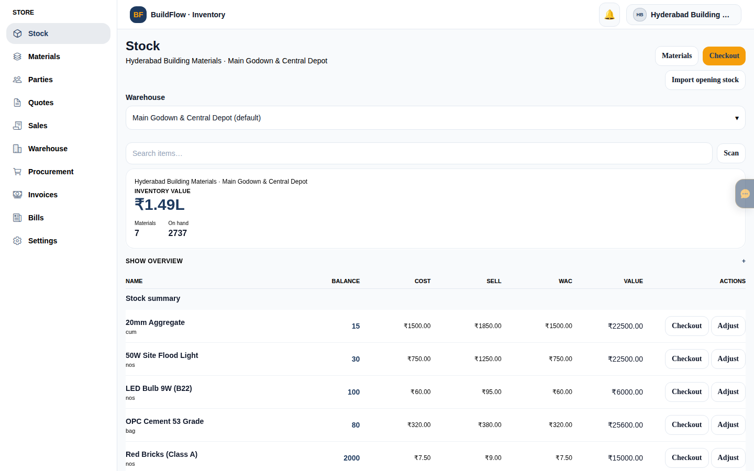
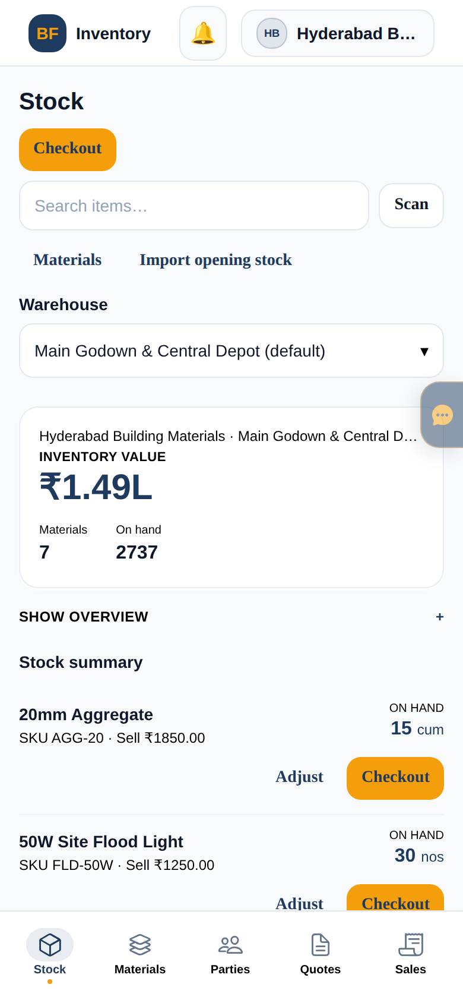
Inventory — Stock home
Value overview, search, scan, checkout, adjust
Web — Stock (Hyderabad Building Materials)
Mobile — Stock + bottom tabs
BuildFlow v2.0 · Internal team walkthrough · Confidential
18 / 27

Slide 19
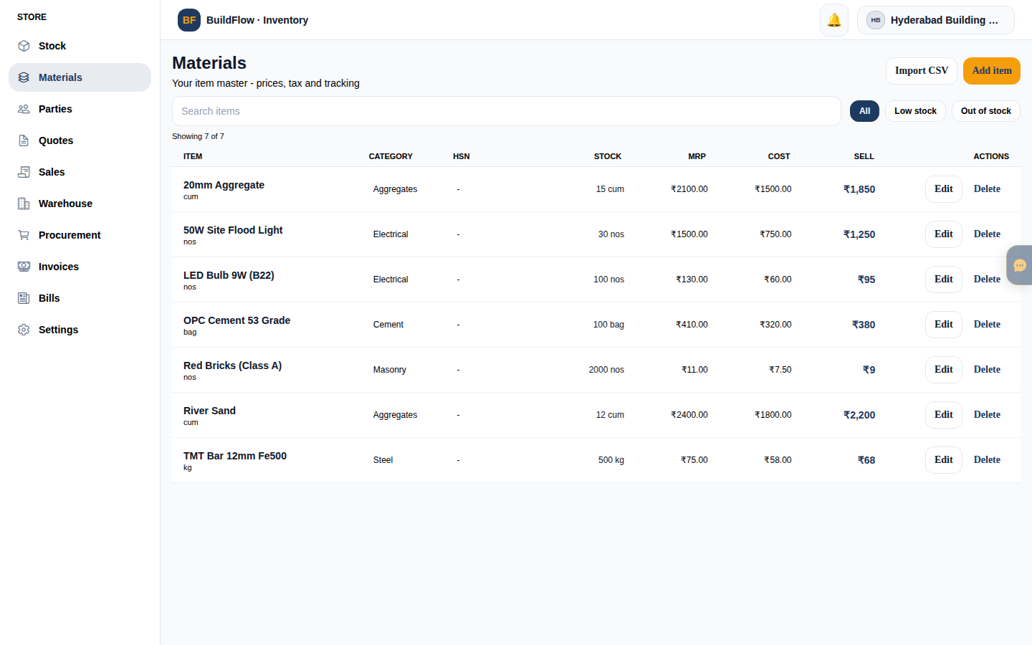
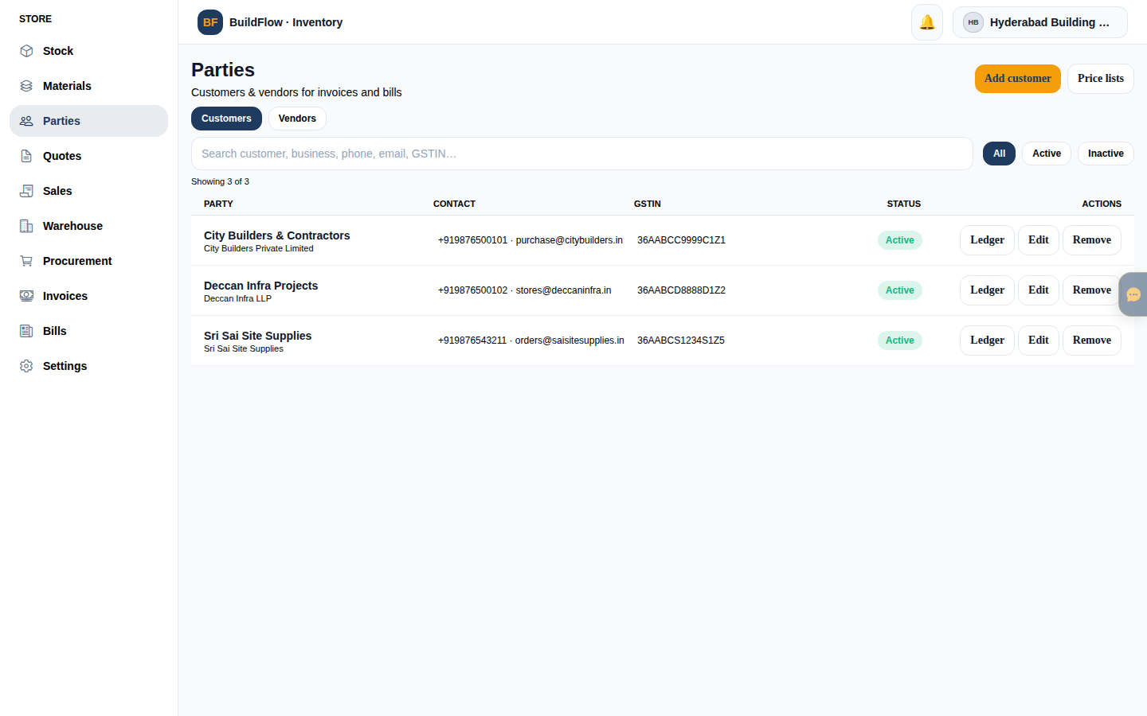
Inventory — Materials & Parties
SKU catalog + customers/vendors
Left: Materials · Right: Parties
BuildFlow v2.0 · Internal team walkthrough · Confidential
19 / 27

Slide 20
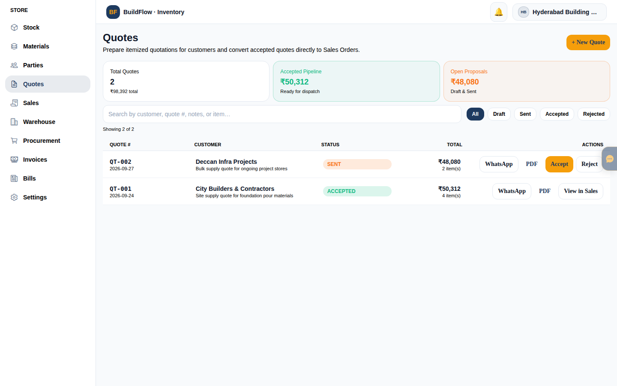
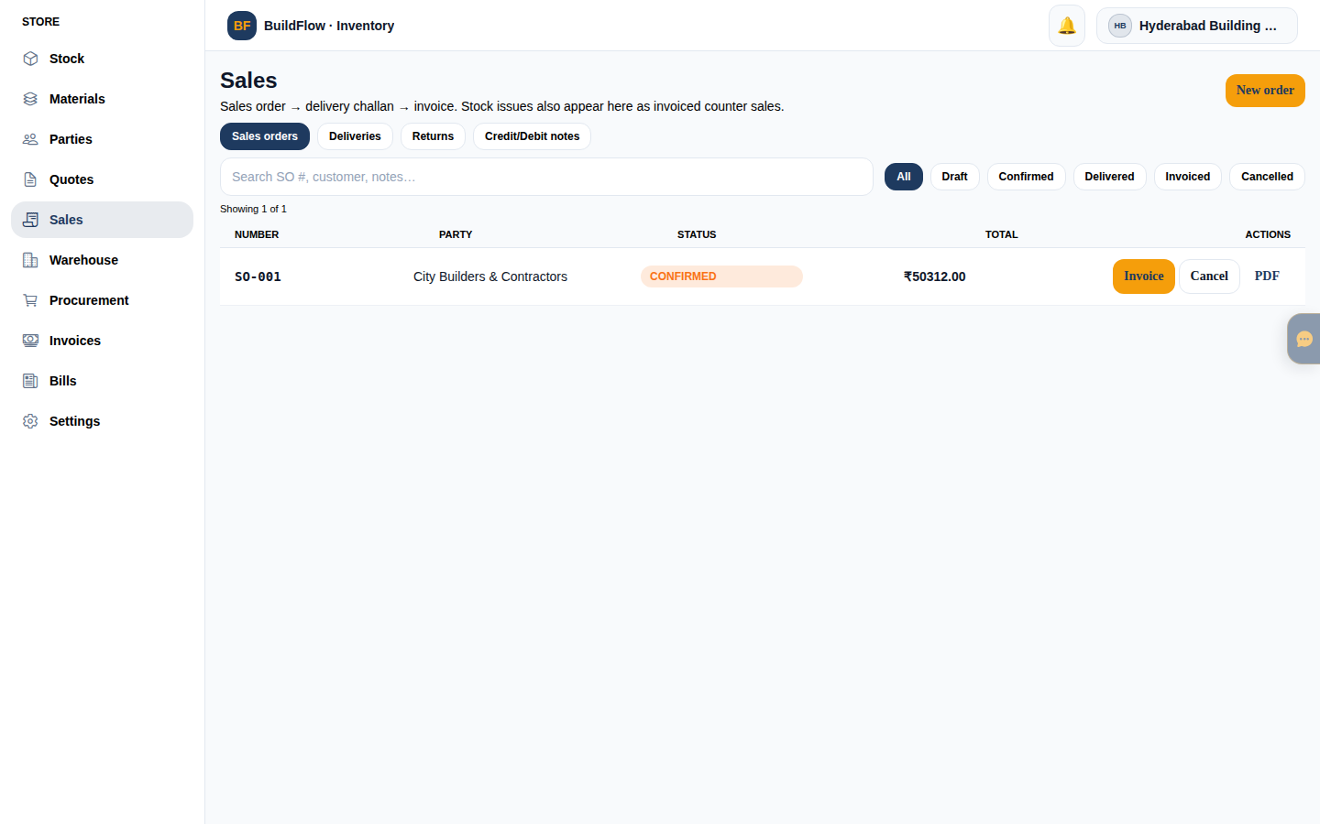
Inventory — Quotes & Sales
Quote → sell / POS-style checkout path
Left: Quotes · Right: Sales
BuildFlow v2.0 · Internal team walkthrough · Confidential
20 / 27

Slide 21
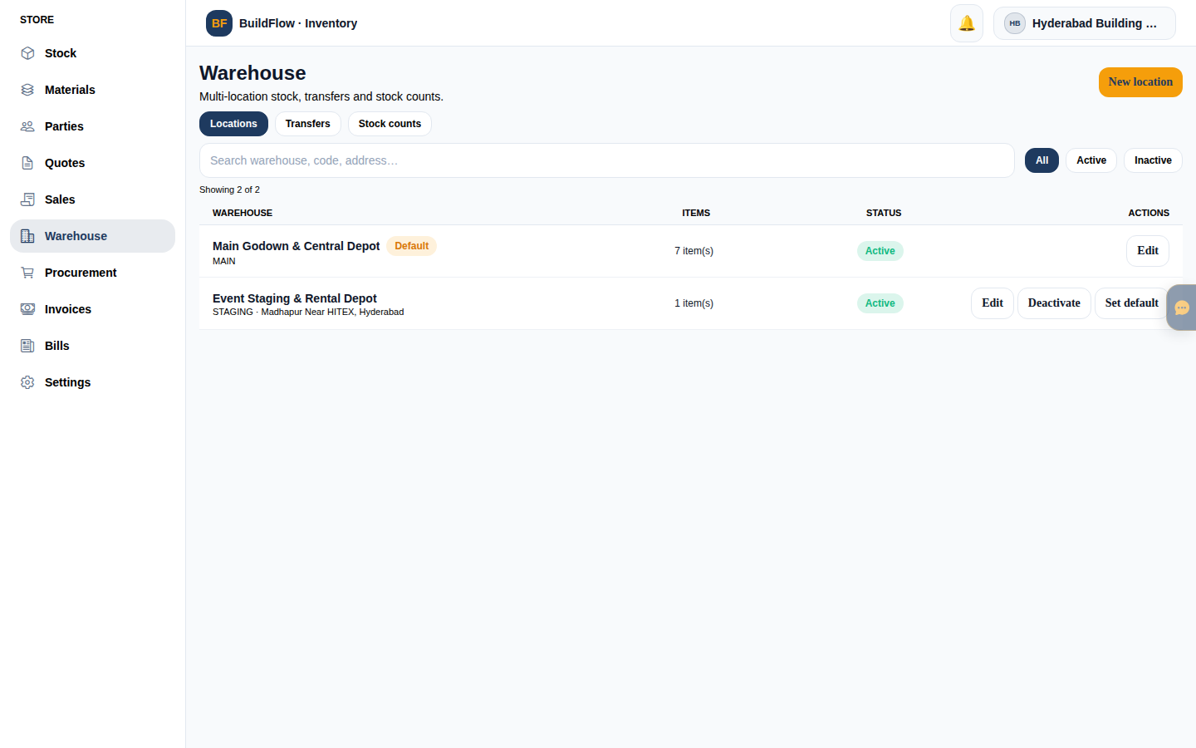
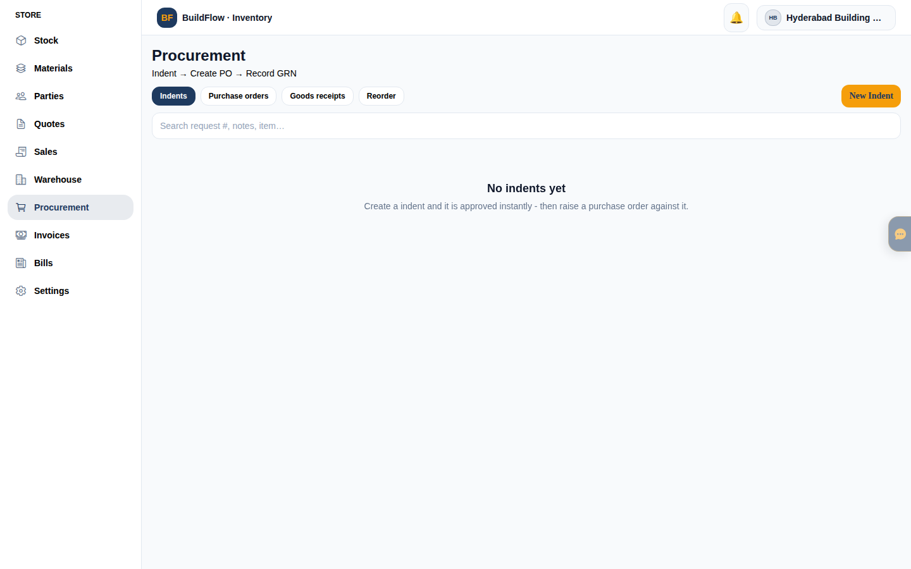
Inventory — Warehouse & Procurement
Transfers, staging, purchase side
Left: Warehouse · Right: Procurement
BuildFlow v2.0 · Internal team walkthrough · Confidential
21 / 27

Slide 22
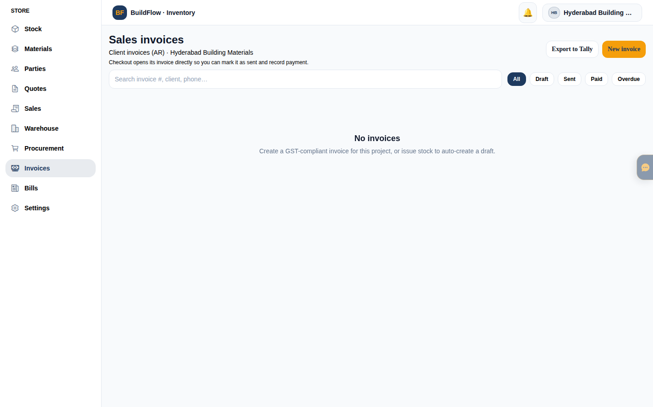
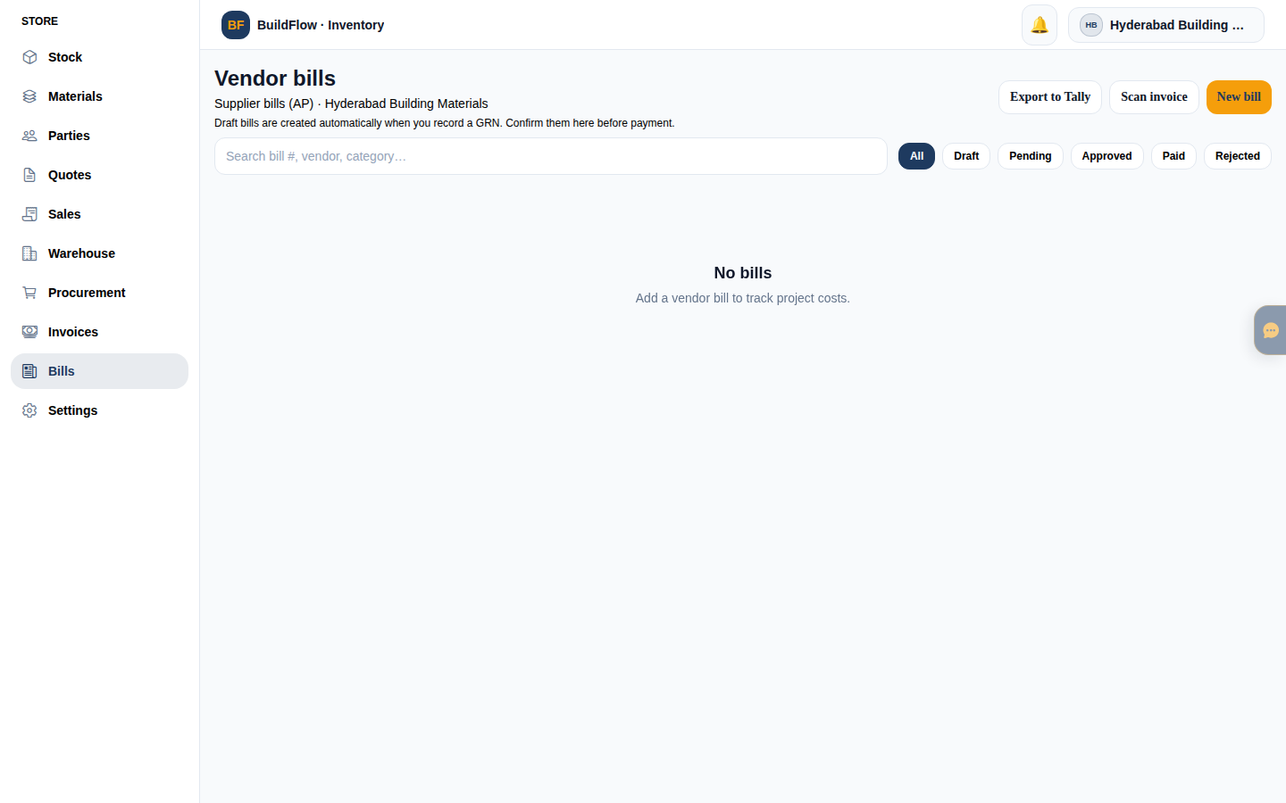
Inventory — Invoices & Bills
AR (sales invoices) and AP (purchase bills)
Left: Invoices · Right: Bills
BuildFlow v2.0 · Internal team walkthrough · Confidential
22 / 27

Slide 23
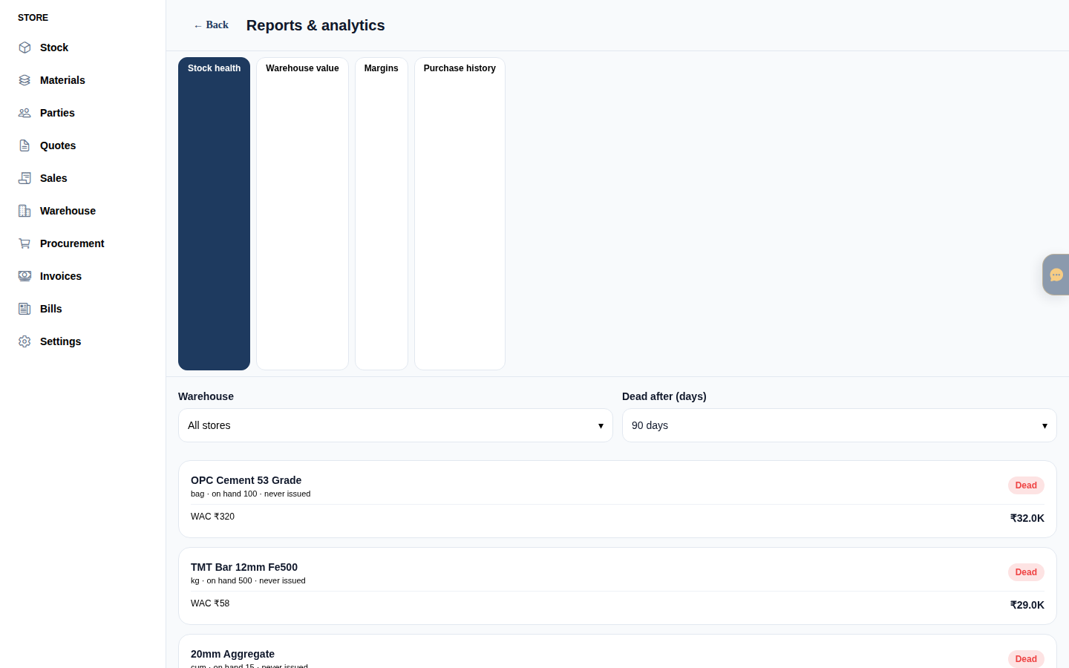
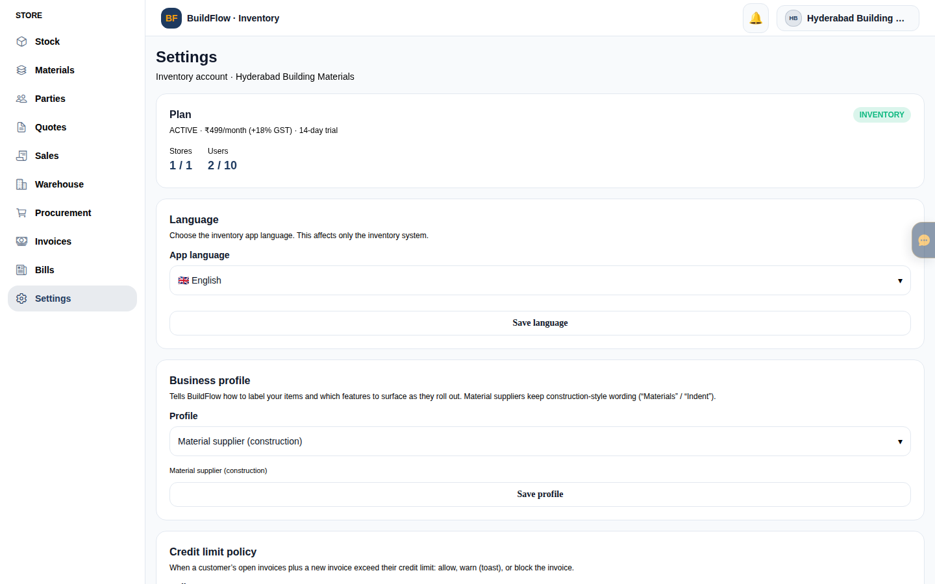
Inventory — Reports & Settings
Ops insights + business profile / users
Left: Reports · Right: Settings (profile, vertical, team)
BuildFlow v2.0 · Internal team walkthrough · Confidential
23 / 27

Slide 24
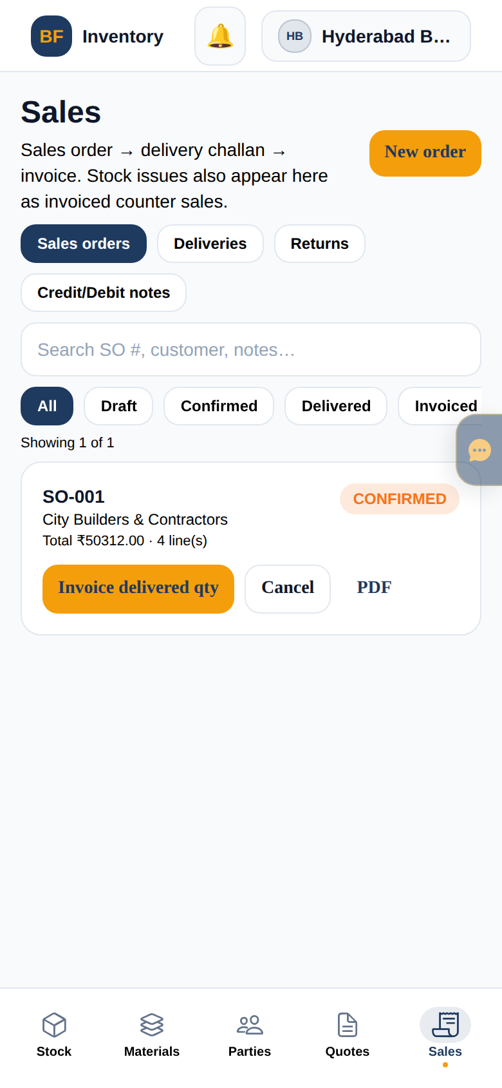
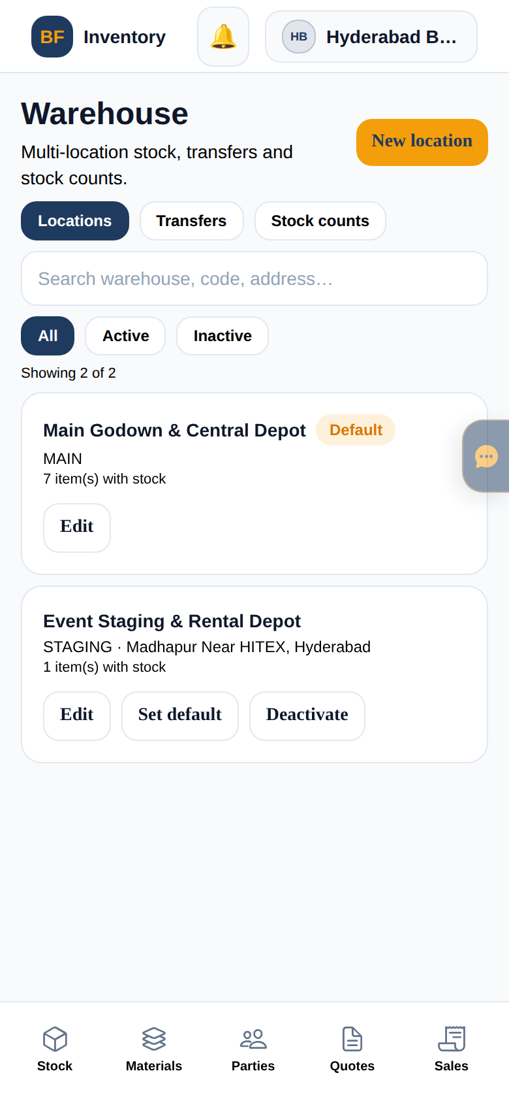
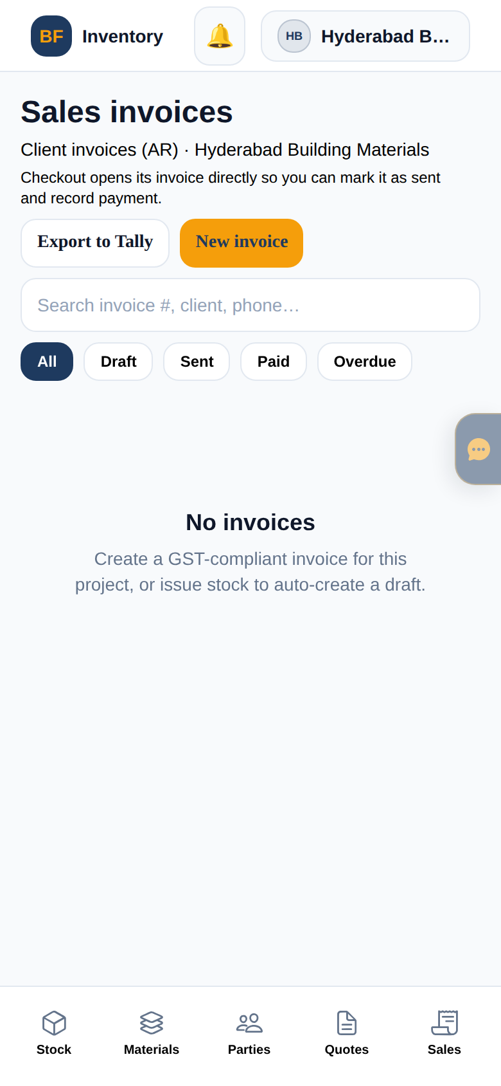
Inventory on mobile
Bottom tabs for field / counter use
Stock
Sales
Warehouse
Invoices
BuildFlow v2.0 · Internal team walkthrough · Confidential
24 / 27

Slide 25
Inventory — function map
Shell tabs + supporting screens
• Stock — on-hand, value, adjust, checkout, barcode scan
• Materials — SKU master, units, prices
• Parties — customers & vendors
• Quotes — customer quotations (events wording where vertical=EVENTS)
• Sales — sell / checkout flows
• Warehouse — multi-location, transfers
• Procurement — purchasing / inbound
• Invoices — sales AR with filters
• Bills — purchase AP with filters
• Reports — inventory analytics
• Settings — business profile, vertical, language, team
• Notifications + AI assistant FAB
Business profiles (demo)
• Material supplier
• Retail / Kirana (GENERAL + FEFO)
• Wholesale / cash & carry
• Distributor / stockist
• Trader
• Equipment dealer
• Events & lighting (EVENTS vertical)
• General business
BuildFlow v2.0 · Internal team walkthrough · Confidential
25 / 27

Slide 26
Suggested team walkthrough
30–40 minutes
Platform
Construction
1
Log in as admin@buildflow.com — open Companies & Tickets.
2
owner@reddyconst.com — Dashboard → Projects → open NH-45 sample.
Estimate path
Site ops
3
Proposals / Estimation → show BOQ & permissions.
4
Planning + Reports + Assistant FAB.
Finance
Admin
5
Accounting + Reports Hub.
6
Settings → Users & Role permissions.
Inventory
Verticals
7
owner@hydmaterials.com — Stock → Sales → Invoices.
8
Optional: kirana-demo (FEFO) or luminalighting (events).
BuildFlow v2.0 · Internal team walkthrough · Confidential
26 / 27

Slide 27
Questions & next steps
Screenshots live under docs/team-ppt/screenshots/
Re-capture anytime: node docs/team-ppt/capture-screens.mjs
Credentials: docs/DEMO_CREDENTIALS.txt
BuildFlow v2.0 — built for the field, designed for the boardroom.

