Slide 1

Ready for owners who run sites & boards
✓ Approve estimates & variations from anywhere
✓ See budgets and receivables on Owner Home
✓ Invite PM, site, store, QC, accounts in minutes
✓ Same live data on Android, iOS, and Web
BuildFlow
Construction ERP
Android · iOS · Web
Owner Quick-Start Guide
One company account. Use it on phone at site and on desktop in the office.
Screenshots: live Reddy Constructions demo · BuildFlow v2.0

Slide 2
One product — three surfaces
Owners and teams use the same Construction ERP on phone and desktop
Android
iOS
Web
Phone & tablet at site, store, weighbridge
iPhone / iPad for PM & Owner on the move
Desktop for estimates, accounting, approvals
How to open it
• Web: open your BuildFlow company URL in Chrome / Edge / Safari
• Android: install the BuildFlow app (or open the same URL in Chrome)
• iOS: install the BuildFlow app (or open the same URL in Safari / Add to Home Screen)
• Login is always email/mobile + OTP — no passwords to share on WhatsApp
BuildFlow Construction ERP · Android · iOS · Web · Owner Quick-Start
2 / 17

Slide 3
What you will learn
Practical path so your company starts using BuildFlow this week
01
02
03
04
Sign in (OTP)
Owner Home
Projects
Estimates → BOQ
05
06
07
08
Procurement
Accounting
Invite team
Day-1 checklist
BuildFlow Construction ERP · Android · iOS · Web · Owner Quick-Start
3 / 17

Slide 4
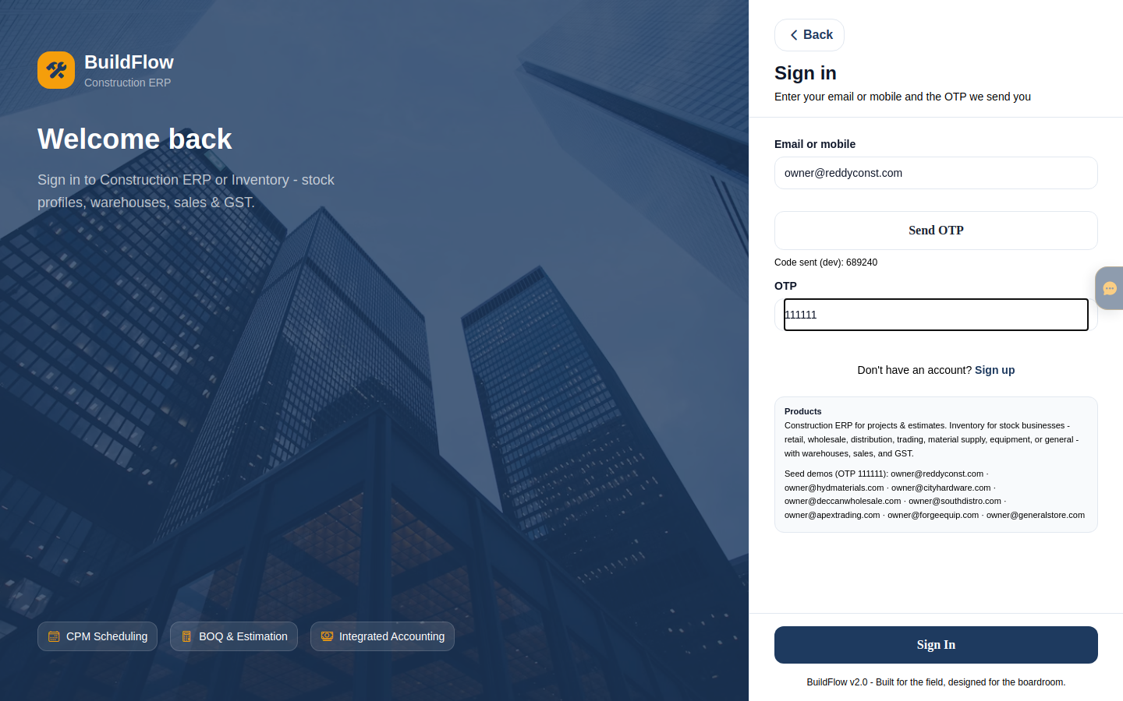
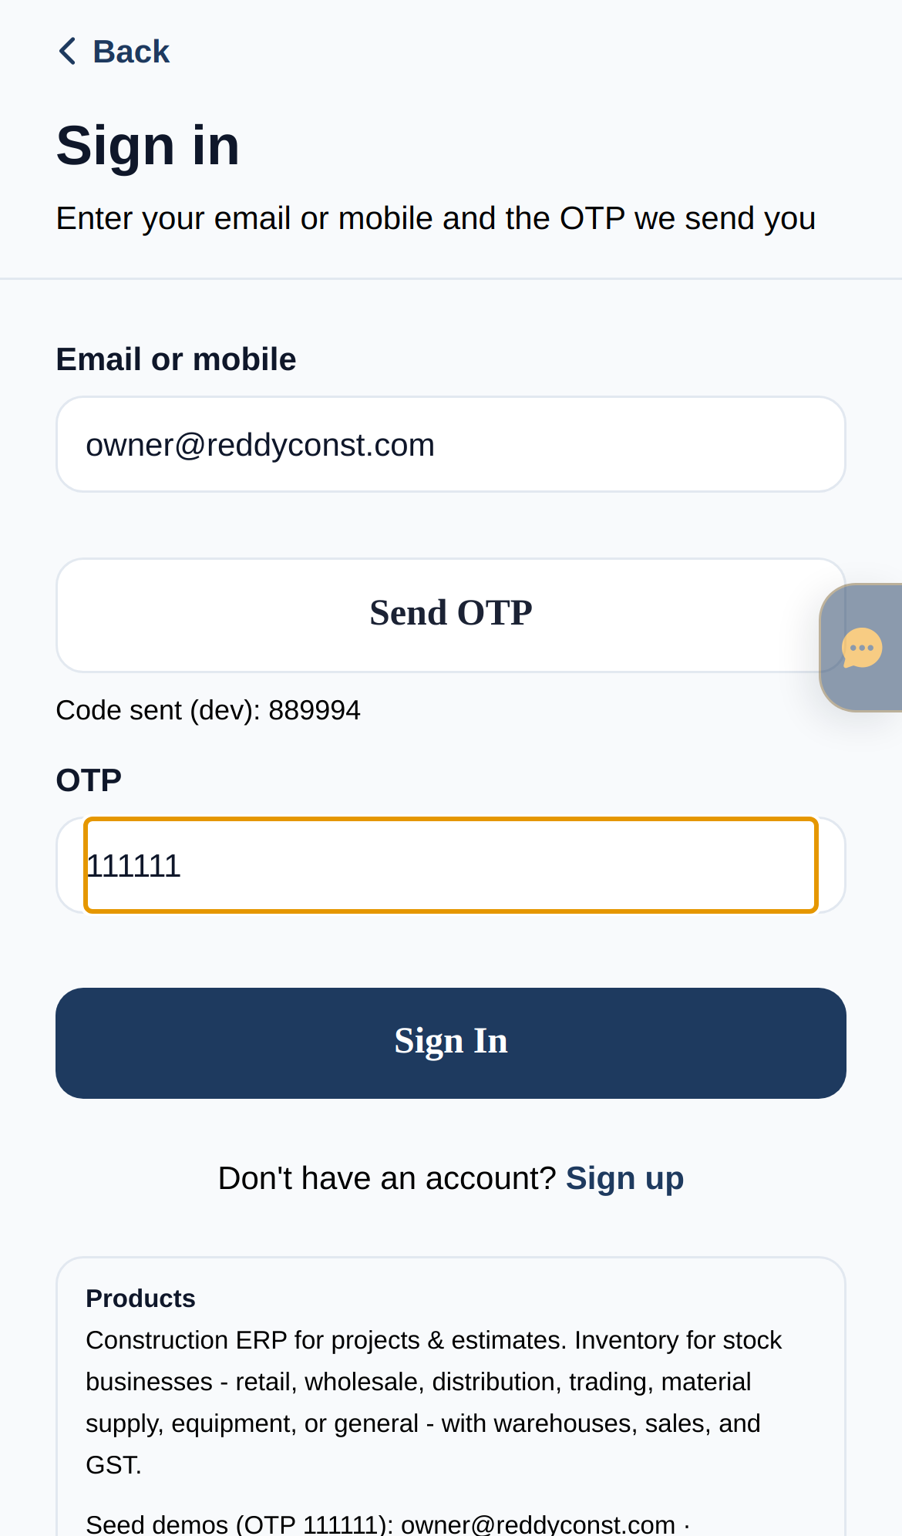
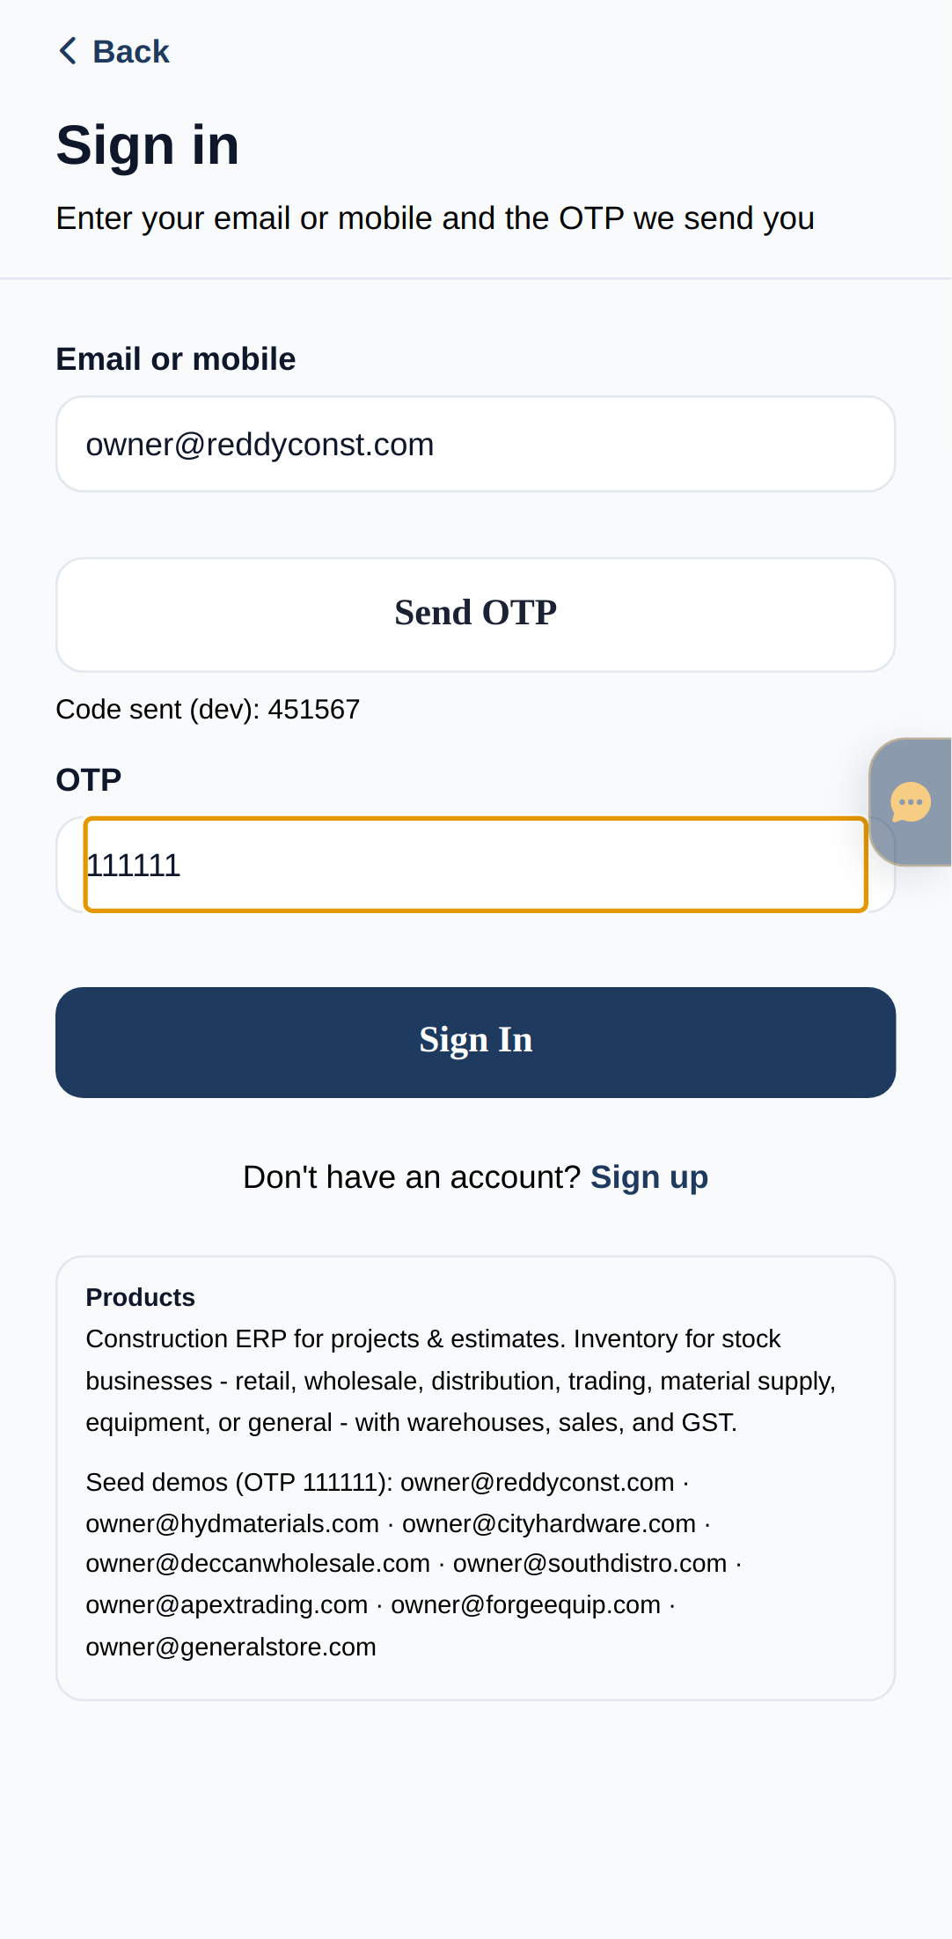
1. Sign in — email or mobile + OTP
Identical login on Android, iOS, and Web. Owners and field staff use the same secure flow.
WEB
iOS
ANDROID
Same account · same data · Send OTP · Enter 6-digit code · Land on Owner Home
BuildFlow Construction ERP · Android · iOS · Web · Owner Quick-Start
4 / 17

Slide 5
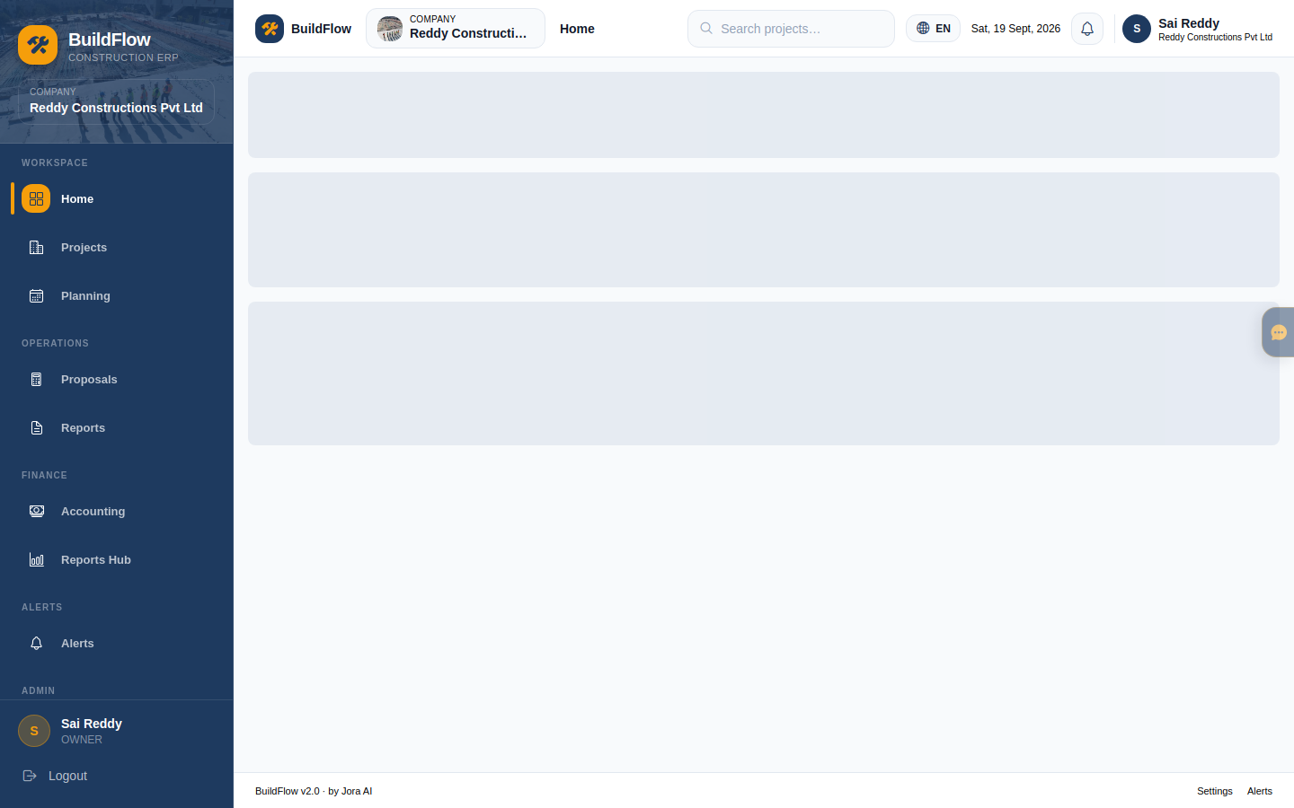
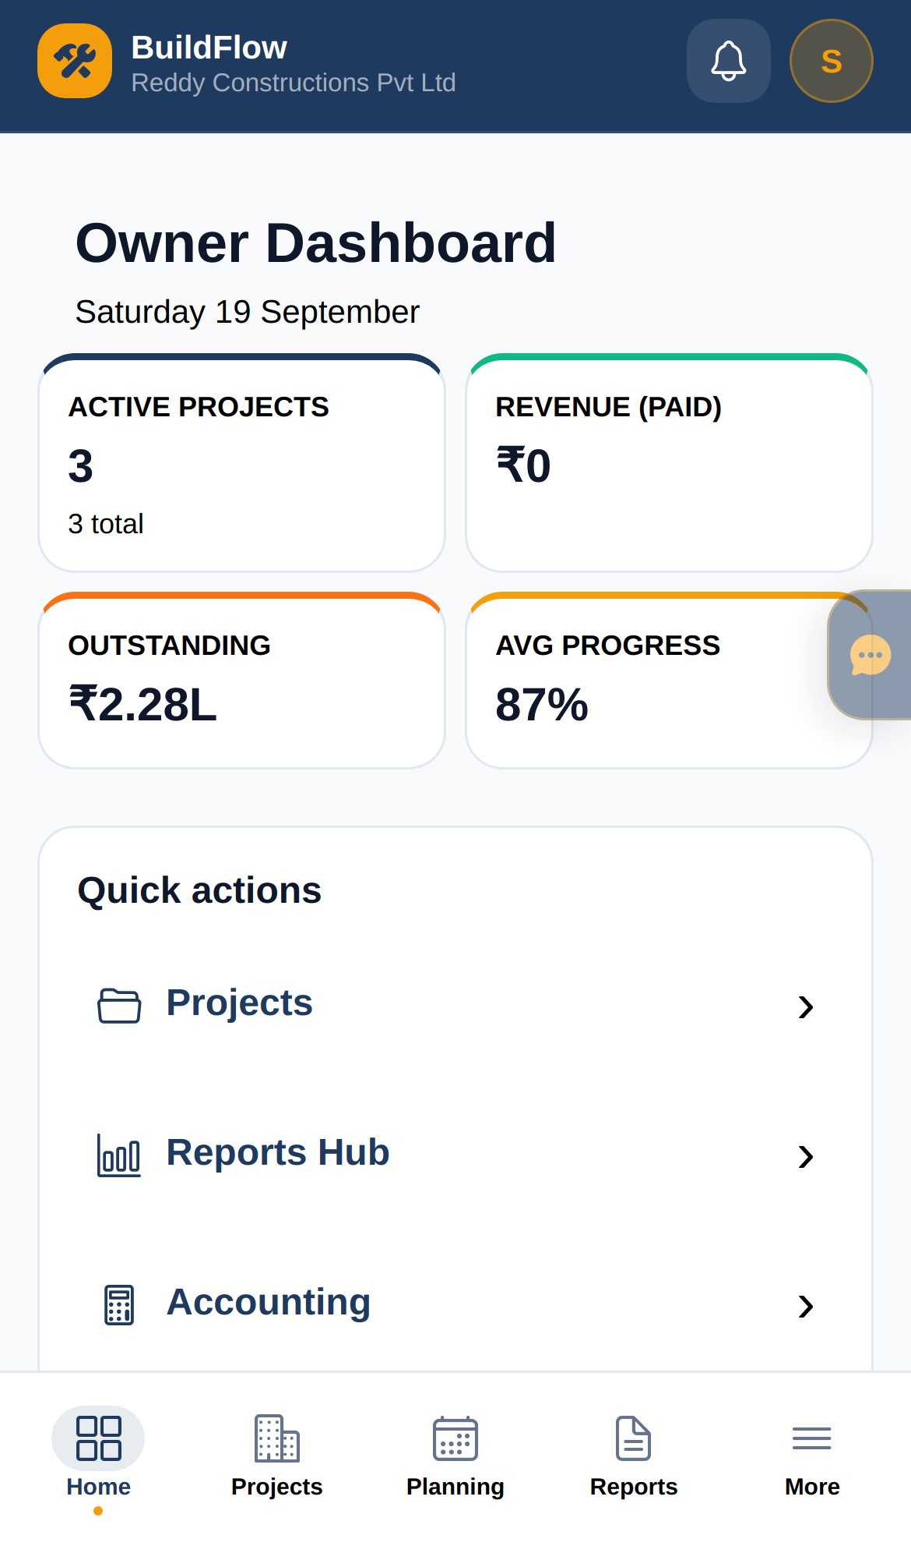
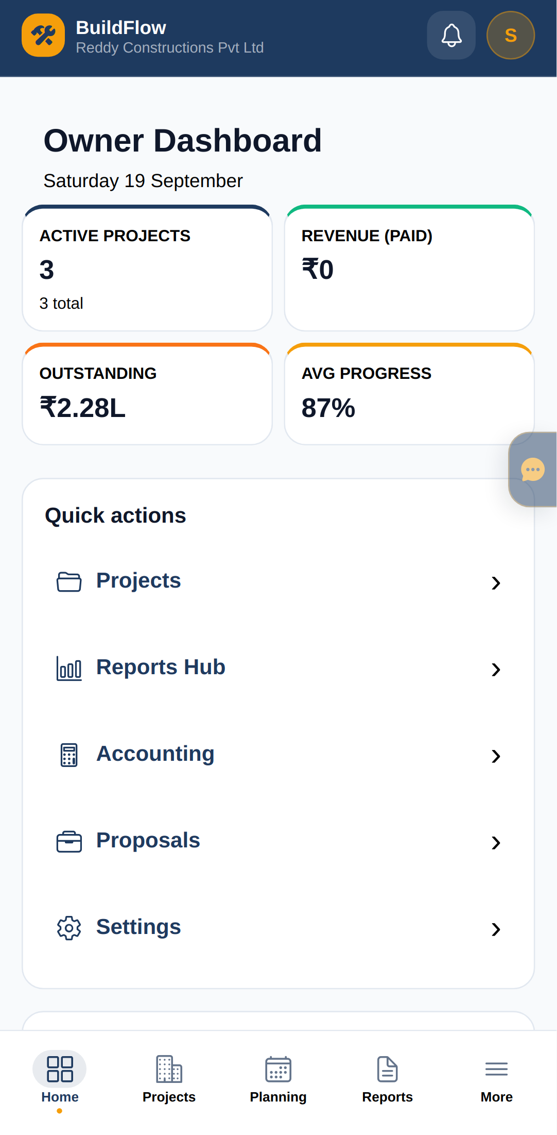
2. Owner Home — company pulse
Active projects, receivables, progress, budget burn, team activity — on phone or desktop.
WEB
iOS
ANDROID
Same account · same data · KPIs at a glance · Quick actions · Approve from anywhere
BuildFlow Construction ERP · Android · iOS · Web · Owner Quick-Start
5 / 17

Slide 6
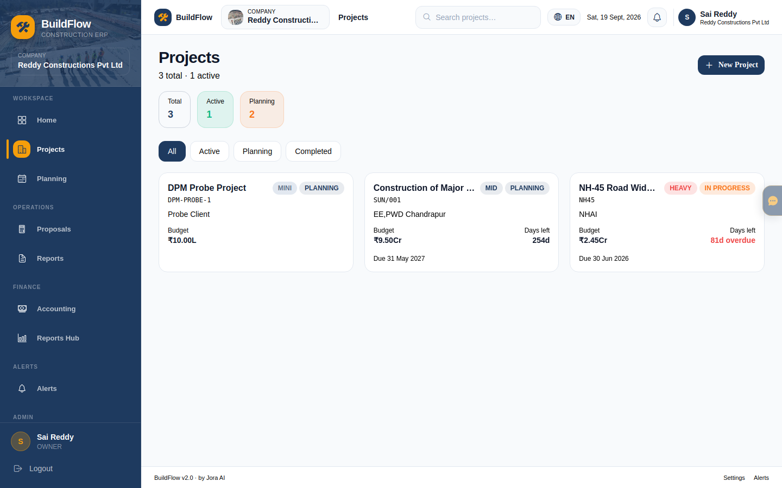
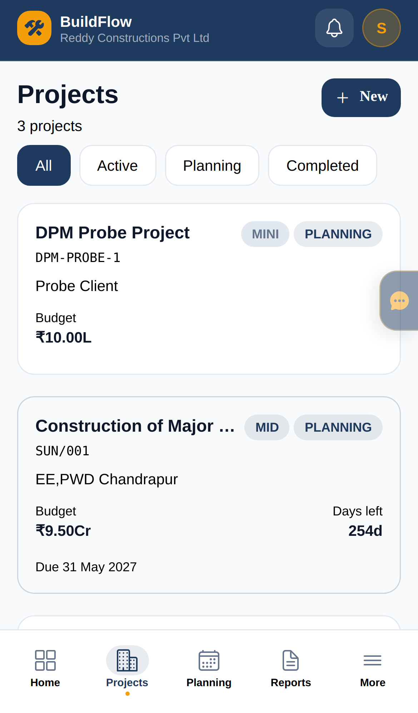
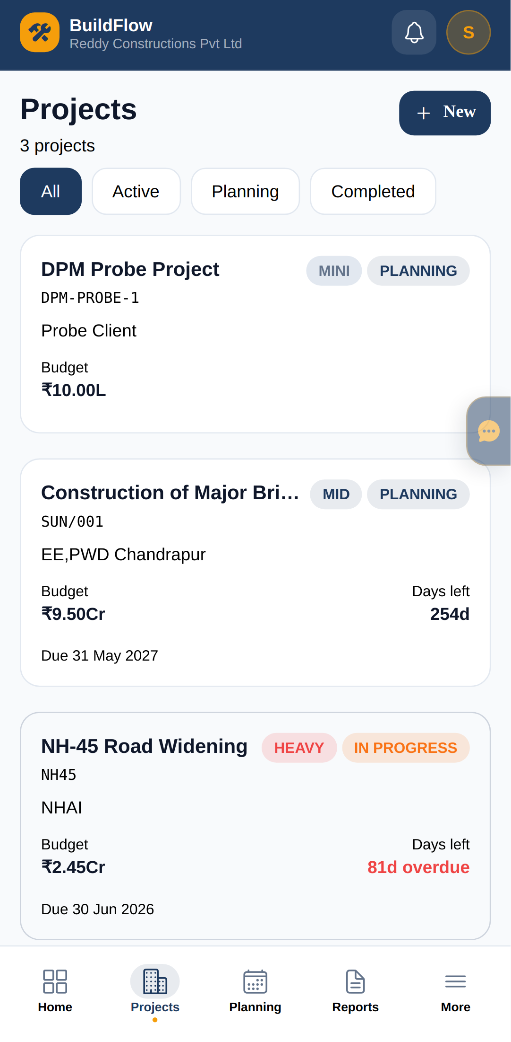
3. Projects — your portfolio
Create jobs, set budgets, open any site. Desktop for planning; phone for quick checks.
WEB
iOS
ANDROID
Same account · same data · + New Project · Filter Active / Planning · Open NH-45 sample
BuildFlow Construction ERP · Android · iOS · Web · Owner Quick-Start
6 / 17

Slide 7
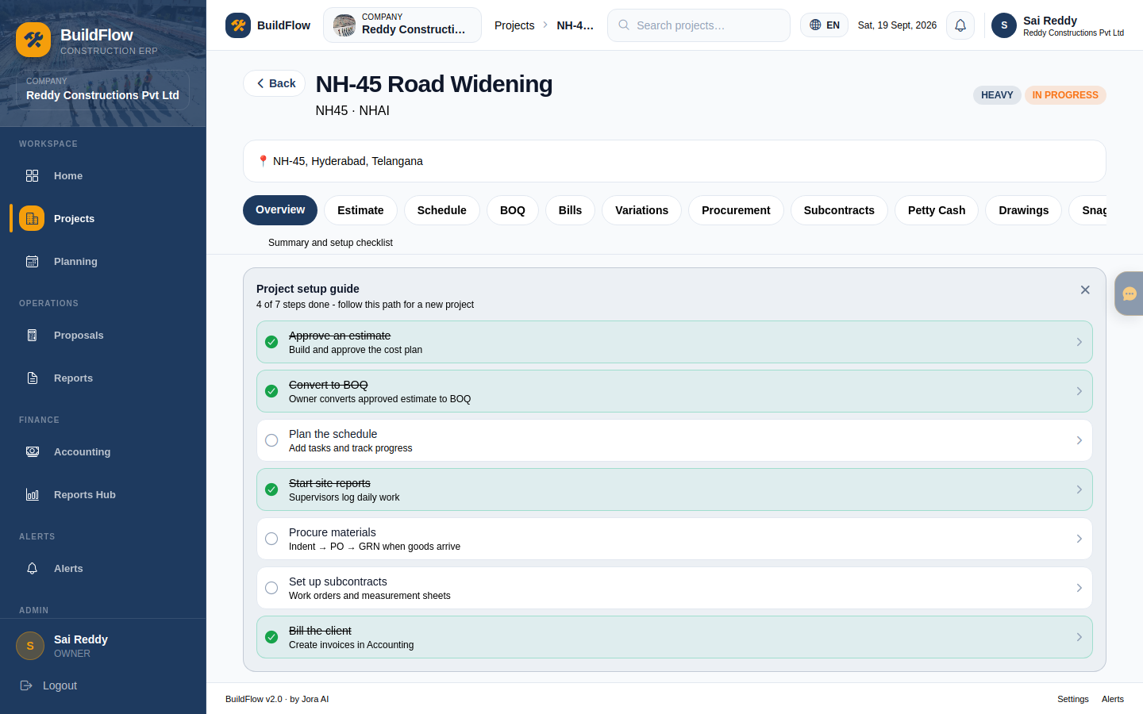
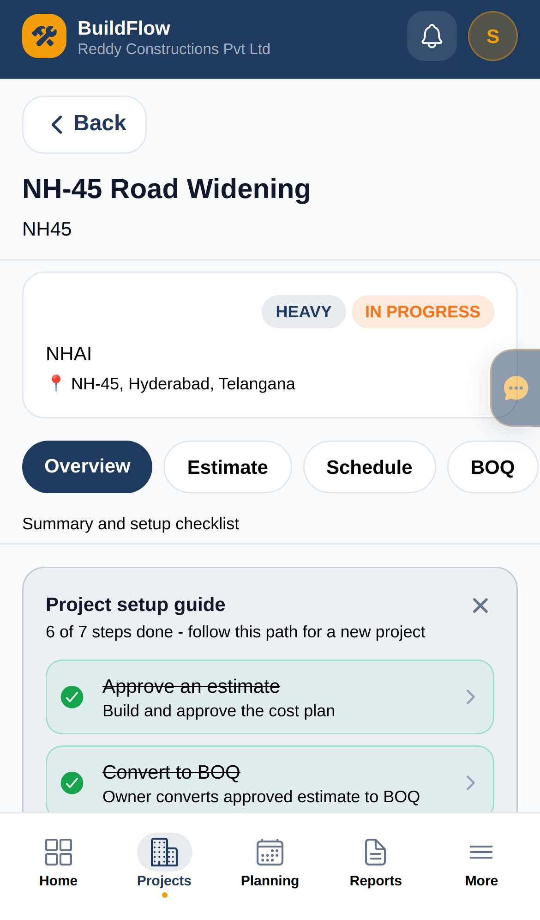
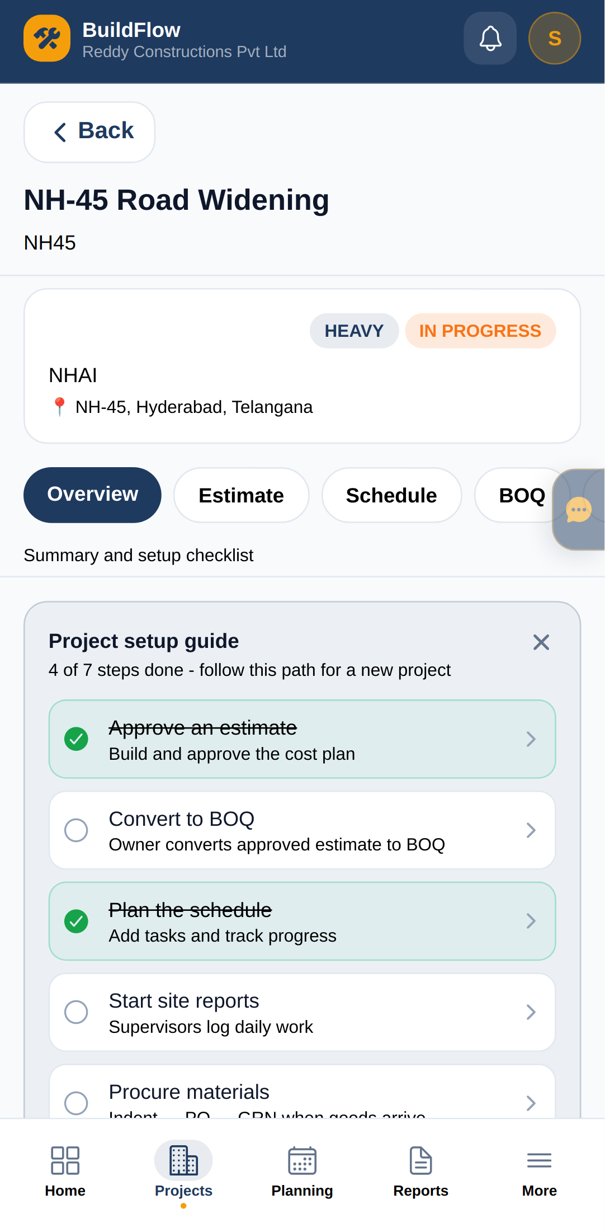
4. Inside a project — Overview
Budget, committed spend, schedule health. Money stays Owner/PM visible.
WEB
iOS
ANDROID
Same account · same data · Overview KPIs · Tabs for BOQ & more · Setup checklist
BuildFlow Construction ERP · Android · iOS · Web · Owner Quick-Start
7 / 17

Slide 8
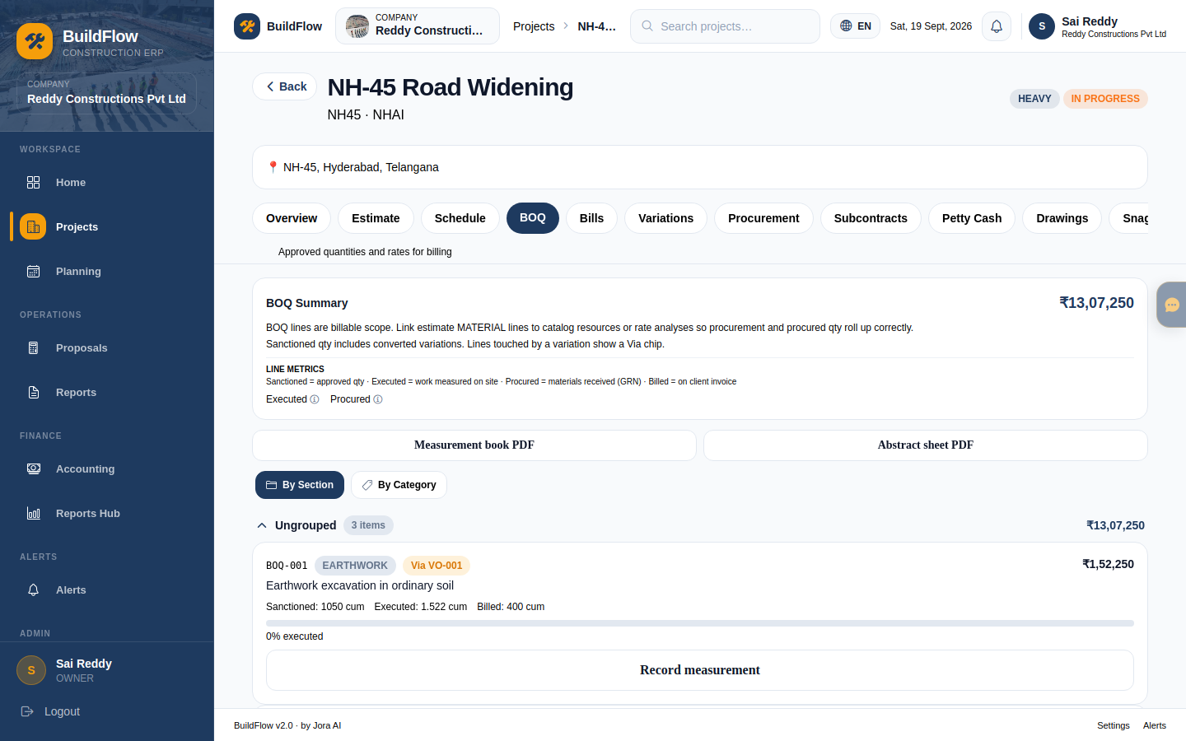
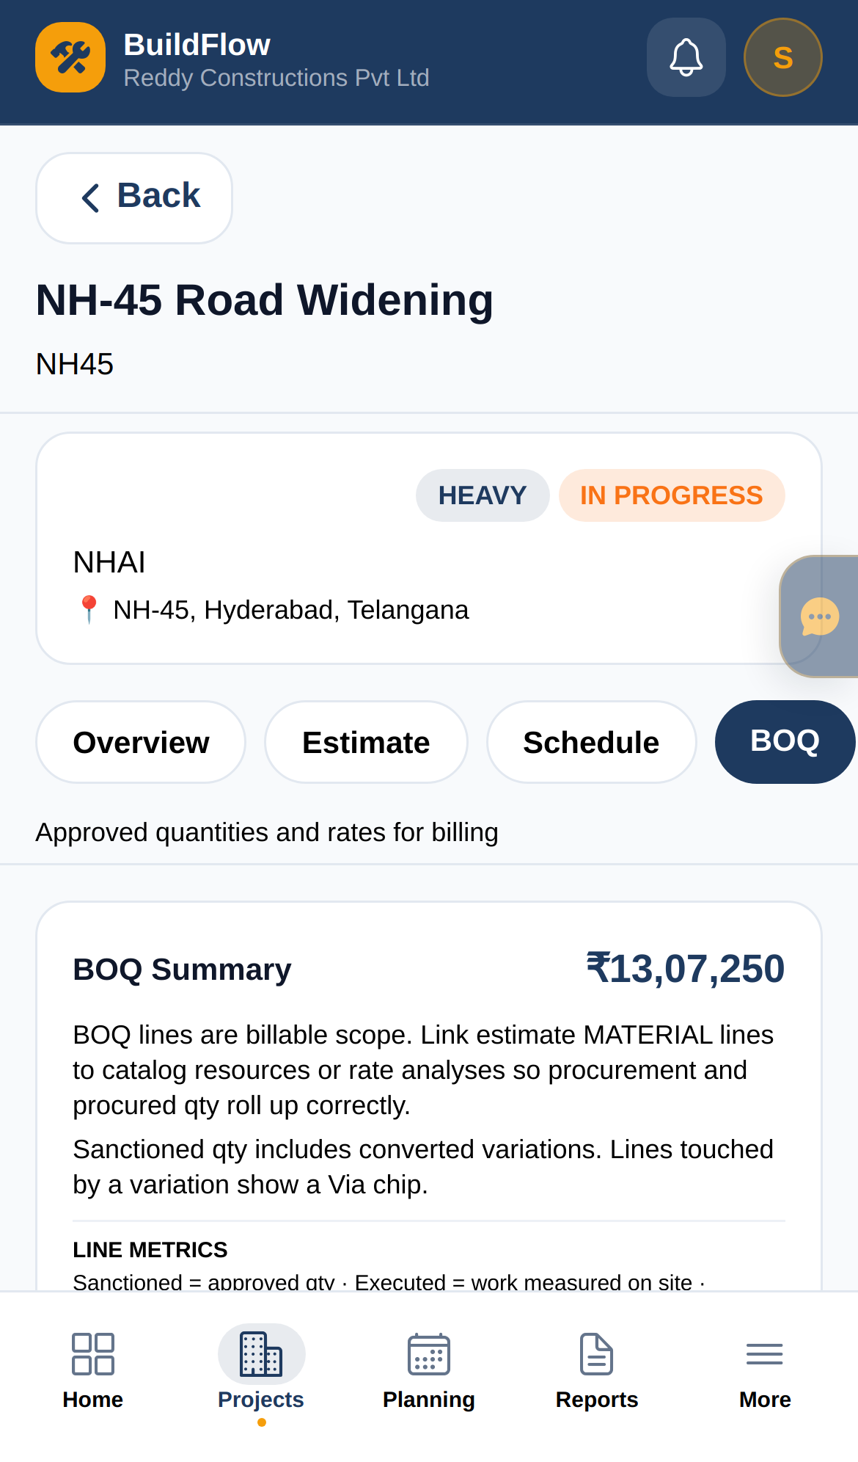
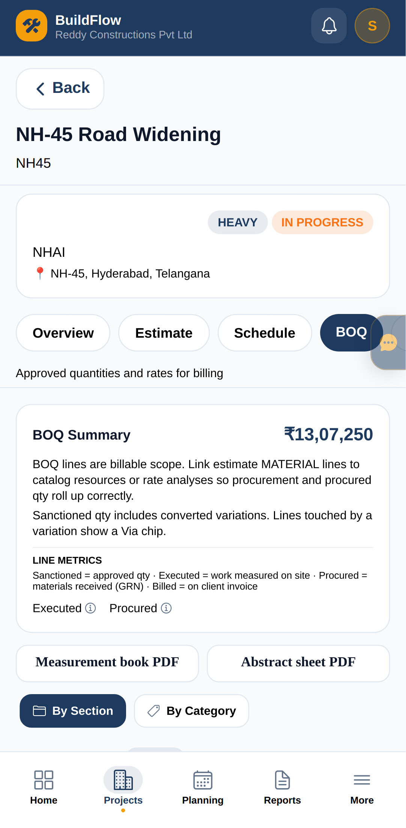
5. Estimates → BOQ
Approve commercially on web; track quantities on site with the phone.
WEB
iOS
ANDROID
Same account · same data · Owner approves estimate · Convert to BOQ · Site measures qty
BuildFlow Construction ERP · Android · iOS · Web · Owner Quick-Start
8 / 17

Slide 9
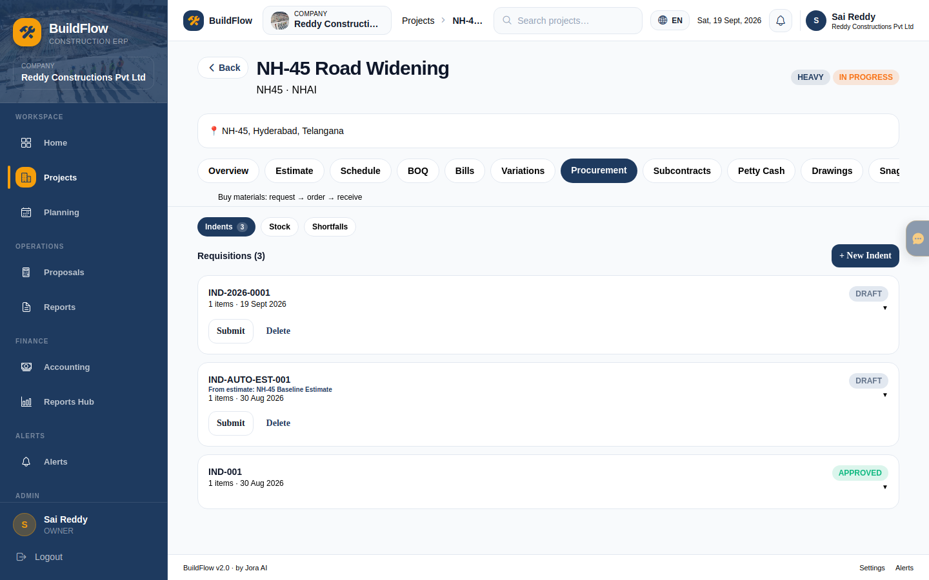
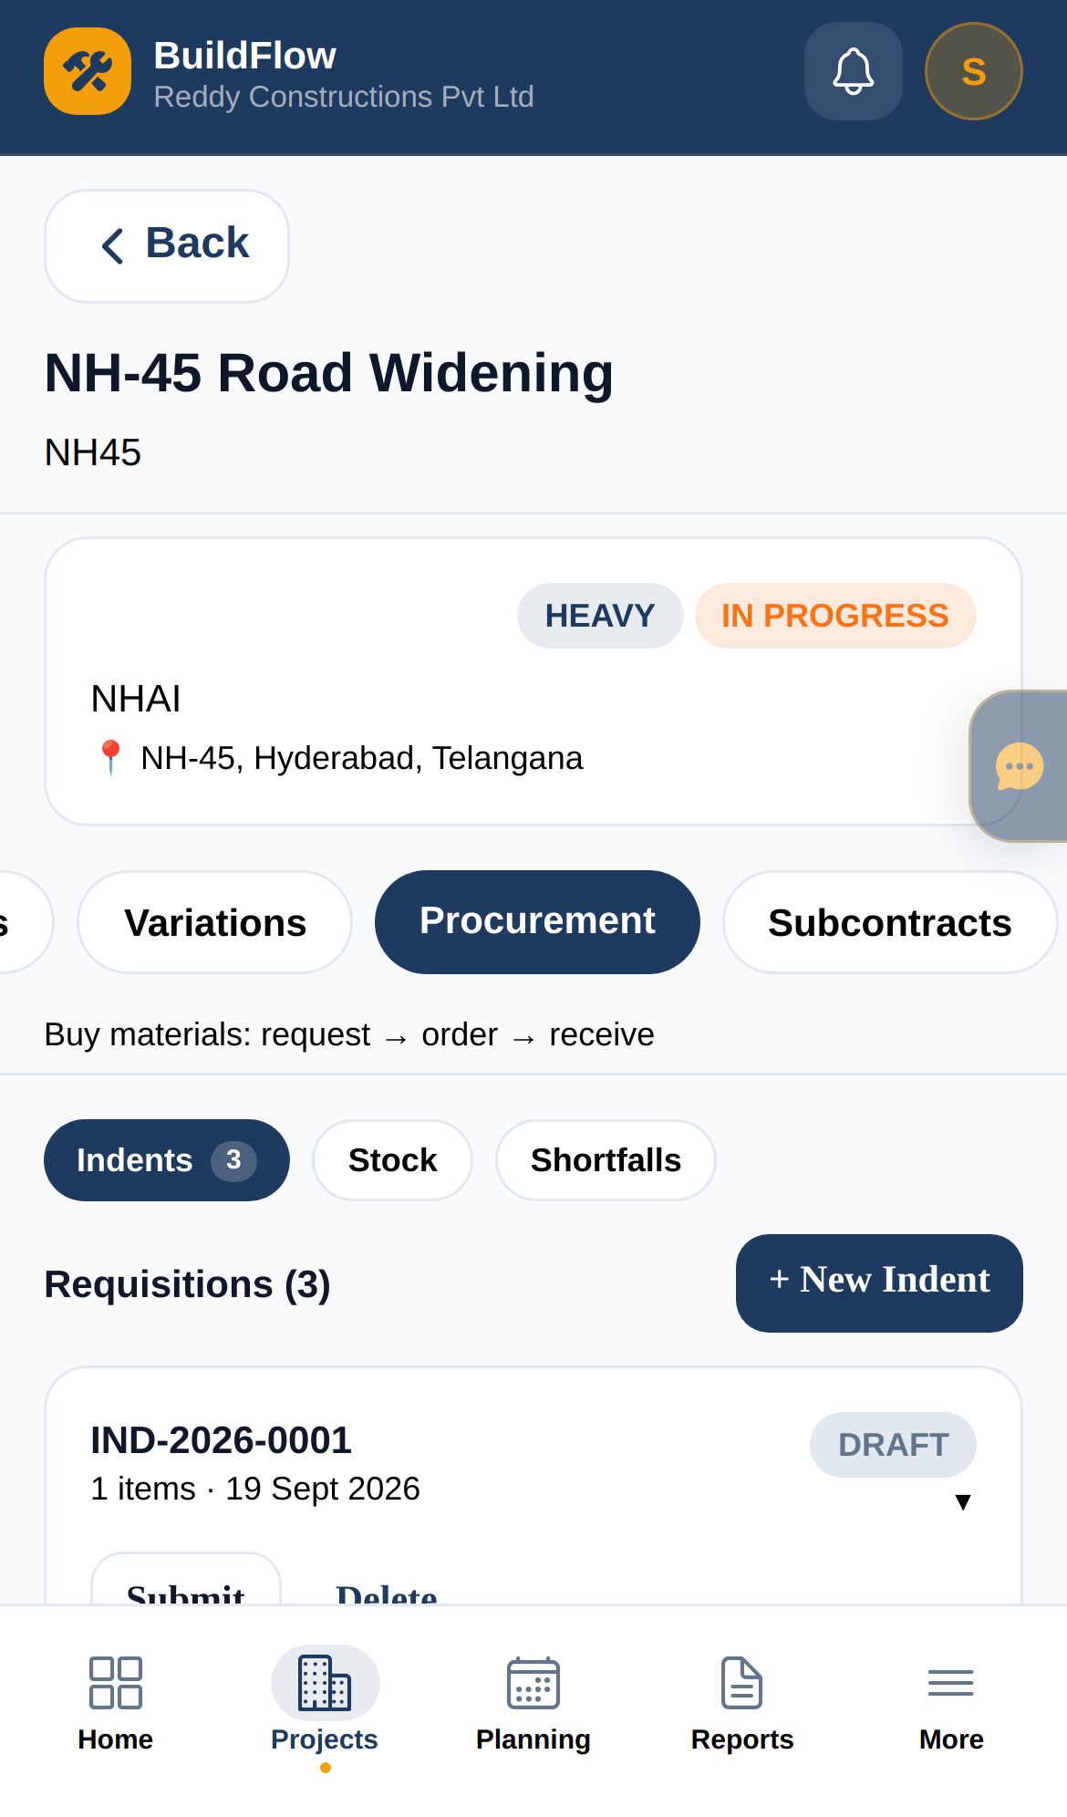
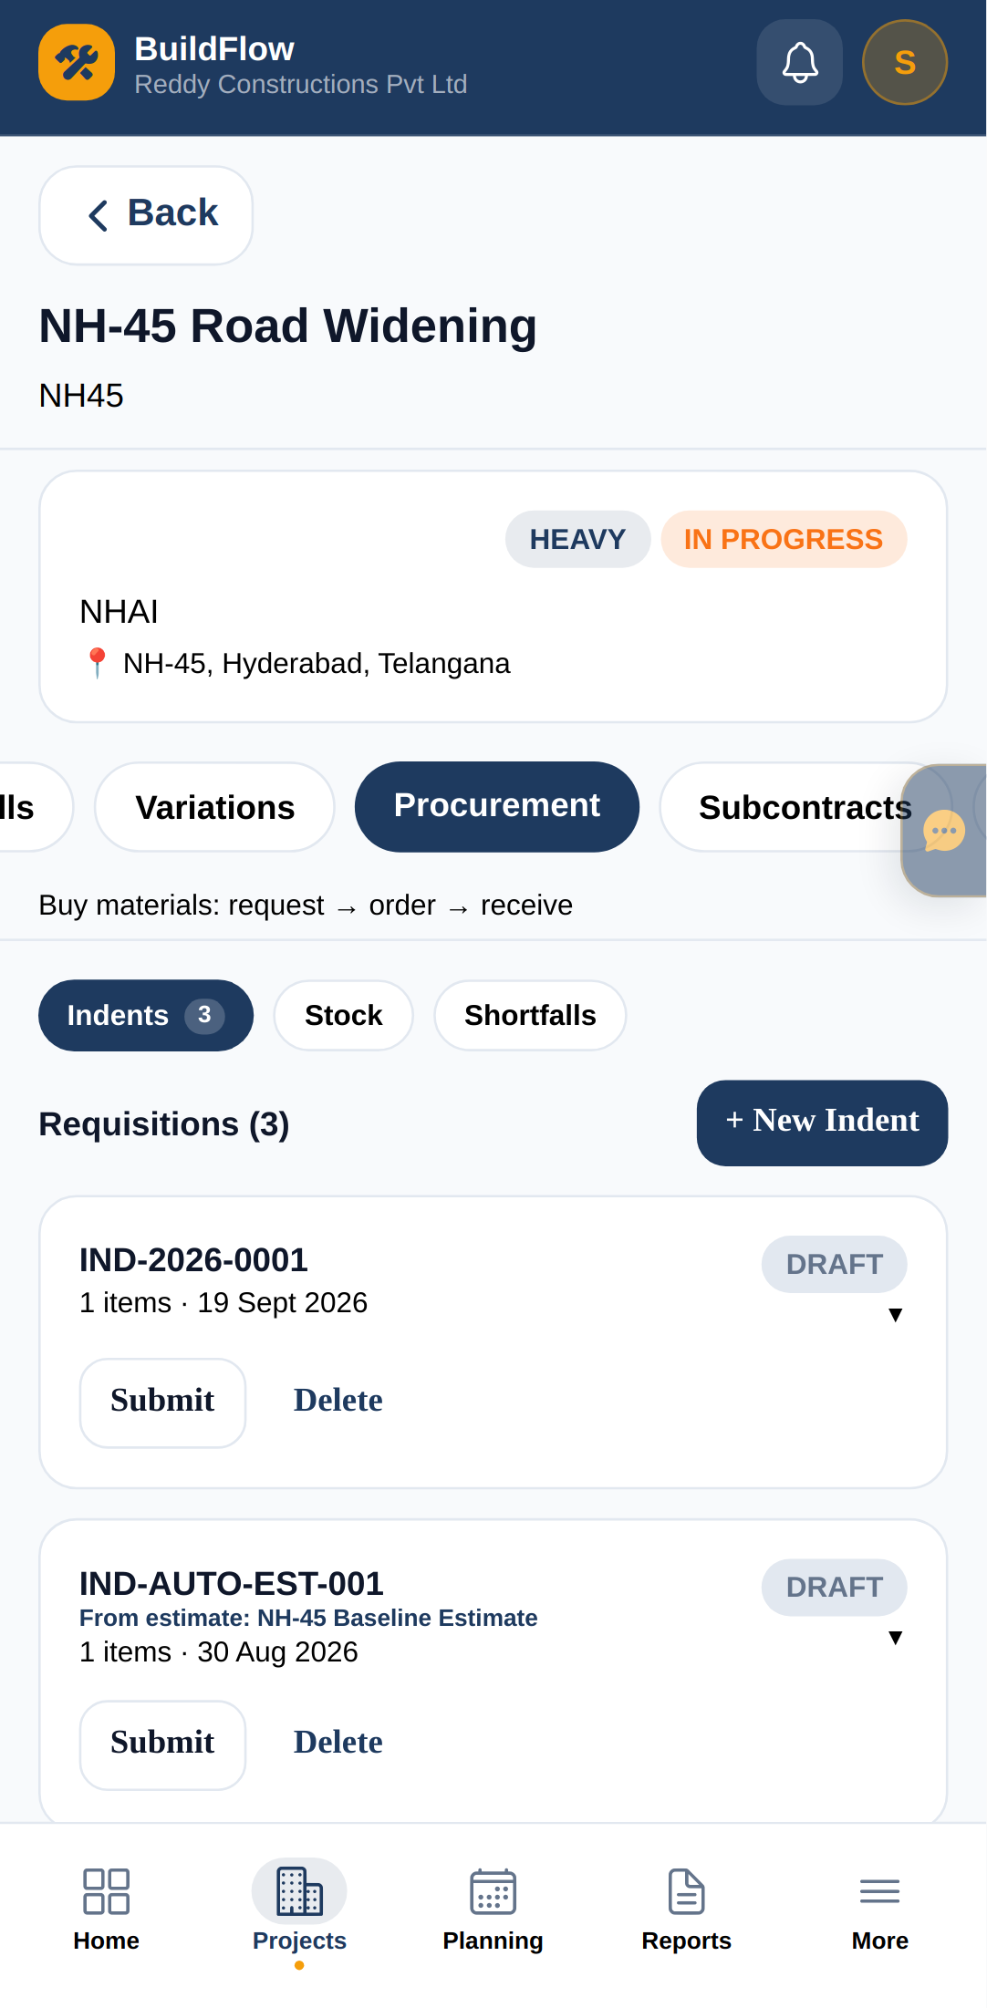
6. Procurement — indents, PO, GRN
PM/Store raise indents; weighbridge/store receive on mobile at the gate.
WEB
iOS
ANDROID
Same account · same data · Indent from BOQ · Approve PO · GRN on phone
BuildFlow Construction ERP · Android · iOS · Web · Owner Quick-Start
9 / 17

Slide 10
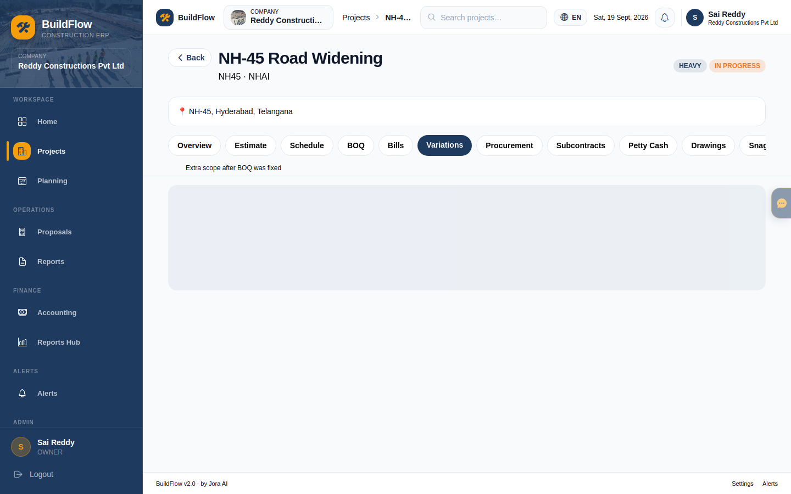
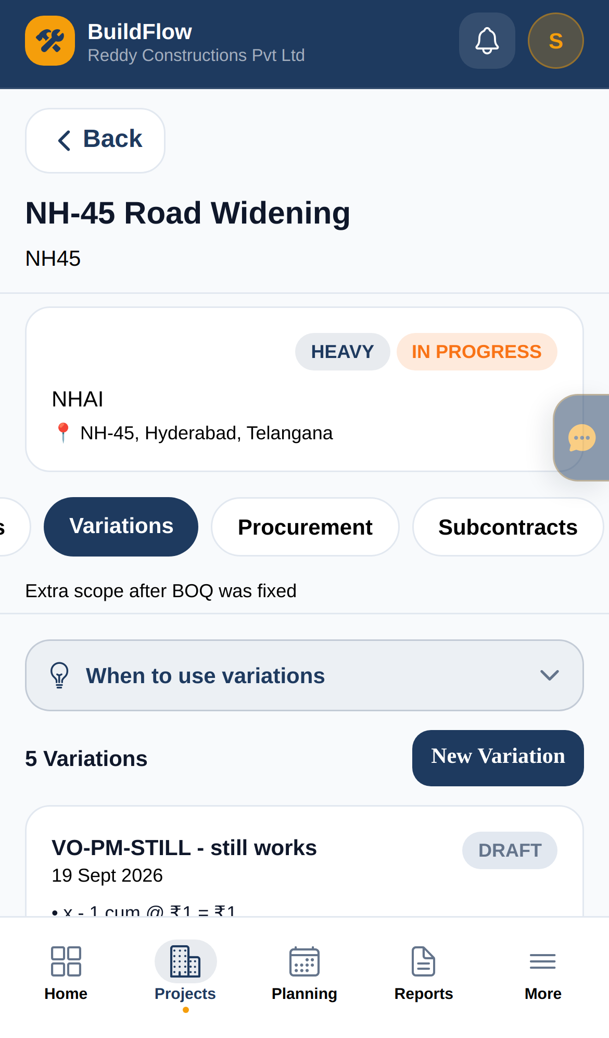
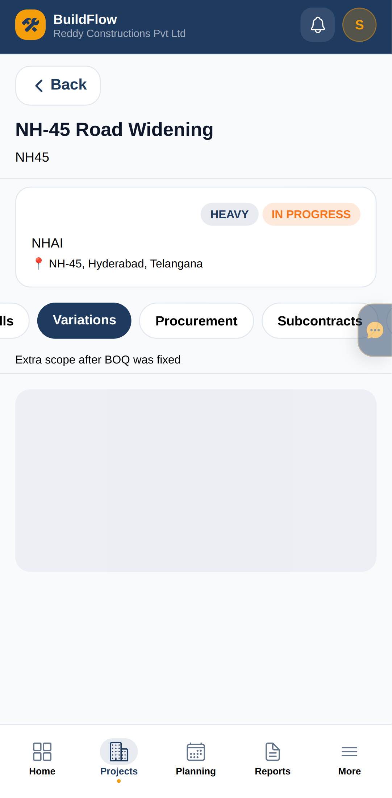
7. Variations — Owner approval
PM/DPM draft change orders; only Owner signs off cost & schedule impact.
WEB
iOS
ANDROID
Same account · same data · Review impact · Approve / reject · Convert VO → BOQ
BuildFlow Construction ERP · Android · iOS · Web · Owner Quick-Start
10 / 17

Slide 11
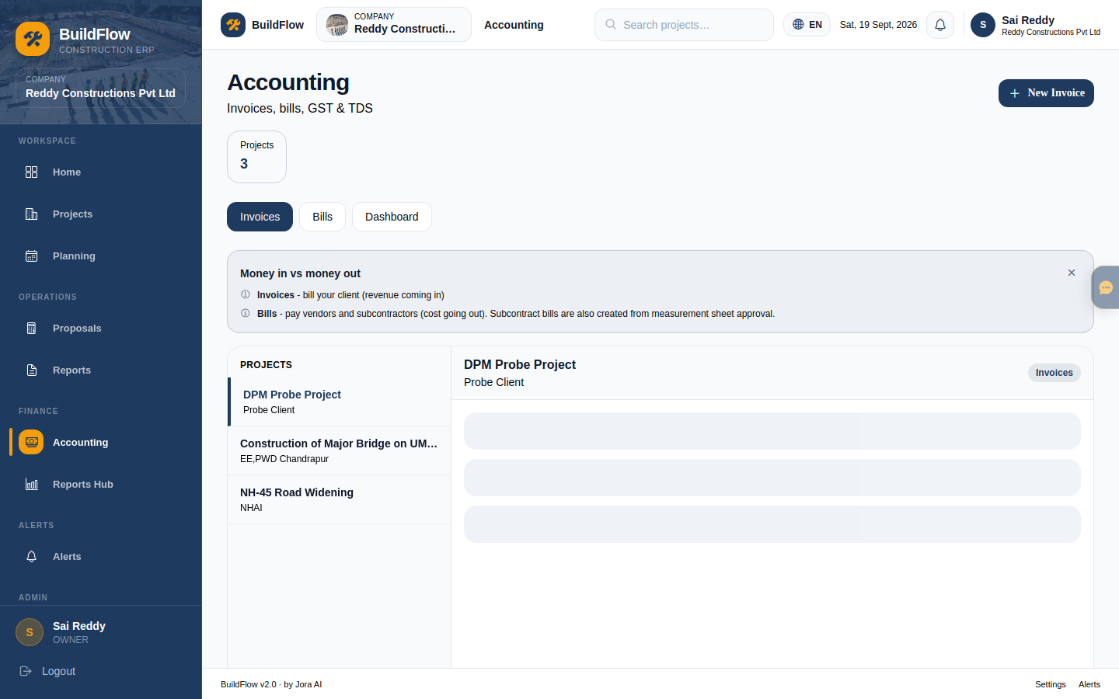
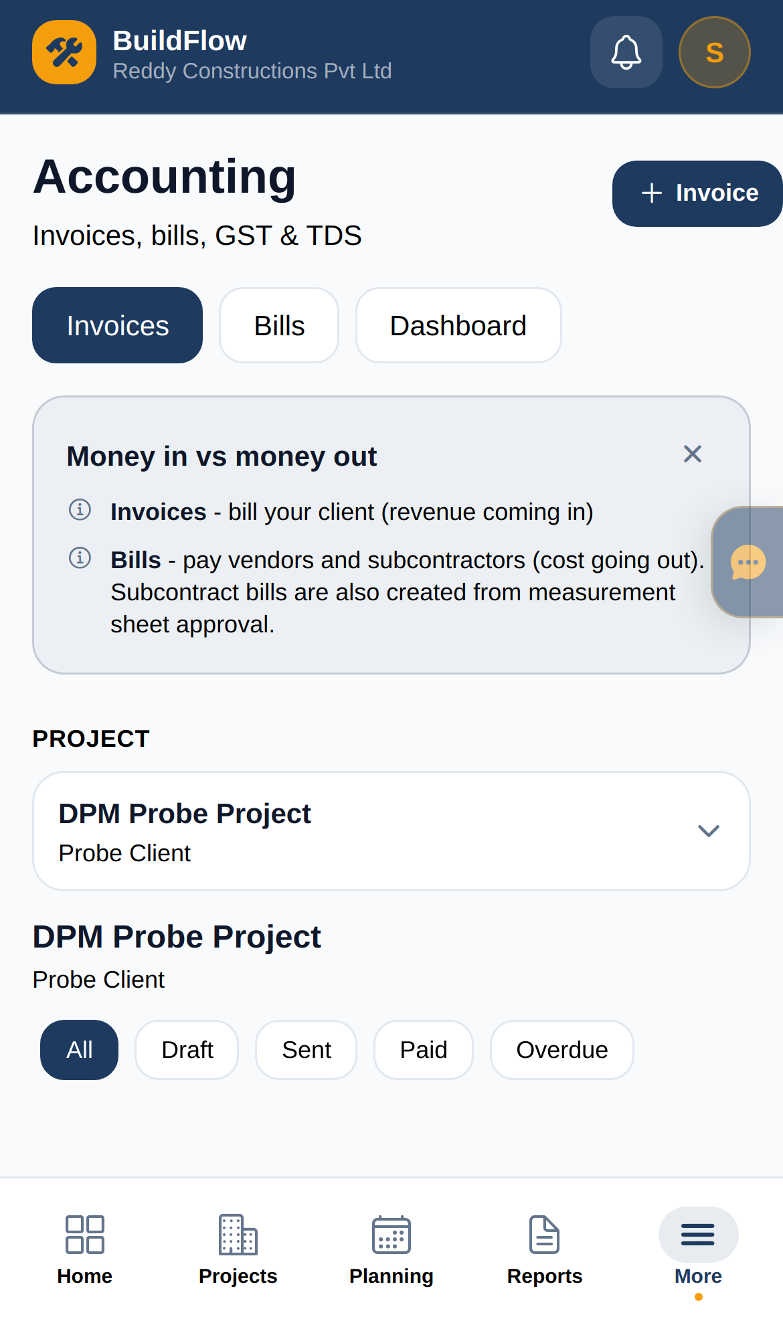
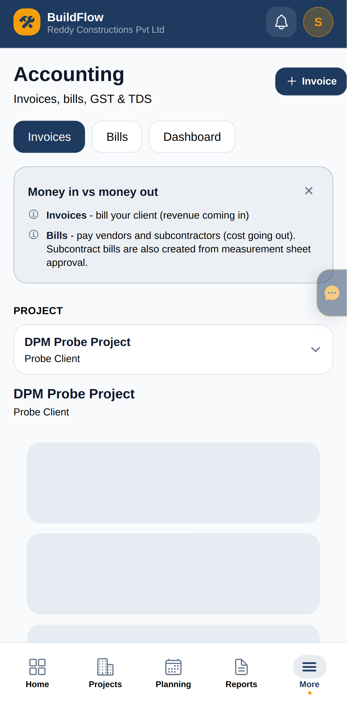
8. Accounting — invoices & bills
Desktop for finance ops; phone for quick status. Accountant can approve bills.
WEB
iOS
ANDROID
Same account · same data · Invoices & bills · Record payments · Tally / GST export
BuildFlow Construction ERP · Android · iOS · Web · Owner Quick-Start
11 / 17

Slide 12
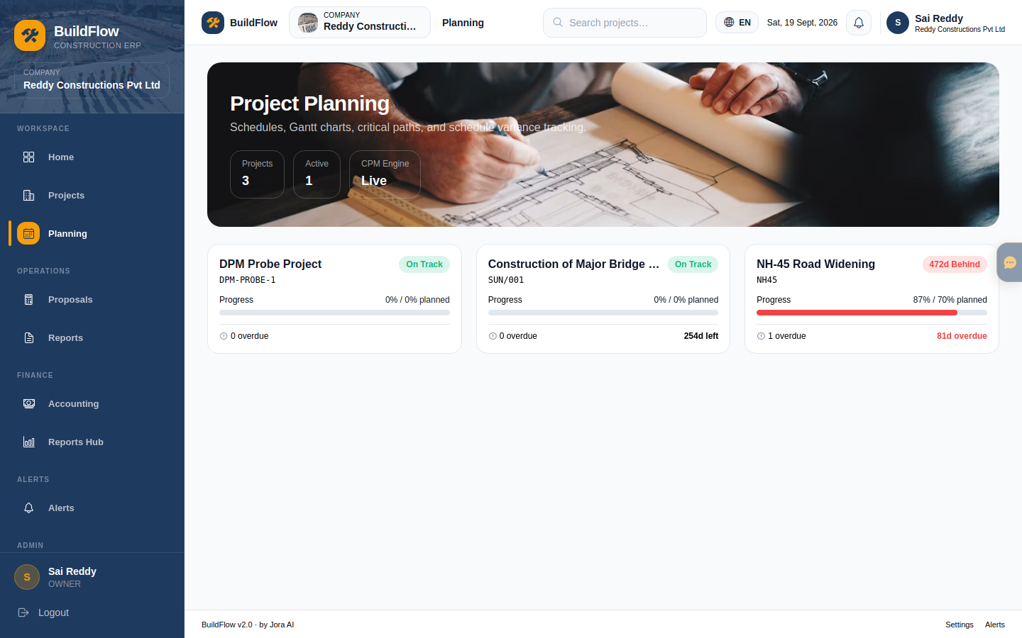
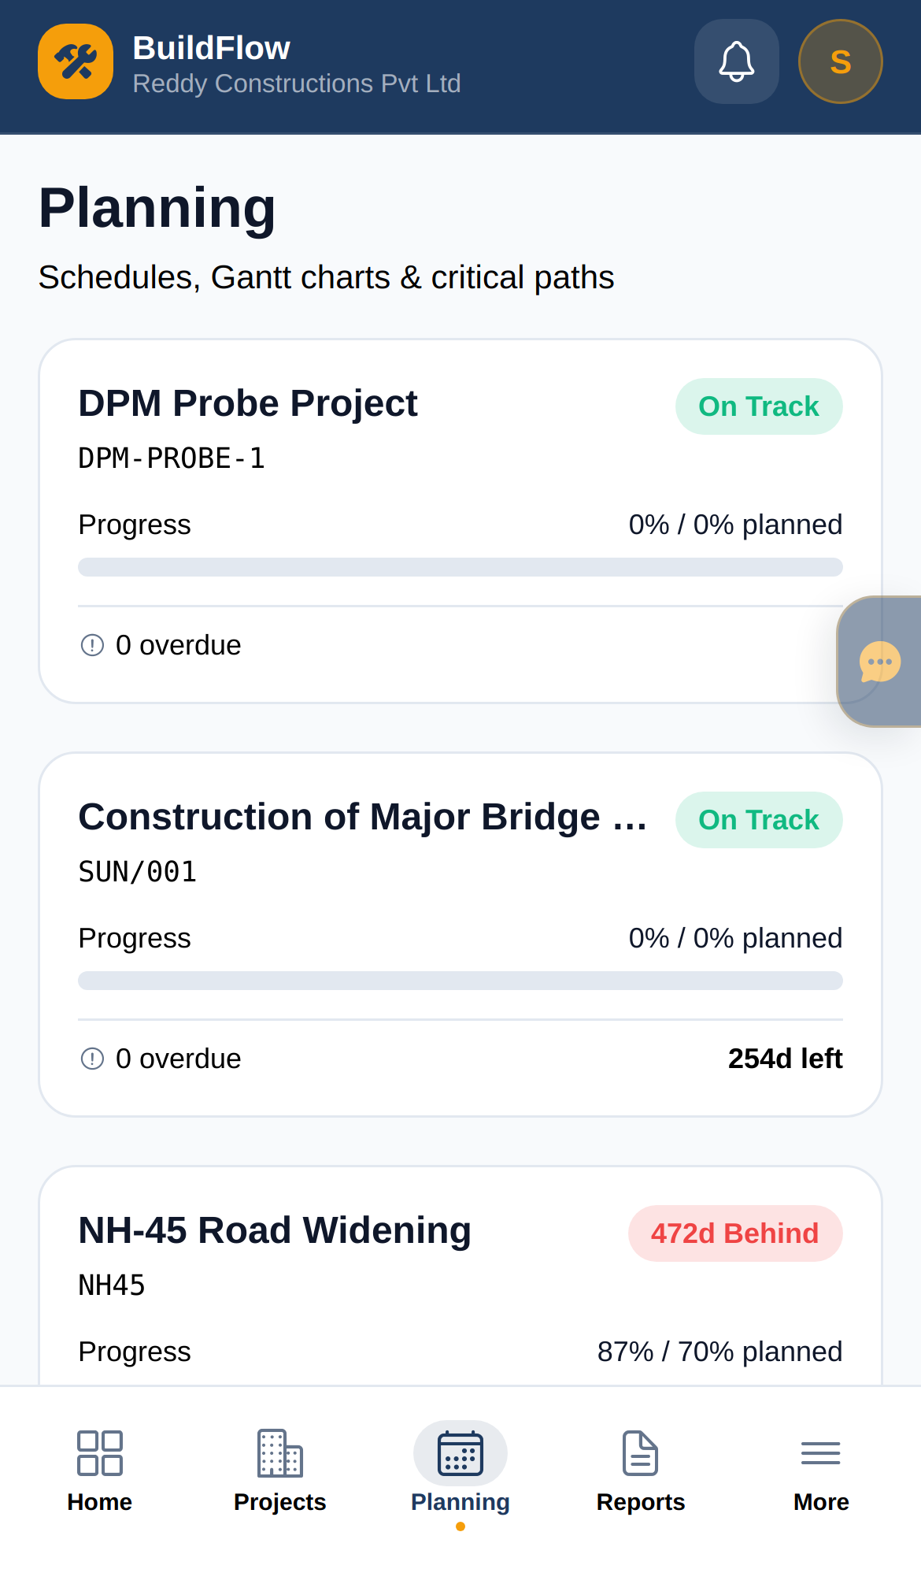
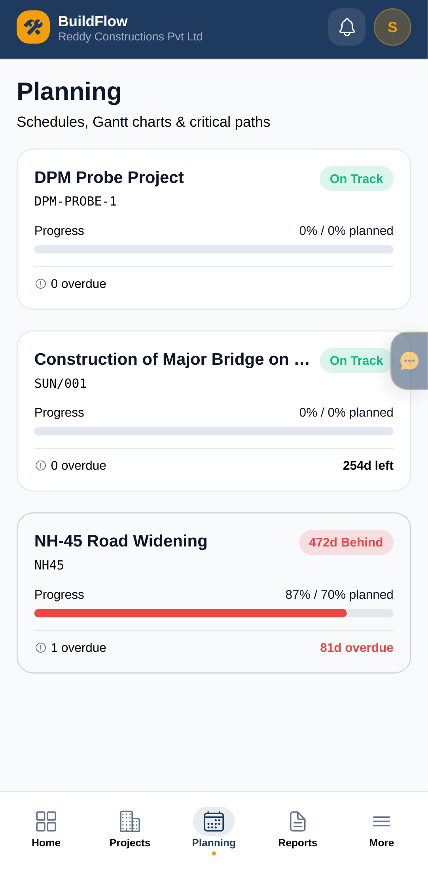
9. Planning & delivery
CPM-style planning on web; progress checks on mobile.
WEB
iOS
ANDROID
Same account · same data · Tasks & schedule · Progress % · Overdue visibility
BuildFlow Construction ERP · Android · iOS · Web · Owner Quick-Start
12 / 17

Slide 13
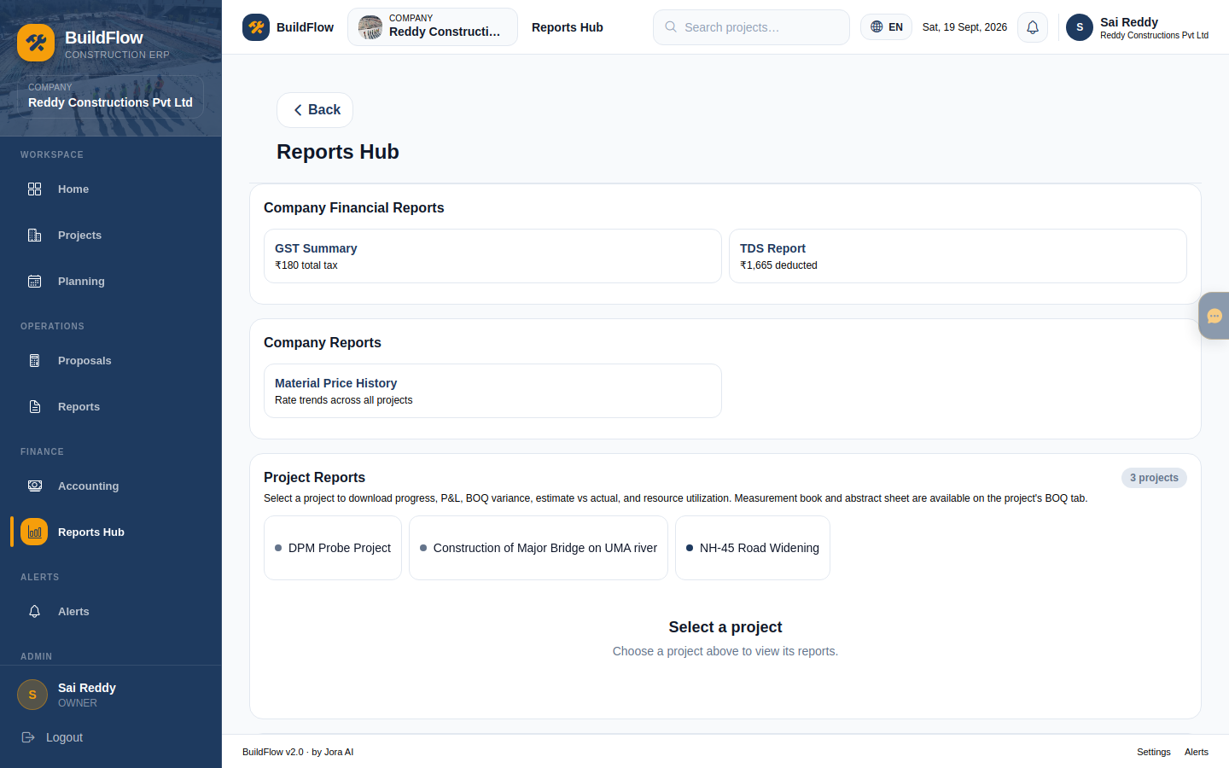
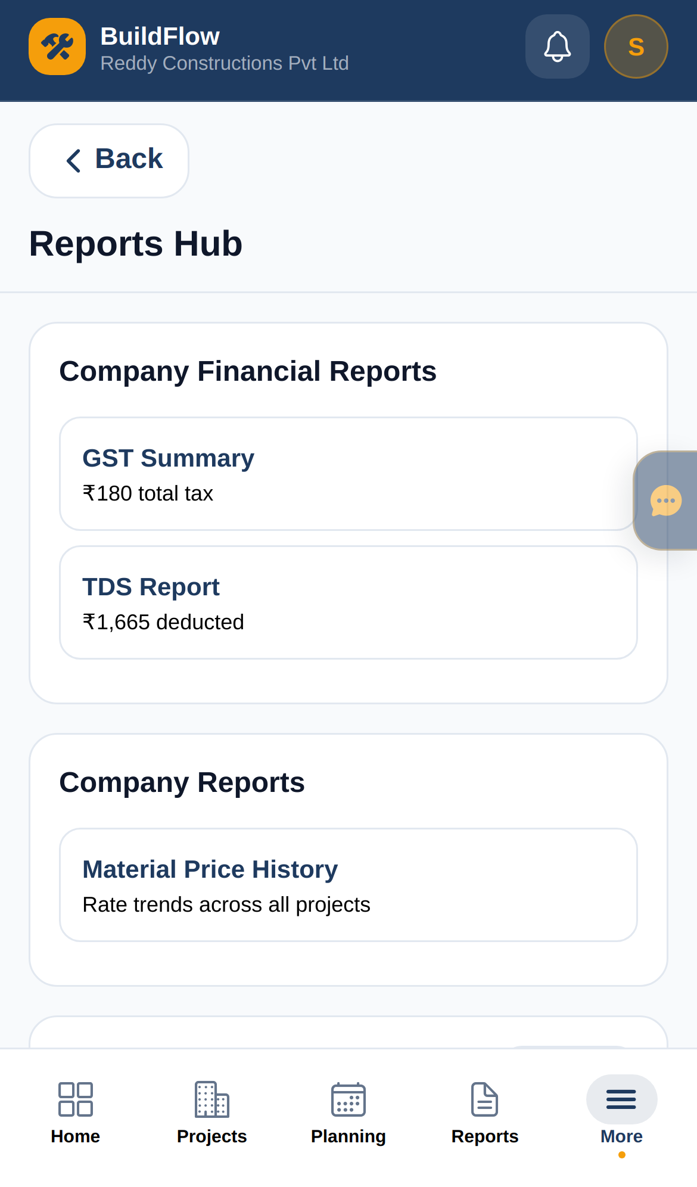
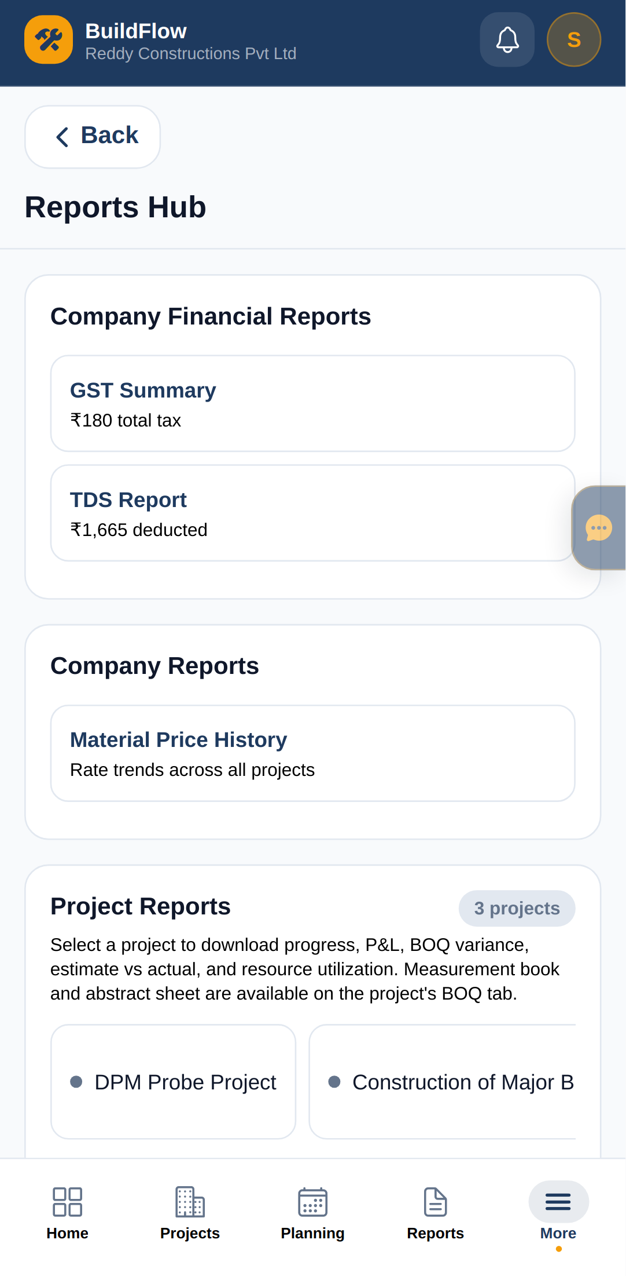
10. Reports Hub
Board packs and PDF downloads — best on web; share links from phone.
WEB
iOS
ANDROID
Same account · same data · Progress PDFs · P&L / EVA · GST & TDS
BuildFlow Construction ERP · Android · iOS · Web · Owner Quick-Start
13 / 17

Slide 14
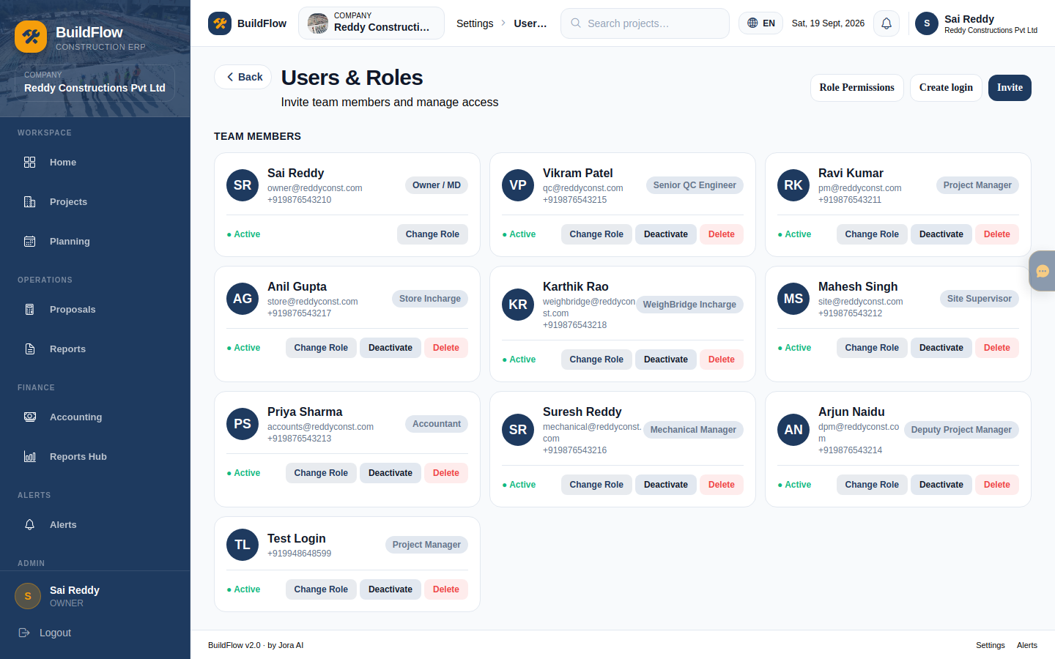
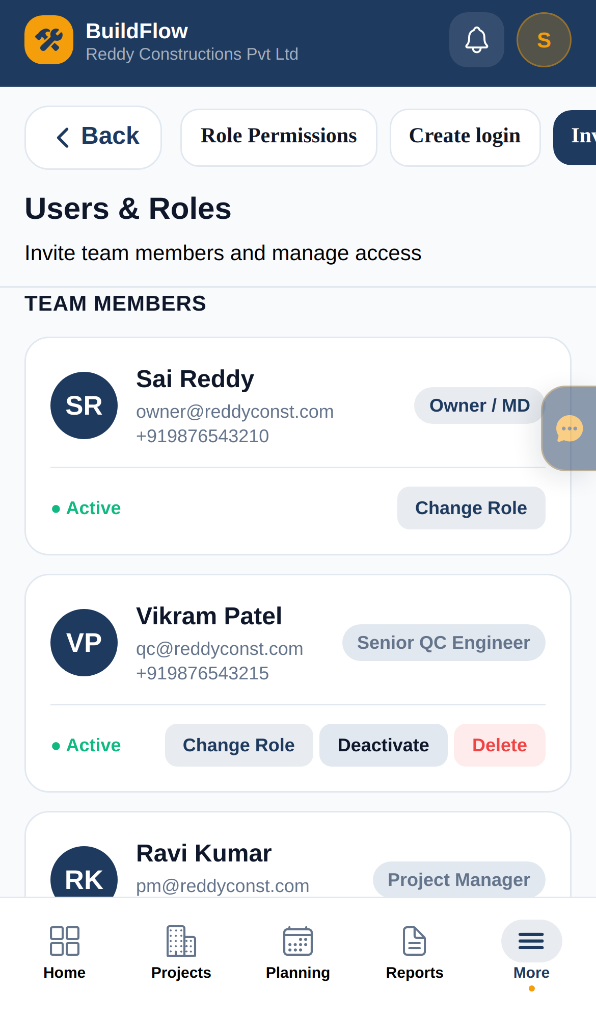
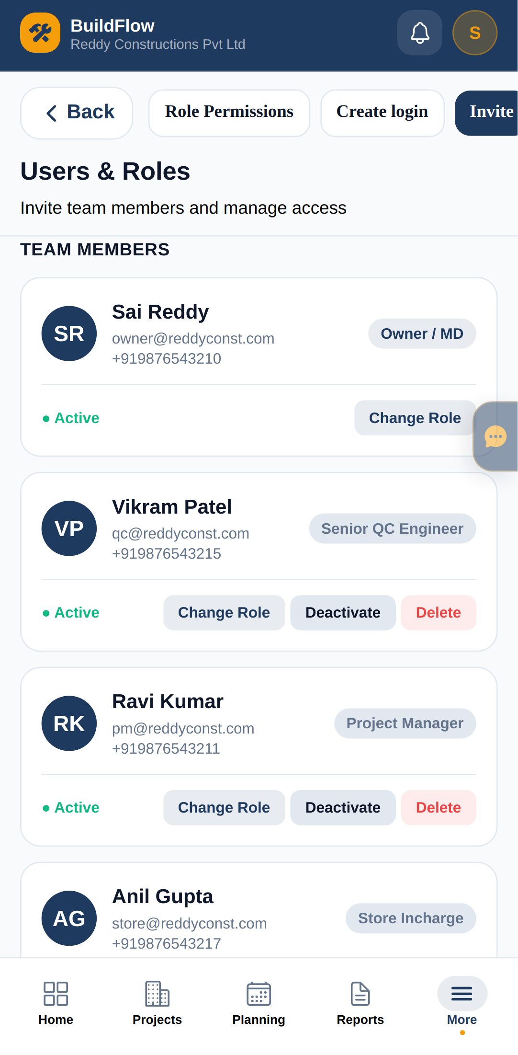
11. Invite your team
Settings → Users on web (recommended). Roles: PM, Site, Store, QC, Accountant…
WEB
iOS
ANDROID
Same account · same data · Invite by email/phone · Pick role · OTP onboarding
BuildFlow Construction ERP · Android · iOS · Web · Owner Quick-Start
14 / 17

Slide 15
Who does what
Share with leadership — works the same on every device
Owner
Approve estimates & VOs · finance · invite users · settings
PM / DPM
Run projects · estimates · procurement · draft variations
Site / QC
Daily reports · measure · drawings · snags (no money)
Store / Weighbridge
Indents · GRN · stock on phone at gate
Accountant
Invoices · bills · payments · Tally / GST
BuildFlow Construction ERP · Android · iOS · Web · Owner Quick-Start
15 / 17

Slide 16
Day-1 checklist
Use phone + web together — start today
Morning (Web or iPad)
• Sign in as Owner (OTP)
• Review Owner Home KPIs
• Create / open your real project
• Set budget, client, dates
• Invite PM + Site + Accountant
• Optional: walk NH-45 sample
Afternoon (Phone + Web)
• PM drafts first estimate (Web)
• You approve on phone or desktop
• Convert to BOQ
• First indent → GRN on Android/iOS
• First vendor bill → Accountant
• Download one PDF from Reports Hub
BuildFlow Construction ERP · Android · iOS · Web · Owner Quick-Start
16 / 17

Slide 17
Android · iOS · Web — you’re ready
Owner approves. PM delivers. Site executes. Store receives. Accounts closes the books — one BuildFlow company everywhere.
Install on phones this week. Run the first live estimate → BOQ → indent cycle on one project.

