Slide 1


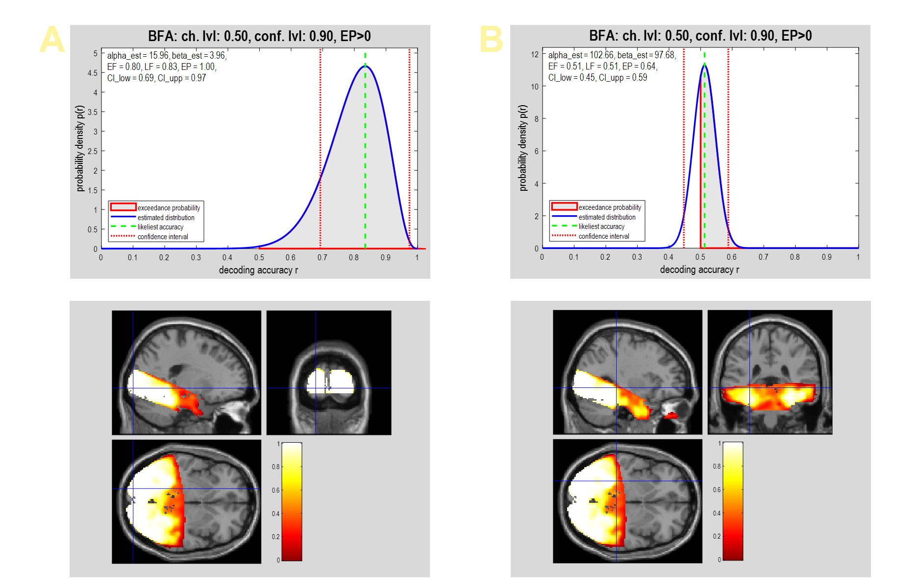
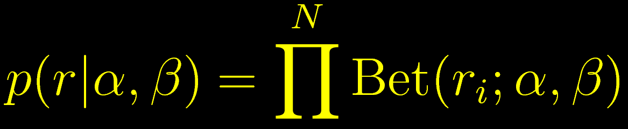
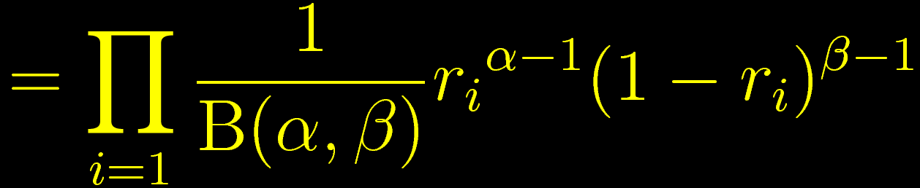
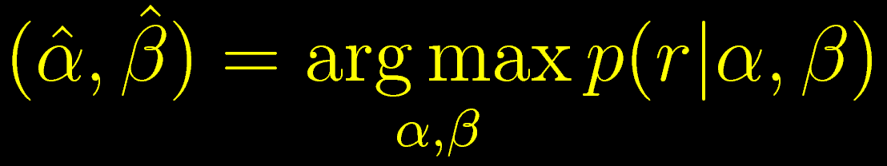
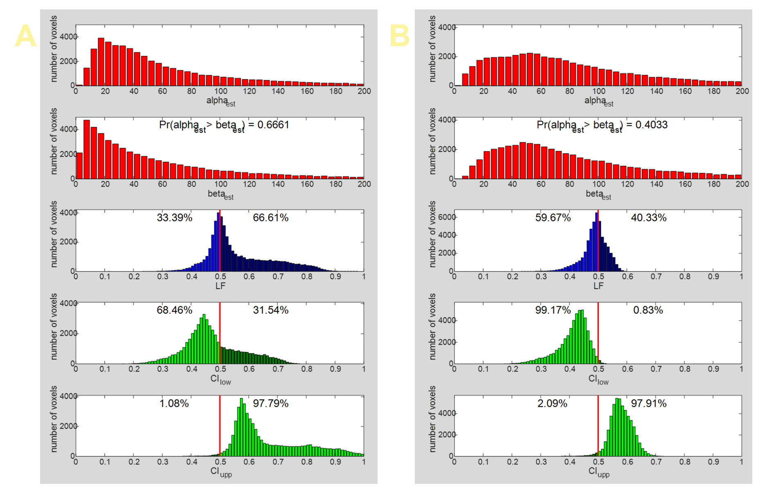

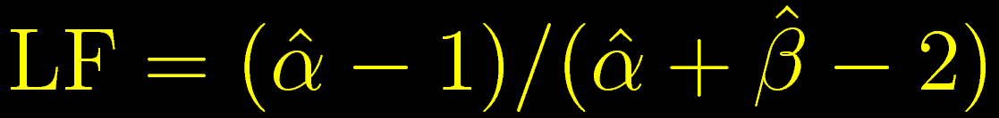
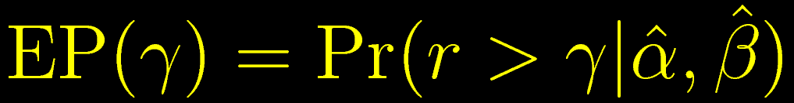
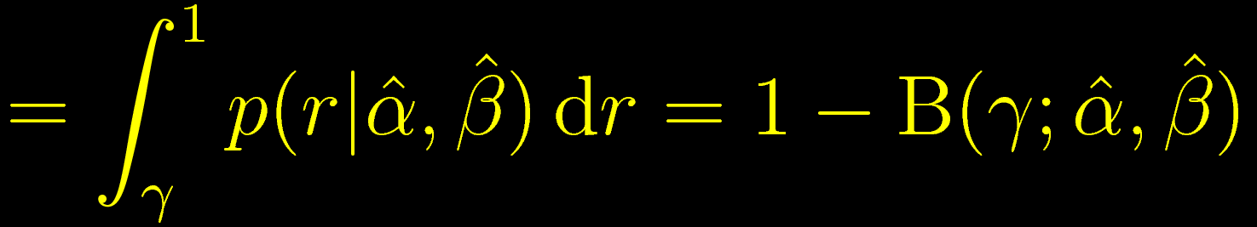

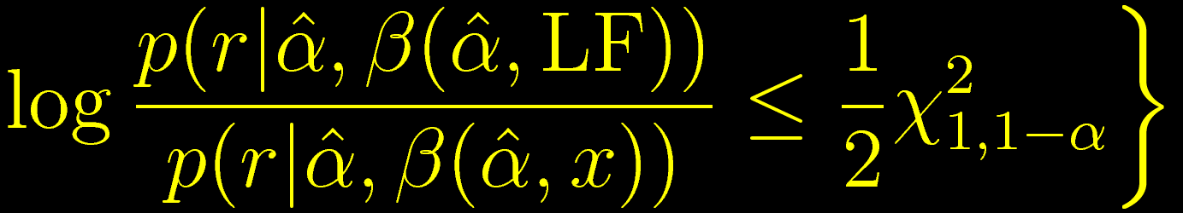
How are cross-validated decoding
accuracies distributed across subjects?
#OHBM2020
@JoramSoch
Abstract #3813
Poster #1737
Joram Soch^{1,2,9,●}, John-Dylan Haynes^{1–8}
¹ Bernstein Center for Computational Neuroscience, ² Berlin Center for Advanced Neuroimaging, ³ Berlin School of Mind and Brain, Berlin, Germany
⁴ Clinic for Neurology, Charité – Universitätsmedizin Berlin, Germany, ⁵ Department of Psychology, Humboldt-Universität zu Berlin, Germany
⁶ EXC NeuroCure, Charité Berlin, ⁷ EXC Science of Intelligence, TU Berlin, ⁸ CRC Volition and Cognitive Control, TU Dresden, Germany
⁹ German Center for Neurodegenerative Diseases, Göttingen, Germany, ● BCCN Berlin, Philippstraße 13, Haus 6, 10115 Berlin, Germany;
e-mail address: joram.soch@bccn-berlin.de.
Bernstein Center
for Computational
Neuroscience Berlin
Introduction
In multivariate pattern analysis (MVPA) for functional magnetic resonance imaging (fMRI) data, cross-validated decoding accuracy (cvDA) maps from first-level decoding analyses are typically subjected to second-level t-tests [1] in order to make population inference. This practice has been criticized as making questionable assumptions about cvDAs and effectively performing a fixed-effects analysis instead of the random-effects analysis which is usually insinuated by the interpretation of the results [2]. The second-level t-test for cvDAs can also be challenged based on the nature of accuracies which, unlike the variates going into a t-test, (i) are neither in an infinite range (but bounded between 0 and 1), (ii) nor are they normally distributed (because they are proportions). Here, we estimate Beta distributions [5,6] from cvDAs across subjects to overcome those problems and provide a number of summary statistics to make statements about the observed accuracies.
Figure 1. Beta distributions for decoding accuracies: high vs. low information.
Methods
The cross-validated decoding accuracies r_{i} from subjects i = 1,…,N are assumed to be independent and identically distributed according to a Beta distribution [5]:
The parameters α and β can be obtained using maximum likelihood estimation (MLE) for the Dirichlet distribution [6], a generalization of the Beta distribution:
From the estimated concentration parameters α and β, one can then calculate (see Figure 1)
a) the expected frequency, i.e. the mean of the accuracy distribution
b) the likeliest frequency, i.e. the most likely decoding accuracy
c) the exceedance probability that the decoding accuracy is larger than chance level γ
d) a confidence interval for the most likely accuracy, given a confidence level (1- α)
which can be derived from Wilks‘ theorem (StatProofBook, P56, Proof "ci-wilks", https://statproofbook.github.io/P/ci-wilks) that makes a statement about the distribution of log-likelihood ratios (LLR).
(A) A voxel containing information about object category (which was decoded in the present analysis). The distribution is centered on a high accuracy value (α much larger than β) and the confidence level (CI) is entirely above chance level. (B) A voxel with less information about object categories. The distribution is much sharper (larger α and β) and the confidence level includes chance level.
Figure 2. Beta distributions for decoding accuracies: unpermuted vs. permuted data.
Beta distribution parameters (α, β) and summary statistics (LF, CI) estimated from decoding accuracies when using (A) the original, unpermuted data vs. (B) permuted object category labels. With original data, there is a large portion of voxels (31.54%) in which the confidence interval is entirely above chance level; while this is almost never the case (0.83 %) when using permuted data.
Discussion
We have provided a method for second-level analysis of cross-validated decoding accuracy (cvDA) maps and validated it using empirical data. Unlike the currently received approach, i.e. the one-sample t-test, this type of analysis (i) acknowledges the domain of accuracies as proportions and (ii) allows the distribution of accuracies to be non-symmetric. A downside of the proposed method is that it, like the t-test, does not take into account that true accuracies cannot be below chance level and inference therefore only pertains to observed accuracies [2]. In the future, we want to evaluate asymptotic properties of this approach using ground-truth simulated data and implement multiple comparison correction for the analysis of whole-brain empirical data.
Dataset
We analyzed a set of cvDA maps [4] that comes from an earlier study on object recognition [3] and was previously used in methods development for second-level decoding inference [2].
We show that the above-mentioned summary statistics can give an intuitive understanding of the amount of information contained in a voxel or searchlight when accuracies of decoding a certain stimulus feature are significantly above (see Figure 1A) or when they are around chance level (see Figure 1B).
Moreover, we observe that estimated concentration parameters across all voxels are compatible with a null distribution when labels were exchanged between classes (see Figure 2B), but not when unpermuted data were used (see Figure 2A).
References
Reverberi C, Görgen K, Haynes JD (2012). Compositionality of rule representations in human prefrontal cortex. CerCor, vol. 22, iss.6, pp. 1237-1246.
Allefeld C, Görgen K, Haynes JD (2016). Valid population inference for information-based imaging:
From the second-level t-test to prevalence inference. NeuroImage, vol. 141, pp. 378-392.
Cichy RM, Chen Y, Haynes JD (2011). Encoding the identity and location of objects in human LOC. NeuroImage, vol. 54, iss.3, pp. 2297-2307.
Allefeld C (2016). Test data based on Cichy et al. (2011). GitHub; URL: https://github.com/allefeld/cichy-2011-category-smoothedaccuracy.
Koch KR (2007). Introduction to Bayesian Statistics. 2nd edition, Springer, Berlin/Heidelberg, ch. 2.4.4, p. 48.
Minka T (2012). Estimating a Dirichlet distribution. Technical report; URL: https://tminka.github.io/papers/dirichlet/minka-dirichlet.pdf.

