Slide 1


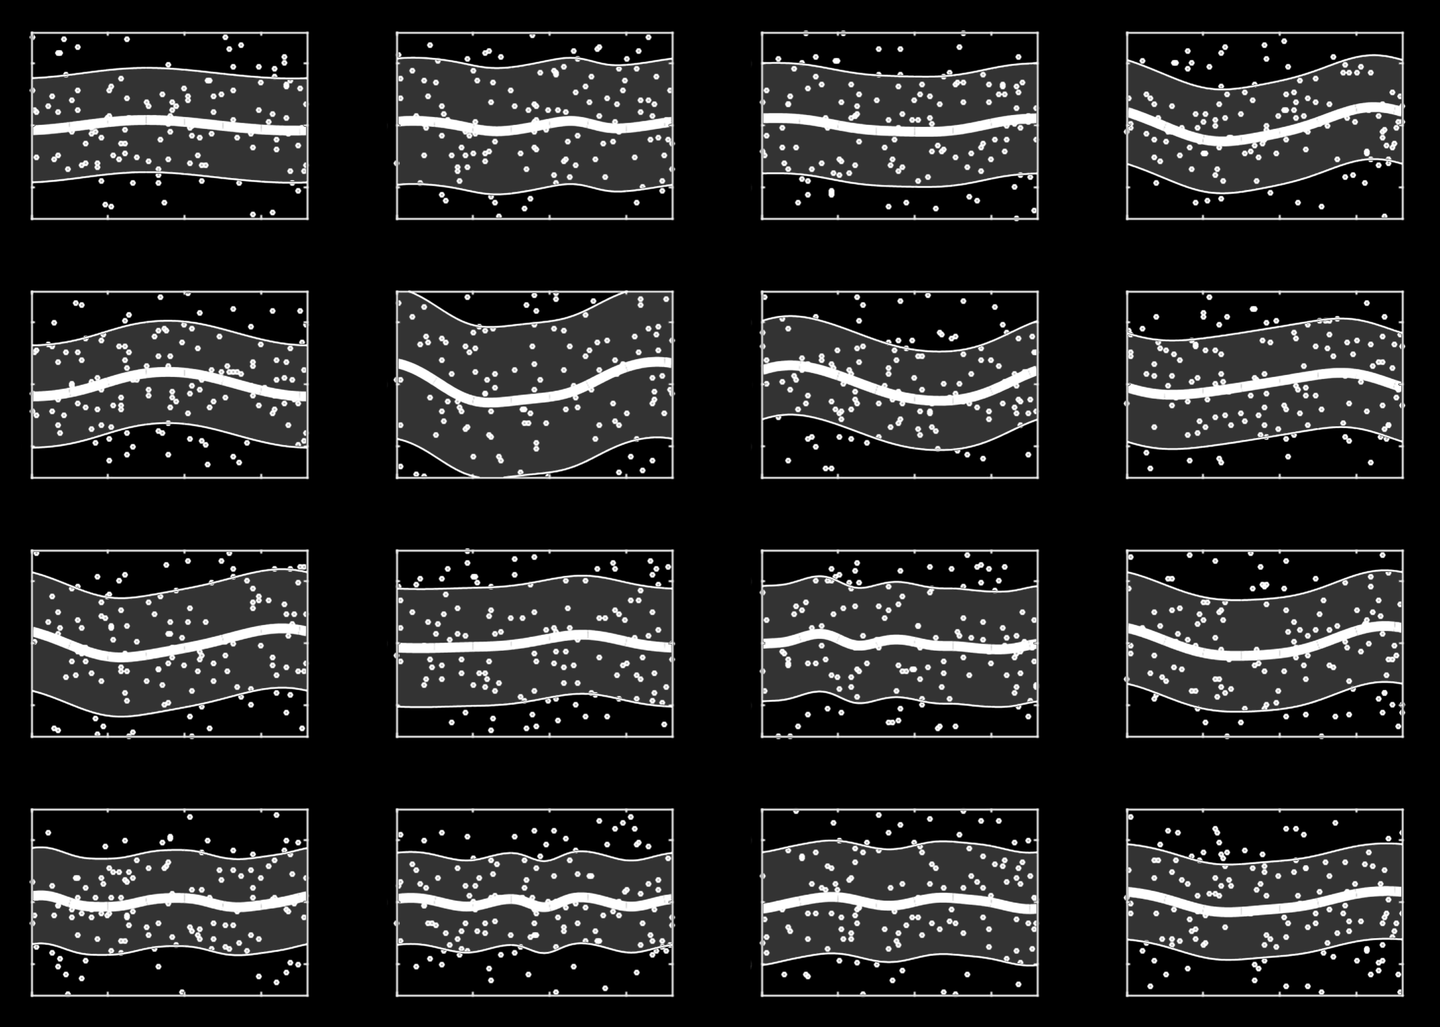
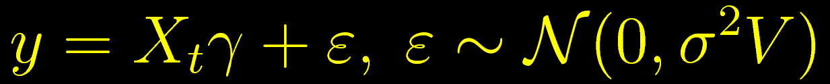
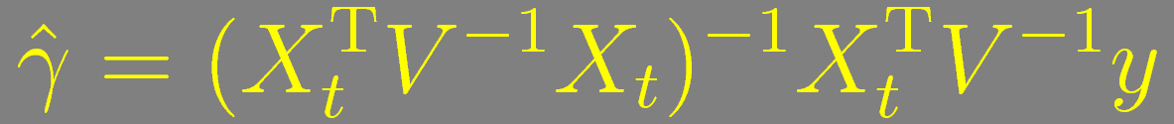
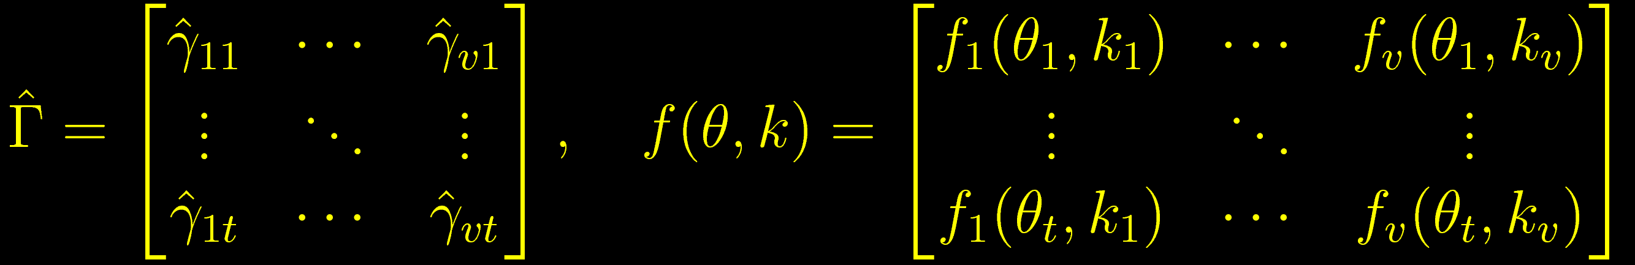
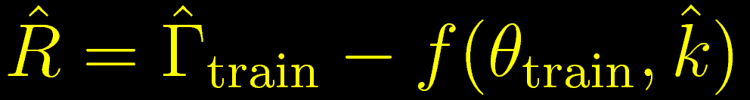
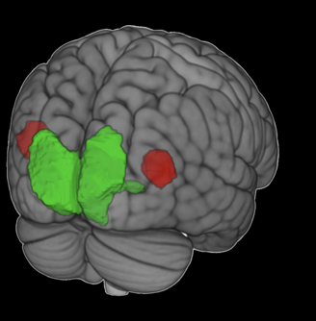
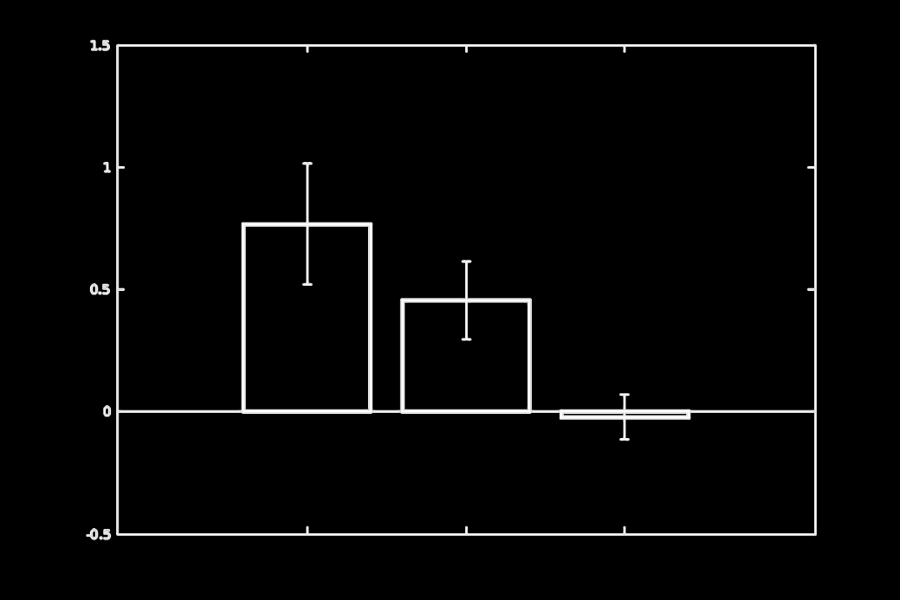
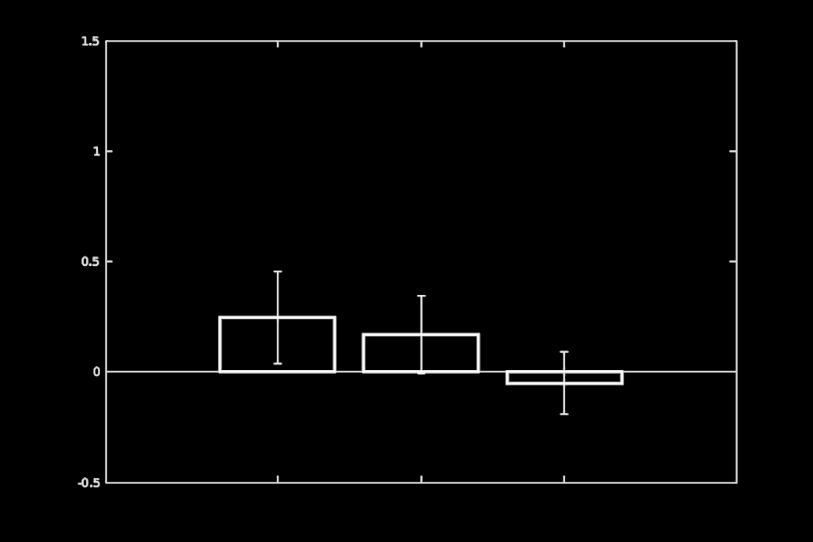
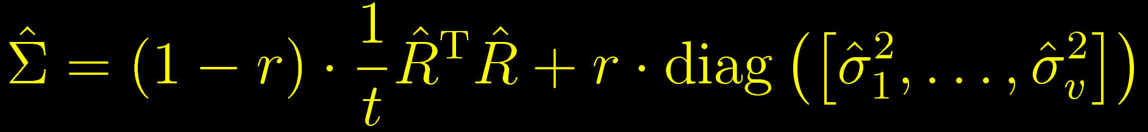
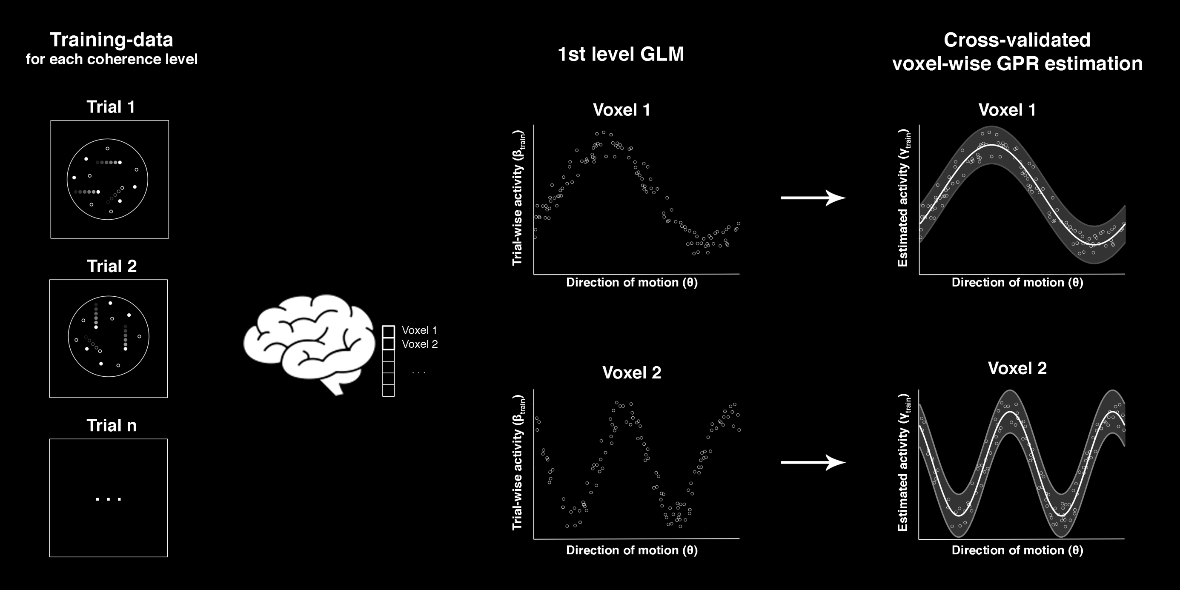
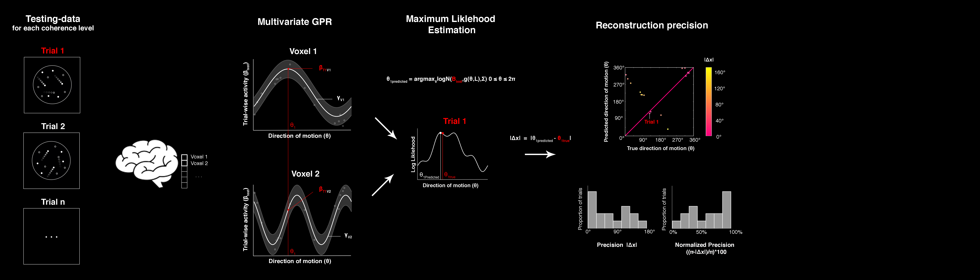
Reconstruction of continuous
motion direction from fMRI data
#OHBM2020
@JoramSoch
Abstract #3904
Poster #2315
Riccardo Barbieri^{1,●}, Felix Töpfer^{1,6,●}, Joram Soch^{1,2,9,●}, Carsten Bogler^{1,2}, John-Dylan Haynes^{1–8}
¹ Bernstein Center for Computational Neuroscience, ² Berlin Center for Advanced Neuroimaging, ³ Berlin School of Mind and Brain, Berlin, Germany
⁴ Clinic for Neurology, Charité – Universitätsmedizin Berlin, Germany, ⁵ Department of Psychology, Humboldt-Universität zu Berlin, Germany
⁶ EXC NeuroCure, Charité Berlin, ⁷ EXC Science of Intelligence, TU Berlin, ⁸ CRC Volition and Cognitive Control, TU Dresden, Germany
⁹ German Center for Neurodegenerative Diseases, Göttingen, Germany, ● BCCN Berlin, Philippstraße 13, Haus 6, 10115 Berlin, Germany;
e-mail addresses: {riccardo.barbieri , felix.toepfer , joram.soch}@bccn-berlin.de.
Bernstein Center
for Computational
Neuroscience Berlin
Introduction
The neural representation of motion perception has been extensively studied in cognitive neuroscience. Functional magnetic resonance imaging (fMRI) and multivariate pattern analysis (MVPA) are often used to identify brain areas associated with motion perception [1,2]. The rationale behind this is that certain voxels are sensitive to motion direction, and the resulting activity pattern can be exploited by a classifier to discriminate between possible motion directions based on previously unseen data.
An alternative approach, inverted encoding modelling (IEM), consists in specifying a forward model describing the mapping between motion direction and voxel activity. Then, this model is inverted to perform stimulus reconstruction from new data [3,4]. IEMs seek the optimal response profile of motion-selective neuronal populations tuned to different directions, but the choice of basis functions is often difficult, as cells tuned to motion direction can exhibit a variety of response profiles [5].
Here, we test a novel non-parametric approach to reconstruction of continuous motion direction. This method uses a cyclic version of Gaussian process regression (GPR) [6] to obtain a continuous estimate of trial-wise direction of motion.
Experiment
N = 23, S = 10, T = 480, t = 160
1 s
2 s
7.5 s
3-9 s
Figure 1. Feature-continuous task. Each trial started with the presentation of a fixation cross for 1s. This was followed by a 2s random dot kinematogram (RDK) shown at 0%, 100% or a medium coherence level, estimated from a behavioral training phase. Immediately after the stimulus offset, a moving bar appeared, rotating clockwise or counter-clockwise. Subjects were asked to report the net motion direction by pressing a button when the bar orientation matched the perceived direction of motion.
Analysis
Using SPM, we specified a trial-wise general linear model (GLM) and estimated trial-wise response amplitudes using weighted least squares (WLS) parameter estimates:
Given trial-wise response amplitudes γ_{j} (in one voxel j) and associated directions of motion θ (actual or reported), we used Gaussian process regression (GPR) to estimate a circular function f_{j} characterized by kernel parameters k_{j} mapping from direction θ_{i} to activation γ_{ji} (in one trial i) :
This can then be extended to a model for responses across voxels, e.g. a region of interest (ROI) or searchlight (SL), for which voxel-wise parameter estimates γ_{j} and GPR predictions f_{j}(θ_{i}) are horizontally concatenated into v x t matrices (numer of voxels v, numer of trials t):
Data are partitioned into training and test set and the covariance within a searchlight is estimated from the residuals of the trained GPR model, plus some diagonal regularization:
Reconstructed directions are obtained via maximum likelihood estimation (MLE), i.e. by searching for the direction θ which best fits with the estimated voxel-wise responses f and across-voxel covariance Σ:
Finally, reconstructed and actual direction of motion are compaired using a trial-wise precision measure:
Results
Figure 4. Exemplary tuning functions This figure is based on 16 direction-responsive voxels from the early visual areas of a single subject. Each plot shows estimated trial-wise response amplitudes (white dots), voxel tuning predictions (white lines) and variance (white shades), as a function of direction of motion (x-axis), estimated using cyclic Gaussian process regression (GPR), cross-validated over fMRI recording sessions. As one can see, GPR allows for flexible estimation of arbitrary tuning functions, varying in precision and smoothness.
Figure 5. Searchlight-based analyses. Thresholded SPM from a second-level analysis of reconstruction precision for presented directions of motion in the 100% coherence condition. Red voxels indicate significant above-chance decoding precision (FWE_{c}, p < 0.05, k = 732; cluster-defining voxel threshold p < 0.001). The resulting map for reported directions of motion looks very similar, because presented and reported directions of motion are highly correlated at 100% coherence.
early
visual
early visual
MT+
decoding precision
decoding precision
MT+
100% medium 0%_
100% medium 0%_
coherence level
coherence level
Figure 6. ROI-based analyses. ROIs were identified via functional localizers, additionally combined with anatomical constraints for early visual areas (V1, V2, V3). Bar plots show average precision minus chance within ROIs, averaged over subjects, as a function of coherence level. Error bars correspond to standard error of the mean (SEM). In visual areas, reconstruction precision was significantly different between 100% and 0% (t₂₂ = 4.327, p = 0.002).
Figure 2.
Training
Figure 3.
Testing.
Training:
voxel-wise GPR
Testing:
searchlight-based MLE
Reporting:
trial-wise precision
References
Kamitani Y, Tong F (2006). Decoding seen and attended motion directions from activity in the human visual cortex. Current Biology, vol. 16, iss.11, pp. 1096-1102.
Hebart M (2013). On the Neuronal Systems Underlying Perceptual Decision-Making and Confidence in Humans’, PhD Thesis, HU Berlin, 24/07/2013;
URL: https://edoc.hu-berlin.de/bitstream/handle/18452/17576/hebart.pdf?sequence=1.
Brouwer GJ, Heeger DJ (2009). Decoding and reconstructing color from responses in human visual cortex. JNeurosci, vol. 29, iss. 44, pp. 13992-14003.
Sprague TC et al. (2018). Inverted encoding models assay population-level stimulus representations, not single-unit neural tuning. eNeuro, vol. 5, art.3.
Albright TD (1984). Direction and orientation selectivity of neurons in visual area MT of the macaque. Journal of Neurophysiology, vol. 52, pp. 1106-1130.
Rasmussen CE, Williams CKI (2006). Gaussian Processes for Machine Learning. MIT Press, Cambridge, Massachusetts; London, England.
Smith PL (2016). Diffusion theory of decision making in continuous report. Psychological Review, vol. 123, iss. 4, pp. 425-451.
Bae GY, Luck SJ (2018). Motion perception in 360° space: Illusory perception of opposite direction of motion. VSS 2018;
URL: https://static1.squarespace.com/static/5ac114ac96d455c1a62e09e7/t/5afa60e7aa4a9925e936c33c/1526358263492/Bae%26Luck_VSS2018.pdf.
Bae GY, Luck SJ (2019). Decoding motion direction using the topography of sustained ERPs and alpha oscillations. NeuroImage, vol. 184, pp. 242-255.
Discussion
The novelty of our research consists in two aspects: First, this is one of the first neuroimaging studies employing a feature-continuous random dot kinematogram (RDK), following categorical tasks almost universally applied in the past [2]. Second, this is the first application of searchlight-based Gaussian process regression (GPR) for predicting a continuous modulator variable (here, direction of motion) from fMRI signals in the field of visual reconstruction [1]. In the present study, this methodology allows for reconstruction of presented (“stimulus”) as well as reconstruction of reported (“response”) direction of motion, as a function of coherence level in the RDK stimulus.

