Slide 1


Structural and functional MRI data differentially predict chronological age and memory performance
#OHBM2022
@JoramSoch
Abstract #2600
Poster #MT738
Talk in Oral Session
Joram Soch*^{,1,2,●}, Anni Richter*^{,3}, Hartmut Schütze^{4,5}, Jasmin Kizilirmak¹, Björn Schott^{1,3,6,7,●}
¹ German Center for Neurodegenerative Diseases (DZNE), Göttingen, Germany
² Bernstein Center for Computational Neuroscience (BCCN), Berlin, Germany
³ Leibniz Institute for Neurobiology (LIN), Magdeburg, Germany
⁴ German Center for Neurodegenerative Diseases (DZNE), Magdeburg, Germany
⁵ Medical Faculty, Otto von Guericke University, Magdeburg, Germany
⁶ Center for Behavioral Brain Sciences (CBBS), Magdeburg, Germany
⁷ Department of Psychiatry and Psychotherapy, University Medical Center Göttingen
Göttingen
Magdeburg

Slide 2
Although cognitive performance declines with increasing age, some older adults show memory comparable to young subjects.
“successful agers”
Cabeza et al., NatRevNeurosci, 2018;
Nyberg & Pudas, AnnRevPsych, 2019.

Slide 3

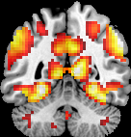
It is an open question whether this is due to preserved structure or functional compensation.
“successful agers”
brain maintenance
cognitive
reserve
Cabeza et al., OUP, 2004; Nyberg et al., TICS, 2012; Cabeza et al., NatRevNeurosci, 2018; Nyberg & Pudas, AnnRevPsych, 2019.

Slide 4
Different hypotheses about successful aging make different predictions about memory performance correlates.
Theory of successful aging | Differences in memory should concur with …
… differences in structural MRI patterns.
brain maintenance
… differences in functional MRI responses.
cognitive
reserve
Cabeza et al., OUP, 2004; Nyberg et al., TICS, 2012; Cabeza et al., NatRevNeurosci, 2018; Nyberg & Pudas, AnnRevPsych, 2019.

Slide 5
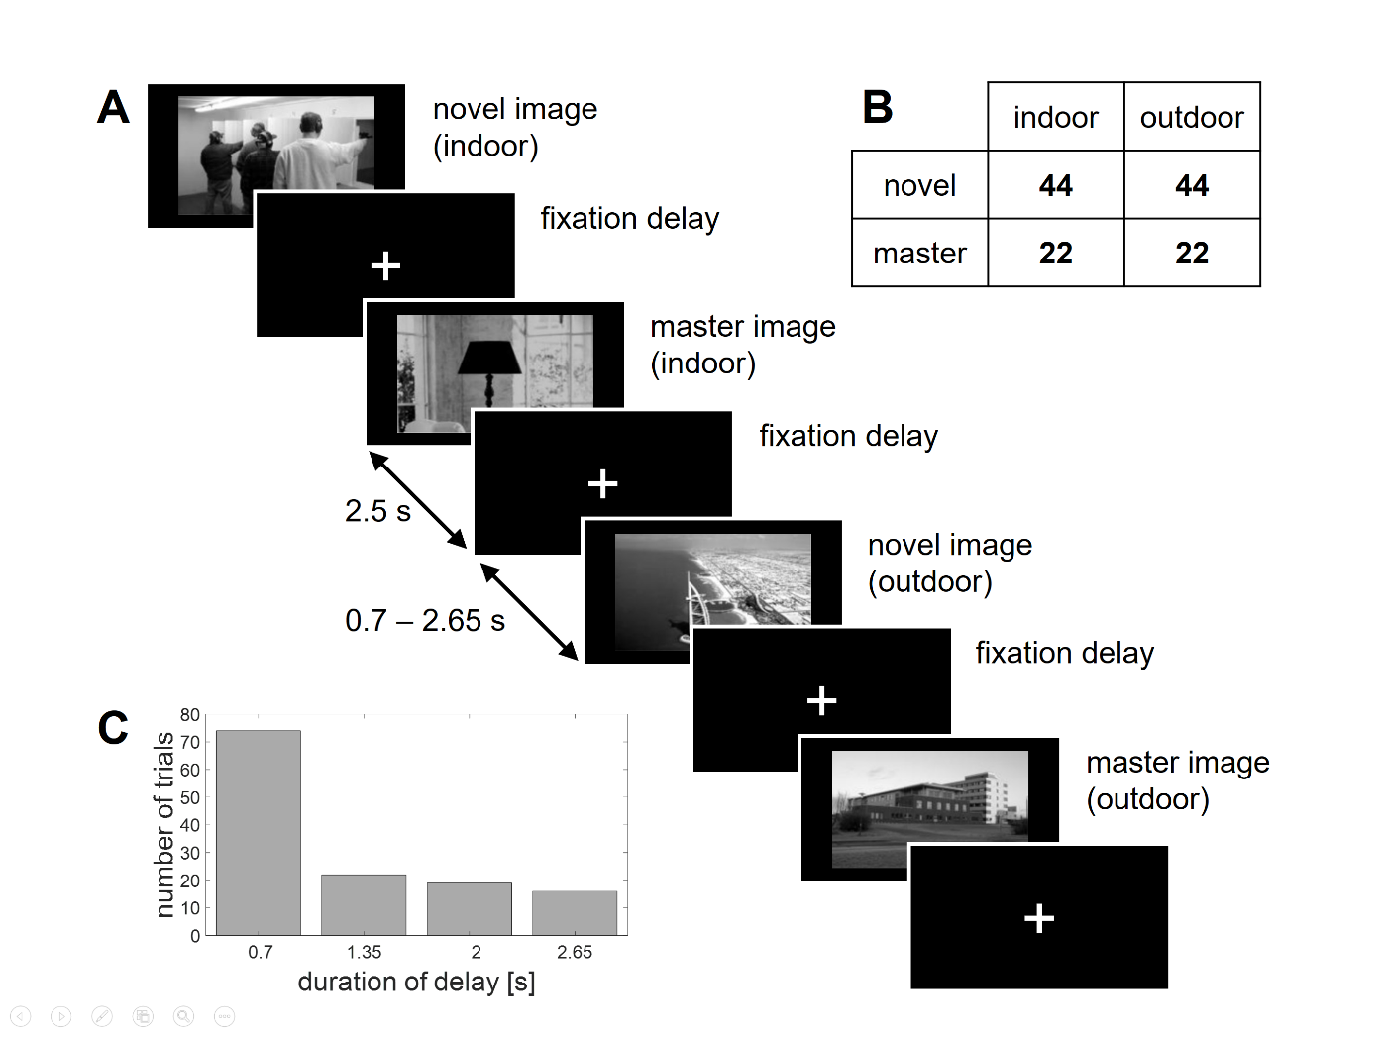
We measured brain activity of young and older subjects while they were seeing novel vs. pre-familiarized (master) images.
Soch*, Richter* et al., NeuImg, 2021, Fig. 1.

Slide 6
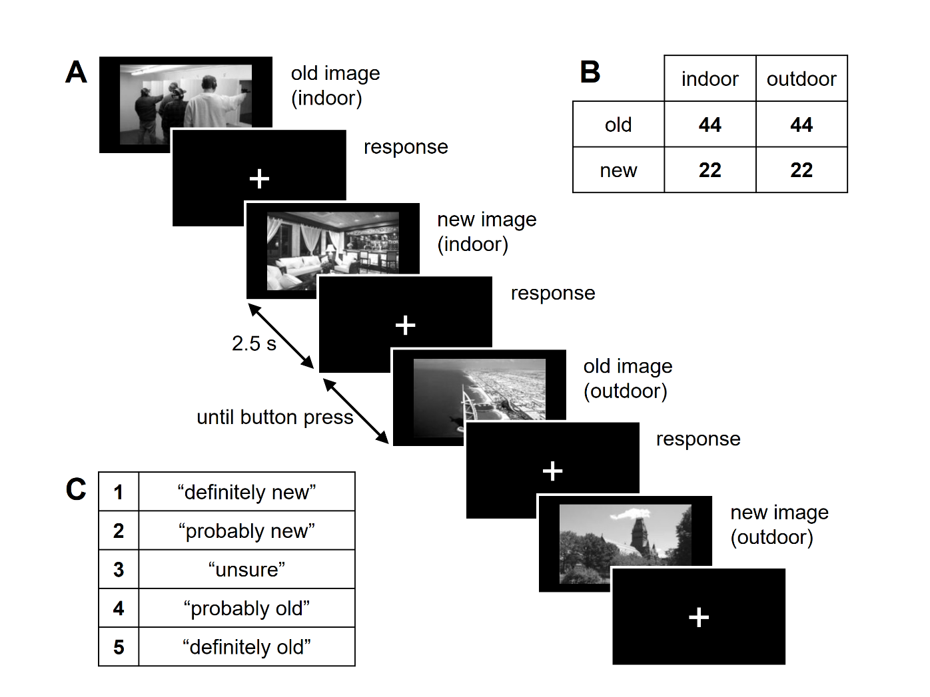
In a subsequent memory test, subjects were shown all old and some new images and provided a memory judgement.
Soch*, Richter* et al., HBM, 2021, p. 4.

Slide 7
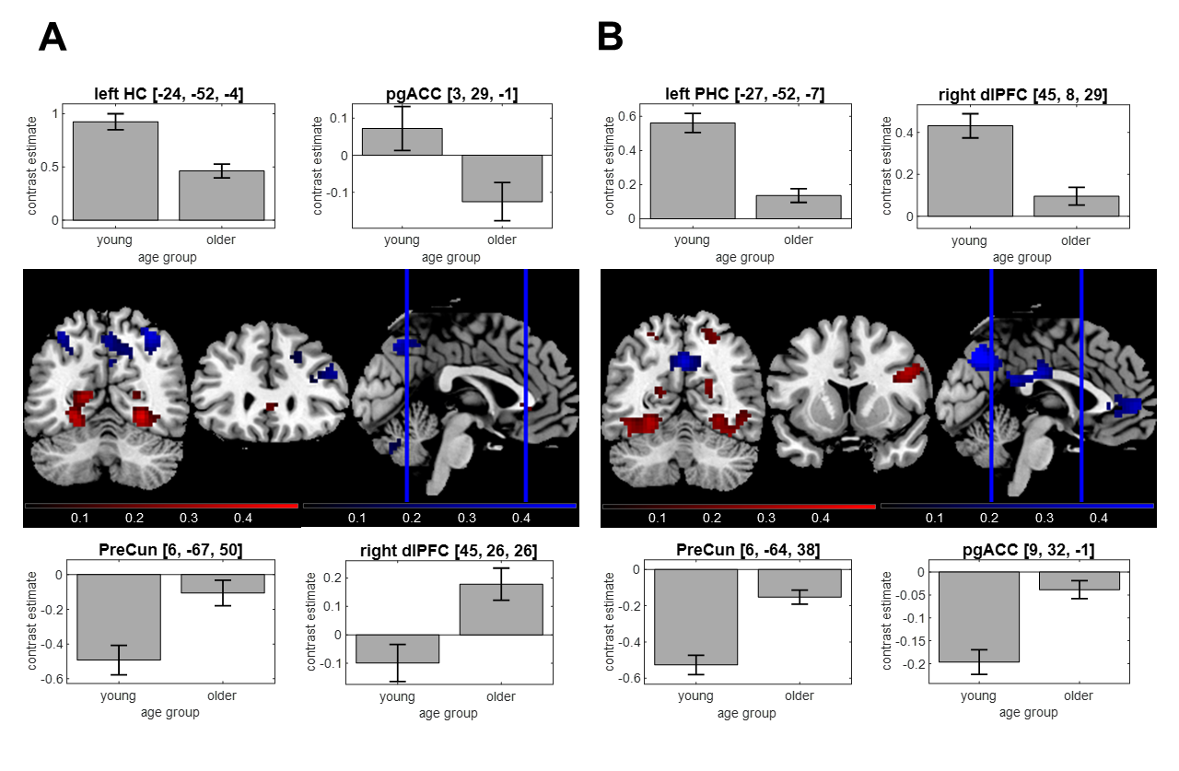
This allows to infer on fMRI activity differences with respect to novelty processing and subsequent memory.
novelty processing
subsequent memory
Soch*, Richter* et al., HBM, 2021, Fig. 2.

Slide 8
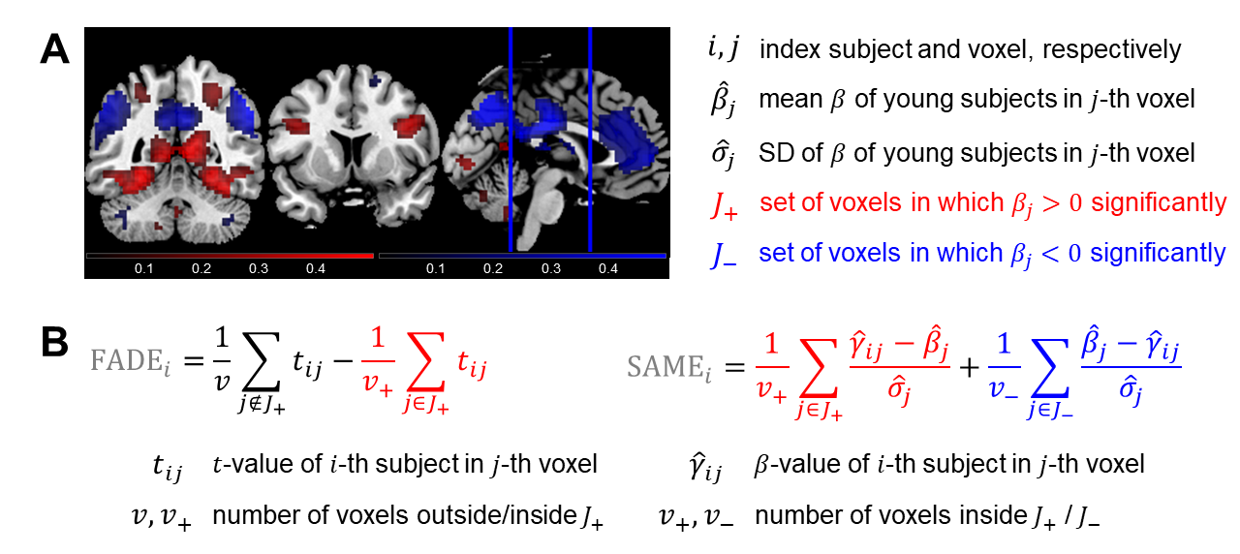
From these fMRI contrasts, we calculated single-value scores indicating similarity with activations of young subjects.
Soch*, Richter* et al., HBM, 2021, Fig. 1.

Slide 9
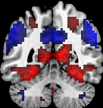
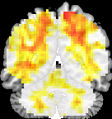
source variables
target variables
behavioral
data
age
group
□ young
□ older
fMRI
scores
support vector classification (SVC)
fMRI
contrasts
prediction
chronological age
age [yrs]
resting-state fMRI
support vector regression (SVR)
memory
perfor-
mance
A’ [AUC
/hits]
structural
MRI
Soch*, Richter* et al., in review, Fig. 1.
all source variables

Slide 10
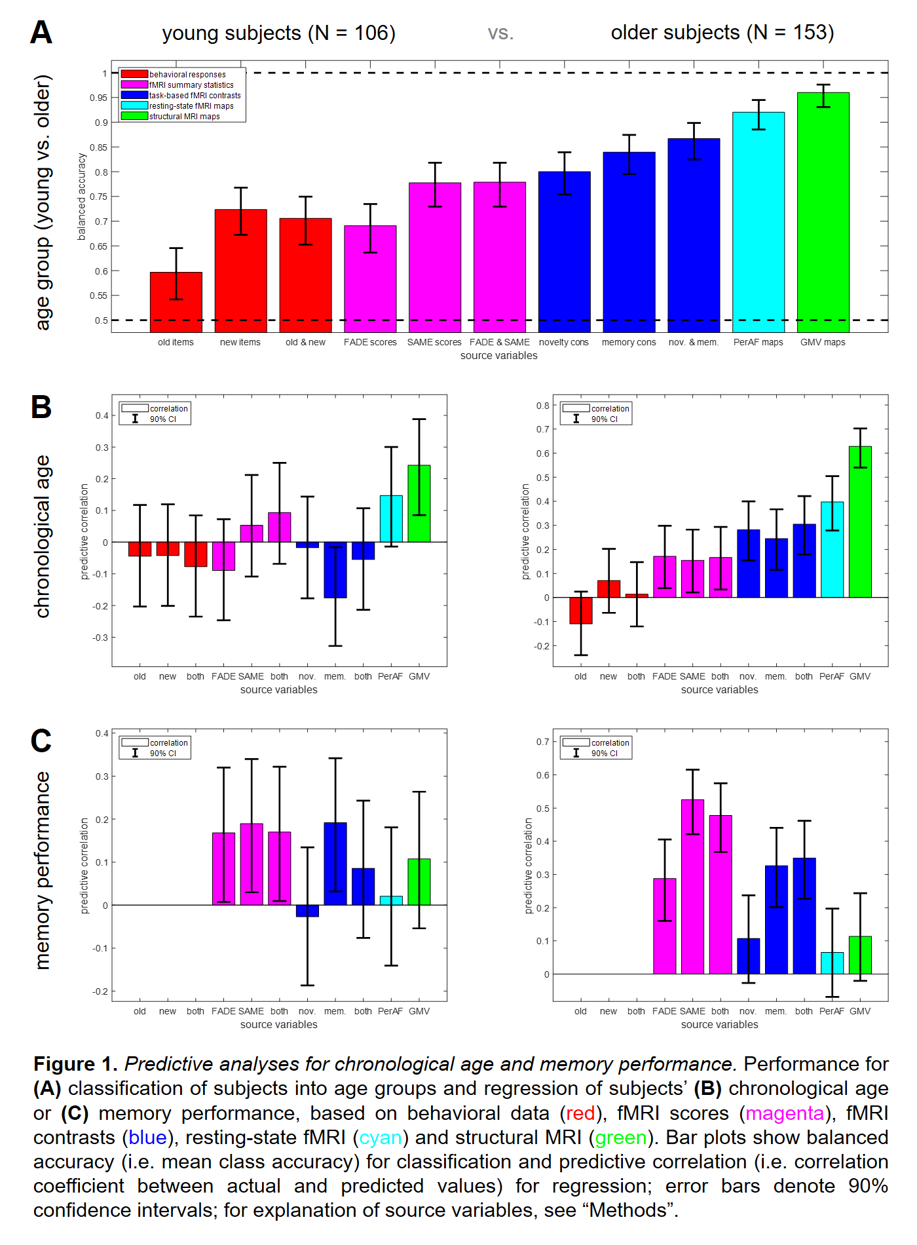
Age group can be classified based on all these variables.
Soch et al., OHBM, 2022, Fig. 1A.

Slide 11
Chronological age is best predicted from structural MRI, but memory performance is best predicted from functional MRI.
Soch et al., OHBM, 2022, Fig. 1B/C.

Slide 12
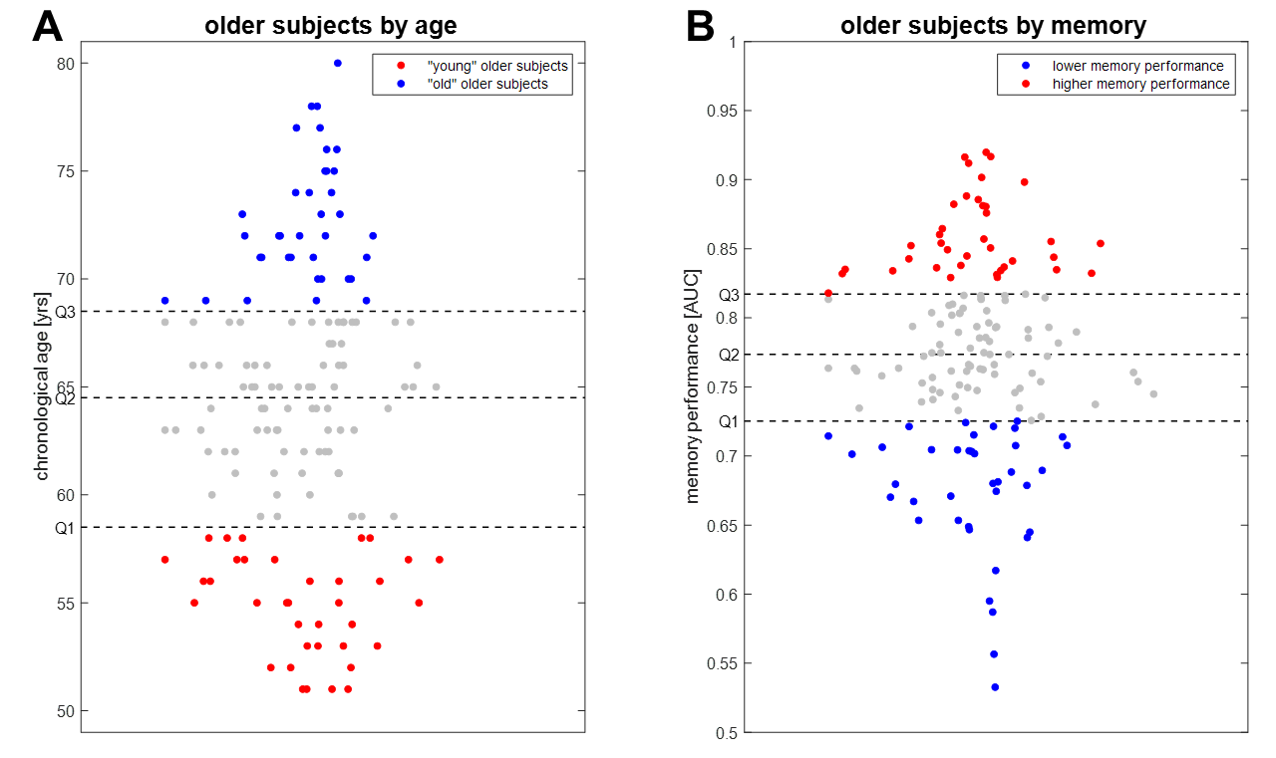
In order to follow up, we partitioned older subjects based on chronological age and memory performance.
Soch*, Richter* et al., in review, Fig. S3.

Slide 13
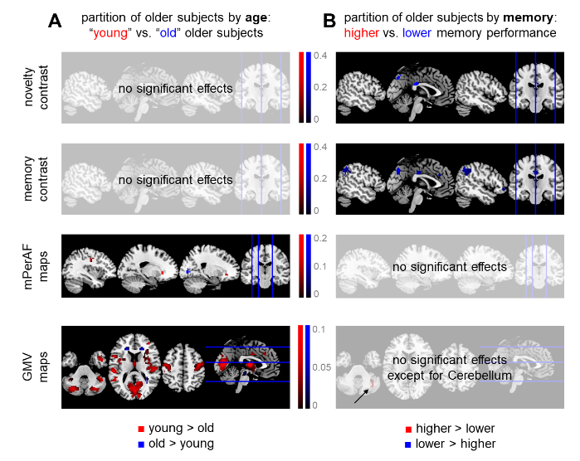
There is a double dissociation between memory vs. age and functional MRI vs. structural MRI (& rs-fMRI)
Soch*, Richter* et al., in review, Fig. 5.

Slide 14
Summary
Chronological age is best predicted from structural MRI, but memory performance is best predicted from functional MRI.
Single-value fMRI scores outperform whole-brain fMRI contrasts in predicting (independent) memory performance.
Successful aging in memory is more likely due to efficient cognitive reserve than preserved brain maintenance.

Slide 15
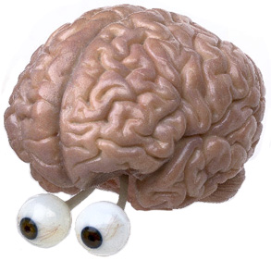
THANK YOU!
QUESTIONS?
Joram.Soch@DZNE.de

Slide 16
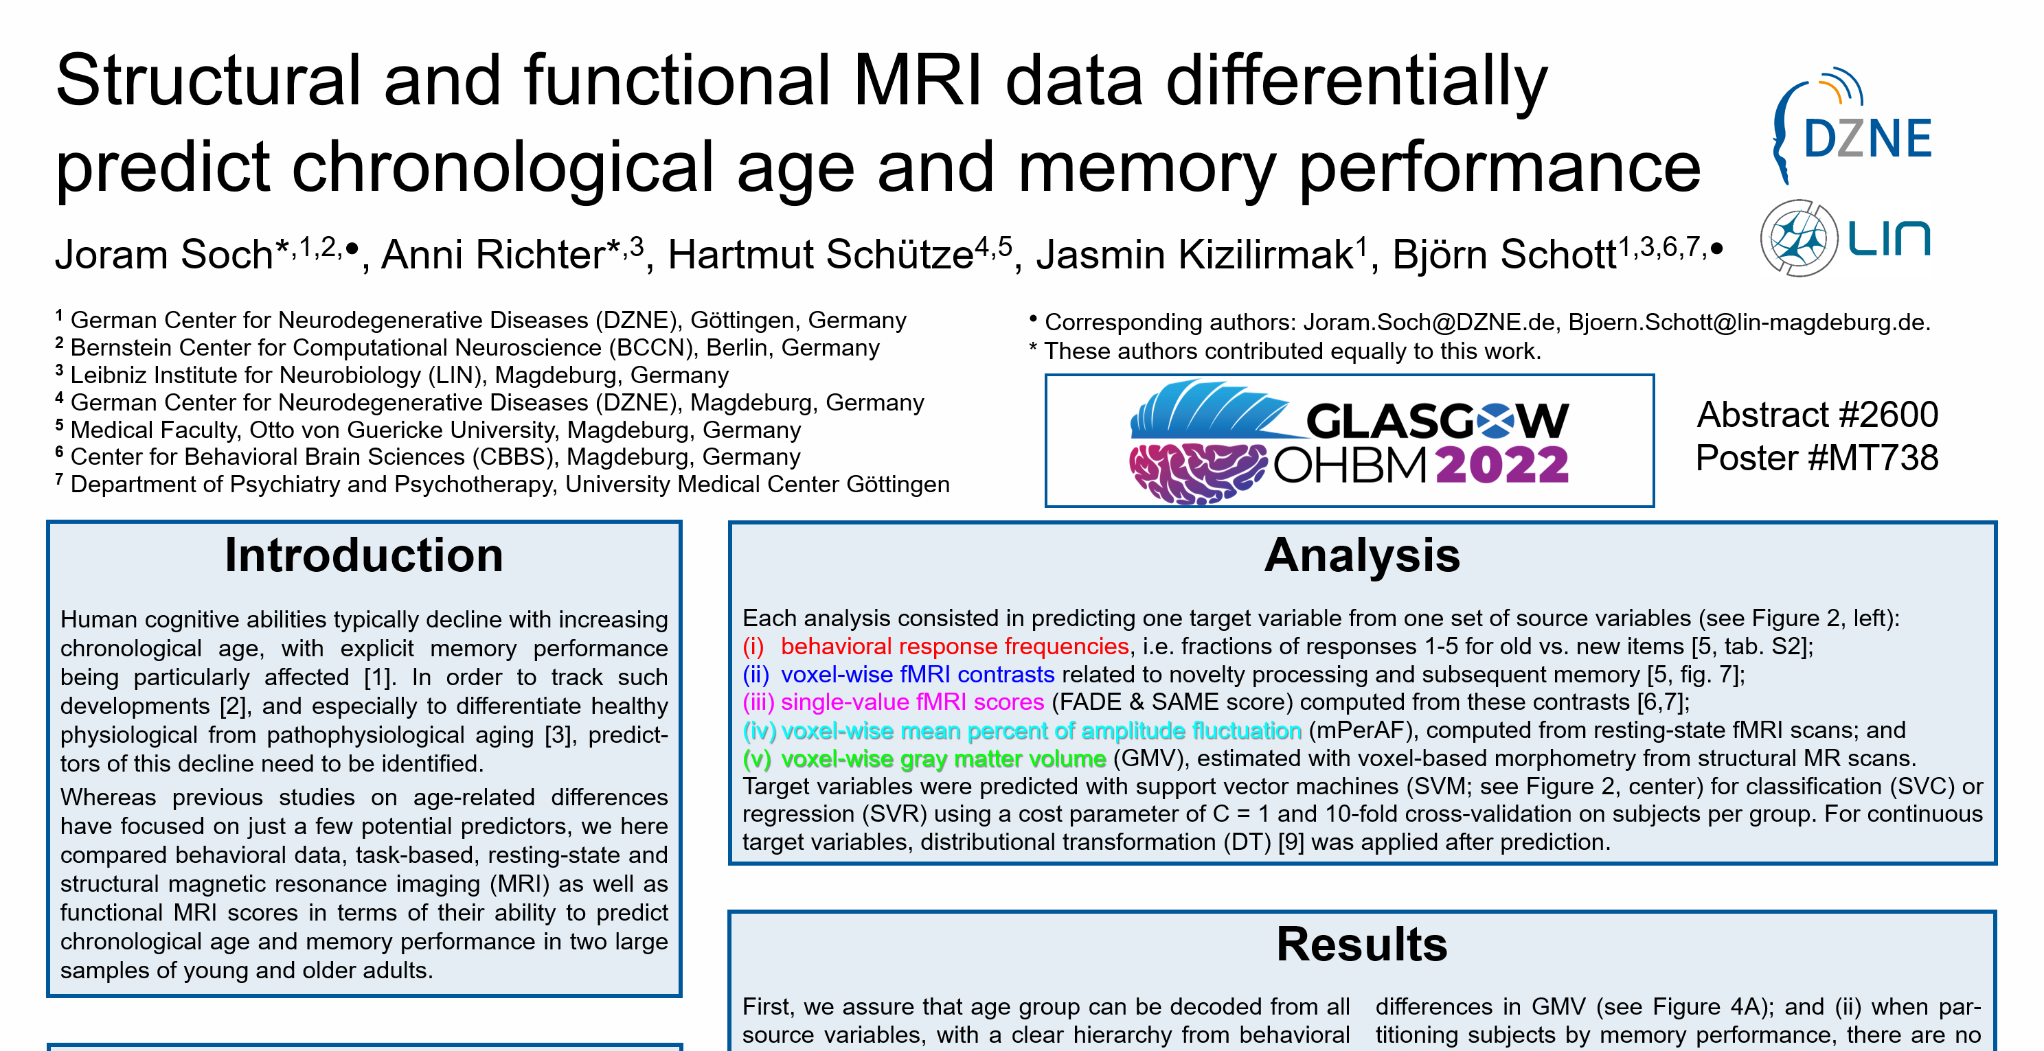
Poster MT738

Slide 17
More Posters
MT736: Age-dependent involvement of DMN structures in episodic long-term memory formation (Jasmin Kizilirmak)
MT790: Construct validity of single-value scores reflecting memory-related fMRI activity (Anni Richter)
WTh594: Searchlight-based trial-wise fMRI decoding in the presence of trial-by-trial correlations (Joram Soch)

Slide 18
THANK YOU!
QUESTIONS?
Joram.Soch@DZNE.de

Slide 19
Appendix

Slide 20
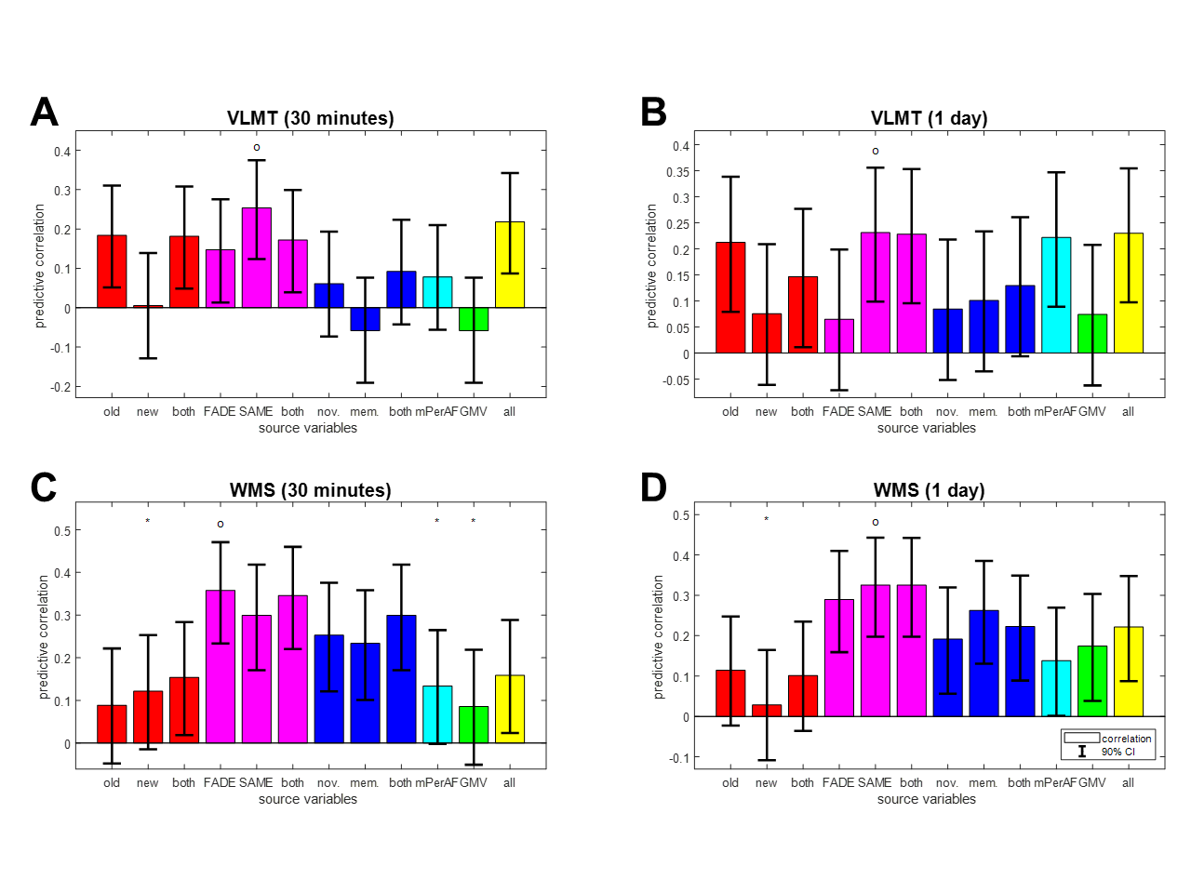
Single-value fMRI scores outperform whole-brain fMRI contrasts in predicting independent memory performance.
Soch*, Richter* et al., in review, Fig. 4.

Slide 21
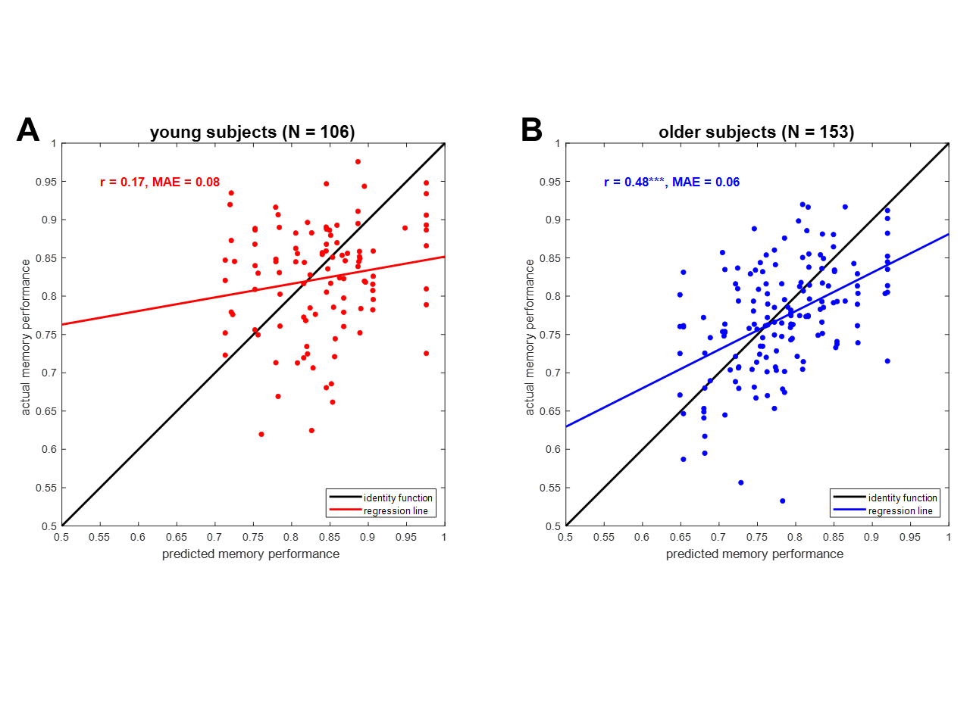
The predictive utility of fMRI scores for memory performance is still moderate.
Soch*, Richter* et al., in review, Fig. 6.

