Slide 1


Structural and functional MRI data differentially predict chronological age and behavioral memory performance
#OHBM2022
@JoramSoch
Abstract/Poster #2600
Talk in Oral Session
Joram Soch*^{,1,2,●}, Anni Richter*^{,3}, Hartmut Schütze^{4,5}, Jasmin Kizilirmak¹, Björn Schott^{1,3,6,7,●}
¹ German Center for Neurodegenerative Diseases (DZNE), Göttingen, Germany
² Bernstein Center for Computational Neuroscience (BCCN), Berlin, Germany
³ Leibniz Institute for Neurobiology (LIN), Magdeburg, Germany
⁴ German Center for Neurodegenerative Diseases (DZNE), Magdeburg, Germany
⁵ Medical Faculty, Otto von Guericke University, Magdeburg, Germany
⁶ Center for Behavioral Brain Sciences (CBBS), Magdeburg, Germany
⁷ Department of Psychiatry and Psychotherapy, University Medical Center Göttingen
Göttingen
Magdeburg

Slide 2
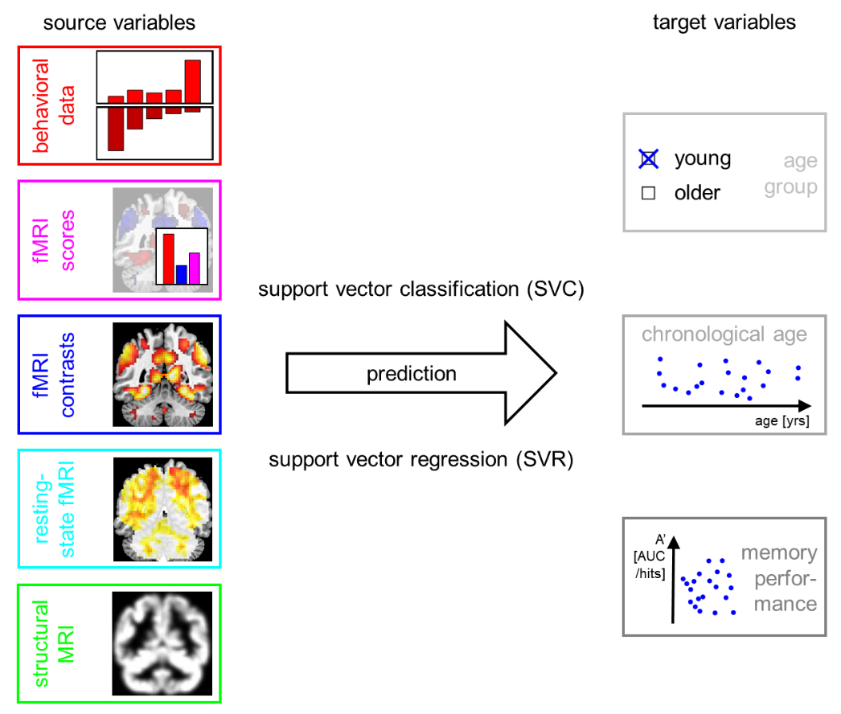
We predicted chronological age and memory performance from a number of source variables / feature sets.
Soch*, Richter* et al., in review, Fig. 1.

Slide 3
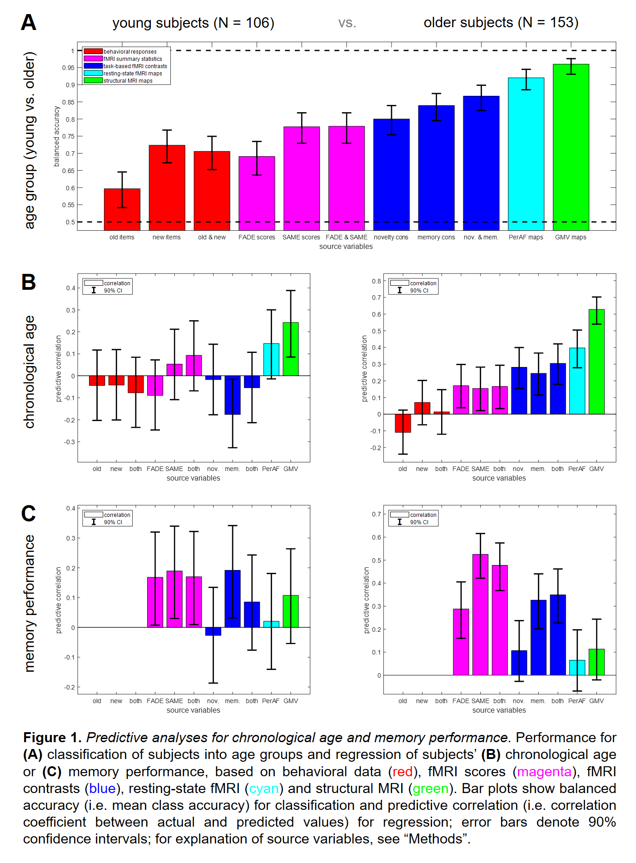
Age group can be classified based on all these variables.
Soch et al., OHBM, 2022, Fig. 1A.

Slide 4
Chronological age is best predicted from structural MRI, but memory performance is best predicted from functional MRI.
Soch et al., OHBM, 2022, Fig. 1B/C.

Slide 5
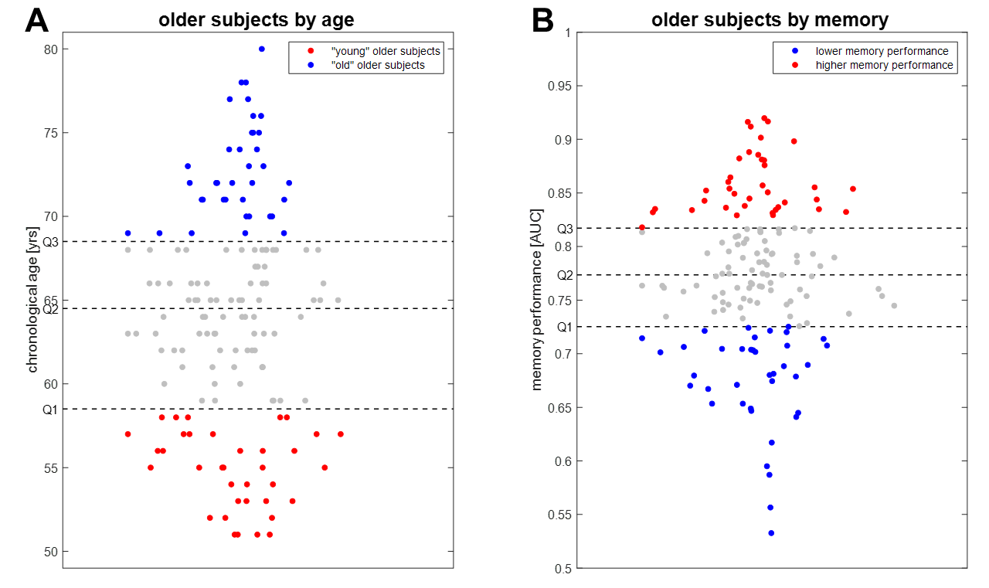
In order to follow up, we partitioned older subjects based on chronological age and memory performance.
Soch*, Richter* et al., in review, Fig. S3.

Slide 6
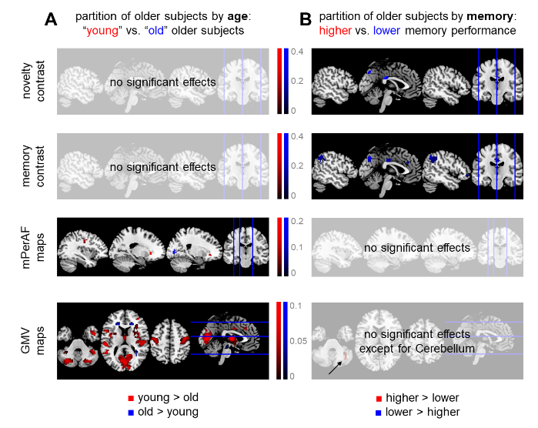
There is a double dissociation between memory vs. age and functional MRI vs. structural MRI (& rs-fMRI)
Soch*, Richter* et al., in review, Fig. 5.

Slide 7
Summary
Chronological age is best predicted from structural MRI, but memory performance is best predicted from functional MRI.
Single-value fMRI scores outperform whole-brain fMRI contrasts in predicting (independent) memory performance.

Slide 8
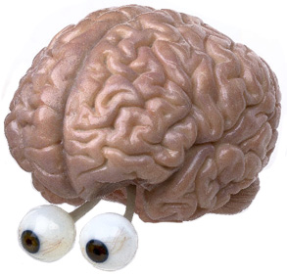
THANK YOU!
QUESTIONS?
Joram.Soch@DZNE.de

Slide 9
Appendix

Slide 10
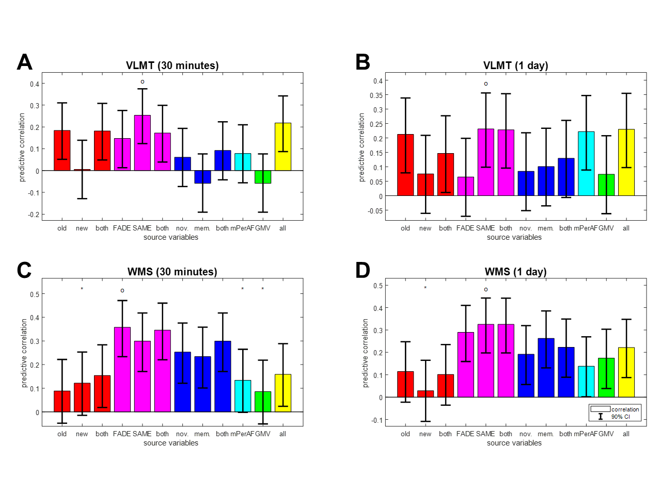
Single-value fMRI scores outperform whole-brain fMRI contrasts in predicting independent memory performance.
Soch*, Richter* et al., in review, Fig. 4.

Slide 11
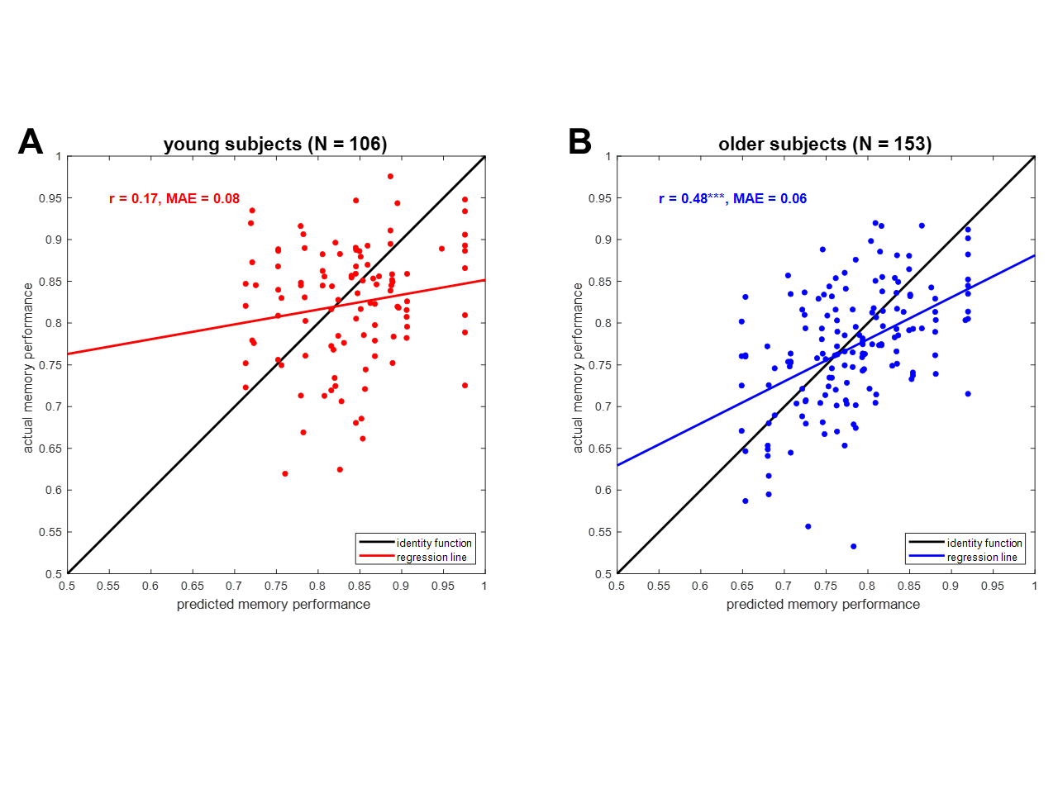
The predictive utility of fMRI scores for memory performance is still moderate.
Soch*, Richter* et al., in review, Fig. 6.

