Slide 1
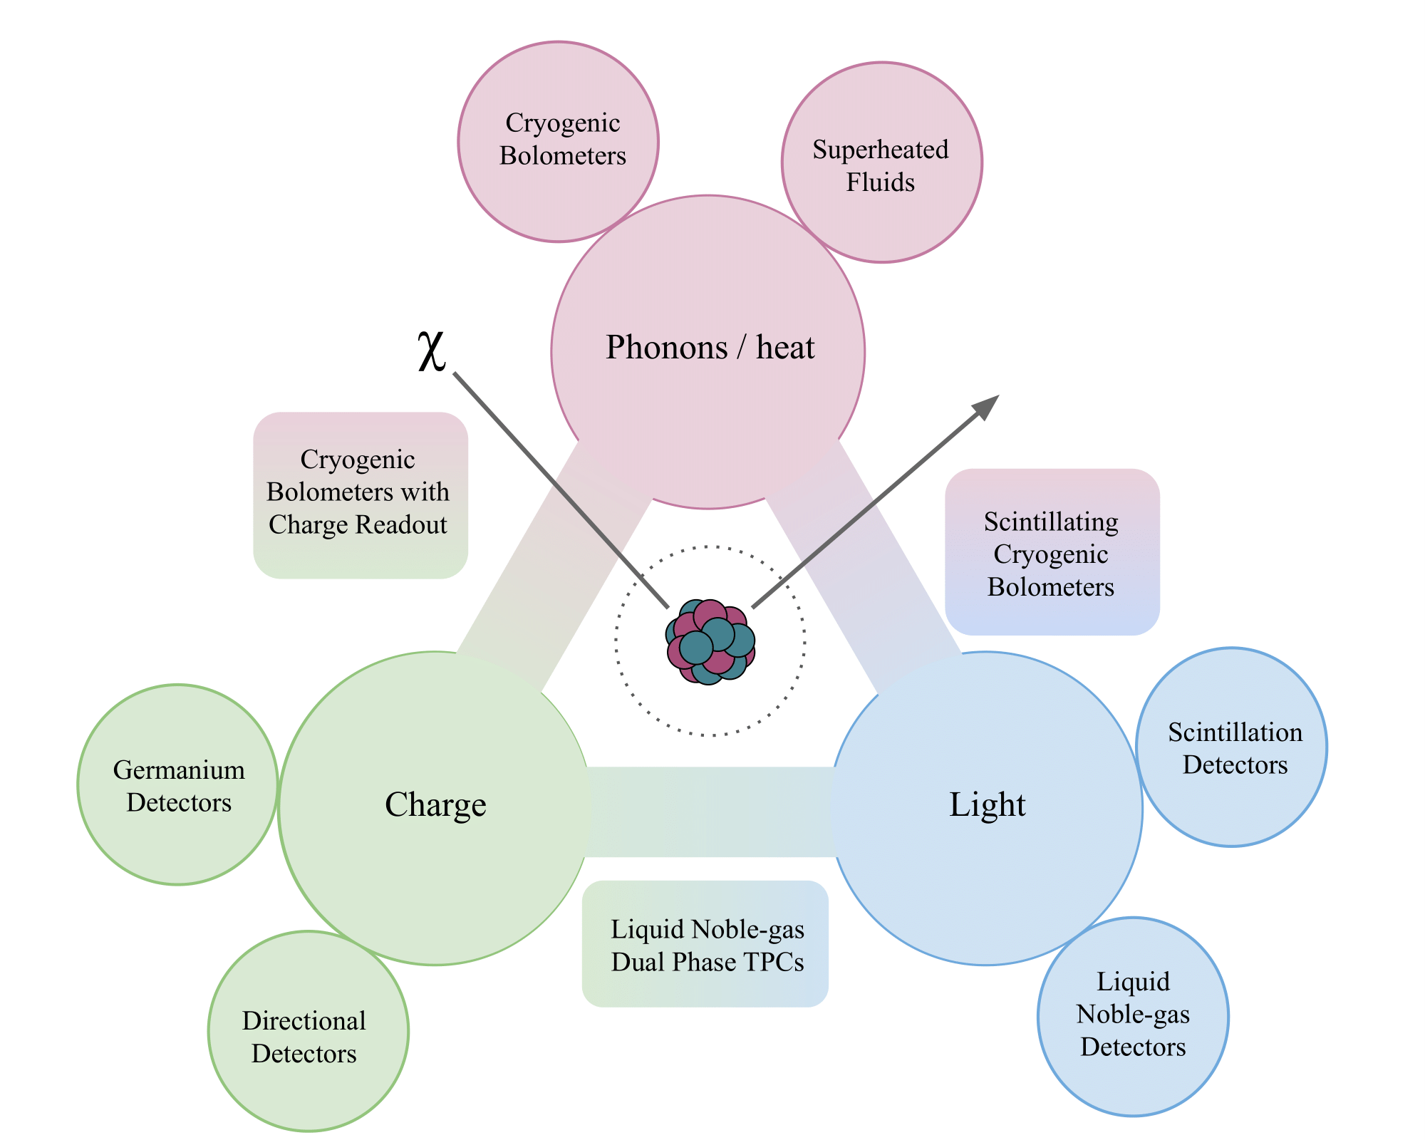
Superheated Fluids
Cryogenic Bolometers
Quantum Sensing
Semi- conductor Materials

