Slide 1
Feature Selection using Stochastic Gates
Hengjun Jiang

Slide 2
Feature Selection
Feature Selection Definition:
Select a subset of meaningful(relevant) features from original features.

Slide 3
Why Feature Selection
model interpretation
memory cost
convergence rate

Slide 4
Difference with Representation Learning
Feature Generation
Input Features
Feature Selection
Representation Learning
Outputs

Slide 5
Feature Selection Methods
Filter Methods
remove irrelevant features based on some pre-defined statistical measure scores(Mutual Information, Dependence Estimation, etc)
Wrapper Methods
learn a subset of relevant features according to the output of a task-oriented model(Random Forests, Xgboost, etc)
Embedded Methods
learn a task-oriented model while simultaneously selecting a subset of relevant features(LASSO(linear models), Neural Networks with L-p norm(nonlinear LASSO), etc)

Slide 6
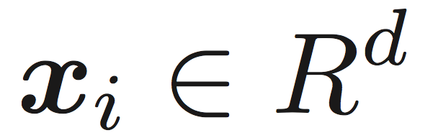


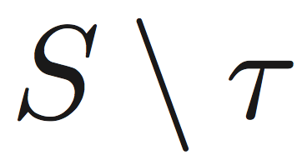
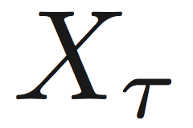
Problem Formulation
Given n i.i.d. samples {(x_{i}, y_{i}), i=1, 2, ..., n}( , with features of size d) generated from an unknown joint distribution P_{X,Y}, to select a subset of features of size m(m<=d)
dependence perspective(filter method):
select a subset of features of size m and the remaining features conditionally independent of Y given
prediction perspective(wrapper method):
select a subset of features and can well predict Y within a specific learning problem

Slide 7
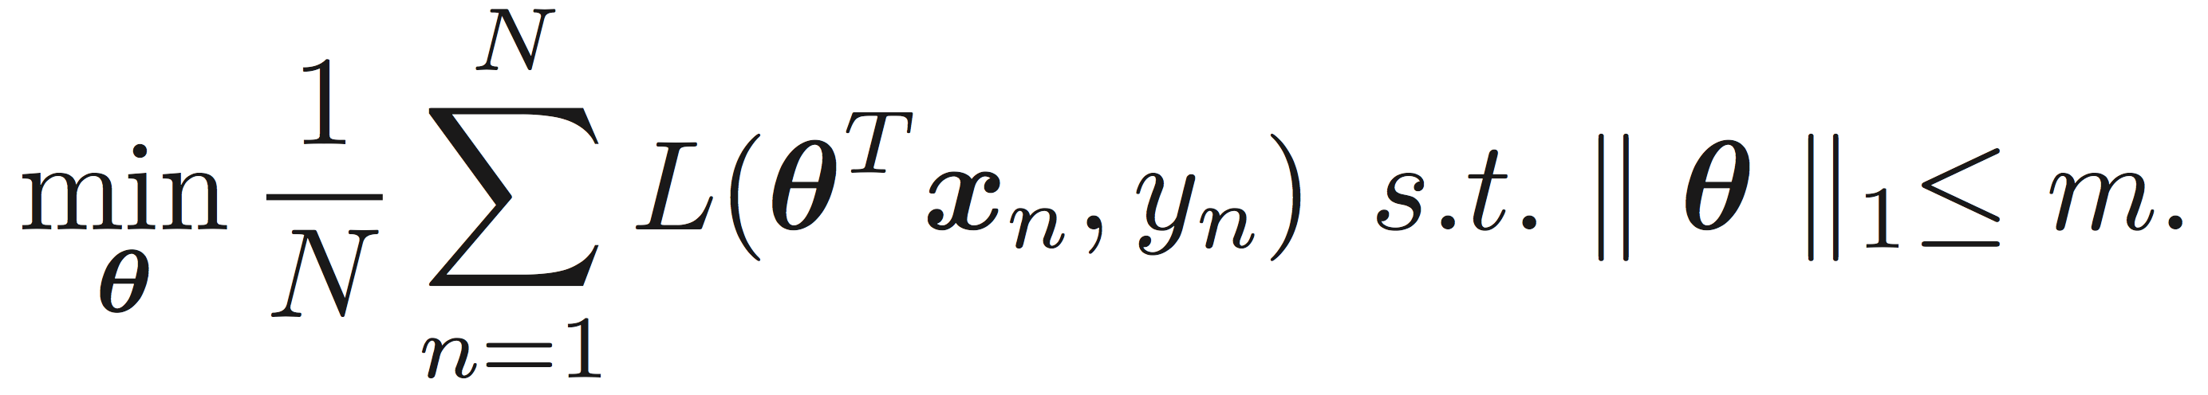

Embeded Methods
LASSO(for linear models):
Limitation: original LASSO optimization problem just shrink the coefficients to approximately select the relevant features.

Slide 8
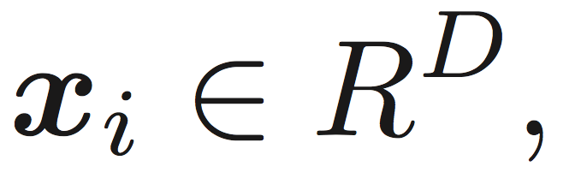
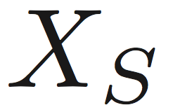

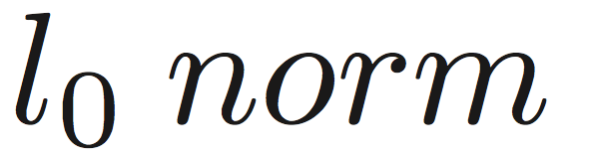
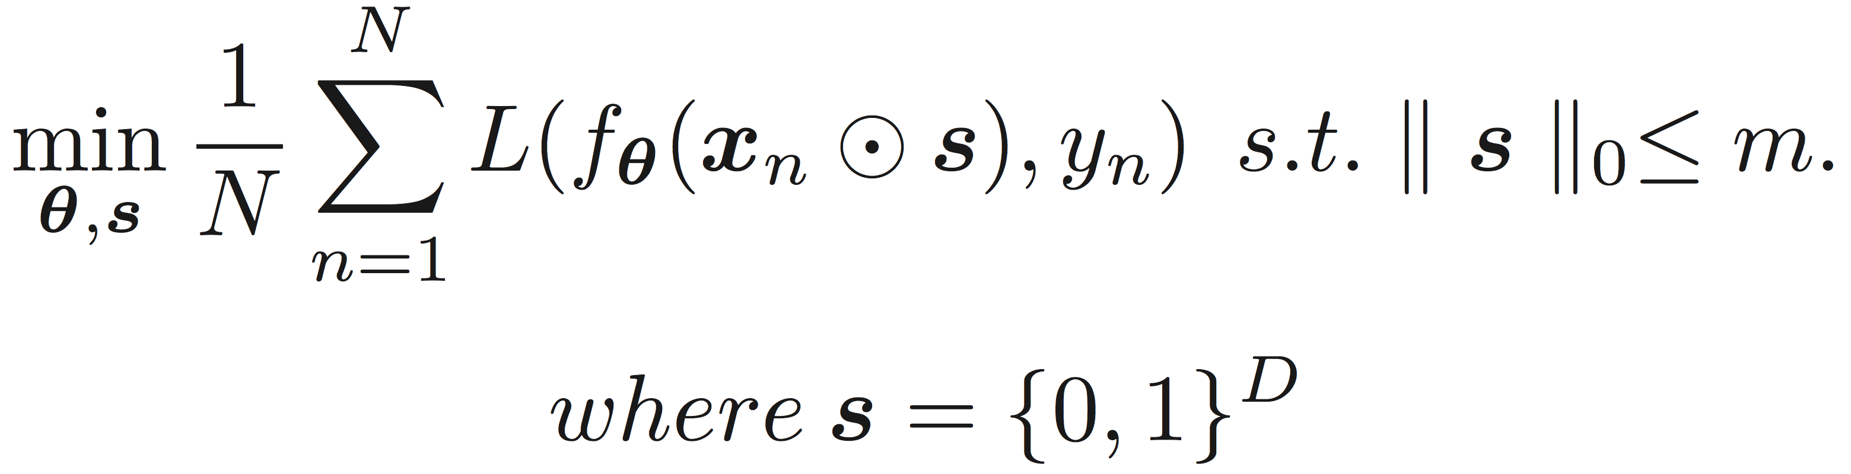
Embeded Methods
Given n i.i.d. samples {(x_{i}, y_{i}), i=1, 2, ..., N}( with features size D) generated from an unknown joint distribution P_{X,Y}, to select a subset of features with feature indices , and simultaneously learn a model to predict Y based on the selected features
LASSO(for nonlinear models):

Slide 9
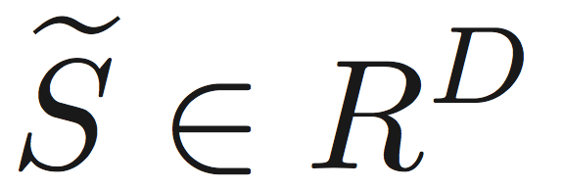
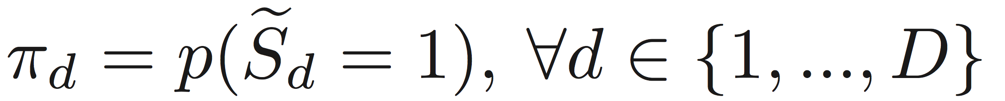
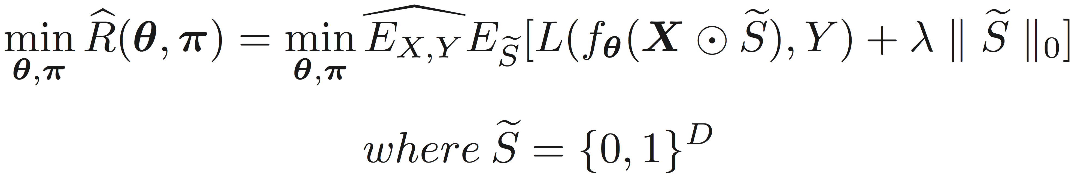
Probabilistic Perspective
let be a random vector sampled from a Multivariate Bernoulli distribution with i.i.d. entries, and
ERR(Empirical Regularized Risk):

Slide 10
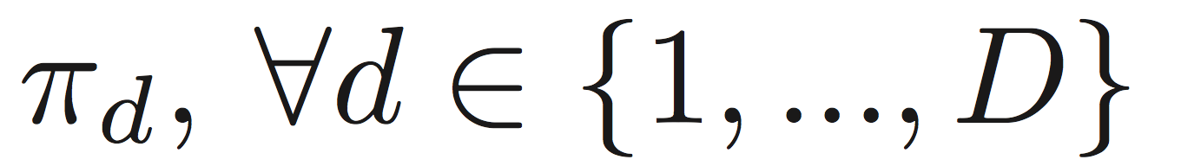
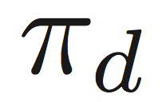
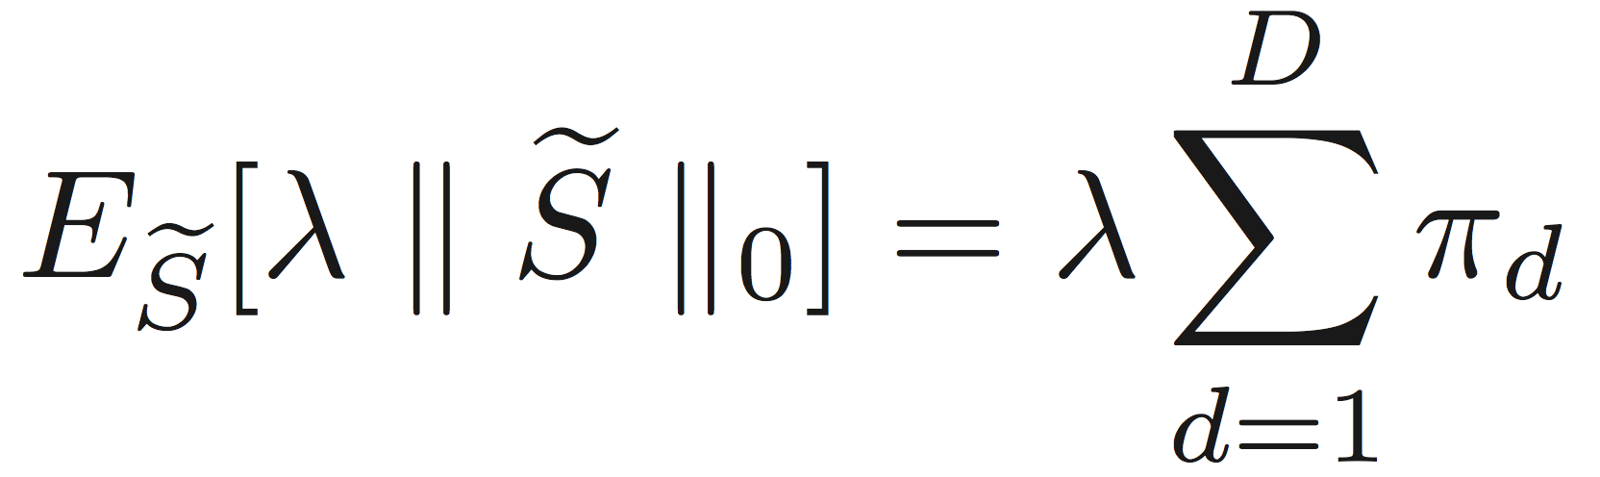
Probabilistic Perspective
ERR(Empirical Regularized Risk):
The first term's gradients with respect to suffer from high variance if be estimated with REINFORCE(Monte Carlo).
The second term's gradients with respect to is differentiable, cause:

Slide 11
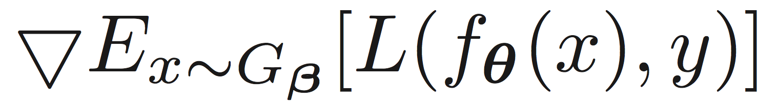
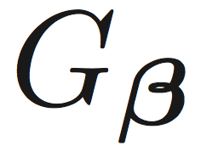
Reparametrization Trick
Objective:
Q:
How to efficiently back propagate the gradients to ?
A:
REINFORCE-Monte Carlo(simple but suffers from high variance)
Reparametrization Trick(simple and have low variance estimation)
p.s. reparametrization trick also works when x is a continuous random variable(vector), e.g. VAEs.

Slide 12
Reparametrization Trick
How reparametrization trick works?

Slide 13
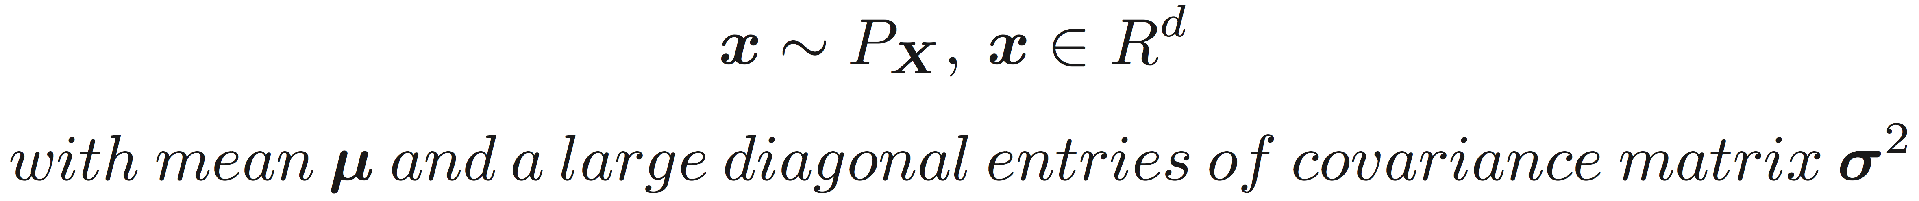
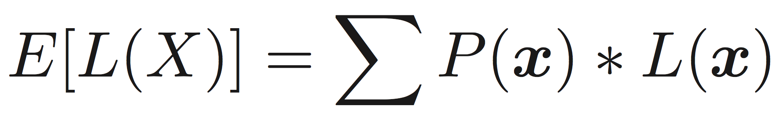
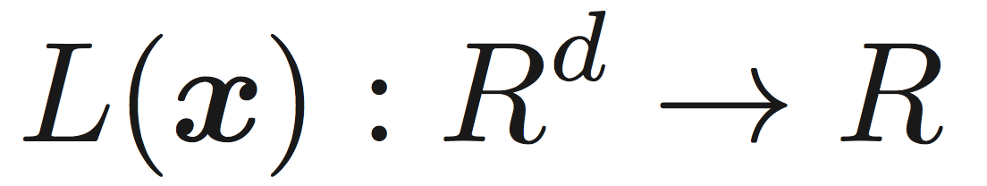
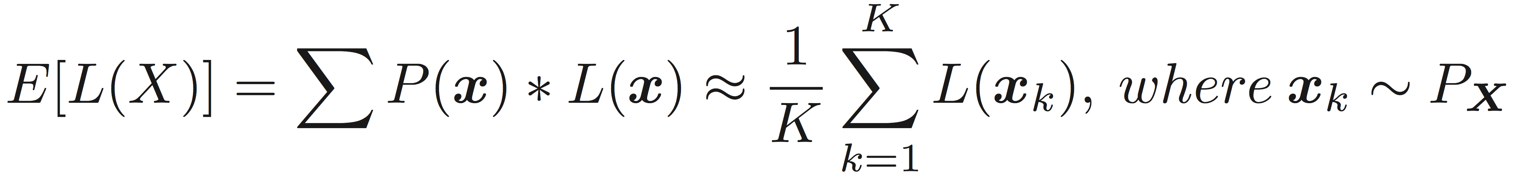
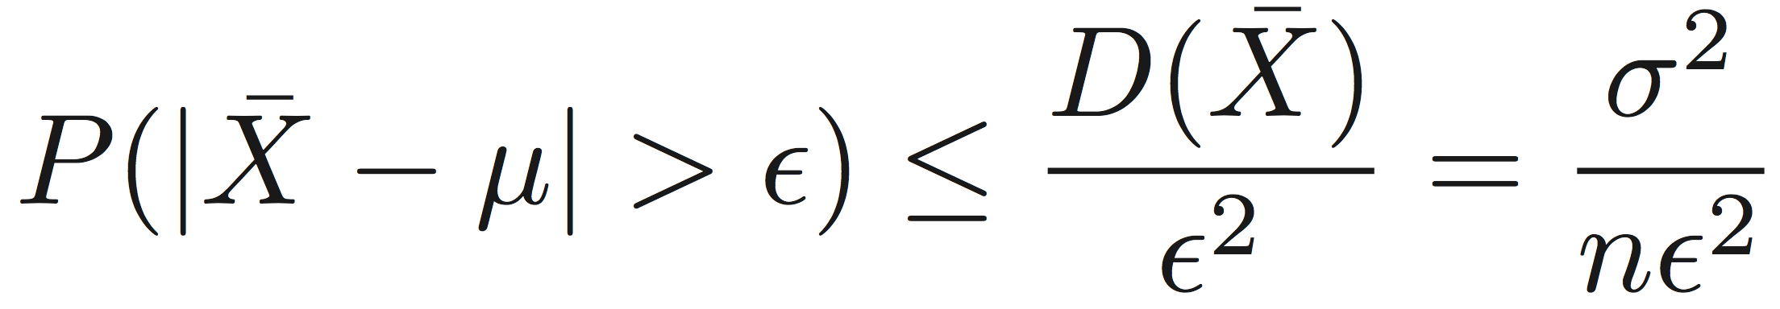
Reparametrization Trick
Consider a random variable(vector) :
How to calculate the expectation of L(X): where:
(Only)Monte Carlo:
Chebyshev's Inequality:
We can conclude:
when sample size n is small and variance σ² is large, it's a high variance estimation!

Slide 14
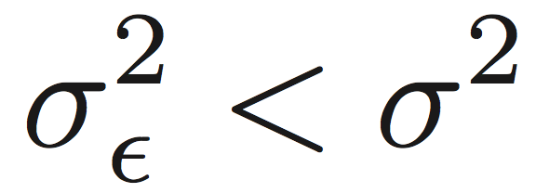
Reparametrization Trick
Consider a random variable(vector) :
How to calculate the expectation of L(X): where:
Reparametrization Trick:
Chebyshev's Inequality:
Cause , so the estimation has lower variance,
and also, it's fully differentiable.

Slide 15
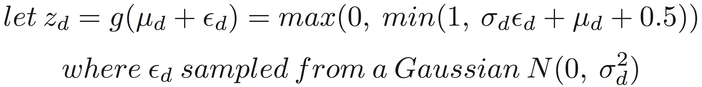
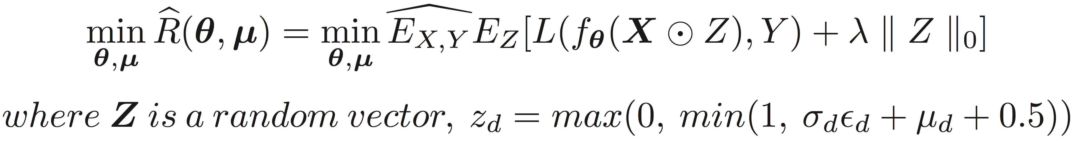
Reparametrization Trick

Slide 16
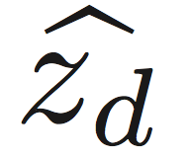
Reparametrization Trick
In inference stage, if is greater than a threshold(e.g. 0.5), then select as a relevant feature, otherwise drop it.

Slide 17
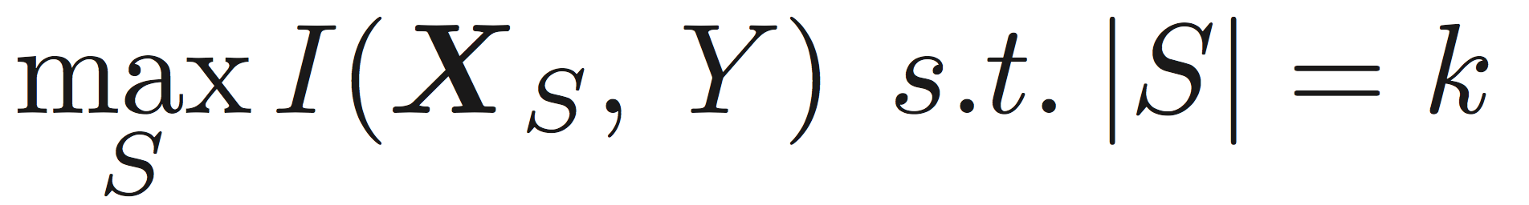
Mutual Information Perspective
To select a subset of features S of size k that has the highest mutual information with the target variable Y.

Slide 18
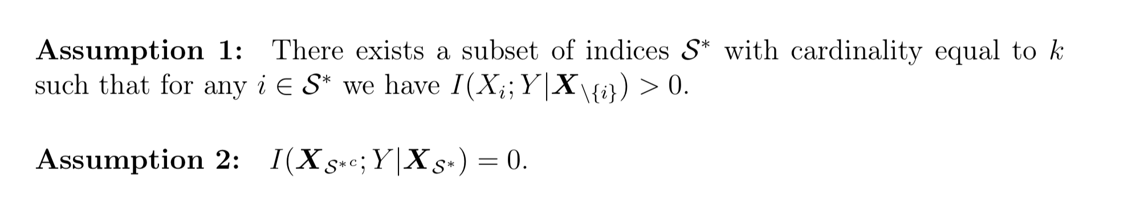
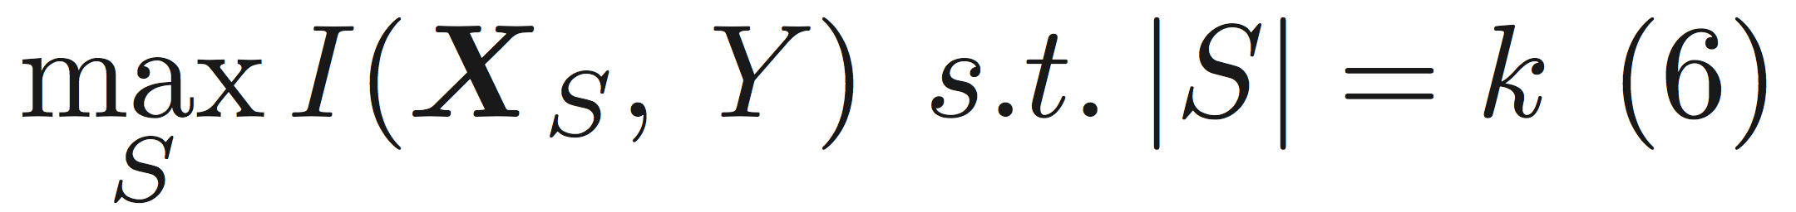
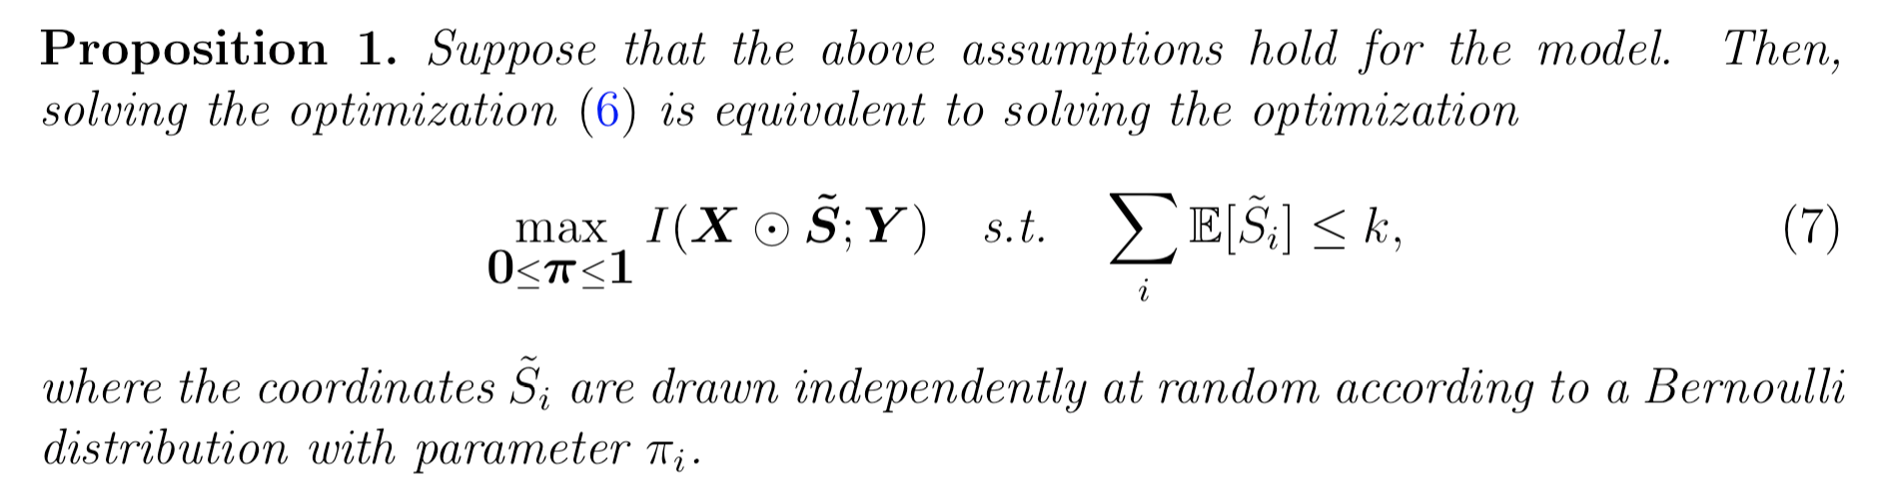
Connection to Mutual Information

Slide 19
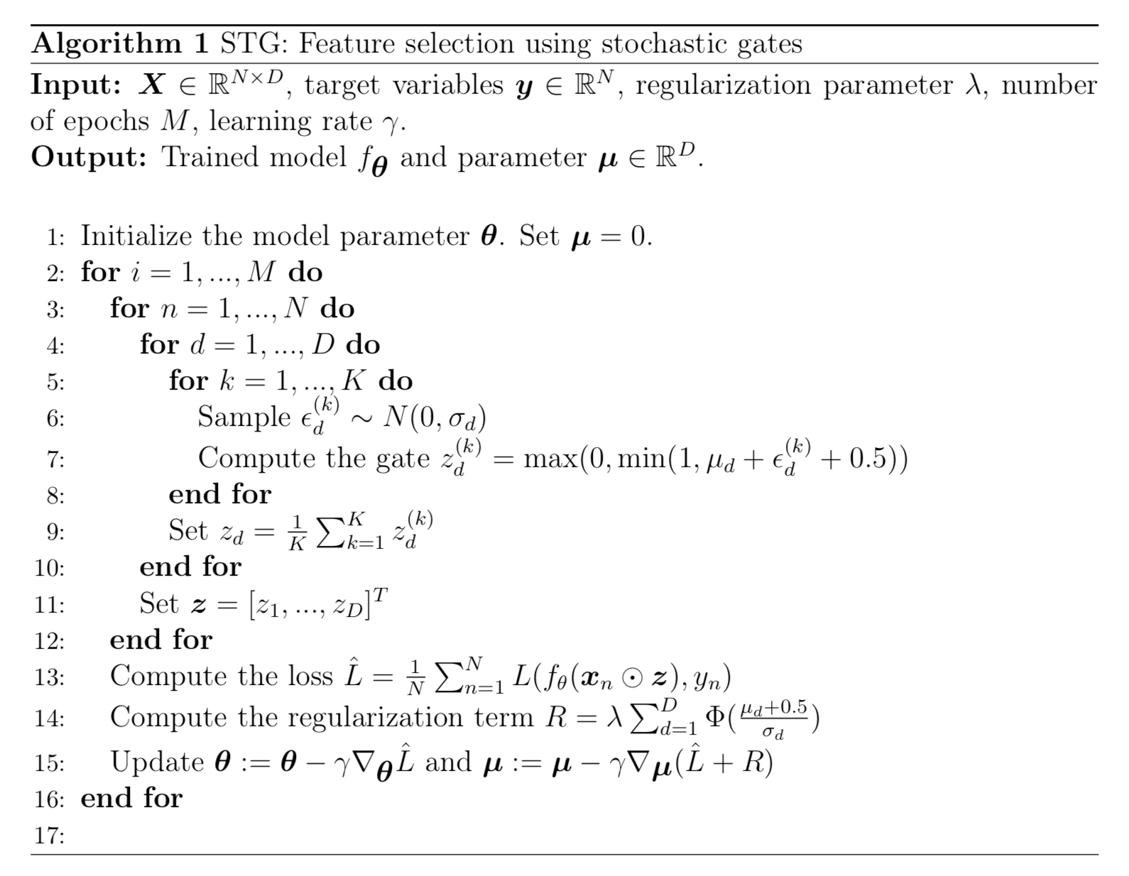
Algorithm

Slide 20
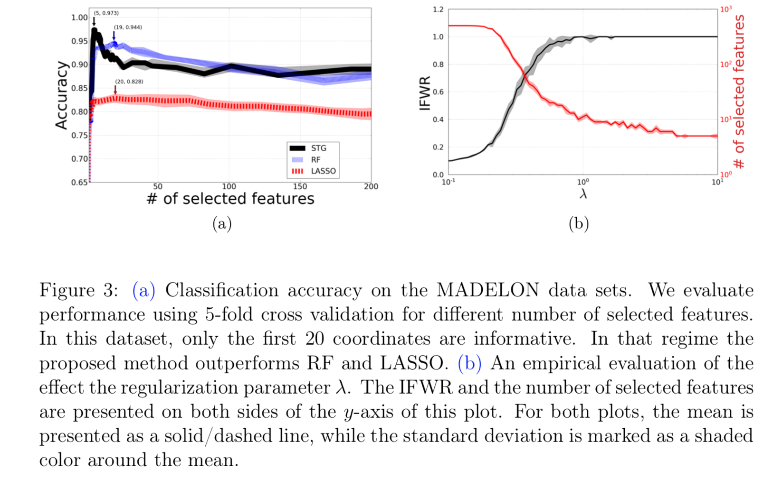
Experiments

Slide 21
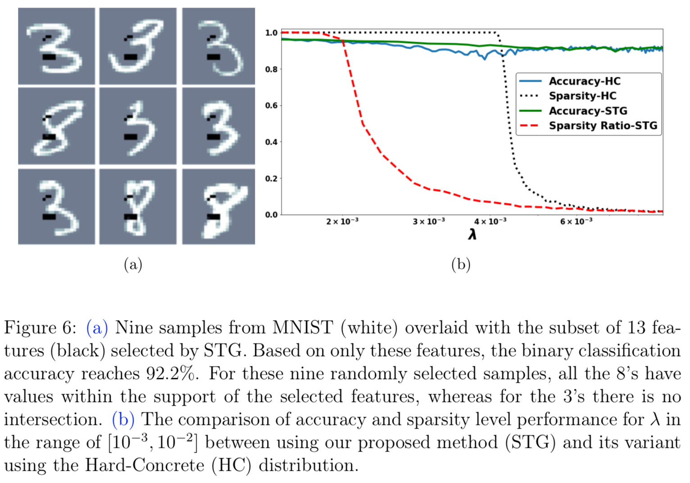
Experiments

Slide 22
References
1. Chen, Jianbo, et al. "Kernel feature selection via conditional covariance minimization." Advances in Neural Information Processing Systems. 2017.
2. Yutaro, Yamada, et al. "Feature selection using Stochastic Gates" arXiv preprint arXiv:1810.04247v3 (2019).
3. Wasserman, Larry. All of statistics: a concise course in statistical inference. Springer Science & Business Media, 2013.

Slide 23
Q&A

