Slide 1
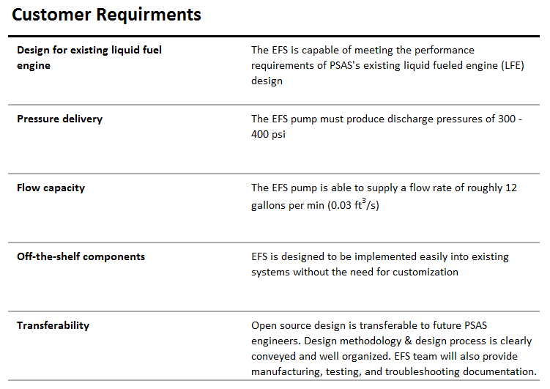
Portland State Aerospace Society | Electric Propellant Feed System
Notes:
allowable test tolerances

Slide 2
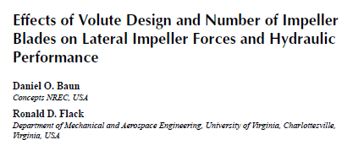

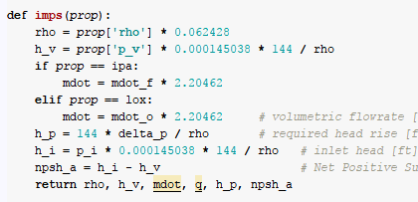





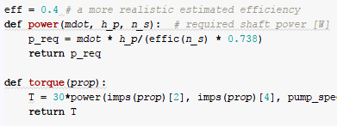




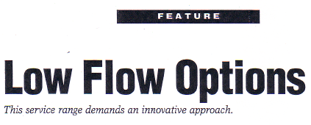

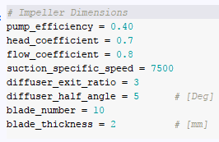



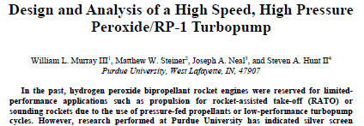


Open-ended literature review
Math is involved
Scientific computing
We make some guesses too
Notes:
literature review to narrow the region of interest. (Don’t solve problems we don’t have to)
Scientific computing as an example of using tools to implement theory OR IDEAS. Matercam, SW, Python, Arduino
Allows us to make calculations (OR DESIGNS) over a wide range of values and explore a little.
We can iteratively develop
note:
Guessing is cheaper
If best head coeff is between 0.5 and 1 we use 0.75 ☺

Slide 3
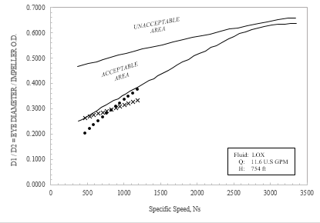
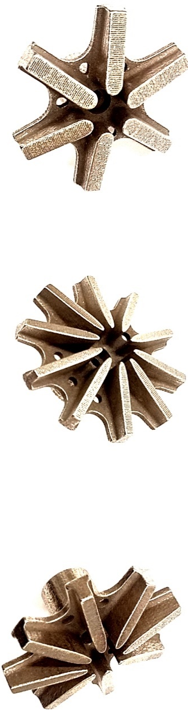
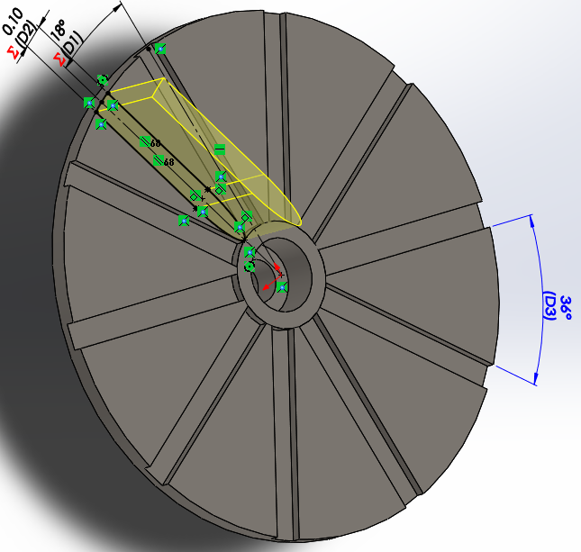
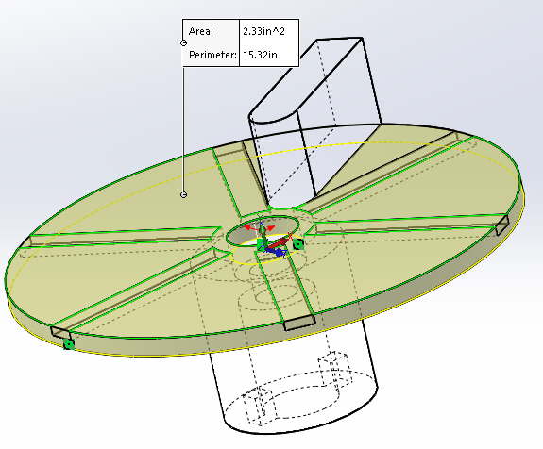
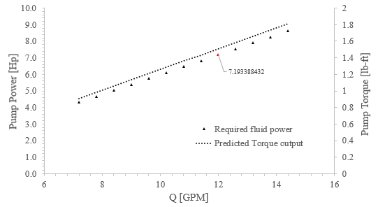
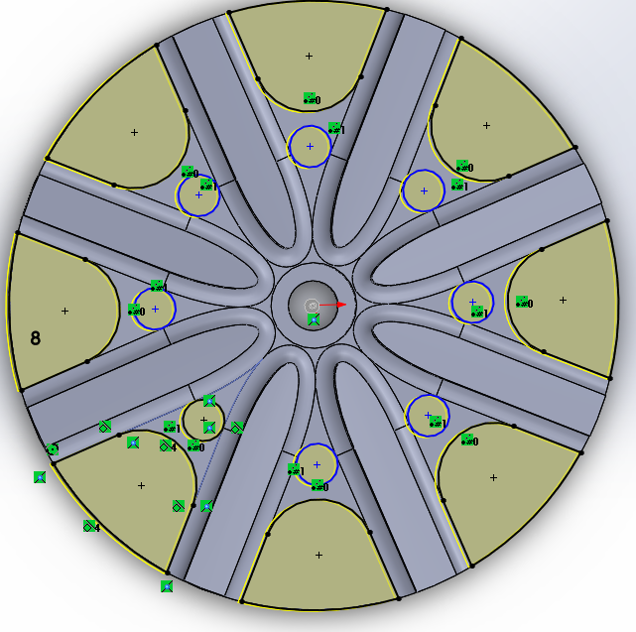
Visualize the Results
(If you can plot it, plot it!)
Parametric Design
(Design freedom)
Viola
(3D-Printed Stainless Steel)
You are here
Notes:
FIRST
We visualize the results of the detailed design in many different ways. Road map
Now that the design is narrow enough we begin breathing life into it.
Give example of Av rule to illustrate the impact of parametrization on success of project
Before showing the results of this methodology as applied to our main hydraulic design
Id like to briefly highlight what makes our pump unique

Slide 4
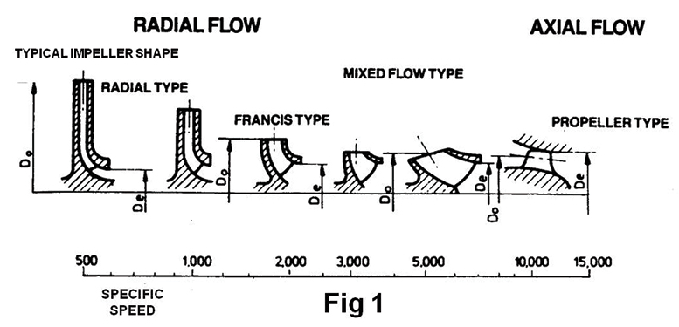
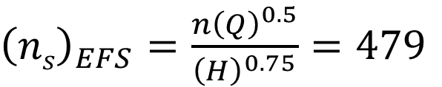
Specific speed is a term used to describe the geometry (shape) of a pump impeller.
Our specific speed
${\left(ns\right)}_{EFS}=\frac{n{\left(Q\right)}^{0.5}}{{\left(H\right)}^{0.75}}=479$
Notes:
Before showing the results of this methodology as applied to our main hydraulic design
Id like to briefly highlight what makes our pump unique
OURS: VERY LOW. Conventional pump design theory and reference information is not well established in this region

Slide 5
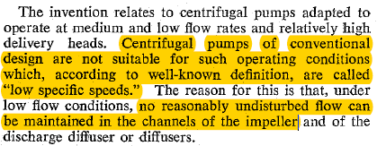
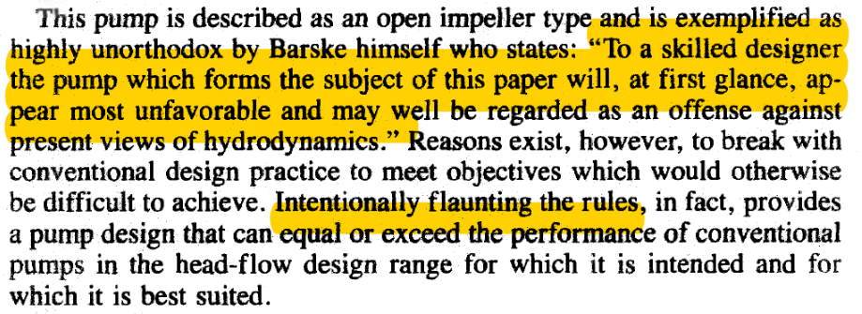
Searching for clues
Notes:
Barske started developmental work on the pump type in Germany prior to world war II
Used our design methodology to couple the subtle hints of barske with conventional pump design and molded it into a suitable design.

Slide 6
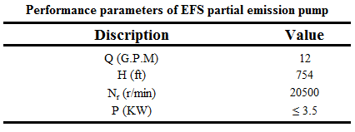
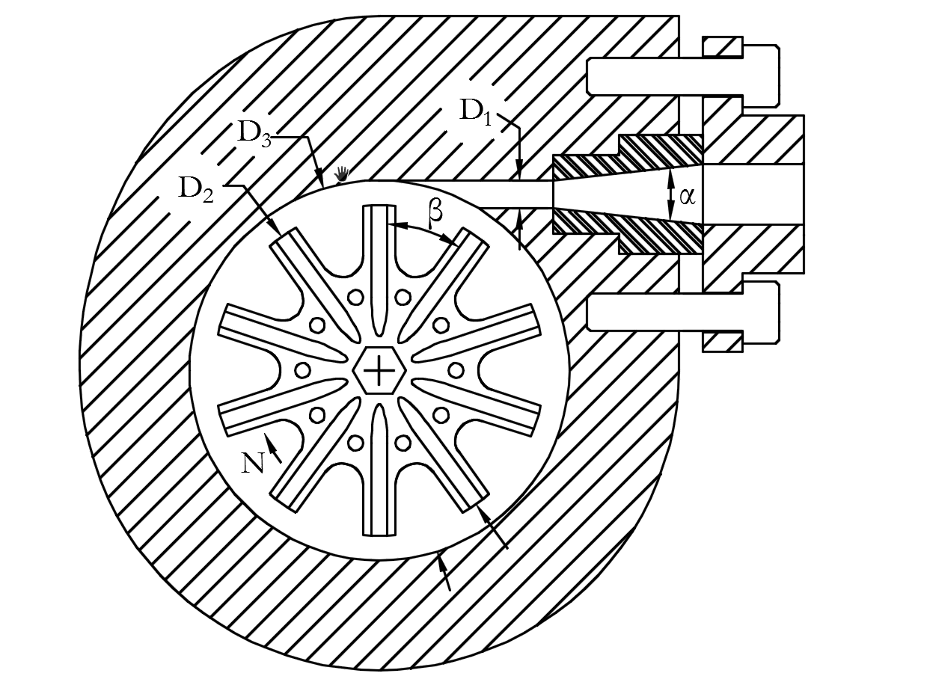
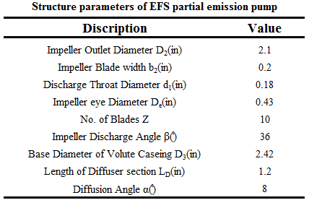
Final parameters of hydraulic structure
Salient Features:
Semi-open impeller
Flow enters axially and exits radially
Casing is bored concentrically with impeller centerline
Fluid allowed to recirculate within the casing
Single emission throat
Conical diffuser oriented tangentially to the case bore
Notes:
WHY? Conical diffuser
- Provides higher efficiency recover because of minimizing wetted area

Slide 7
Performance Testing
Notes:
Centrifugal pump is a complex turbomachine
Purely analytical prediction not possible
Hence, performance is obtained empirically

Slide 8
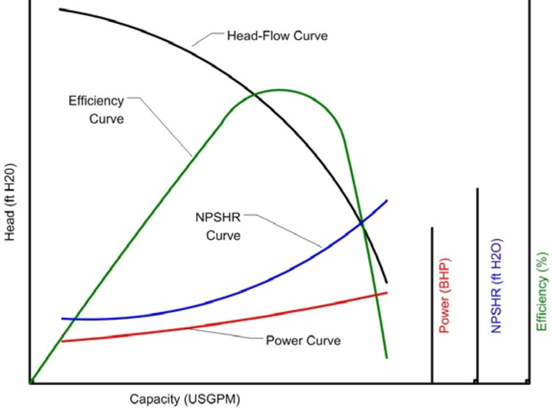
Characterizing the performance of Piglet
Using Hydraulic Test Standard (ANSI/HI 14.6)
Typically performance is given by curves of:
• Head versus capacity
• Power versus capacity
• NPSH versus capacity
Hydraulic Institute Test Standard (ANSI/HI 14.6 "Rotodynamic Pumps for Performance Acceptance Tests," 2011)
Notes:
We followed hydraulic standards intended to demonstrate hydraulic performance and mechanical integrity
• Head versus capacity
Using head and not pressure = head-capacity performance independent of the specific gravity of the liquid.
• Power versus capacity
BHP and WHP
• NPSH versus capacity
Lengthy description of value is unavoidable. Love to explain at the showcase
– Maximum head is at zero capacity
– The maximum capacity of the pump

Slide 9
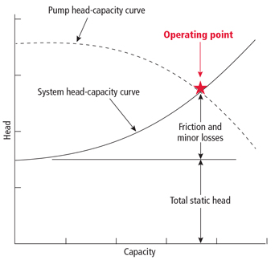

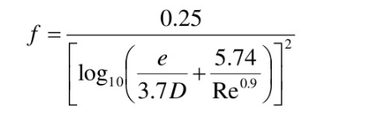
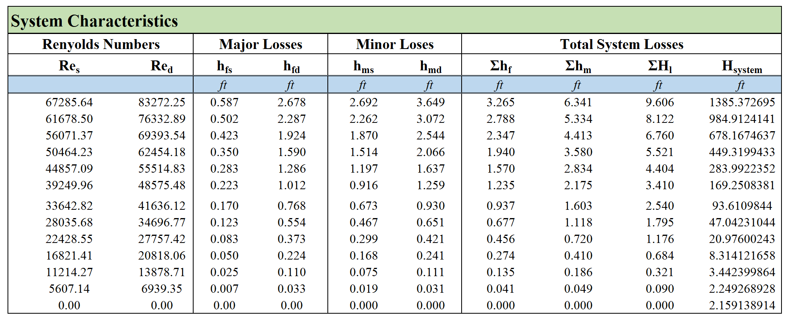
System Characteristics
Energy Equation
Swamee-Jain Equation (1976)
Explicit expression 10⁻⁶ < e/D, 10⁻²; 5000 < N^{R} < 10⁸
Notes:
HEAD OF PUMP VS SYSTEM HEAD
The height to which a pump can raise the water is the pump head and it is measured in meters (feet) of flowing water. The head required to overcome the losses in a pipe system at a given flow rate is called the system head.
Using head and not pressure = head-capacity performance independent of the specific gravity of the liquid.
Energy equation
Each of these individual total heads = sum of the static pressure head, velocity head and elevation head.
That is, analyze the system to determine the pump head required as a function of flow rate through the pump … This will form the system line.
Plotting the pump curve and system curve will result in an intersection point, which is called the operating point.
Friction head
The friction head consists of the sum of the pipe friction head losses in the
Velocity head
Velocity head The velocity head is the kinetic energy contained in the water being pumped at any point in the system

Slide 10
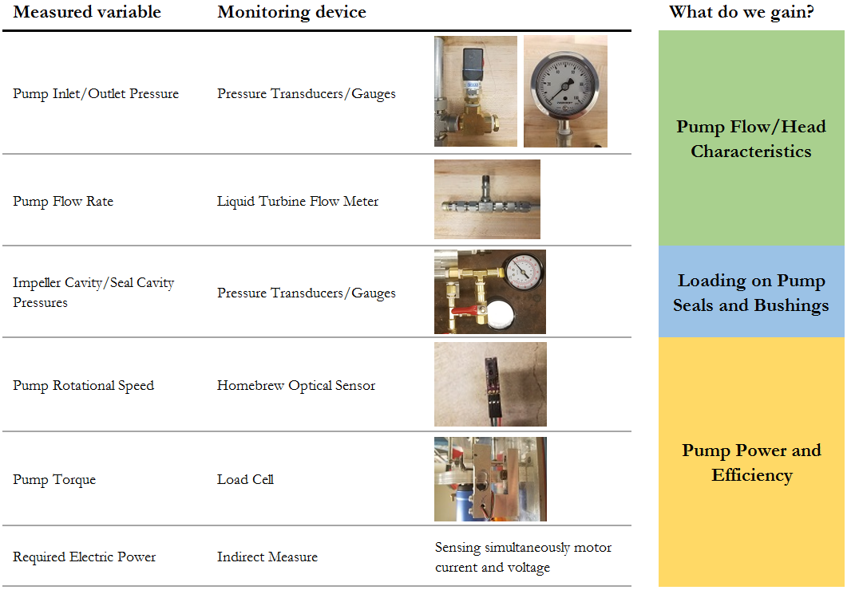

Slide 11
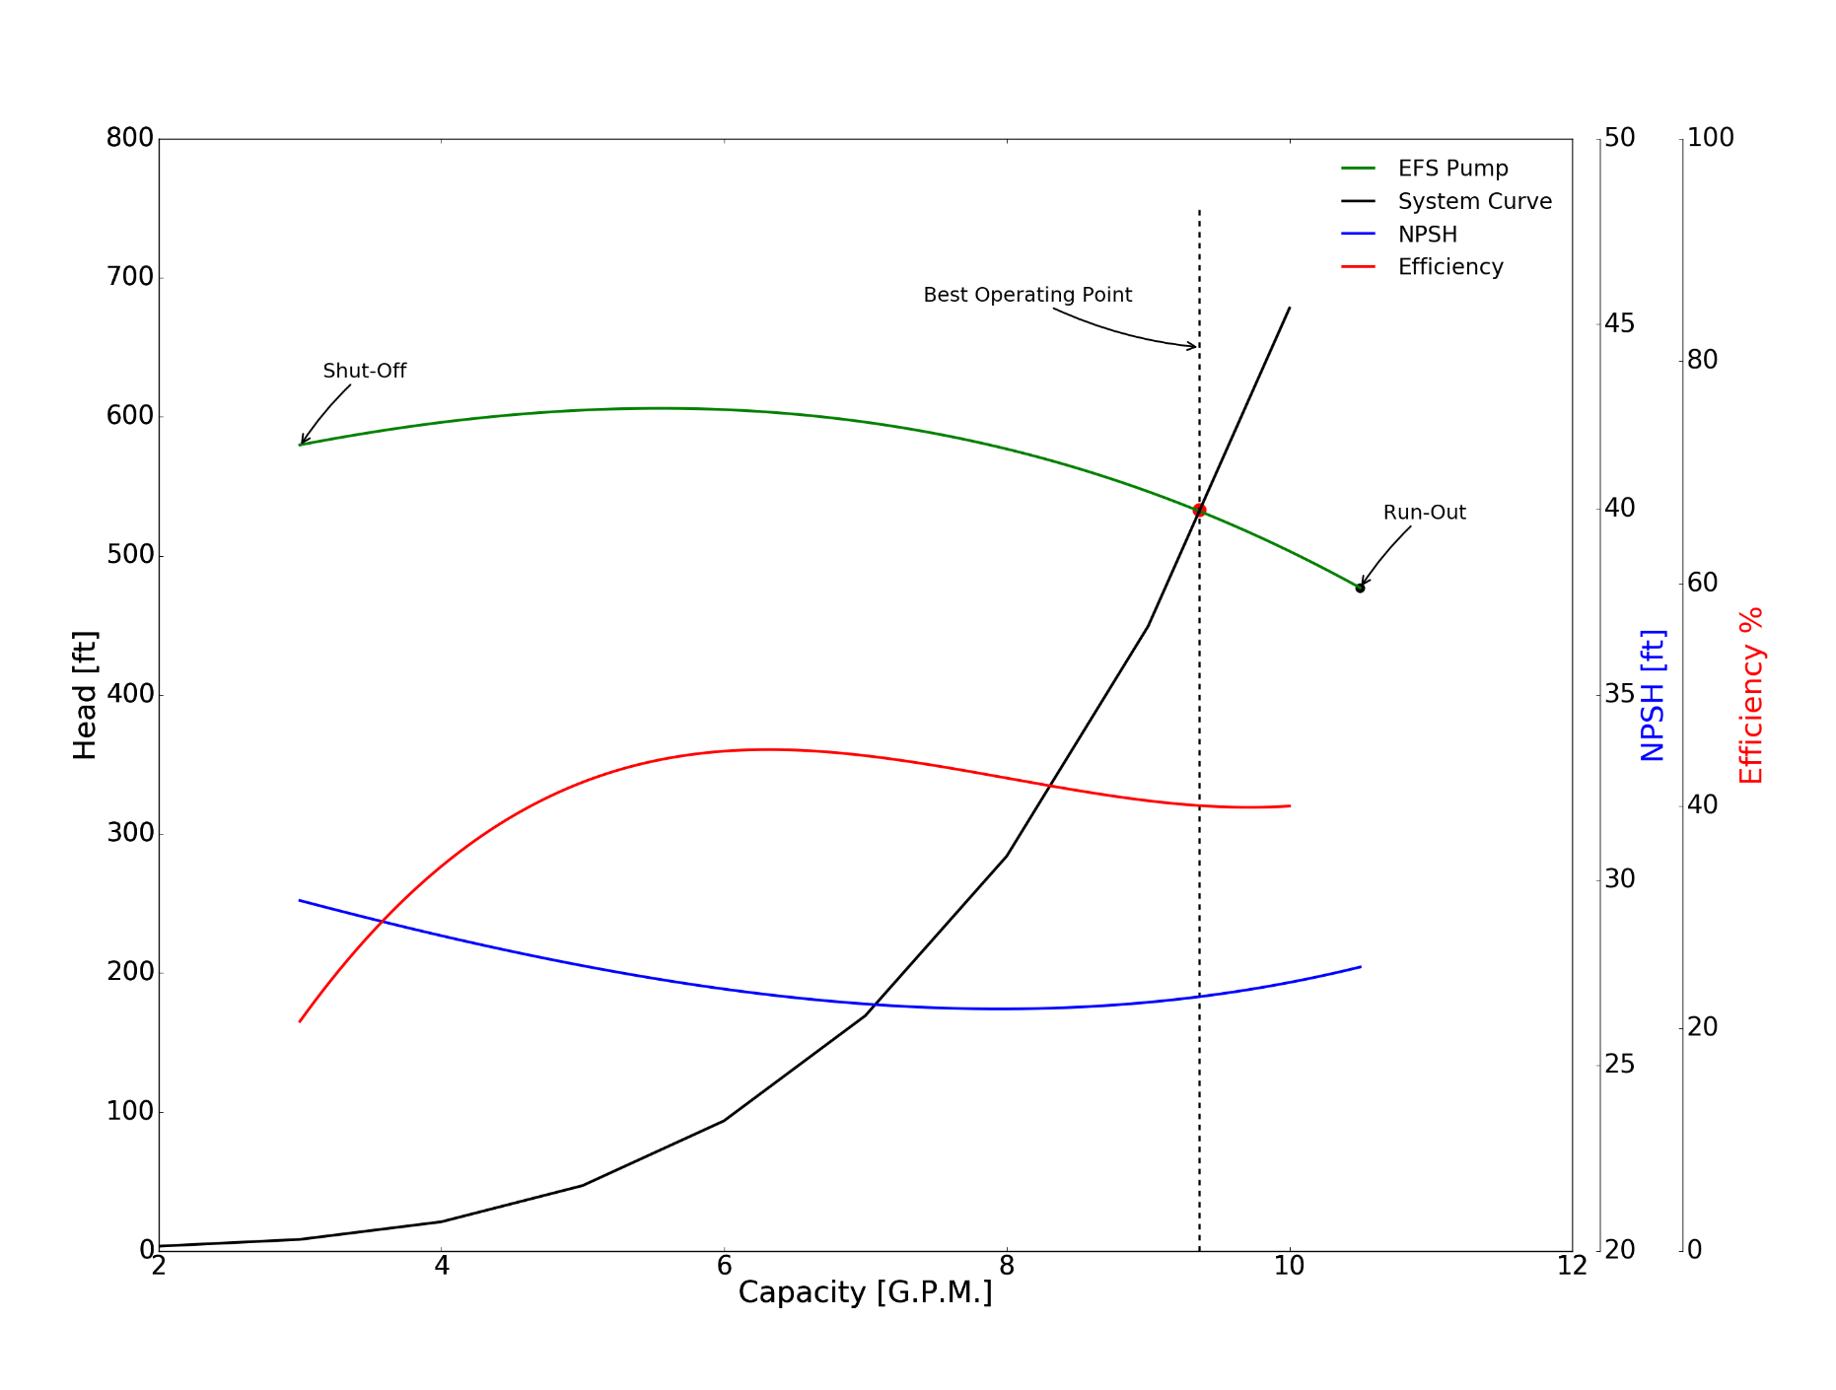
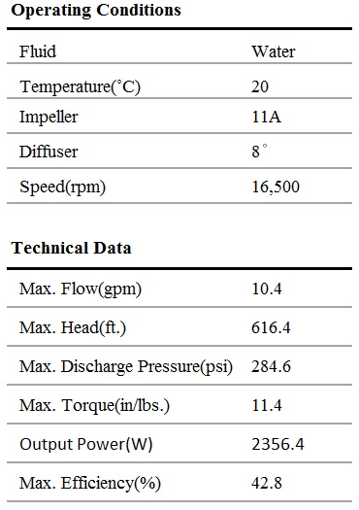
Centrifugal Pump Performance @ 16,500 rpm
Figure: EFS model PIGLET-1 2.1in Diam. Impeller experimental results at 16500 rpm.
Notes:
The NPSH always rises as the centrifugal pump capacity approaches shut‑off (zero flow rate).
minimum value at a capacity Q about 40 percent of the best‑efficiency capacity

Slide 12
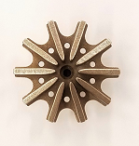
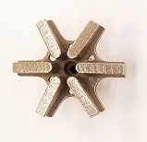
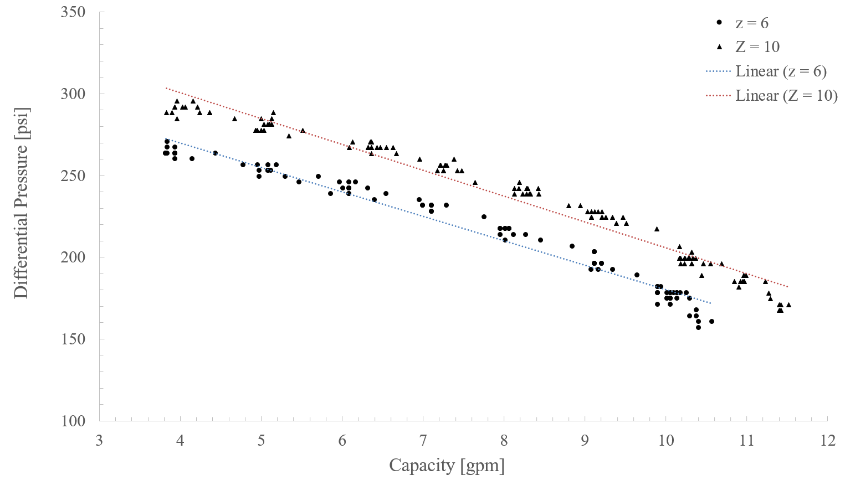
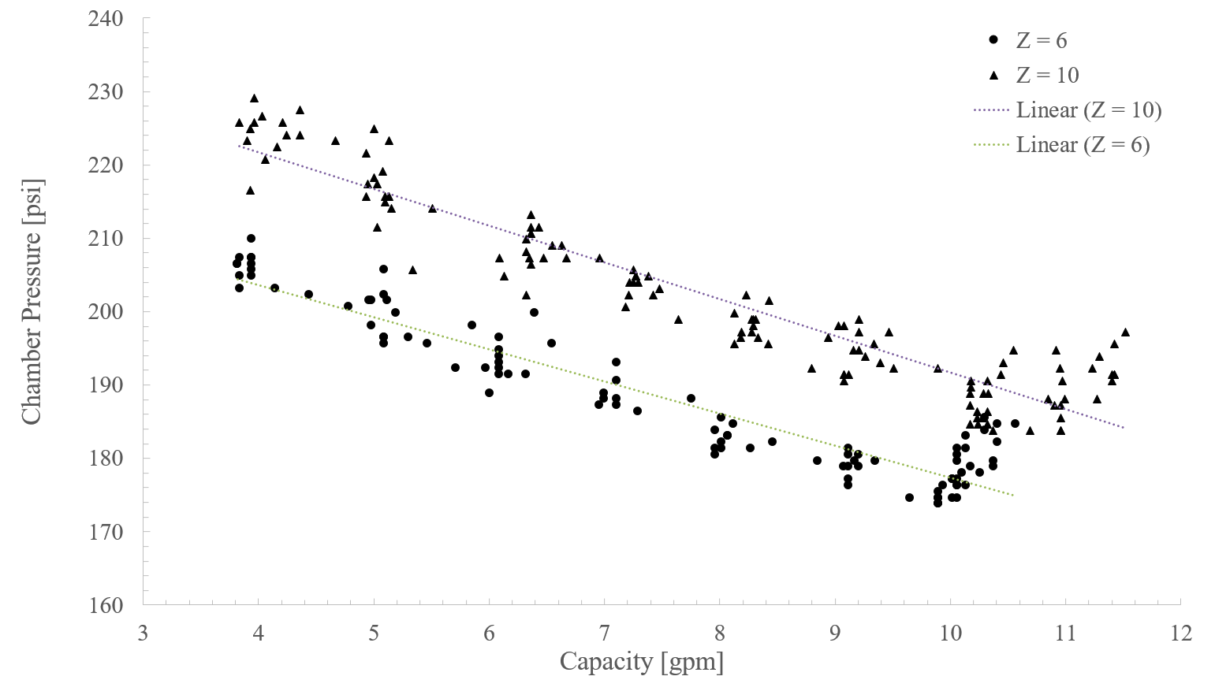
Vs.
Z = 10
Z = 6
10 Blades
Slightly higher (~ 2 %) discharge pressures for a given flow rate.
6 Blades
Lower chamber pressures (~ 8 %)
Earlier run-out (lower max. flow)
Notes:
Effects of blade number variation on performance involves many hydrodynamic considerations.
We are hesitant to draw any meaningful conclusions at this point in the testing/analysis
This slide serves as an example us switching from the engineering side of things to the science side of things.
Where we study the behavior of the system in a more general and exploratory way
Possible
Frictional loss effects
An increases of interface between fluid stream and blade can cause an increment of hydraulic loss

Slide 14
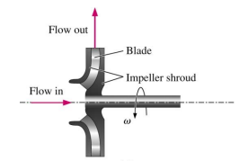

Notes:
A centrifugal pump is a very complex turbomachine, and purely analytical prediction of its performance is not possible. Hence, performance is obtained empirically.
Despite the low efficiency, regenerative ring pumps have several advantages over other turbomachines with similar tip speed due to relatively low manufacturing costs, simplicity, high reliability, enhanced priming behavior and can in many applications offer a more efficient alternative.

Slide 15
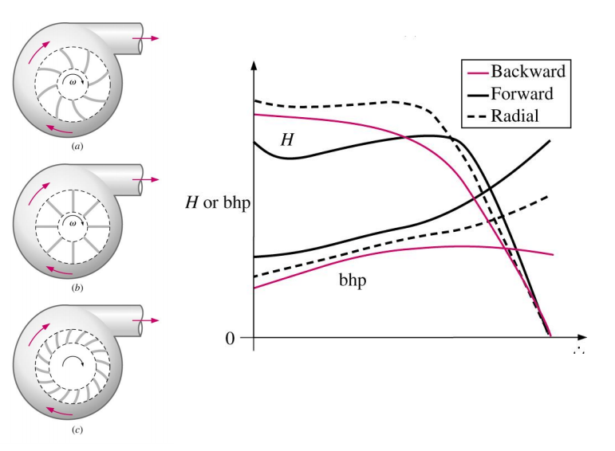
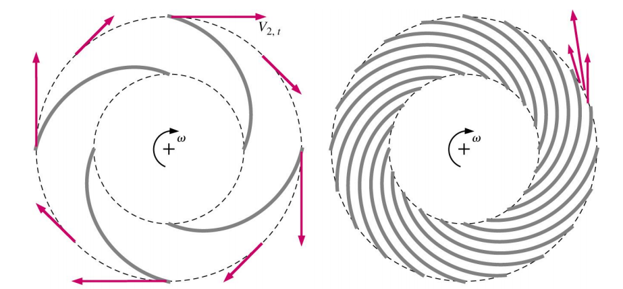
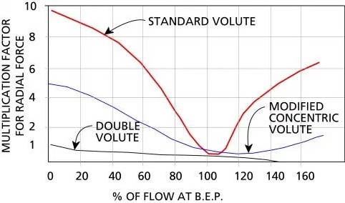
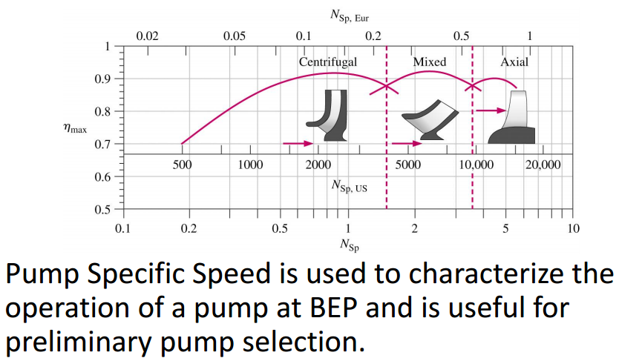
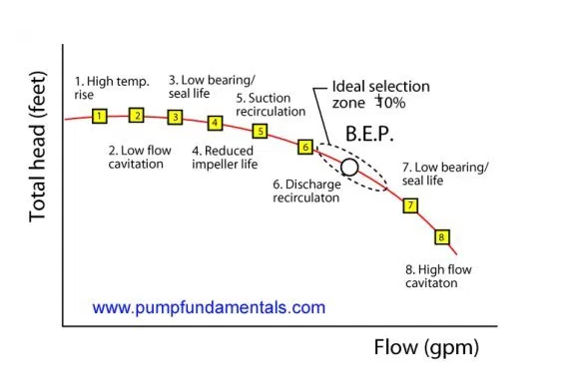
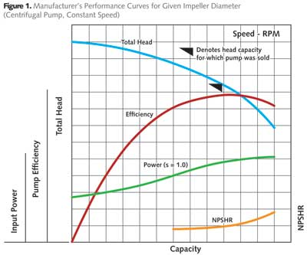
Blade number affects efficiency and introduces circulatory losses (too few blades) and passage losses (too many blades)
Notes:
operating the pump against close valve for a long time causes considerable damage on the pump since almost all the motor power is transformed into thermal energy which is absorbed by the pumped liquid.
Straight radial vane impeller in a single emission point
affinity laws should only be used for impeller trims of about 5 percent

