Slide 1
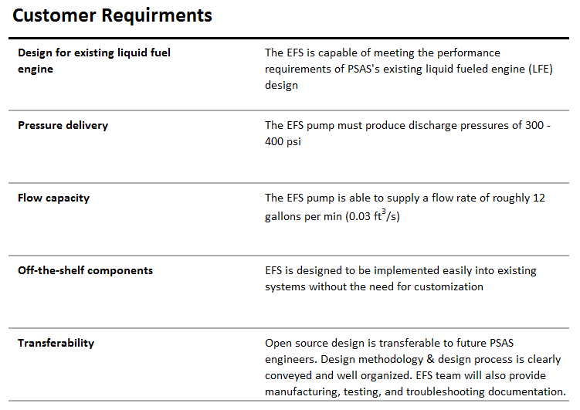
Portland State Aerospace Society | Electric Propellant Feed System

