Slide 1



Electric Propellant Feed System
Johnny Froehlich, Jonathan Talik, James Luce, Rawand Rasheed, Mimi Shang, Jordan Roland
Affiliations: ¹Portland State Aerospace Society, ²Maseeh College of Engineering and Computer Science Portland, OR, 97201, United States

Slide 2
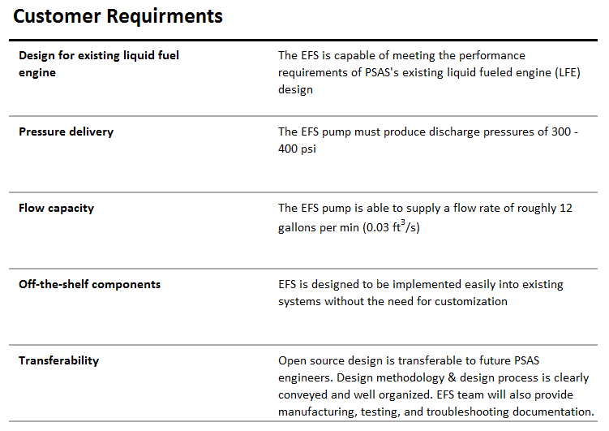
Portland State Aerospace Society | Electric Propellant Feed System

Slide 3
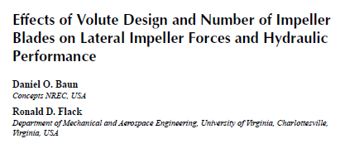

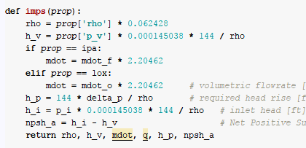





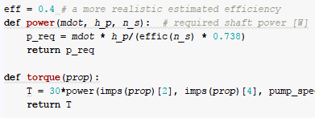






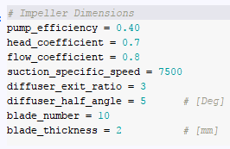



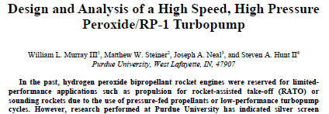


Open-ended literature review
Puzzle break
Scientific computing
We make some guesses too
Notes:
Heavy initial literature review to narrow the region of interest. (Don’t solve problems we don’t have to)
Puzzle Break comes in. We make sure to make time for fun and games.
Scientific computing as an example of using tools to implement theory.
- We can solve equations over a wide range of values and iteratively develop bounds
Some things are guesses. If best head coeff is between 0.5 and 1 we use 0.75 ☺

Slide 4
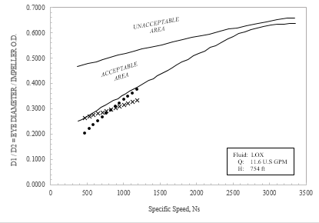
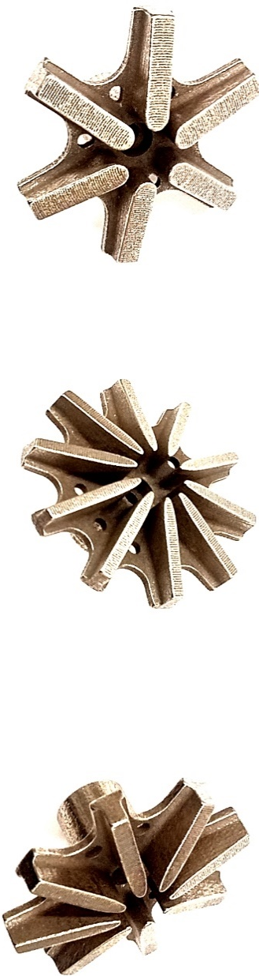
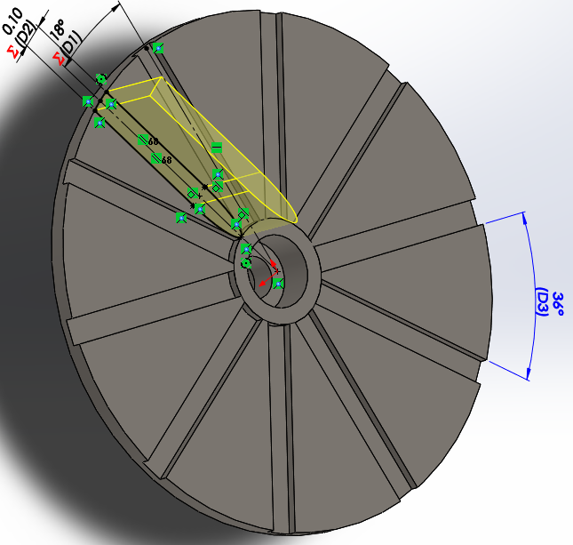
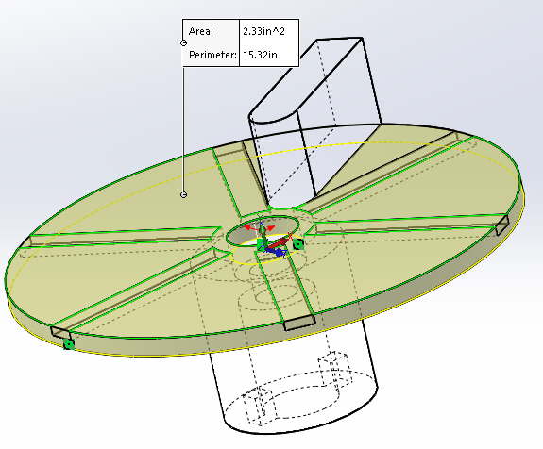
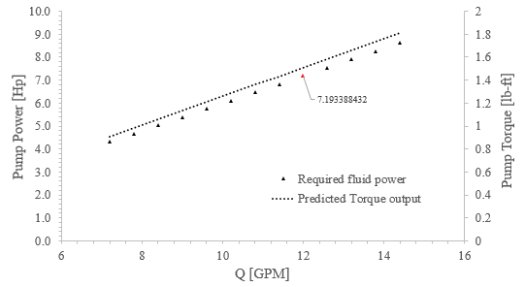
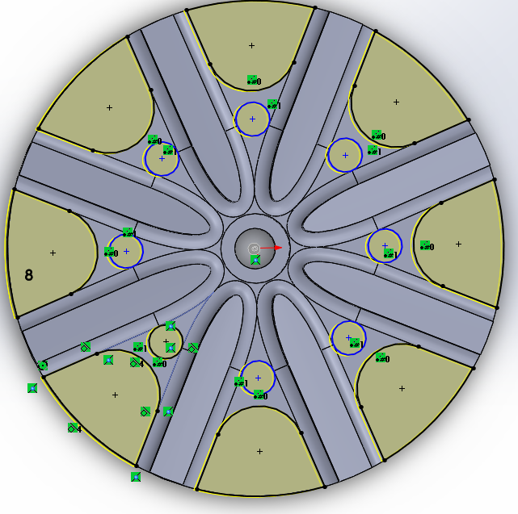
Visualize the Results
(If you can plot it, plot it!)
Parametric Design
(Design freedom)
Viola
(3D-Printed Stainless Steel)
You are here
Notes:
We visualize the results of the detailed design in many different ways
If you can plot it, plot it.
Now that the design is narrow enough we begin breathing life into it.
We can play with the design without leaving the theoretical and conceptual bounds by mistake

Slide 5
