Slide 1
Notes:
Unfinished pieces:
more robust (safe) controls system
more variation of impeller geometry
a method of manufacturing diffusers that can be extended to a lox design
What you learned:
we overbuilt the hell out of this pump
What should be done next:
Full suite of testing to inform the next design decisions.
optimize seals bearing and material selections for cryo/Lox
v2 ready for hot fire testing.

Slide 2
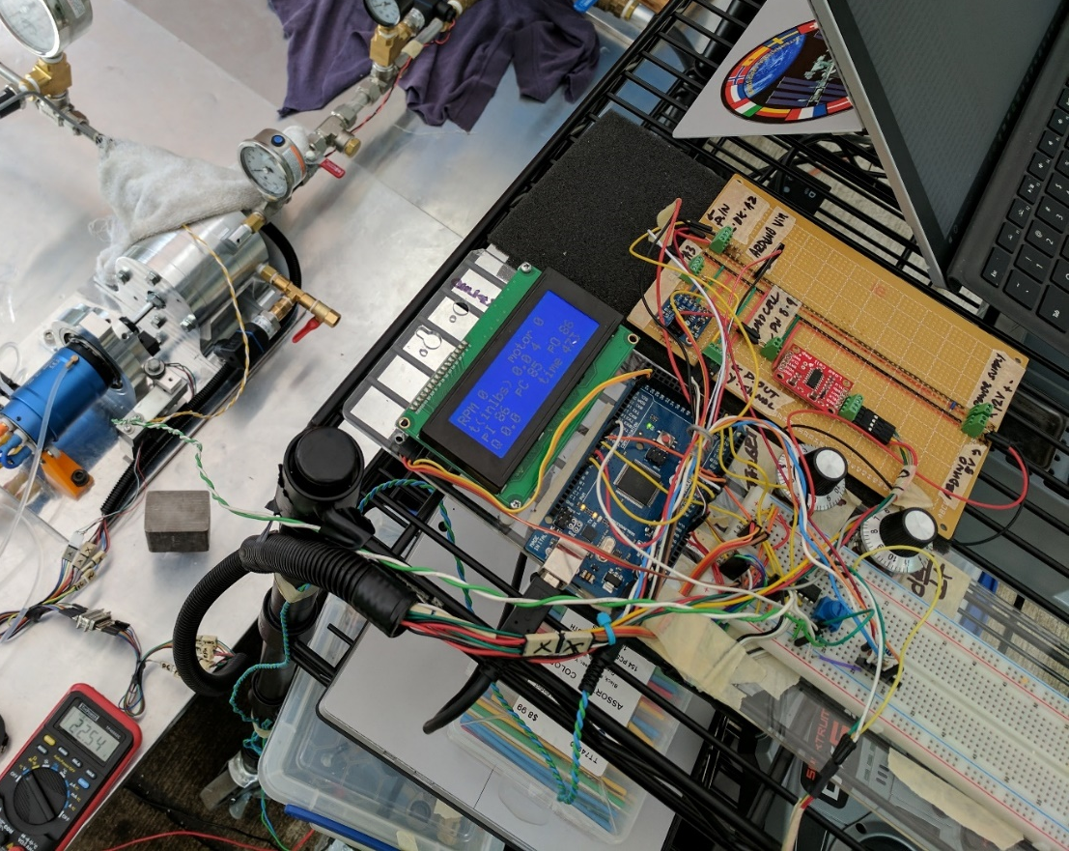
Unfinished Business: Controls and Safety
More robust (read safe) controls system
Clean up wiring
Either a dedicated transmitter set up or hard wired throttle control
Replace all gauges with data

Slide 3
Unfinished Business: Lessons
Pump is over-designed but for a reason

Slide 4
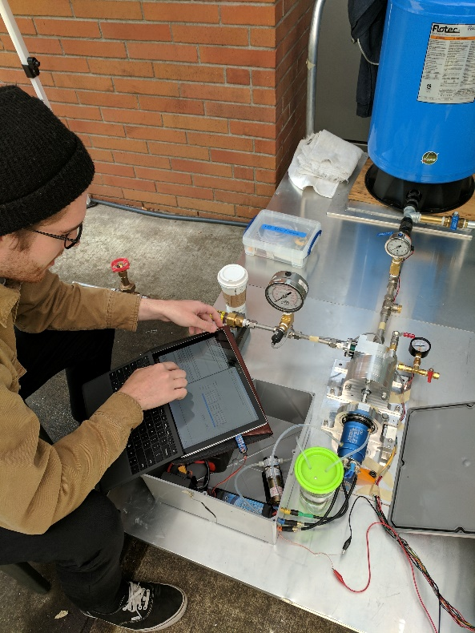
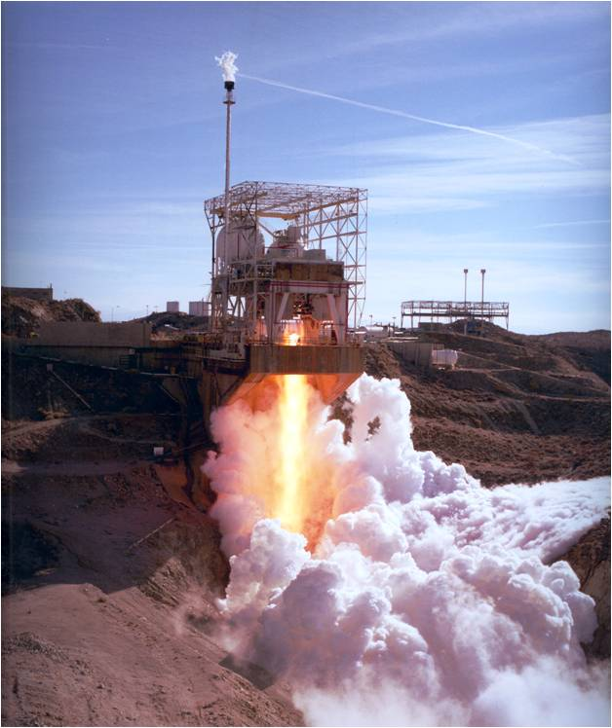
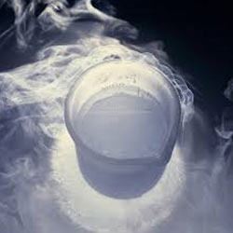
Next steps:
Design it for really fucking cold
Make FIRE!!!!
Full suite of testing

