Slide 1
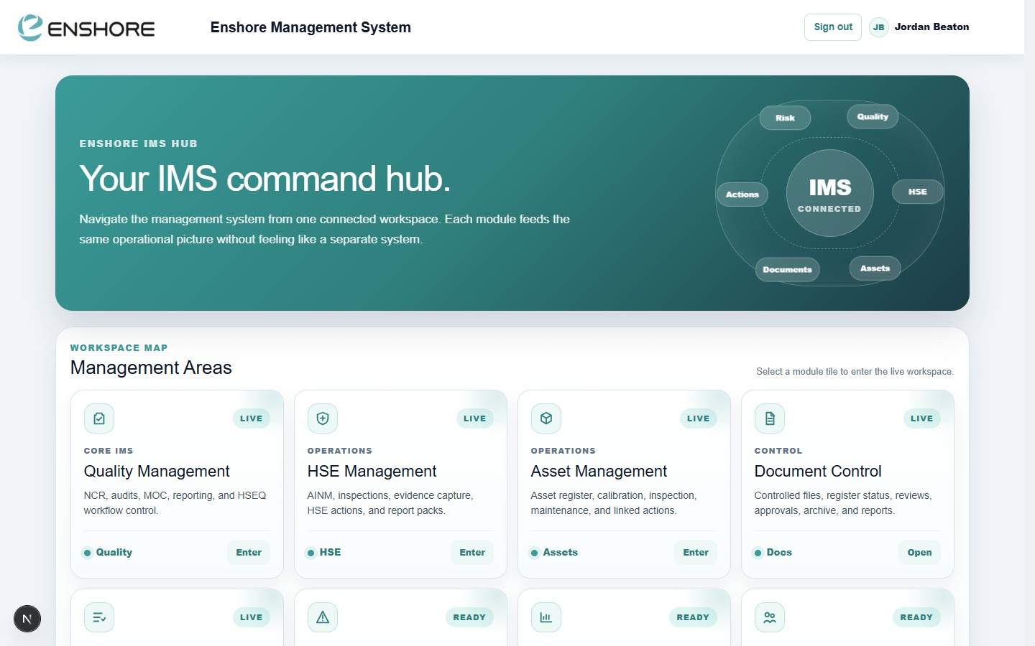
ENSHORE SUBSEA
Integrated
Management
System
One platform. Every department.
Quality · HSE · Document Control · Risk · Assets · Actions
Live Dashboards
Auto PDF Reports
Mobile Friendly
QR Code Access
Role-Based Security
Paperless Workflow
Bespoke for Enshore Subsea · Cloud-hosted · Always-on

Slide 2
Sound familiar?
The old way of managing HSEQ — scattered, slow, and impossible to audit.
📁
Documents scattered across shared drives — no version control, no review dates, no audit trail.
📧
Review and approval chased over email — no visibility of who's approved what or when.
📋
Inspections on paper forms — data entered hours later, findings lost, reports never generated.
📊
Monthly HSEQ reports take hours to compile from multiple Excel sheets and folders.
⚠️
Actions raised in meetings, written on whiteboards — no tracking, no accountability, no closure.
🔍
Audit preparation means a frantic search for evidence across email threads and network drives.
2 / 20

Slide 3
THE ENSHORE IMS SOLUTION
One connected system. Zero paper. Total visibility.
localhost:3000
🌐
⚡
Cloud-hosted
Always live
Access from any device, anywhere — no VPN, no install.
Real-time dashboards update the moment data is entered.
📱
🔒
Mobile-first
Role-based access
Full mobile support for on-site inspections and field capture.
Staff see only what they need to see — built-in security.
🔗
📄
Fully connected
Auto-reports
Every module feeds the same operational picture — no silos.
One click generates a fully formatted PDF report — no Excel.
IMS Command Hub — every module in one place
3 / 20

Slide 4
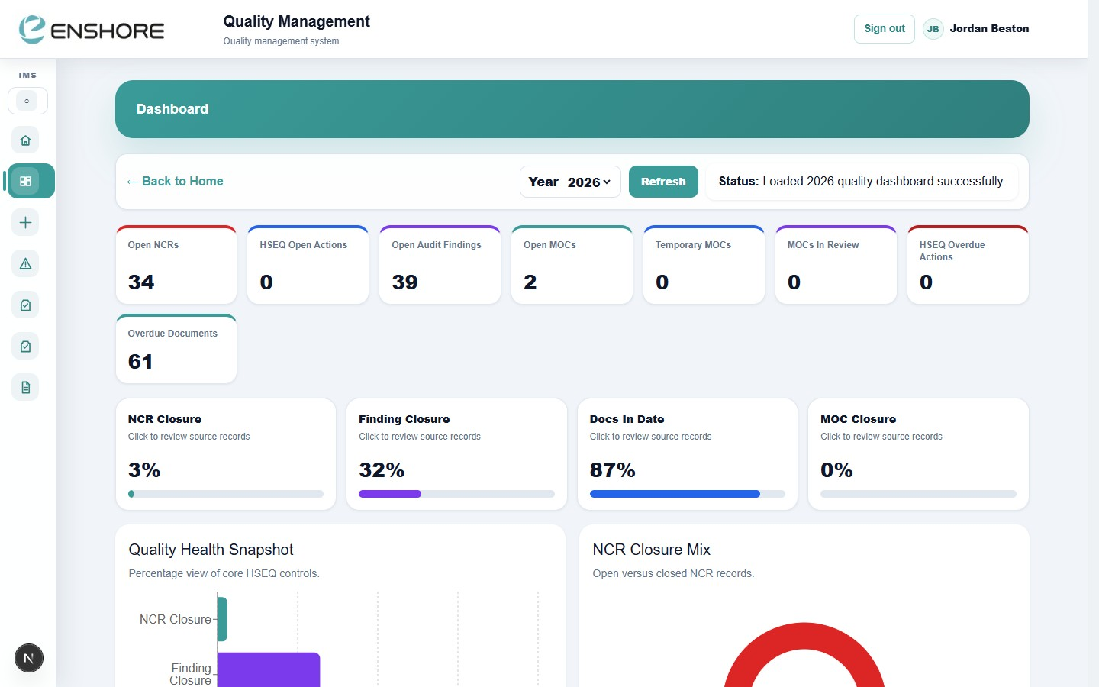
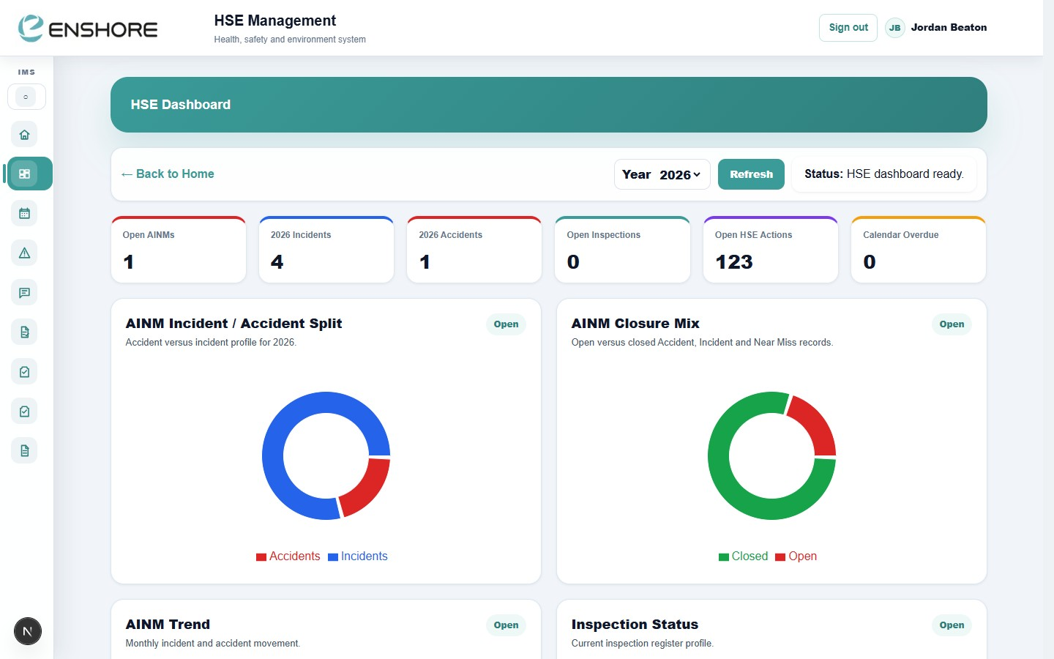
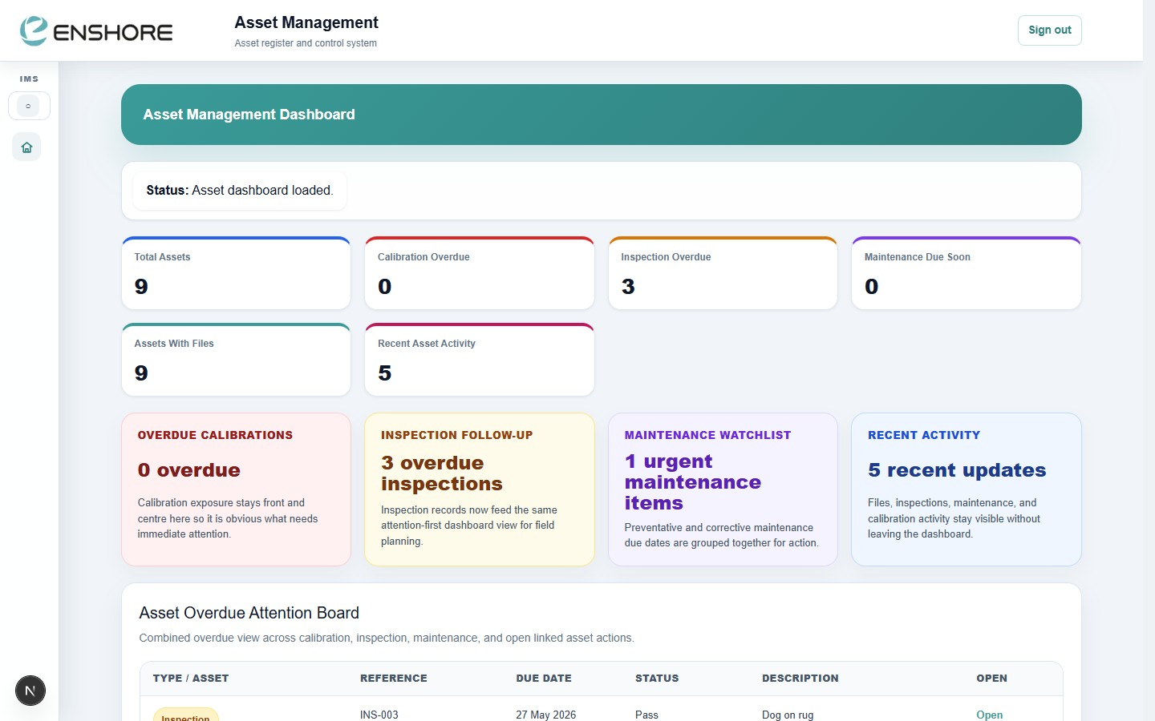
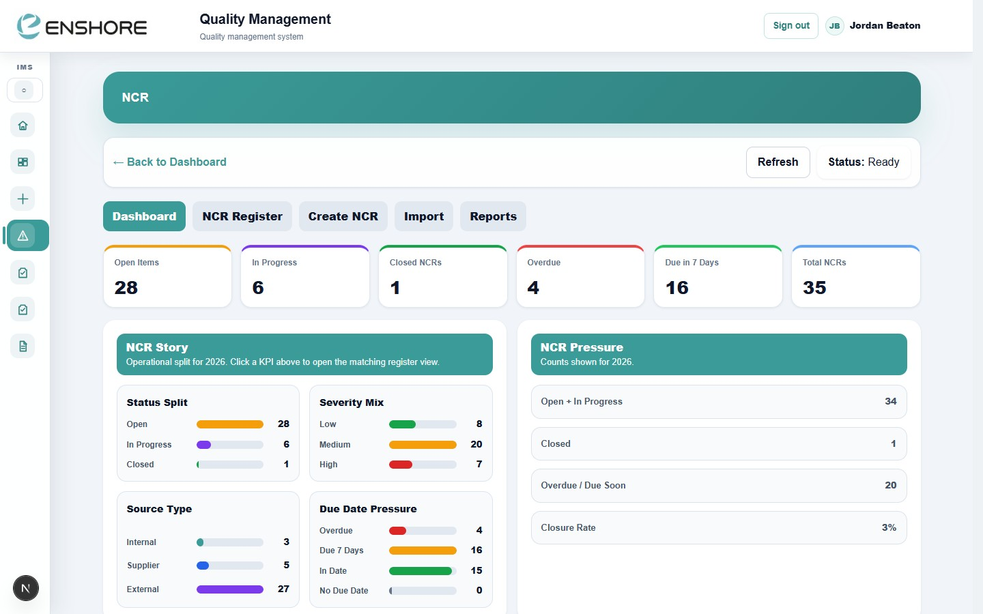
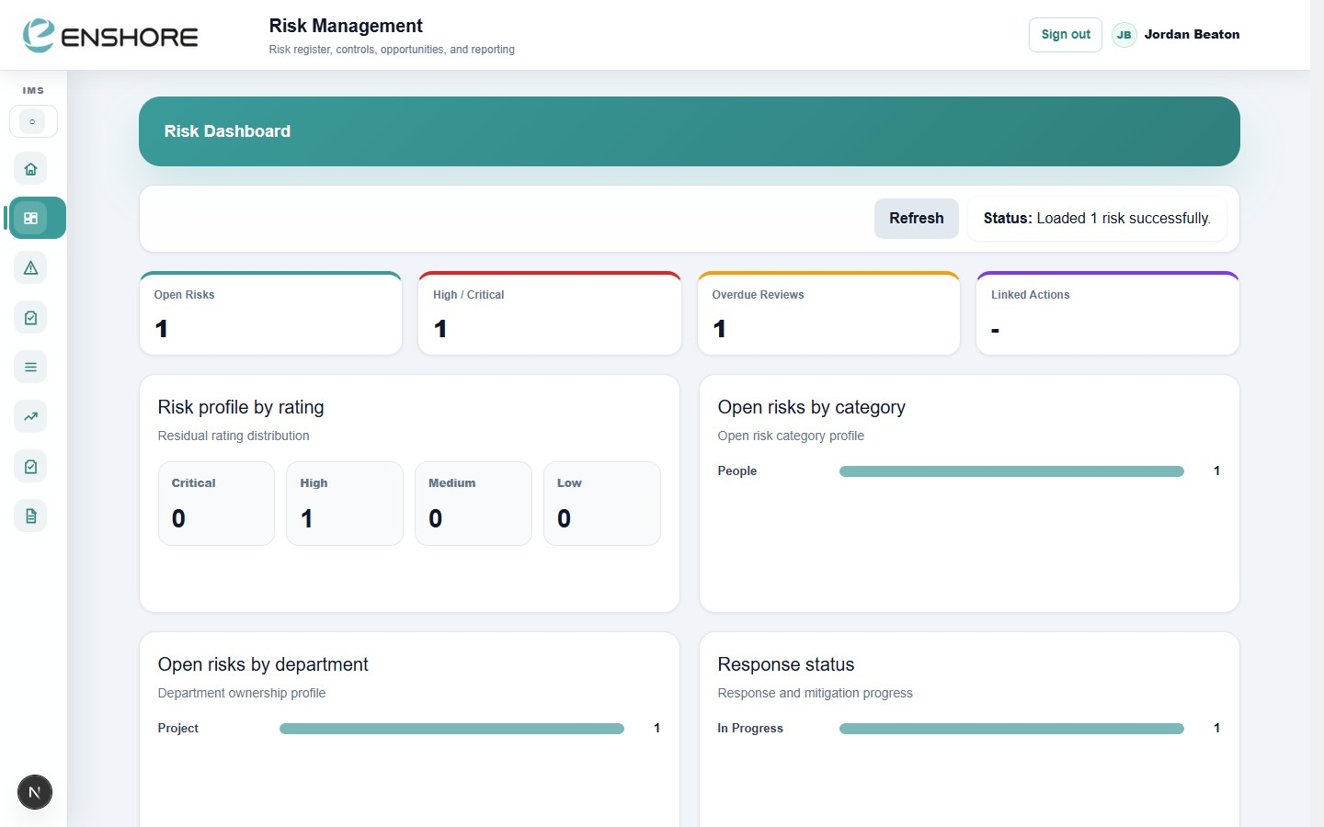
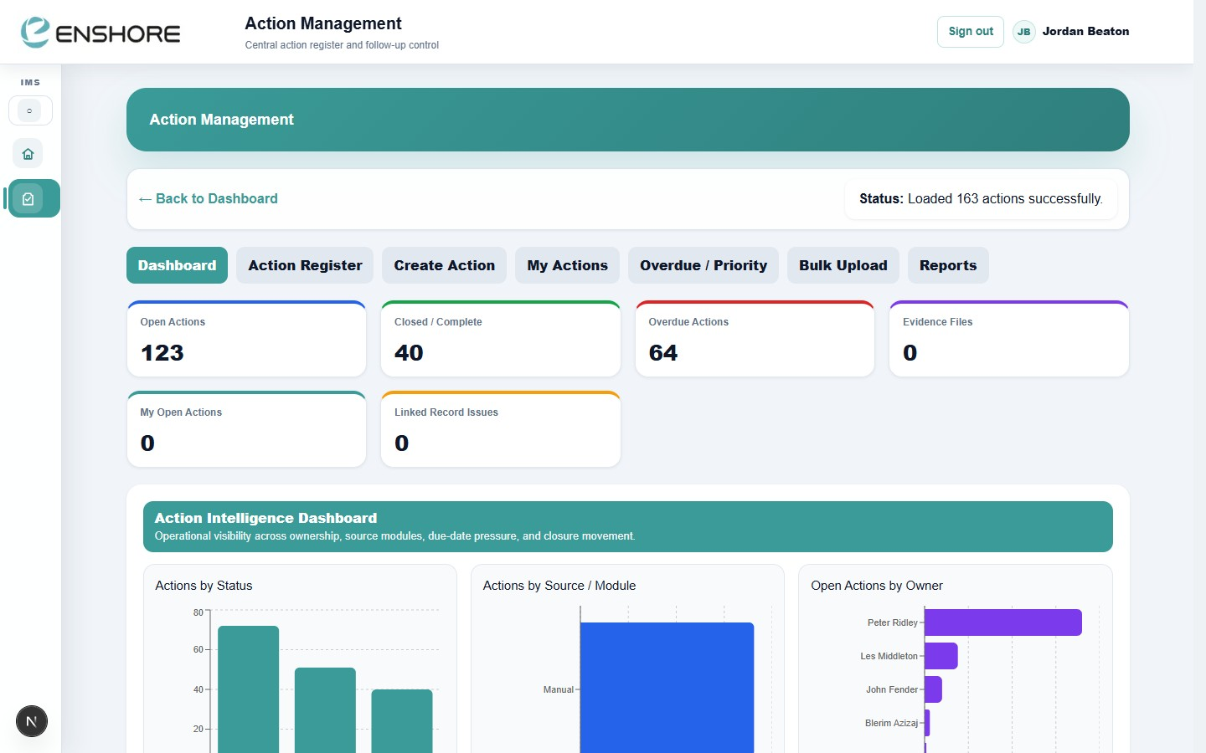
Live, Interactive Dashboards
Every module has its own live dashboard — KPIs, charts, and overdue alerts updating in real time.
localhost:3000
localhost:3000
localhost:3000
Quality Dashboard
HSE Dashboard
Asset Dashboard
localhost:3000
localhost:3000
localhost:3000
NCR / CAPA
Risk Dashboard
Action Management
4 / 20

Slide 5
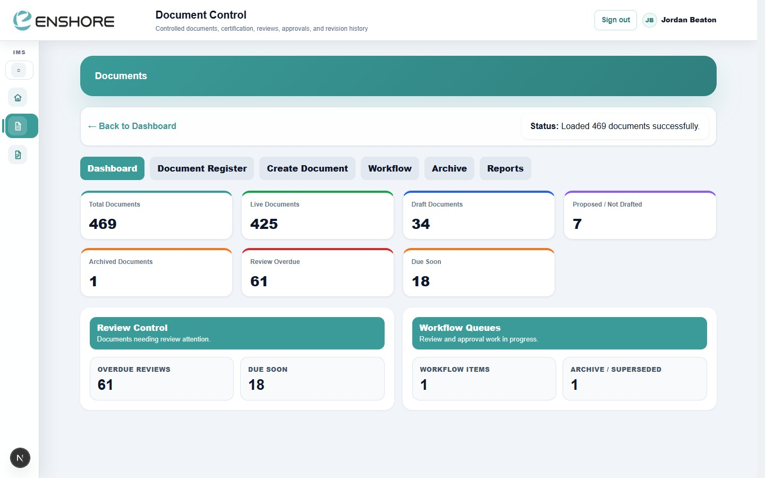
DOCUMENT CONTROL
468 controlled documents.
One register. Always current.
localhost:3000
Forget searching shared drives or emailing for the latest revision.
Every document — procedures, forms, certificates — is version-controlled,
review-dated, and accessible to the right people instantly.
468
425
61
Auto
Total Documents
Live & Approved
Reviews Overdue
PDF Generated
Document Control Dashboard — 468 live documents
✅ Auto document numbering (Dept + Type + Sequence)
✅ Draft → Review → Approval → Live workflow
✅ Email notifications at every workflow step
✅ Full revision history and archive
✅ Overdue review alerts on the dashboard
✅ PDF report pack — one click, fully formatted
5 / 20

Slide 6
Your full document library.
Searchable. Filterable. Live.
localhost:3000
Find any document in seconds. Filter by department, type, status, owner, or review date.
Click any row to open the full document detail, upload files, and trigger workflow.
• Document No.
Document Register — 468 records, live
Auto-generated, structured, unique
• Live Status
Approved / Draft / In Review at a glance
• Next Review
In Date / Overdue flagged automatically
• Workflow Status
Current stage visible on every row
6 / 20

Slide 7
One click.
Instant PDF report.
No more copying data into Word. No more waiting for someone to compile the monthly report.
📋 NCR / CAPA Report
🔒 PTW Report Pack
🔍 Inspection Report
Full nonconformance register with status, severity, root cause, actions, and closure rate. Auto-numbered, department-branded.
Every Permit to Work as a formatted PDF — work description, hazards, precautions, signatures, and close-out status.
Site inspection checklists converted to PDF — findings, pass/fail, evidence photos, linked corrective actions.
⚠️ AINM Report
📊 Monthly HSEQ Pack
📄 Document Register Report
Accident, Incident and Near Miss investigation packs — event details, investigation, root cause, and preventive actions.
Combined performance report — KPIs, trend charts, open actions, overdue items — all auto-populated from live data.
Full controlled document register as a PDF — status, revision, owner, review dates — for client or auditor submission.
⚡ Reports are generated in seconds directly from live system data — no manual data entry, no errors, no delays.
7 / 20

Slide 8
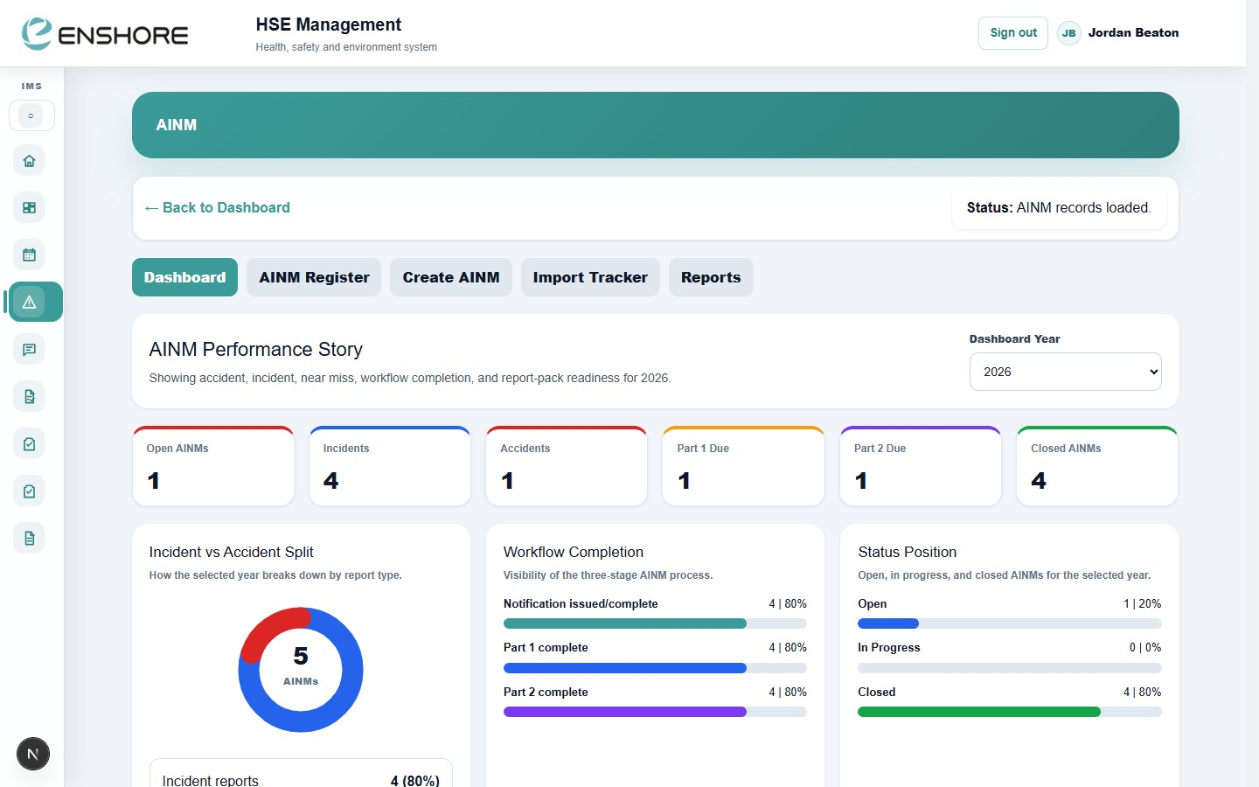
HSE MANAGEMENT
localhost:3000
localhost:3000
HSE Dashboard — live AINM, inspection, and action KPIs
AINM — Accident, Incident & Near Miss register
🚨
👁️
🔒
🔍
📅
AINM
Observations
Permit to Work
Inspections
HSE Calendar
Log accidents, incidents and near misses. Two-part investigation workflow with automatic report generation.
Positive and negative safety observations. Public submission link for field teams — no login needed.
Digital PTW with 6-stage workflow — work type, description, precautions, issue, extensions, closure.
6 live digital inspection forms — mobile-friendly, evidence upload, PDF output, register tracking.
Recurring inspection planner — overdue items flagged, upcoming schedule visible.
8 / 20

Slide 9
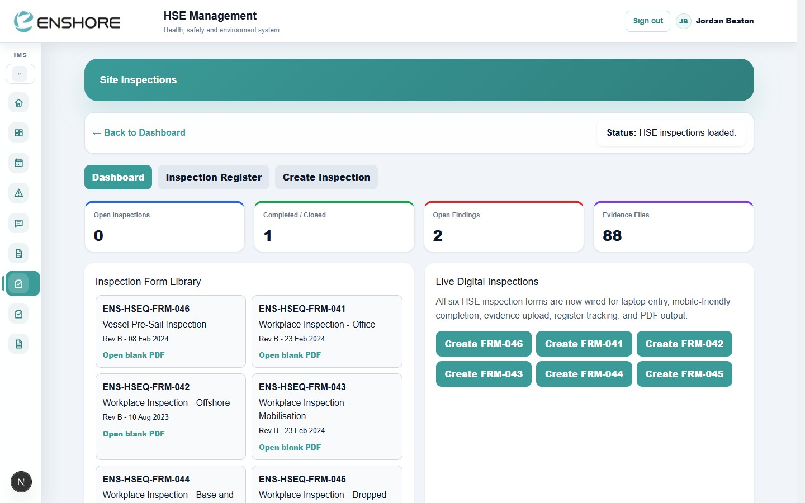
On the job.
On your phone.
localhost:3000
No clipboards. No paper forms. No transcription errors.
Inspect on-site, enter findings in real time, upload photo evidence,
and generate the PDF report before you leave the platform.
📱
Mobile-Friendly Interface
📋
6 Live Forms
Touch-optimised controls for use on tablets and phones on-site. No pinching or zooming needed.
Vessel Pre-Sail, Workplace (Office / Offshore / Base & Site / Mobilisation / Dropped Objects) — all digitised.
HSE Inspections — 6 digital forms, mobile-ready
📸
Evidence Photo Upload
🔗
Register Tracking
Capture and attach photos directly from your device camera — evidence linked to the specific finding.
Every inspection saved to the register — searchable, filterable, with open findings tracked to closure.
📄
Instant PDF Output
📡
Public QR Observation Link
Completed inspection auto-generates a branded, formatted PDF — ready for the client or file within seconds.
Share a QR code for anonymous safety observations from the field — no login, instant submission.
9 / 20

Slide 10
Functional QR Codes.
Instant field access.
🔗
Public Safety Observation Link
Post a QR code on-site or offshore. Workers scan and submit safety observations instantly — no login, no app download, no friction.
📋
Asset Inspection Access
QR code on each piece of equipment links directly to that asset's inspection form — one scan and the right form opens pre-populated.
🔒
Permit to Work
QR code on work areas links to the active PTW — supervisors scan to confirm controls in place before work starts.
📄
Document Quick Access
QR codes on physical equipment or notice boards link to the live controlled document — always the current revision, not a printed copy.
10 / 20

Slide 11
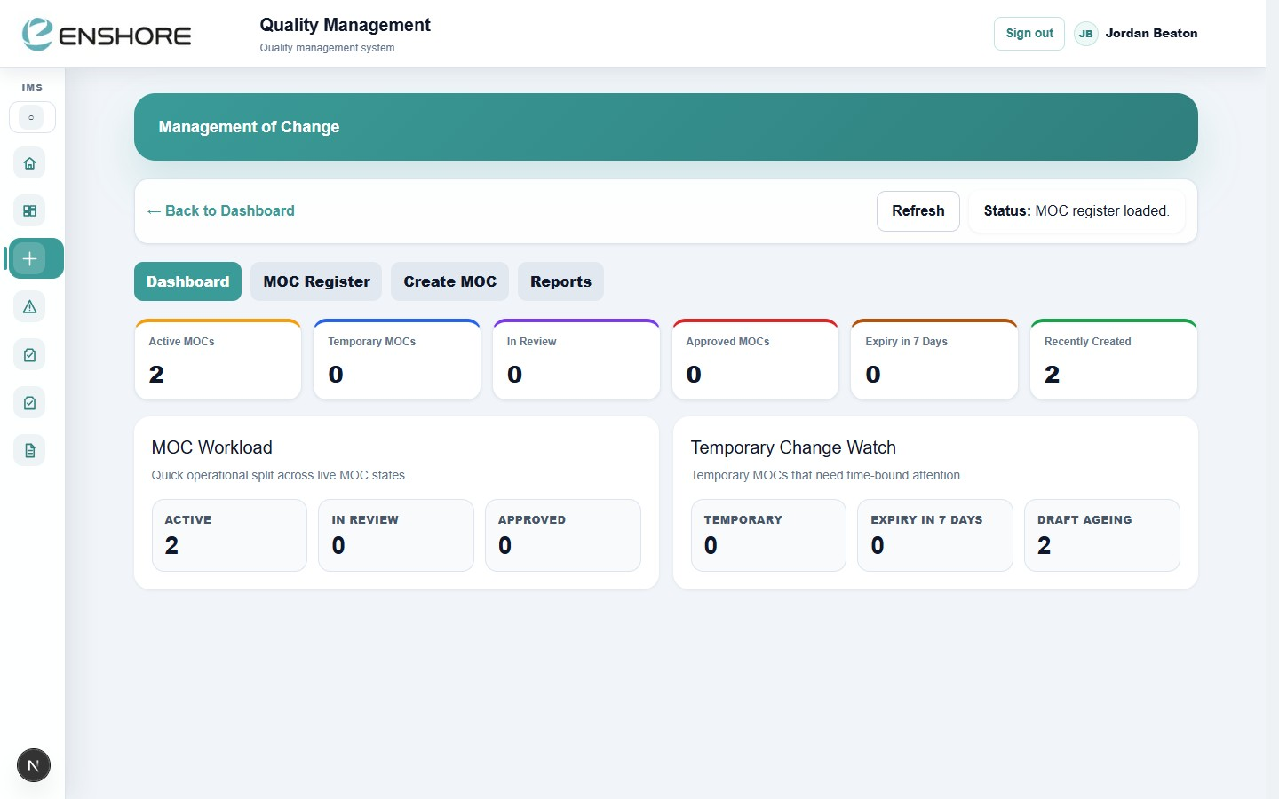
QUALITY MANAGEMENT
localhost:3000
localhost:3000
NCR / CAPA Dashboard
Management of Change
⚠️ NCR / CAPA
🔄 Management of Change
🔍 Audits
📊 Quality Dashboard
Log nonconformances, assign root cause, corrective and preventive actions. Track to closure with full audit trail.
Formal MOC process — temporary and permanent changes, impact assessment, approval routing, expiry tracking.
Internal and external audit programme, findings register, corrective actions, and programme status reporting.
Live KPIs — open NCRs, audit findings, MOC workload, overdue actions, closure rates — all in one view.
11 / 20

Slide 12
Risk Management
Identify, assess, control and review risks — with a live register, rating matrix, and audit-ready reporting.
localhost:3000
Live risk register with inherent and residual ratings
Controls register — document controls and track effectiveness
Opportunities register — track improvement potential
Formal review scheduling — overdue reviews flagged
Risk by category, department, and rating dashboards
One-click PDF risk register export for client/audit
Risk Management Dashboard
12 / 20

Slide 13
ASSET MANAGEMENT
Never miss a calibration.
Never miss an inspection.
localhost:3000
The Asset Dashboard flags overdue calibrations, inspections, and maintenance items the moment they fall due — no spreadsheet chasing needed.
9
3
0
5
Registered Assets
Inspections Overdue
Calibrations Overdue
Recent Activity Items
• Asset register with document ID codes for QR linking
Asset Dashboard — overdue attention board
• Calibration tracking — certificates, due dates, alerts
• Inspection scheduling and history per asset
• Maintenance work orders — planned and reactive
• Overdue Attention Board — all asset issues in one view
• Reports — calibration status, inspection compliance
13 / 20

Slide 14
Every action. Tracked. Closed.
Actions from every module — Quality, HSE, Risk, Assets — flow into one central register.
Nothing slips through the cracks.
localhost:3000
📊
Intelligence Dashboard
Actions by status, source, owner, due date pressure, and closure trend — all on one screen.
⭐
My Actions
Every user sees only their own actions — clear personal accountability without noise.
⚠️
Overdue / Priority View
'Overdue First' and 'Due This Week' smart views — know exactly what needs chasing.
📎
Evidence Upload
Attach photos, documents, or emails as proof of closure — evidence stored against the action forever.
🔗
Cross-Module Linking
Every action linked back to its source — NCR, MOC, audit finding, or inspection — full traceability.
Action Intelligence Dashboard
14 / 20

Slide 15
Why cloud beats server.
Server-based HSEQ systems were built for the office. Enshore IMS is built for the way you actually work.
Traditional Server System
✅ Enshore IMS
Access
✗ Office only / VPN required
✓ Any device, anywhere, any time
Mobile / Field
✗ Desktop browser only
✓ Full mobile-optimised interface
Inspections
✗ Paper → manual data entry
✓ Digital, on-site, evidence upload
Reports
✗ Hours to compile in Excel/Word
✓ One click — instant PDF output
Notifications
✗ Manual email chasing
✓ Automatic at every workflow step
Updates
✗ IT team, downtime risk
✓ Instant, zero downtime
Disaster Recovery
✗ Server backup risk
✓ Cloud-hosted, always replicated
Cost
✗ Hardware + licences + IT support
✓ Subscription, no infrastructure
15 / 20

Slide 16
ROLE-BASED ACCESS & SECURITY
Right person. Right data.
Right time.
Role-based permissions ensure every user sees exactly what they need — nothing more.
Admin-configurable with per-module permission overrides.
Manager
HSE Officer
Quality Engineer
All modules, full access
HSE + Actions
Quality + Documents + Actions
Document Controller
Asset Manager
Viewer
Documents + Actions
Assets + Actions
Read-only across all modules
16 / 20

Slide 17
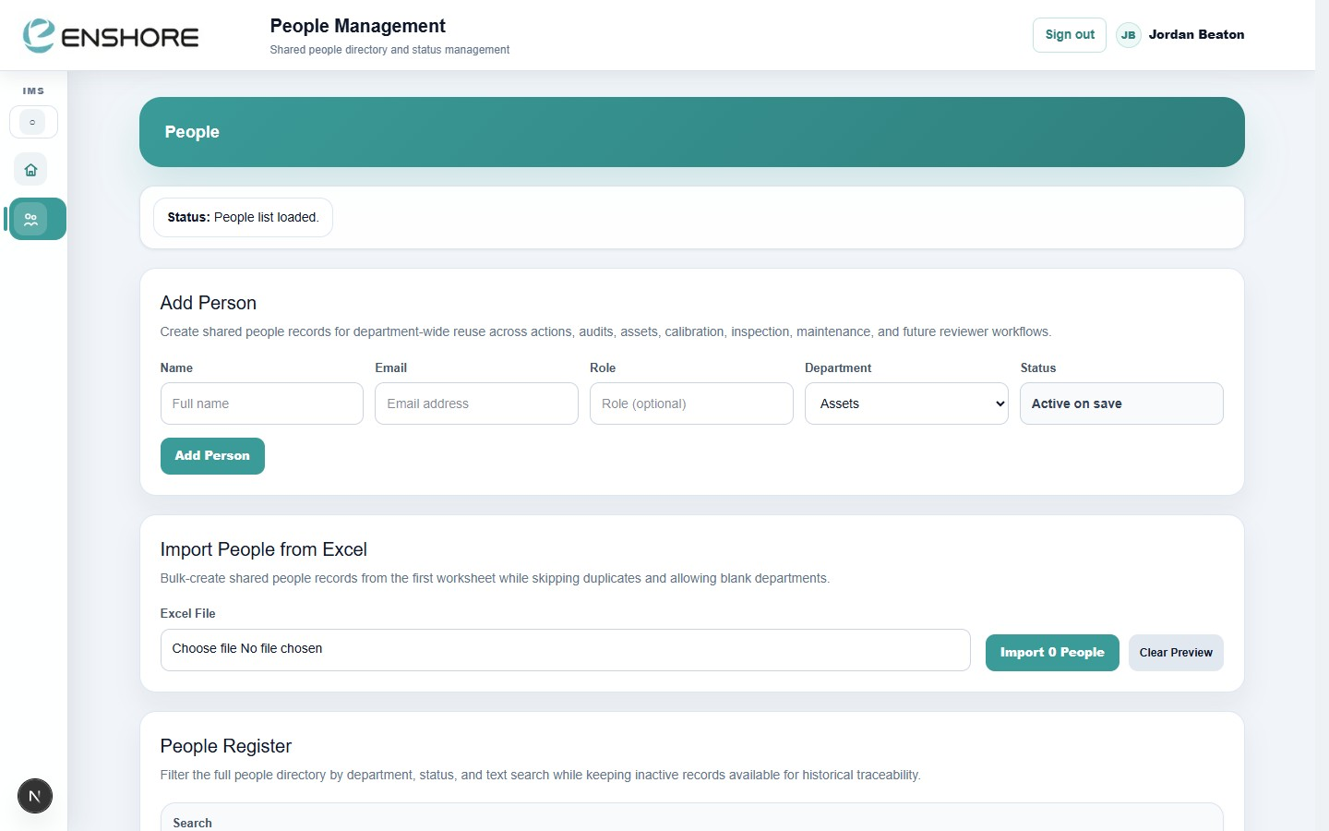
Automated workflows.
Zero chasing.
localhost:3000
Email notifications fire automatically at every workflow step — document reviews, approvals, action assignments, and overdue alerts. Your team always knows what needs their attention.
People Management — shared directory
📧
Document submitted for review
Reviewer receives email with direct link to the document.
📧
Document approved
Originator notified when their document goes Live.
📧
Action assigned
Owner receives immediate notification with due date.
📧
Overdue action alert
Automatic reminders for actions past their due date.
📧
AINM investigation due
Investigator notified when Part 1 or Part 2 is overdue.
17 / 20

Slide 18
What the system delivers today.
468
6
7
100%
Controlled
Documents
Live Digital
Inspection Forms
Integrated
Modules
Cloud-Hosted
Always On
1-click
Auto
QR
Mobile
PDF Report
Generation
Email Workflow
Notifications
Field-Ready
Access
On-Site
Capture
18 / 20

Slide 19
GETTING STARTED
Up and running in days, not months.
No servers to procure. No software to install. No IT project to manage.
Users access the system via browser — desktop, tablet, or phone.
1
User Setup
Admin creates user accounts and assigns roles. People records added for workflow notifications.
2
Reference Data
Departments, document types, inspection forms, and asset categories configured in Admin / Settings.
3
Document Import
Existing documents imported into the register. Review dates and owners assigned.
4
Team Training
Module walkthroughs for each role group. Most users are confident within a single session.
5
Go Live
System goes live. All workflows, notifications, and dashboards active from day one.
19 / 20

Slide 20
ENSHORE SUBSEA
One system.
Every module.
Total control.
Live dashboards · Auto PDF reports · Mobile inspections
QR code access · Email workflows · Role-based security
Quality · HSE · Documents
Risk · Assets · Actions
Request a Live Demo
One platform built for subsea operations.
jbeaton@enshoresubsea.com
enshore-ims.vercel.app
Built by Enshore Subsea · Hosted on Vercel · Powered by Supabase

