Slide 1

Exploratory Data Analysis
G2M Case Study
06-20-2022

Slide 2

Agenda
Executive Summary
Problem Statement
Approach
EDA
EDA Summary
Recommendations

Slide 3
Executive Summary

Slide 4
Premise - Insight for Cab Investment firm
XYZ is a private firm in US. Due to remarkable growth in the Cab Industry in last few years and multiple key players in the market, it is planning for an investment in Cab industry and as per their Go-to-Market(G2M) strategy they want to understand the market before taking final decision.
We are an analyst tasked with delivering key insights to attempt to find the right company for XYZ’s investment.
This section is divided into four parts:
Business Problem Analysis and Data Exploration
Comparison of profits between Yellow Cab and Pink Cab
Customer Analytics
Recommendations and Considerations

Slide 5
Problem Statement

Slide 6
First, what is our Business Problem?
Objectives of our Client, XYZ.
What is a G2M?
Choose company which will provide best Rate of Return (RoR)
As an investment firm, preserve personal and shareholder capital used for funding investments.
Implement the guided Go-to-Market (G2M) strategy.
A go-to-market (G2M) strategy is a step-by-step plan for launching a new product or expanding an existing product into a new market.
In this case, XYZ gives a service, expanding capital to a new market, the cab industry.

Slide 7
G2M Continued – The Root of our Analysis
G2M’s big four questions:
XYZ’s specific questions:
What product/service is being sold, what is unique about it?
Who is our ideal customer/client, what is expected?
How will the product/service be distributed?
How will demand be retained?
How effectively does Cab A
What is the ideal company’s demographic for cab service?
Where does the ideal cab company operate in?
In the event a cab company has weak demand, how demand it created?

Slide 8
Approach

Slide 9
Our Approach
After a merge and renaming columns for convenience, we shall begin out data analysis of these companies and what potential advantages and disadvantages they could have for an investment. This will be done through two primary fields of analysis: by profit and by customer.
From the perspective of an investment firm, we are going to want to know what kind of profit can be generated from my contributions. Typically, when we are evaluating a company, we would look at their financial statements, brand, investor relations, and other sources. However, since we do not currently have such for this data, we can assume it is at least satisfactory. Therefore, a concentration on the metrics given will be used to determine profit.
Once we have looked at the profits in comparison between Pink and Yellow, we should ask who their target demographic is. Just who are their customers and how are they reaching them? Examination for potential differences in customer type, whether by age, location, or income, and what potential findings which could root a better possible investment.

Slide 10
EDA – Profit Analytics

Slide 11
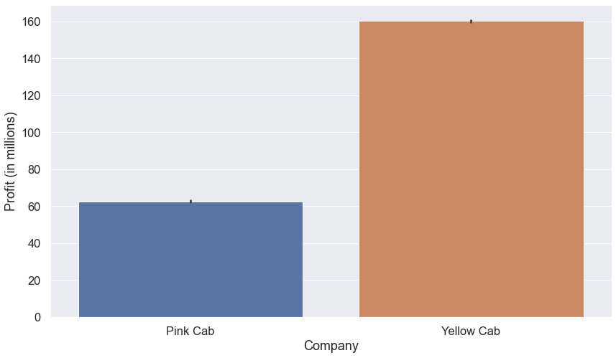
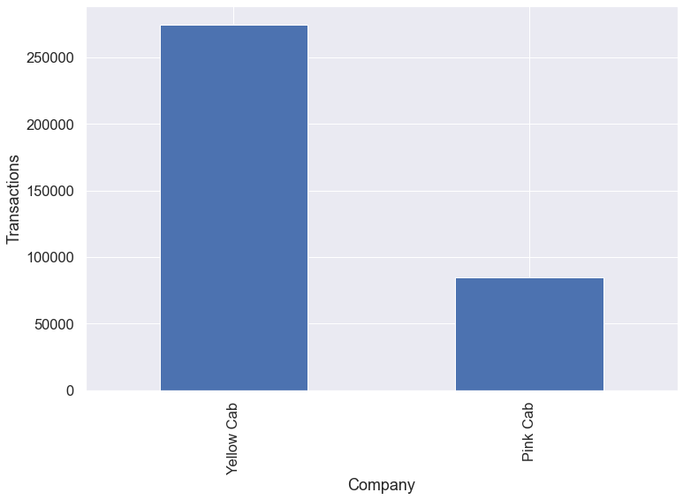
Base Profit vs Number of Transactions
Profit
Number of Transactions

Slide 12
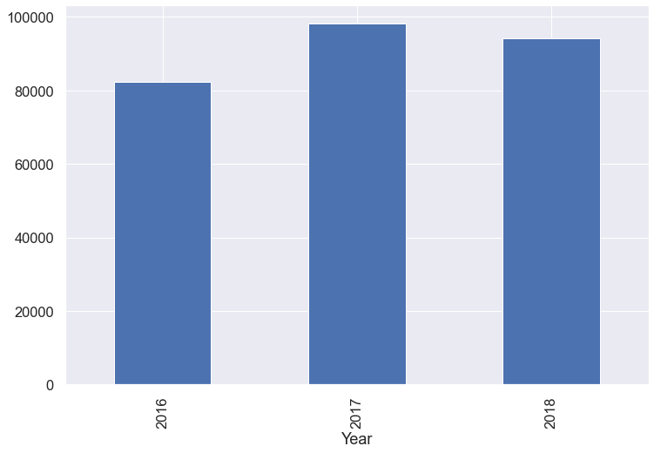

Profits over time
Yellow Cab profit YoY
Pink Cab profit YoY

Slide 13
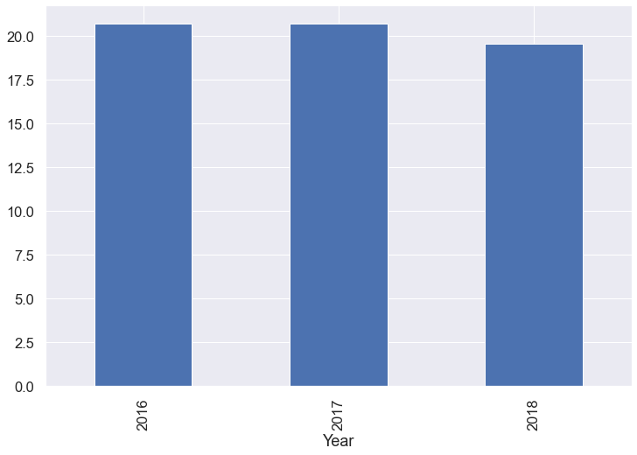
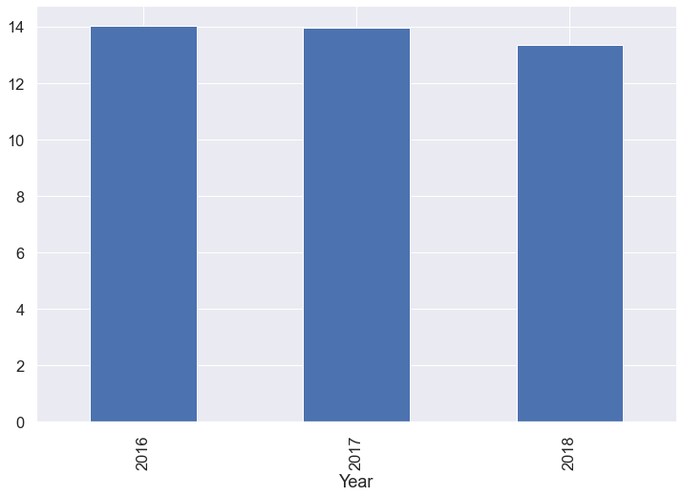
Profits per KM over YoY
Yellow Cab Profit per KM
Pink Cab Profit per KM

Slide 14
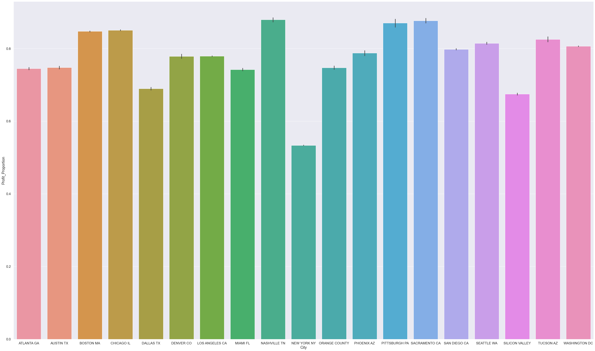
Profit Proportion for both Companies per City

Slide 15
An Analysis of Profits
On the surface, we can see that Yellow Cab has without competition far more profits compared to Pink Cab, and has such YoY, so no sudden outlier year.
This consistency holds even when comparing profit mean and profit/km – i.e. for every KM driver what dollar was gained?
However, this is in proportion to their number of transactions, which could possibly indicate that Yellow is far larger of a company than Pink, and can meet demand more.
Distribution across all other fields, including time and place, remains the same. This is a possible advantage to Yellow.

Slide 16
EDA – Customer Analytics

Slide 17
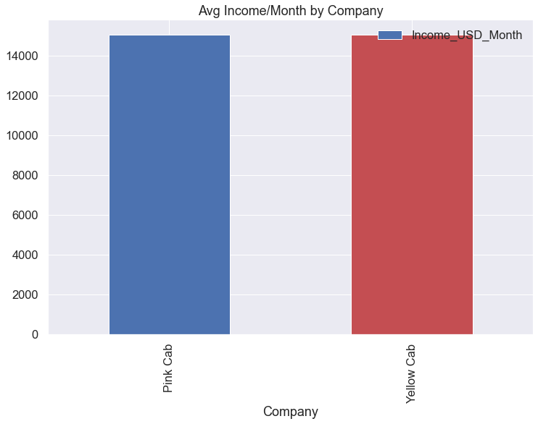
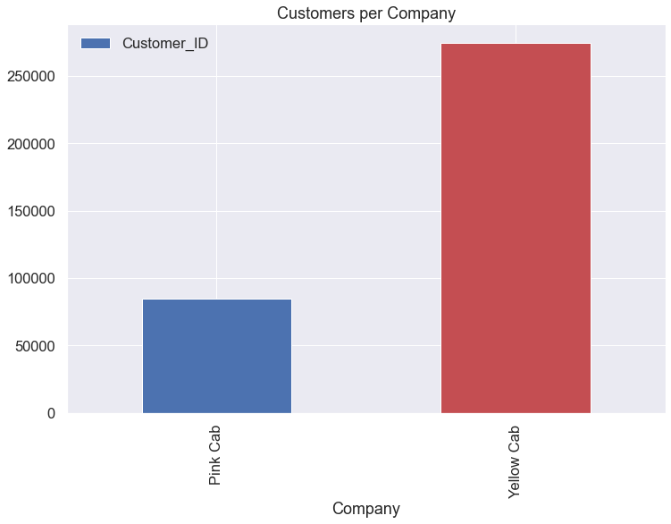
Average Income and Number of Customers
Average Income
Number of Customers

Slide 18
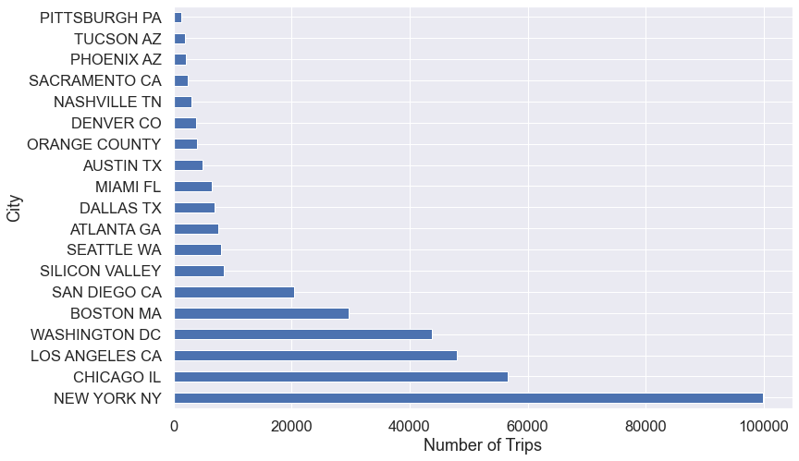
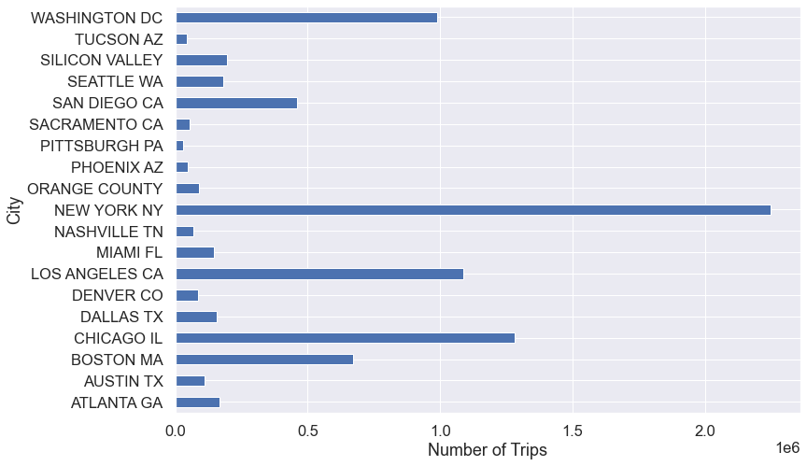
Transactions and Customers per City
Number of Transactions per City
Customers per City

Slide 19
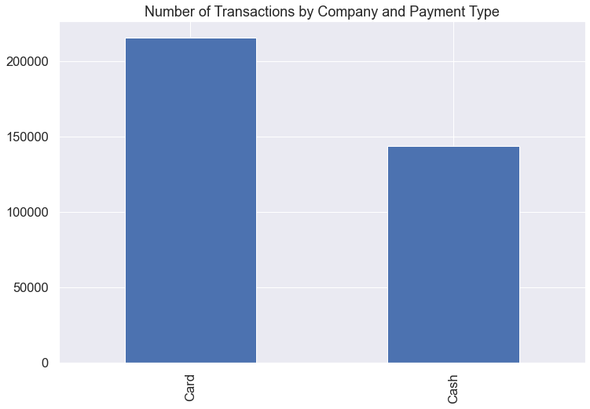
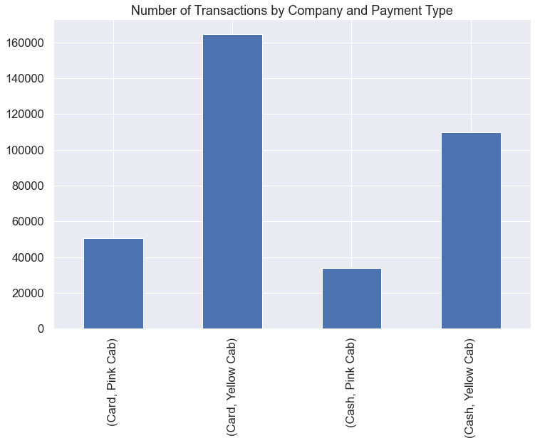
Total Transactions by Type
Total Transactions by Type
Transaction Type by Company

Slide 20
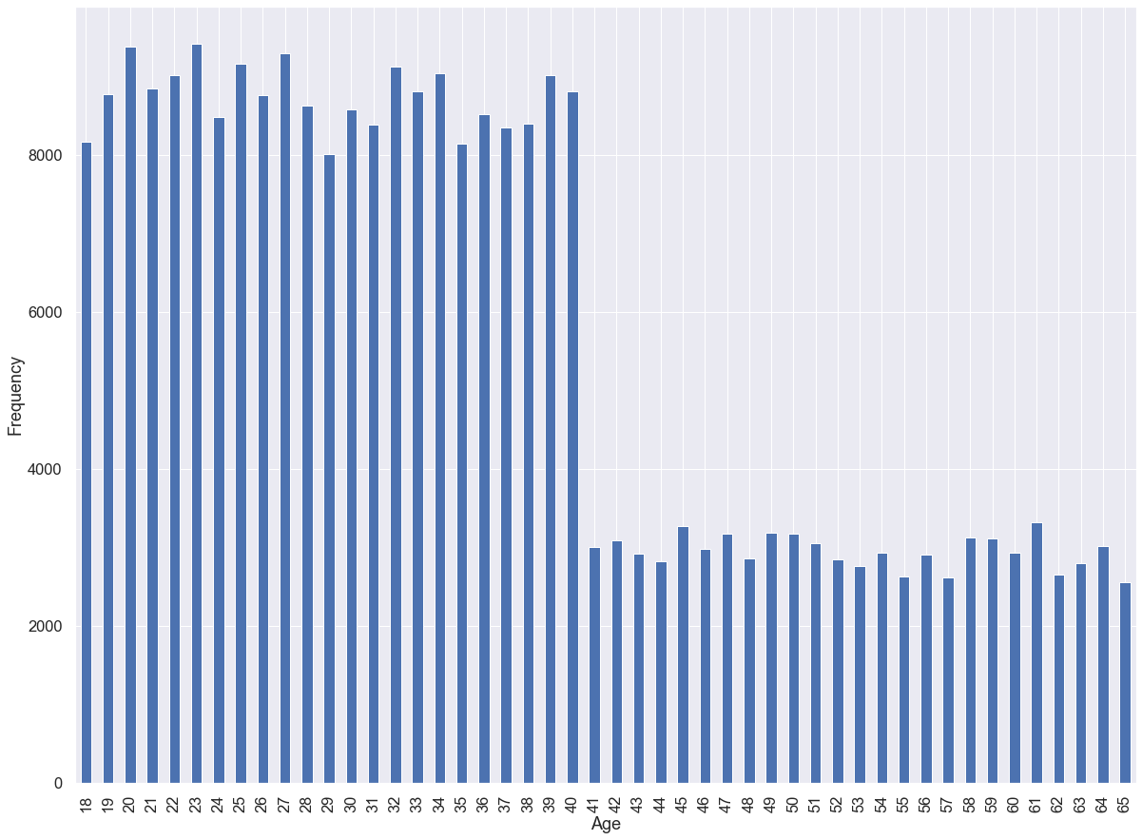
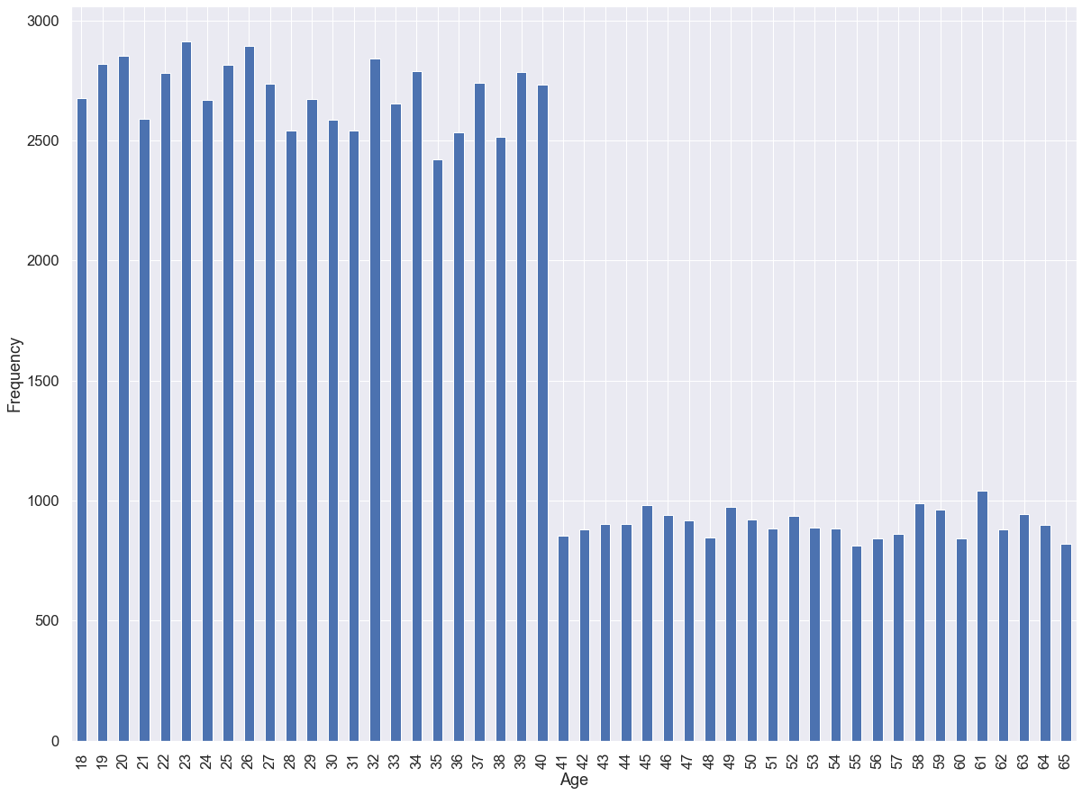
Age Distribution between Companies
Age Distribution – Yellow Cab
Age Distribution – Pink Cab

Slide 21
Customer Analytics
Much like most fields for profits, the distribution and proportion for customer types across different companies remains to be the same.
The one major change is that of number of unique customers. Yellow does not just command a count of transactions, but indeed has a wider reach.
The city-based distribution can tell us several notions about the average customer type of both companies. Most cab trsnactions takes place in most urban areas, and additionally most unique customers live there as well.
Similarly, how they pay for these fairs appears to also be stringly distributed.

Slide 22
Recommendations

Slide 23
Findings and Extrapolations
What we have Found
Possible inferences
Yellow Cab commands a higher portion of profit and customer reach compared to its competitor.
Most fields such as card transaction type, age, income, and other fields are roughly even in proportion between the two companies.
Urban areas command the most demand and most customers by location for both companies.
Yellow Cab is possibly a larger company. It could be that they have more cabs and more availability, which is why they have a surplus of profit and transactions.
Customers have no major particular preference in terms of *who* is taking them, as there is no major distinction in travel or other factors between the companies. They both on average cost the same per km and arrive the same.

Slide 24
Final Recommandations
Customer Demand: Yellow Cab commands a far larger reach in terms of unique customers and number of transactions compared to its competitors across its area. No significant difference in proportion to city reach between Yellow and Pink leads the assertion it may possibly be due to Yellow being larger.
Profits: Similarly, Yellow holds far higher profits across all distribution types, including distribution over travel time. This however is likely due to the extreme difference in customer transactions between companies.
Profits over Time: Both companies exhibit the same year over year trend, where they have down turned around the same level of proportion. Neither company had a significant difference in profit over time, year over year.
Profits per City: Both companies are distributed across roughly across the same cities, and profit per kilometer is mostly the same, save for heavy urban centers such as New York, where most transactions take place.
Customer Demographic: Yellow and Pink cab command a similar type of customer: average age 35, large customer base between 18 and 40, with similar average incomes and payment types. This leads to the assertion both companies would reign as constant competitors for the same pool of clients.
Transactions per City: Most transactions exist in heavy urban areas where the profit per km could be considerably lower than the average, such as New York and Washington. Both companies are distributed mostly evenly in these cities by proportion, leading the assertion that neither – despite the difference in size and profit allocation – seeks differentiation in location.
Conclusions: Due to the roughly same distribution in customer type, transaction type, city, and other fields, our main signifiers are profit and customer demand, both of which favor Yellow Cab heavily. However, an absolute conclusion of them being the better choice cannot be drawn. While higher profits, there is a chance that Yellow Cab is simply a far larger company in proportion. Their profit could be dwindled into any number of costs, inventory, debt, and investments. We could determine the difference in company scale with public resources between the firms. This could be a choice investment of taking a larger firm versus a smaller startup, whose risks tend to give greater rewards. However, assuming information could be found on size, management type, and other factors of Yellow Cab and Pink Cab, and assuming external financial data all is equal, Yellow Cab would predominantly be the better choice.

Slide 25
Thank You

