Slide 1
What Are You Complaining About?
An NLP Study of Consumer Complaints
By Jordan Fairbanks

Slide 2
The Problem
Online forms are a common way to reach out for help
People aren’t always good at categorizing their questions
What if they could just type in a question and it would automatically go to the right person?

Slide 3
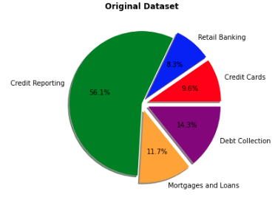
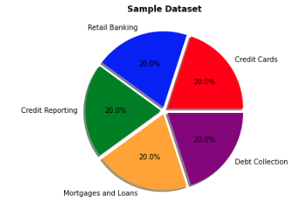
The Data
The dataset comes directly from the Consumer Financial Protection Bureau website
162,000 complaints, sorted into 5 categories
Imbalanced

Slide 4
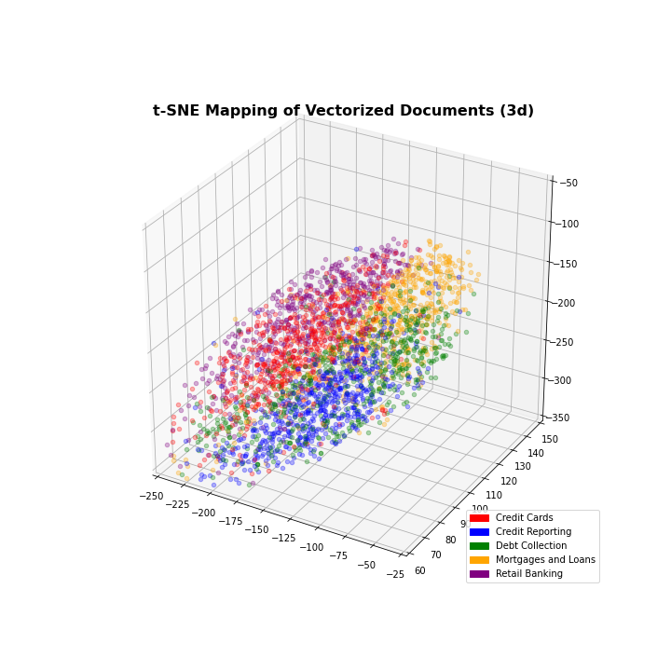
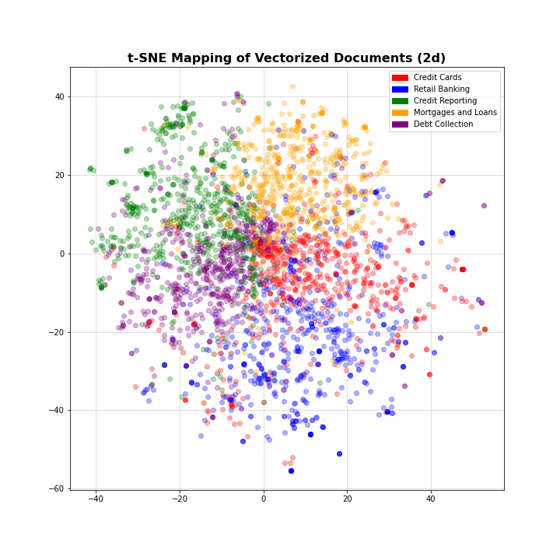
t-SNE
Using a method called t-distributed stochastic neighbor embedding, we can visualize what each document (as a tfidf vector) looks like in a lower dimensional space.

Slide 5
Important words (according to the TFIDF matrix)
Category | Words with the highest TFIDF score
Credit Cards | 'charge' 'one' 'balance' 'fee' 'dispute' 'interest' 'chase' 'month' 'capital' 'due'
Retail Banking | 'money' 'check' 'pnc' 'fund' 'paypal' 'transaction' 'back' 'chase' 'transfer' 'link'
Credit Reporting | 'item' 'inquiry' 'dispute' 'bureau' 'remove' 'identity' 'letter' 'fraudulent' 'theft' 'sent'
Mortgages and Loans | 'loan' 'mortgage' 'month' 'due' 'amount' 'back' 'interest' 'escrow' 'sent' 'home'
Debt Collection | ‘letter' 'sent' 'agency' 'amount' 'bill' 'owe' 'identity' 'service' 'bureau' 'phone'

Slide 6
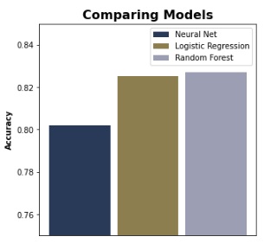
Results

Slide 7
Predictions
Original Text | Actual Label | Neural Network | Logistic Regression | Random Forest
dear legal department credit dispute submitted new evidence dispute account... | Credit Reporting | Credit Reporting | Credit Reporting | Credit Reporting
company lexisnexis case number sent letter pin code access report recognized... | Credit Reporting | Credit Reporting (low certainty) | Retail Banking | Debt Collection
open dont proof debt messing credit getting house world finance | Debt Collection | Debt Collection | Credit Reporting | Credit Reporting
checking recent credit report noticed credit inquiry authorize | Credit Reporting | Credit Reporting | Credit Reporting | Credit Reporting
friday went customer service counter walmart indicated wanted send moneygram fellow asked | Retail Banking | Retail Banking | Retail Banking | Retail Banking
 |  | 5/5 | 3/5 | 3/5

Slide 8
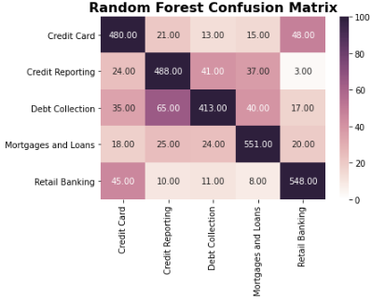
Confusion Matrix
All models have trouble in similar areas

Slide 9
Next Steps/How to improve
Incorporate t-SNE features into the tfidf matrix
Add more Categories
Examine and experiment with more stopwords
Work on tuning models for longer
Different subject with more distinct language in each Category

