Slide 1
Application modules
Event List
Event Count
Score Trend
Event Management Module
AWS Load Balance
JVM Server
JVM Server
JVM Server
EC2
H2 Database Server
Data File

Slide 2
Event Management Module：Intake event data and do query for application modules
Event List: Show all event data of the two teams
Event Count: Count every event amount and show them with average data
Score Trend: Display the score trend in lines
AWS Load Balance: Ensure application availability and scale up/down EC2 machines according to the traffic requirement.
JVM Server: Java runtime environment, start up by springboot.
H2 Database Server: In-Memory database, persist data in files.

Slide 3
API: /api/createEvent Save Event
Request：
{
"team": "Leinster",
"event": "Wide",
"minutes": 5,
"seconds": 18.38154800000001
}
Response:
{"id":270,"team":"Leinster","event":"Wide","minutes":5,"seconds":18,"score":null,"updateTime":1690230338629}

Slide 4
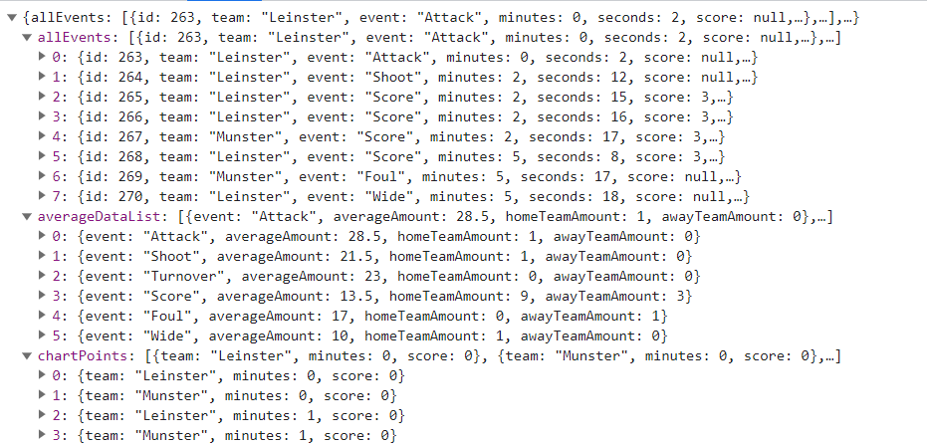
API: /api/loadData Load data
Request：
{
"homeTeam": "Leinster"
"awayTeam": "Munste"
}
Response:

