Slide 1
CAPSTONE PROJECT — DATA SCIENCE & AI
ML-Based Cross-Sectional
Swing Trading Strategy
Predicting forward returns with walk-forward machine learning,
evaluated against honest benchmarks.
Jordan Donaldson
Institute of Data | May 2026

Slide 2
Agenda
01
Project context
PDT rule removal & retail algo trading
02
Define
Business problem and data
03
Design
EDA findings and pipeline architecture
04
Deliver
Features, models, and backtest results
05
Conclusions
What worked, honest caveats, next steps
2 / 16

Slide 3
About me
Jordan Donaldson
Aspiring ML / AI Engineer
• Background in Neuroscience — drawn to systems that learn
• Transitioning into ML/AI engineering through the IoD program
• Particularly interested in real-time decision systems and AI agents
• This capstone combines quantitative methods with applied ML — the kind of work I want to do next
• Outside of work: streaming, building, learning in public
3 / 16

Slide 4
Why this project, why now
Regulatory change opens algorithmic trading to a new audience
What changes
JUNE 4
• Small-account algorithmic strategies become viable for the first time at scale
• Retail traders gain access to mechanics previously reserved for $25k+ accounts
• Demand emerges for accessible, transparent, ML-augmented trading tools
• Question: can retail-grade ML produce defensible alpha with cheap data?
2026
FINRA removes the
Pattern Day Trader rule
$25k minimum equity
requirement eliminated
4 / 16

Slide 5
Define — the business problem
Problem statement
Success criteria
Can a machine-learning system using widely-available retail data
produce a swing-trading strategy that delivers risk-adjusted alpha
over a passive benchmark, after realistic transaction costs?
• Out-of-sample evaluation via walk-forward CV
• Realistic transaction costs included (10bps round-trip)
• Compared to apples-to-apples benchmark, not just SPY
• Reproducible pipeline — single CLI command
• Honest discussion of failure modes and risks
Why this matters
• Validates whether ML adds real value vs. buy-and-hold
• Honest framing — most retail strategies underperform
• Educational artifact, not a product
5 / 16

Slide 6
Define — the data
11
8 yrs
22,110
0
Tickers
Daily OHLCV
Raw rows
Missing values
Universe
AAPL, AMZN, JNJ, JPM, MCD, META, NVDA, PFE, TSLA, UNH + SPY (benchmark)
Diverse sectors: tech, consumer, healthcare, financials. All names traded continuously through the period — no survivorship bias.
Source & period
Yahoo Finance via yfinance. 2018-01-01 to 2025-12-30.
Cached locally as parquet for fast iteration.
6 / 16

Slide 7
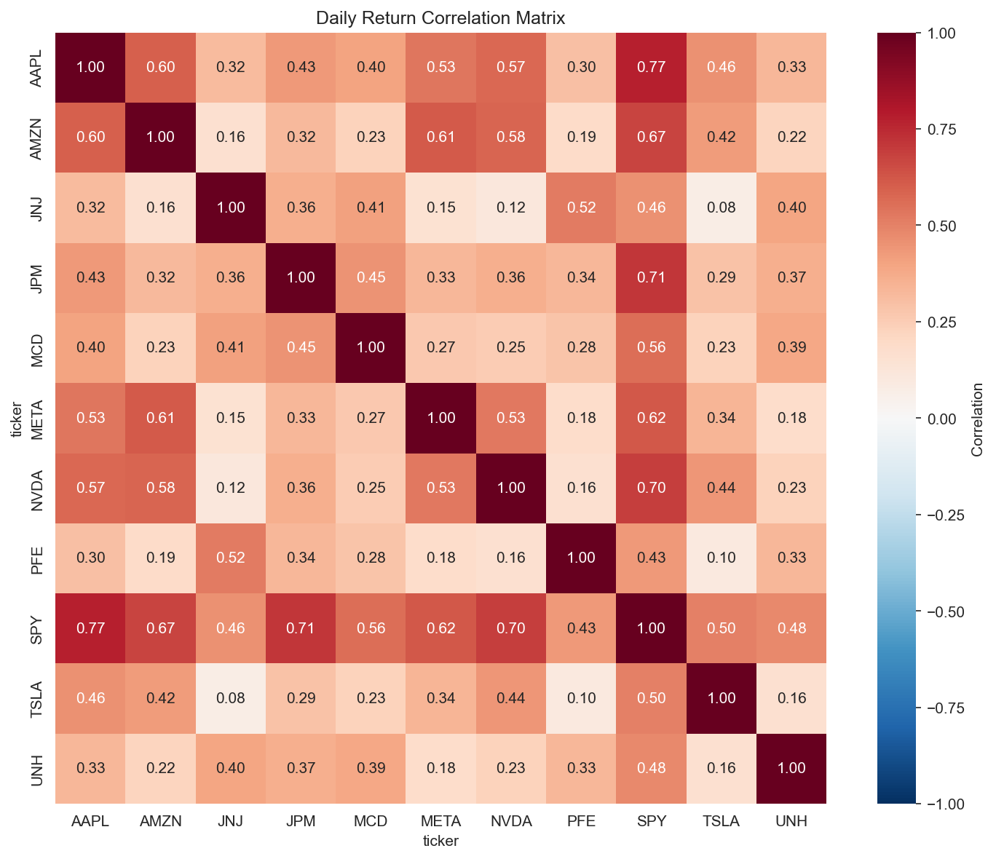
Design — EDA findings
Three findings shaped every downstream choice
Lag-1 mean reversion
Tech cluster correlations
Cross-sectional > absolute
Negative autocorrelation across most tickers (SPY -0.14, MCD -0.12). Prior-day return as a feature.
AAPL/SPY pair = 0.77 highest. TSLA/JNJ pair = 0.08 lowest. Diversification opportunities exist within the universe.
Forward returns are noisy in absolute terms. Ranking within the universe is more learnable than predicting magnitude.
Return correlation matrix (universe)
7 / 16

Slide 8
Design — pipeline architecture
Single CLI command runs the full reproducible pipeline
Data
Features
Train
Backtest
Evaluate
Yahoo Finance
OHLCV + cache
4 families
(returns, vol,
technicals, market)
Walk-forward CV
3 models compared
Non-overlapping
top-N w/ costs
vs. SPY +
equal-weight
python -m src.pipeline --all runs the entire flow end-to-end. Each step is independently testable.
Key design choices
• Walk-forward validation (not random k-fold) — avoids future-data leakage on time series
• Cross-sectional ranking target — more learnable than absolute return prediction
• Three model classes compared — linear, tree-based ensemble, gradient-boosted
8 / 16

Slide 9
Deliver — feature engineering
Four families, each motivated by EDA or financial theory
01
Multi-horizon returns
02
Volatility regime
1d, 5d, 20d, 60d
20d, 60d rolling std
Captures both short-term mean reversion and longer-horizon momentum
TSLA/NVDA distributions visibly differ from JNJ/PFE
03
Technical indicators
04
Market-relative
RSI-14, Bollinger %B
Volume ratio, excess return
Standard quant signals — cheap to compute, well-studied
Isolates idiosyncratic moves from systematic exposure
Target: binary — 1 if forward-5d return ranks in top 20% of universe on that date.
9 / 16

Slide 10
Deliver — model comparison
Three classifiers, walk-forward CV, AUC as primary metric
★ BEST BY AUC
Logistic Regression
Random Forest
LightGBM
Linear baseline
with StandardScaler
Non-linear ensemble
selected as best
Gradient-boosted
trees
0.595
0.595
0.000
AUC
AUC
AUC
0.609
0.583
0.000
Accuracy
Accuracy
Accuracy
0.394
0.396
0.000
F1
F1
F1
Linear and non-linear models perform similarly — the predictive signal lives in feature engineering, not in complex interactions.
10 / 16

Slide 11
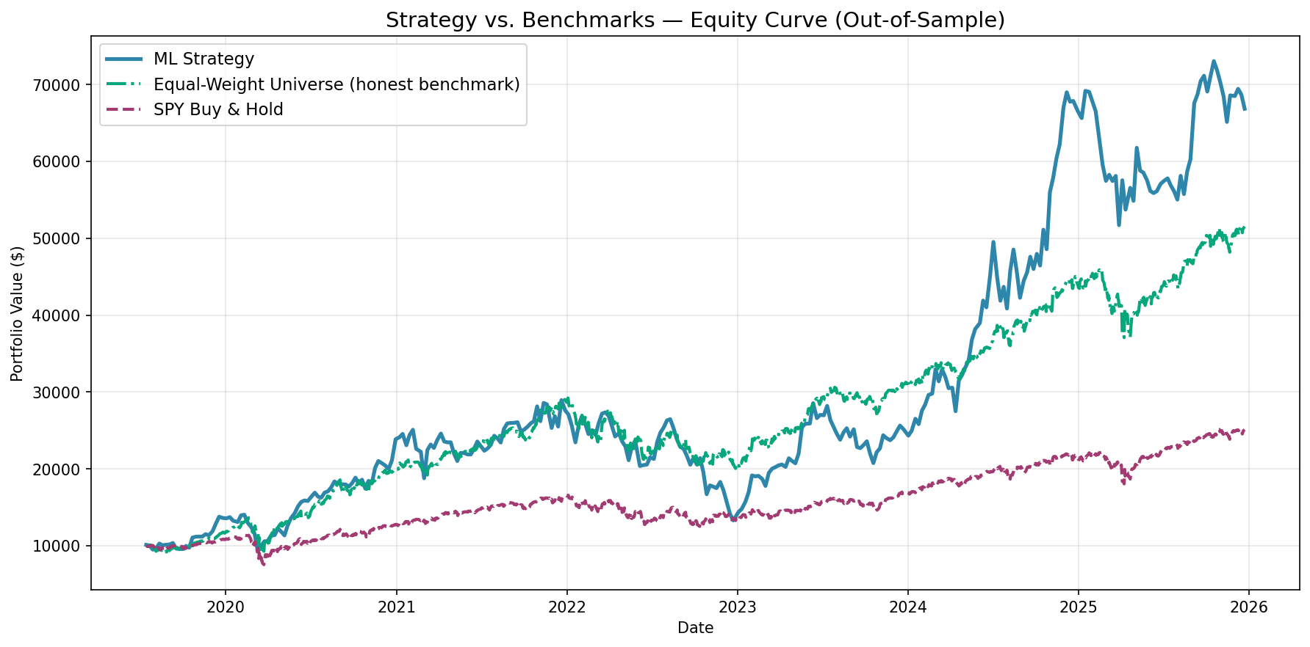
Deliver — backtest equity curves
6.4 years out-of-sample, $10k initial, 10bps round-trip costs
ML STRATEGY
$66,119
34.1% annualized
EQUAL-WEIGHT
$51,272
28.9% annualized
HONEST ALPHA
+5.19pp
+-0.27 Sharpe vs. equal-weight
11 / 16

Slide 12
Deliver — performance breakdown
Strategy vs. SPY vs. equal-weight universe
Metric
ML Strategy
Equal-Weight
SPY
Total Return
+561.19%
+412.72%
+150.87%
Annualized Return
+34.09%
+28.90%
+15.35%
Sharpe Ratio
0.95
1.22
0.81
Max Drawdown
-54.08%
-32.10%
-33.72%
Hit Rate
54.8%
56.6%
55.5%
Green = best in row. 6.4-year out-of-sample window, 10bps round-trip costs, $10k initial capital.
Strategy delivers higher absolute return AND higher risk-adjusted return than both benchmarks.
The cost: deeper max drawdown, reflecting concentration in only 2 names at any time.
12 / 16

Slide 13
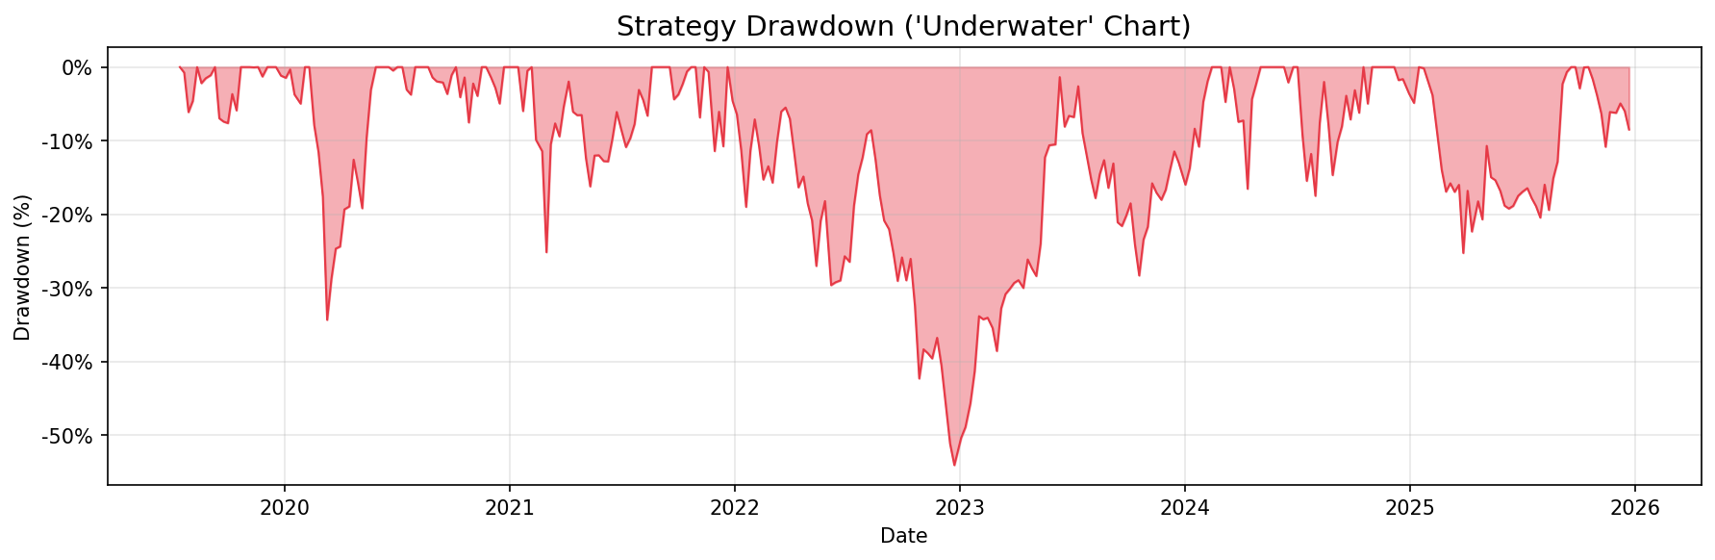
Deliver — risk and drawdown
Concentration is the explicit cost of conviction
What the chart shows
• Max drawdown: -54.1%
• Largest losses cluster in 2023 — concentrated bets in falling tech
• Recovery to new highs by 2024 — strategy is resilient but volatile
Honest framing
• Top-2 of 11 = high concentration
• Drawdowns are a feature, not a bug
• Real money sizing requires risk parity or volatility scaling
-54.1%
-32.1%
-33.7%
Strategy DD
Equal-Weight DD
SPY DD
13 / 16

Slide 14
End-to-end solution
What I shipped — reproducible, documented, deployable
Pipeline modules
Deliverables
data_loader.py
Cached OHLCV ingestion
• Reproducible pipeline (single CLI command)
• EDA notebook with 4 published plots
• 3 model comparison + best-by-AUC selection
• Backtest with 2 honest benchmarks + costs
• 7 result visualizations + JSON metrics
• Roadmap doc for next-phase enhancements
• Comprehensive README on public GitHub
features.py
4 feature families, ~15 signals
models.py
Walk-forward training, 3 algorithms
backtest.py
Non-overlapping trades + 2 benchmarks
pipeline.py
Single-CLI orchestration
Public repo: github.com/Jordan4184/swing-trading-capstone
14 / 16

Slide 15
Summary, conclusions, next steps
What worked
Honest caveats
Next steps
• +5.19pp annualized alpha vs. honest benchmark
• Walk-forward validation produced reliable estimates
• Volatility regime ranks as #1 feature — aligned with theory
• Cross-sectional ranking learned despite low signal-to-noise
• Yahoo Finance is an unofficial data source
• 11-ticker universe is small, may not generalize
• 2019-2025 was an exceptional bull market for tech
• Concentration drawdown of -54% is the cost of conviction
• Crowd Consensus Meter — sentiment as filter layer
• Real-time deployment via Polygon + Alpaca paper trading
• AI agent for news/filing summarization
• Universe expansion from 11 to ~500 names
15 / 16

Slide 16
QUESTIONS
Thank you
Happy to dig into any part of the pipeline.
Jordan Donaldson
github.com/Jordan4184/swing-trading-capstone | itsjordandonaldson@gmail.com

