Slide 1
Predictable Purchases by Jordan Deagan
On predicting the purchase of certain items based on when and what was purchased

Slide 2
The Question
Based on data from previous purchases from a variety of shoppers, can a predictive algorithm correctly guess when someone will purchase a given item?

Slide 3
The Data(0)
Using information from Instacart about orders made by users on Instacart, as well as product and aisle information to provide reference to the data.
The Instacart Online Grocery Shopping Dataset 2017”, Accessed from https://www.instacart.com/datasets/grocery-shopping-2017 on 10/26/18

Slide 4
The Data(1)
Orders are split into 3 data sets:
One has the user ID and time variables for all purchases, organized by user ID and purchase order.
The second one contains the products bought in the most recent purchase of each user, organized by order ID and the order the product was added.
The last one has product organization for all previous purchases.

Slide 5
My Approach
Using the data sets provided by Instacart, I will use predictive modeling to check whether or not a customer’s next purchase will include beef jerky, trail mix, protein bars, all of them, or none.

Slide 6
Why?
I want to see if I can develop a classifier based on chaotic data such as grocery purchases
I normally see beef jerky and trail mix, and many protein bars, as trail and camping food for over the weekend, and I am interested in seeing if that holds true for the majority of purchases

Slide 7
The Process(0)
To predict purchases of said items, I need to find said items, so I will compile three lists of the product IDs for each instance of the product in the product list
I will also organize the user orders to check purchase information on orders containing a product, and order contents of purchases before a product is bought

Slide 8
The Process(1)
Use Apriori to find correlation in purchased products before a product was bought. This will be run twice for each product, checking all orders before the first purchase of a product, and checking the orders right before the purchases of products for those who have bought an item before. This will hopefully create associations for first time buyers and for repeat buyers.

Slide 9
The Process(2)
After a potential correlative connection has been created for past purchases, I will create a Propensity model based on previous purchases, time of day, day of the week, how long since their last purchase, and if they are a repeat or potential first time buyer of the product
I will use k-folds cross validation to train the model

Slide 10
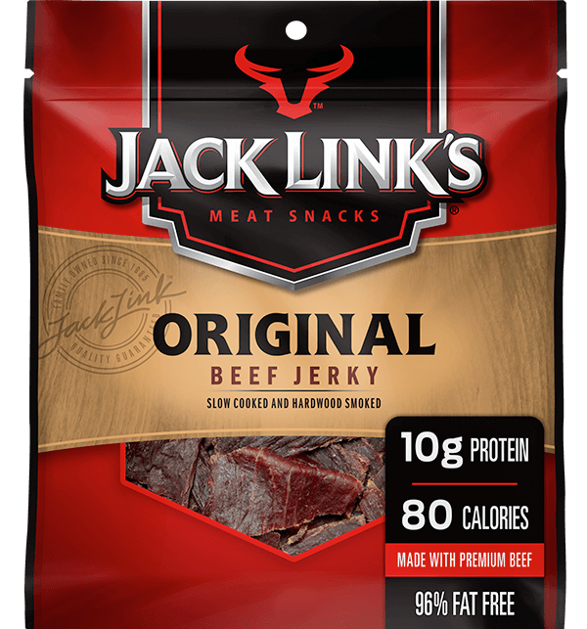
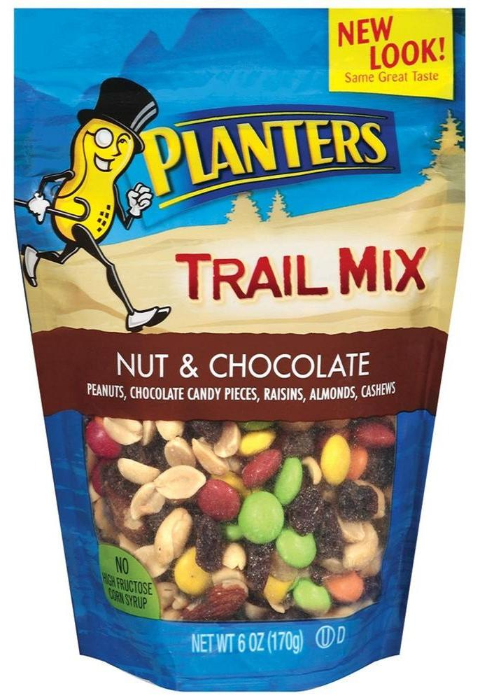
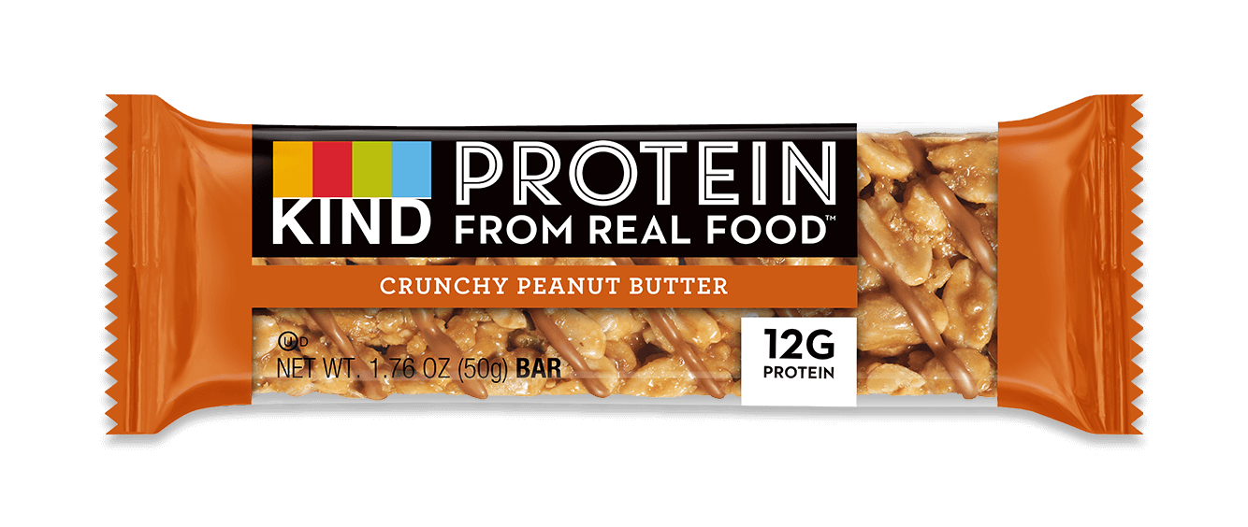
Sample Products

Slide 11
The results
The end result should be three classifiers that can take in the previous purchases of a user, the day they come in to purchase something, the time of day, and how long it has been since they last bought something, and return whether or not that user will purchase any of the associated products.

Slide 12
Testing
To make sure these classifiers work, I will have kept the most recent purchases separate, and then run the classifiers on these purchases without letting it see the actual contents, and compare the result of the classifiers to actual the ordered products based on my earlier lists of product IDs

Slide 13
Conclusion(0)
The primary conclusion will be whether the algorithms and process I used will be able to accurately predict purchases. This will come from comparing true and false purchase predictions.

Slide 14
Conclusion(1)
My other conclusion will be looking at the data I have, and if it is accurate, figuring out what it means in the context of purchasing beef jerky, trail mix, and protein bars.

Slide 15
Future Work
Using different algorithms to find which one better predicts
Test on more specific products or undersampled products
Actually make it work (if I fail)

Slide 16

Questions?

