Slide 1
News Article Bias Detector
A tool to assist readers in getting multiple perspectives on the news

Slide 2
Team Members
Jordan Shaheen
shaheejn@mail.uc.edu
Cole Hutchins
hutchicj@mail.uc.edu
Toby Knueven
knueveta@mail.uc.edu
Xander Hatton
hattonab@mail.uc.edu
Dr. William Hawkins III (Advisor)
hawkinwh@ucmail.uc.edu

Slide 3
Abstract
Modern readers of online political content are often just looking for the facts so that they can form their own opinions. Unfortunately, many news sources and articles are biased to one side or the other in their reporting, which can make up readers’ minds for them. For readers who don’t have the time to investigate every author, source, and claim, our tool will provide a simple bias score for any online news article. Readers will then be able to make informed decisions about which articles they choose to read and check other sources if they wish.

Slide 4
User Stories
As a person reading the news, I want to understand the bias of articles I read in order to come to my own understanding of topics I am interested in.
As a Polysci student, I want a bias-metric to understand the mathmatical measurement of the bias in order to research more effectively.
As a marketing professional, I want to understand the bias in news articles to help advertise correctly to the right audiences.

Slide 5
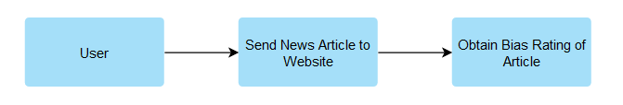
Design Diagram: Level 0

Slide 6
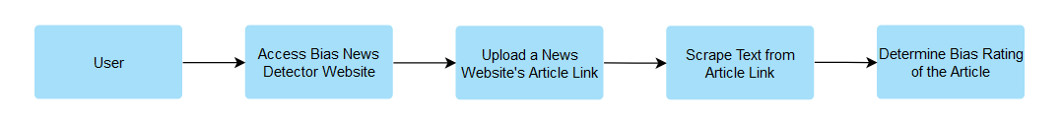
Design Diagram: Level 1

Slide 7
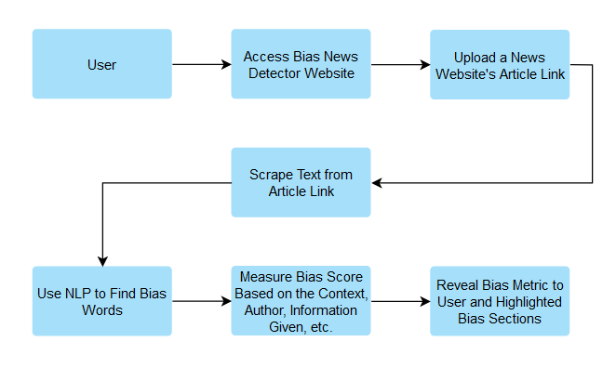
Design Diagram: Level 2

Slide 8
Major Project Constraints
The development and deployment of our news bias detector are influenced by multiple economic, ethical, security, and social constraints. Economically, our project relies heavily on open-source software and publicly available tools due to the short time for development, and our team has no budget for the project. These circumstances may limit the range of features we can offer and the quality of our bias detection. Professionally, this project aims to bolster the reputation of an unbiased, factual news distribution. From an ethical standpoint, our detector's potential influence on a user's perception of news presents a significant challenge. Our tool mustn't inadvertently promote a particular narrative or suppress another, ensuring its impact remains neutral. Security concerns also arise, mainly related to user data privacy. Since users will submit news article URLs for analysis, measures to prevent data breaches and ensure the anonymity of user submissions are paramount. Socially, the news bias detector is intended to serve the broader public by promoting informed citizenship. By helping users discern biases in news, we aspire to enhance the quality of public discourse. Environmental and cultural constraints are less predominant in our project; however, our design is focused on accessibility, ensuring diverse user groups, irrespective of language or background, can benefit from our tool.

Slide 9
Current Progress
Preliminary Django backend framework
Investigate web scraping options
Beautiful Soup
Newspaper 3k
jusText
Research into NLP and ML tools and options
Support vector classifier, deep learning
Research into document encoding technique options
Doc2Vec

Slide 10
Expected Accomplishments
Comprehensive Research: Conduct an extensive literature review on existing bias detection tools, algorithms, and methodologies.
User Experience Design: Develop an intuitive user interface that ensures easy URL input and clear presentation of bias results.
Algorithm Selection: Determine the most suitable NLP and ML algorithms for accurate bias detection, considering both supervised and unsupervised methods.
Data Collection: Assemble a diverse dataset of news articles, spanning various biases, for training and validation purposes.
Prototyping: Build a working prototype of the News Bias Detector for preliminary testing.
Feedback Mechanism: Design an integrated feedback system allowing users to agree or disagree with the bias rating, aiding in continuous algorithm improvement.

Slide 11
Division of Labor
Task Description | Team Member of Primary Responsibility | Shaheen Effort (%) | Hatton Effort (%) | Knueven Effort (%) | Hutchins Effort (%)
Task 1: Webpage outline | Jordan Shaheen | 75% | 25% | 0% | 0%
Task 2: Webscraper | Alexander Hatton | 25% | 75% | 0% | 0%
Task 3: Bias metric/training data | Tobias Knueven | 0% | 0% | 75% | 25%
Task 4: ML NLP bias classifier | Colson Hutchins | 0% | 0% | 25% | 75%

Slide 12
Expected Demo
For our demonstration at the Senior Design Expo, we will have our website available for attendees to select a news article of their choice, paste the link, and generate a bias report.

