Slide 1
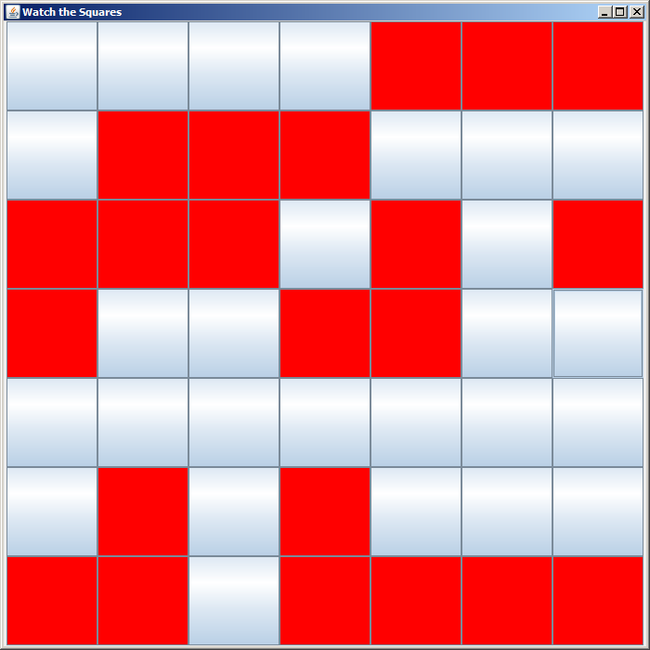
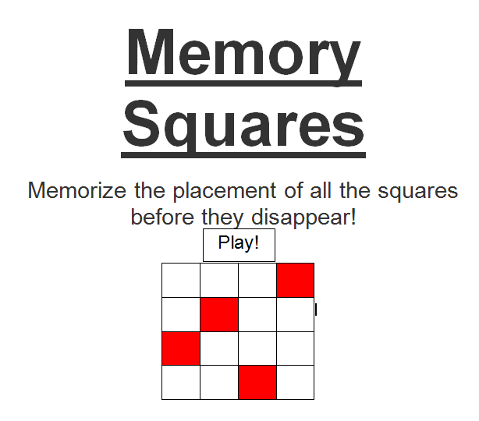
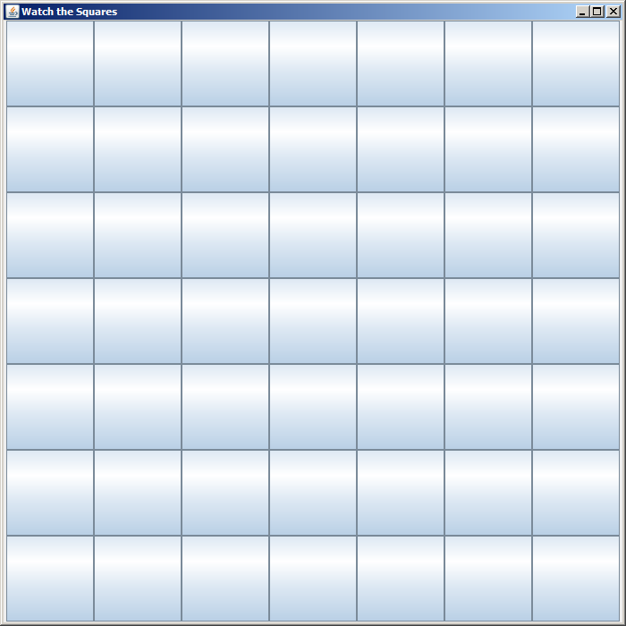
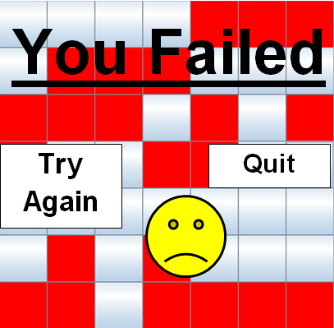
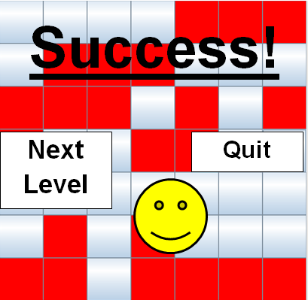
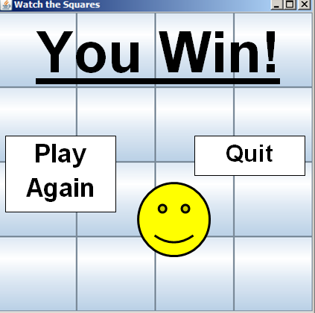
Memory Squares
Jordan Eng and Kimberly Rupp
Memorize all the squares before they disappear!
Description
How it’s played (A WIP)
Discoveries
This game is a simple memory challenge. A grid will be shown with various colored squares in a pattern. After several seconds, the pattern will disappear and is replaced with a new, empty, interactive grid where the user needs to click the squares to recreate the pattern. With each level you pass, the size of the grid increases. If you click an incorrect square, you lose a life (one out of three). It has been interesting for us trying to create an interactive program using all the concepts we’ve learned in this class.
Over the course of this project, we’ve learned how to use JFrame and buttons. While it is frustrating and challenging to write exactly what we want, it’s also convenient using GridLayout to create just the type of output we want.
BoardFilled – Displays a patterned board for several seconds before disappearing.
Challenges
TitleScreen – Displaying a play button and the title
It took us too long to figure out how to write our program (whether or not it’d be in DrawingPanel or JFrame, and whether or not we used MouseEvents or actionListener). We’re still figuring out actionListener and how we’d change each individual button based on the click and whether or not it’s correct.
Also, we have not yet begun to implement different levels or a lives system, so we don’t know what kind of issues those will create or how to do them.
Outline of Structure
Imported Data Structures We Use:
ArrayList
Classes We’ve Created For the Project
ClickBoard – The blank board that the user clicks
BoardFilled – The example patterned board
MemorySquaresClient – The client program
TestingTesting – The class that allows us to test our code
We still may need an abstract class for ClickBoard and BoardFilled as they both create boards of the same size
We have yet to begin working on a lives system, or different levels, which will entail more research and work.
ClickBoard – Displays an unfilled board where the user may click the buttons of the correct colored squares
If the user clicks an incorrect square, the square is turned black and the user is directed to a fail screen.
Target Users
This game is perfect for those who like a mental challenge, or who want to experience the joy of playing a fun game. It helps people exercise their memory, and it solves the problem of boredom. Users include, people who want to test their memory, bored people, people who are wondering if they’re color blind, people who like winning, people who want to be good at something, doctors who want to test for Alzheimer’s or Dementia, people of ages 3-150, parents who want to test if their child’s brain is developing on time, and anyone else who feels like playing a great game.
What’s Next?
What we have to do next is finish the ClickBoard (and get our program to actually work…). After we’re able to program a working game, then we’ll work on embellishing through levels (maybe prompting a user for a size of board) and a lives system.
If the user completes the entire board correctly, then they’re directed to the success screen and they can choose whether to continue or quit.
There are two buttons, one to play again, and one to quit the game.
When the user makes it to the end, there is a “You Win” screen that gives them the option to play again.

