Slide 1
Fast, non-stiff methods for the Immersed
Boundary Method
Jordan E. Fisher
Advisor: Hector D. Ceniceros
August 12, 2011

Slide 2
Overview
The Immersed Boundary Method
The stiffness problem
The Matrix Method
The Multipole Method
Peristaltic pumps
Solutions

Slide 3
Overview
The Immersed Boundary Method
The stiffness problem
The Matrix Method
The Multipole Method
Peristaltic pumps
Solutions

Slide 4
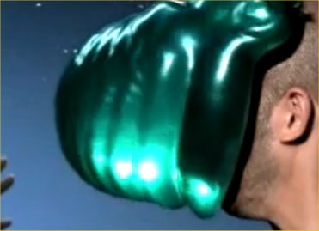
What do we want to model?

Slide 5
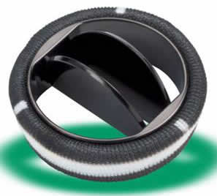
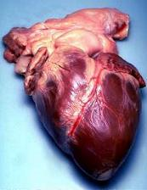
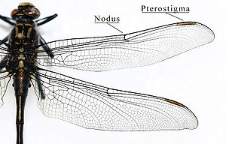
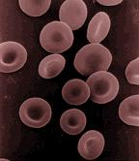
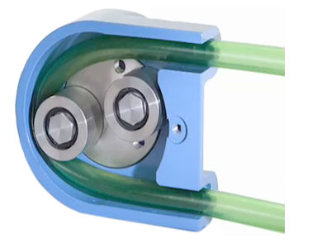

Slide 6
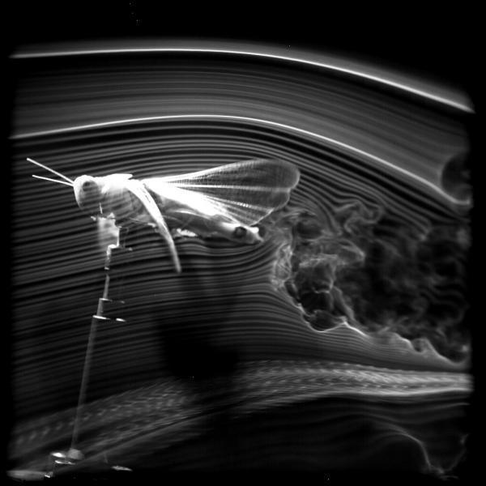
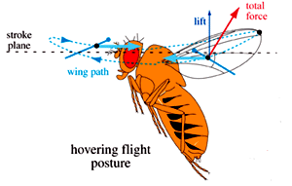

Slide 7
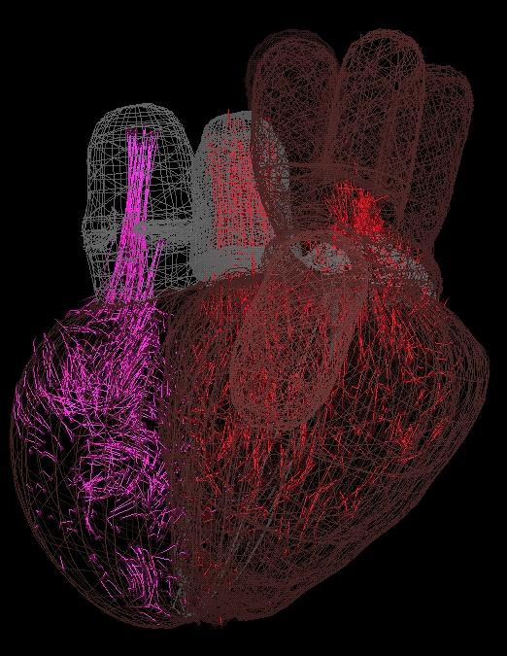

Slide 8
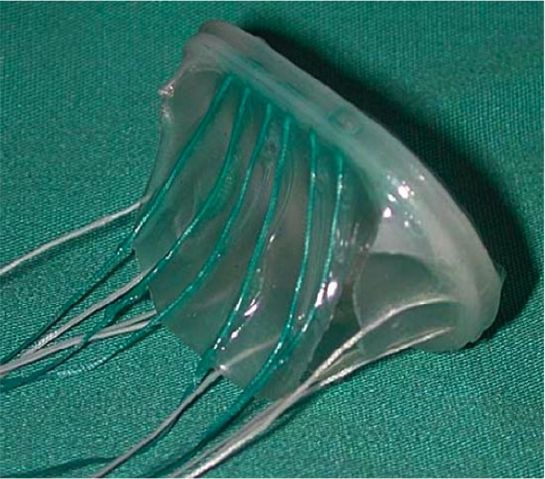
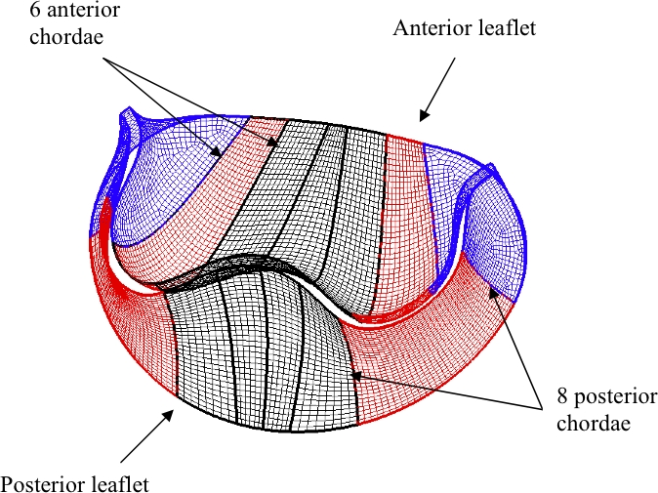
?

Slide 9
History
Originally developed by Charles Peskin for his model of an artificial heart valve
The method proved to be useful for modeling a wide range of phenomenon

Slide 10
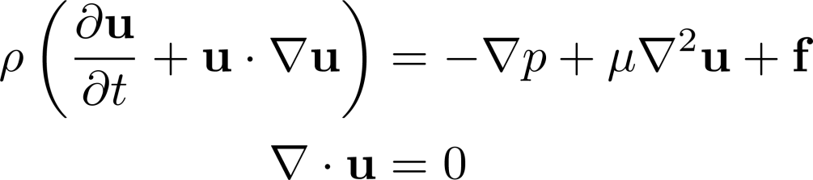
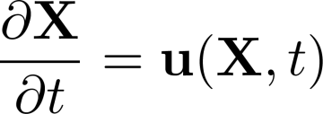

Immersed Boundary Equations
Navier-Stokes
No-slip boundary
Fiber force

Slide 11
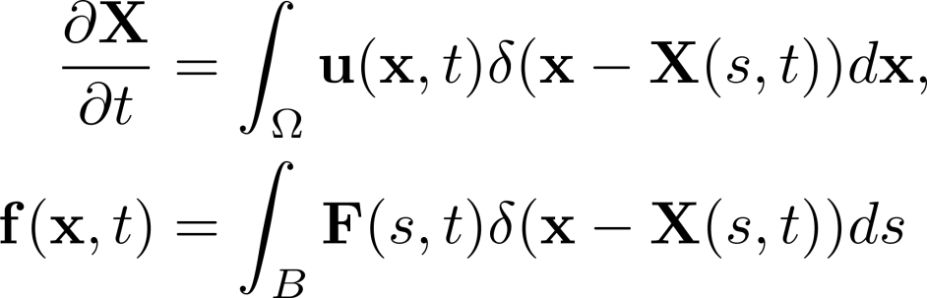
Spreading / Interpolation
Immersed Boundary Equations
Navier-Stokes
No-slip boundary
Fiber force

Slide 12
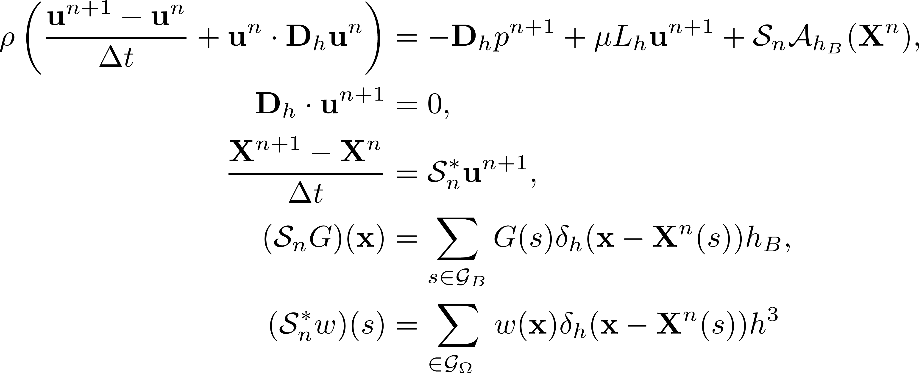
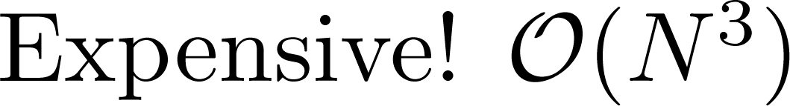
Forward Euler/Backward Euler

Slide 13
Overview
The Immersed Boundary Method
The stiffness problem
The Matrix Method
The Multipole Method
Peristaltic pumps
Solutions

Slide 14
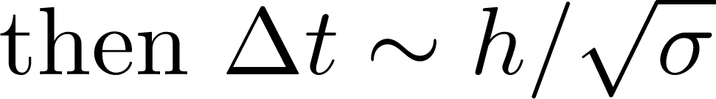
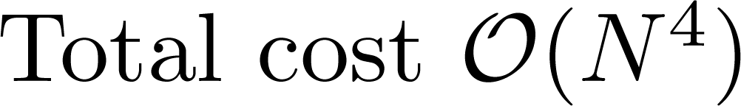

Slide 15



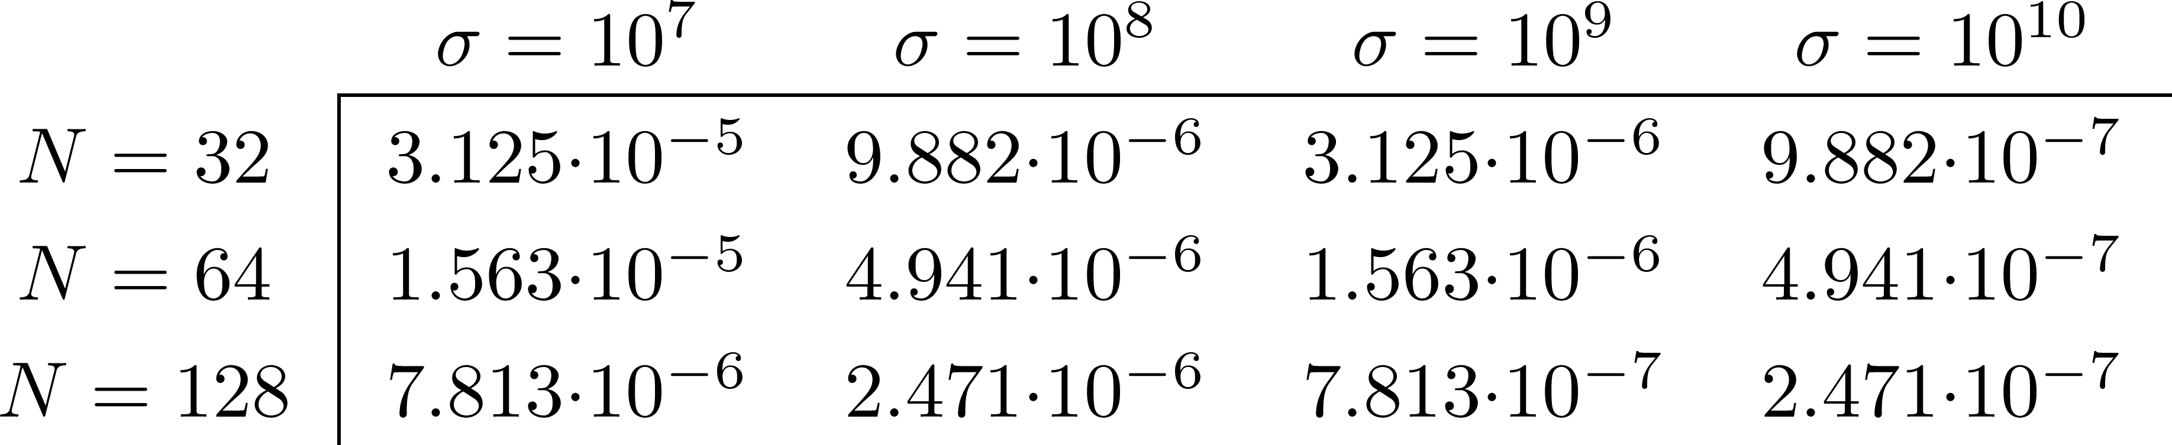
Oh, no!
Notes:
Small values of N!

Slide 16
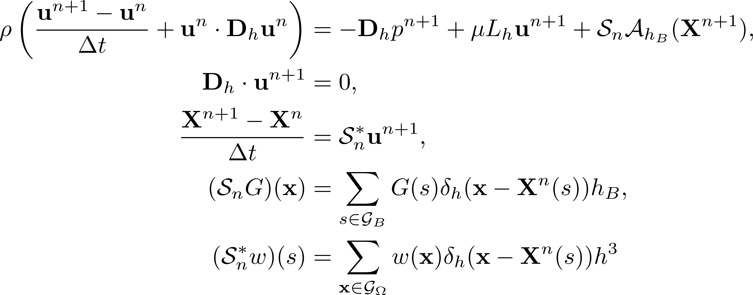

Lagged Semi-Implicit Discretization

Slide 17
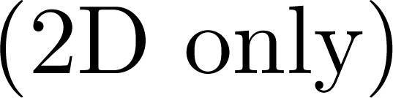
Overview
The Immersed Boundary Method
The stiffness problem
The Matrix Method
The Multipole Method
Peristaltic pumps
Solutions
Notes:
2D only.

Slide 18
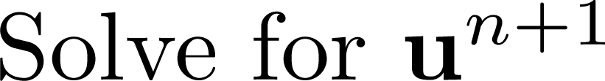
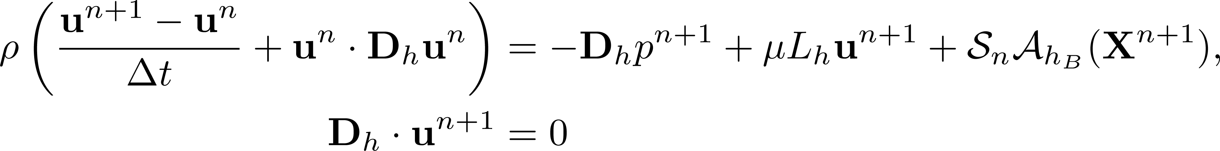
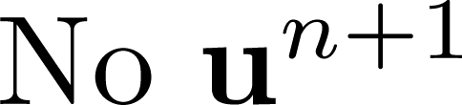
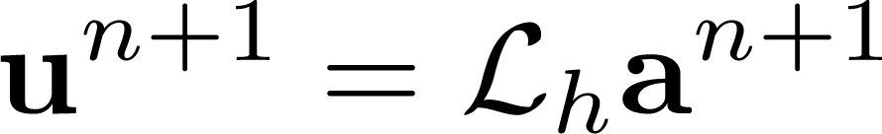

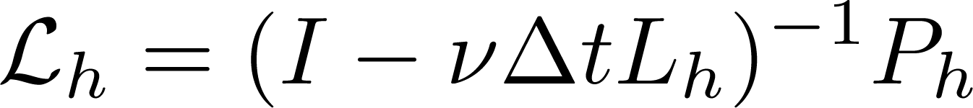
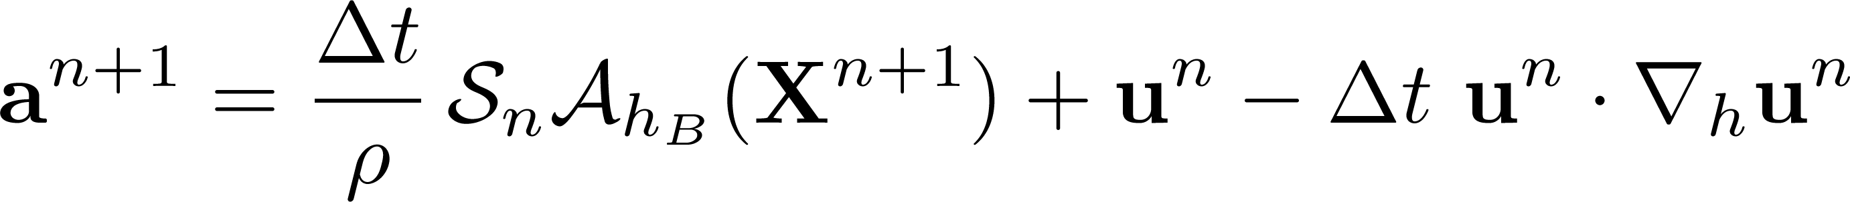

Slide 19
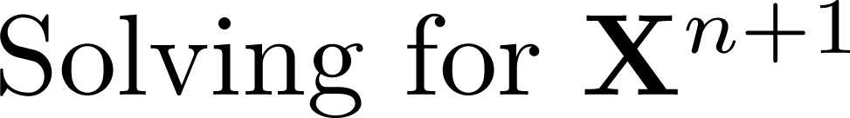
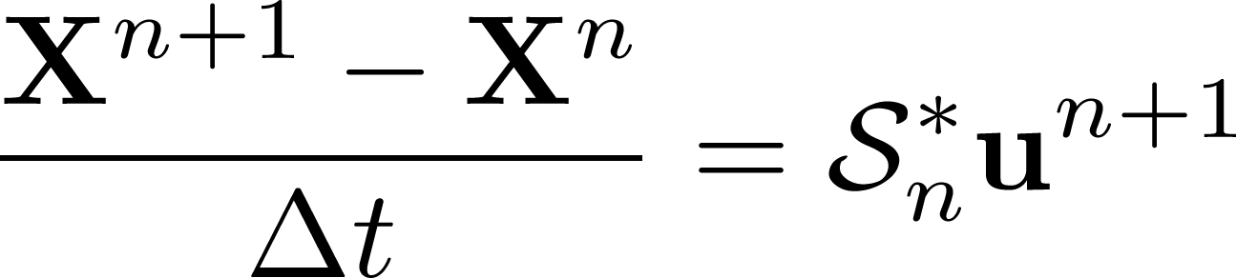

Slide 20
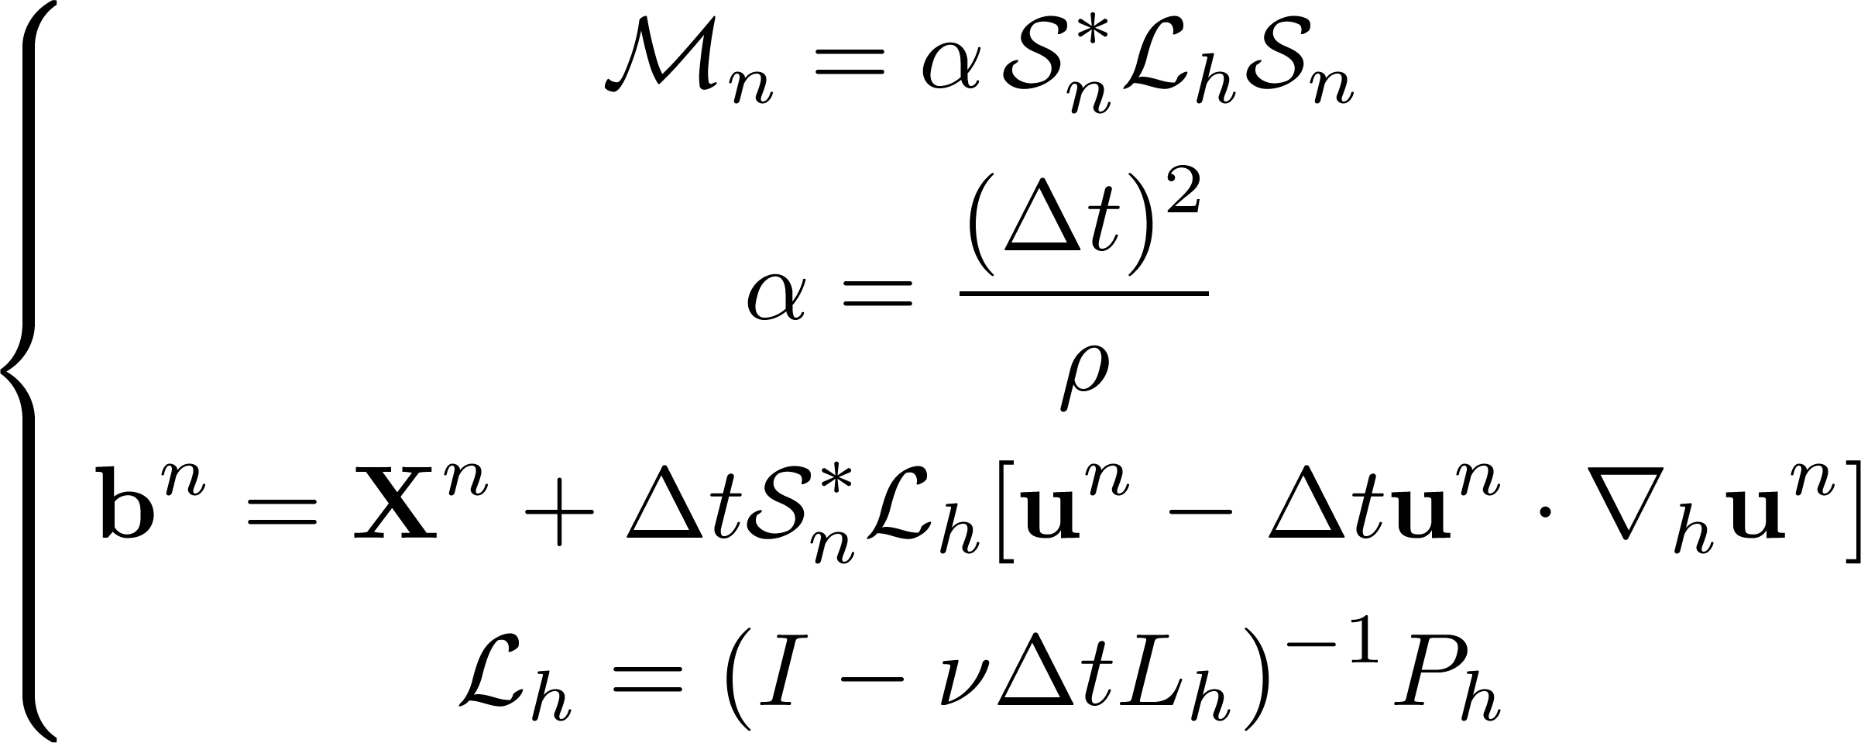

Slide 21
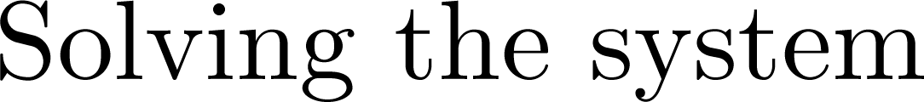
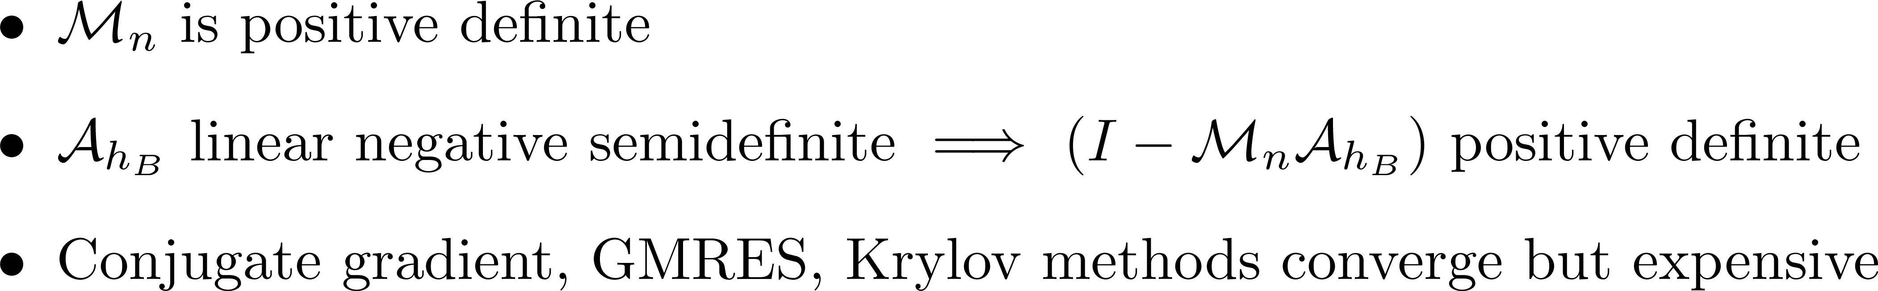
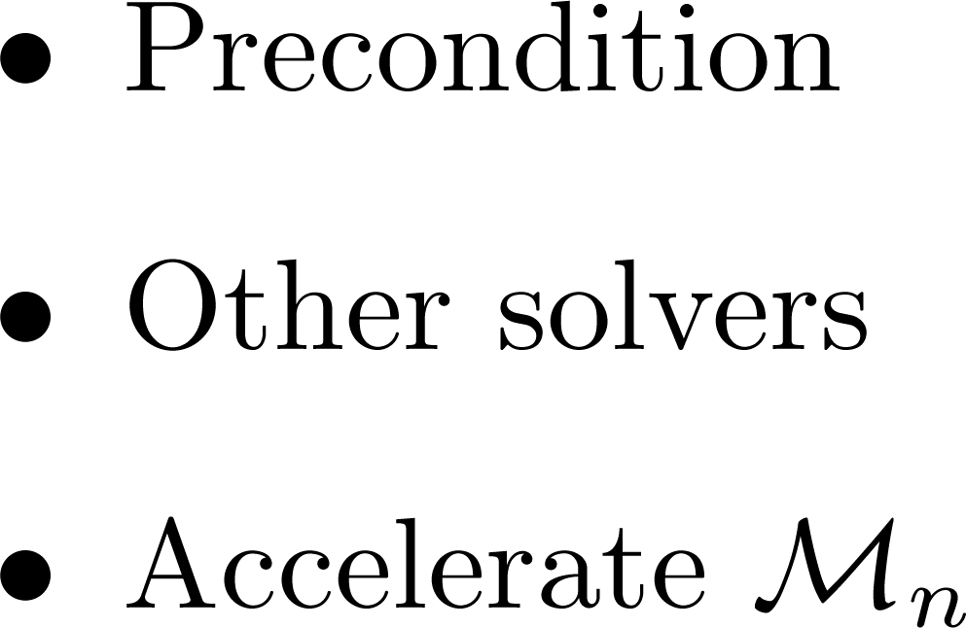

Slide 22

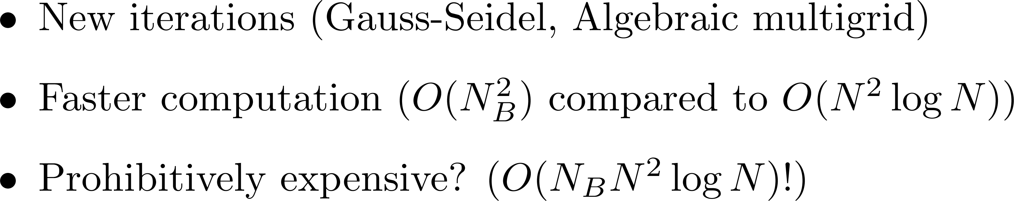

Slide 23
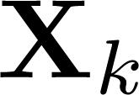
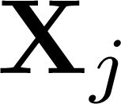
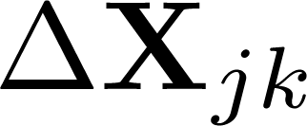

Fiber forces cause fiber displacement

Slide 24
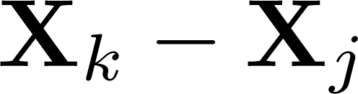
Displacement depends on
?

Slide 25

























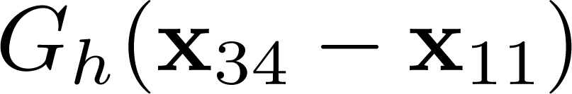
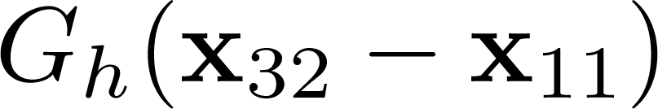
Precalculate every Eulerian point

Slide 26
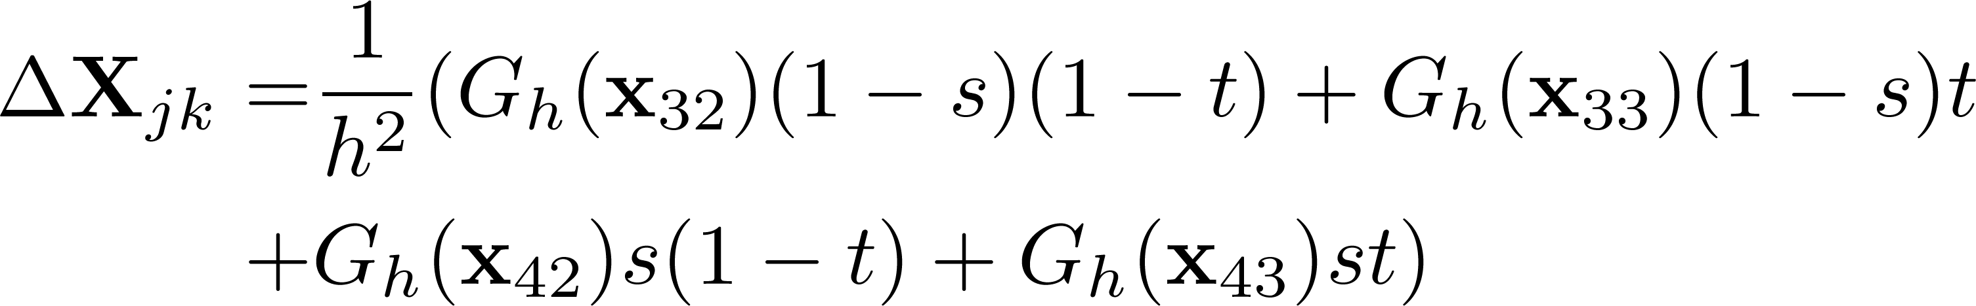
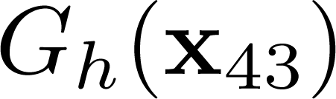
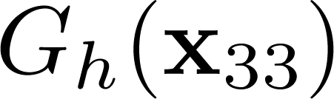


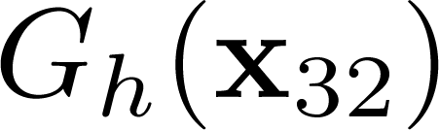
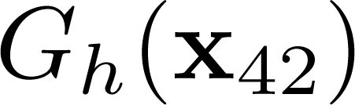

Non-Eulerian points?

Slide 27


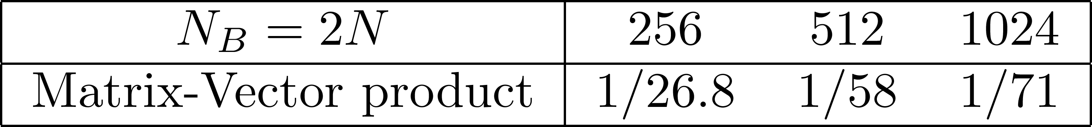

Slide 28
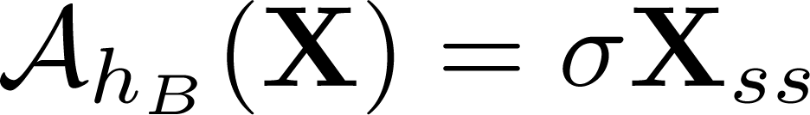
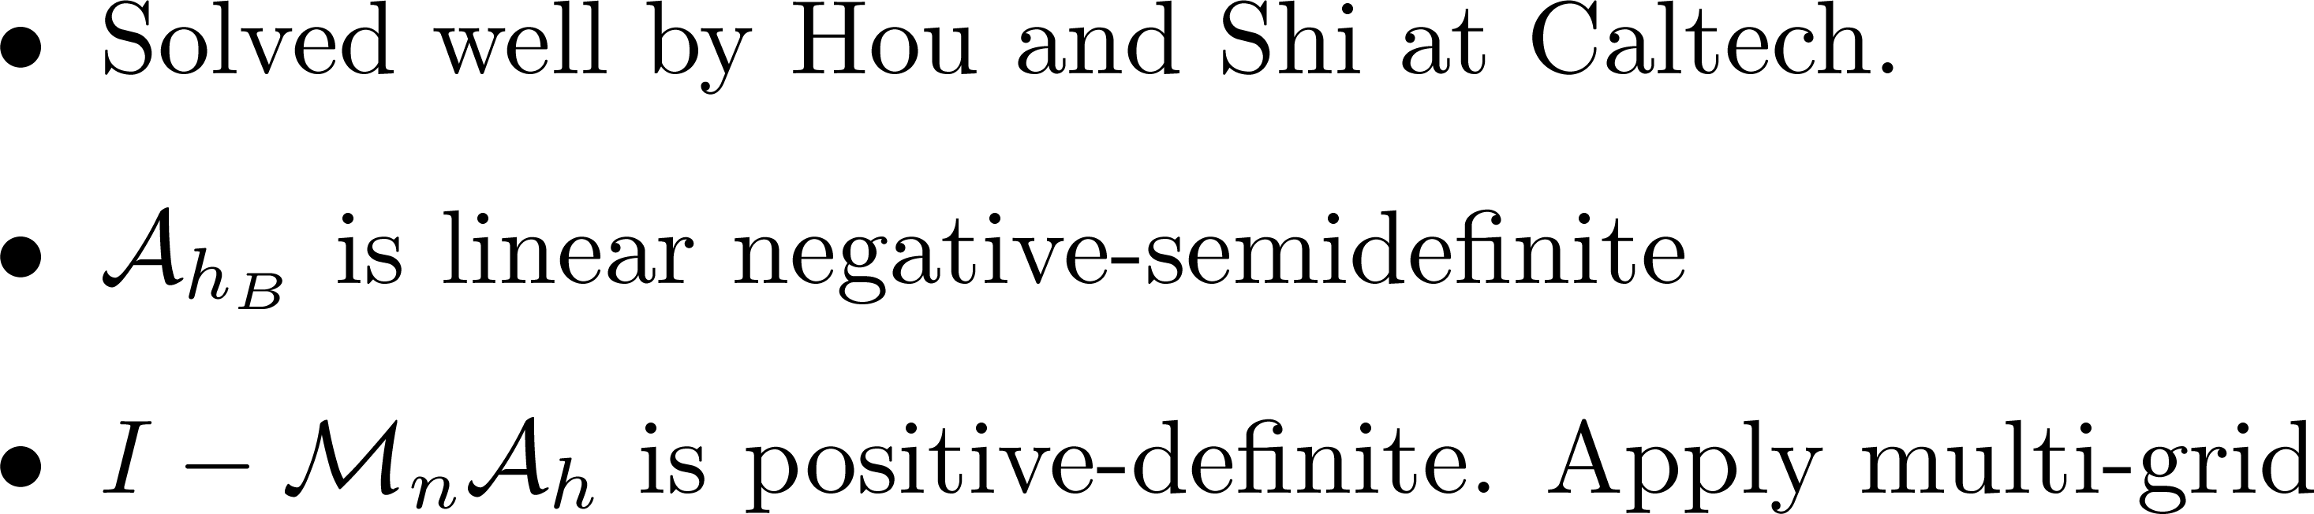

Slide 29

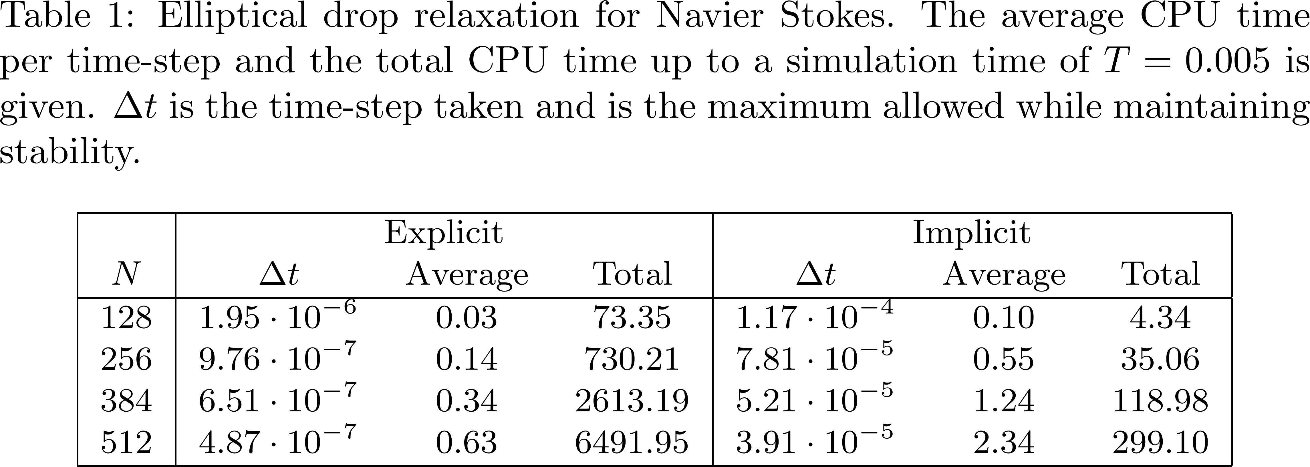

Slide 30
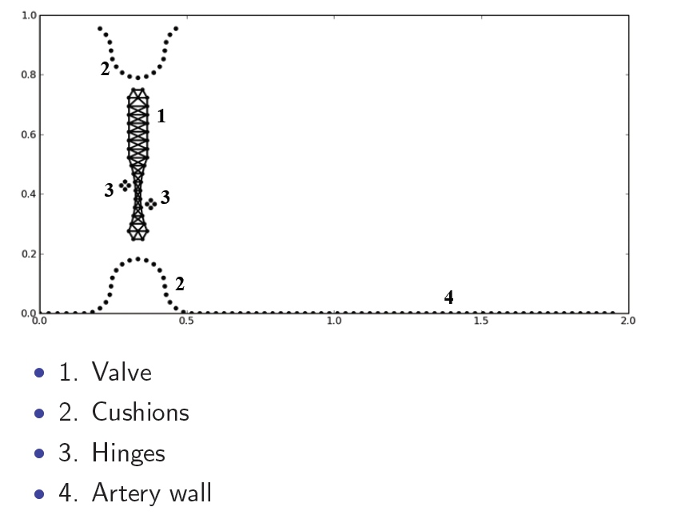




Slide 31




Slide 32


Slide 33





Slide 34
Overview
The Immersed Boundary Method
The stiffness problem
The Matrix Method
The Multipole Method
Peristaltic pumps
Solutions

Slide 35


Known methods to accelerate, if regular enough.
Can use to implement Gauss-Seidel

Slide 36





Slide 37






Slide 38



Slide 39








Slide 40




Slide 41




Slide 42



Slide 43
Overview
The Immersed Boundary Method
The stiffness problem
The Matrix Method
The Multipole Method
Peristaltic pumps
Solutions

Slide 44


Slide 45


Slide 46


Slide 47


Slide 48


Slide 49


Slide 50



