Slide 1

Magical Thinking and the Psychological Roots of the Hostile Media
Perception
Jordan M. Foley, Mallory R. Perryman, Michael W. Wagner
Notes:
Part of a few preliminary cuts of data collected right before the 2016 election. Emerges out of a data we presented at AEJMC conference early August that focused more on third person effects.
This paper focuses on two core research questions:
Can we find evidence of a relative hostile media perceptions in poll reports in the lead up to the 2016 election?
2) What kinds of psychological traits and/or beliefs are associated with perceptions of bias against the candidates?

Slide 2
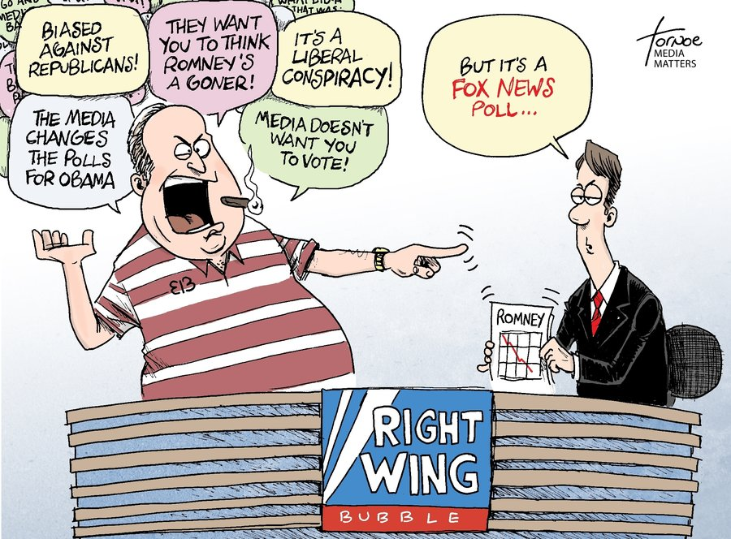
Hostile Media Perceptions
HMP occurs when partisans on both sides see bias against them in the same, neutral content
(Vallone et al., 1985; Perloff, 1989; Giner-Sorolla & Chaiken, 1994; Gunther & Chia, 2001)
Relative HMP occur when slanted content causes an up or down adjustment in perceived bias, but relative group differences remain the same
(Gunther et al., 2001)
Most HMP research is over controversial policy issues, but few focus on media reports of election polling, especially in battleground states.
(Wei, Chia, & Lo, 2011)
Some evidence suggests that voters perceive pollsters as biased and try to influence outcomes.
(Price & Stroud, 2005)

Slide 3
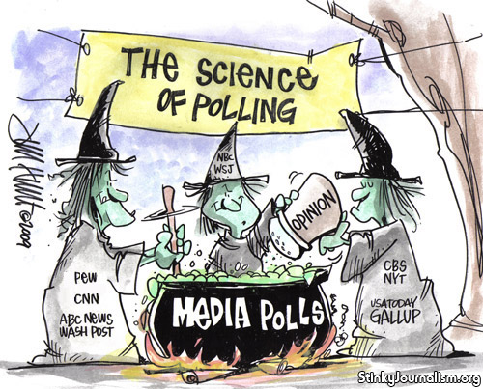
Magical Thinking
Academic roots:
1. Anthropology (E.B. Tylor, James Frazer)
2. Sociology (Durkheim, Mauss)
3. Psychology (Piaget, Carol Nemeroff, Paul Rozin, Karl Rosengren)
4. Political Science (Eric Oliver, Tom Wood, Joe Uscinski)
Follows Eric Oliver and Tom Wood’s (2014) work on conspiracy theories, religious fundamentalism, and intuitive thinkers.
Present from childhood and continues into adulthood. Most prevalent during high-stress events where uncertainty is high and individuals sense a lack of control over their environment.
Characterized by:
- Search for causality
- Tendency to essentialize
- Role of knowledge
- Cultural support
(Rosengren & French, 2013)
Notes:
“To summarize, our delineation of magic is comprised of the following elements:
1. Magic is an intuitive, and possibly universal, aspect of human thinking. As corollaries, (a) magic is defined in terms of a belief or set of related beliefs, and (b) these beliefs may be held at different levels of explicitness, ranging from spontaneous, vague, "as if" feelings, all the way to explicit, culturally taught beliefs.
2. Magic generally does not make sense in terms of the contemporary understanding of science.
3. Magic typically relies on subjective evidence and involves the assumption - whether explicit or implicit - of correspondence or conflation between the subjective, internal world and the world of reality.
4. Magic may serve important functions (e.g., cognitive, emotional, social, or adaptive functions.)
5. Magic in its most prototypical form involves the sympathetic principles of similarity and contagion, and the notion of an imperceptible force (essence) that drives, carries, or provides the mechanism for effects.”
Nemeroff and Rozin
“When we refer to magical thinking, we are referring to a tendency to make causal attributions to unobservable forces. For a belief to be magical, it must point to some invisible power, whether it is luck, God, or the Illuminati, that makes things happen. Of course, simply believing in unobservable forces doesn’t make a belief magical—their are plenty of scientific theories that refer to things we can’t observe, like Dark Matter in physics. Rather, for a belief to be magical it must also contradict an alternative explanation that is based on observable phenomena. Magical thinkers not only assume that hidden, invisible powers are behind much of what happens in the world, but that this explanation is more correct than an empirical one." p. 15-16 EO

Slide 4
Magical Thinking
H1: The worse an article depicts the poll performance of their party’s candidate, the more bias those voters will perceive in the article.
H2: Magical thinking will predict levels of perceived bias against the both candidates in the articles.

Slide 5
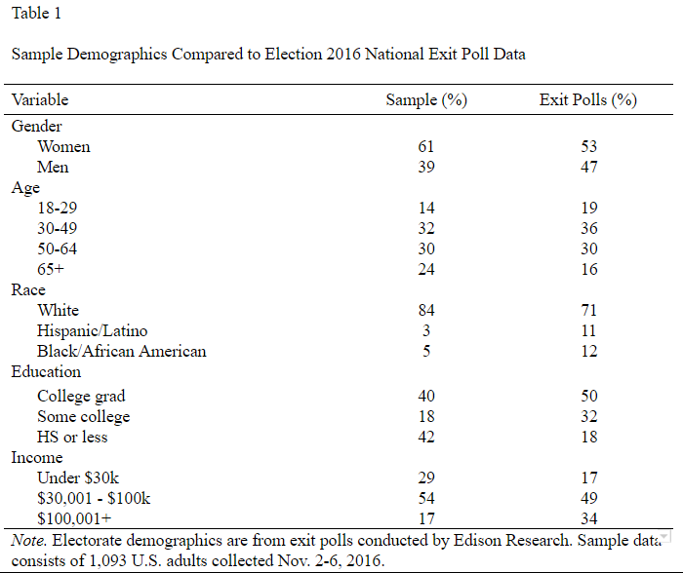
Recruitment and Procedure
Experimental Design
Survey Sampling International (SSI)
Quota sampling to meet census targets
1,093 likely voters
November 2 – 6, 2016
Participants randomly assigned to one of three conditions:
Trump Ahead (NC)
Tied (Iowa)
Clinton Ahead (Ohio)
Party ID (Exit Poll)
44% Democrat (36%)
25.1% Independent (31%)
30.9% Republican (33%)

Slide 6
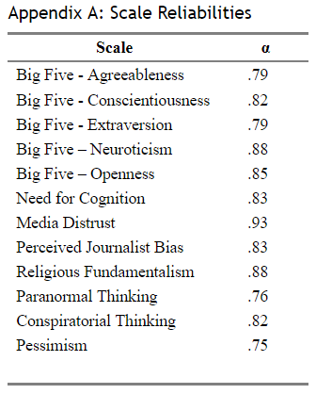
Measuring Magical Thinking
Conspiratorial Beliefs (α = .82)
- 4-item, 5-point scale (disagree/agree)
Examples:
- Much of our lives are being controlled by plots hatched in secret places.
Big events like wars, recessions, and the outcomes of elections are controlled
by small groups of people who are working in secret against the rest of us.
Paranormal Beliefs (α = .76)
- 4-item, 3-point scale (no/not sure/yes)
Examples:
- Do you believe in ESP?
- Do you believe in ghosts?
Religious Fundamentalism (α = .88)
- 4-item, 5-point scale (disagree/agree)
Examples:
- We are living in End Times as foretold by Biblical prophesy.
- The Bible is the literal word of God and without error.
- The Bible has hidden secrets about the future if one knows where to look.
Notes:
Also election news attention and election interest.

Slide 7
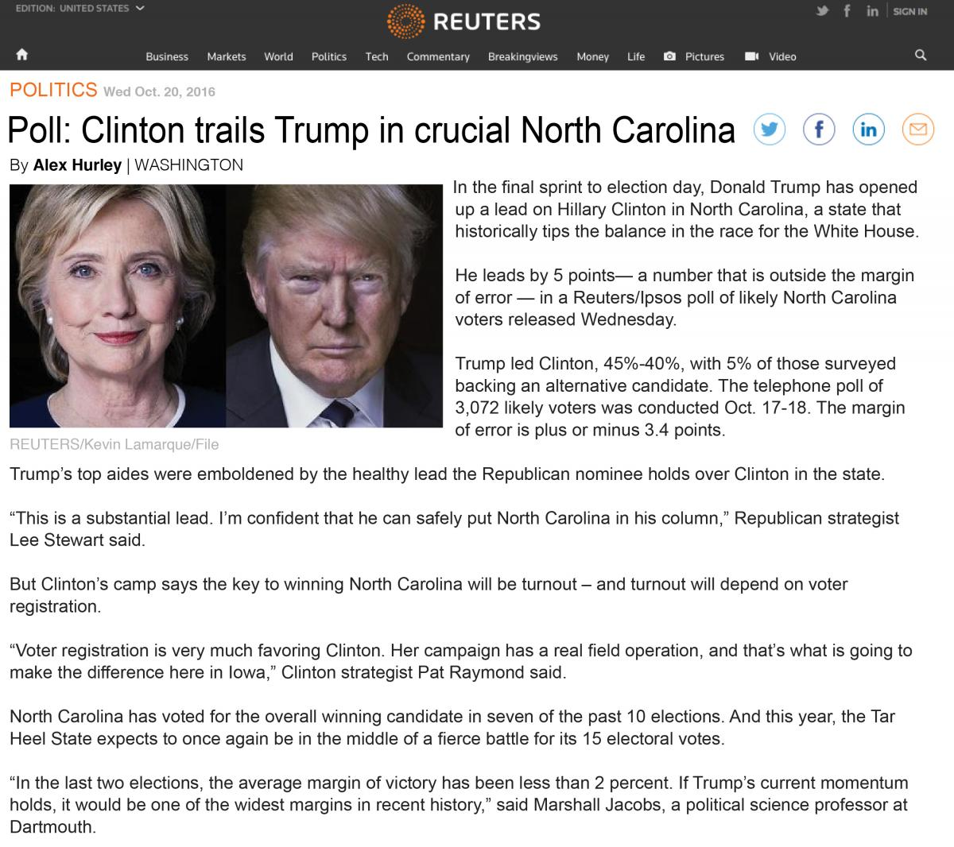
Poll Report Stimuli
Story Structure by Paragraph:
1 | Lede reflects headline
2 - 3 | Poll Info
4 - 5| Reaction from poll leader’s camp
6 - 7 | Response from opponent -
turnout/voter registration angle
8 | Stat reinforcing importance of
battleground state
9 | Stat from neutral source noting
significance of poll margin

Slide 8
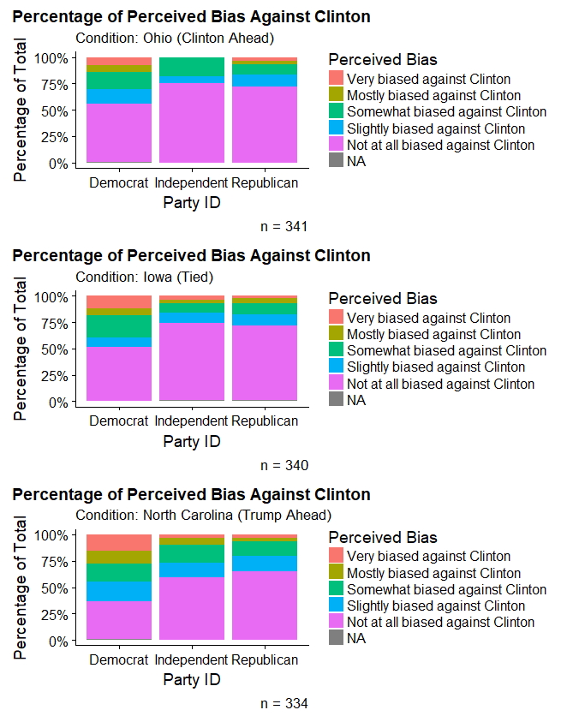
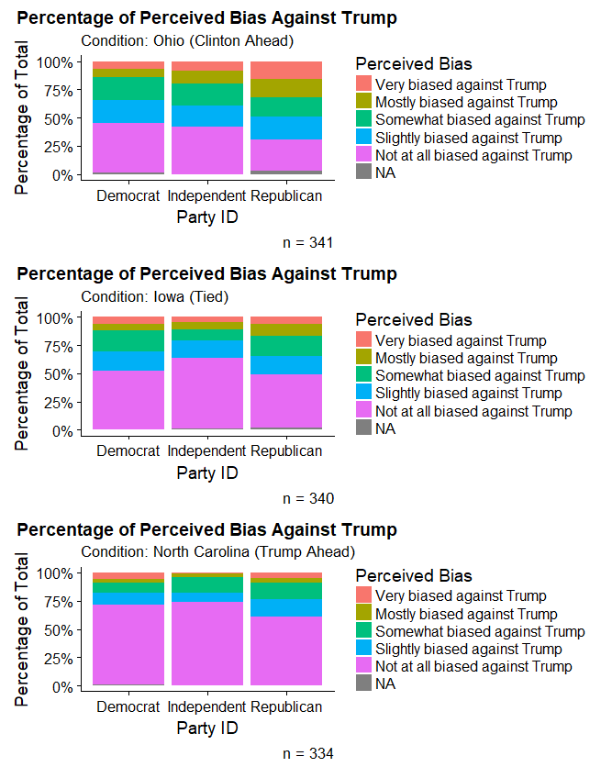
Perceived Bias Against Candidates - All

Slide 9
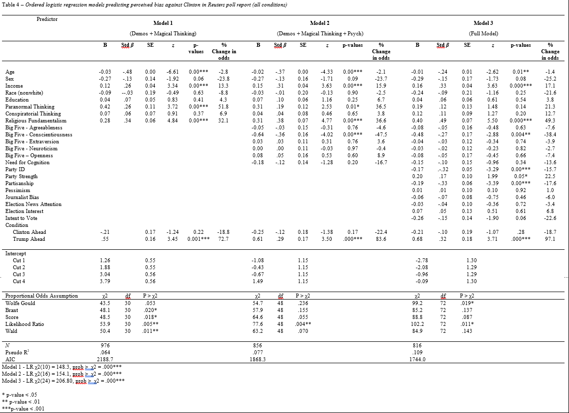

Slide 10
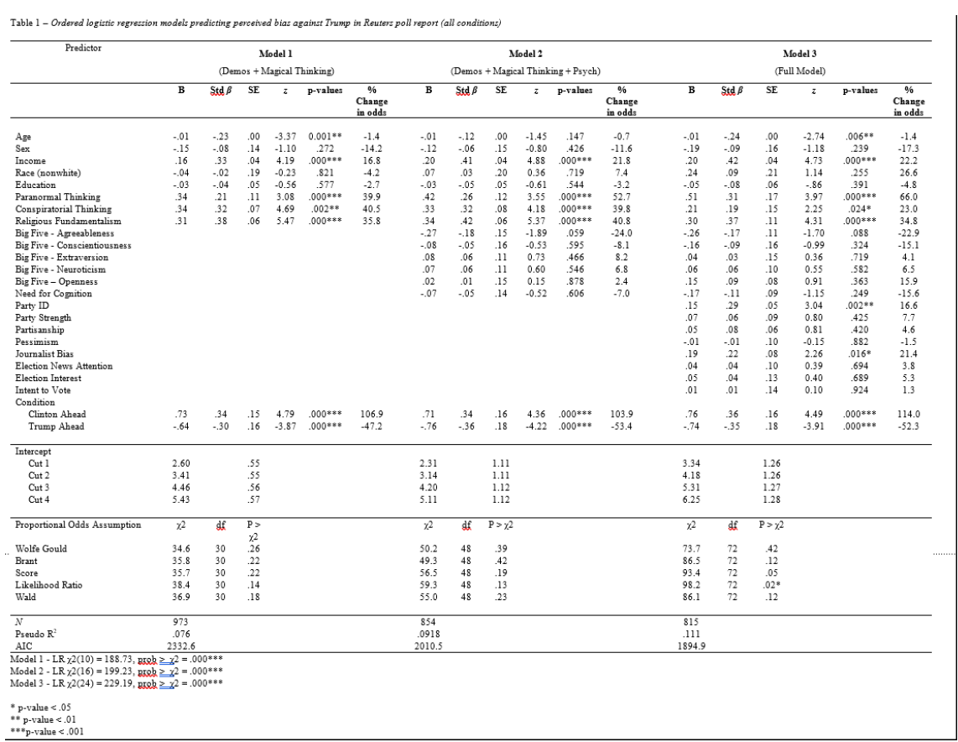

Slide 11
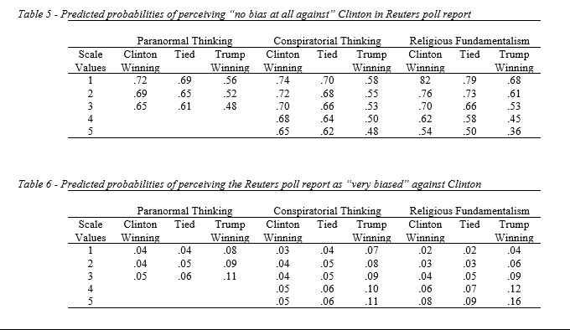

Slide 12
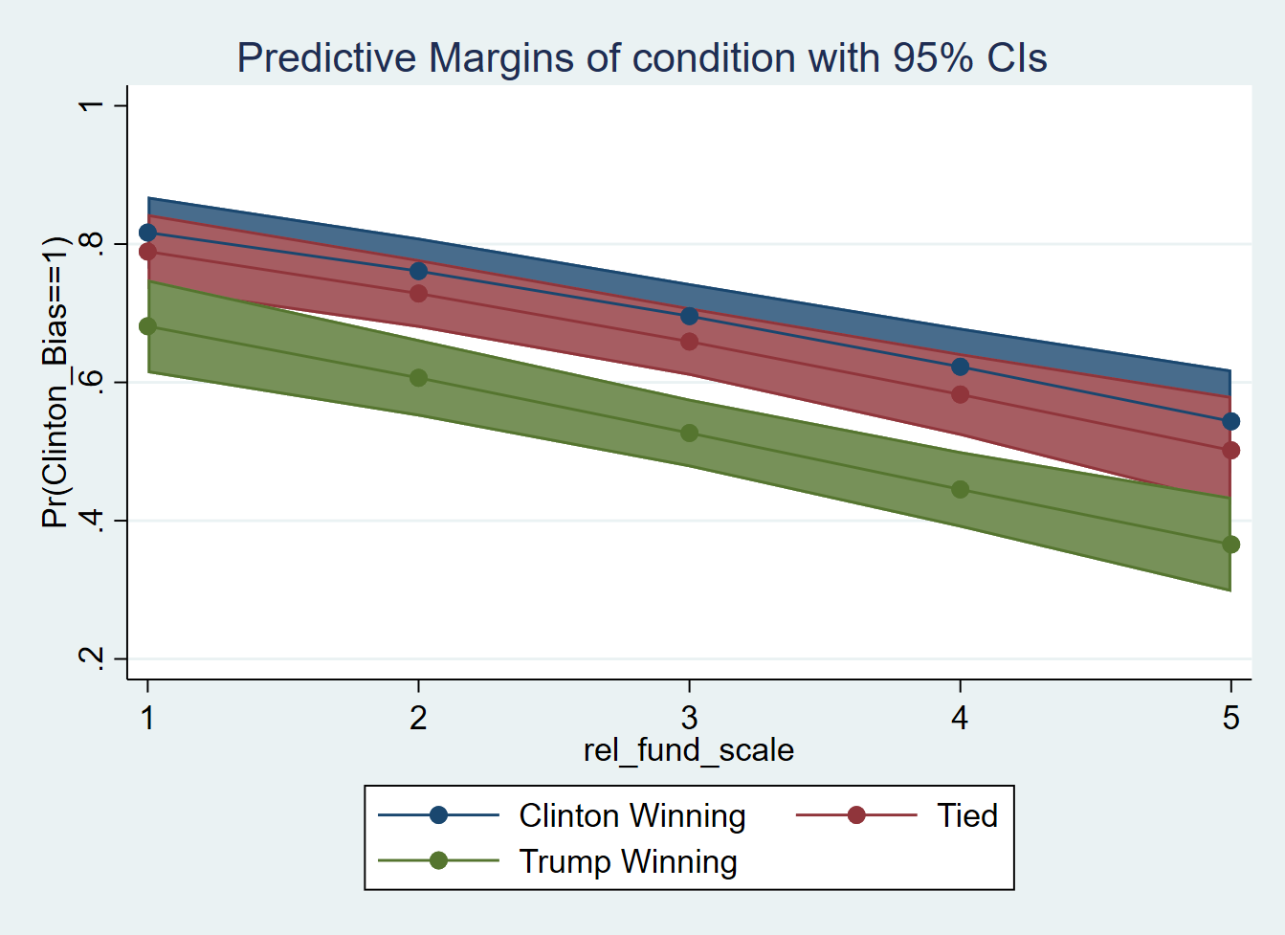
Bias Against Clinton
Religious Fundamentalism

Slide 13
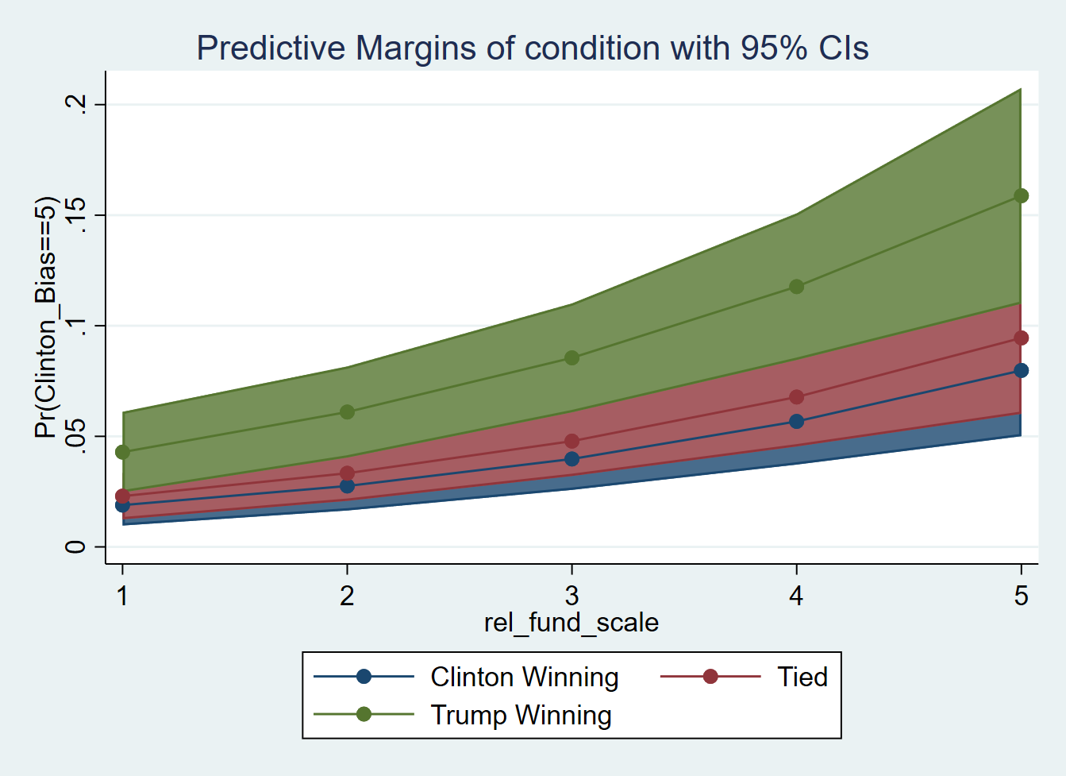
Bias Against Clinton
Religious Fundamentalism

Slide 14
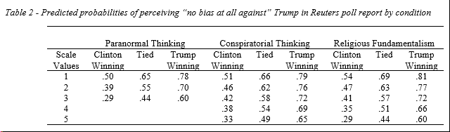
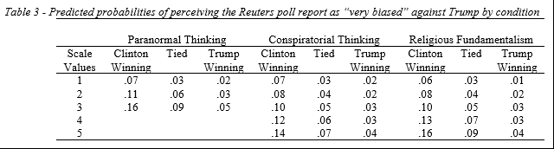
Notes:
No bias -

Slide 15
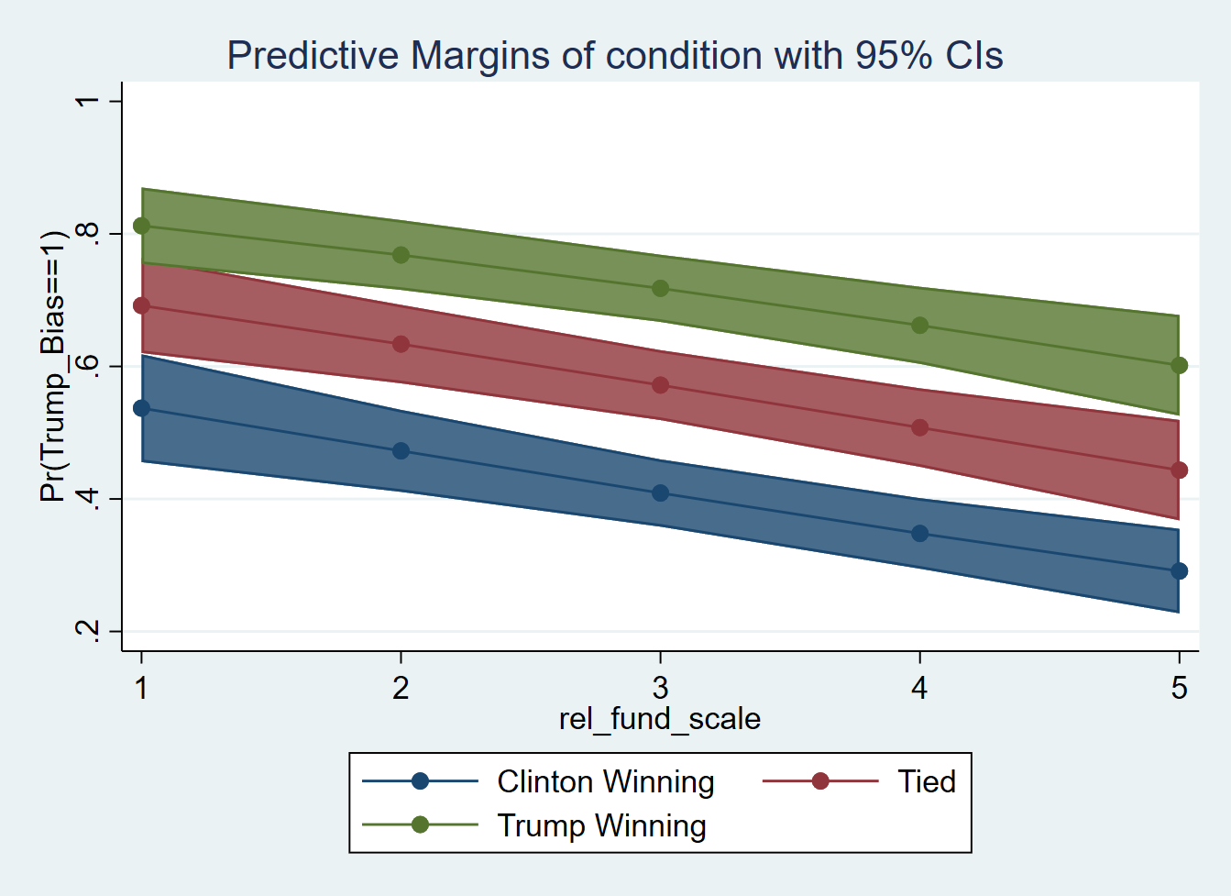
Bias Against Trump
Religious Fundamentalism

Slide 16
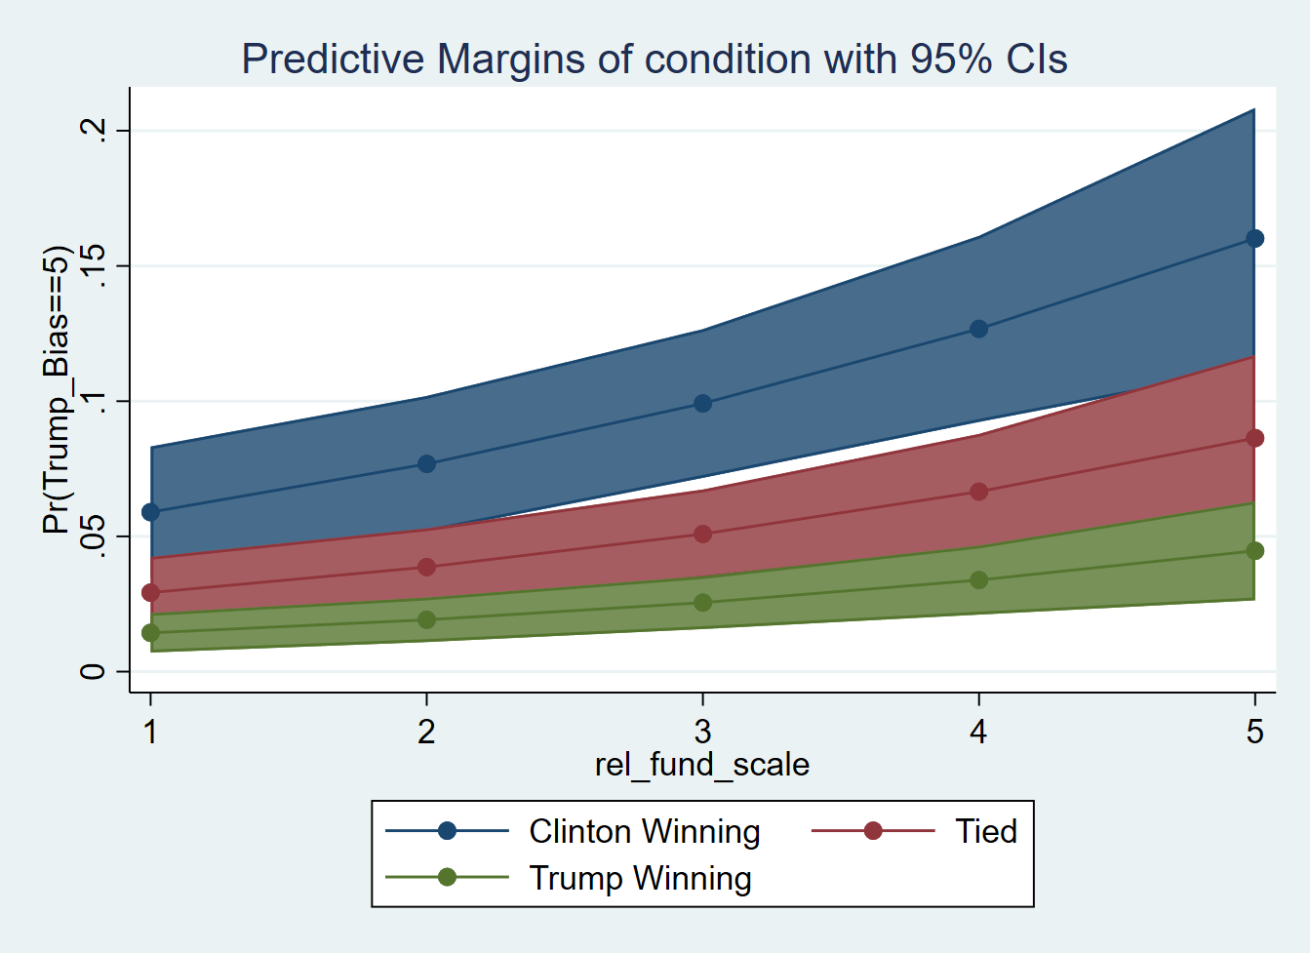
Bias Against Trump
Religious Fundamentalism

Slide 17
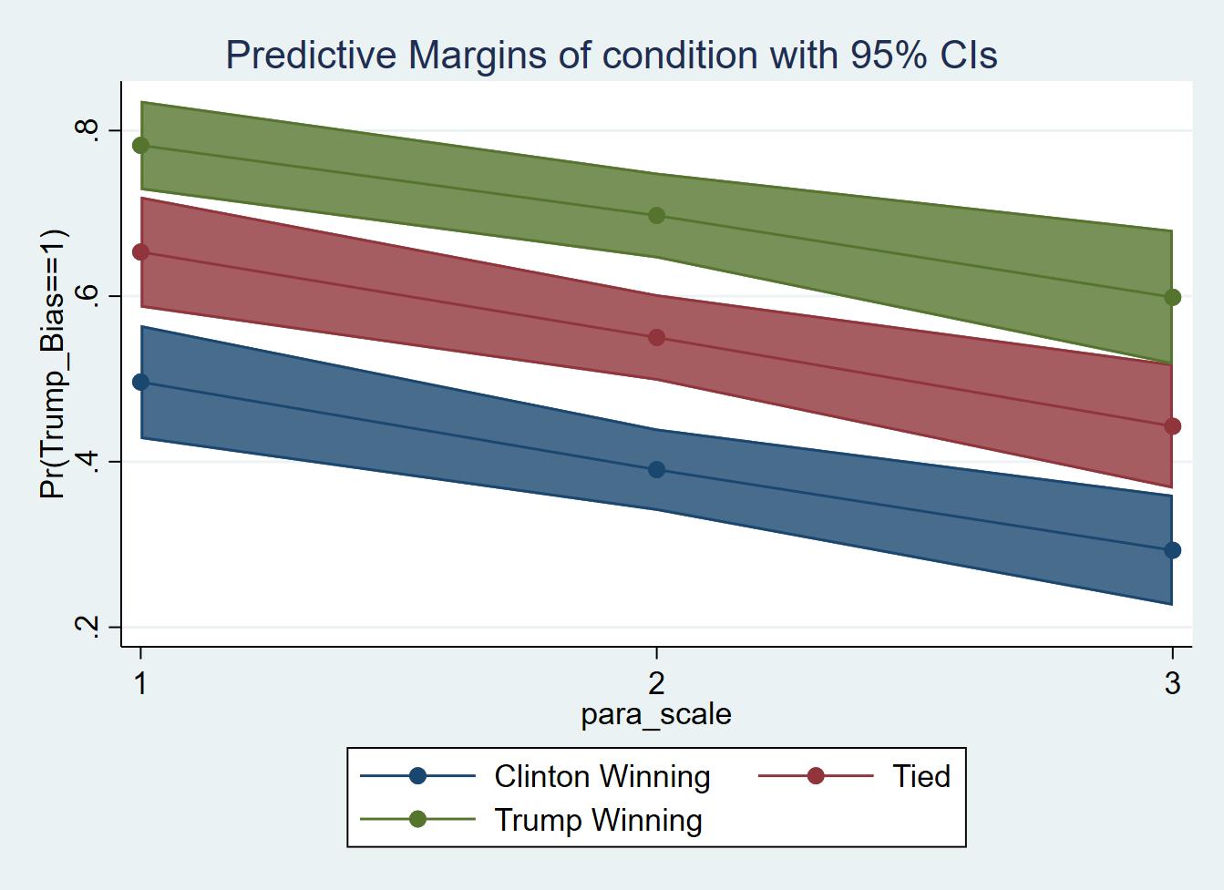
Bias Against Trump
Paranormal Beliefs

Slide 18
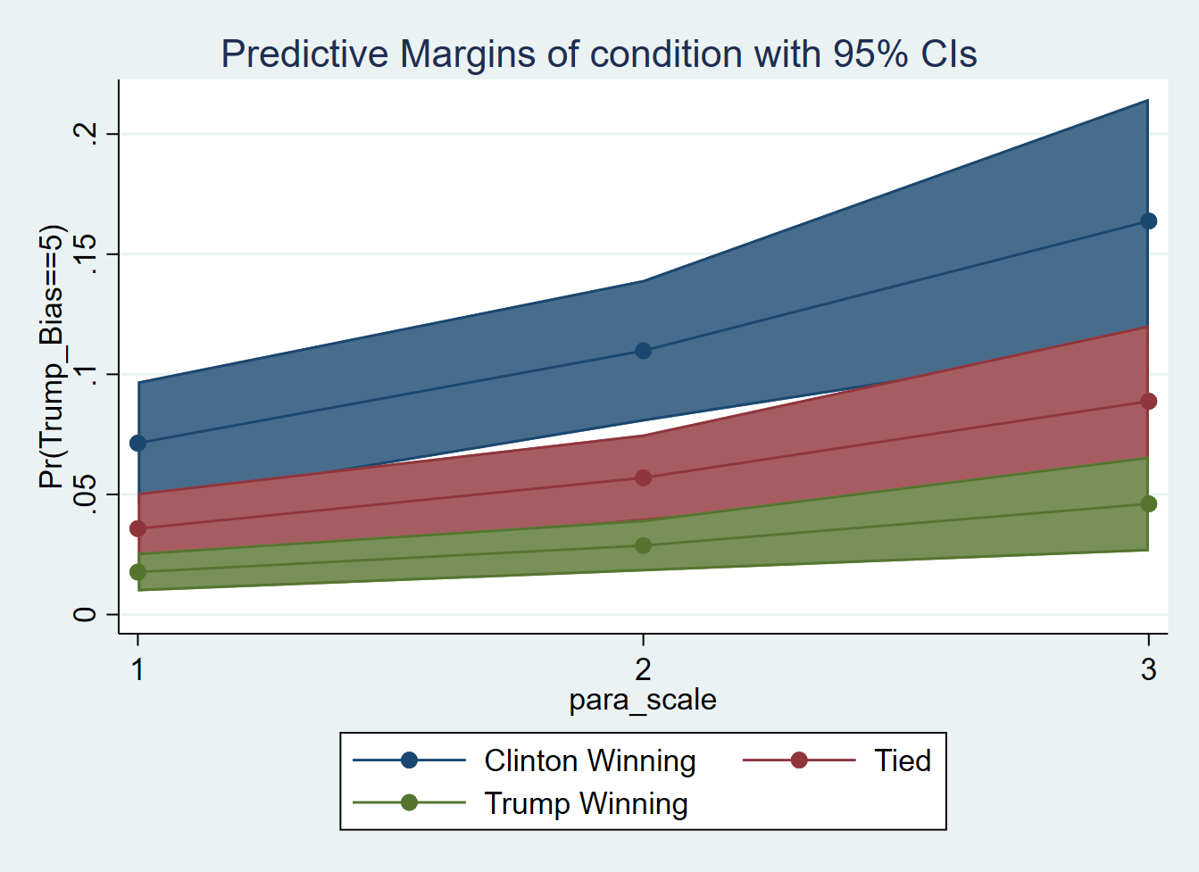
Bias Against Trump
Paranormal Beliefs

Slide 19
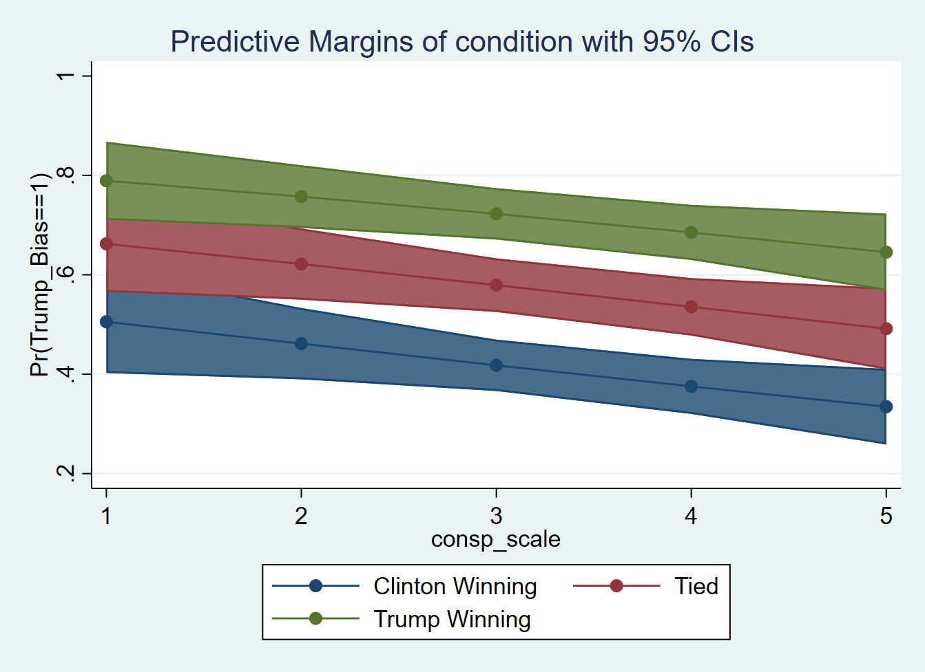
Bias Against Trump
Conspiratorial Beliefs

Slide 20
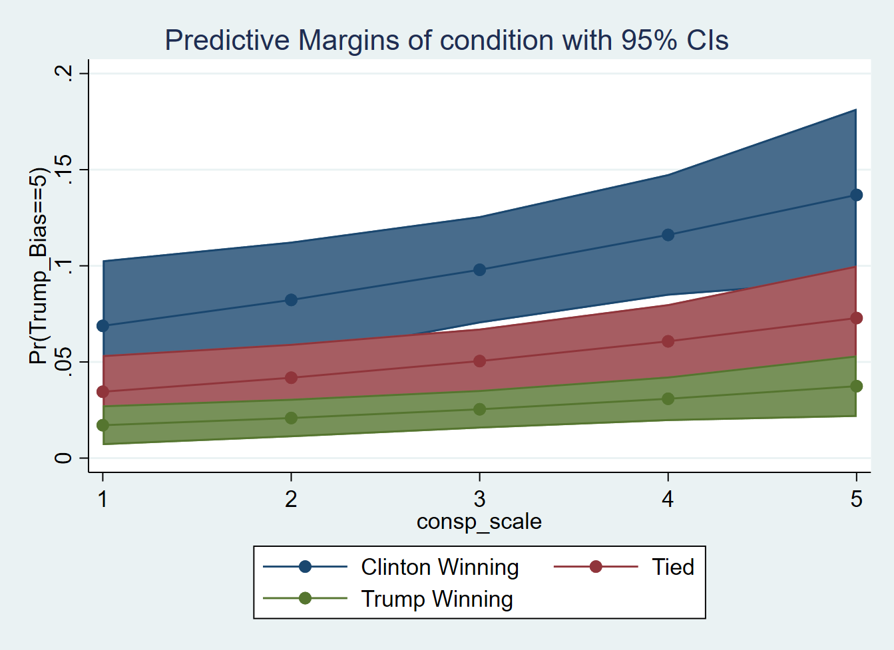
Bias Against Trump
Conspiratorial Beliefs

Slide 21
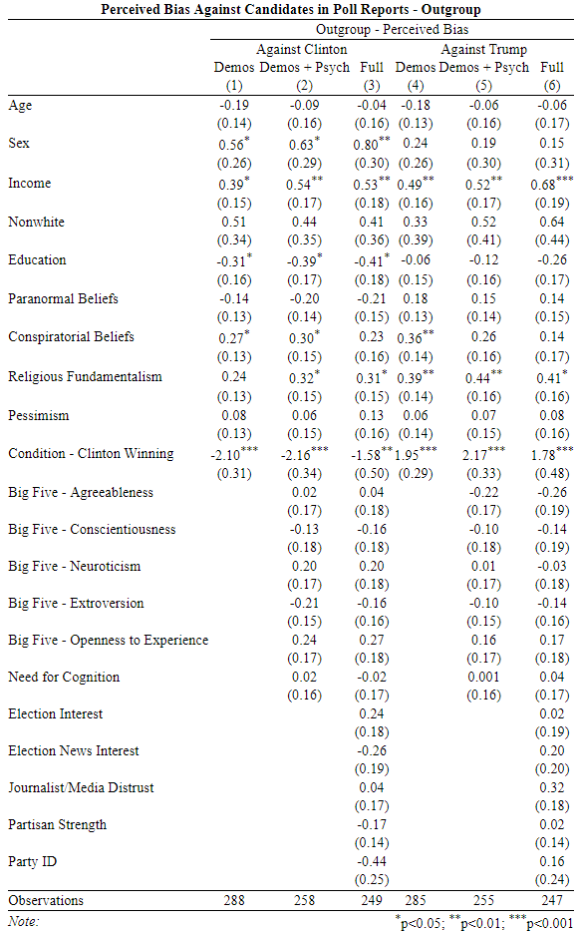
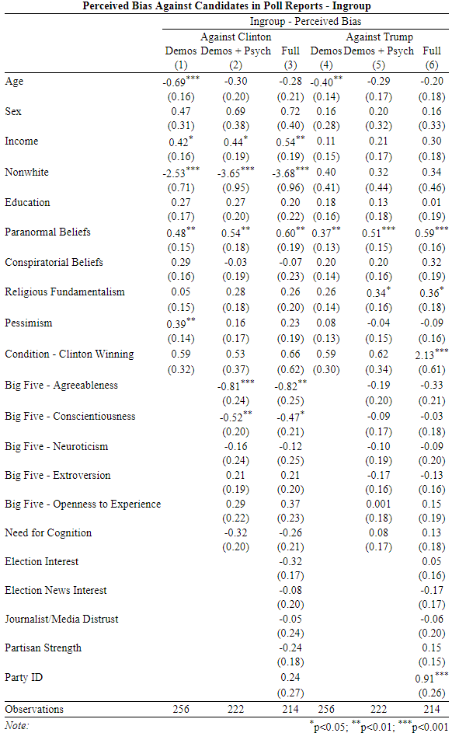

Slide 22
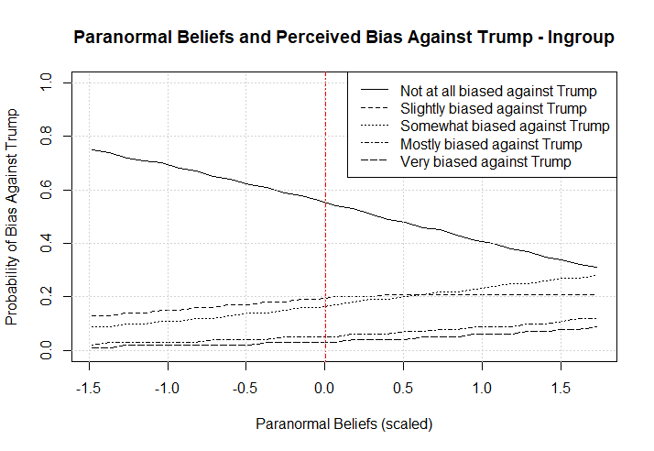

Slide 23
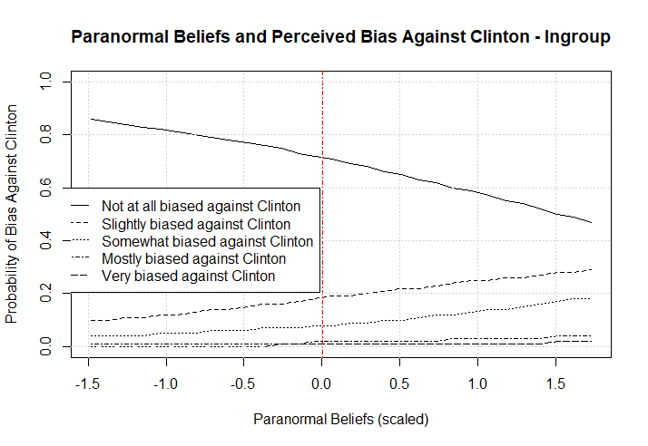

Slide 24
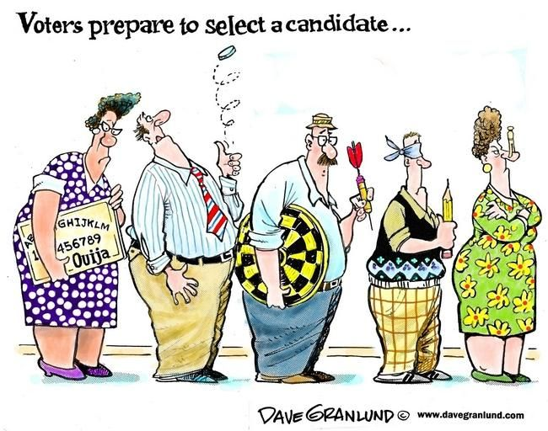
Discussion/Conclusion
Takeaway:
We find evidence of relative hostile media perceptions for both Clinton and Trump (H1)
All three magical thinking scales predicted perceived bias against Trump, but only one for perceived bias against Clinton. (H2)
No bias at all against Clinton :
High Religious Fundamentalist: ~25% less likely
No bias at all against Trump:
High Religious Fundamentalism: ~23% less likely
High Conspiratorial Beliefs: ~17% less likely
High Paranormal Beliefs: ~20% less likely
Limitations:
- Sampling
Experimental Conditions
Control variables
Measurement
Notes:
Limitations:
Mentioned in the introduction, not exactly generalizable.
Battle ground state differences can potentially influence the results, but we felt confident in our general findings
Joanne Miller and colleagues at Minnesota have shown that variables like political knowledge and political trust may influence the relationship between conspiracy endorsement and Democrats and Republicans.
Magical thinking measurements are incomplete – there is a large literature on superstitious beliefs and other psychological indicators of magical thinking (Paul Rozin and Carroll Nemeroff, Eugene Subbotsky, and others). More qualitative work is also necessary, but this provides some evidence of political

Slide 25
THANK YOU!

