Slide 1
Press Credentials, Boundary Work, and Conspiracy Discourse: The Case of WorldNetDaily
Jordan Foley, University of Wisconsin-Madison
School of Journalism and Mass Communication

Slide 2
Presentation Outline
Why Boundary Work?
Why Press Credentials?
Why WorldNetDaily (WND)?
Why Should You Care?

Slide 3
Why Boundary Work?
Science and Technology Studies (STS)
Gieryn (1983)
“Attribution of selected characteristics to the institution of science (i.e., to its practitioners, methods, stock of knowledge, values and work organization) for purposes of constructing a social boundary that distinguishes some intellectual activities as "non-science.”” (p. 782)
Eyal (2010)
Bourdieu (Field Theory)
Latour (Actor-Network Theory)
Spaces Between Fields

Slide 4
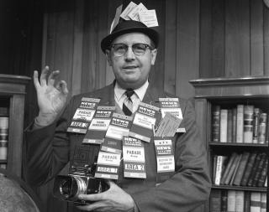
Congressional Press credentials

Slide 5
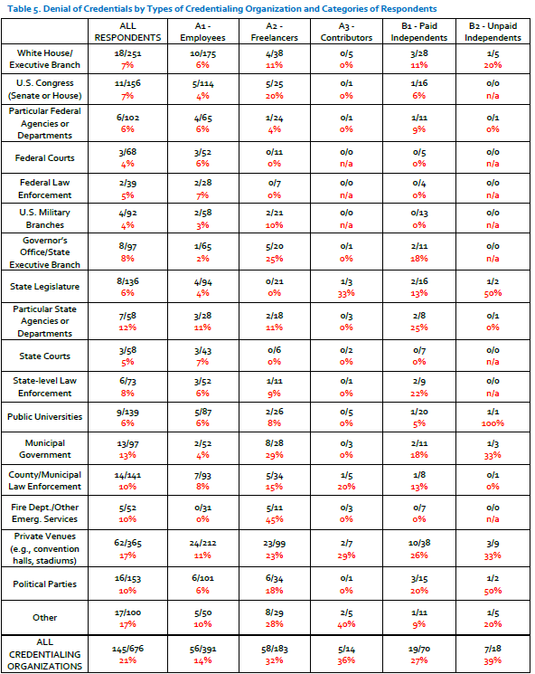

Press Credential Denials (Hermes et al, 2014)

Slide 6
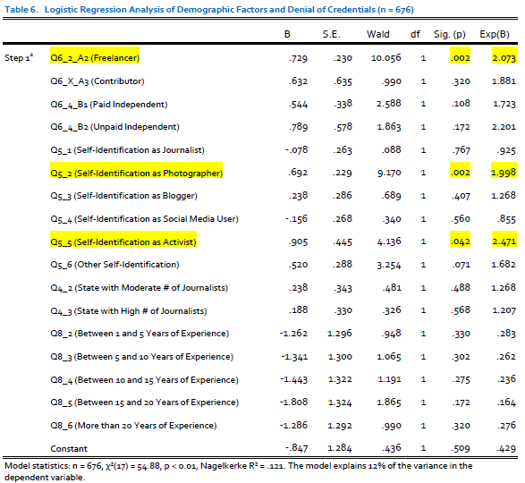
Three groups are statistically more likely to be denied a press credential:
Freelancers
Self-Identified Photographers
Self-Identified Activists

Slide 7
Congressional Press credentials
Standing Committee of Correspondents (SCC)
Multiple press galleries (periodicals, daily news, photographers, etc)
Symbolic and Material Benefits
Access to workspace/staff, prestige, prerequisite to other credentials
Unique Case Study
Journalists as congressional agents
Paradox of the 1st Amendment

Slide 8

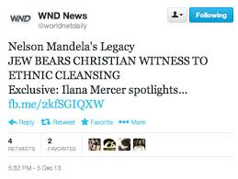
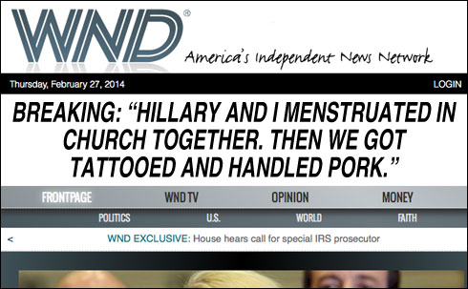
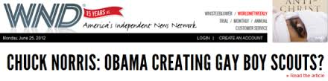
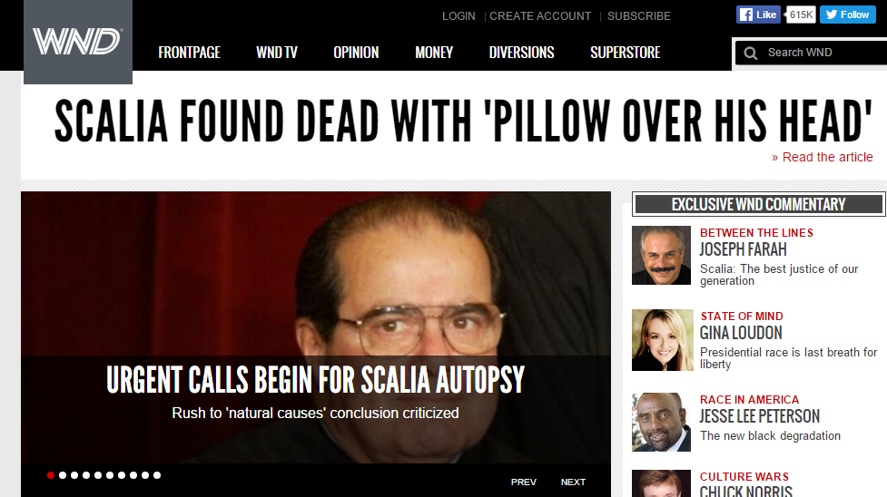
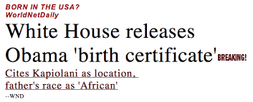
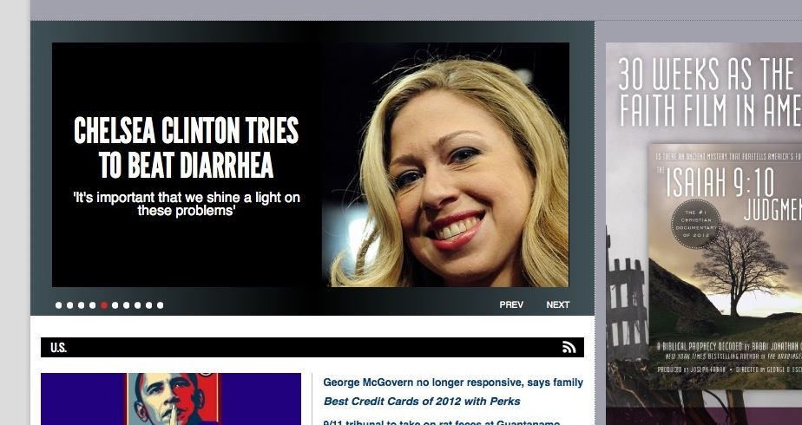

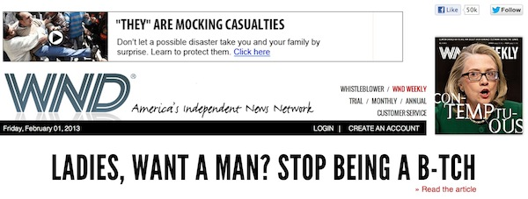


Slide 9
Congressional Press Credential Eligibility Rules
The Standing Committee of Correspondents shall limit membership in the press galleries to bone fide correspondents of repute in their profession
An applicant for press credentials through the Daily Press Galleries must establish to the satisfaction of the Standing Committee of Correspondents that he or she is a full-time, paid correspondent who requires on-site access to congressional members and staff.
Correspondents must be employed by a news organization: (a) with General Publication periodicals mailing privileges under U.S. Postal Service rules, and which publishes daily; or (b) whose principal business is the daily dissemination of original news and opinion of interest to a broad segment of the public, and which has published continuously for 18 months.
The applicant must reside in the Washington, D.C. area, and must not be engaged in any lobbying or paid advocacy, advertising, publicity or promotion work for any individual, political party, corporation, organization, or agency of the U.S. Government, or in prosecuting any claim before Congress or any federal government department, and will not do so while a member of the Daily Press Galleries. Applicants’ publications must be editorially independent of any institution, foundation or interest group that lobbies the federal government, or that is not principally a general news organization

Slide 10
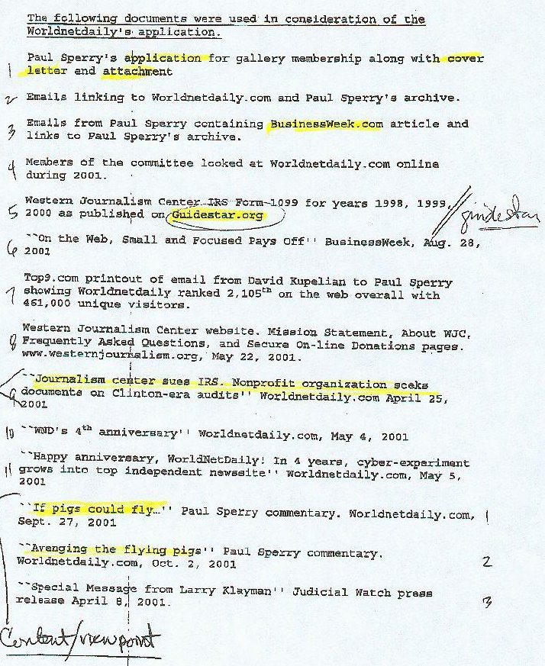
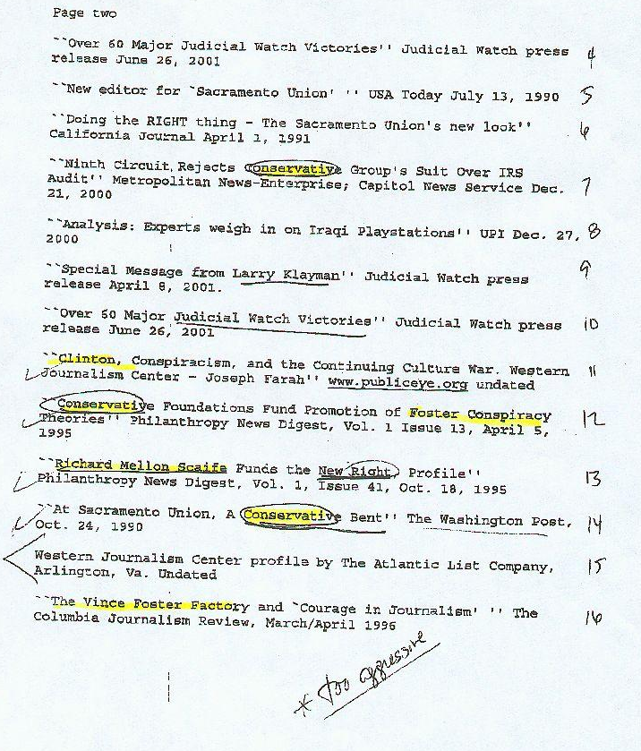


Slide 11
Conclusions and takeaways
Press credentials deserve more systematic research from journalism scholars.
Boundary zones are a useful conceptual tool to understand the rising influence of conspiracy discourse in online news.
Congressional press credentials operate in boundary zone between political and journalistic fields.
The WND case illustrates the power of institutional balancing acts during a period of professional upheaval.

