Slide 1

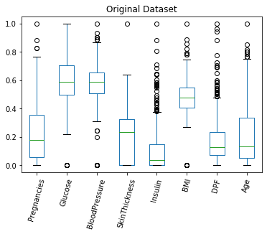
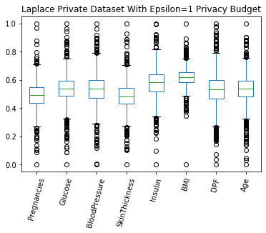
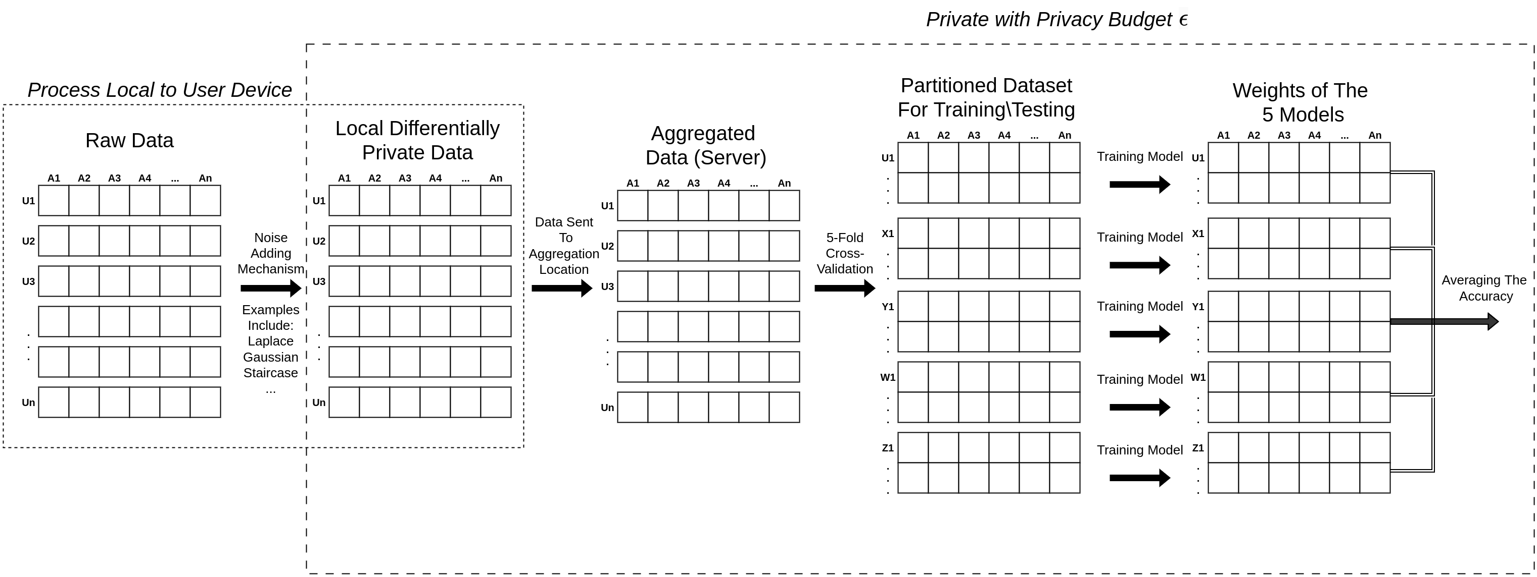
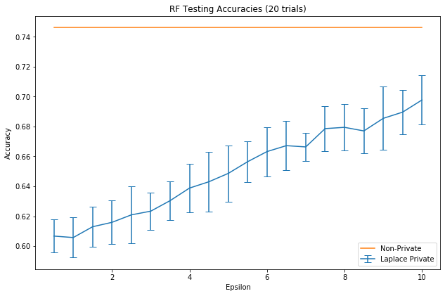
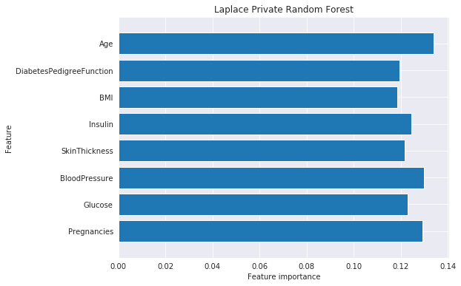
Privacy Preserving AI Implementation
By Jordan Foss, Supervised By Dan Kim
PROJECT GOALS:
Identify and investigate noise adding mechanisms for LDP
Implement these mechanisms on a sample dataset
Construct a model for comparing the effectiveness of models trained on data perturbed by these mechanisms
Identify the strengths and weaknesses of the mechanisms on various ML algorithm
BACKGROUND:
DATA PRIVACY VS SECURITY:
LOCAL DIFFERENTIAL PRIVACY (LDP):
Perturb the data with random noise
Mechanism (e.g Laplace) used to supply the random noise
PROJECT ACHIEVEMENTS:
Three LDP mechanisms were implemented
Six machine learning algorithms were trained on this noisy data
Model capable of training and comparing different LDP mechanisms under different ML algorithms with different privacy budgets
(LDP):
SOFTWARE MODEL DEVELOPED:
Model accuracy for varying level of privacy:
Feature Importance:

Slide 2
Privacy Preserving AI Implementation
By Jordan Foss, Supervised By Dan Kim
MAIN HEADINGS – BODONI MT 18PT ALL CAPS
Subheadings – Helvetica Neue Bold 14pt
Body Text – Helvetica Neue 14pt (min 12pt)
Don’t have the above fonts installed?
Substitutes for Bodoni MT:
Didot on Apple
or Times New Roman (Apple & Windows)
Substitutes for Helvetica Neue:
Helvetica (Apple)
or Arial (Apple & Windows)
General Hints & Tips
Do not change the colour/size/logos/positioning of the Slide Master.
This is a standard format across all Innovation Expo posters.
Do not add other corporate logos. This is an infringement of copyright, unless you have express permission to do so.
Do use this space as creatively as you wish.
Avoid using large background colours – doesn’t print well.
Stick to the basic fonts & sizes (left) – these read clearly. If you need to reduce the text size, you are trying to put too much on your poster.
As a check, print “scaled to fit” onto A4 and read at arms length.
Save your poster as you work on it.
You shouldn’t need to change the sizing of this file, it should already be landscape format with width: 41cm and height: 28.7 cm (A3 with 5 mm borders all around).
The title may look to close to the top edge – don’t be tempted to change it. It allows for the extra 5mm from the printing.

